Slide 1
Design for Service:
The Rolls-Royce Advanced Services Transformation Roadmap
Professor Andrew Harrison
Engineering Associate Fellow – Rolls-Royce plc

Slide 2
Content
The Rolls-Royce Business context
What are Advanced Services
The Design for Service process

Slide 3

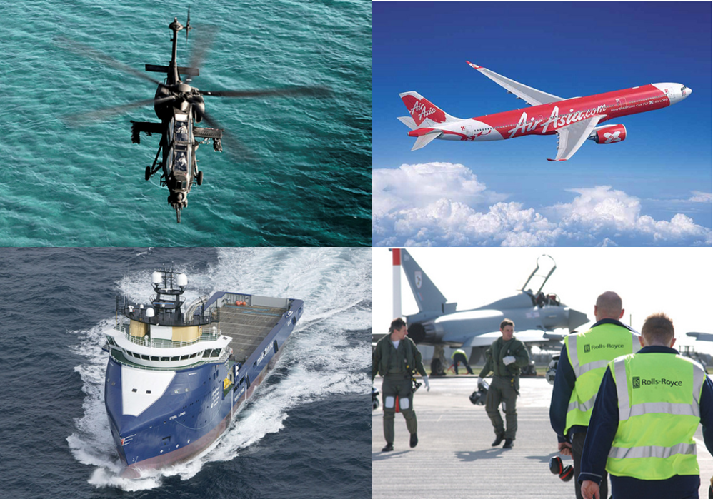
The Rolls-Royce business context
Pioneering the power that matters:
Business to Business
Very high safety & reliability requirements
Very high performance demands
Long life (>25 years for almost all products)
Mostly sold with a long term, fixed price maintenance contract ‘Power by the hour’™
and we don’t make cars

Slide 4
Designed for Service?
But if we did…….
We would:
Design supercars, at the cutting edge of performance technology
We would sell them to Taxi Cab companies
They would be used for up to 14 hours every day
They would only have a major service every 3 to 5 years (every 350,000 miles)
They would operate for more than 25 years before being scrapped
We would guarantee the total costs of ownership for the 2 million miles they would be expected to cover over their lifetime
  through a fixed price cent / hour support contract
Rolls-Royce proprietary information

Slide 5
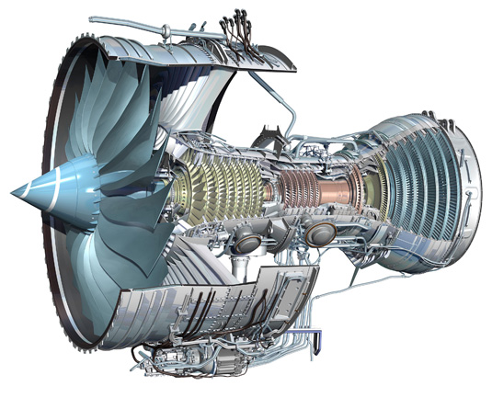
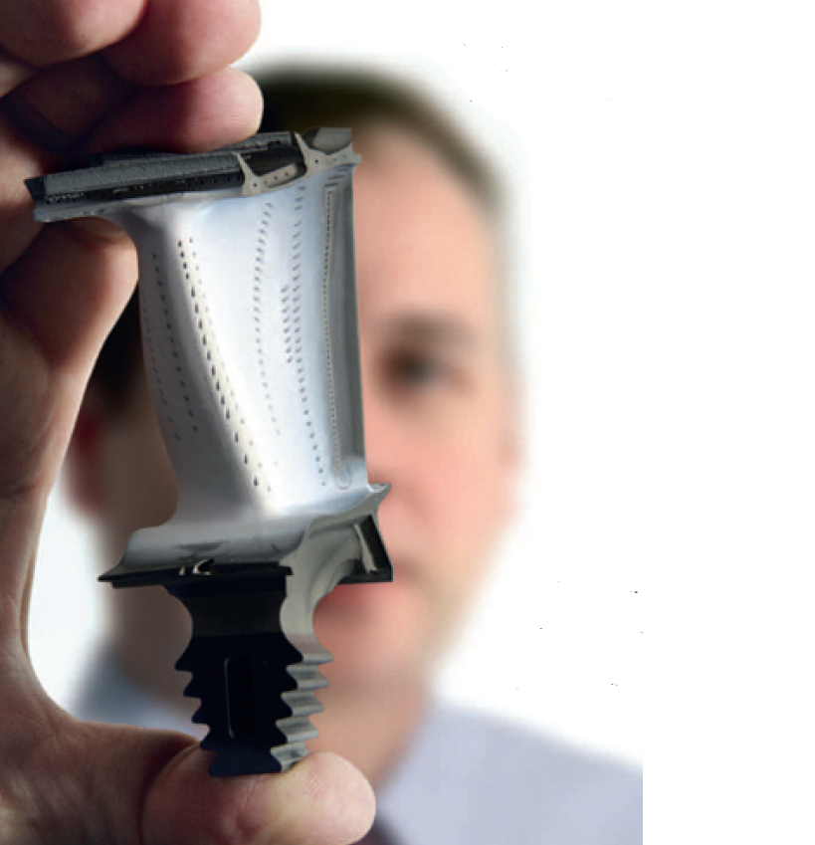

Gas Turbine Aircraft engine illustration – the physical product
Fan blade enough energy to throw a family car 50m into the air
HP Turbine Blade
At full speed each blade produces
more power than a Formula 1 race car
and has the equivalent weight of a London bus
Intake
~ 1.5 tonnes of air per second
Equivalent to:
Making an Ice Cube survive in a 200 ⁰C oven for up to 5 years
Turbine Entry Temperature
Air flow >200 Degrees C hotter than the melting temperature of the metal parts that sit in it
Combustor
Gas temperature ~ half the temperature of the suns surface
‘Cooling’ air
Up to 900 degrees C temperature
Rolls-Royce proprietary information

Slide 6
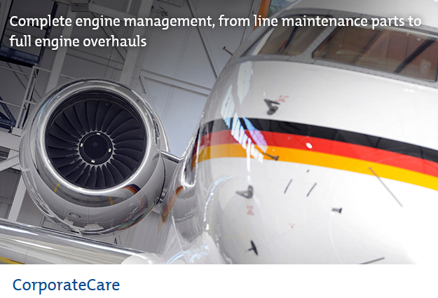
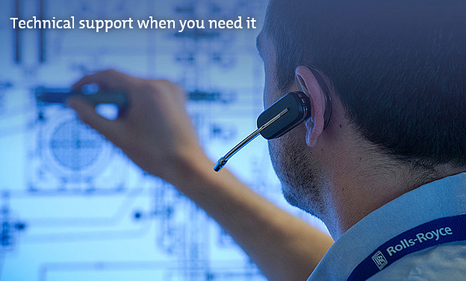
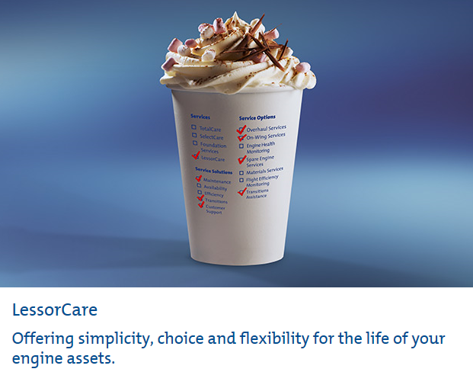
Gas Turbine Aircraft engine illustration – the service offering
Maintenance Repair and Overhaul services
keep the product healthy
Advanced Services:
Contracting for outcome.
Pay per use, pay for output.
Support Services:
Asset Capability: ‘ready for use’
Health monitoring, maintenance, upgrade, life extension, trouble shooting …
Asset Availability: ‘available for use’
Inspection / maintenance scheduling, logistics, spares, repairs, tooling, leasing, transport, finance …
Asset Utilisation: ‘more value from use’
Training, operators, consumables, schedule/performance optimisation …
Mission Cost: ‘affordable in use’
Designed for through-life cost, cost control & optimisation, used
material service, residual value guarantee, buy back …
24/7 technical support –
keep the product flying
Asset Management services
Maximise residual value

Slide 7
Gas Turbine Aircraft engine illustration – the timeline challenge
1st sales campaigns begin
Market price established
Last production engine made
1st sale (product & service)
Up to 1/2 of all projected sales made
Service Costs understood
Project year
1 2 3 5 10 15 25 50
Component design
1st engine on test
1st planned overhaul
Final product retired
Architectural design
1st parts on test
1st customer delivery
1st Mature product overhauls
Rolls-Royce proprietary information

Slide 8
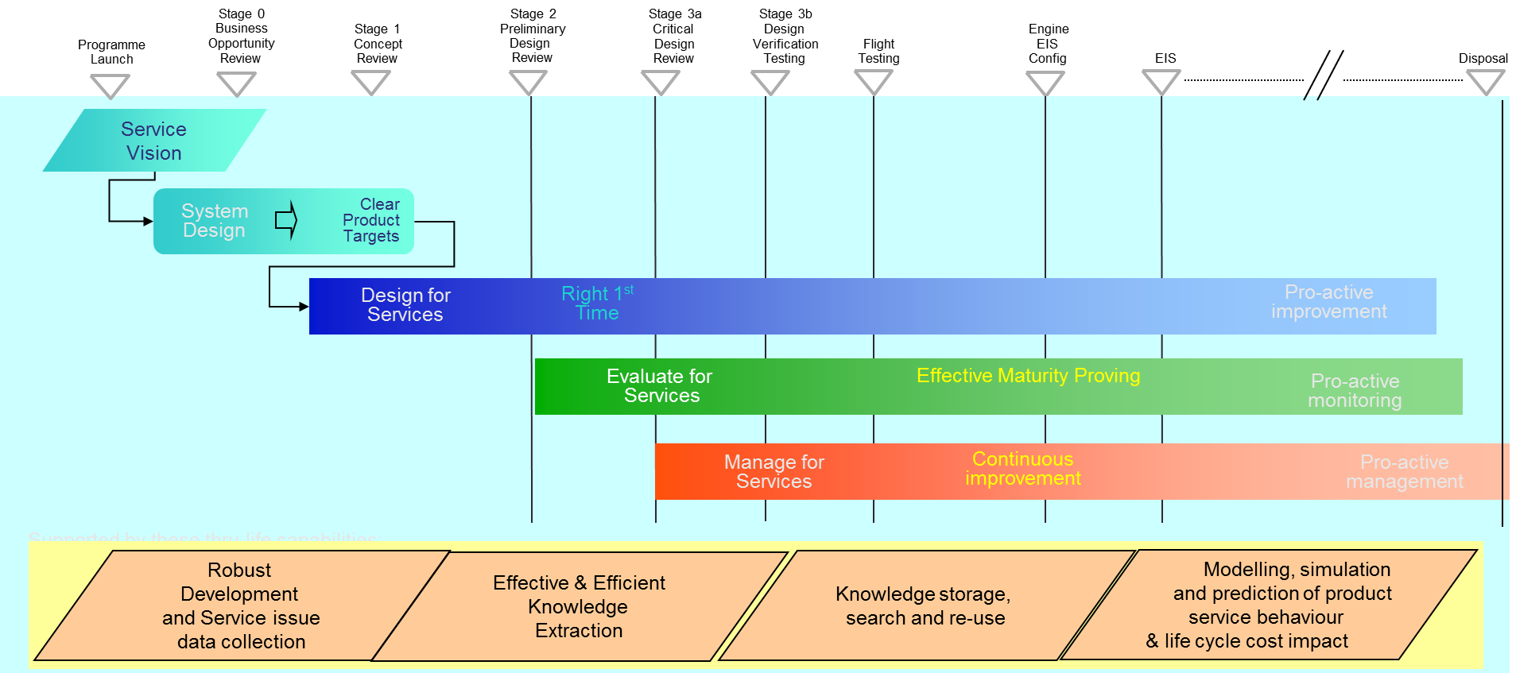
Design for Service – Overview

Slide 9
Design for Service – Service Vision

Slide 10
Design for Service – Service Vision
Customers want output,
not hardware
Competitive benchmark
Engineered products slowly degrade over time
(wear and tear)
Significant outage periods for complex maintenance activity
Competition dictates the ‘retirement’ point for the asset
Better competitive gap
- Reduced deterioration
- Technology insertion
- Longer service life
Uptime increase
- Longer operating periods
- Shorter overhaul times
Passenger / Cargo
Tonne Miles per $
output
output
output
Years of operation
Rolls-Royce proprietary information

Slide 11
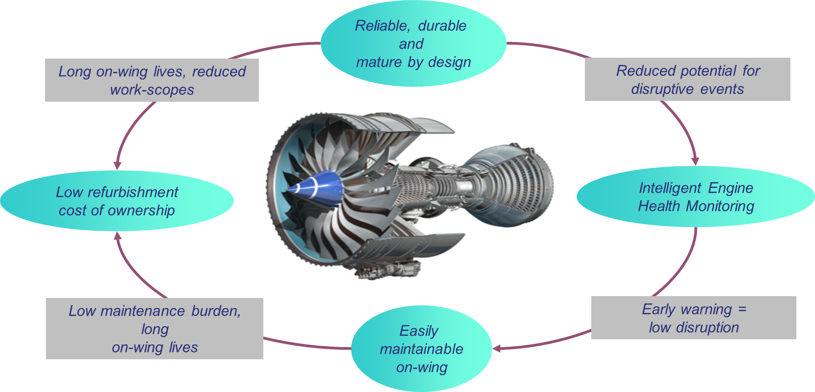
Design for Service – Service Vision
Rolls-Royce proprietary information

Slide 12
Design for Service – Requirements

Slide 13
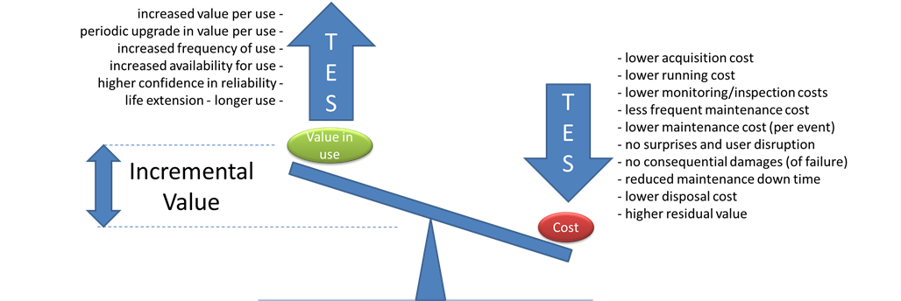
Design for Service – Requirements
Increase the ‘Value drivers’
Decrease the ‘Cost drivers’
Rolls-Royce proprietary information
Rolls-Royce proprietary information

Slide 14
Design for Service – Design

Slide 15
Design for Service – Design
Product Deterioration drives cost…
Avoid
Change the reality of deterioration and hence the need for maintenance activity
Contain
Minimise the incremental cost of ‘disruption’ to customer operations
Recover
Execute physical maintenance activity at the optimum cost for the life recovered
Rolls-Royce proprietary information

Slide 16
Design for Service – Design
Overhaul Shop Visit Causes (Last 10 years)
HP Turbine Blade – 19%
IP Compressor FOD – 15%
Combustor Cracking – 12%
HP Bearing debris – 5%
……………
………………
………………..
…………………..
Overhaul Shop Visit Cost Pareto (Average SV)
Average Shop Visit Utilisation
of Cleared Repairs
IP Turbine Blade
  FRS…… Fin Tip Weld (70%)
  FRS ……Re-Coat (70%)
  ………………..
  …………………..
Combustor Casing
  FRS ……….
  FRS………
Strip /Build
Hrs
Scrap Rate
Repair Rate
Replace Cost
Repair Cost
Total
Cost
HPT Blade
IPC rotor 1
HP Bearing
Combustor
12
100%
0%
100
0
102
18
3%
97%
1
18
21
8
15%
57%
8
6
15
3
2%
15%
3
2
5
I can’t recall any occasion where this part has caused a shop visit but the overhaul cost contribution is typically high on the parito list.
It’s always a customer issue at conferences!
So we need to try and minimise the scrap and repair costs at Overhaul without becoming a cause of Shop visits!
Aftermarket Business
Design
Service Engineering
If experience is a guide this material change is going to cause some repairability issues!
Repair
Team Knowledge Sharing

Slide 17
Design for Service – Data → Decisions

Slide 18
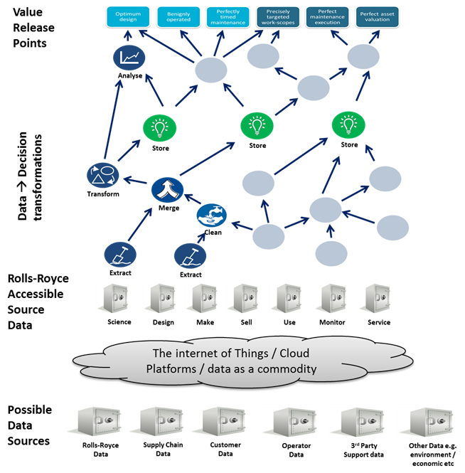
Design for Service – Data → Decisions
The Digital Landscape is changing fast
IoT – more data, faster delivery
Big Data – improving analytics, broader real time issue recognition
Information services – weather, pollutants, flight operations
Semantic Web – connecting datasets across the life cycle
Industrie 4.0 – complete accessible manufacturing and maintenance history for every part, from birth to death
Rolls-Royce proprietary information

Slide 19
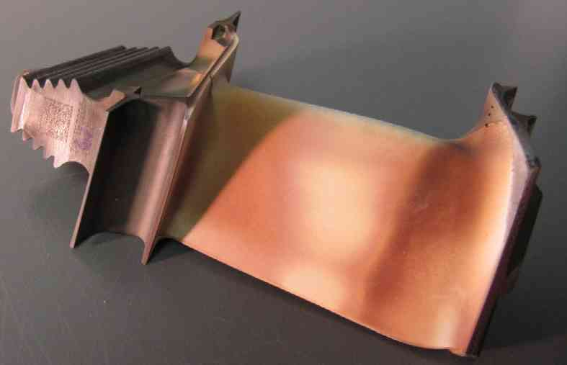
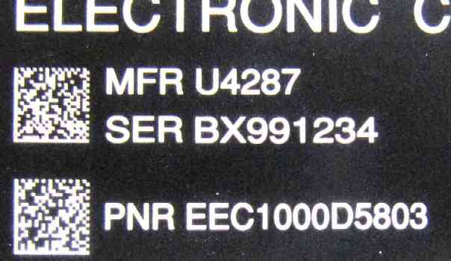
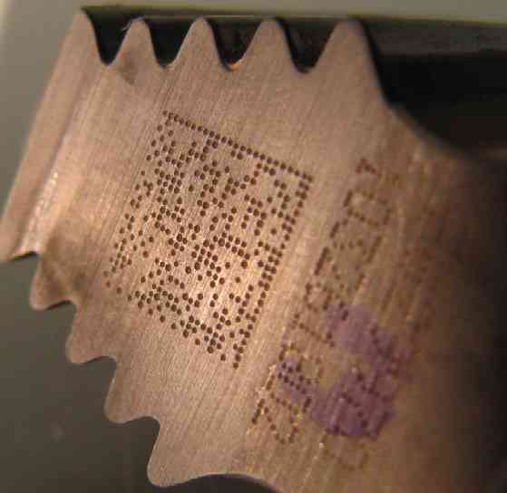
Design for Service – Data → Decisions
Actual scan data:
MFR K0680
PNR FW29970
SER 103261802
~50000 tracked part numbers in Rolls-Royce
~6000 tracked movement records each week
~3000 serials recorded per engine
Phone-based data-scanning technology becoming available
Rolls-Royce proprietary information

Slide 20
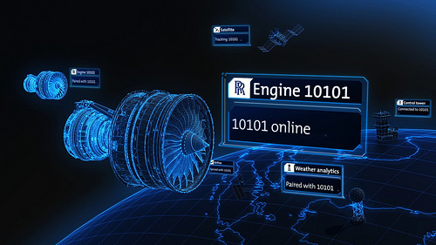
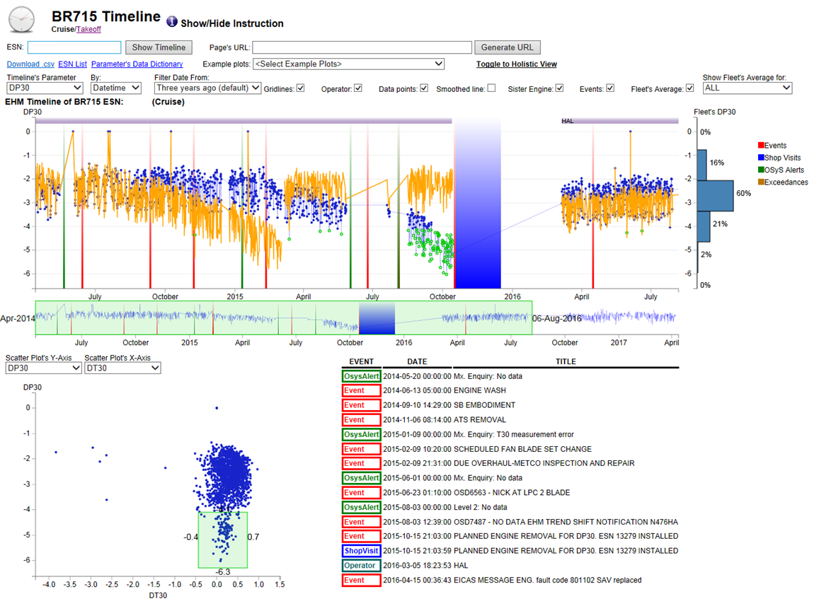
Design for Service – Data → Decisions
Data every second throughout the flight
Rolls-Royce proprietary information

Slide 21
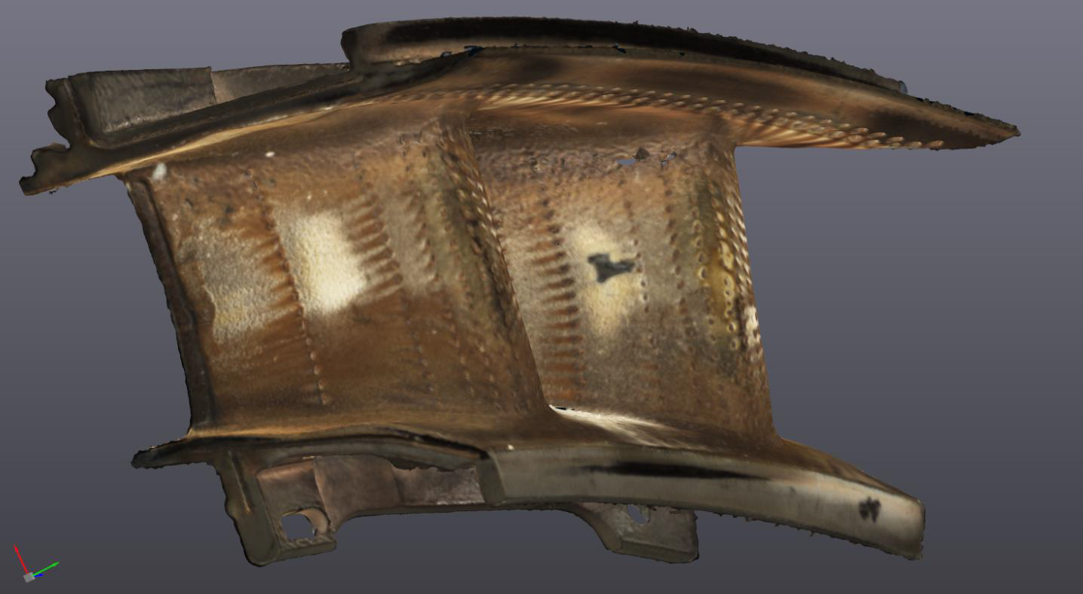
Design for Service – Data → Decisions
Rolls-Royce proprietary information

Slide 22
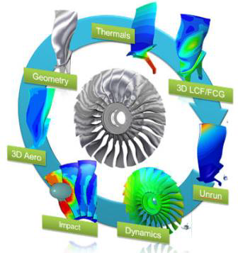
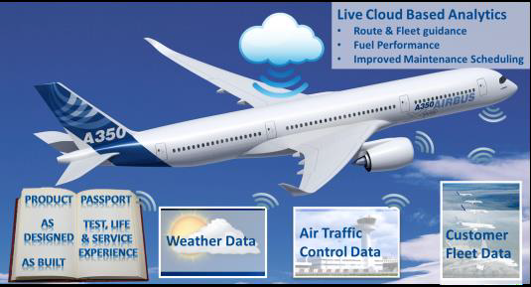
Design for Service – Data → Decisions
Past - Twin of the ‘standard’
Geometry, assembly, thermals, stress
Current - Twin of the ‘population’
Variance analysis, distributions, probabilities
Future - Twin of the ‘individual’
Individual geometry, individual history, individual health, individual prognosis
Rolls-Royce proprietary information

Slide 23
Design for Service – Evaluate

Slide 24
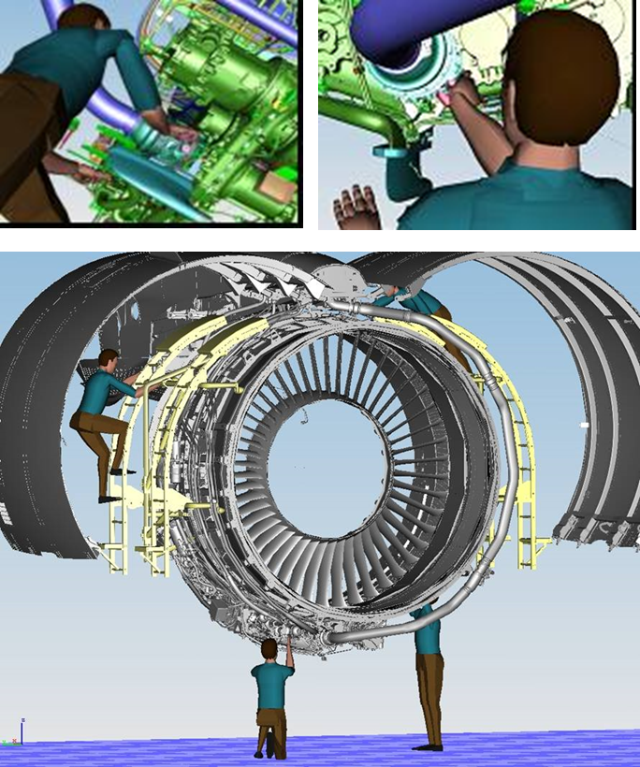
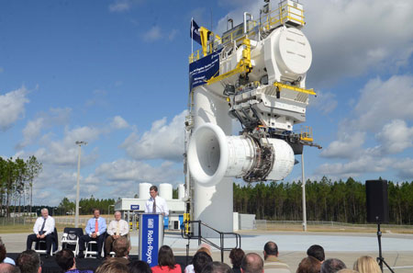
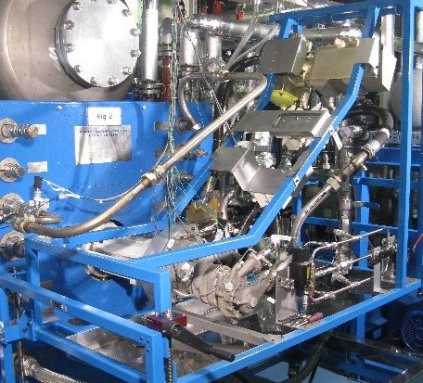
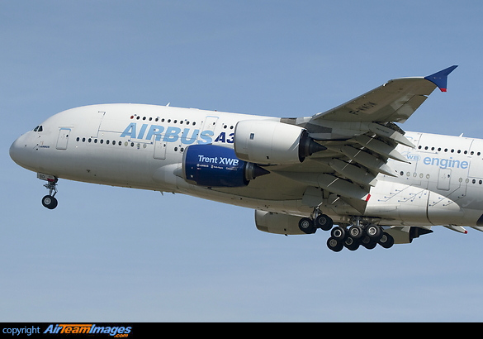
Design for Service – Evaluate
Virtual
Engine
Test Rig
Flight
Rolls-Royce proprietary information

Slide 25
Design for Service – Manage

Slide 26
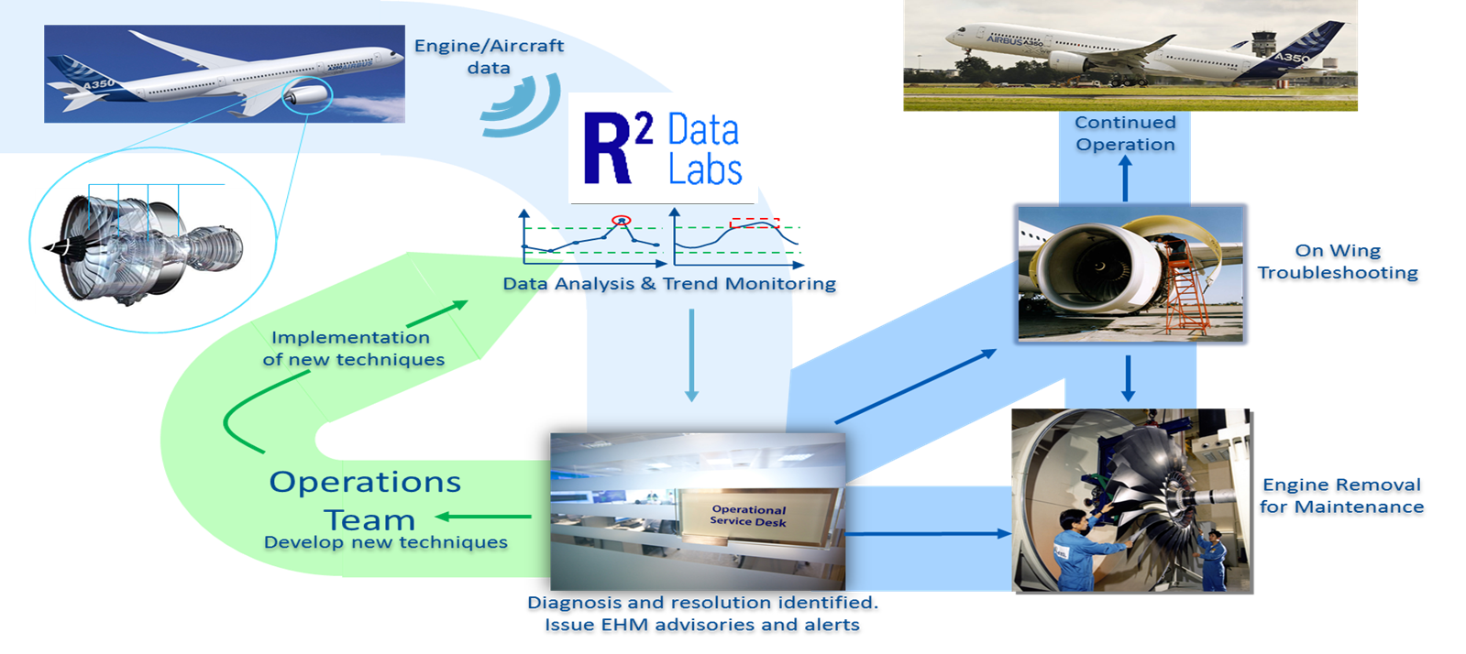
Design for Service – Manage
45% reduction in customer disruption rate over the last 10 years
Rolls-Royce proprietary information

Slide 27
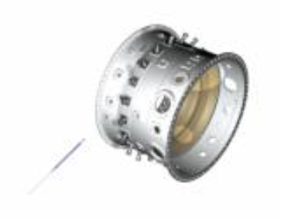
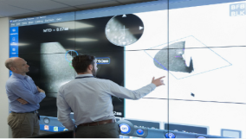
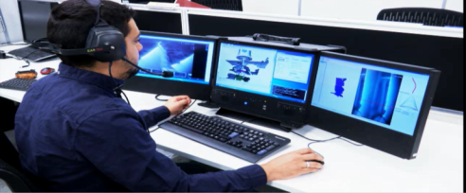
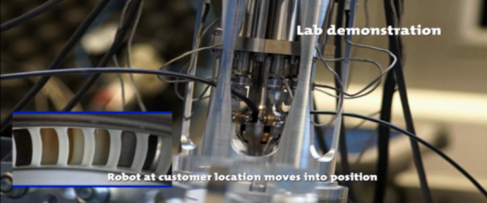
Design for Service – Manage
The Digitised Boroscope journey
Line of sight → snake arm deployment
Local interpretation → global expert live connection
Manual assessment → automated digital visual analysis
Local Manual control → remote robotic control
Passive inspection → digitally controlled dressing
Rolls-Royce proprietary information

Slide 28
Design for Service – Summary
Services are key to Rolls-Royce profitability
  Design for Service is a key underpinning capability
Design for Service is complex, with many degrees of freedom
  A structured approach throughout the life-cycle is a huge step forward especially when fuelled by access to service experience
Current & emerging digital technologies will drive a step change going forward
Rolls-Royce proprietary information

