Slide 1





Climate Mental Health Trauma & Resilience
April 11, 2025
Jyoti Mishra, PhD MBA
Director, NEATLabs
Associate Professor, Dept. of Psychiatry
School of Medicine, UC San Diego
Co-director, UC Climate Resilience Initiative
https://www.climateresilience.online/

Slide 2
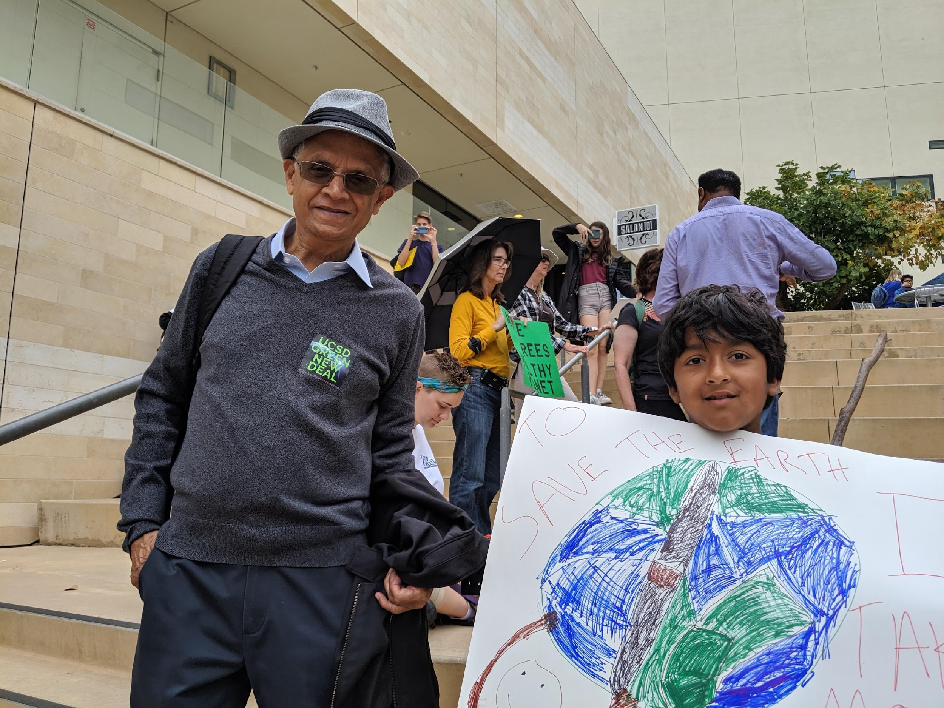
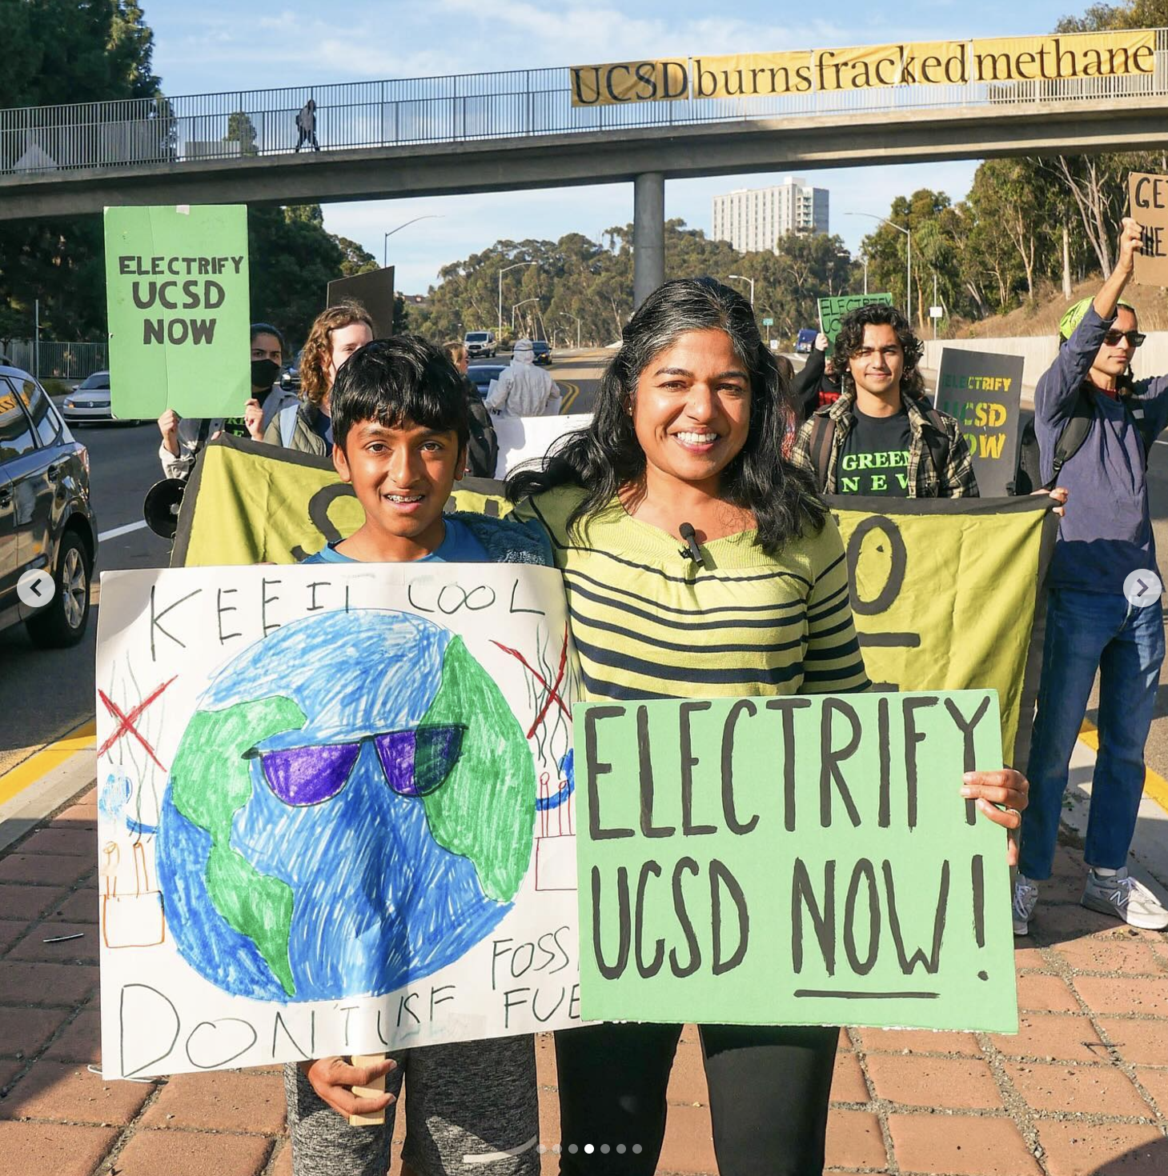
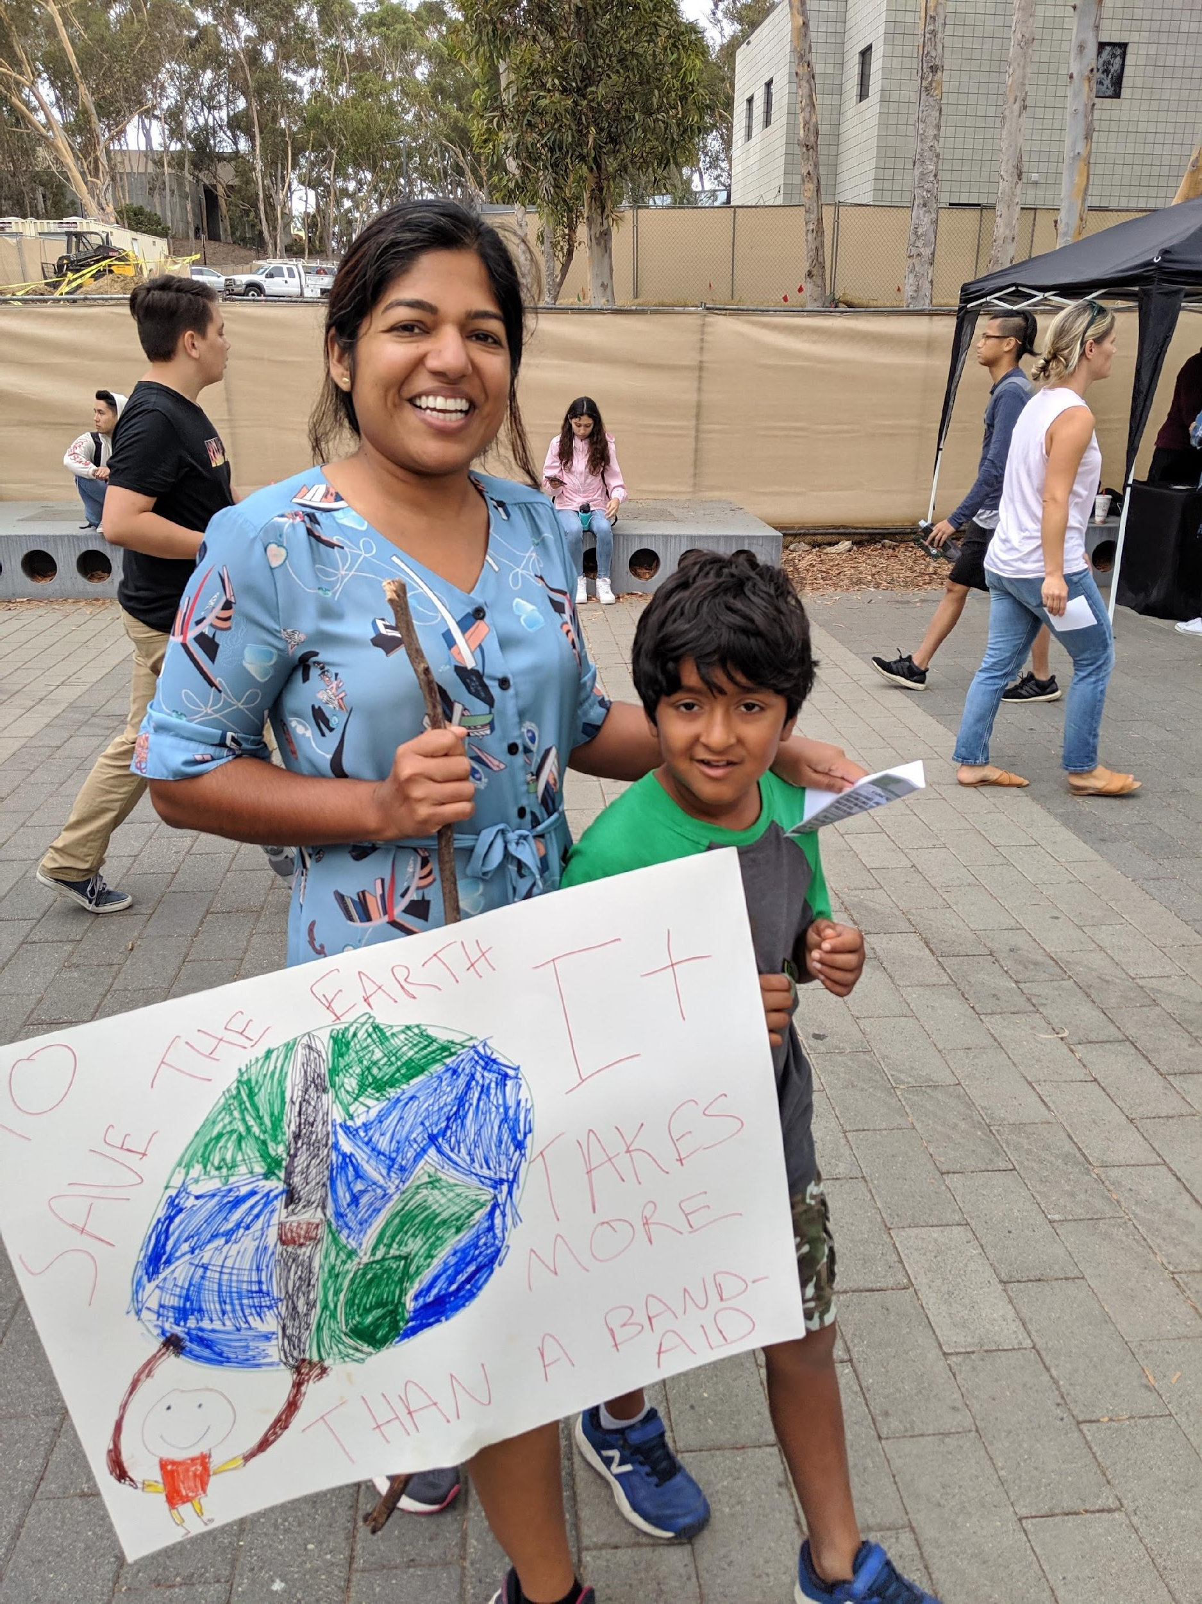
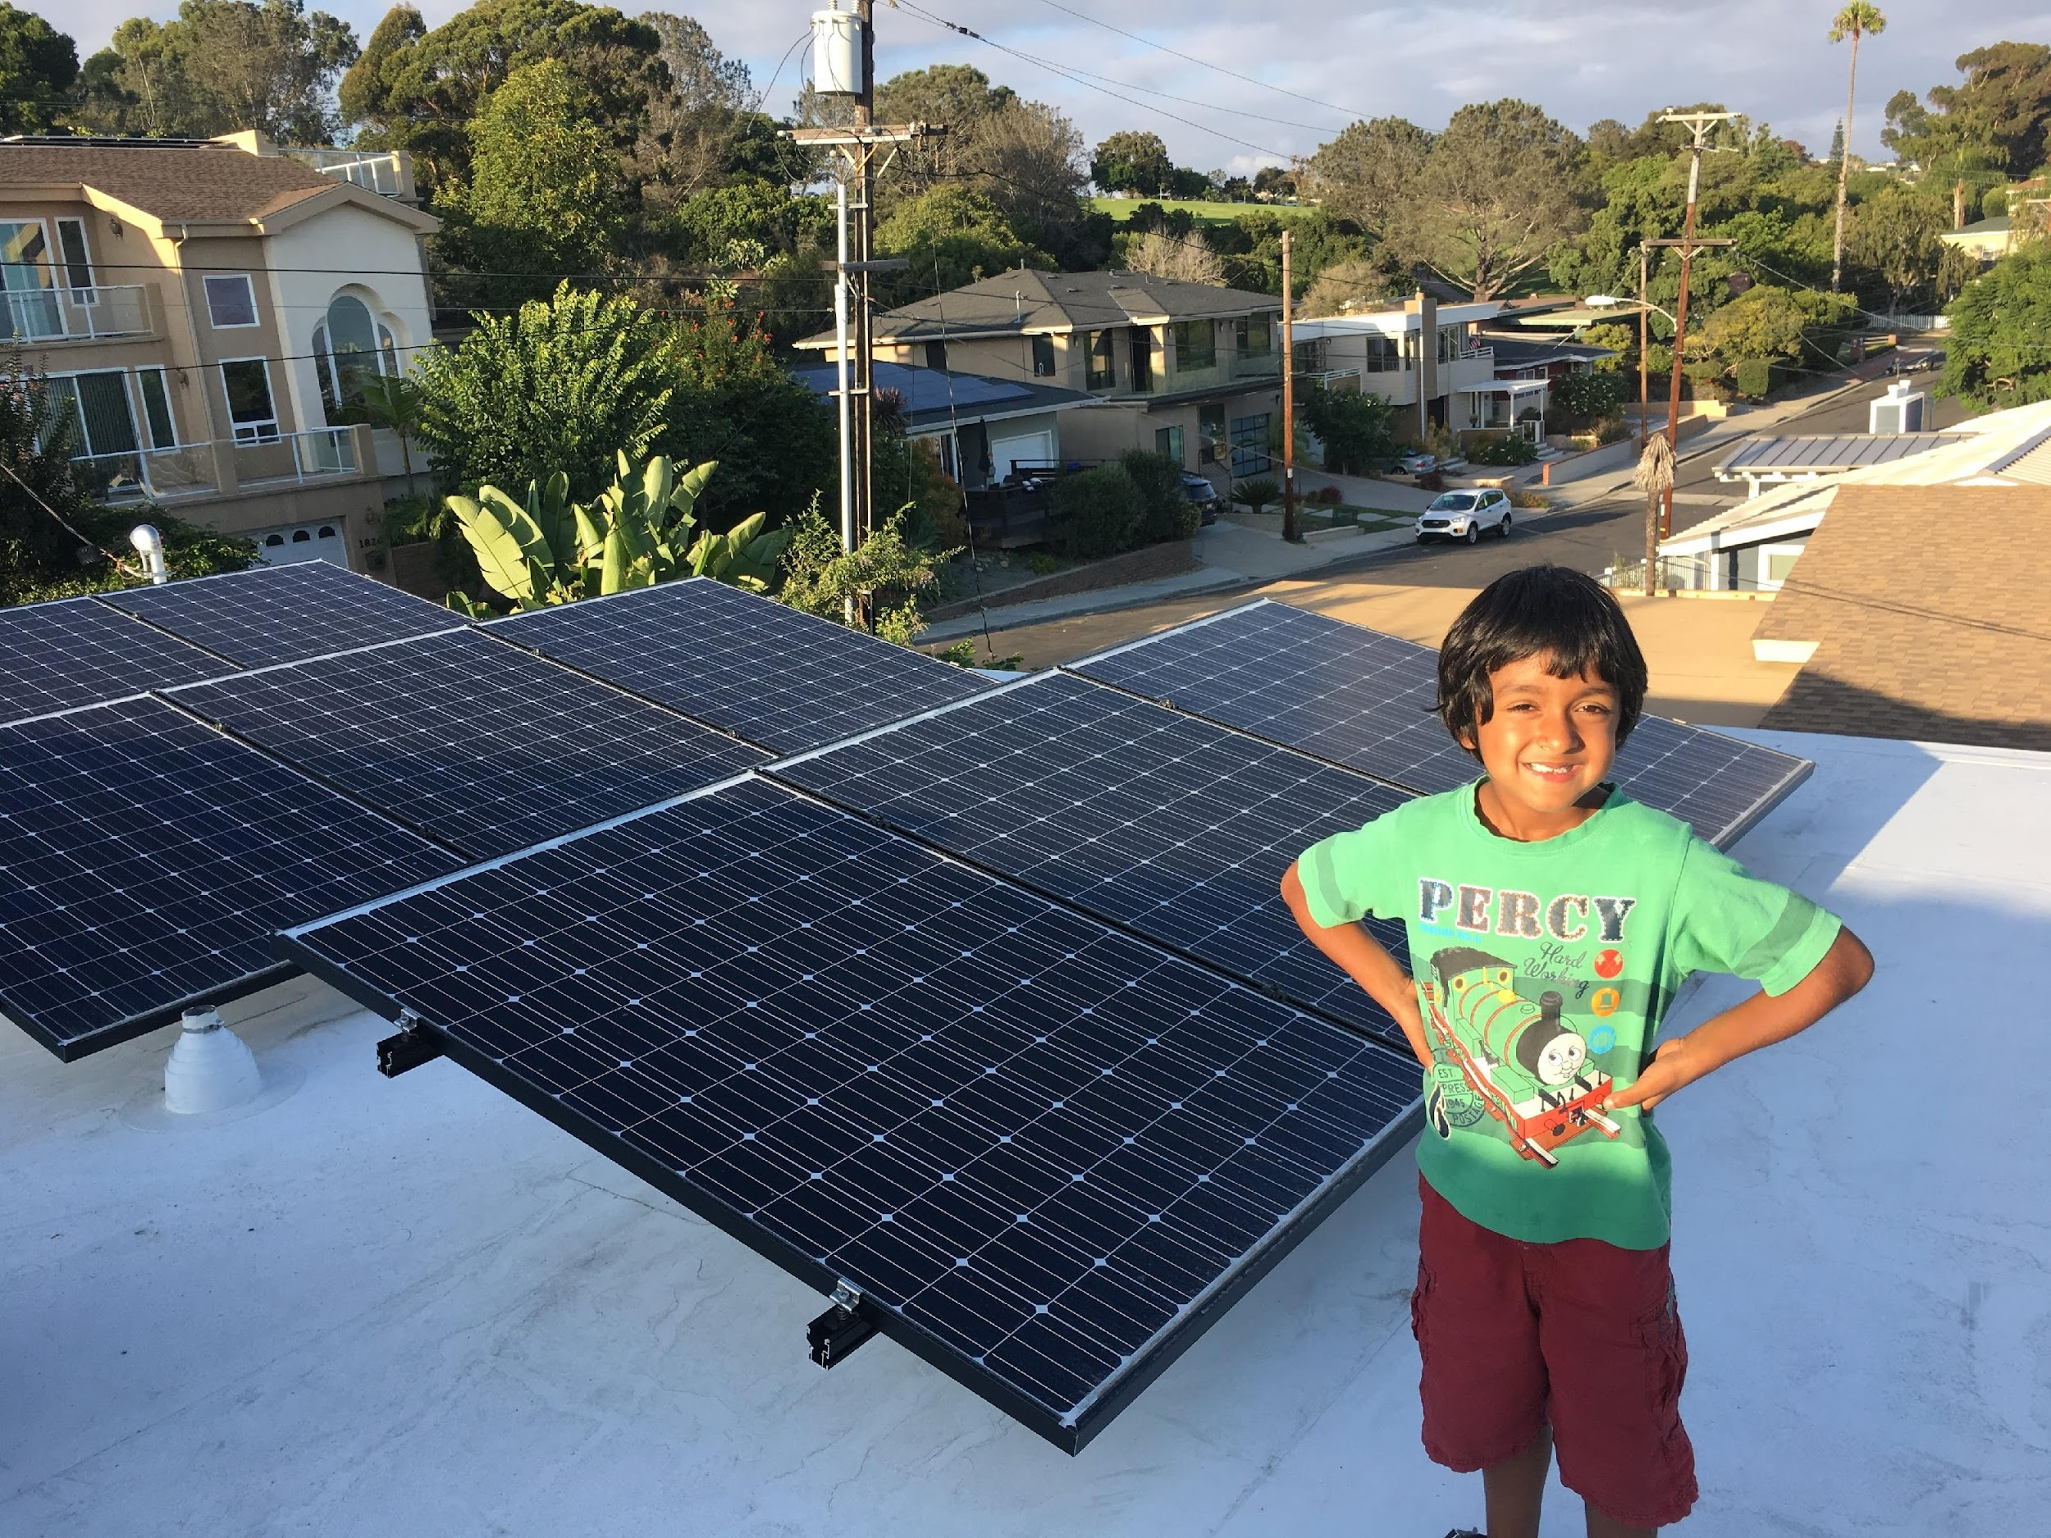
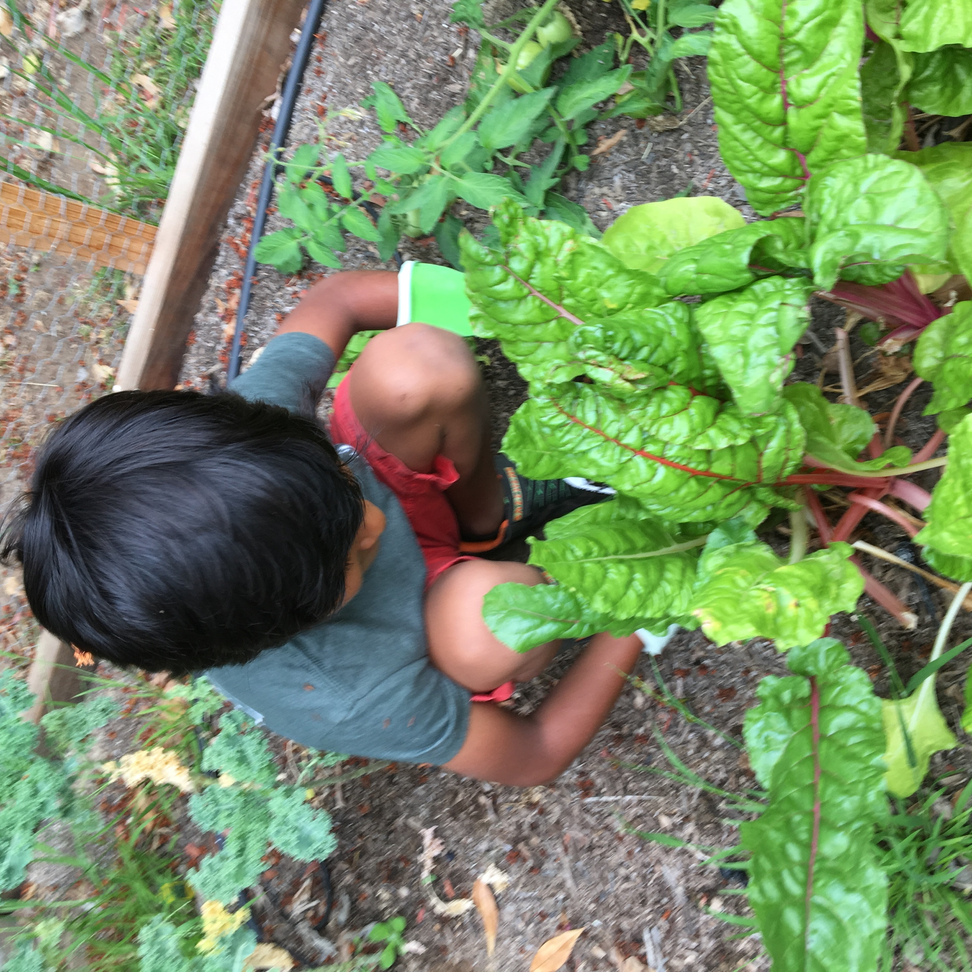
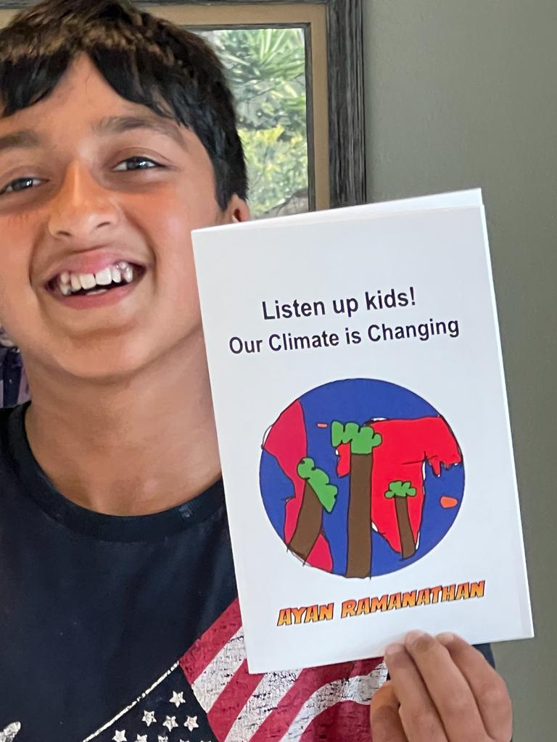

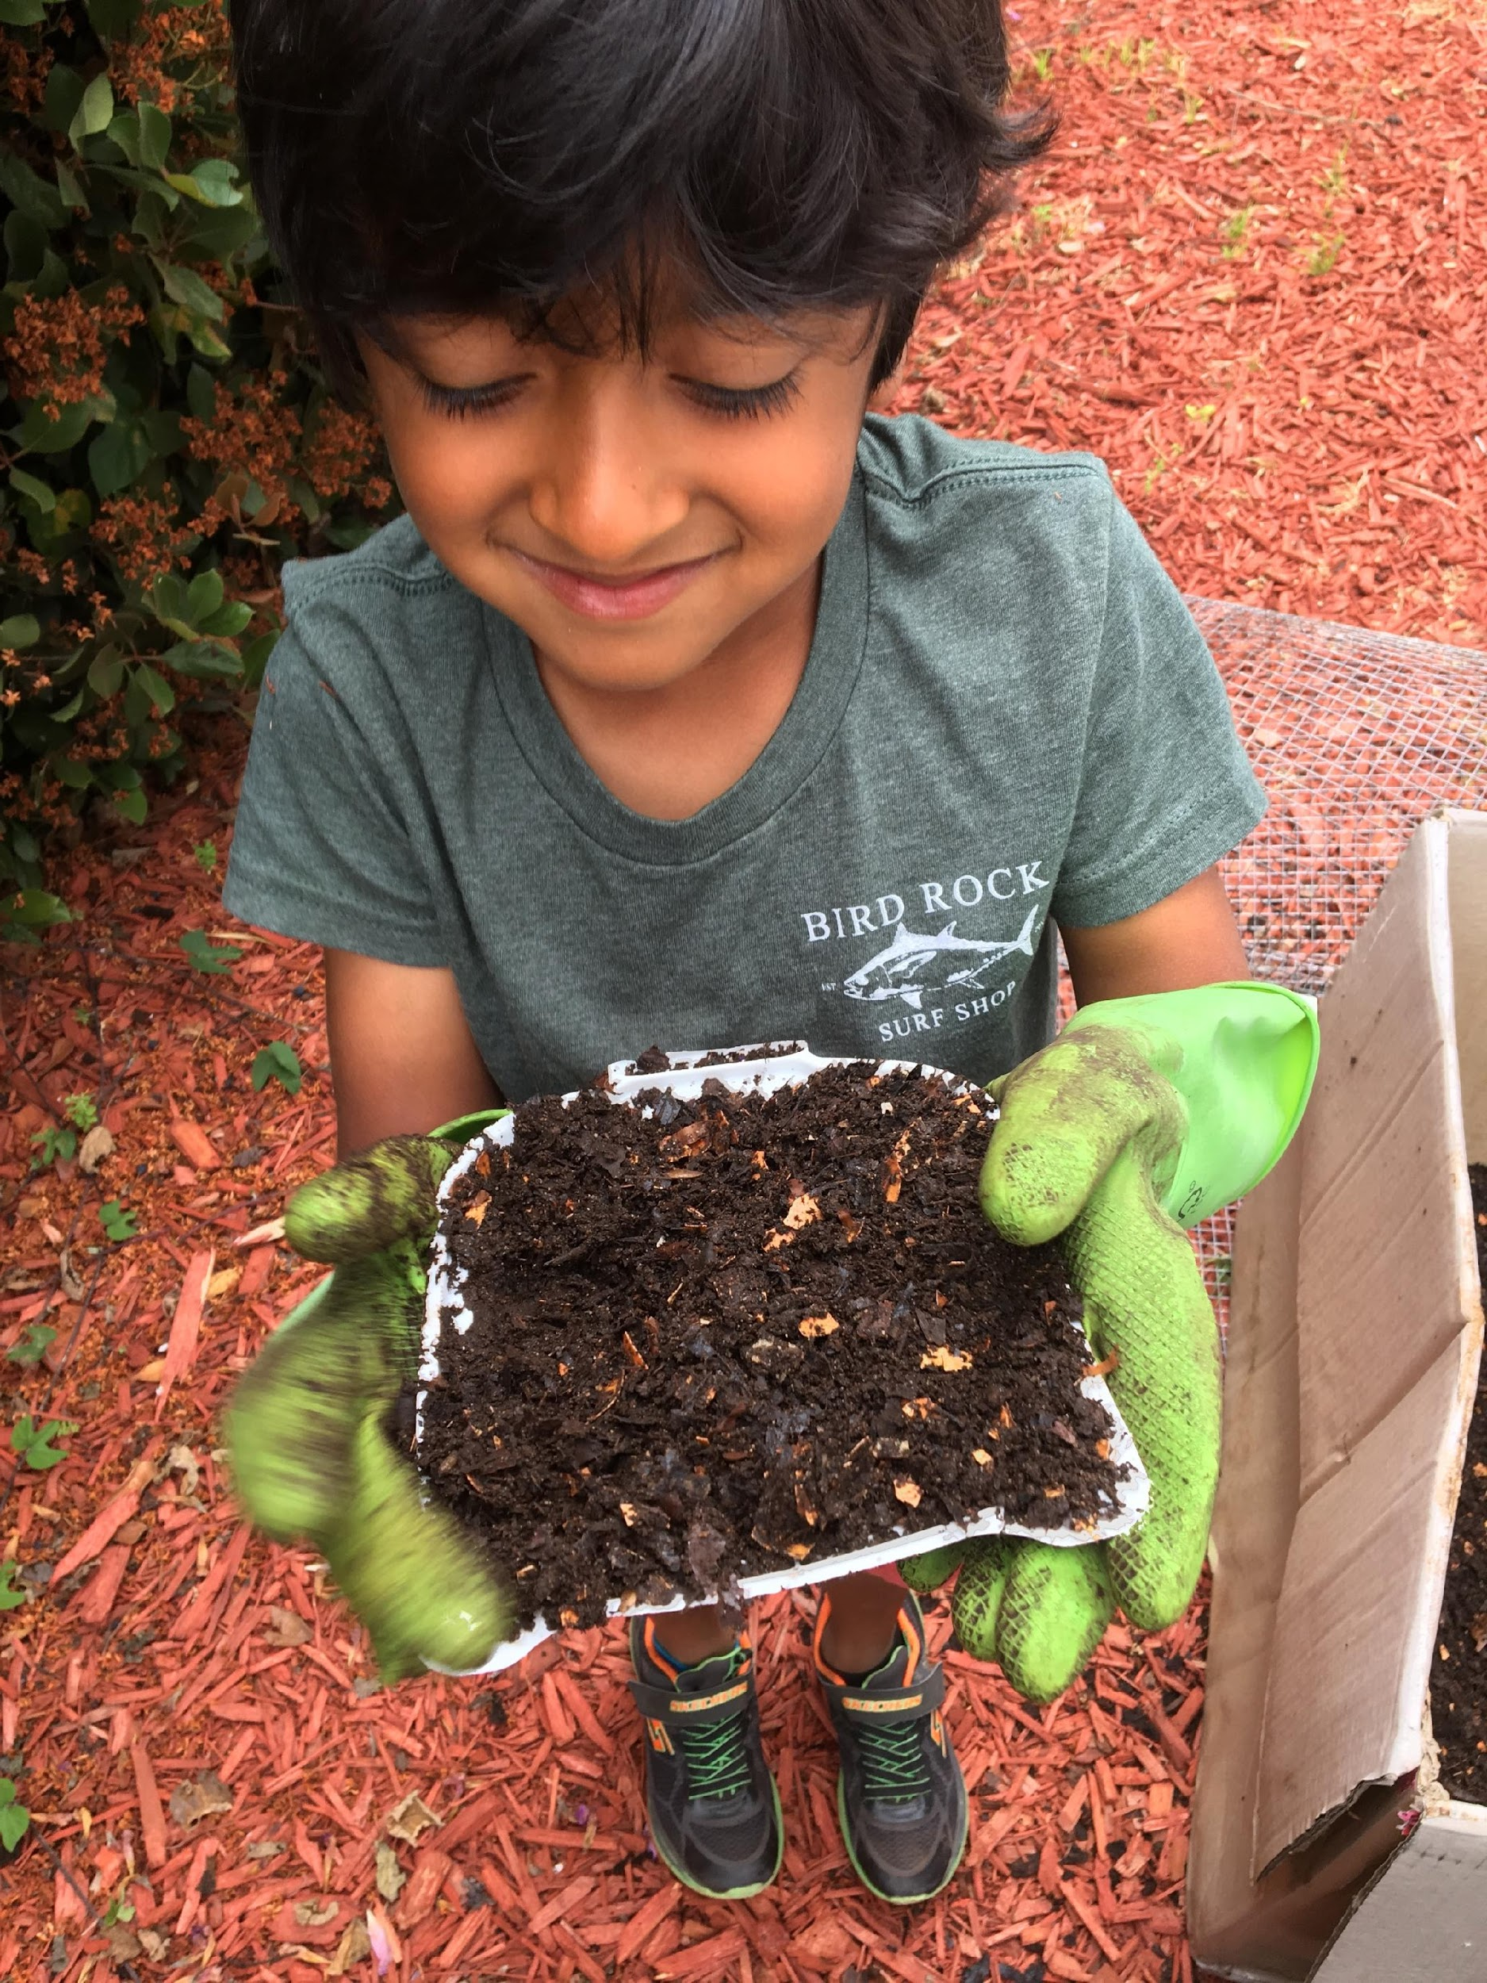
This work is inspired by my previous & future generations
Because this is the duty of ALL generations 🙏🏽

Slide 3




The societal mental health burden is already ginormous!
Only ~10
MH workers per 100K population
1 billion
living with MH disorders worldwide
$1 trillion
annual cost of MH disorders
< 2%
of govt. budgets spent on MH!
World Health Organization

Slide 4
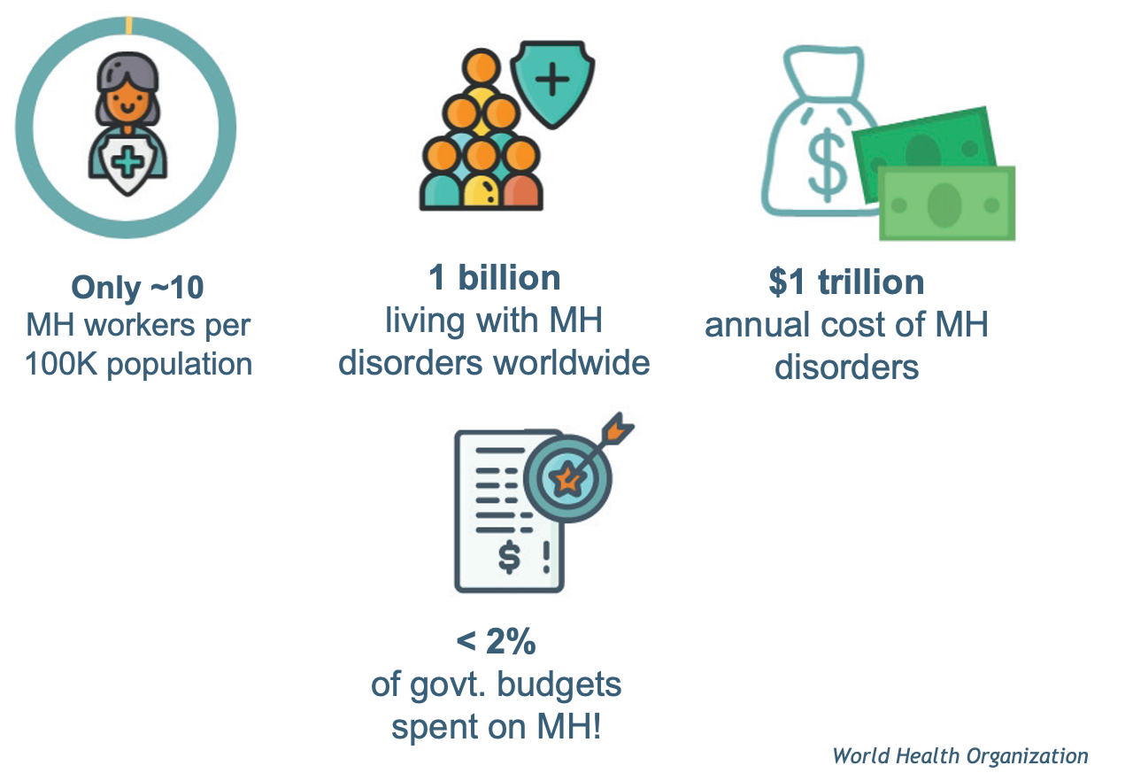


Climate extremes AMPLIFY the MH burden

Slide 5
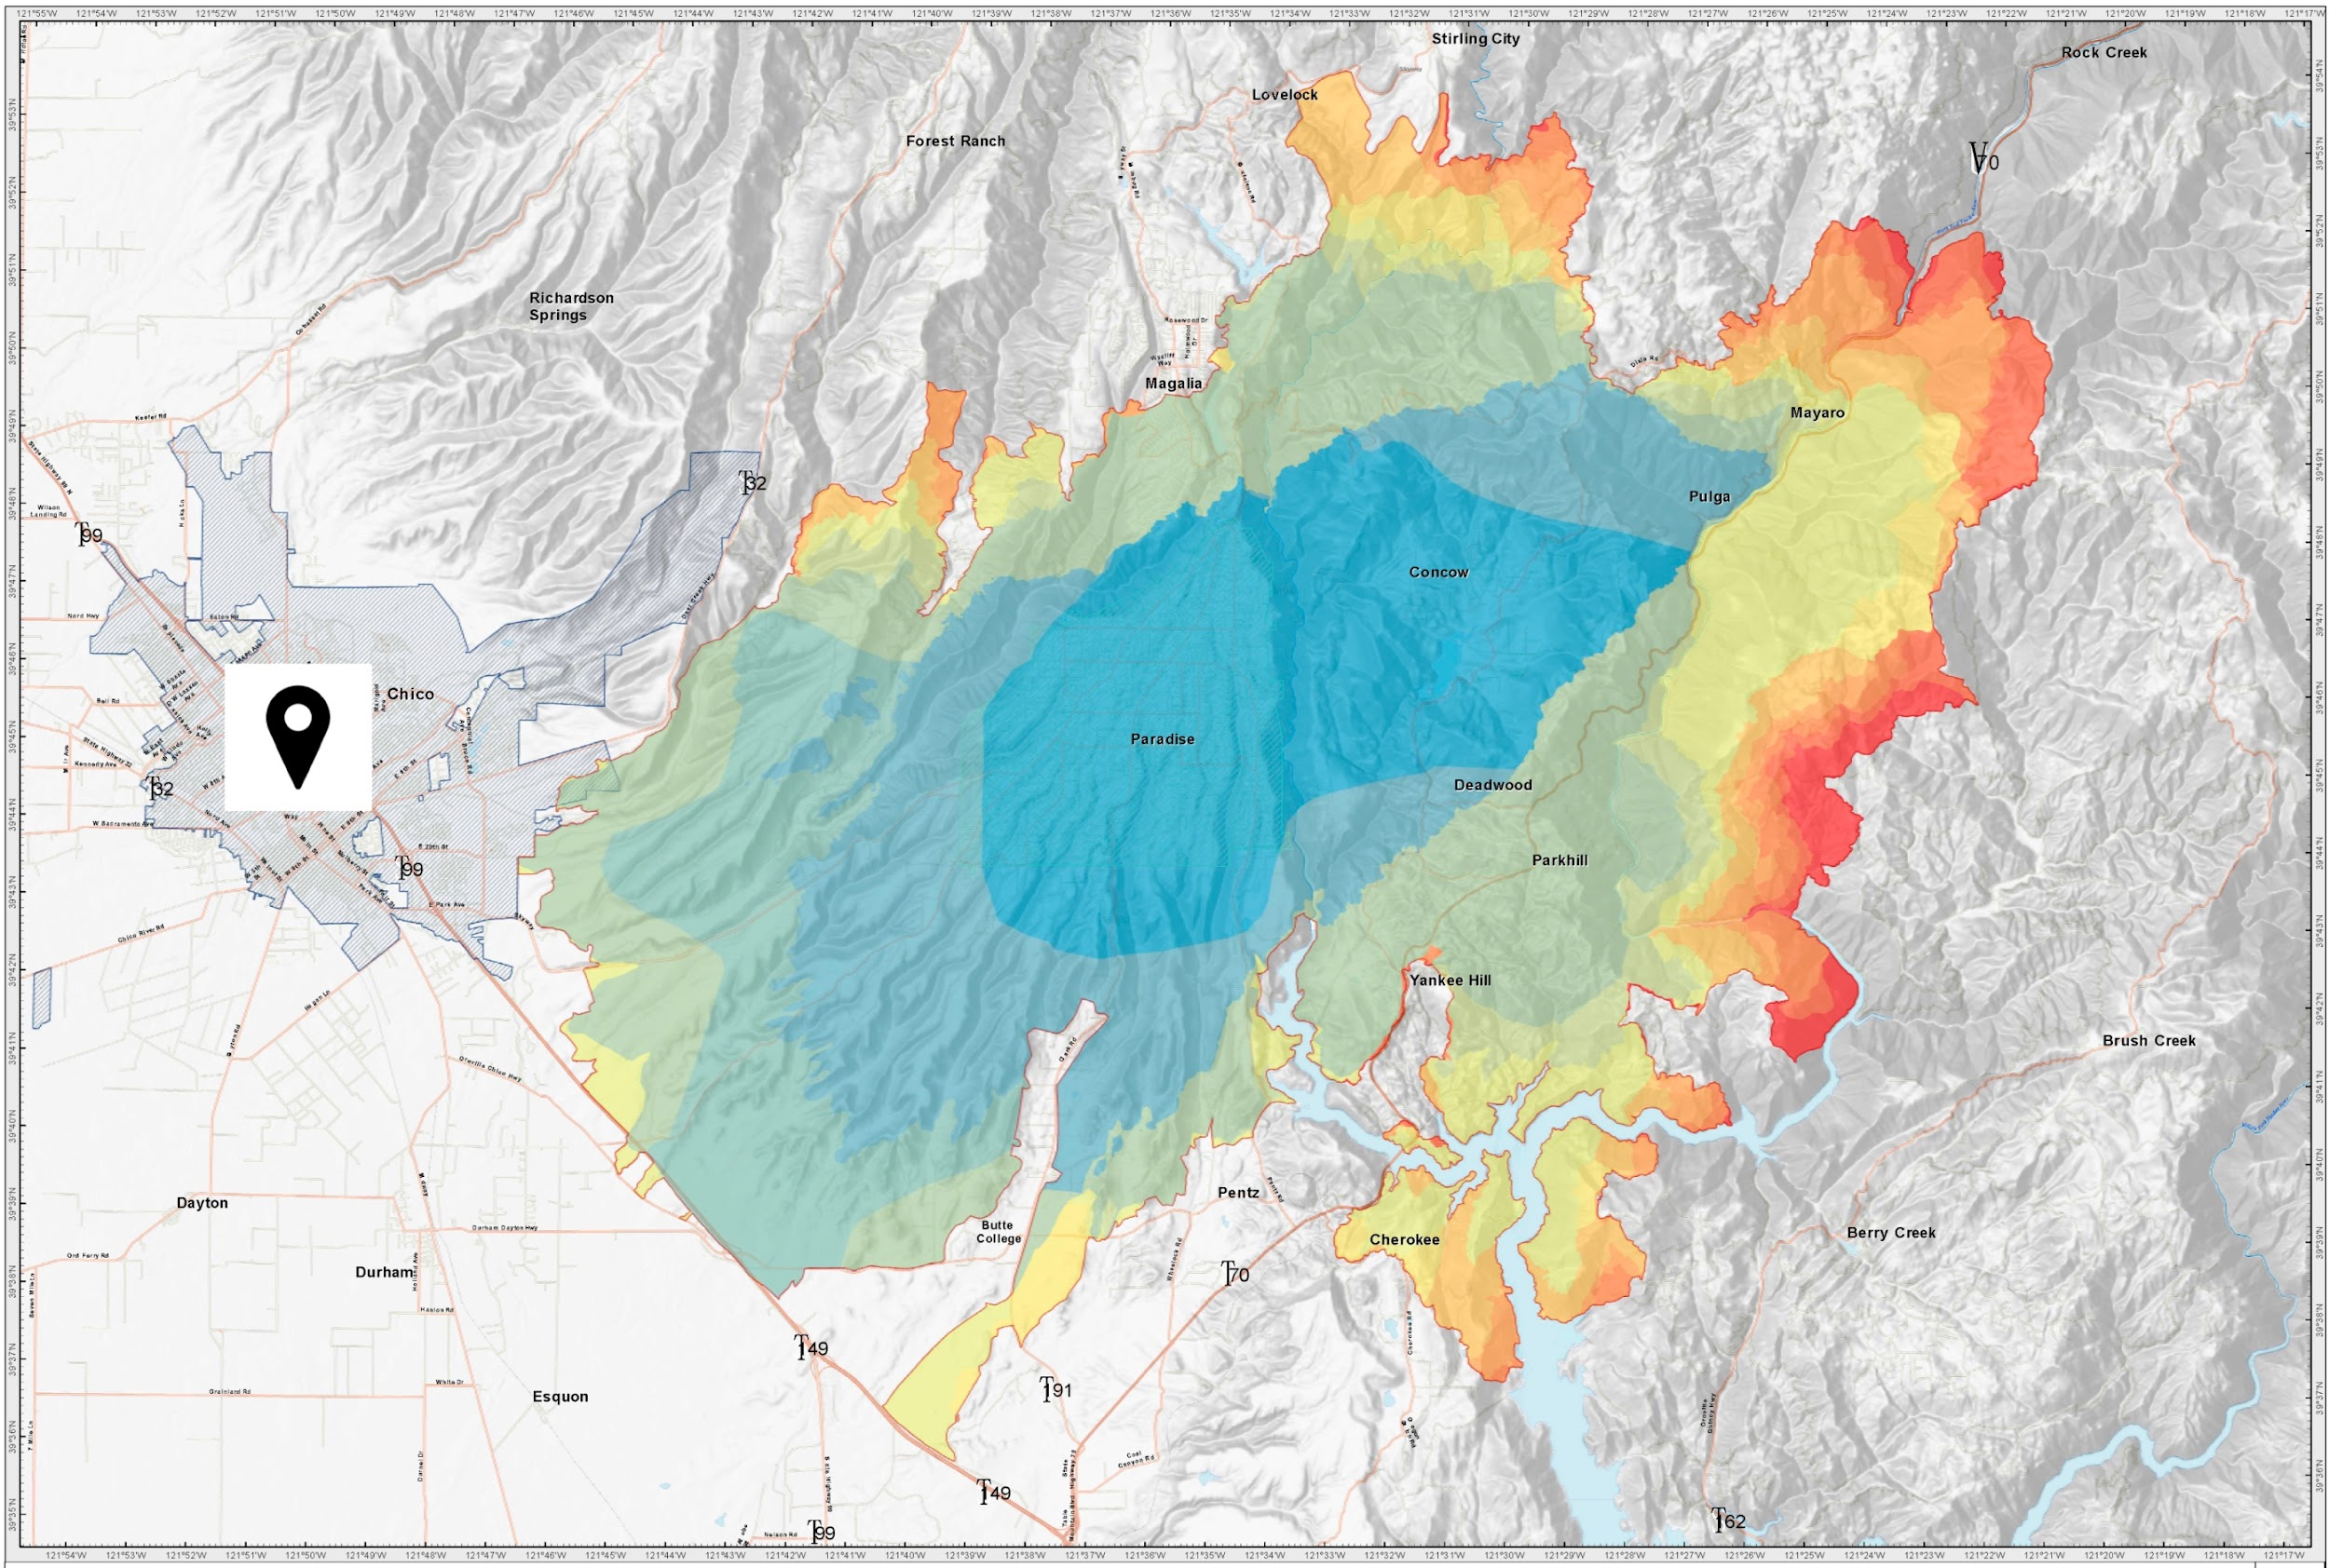
Mental Health impacts of California’s Deadliest Wildfire
Camp Fire, 2018
Butte County, CA
Chico, CA
Silveira et al., Int. J. Env. Res. & Public Health 2021

Slide 6
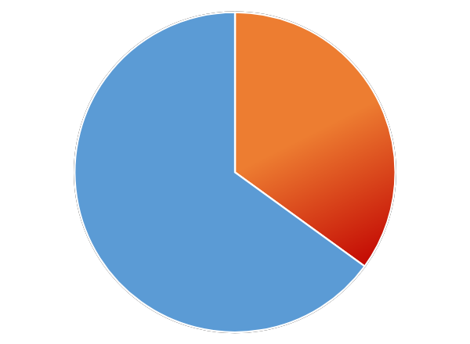
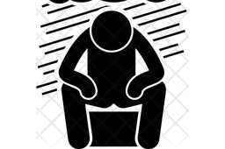
Mental Health impacts were observed at the Community wide level
Camp Fire, 2018
Butte County, CA
Chico, CA
~35% of community members had Climate Mental Health Trauma
= PTSD, Depression, Anxiety
Silveira et al., Int. J. Env. Res. & Public Health 2021

Slide 7
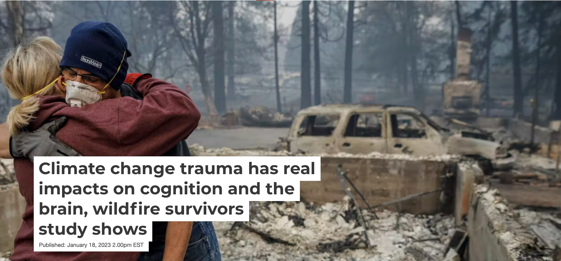
Significant and persistent Cognitive impacts were also observed
HIGH
Distractibility
POOR
Decision-making
Grennan et al., PLOS Climate 2023; Nan et al., Nature Scientific Report 2025 in press

Slide 8
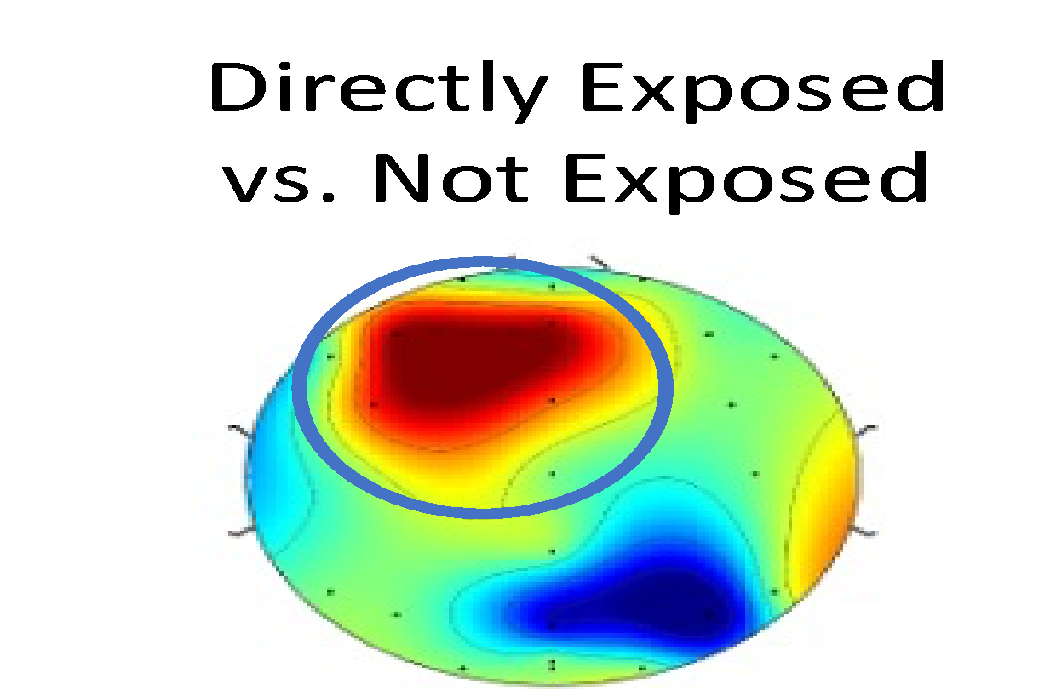
For the first time ever, brain impacts of wildfire exposure were revealed
🧠
FIRE BRAIN
🔥
Fire-Exposed vs. Not Exposed
Grennan et al., PLOS Climate 2023

Slide 9
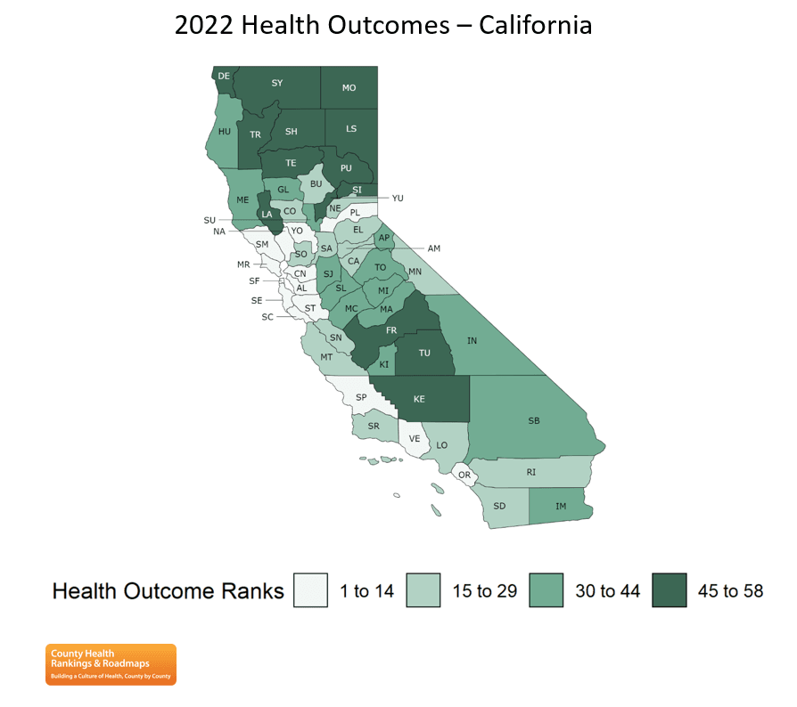
These climate impacts usually hit already vulnerable communities
Camp Fire, 2018
Butte County, CA
Chico, CA
Silveira et al., Int. J. Env. Res. & Public Health 2021

Slide 10
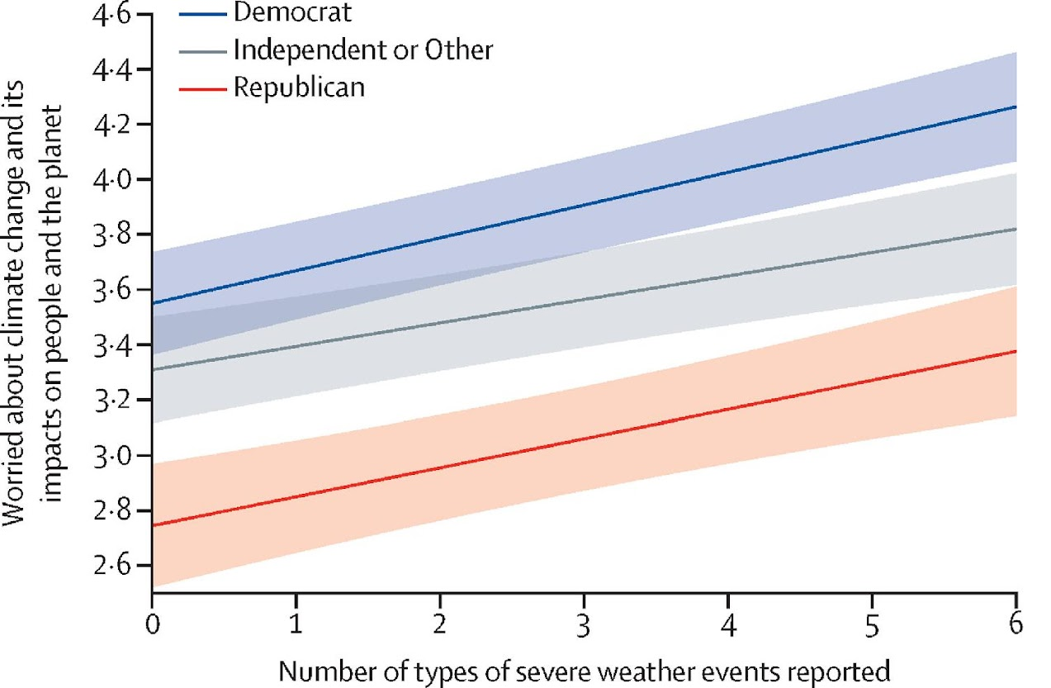
Widespread Climate Distress, esp. in Youth
~85% youth were moderately or extremely distressed
Lewandowski et al., Lancet Planetary Health 2024
Notes:
16-25 years of age

Slide 11
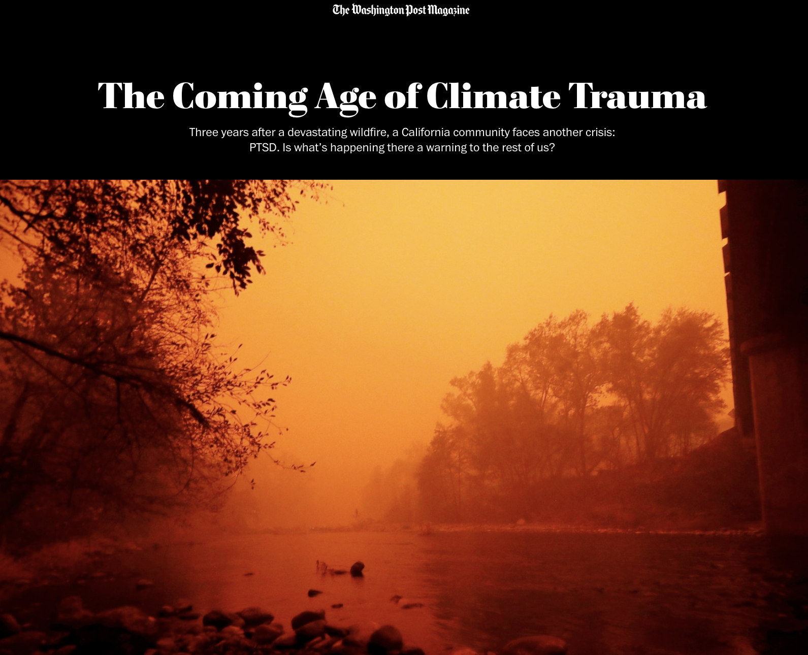
Climate Trauma exacerbates the mental health burden and is associated with poor and persistent mental health symptoms, as well as poor cognition and brain function.
Climate trauma adds another layer of disadvantage for the communities that face the worst of climate change and have done the least to cause it. These are the communities that already deal with high levels of (non-climate) trauma. We must address this “Climate Gap”.

Slide 12
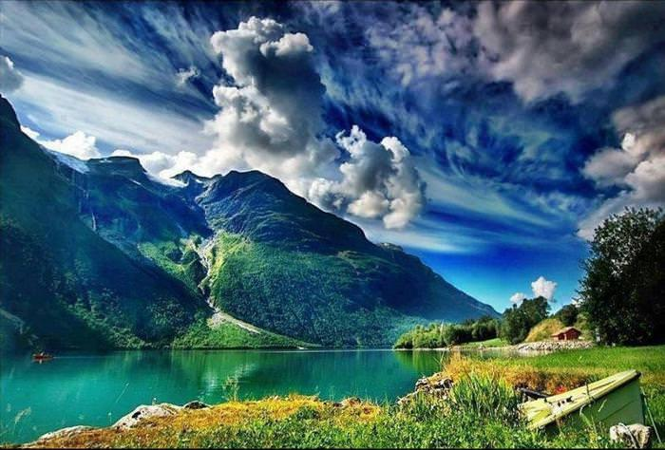
Building Resilience -
Addressing Climate Mental Health Trauma

Slide 13


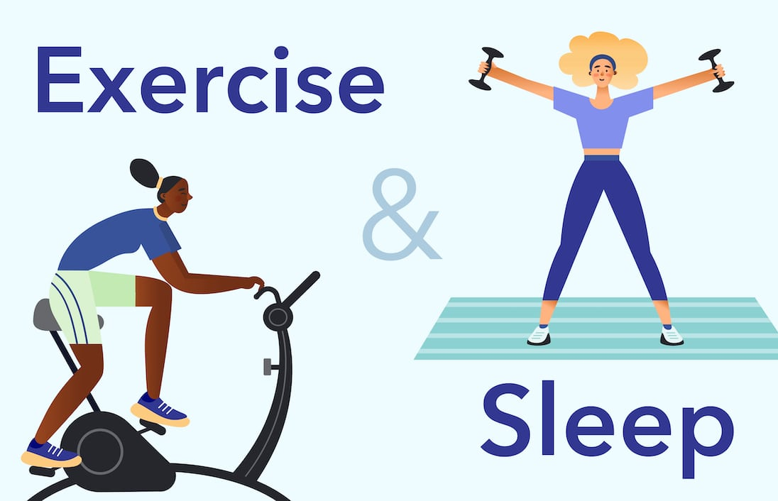

FOUR Personal Factors foster Resilience
Personal Resilient Belief
Mindfulness
Exercise
Family & Community Ties
Silveira et al., 2021; Kornbluh et al., 2022

Slide 14


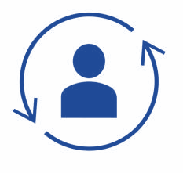





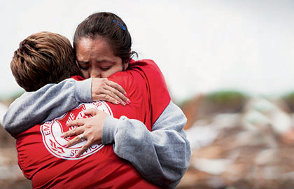



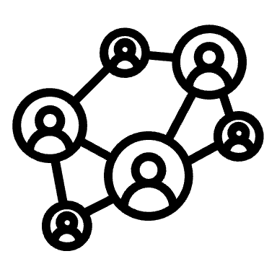


Building Societal Climate Resilience
MITIGATION
SOCIETAL TRANSFORMATION
ADAPTATION
Climate Education for All
Coalition building
Long-term Policymaking
Social Cohesion

Slide 15
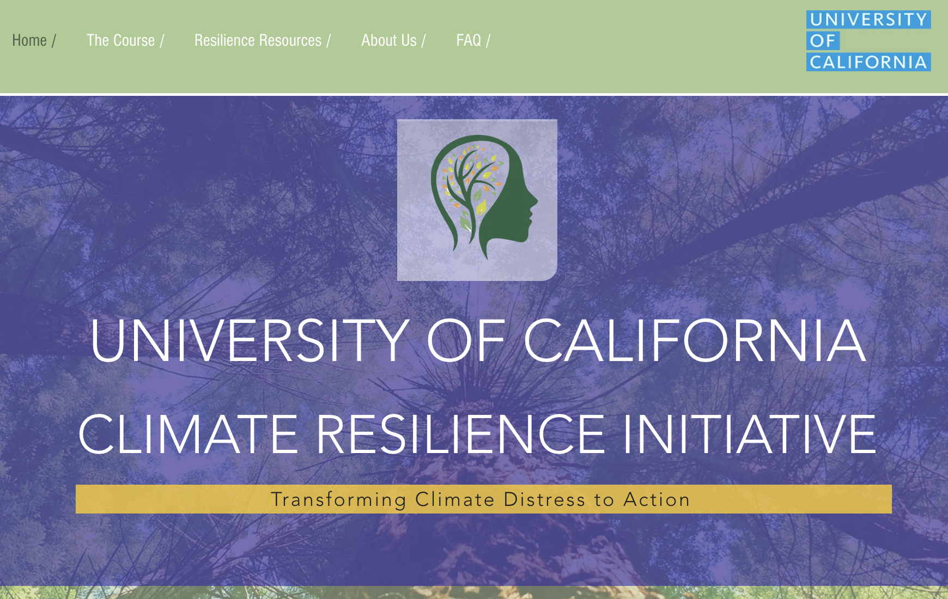
https://www.climateresilience.online/

Slide 16

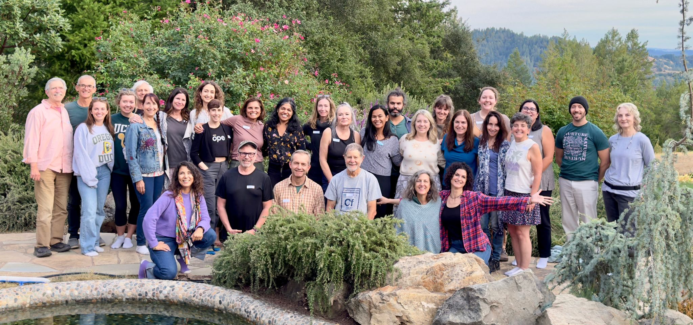
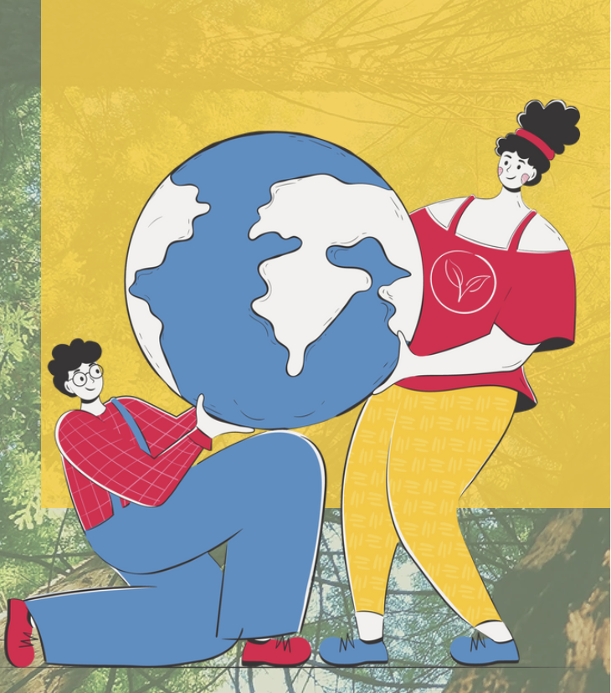
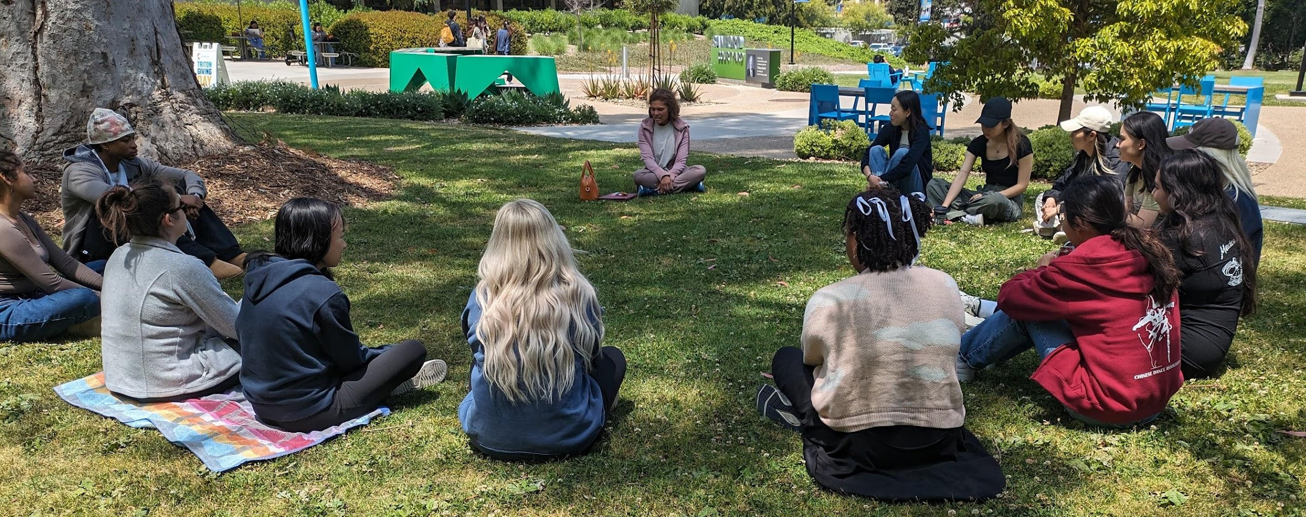
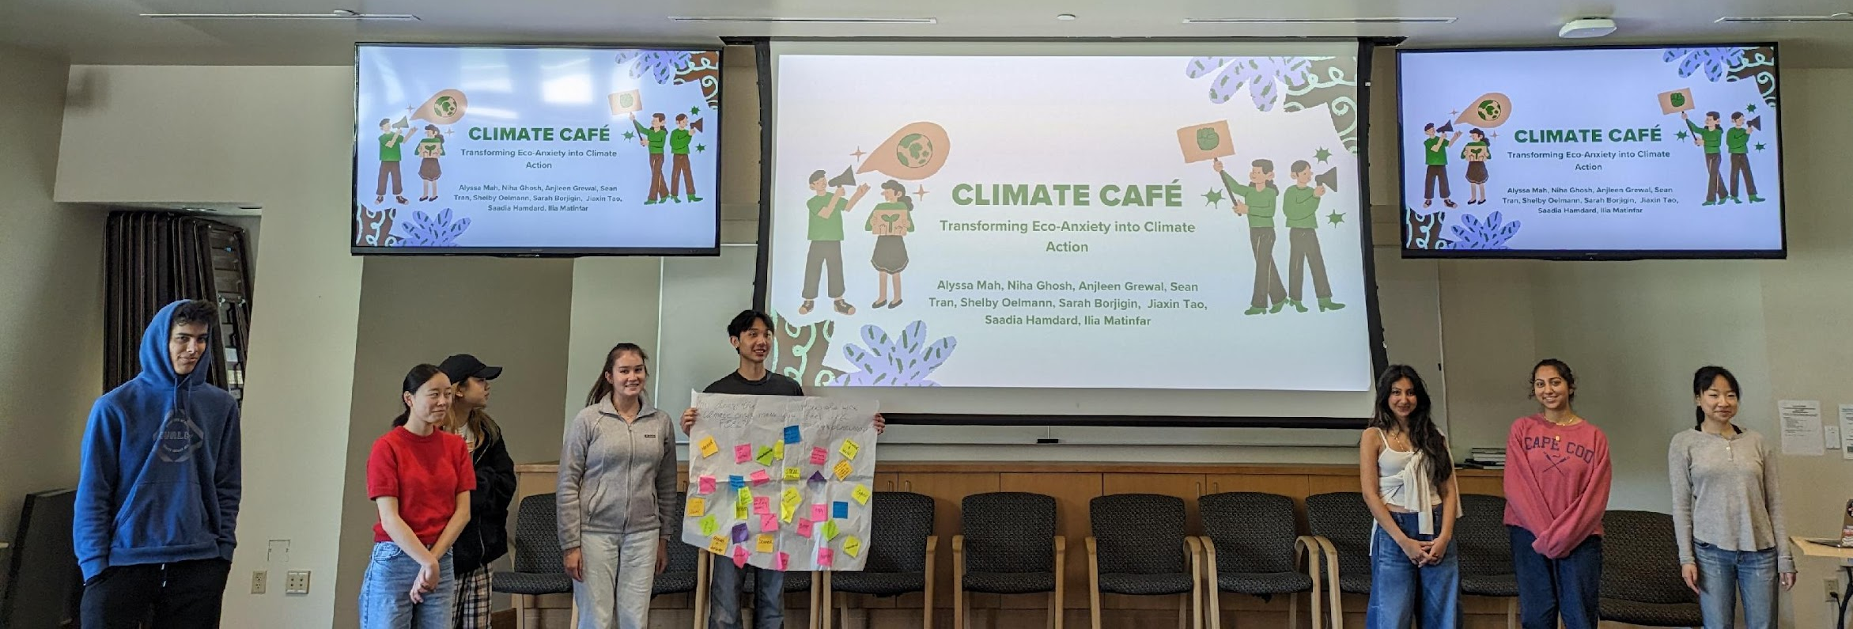
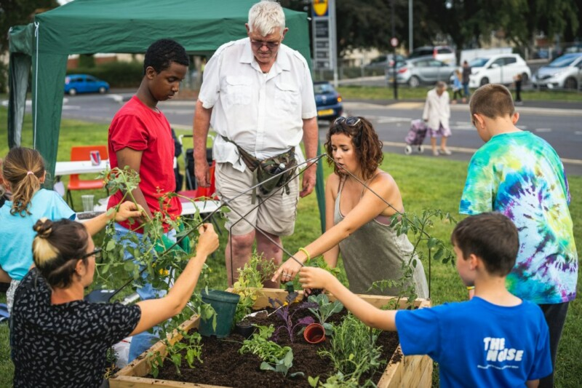
Climate Resilience Education
https://www.climateresilience.online/

Slide 17
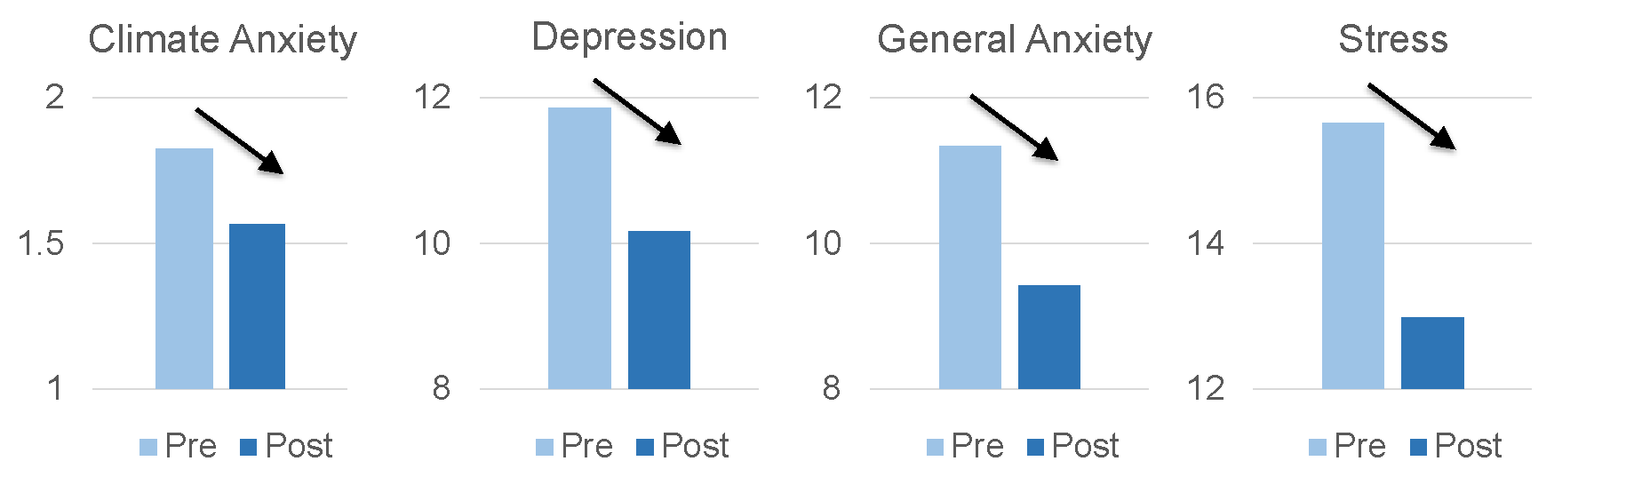
Climate Resilience Education benefits Mental Health
Epel, Mishra et al., Sustainability 2025

Slide 18
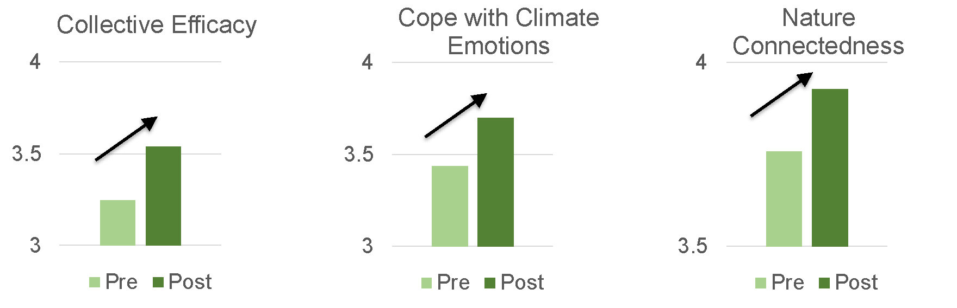
Climate Resilience Education generates Collective Action & Community Cohesion
Epel, Mishra et al., Sustainability 2025

Slide 19
Building Climate Resilience is a necessity and an opportunity for
Inter-generational Flourishing
Thank You
jymishra@ucsd.edu | climateresilience@ucsd.edu

