Slide 1
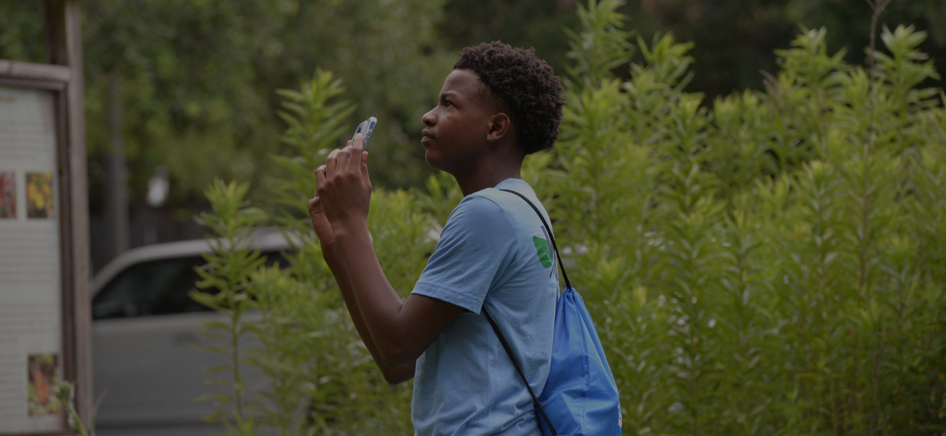



Slide 2


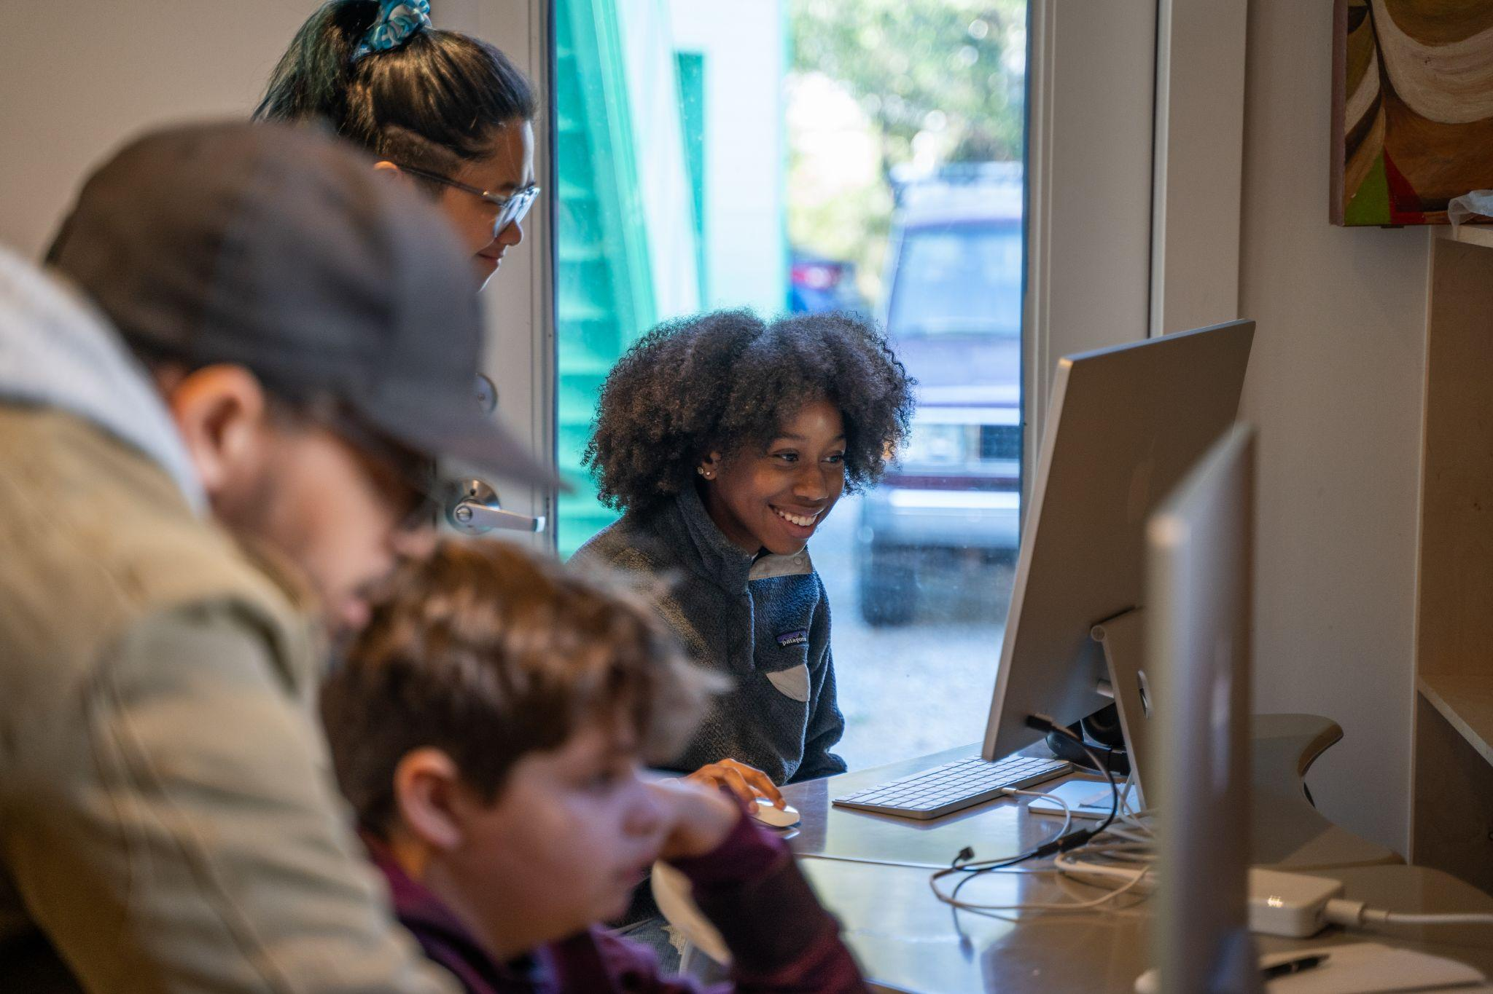
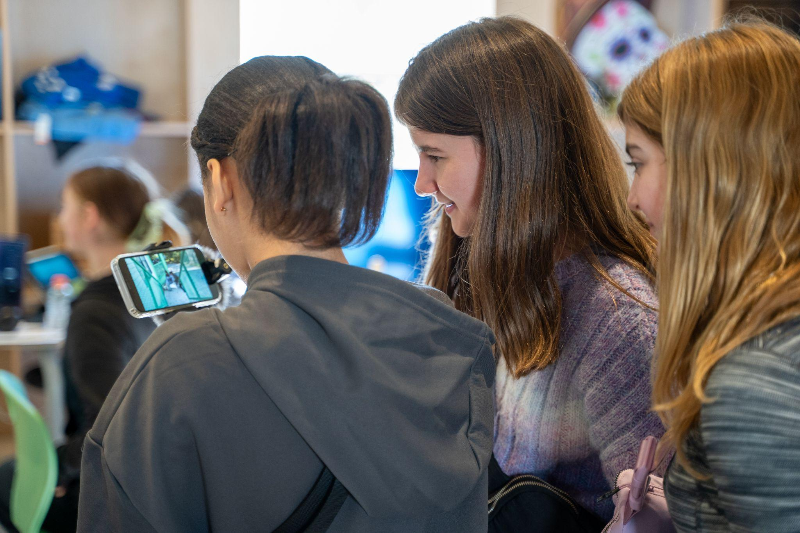
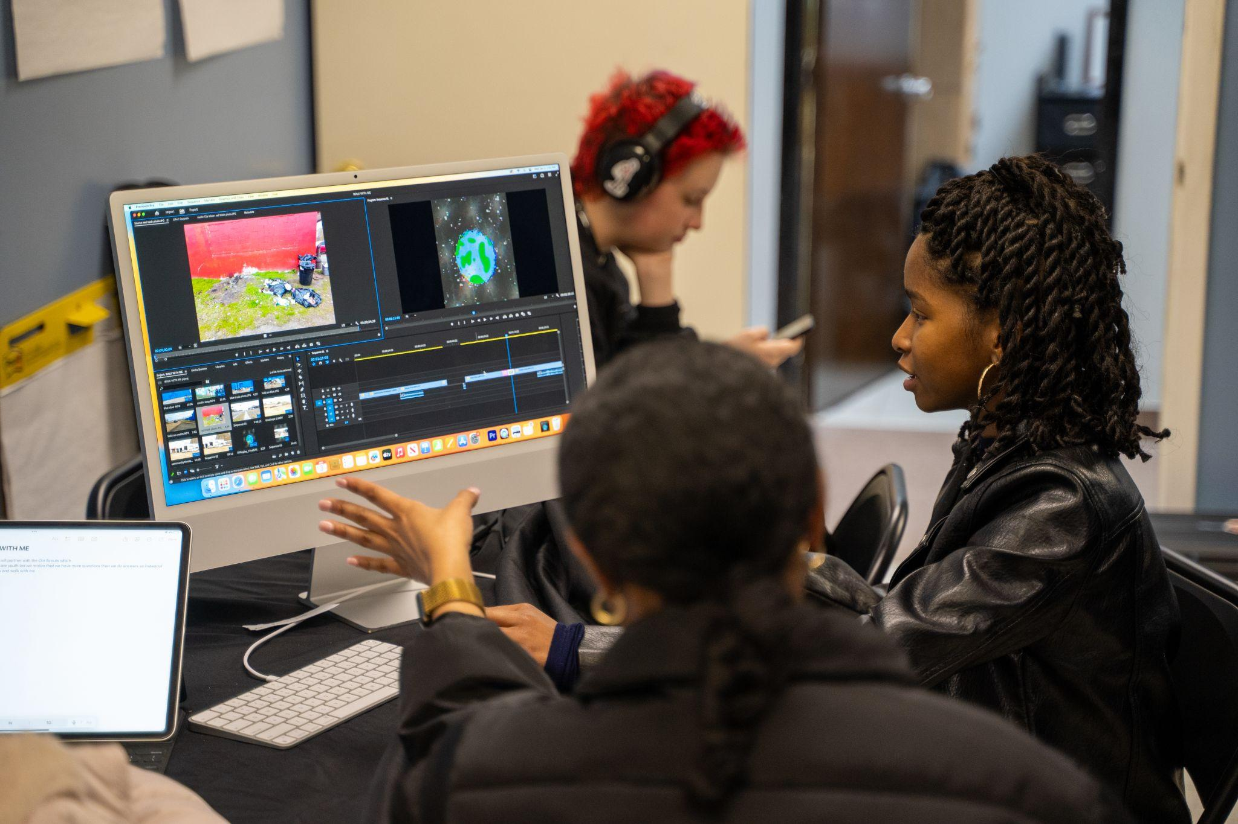

Slide 3
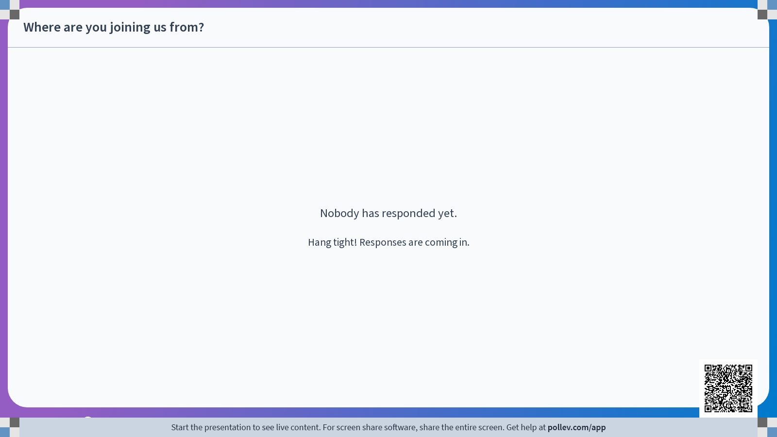

Slide 4
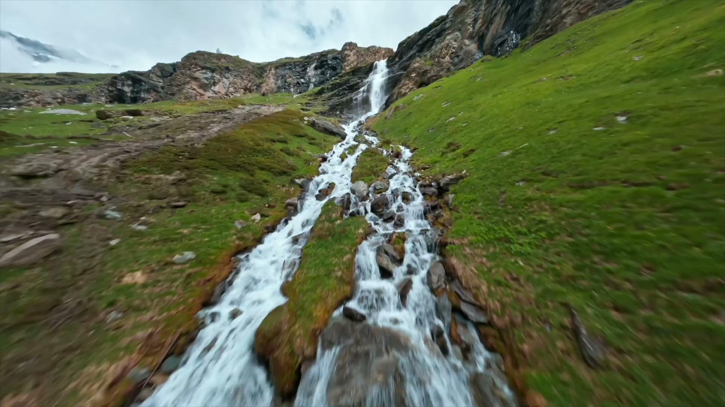

Slide 5
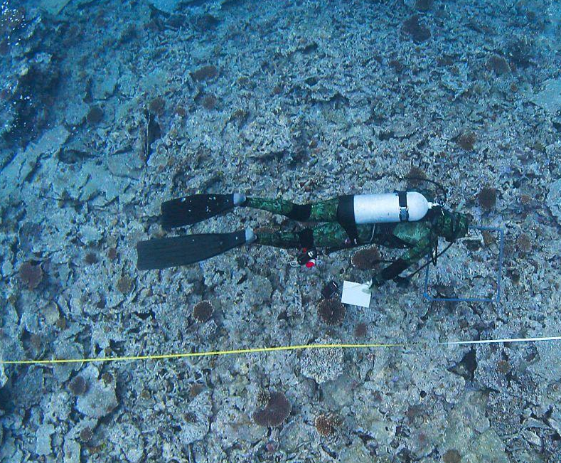
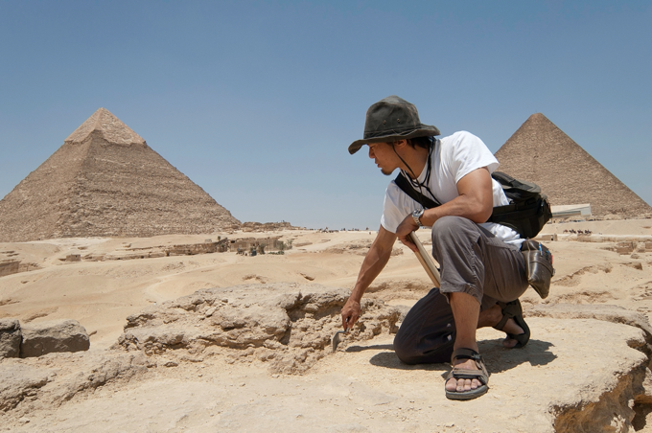
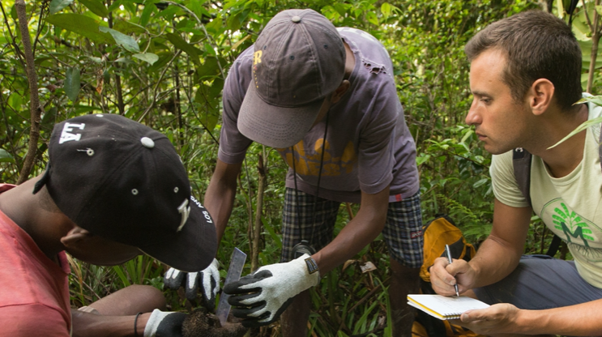
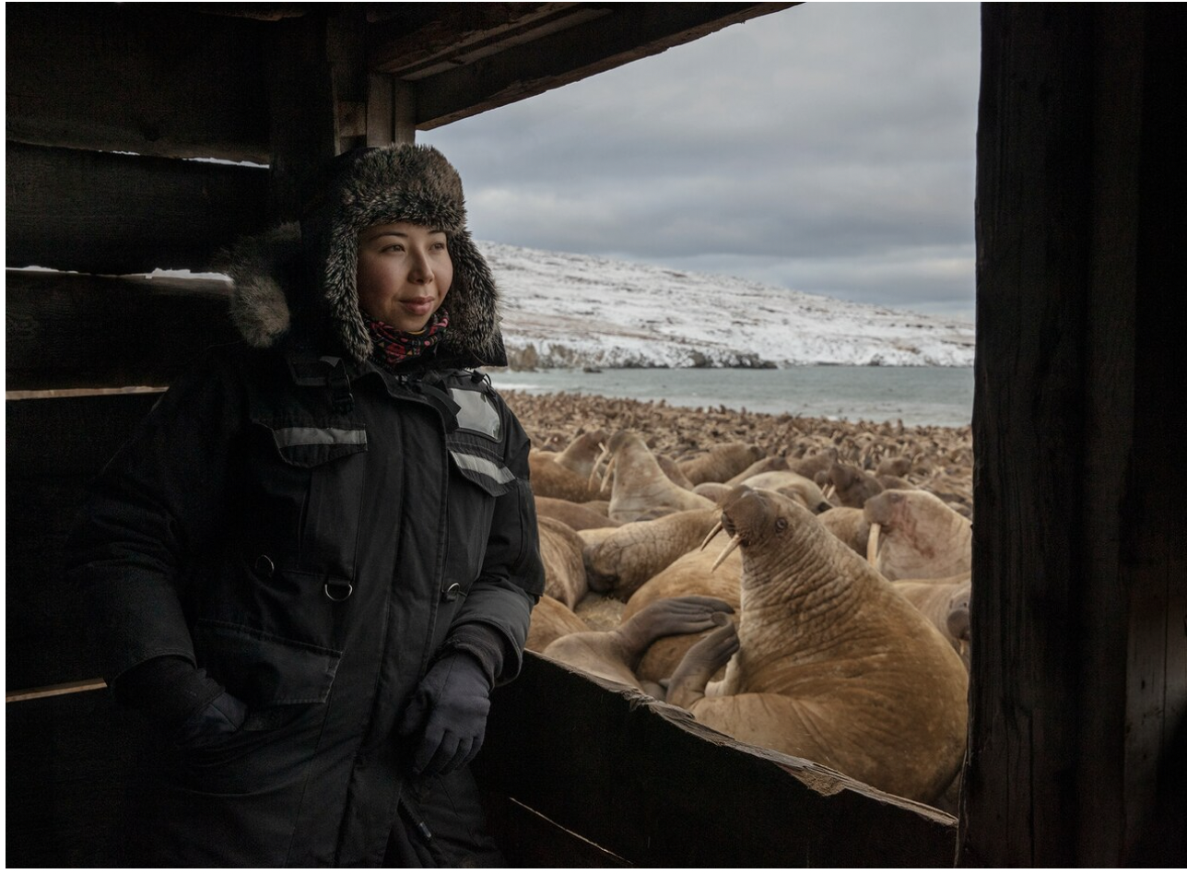
PROGRAM OVERVIEW
The SLINGSHOT CHALLENGE is an global youth challenge that aims to identify and support the next generation of problem-solvers, advocates, and stewards for the planet.
Designed for youth ages 13-18 and their educators, the challenge will encourage youth to use their voice and ingenuity to tackle environmental issues such as:
Clean the air
Restore the ocean
Protect nature
Reduce waste
Address climate change
Notes:
Funded by a $5M grant from the Paul G. Allen Family Foundation

Slide 6
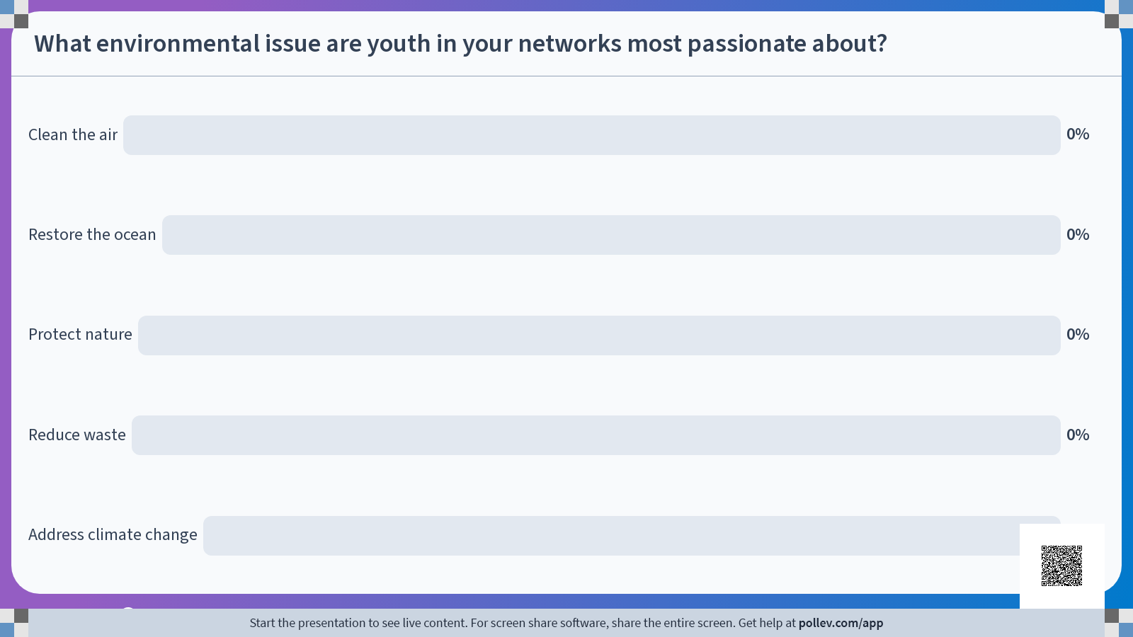

Slide 7



SLINGSHOT BASICS
Youth can work by themselves or in a team of up to six members.
Everyone on the team must be 13-18 years old at the time of submission.
Open globally; The video submissions must be in either English or Spanish.

Slide 8




REQUIREMENTS FOR SLINGSHOT CHALLENGE VIDEO SUBMISSIONS
Videos must be no longer than one minute, must be in either English or Spanish, and files must be no larger than 200MB.
Videos can be filmed on any equipment, including a cell phone,
and can be filmed in either horizontal (landscape) or vertical (portrait) format.
All content must be original or copyright-free.
Videos should be submitted at slingshot.videosforchange.org

Slide 9




Get started today! Here are the steps:
Get registered for the challenge on
Videos for Change at slingshot.videosforchange.org
Download the challenge toolkit packed with tips and resources.
Get Inspired! Check out past Slingshot Challenge award recipient videos to see examples of how you can make an impact.

Slide 10

Slingshot Challenge Resources

Slide 11
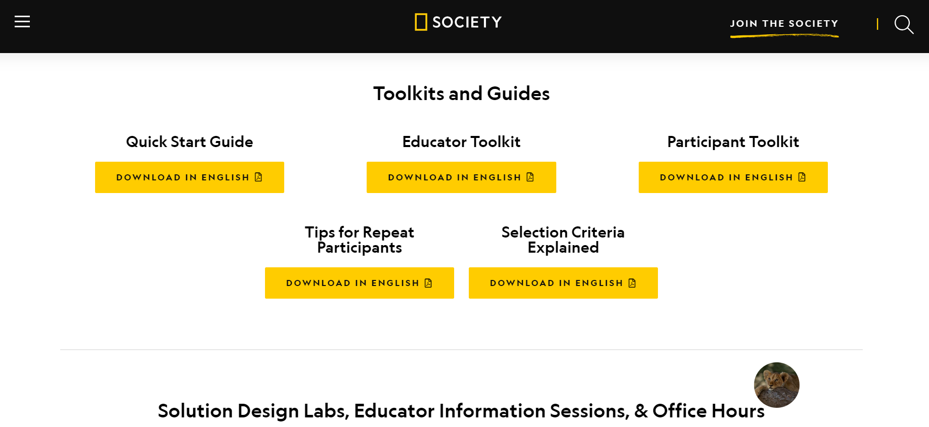
Slingshot Challenge Resources

Slide 12
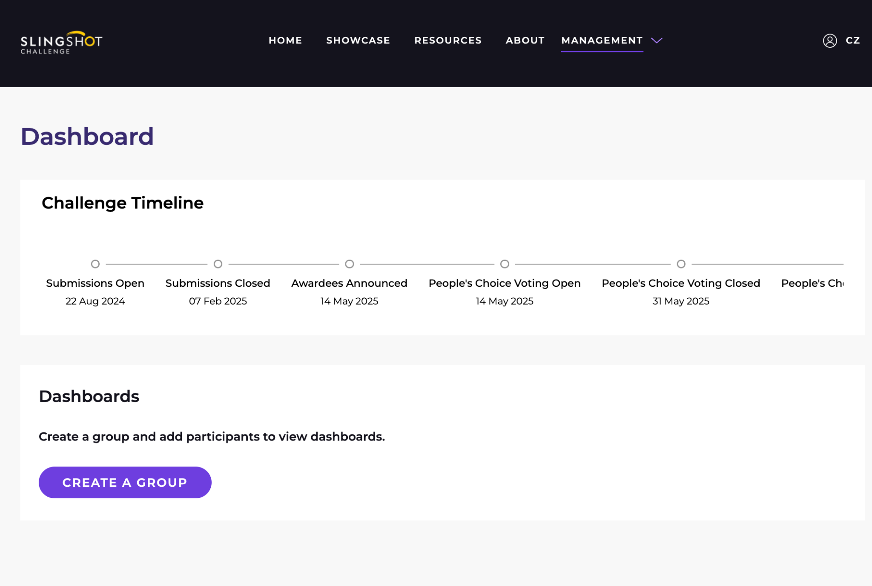
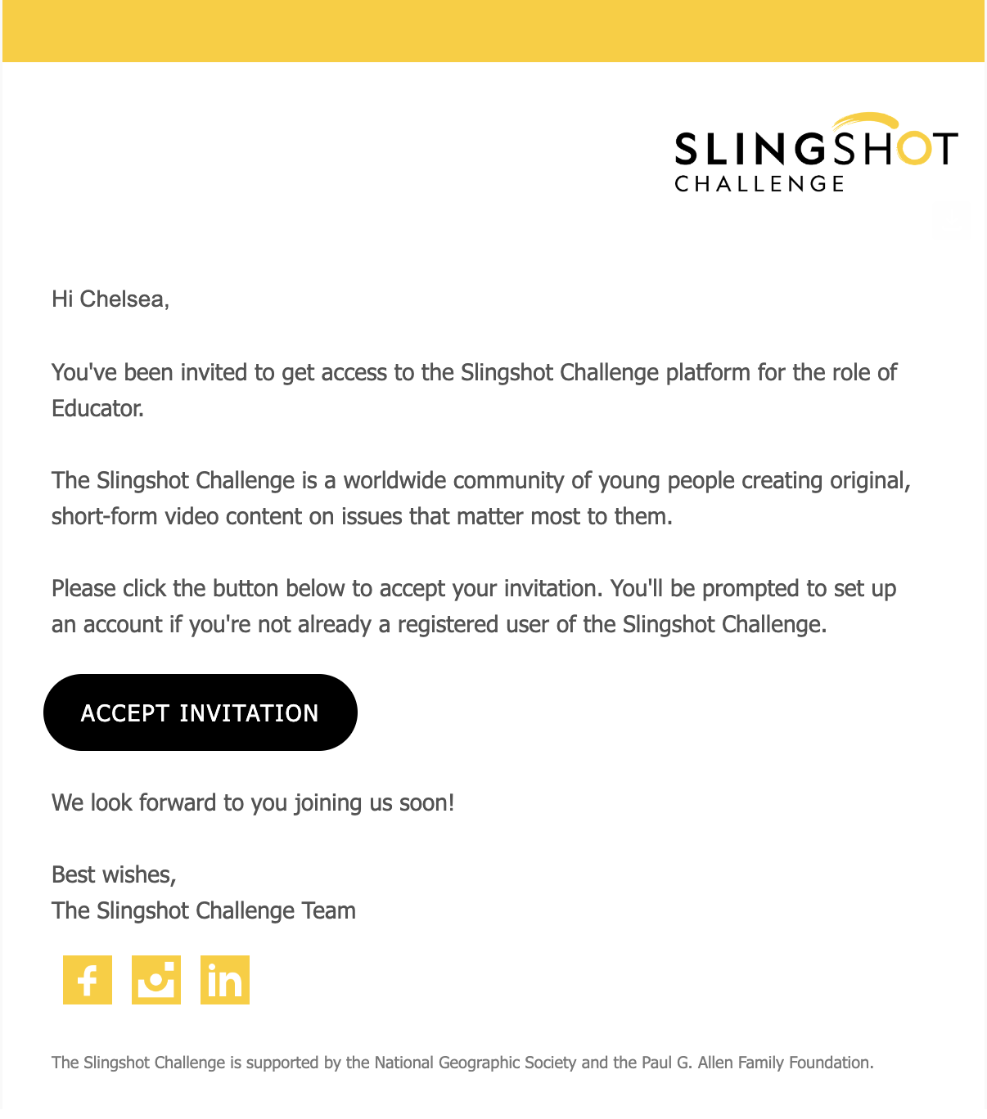
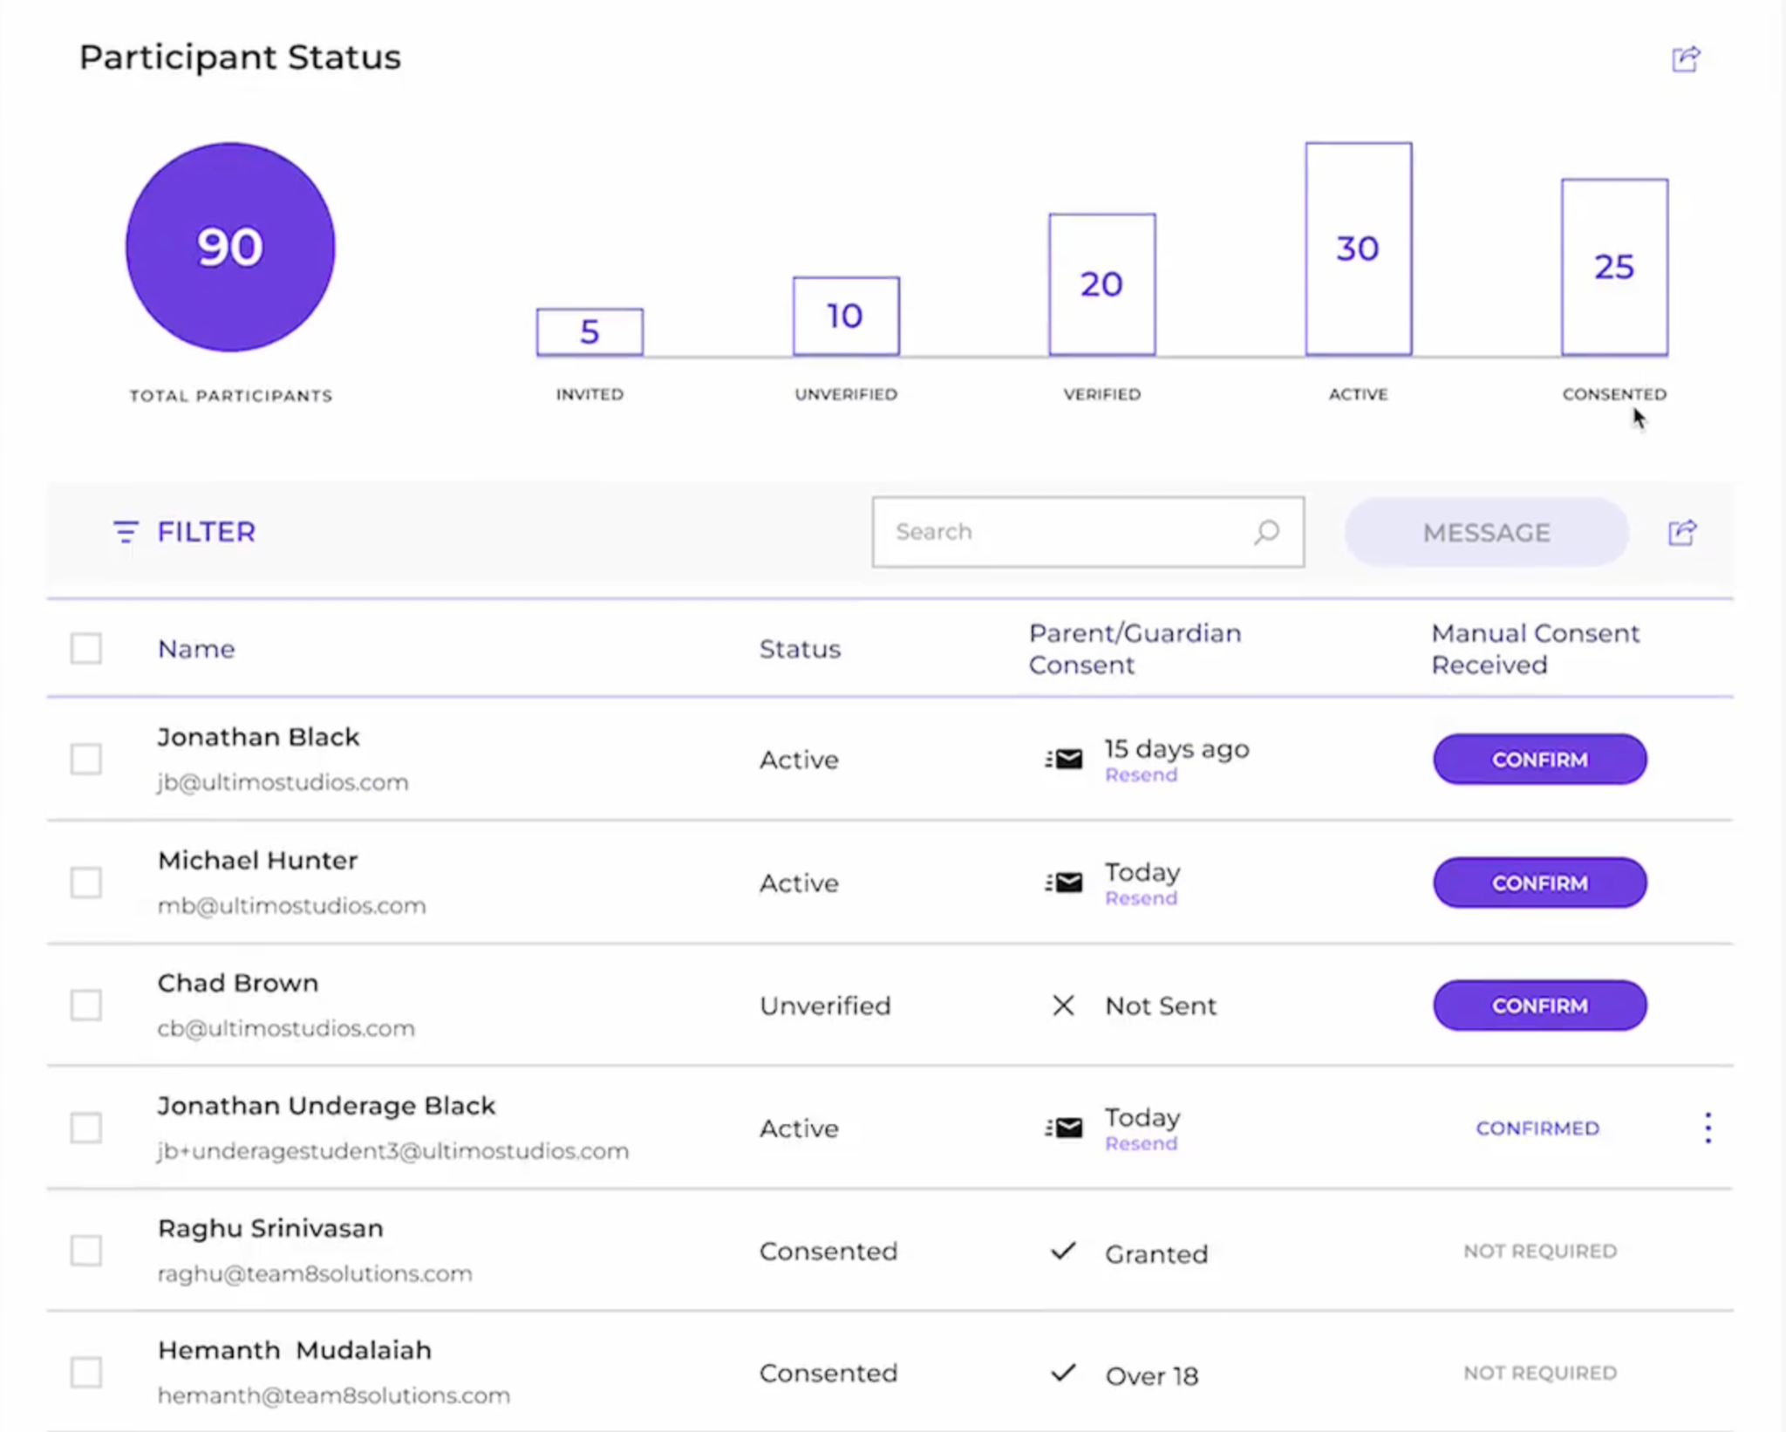
Educator Dashboard in Videos for Change

Slide 13
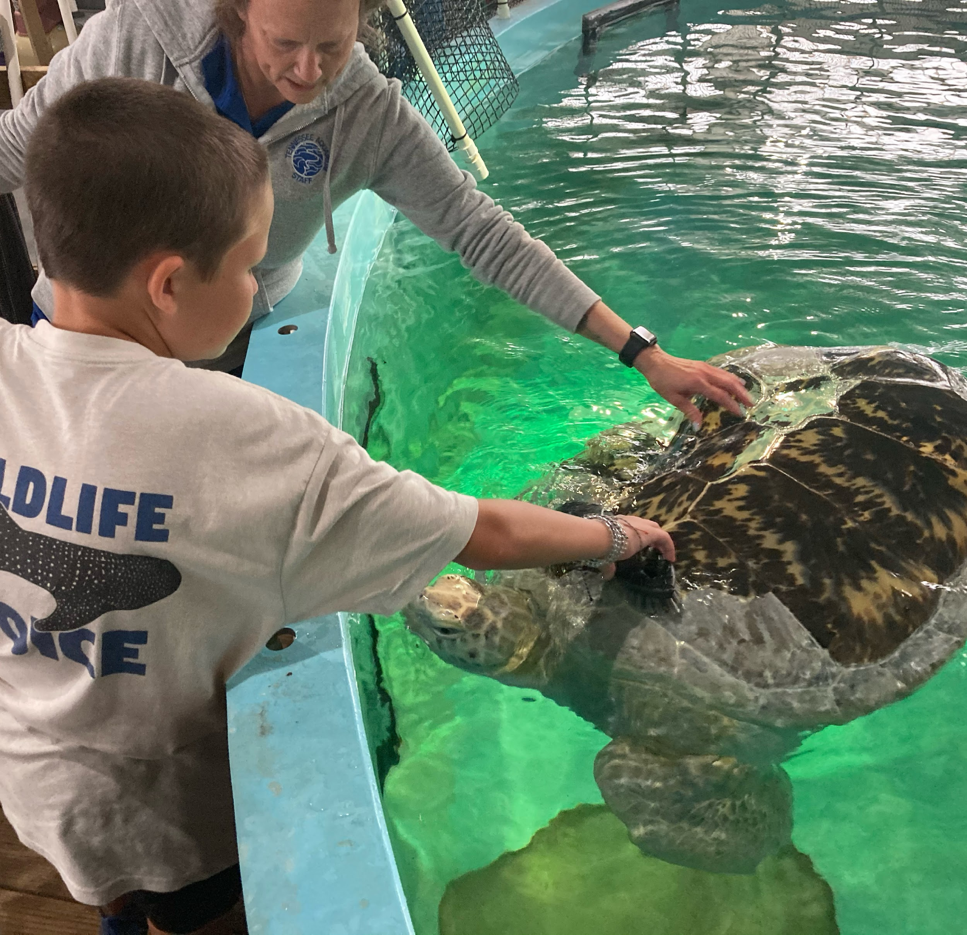
Every passion starts somewhere.

Slide 14
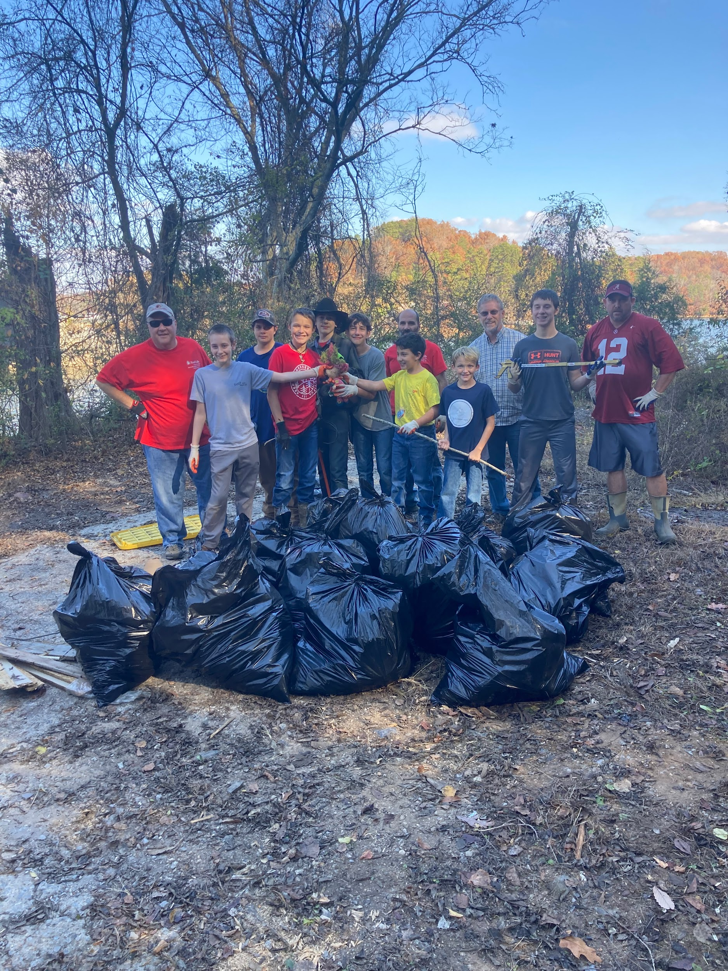
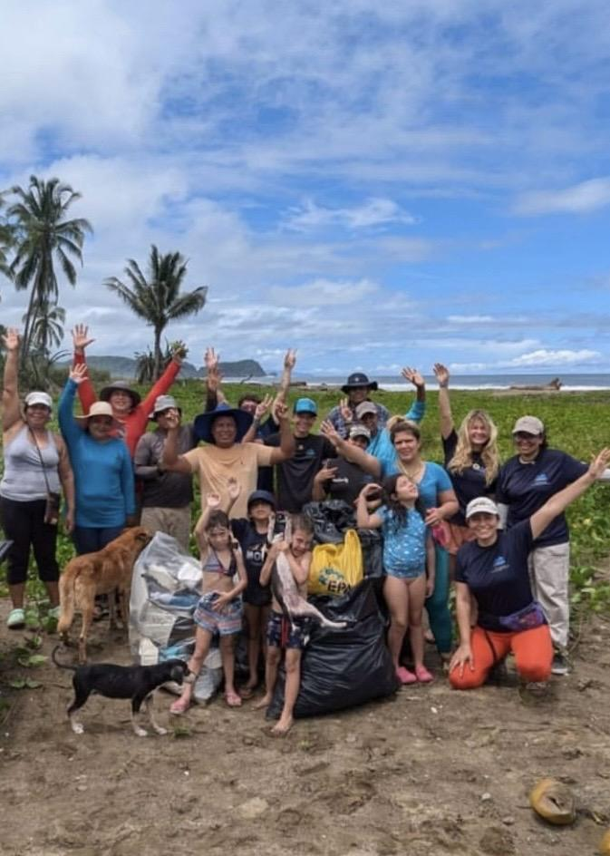
It all started with simple cleanups.

Slide 15
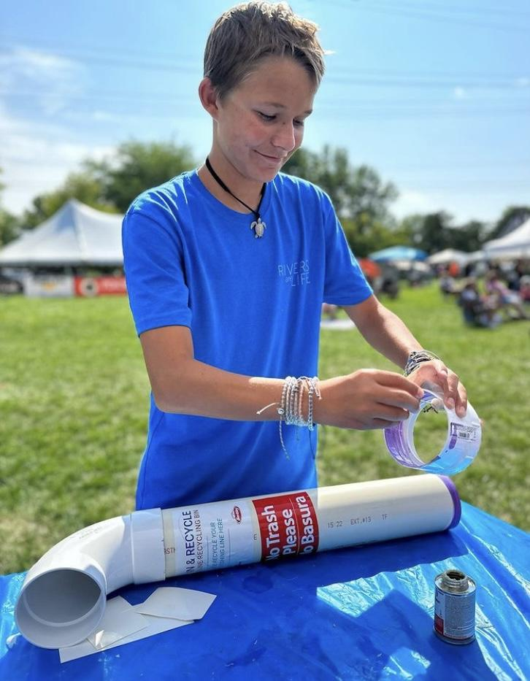
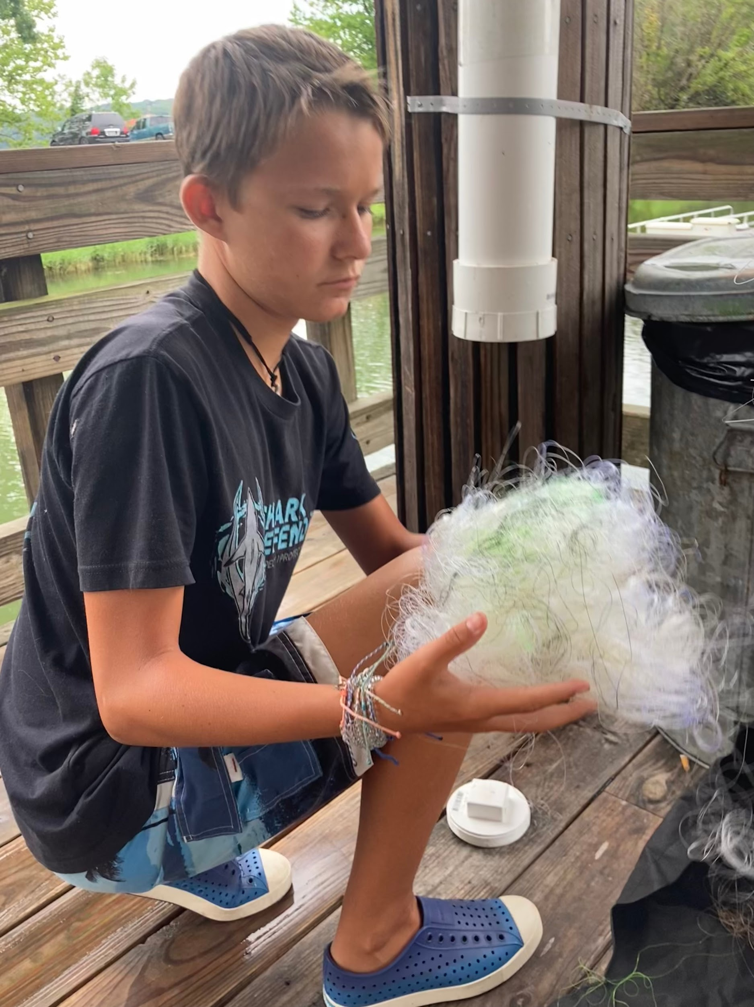
Lines of Hope
6 years, 5 states, and growing!

Slide 16
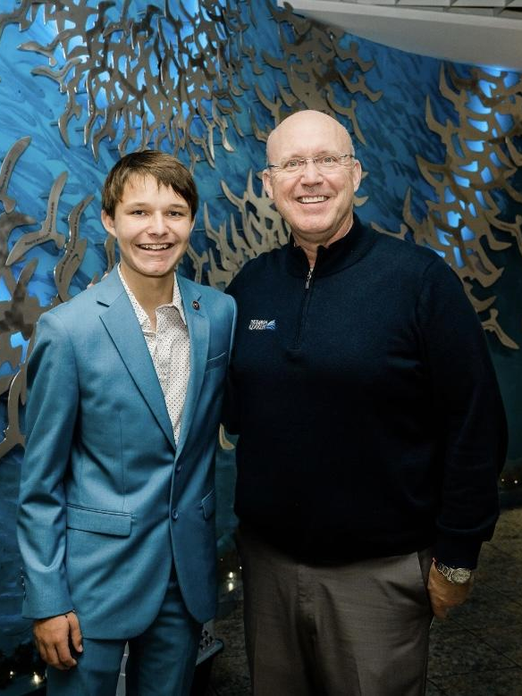
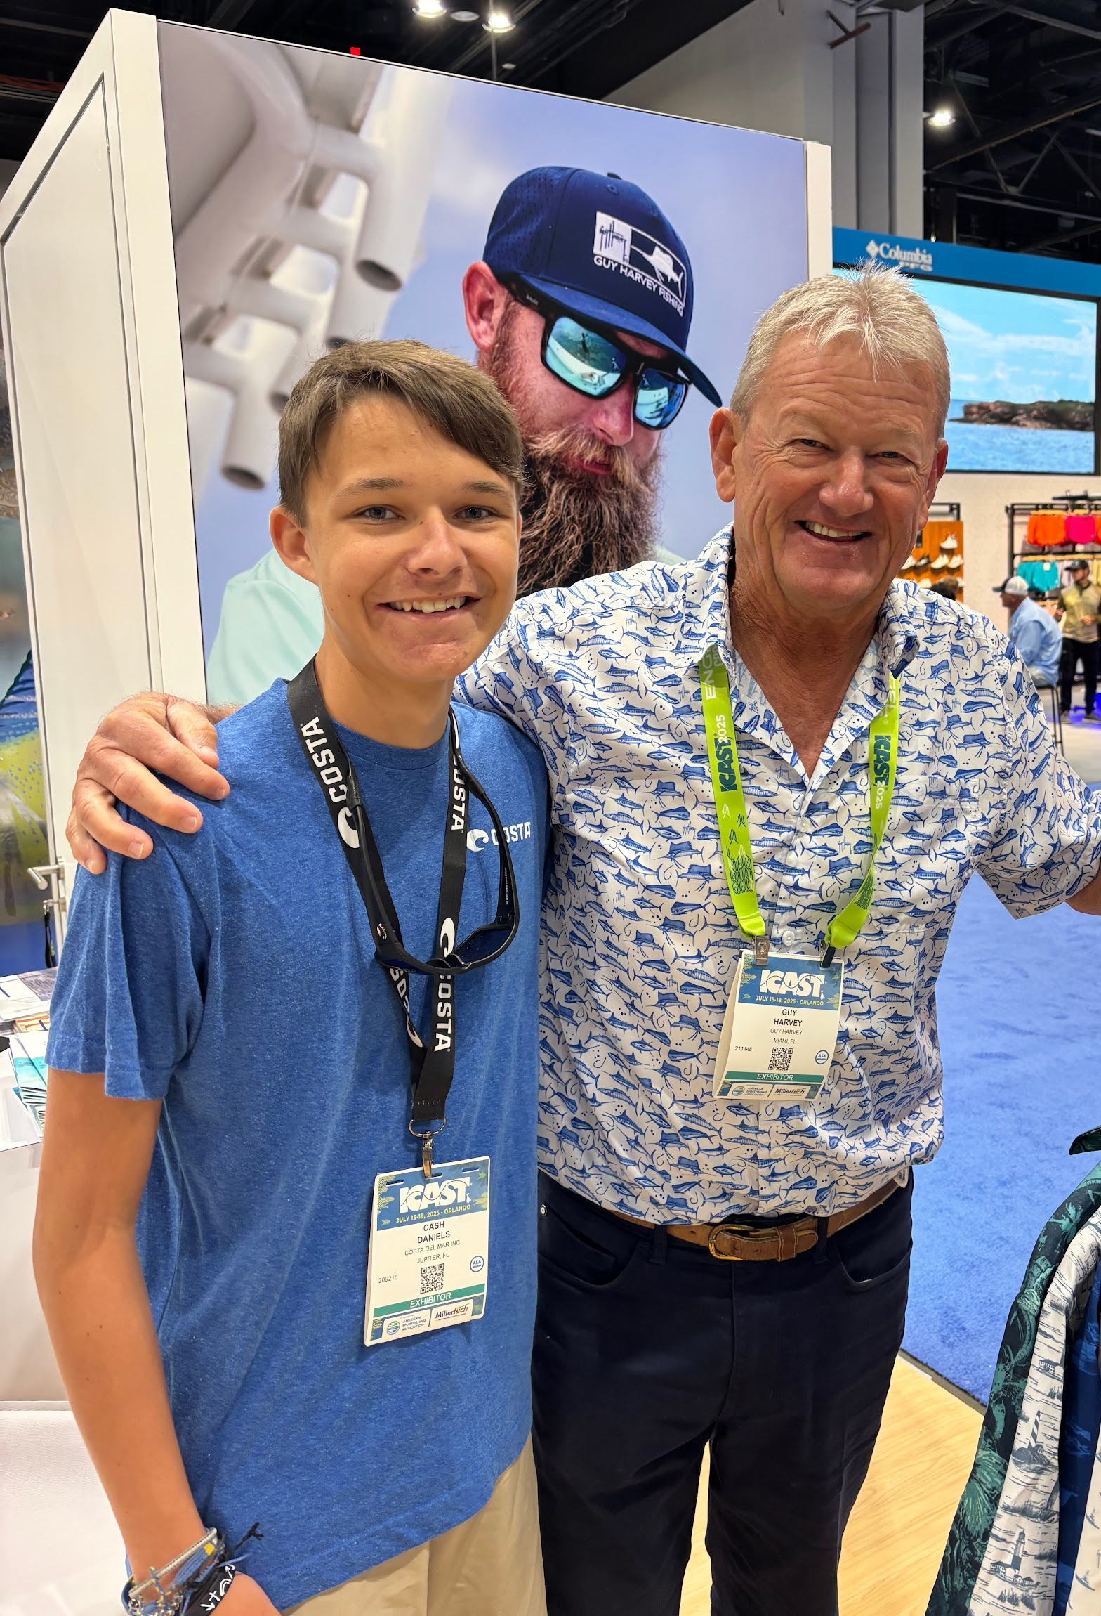
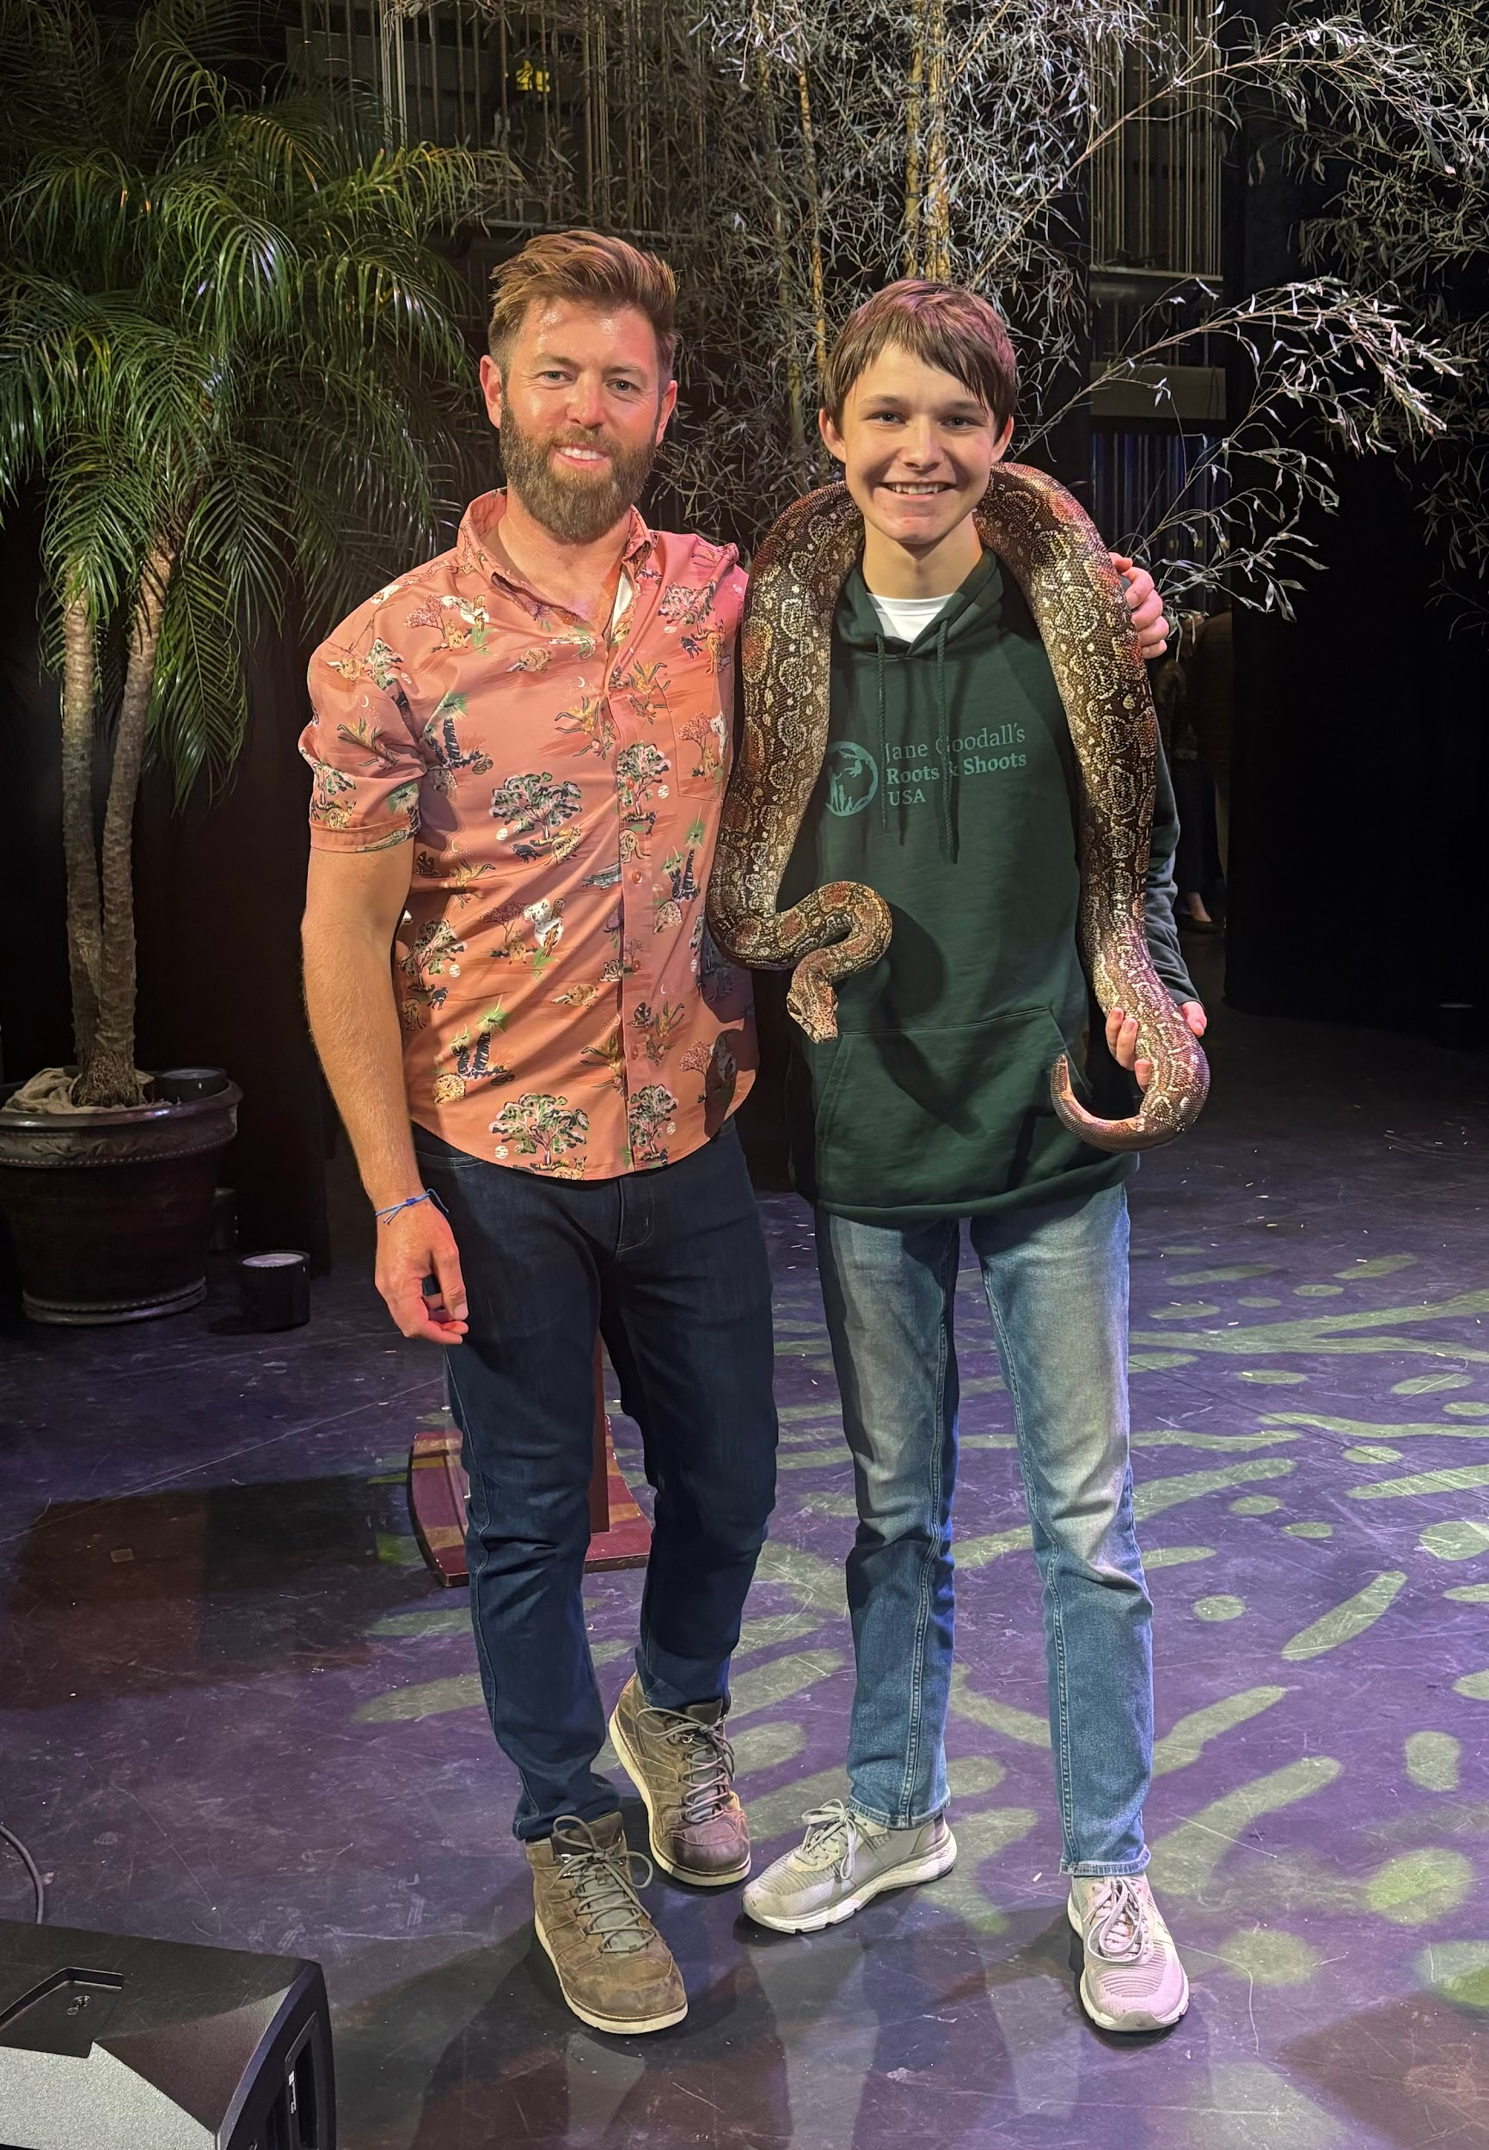
Community and Collaboration are Key!

Slide 17
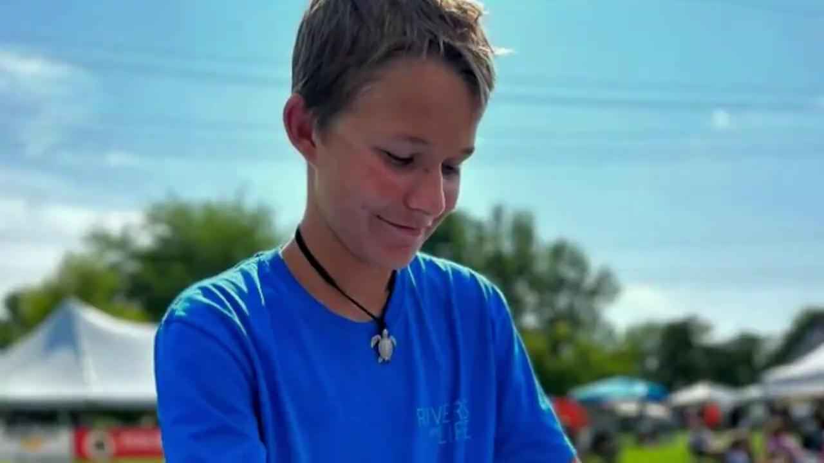

Slide 18
Thank you!
Follow along:
Instagram: Theconservationkid
Facebook: Theconservationkid

Slide 19
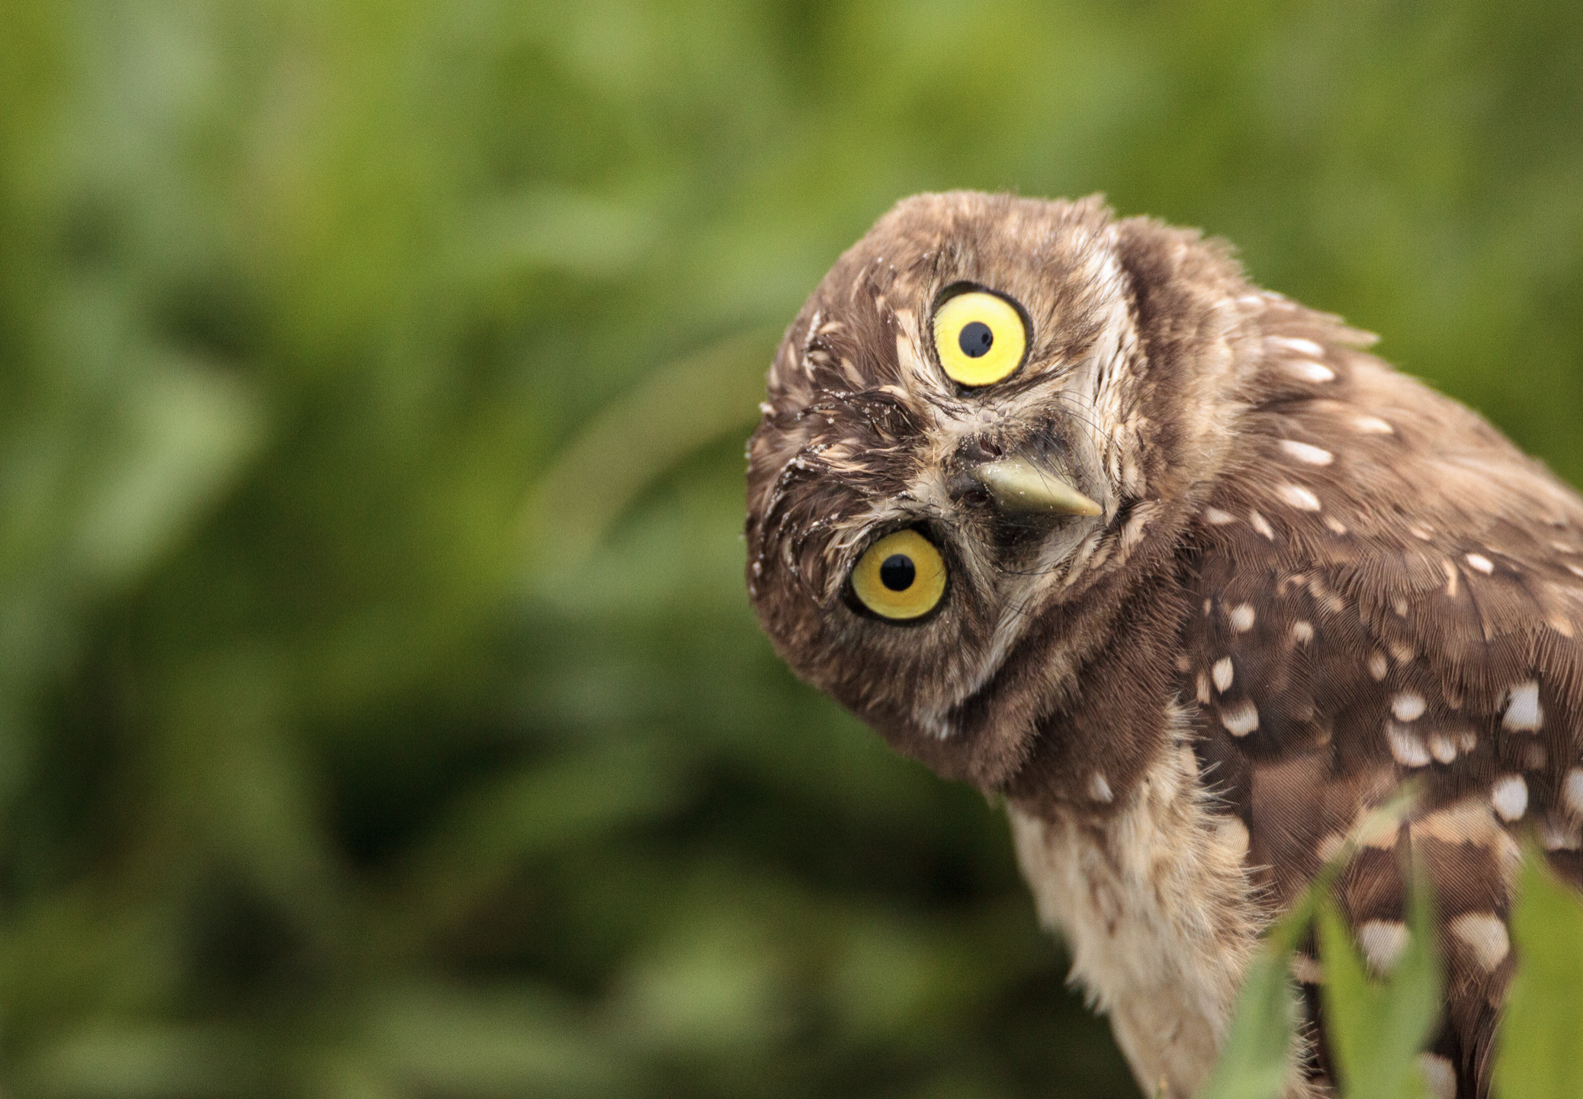
QUESTIONS?

Slide 20

Reminders
Register as an educator at slingshot.videosforchange.org
Challenge closes February 6, 2026.
Email slingshot@ngs.org for support.

