Slide 1

aer@aerbvi.org | 703-671-4500
www.aerbvi.org
Notes:
PLEASE DO NOT EDIT OR REMOVE

Slide 2
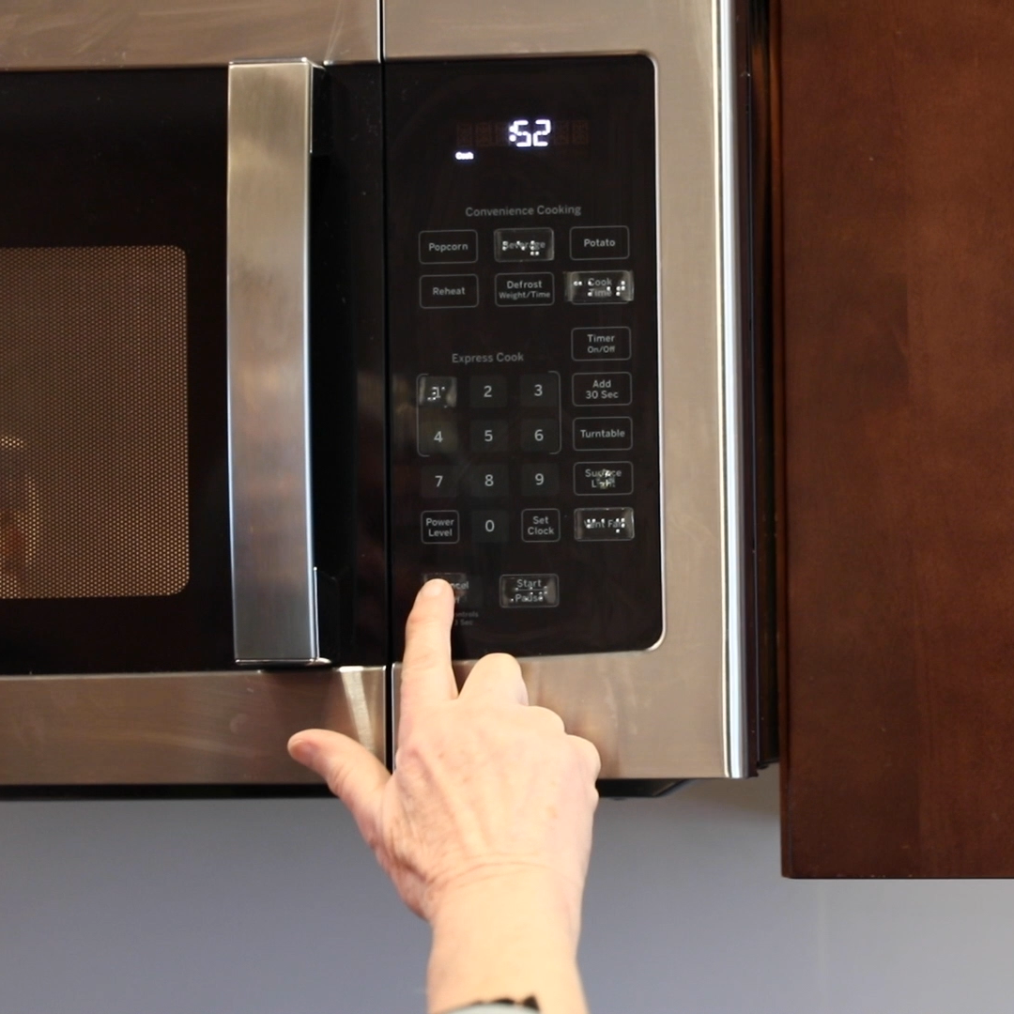

AER VRT Professional Division
Chair: Polly Abbott
Email: vrtpd@aerbvi.org
Notes:
PLEASE DO NOT EDIT OR REMOVE

Slide 3


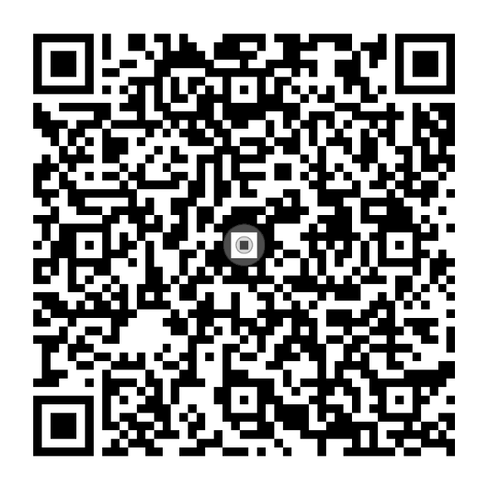
Foundations of Vision Rehabilitation Therapy
EDITORS
Dr. Helen Lee and Jennifer Ottowitz
To order online,
visit aph.org/shop
Or call 1-800-223-1839
Notes:
PLEASE DO NOT EDIT OR REMOVE

Slide 4
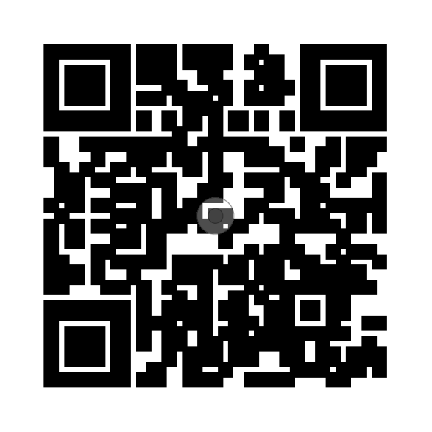

Foundations of Vision
Rehabilitation
Therapy
Access the entire AER eLearning series when you
scan the QR code.
Notes:
PLEASE DO NOT EDIT OR REMOVE

Slide 5

Earning ACVREP Continuing Education Credits
To earn your ACVREP credit for this session you must be in attendance for 85% of the webinar to qualify. At the end of this session, take the survey on the e-learning platform. Once you have completed the survey, the certificate of CEU’s will be sent in an email and also will be available in your e-learning account
Sessions and ACVREP CE credits are included in your AER Membership.
Notes:
PLEASE DO NOT EDIT OR REMOVE

Slide 6
Foundations of VRT: Chapter 3, The Assessment and Planning Processes

Slide 7
Objectives
1. Describe types and purposes of assessments and plans used throughout the vision rehabilitation process.
2. Analyze assessment information to identify client needs and instructional priorities.
3. Apply client-centered assessment and interview practices to support collaborative planning.
4. Develop measurable goals that translate assessment results into functional instruction.

Slide 8
Assessment

Slide 9
Purpose of Assessments
Determines eligibility for services.
Determines need and skill level of client.
Determines priorities and where to begin instruction.
Makes effective use of time and resources.
Helps build rapport and trust

Slide 10
Types of Assessments
Eligibility determination
Intake
Comprehensive VRT assessment
Learning Media Assessment
Job site evaluation

Slide 11
Comprehensive VRT Assessment Process
Assessment of case file
Assessment Interview
Performance-based assessment
Observation

Slide 12

Overcoming Possible Communication Issues
Build rapport
Express empathy not sympathy
Accept client behaviors, fears, and concerns
Evaluate personal biases
Evaluate your personal role
Be aware of impact of client personality, attitudes, and degree of adjustment to vision loss

Slide 13

Conducting Assessments
Opening and closing the interview
Systematic vs. triage approach
Systematic vs. conversational
Open-ended vs. yes/no questions
Active/reflective listening
Level of detail for documentation

Slide 14

Assessment Tools
Checklists
Rating scales
Standardized assessments for given areas
Functional Independent Living Assessment
Photo from Guide Dogs UK

Slide 15
VRT Areas of Assessment
Clothing care
Adapted food preparation
Home management
Leisure pursuits
Psychosocial adjustment
Communications
Financial management
Time management
Indoor mobility
Personal management

Slide 16
Instructional Plans

Slide 17
Purposes of Instructional Plans
Informs of services to be provided and expectations
Presents a logical sequence of instruction
Provides measurable goals/objectives
Helps with preparation and efficient use of time
Provides outcomes to measure individual/program performance

Slide 18
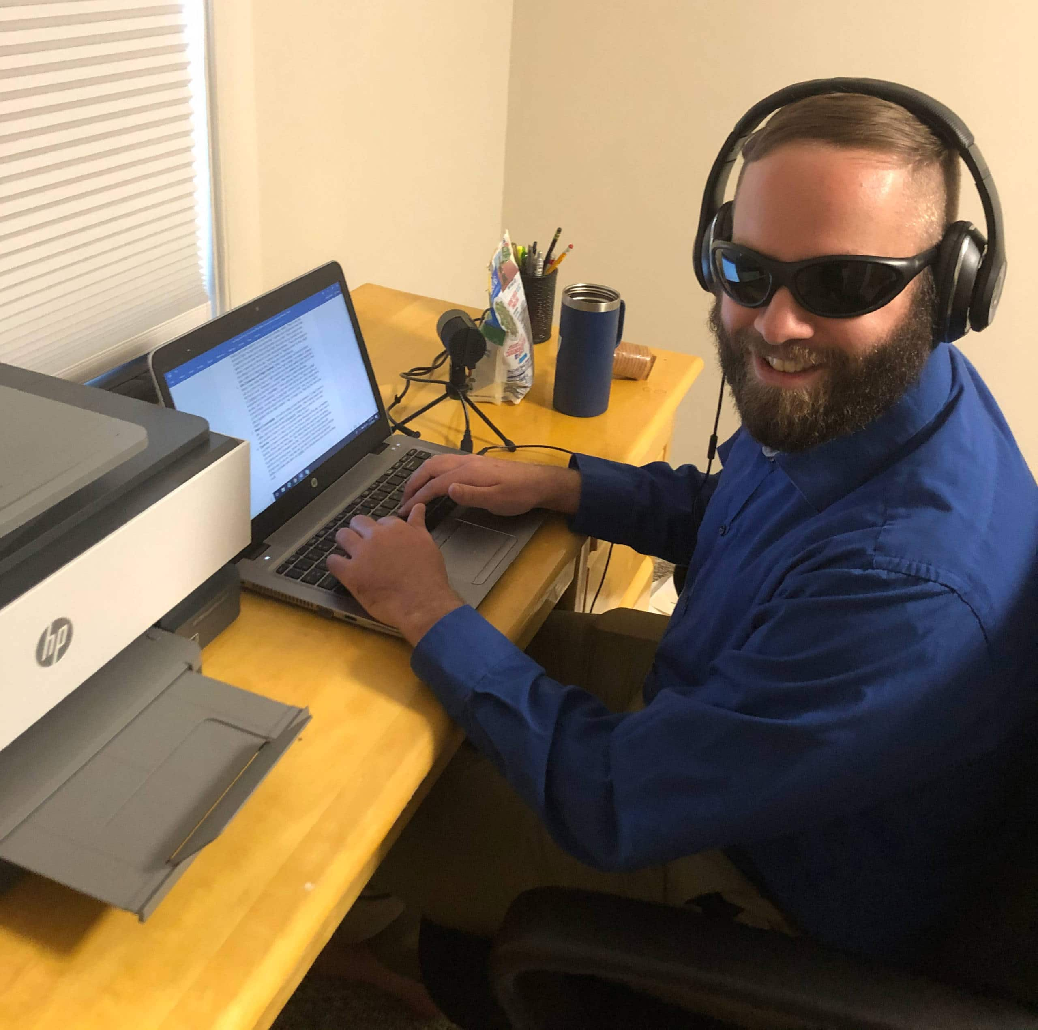
Types of Plans
Service/treatment plan
Lesson plan
Individual Plan for Employment
Transition plan
Photo from the Foundation for Blind Children

Slide 19
Moving From Assessment to the Plan
Prioritize safety needs
Differentiate between vocational and personal goals
Address what is needed to meet goals and further prioritize
Determine recommended training time

Slide 20

SMART Goals
S = Specific
M = Measurable
A = Attainable/action-oriented
R = Realistic
T = Timely/time-bound

Slide 21
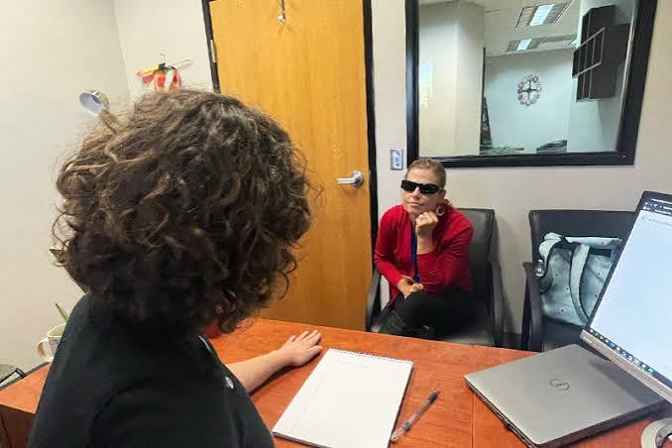
Behavioral Objective Format
Condition
Behavior
Criteria
Photo from the Foundation for Blind Children

Slide 22
Tips for Creating Plans
Create goals “with” not “for clients.
Perform a task analysis to identify steps in the procedure part of lesson plans.
Remember that assessment continues throughout instruction.

Slide 23

Questions?

Slide 24

Thank you
Name
000-000-0000
email@domain.com
www.website.com
Notes:
To add alt text in PowerPoint, select the object to which you want to add alt text. Right click on the object and select “edit Alt Text” from the drop-down menu. Type the alt text into the content box on the right, have PowerPoint generate a description for you, or mark the object as decorative.

