Slide 2
Reflect-
“If nothing changes…..nothing changes.”
-Courtney C. Stevens (author)
“Who you are becoming is more important than what you are doing.”
- Michael Hyatt (speaker, author)
Notes:
Giving students substantial time during class to pause, reflect on, and verbally process their understanding can help them consolidate their learning and generate new ideas. These practices can also help teaching teams stay abreast of how students’ thinking is changing.

Slide 3
Notes:
pause for reflection

Slide 4
Connection to our last session-
Use strategies that help me focus on my priorities and overcome challenges.
Apply what I am learning through a case study to my own inquiry.
Identify evidence that will help inform my inquiry.
Make a leadership action into a leadership habit.
Notes:
10:00 a.m.-10:15 a.m.
Ashley

Slide 5
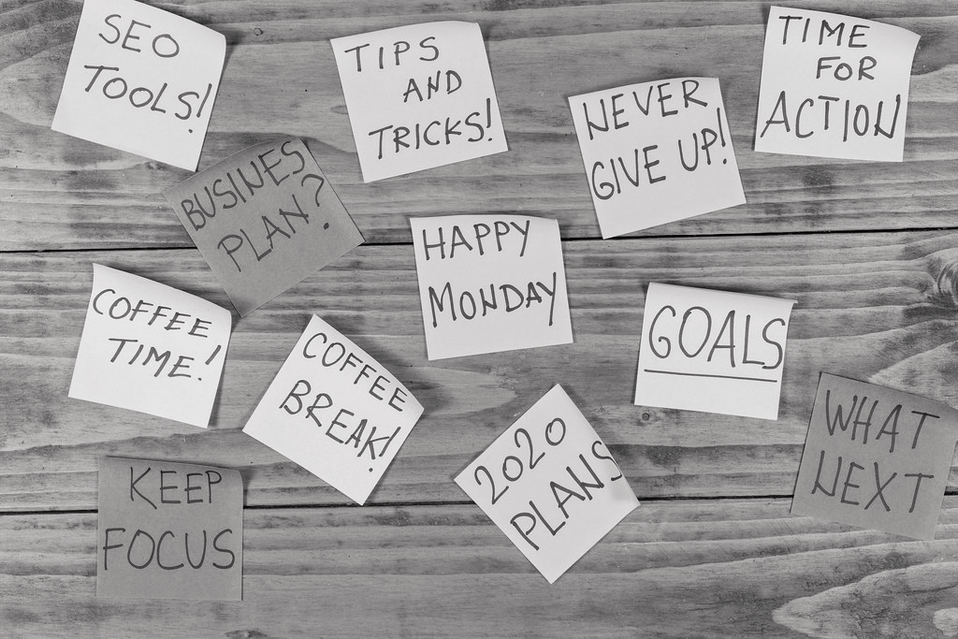
Reminders-
Breakout Rooms
Clock Hours
Room Confirmation
Times for our February Face to Face Session: 2/25, Sunday 5-9PM;
2/26, Monday 8-3PM
Notes:
at the end we will discuss the in person

Slide 7
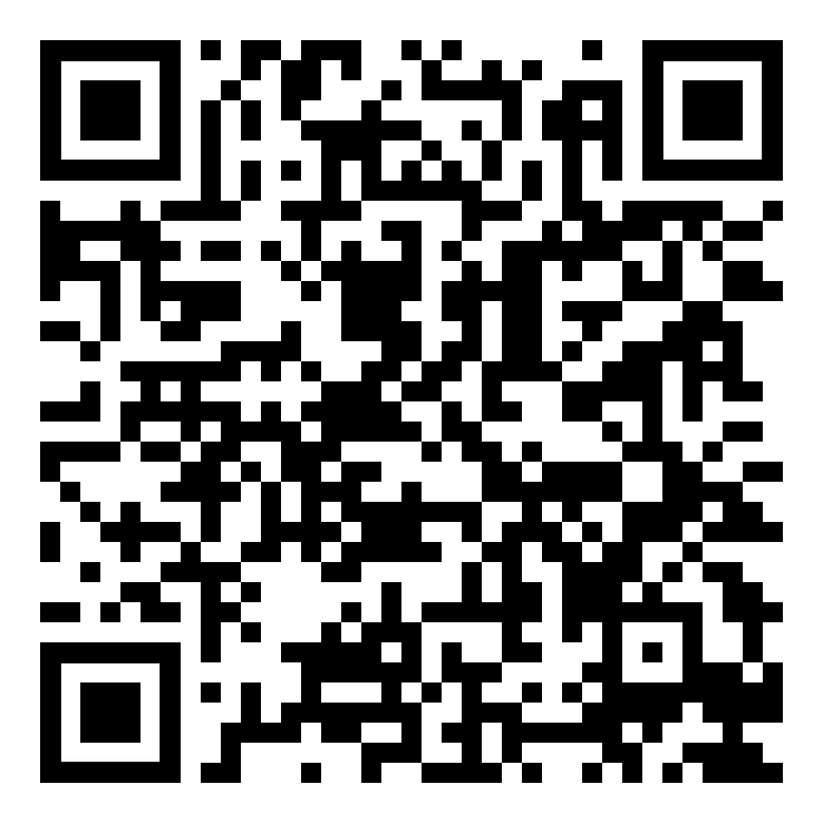
Note-Taking Template (Guided Notes)
Guided note-taking has been demonstrated to be a key factor in engagement and learning.
Reynolds, S.M., & Tackie, R.N. (2016).

Slide 8
Learning Intentions
We are learning:
To apply the leadership skills we’re learning to our personal collaborative inquiry cycles.
How to make better analysis of evidence in order to improve decision-making.

Slide 9
Success Criteria
I can identify actions I can take to promote attainment of my NLL goals (as articulated on my placemat) and begin forming productive leadership habits.
I can identify important elements of the ‘assess’ phase of a collaborative inquiry cycle (infinity loop and placemat).

Slide 10
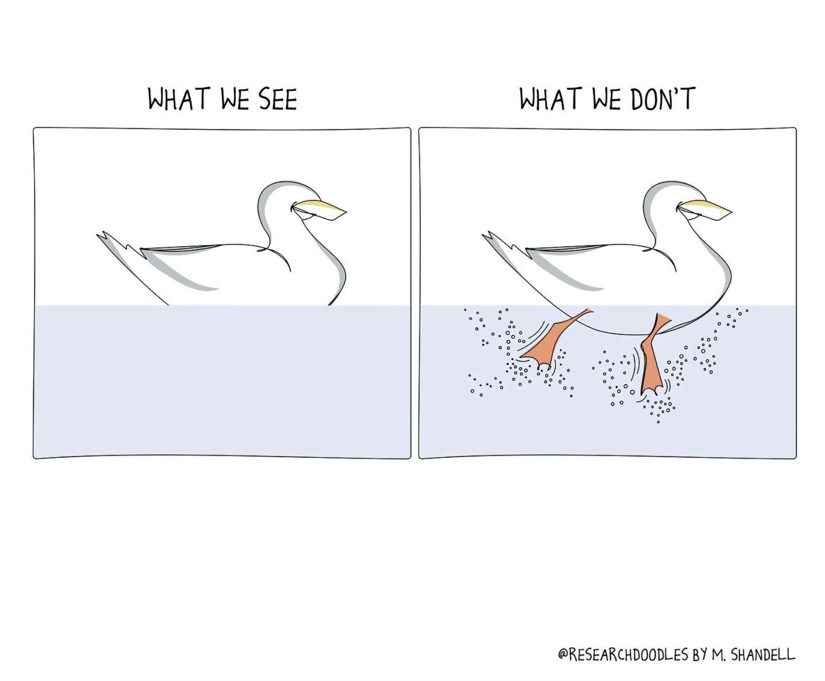

Slide 11
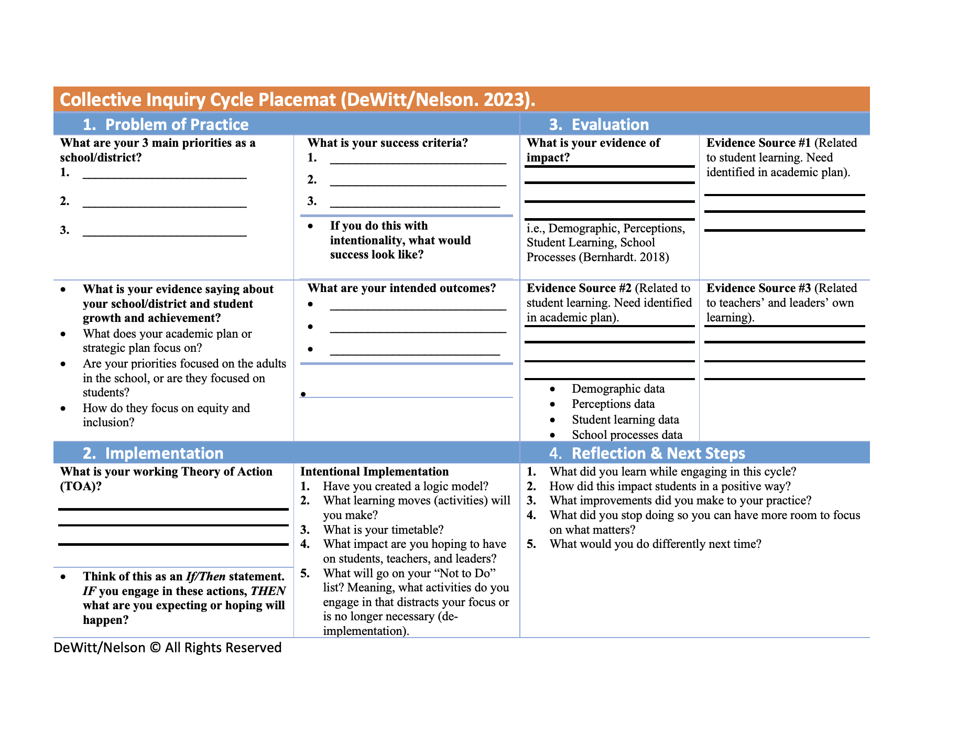
Cycle of Inquiry
Notes:
What are your current learning needs?
Peter
Given our learning intentions and success criteria, what are your learning needs for this session?
If June is your finish line, what would success look like?

Slide 12
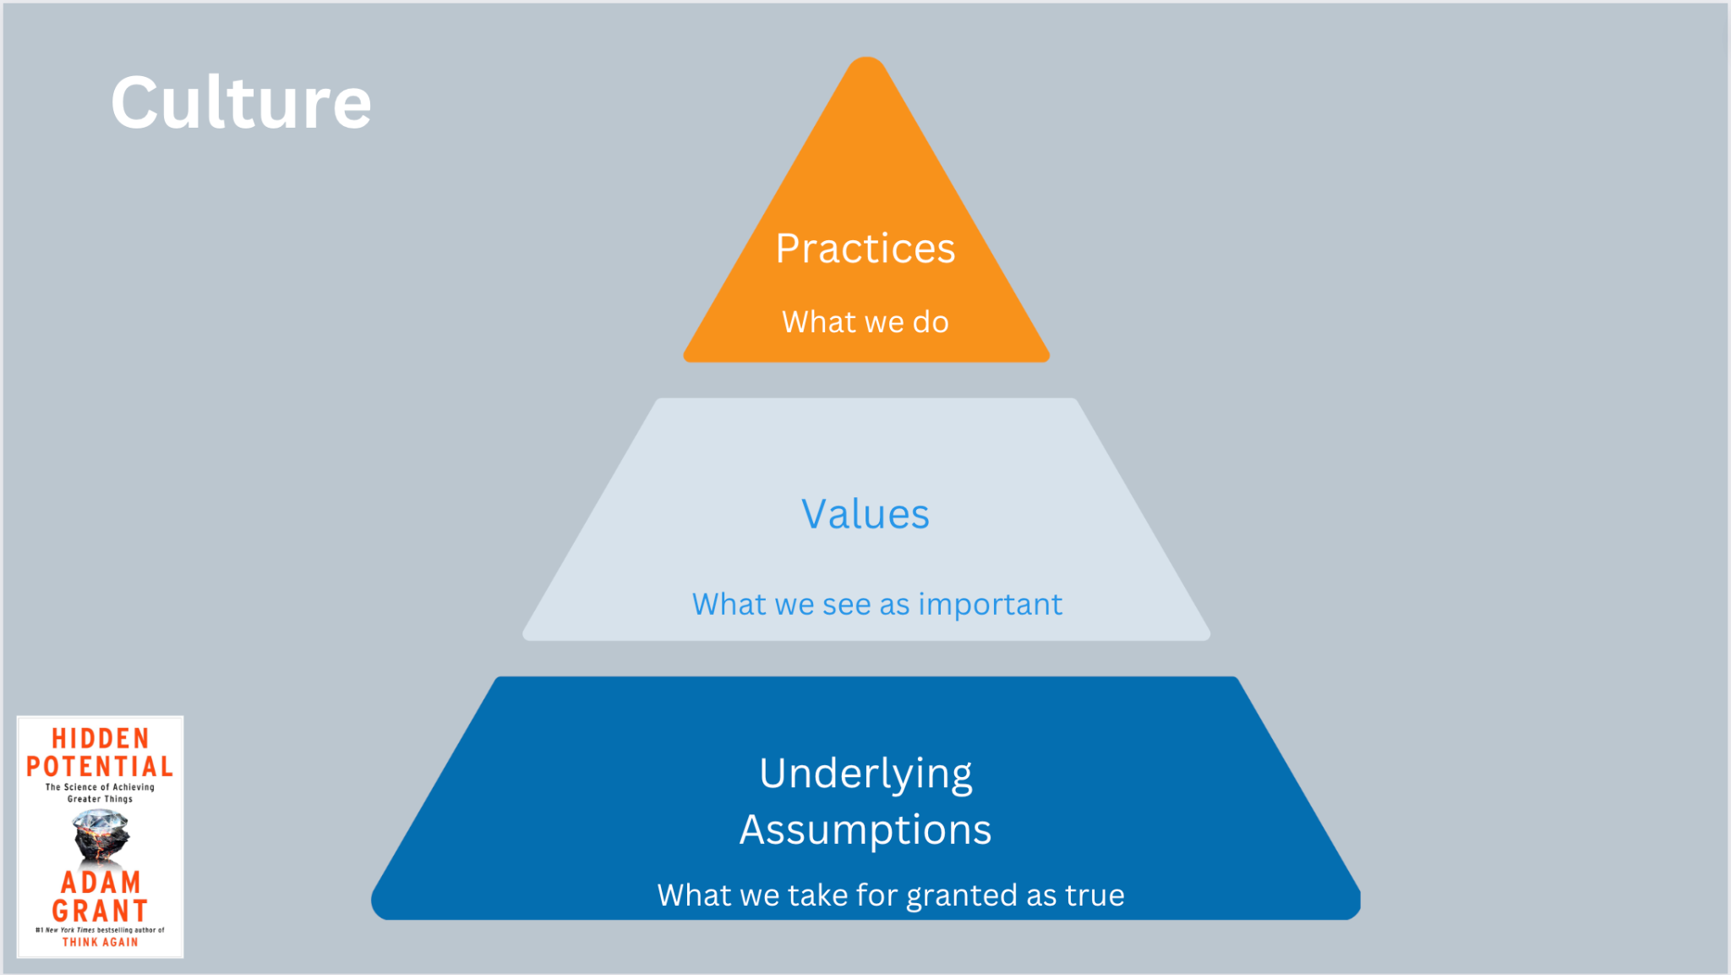
Learning walks, walkthroughs, observations, faculty meetings, leadership team meetings somehow focus on our priorities.
Our priorities are focused on having a positive impact on students.
All of the actions we take move us closer to achieving our priorities.

Slide 13
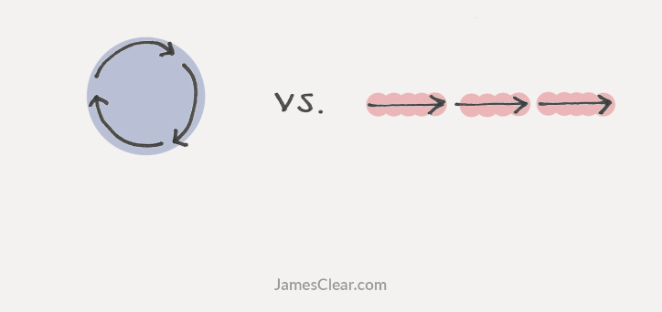
James Clear’s Atomic Habits Recap
Action to Motion
Notes:
M and K - Further the James Clear learning and connect it to taking action around collecting data information
Impact of Evidence
Examine the Placemat - for habit building opportunities. What would an entry point be for that habit?
https://youtu.be/1gdkBt9it84?si=cLJ8cpqNylLP8Nlv 9 min. Video
What’s one thing you remember from our previous sessions? - In chat

Slide 14
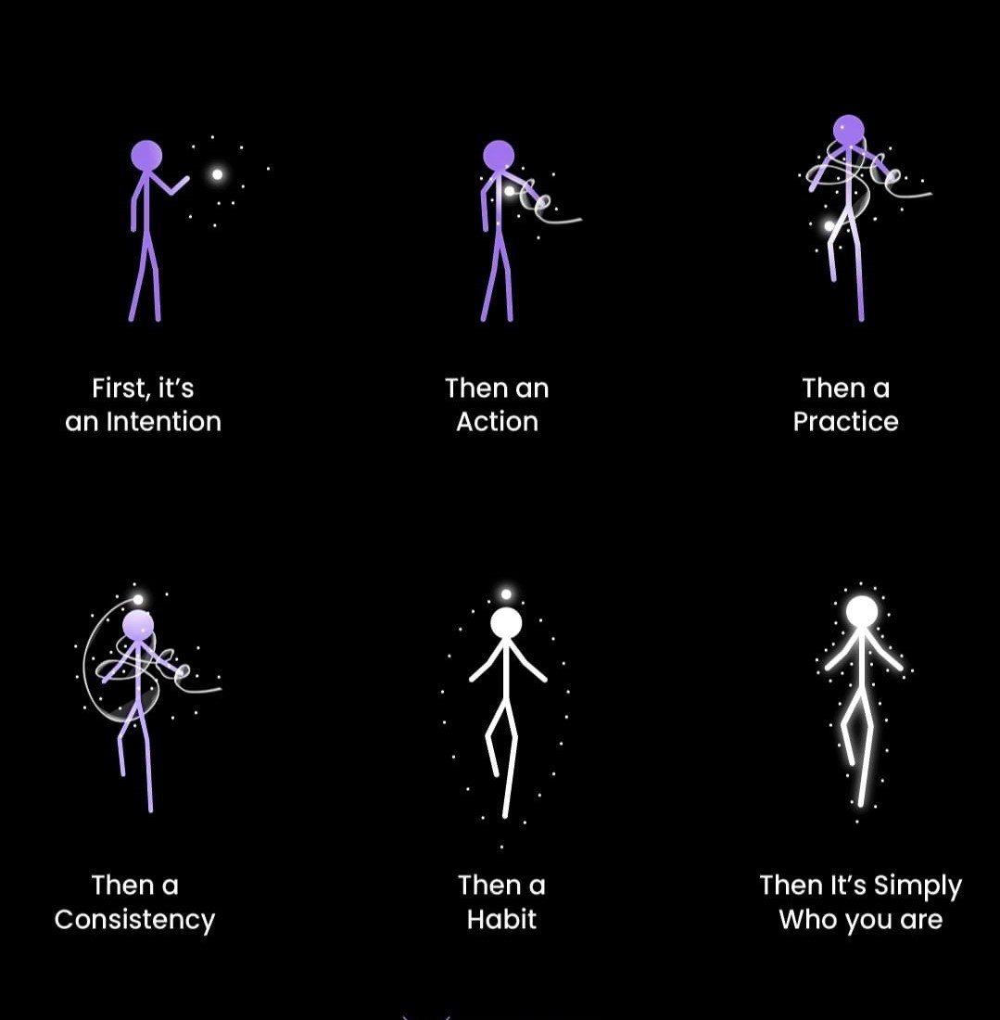
Next Level Leaders incorporate their intentions into their way of being!
Notes:
Further the James Clear learning and connect it to taking action around collecting data information
Impact of Evidence
Examine the Placemat - for habit building opportunities. What would an entry point be for that habit?
https://youtu.be/1gdkBt9it84?si=cLJ8cpqNylLP8Nlv 9 min. Video

Slide 15
https://youtu.be/1gdkBt9it84?si=cLJ8cpqNylLP8Nlv 9 min. Video
Mike and Kim
4:30-7:50
Notes:
Further the James Clear learning and connect it to taking action around collecting data information
Impact of Evidence
Examine the Placemat - for habit building opportunities. What would an entry point be for that habit?
https://youtu.be/1gdkBt9it84?si=cLJ8cpqNylLP8Nlv 9 min. Video 4:30-7:50

Slide 16
Habit Mapping
Goal - What do we want to achieve?
Pick a small doable habit to try that you can do tomorrow (micro progress - 2 minutes goal)
Implement
Inspect - Collecting Evidence
Scale
Notes:
Further the James Clear learning and connect it to taking action around collecting data information
Impact of Evidence
Examine the Placemat - for habit building opportunities. What would an entry point be for that habit?
https://youtu.be/1gdkBt9it84?si=cLJ8cpqNylLP8Nlv 9 min. Video

Slide 17
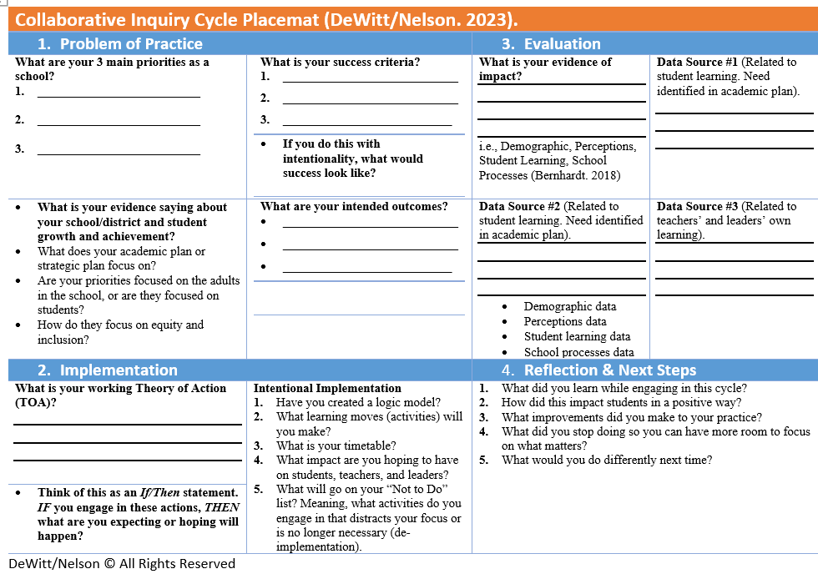
Application - Placemat Scavenger Hunt
Notes:
Further the James Clear learning and connect it to taking action around collecting data information
Impact of Evidence
Examine the Placemat - for habit building opportunities. What would an entry point be for that habit?
https://youtu.be/1gdkBt9it84?si=cLJ8cpqNylLP8Nlv 9 min. Video

Slide 18
Placemat Scavenger Hunt
Search your placemat for habit building opportunities.
What would an entry point (2 min. goal be for the habit)
How can you collect evidence to record your progress toward your habit?
Notes:
Further the James Clear learning and connect it to taking action around collecting data information
Impact of Evidence
Examine the Placemat - for habit building opportunities. What would an entry point be for that habit?
https://youtu.be/1gdkBt9it84?si=cLJ8cpqNylLP8Nlv 9 min. Video

Slide 19
Placemat Scavenger Hunt
Debrief
How does this enhance your current data protocols?
How can collecting, analysing and/sharing evidence (making the data visible) become a habit?
Notes:
Further the James Clear learning and connect it to taking action around collecting data information
Impact of Evidence
Examine the Placemat - for habit building opportunities. What would an entry point be for that habit?
https://youtu.be/1gdkBt9it84?si=cLJ8cpqNylLP8Nlv 9 min. Video

Slide 20
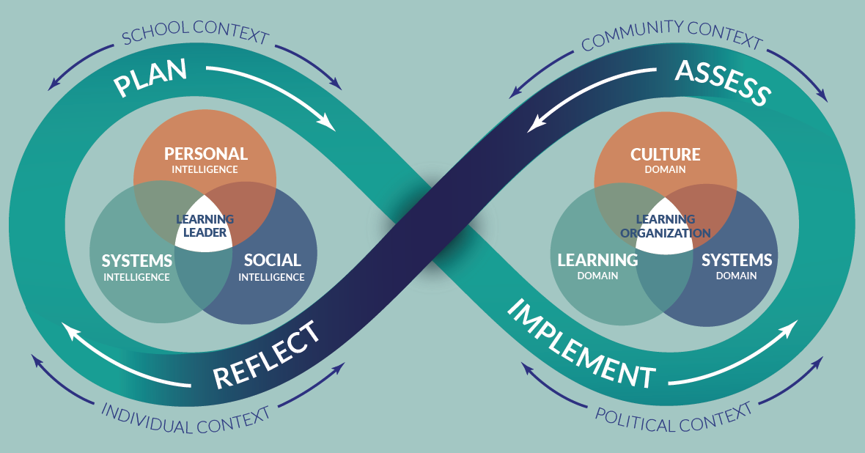
School Leader Paradigm
Notes:
Jenni? Why this - why now?
Get them ready to learn

Slide 21
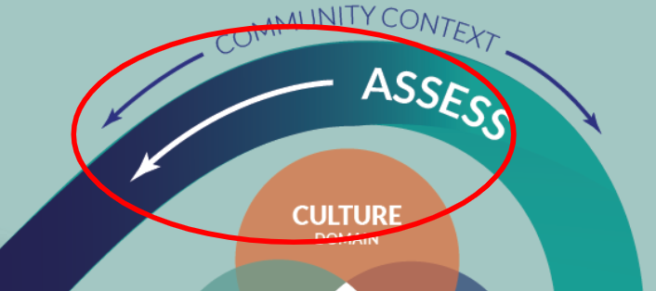
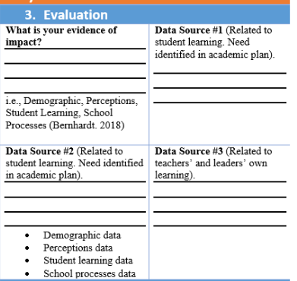
What will we be learning and how will we apply it?
Notes:
Why this - why now? AWSP’s Evidence of Impact form
Get them ready to learn.

Slide 22
Collaborative Inquiry: Assess
What makes a good learner?
Notes:
Jenni
10:30 a.m.-11:00 a.m.

Slide 23
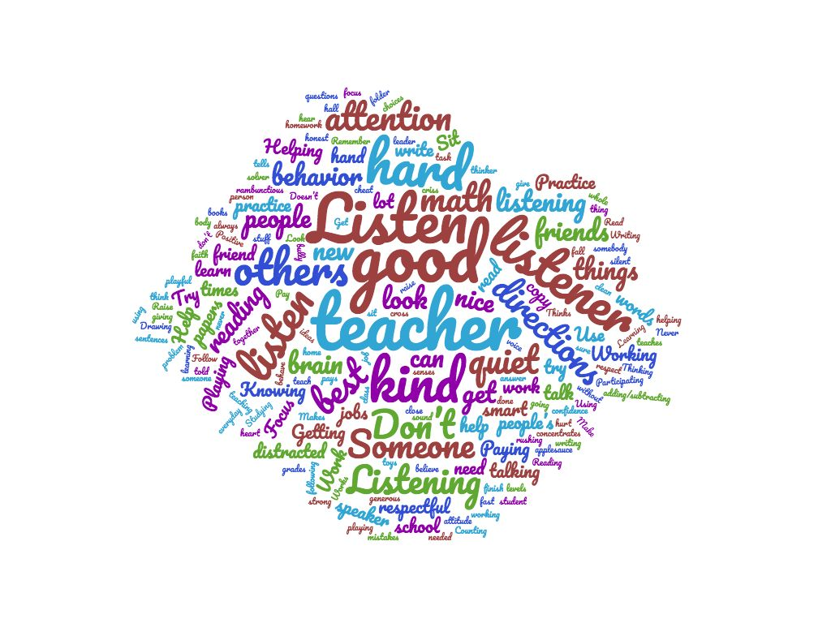
Collaborative Inquiry: Assess
K-3
Notes:
Jenni
10:30 a.m.-11:00 a.m.

Slide 24
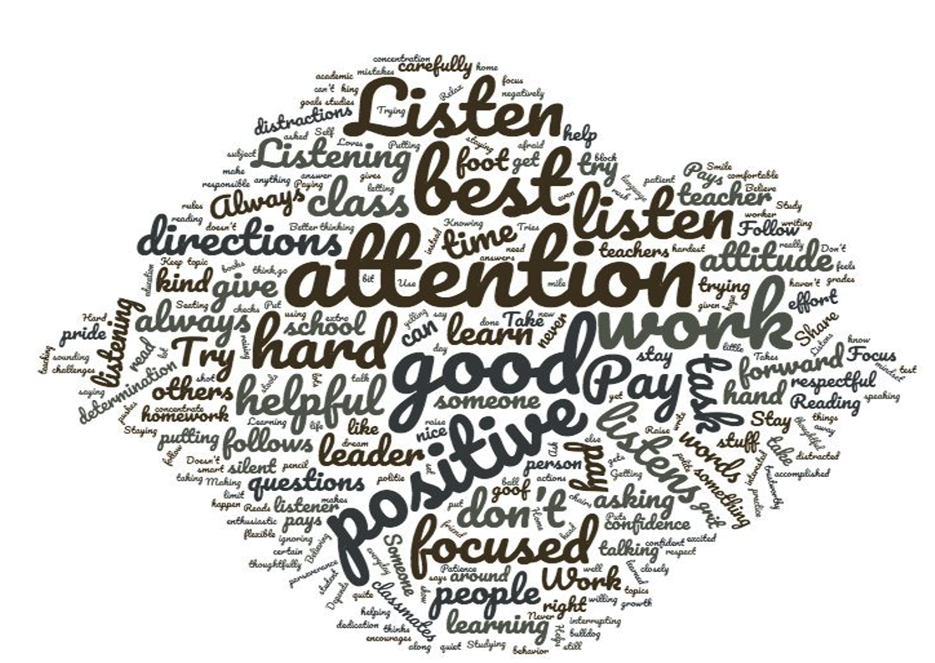
Collaborative Inquiry: Assess
4-6
Notes:
Jenni
10:30 a.m.-11:00 a.m.

Slide 25
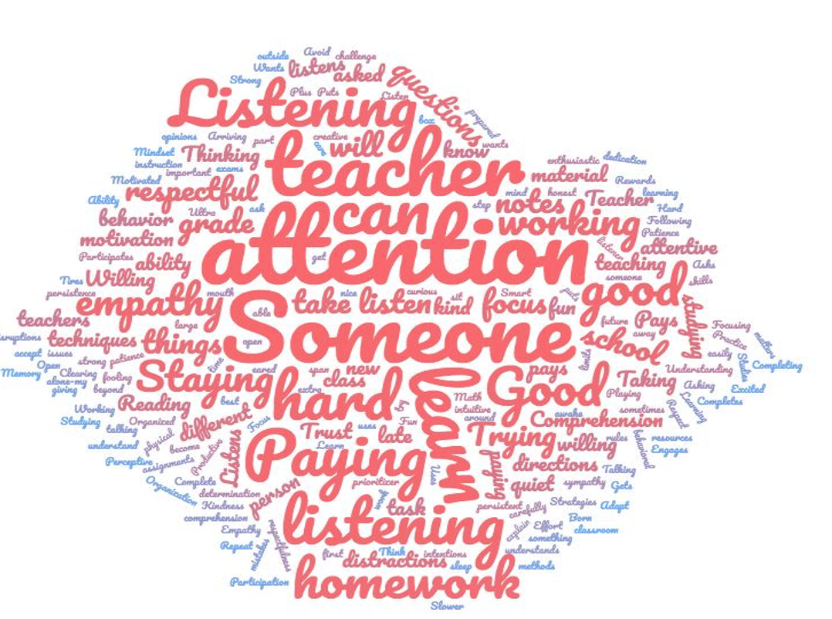
Collaborative Inquiry: Assess
7-9
Notes:
Jenni
10:30 a.m.-11:00 a.m.

Slide 26
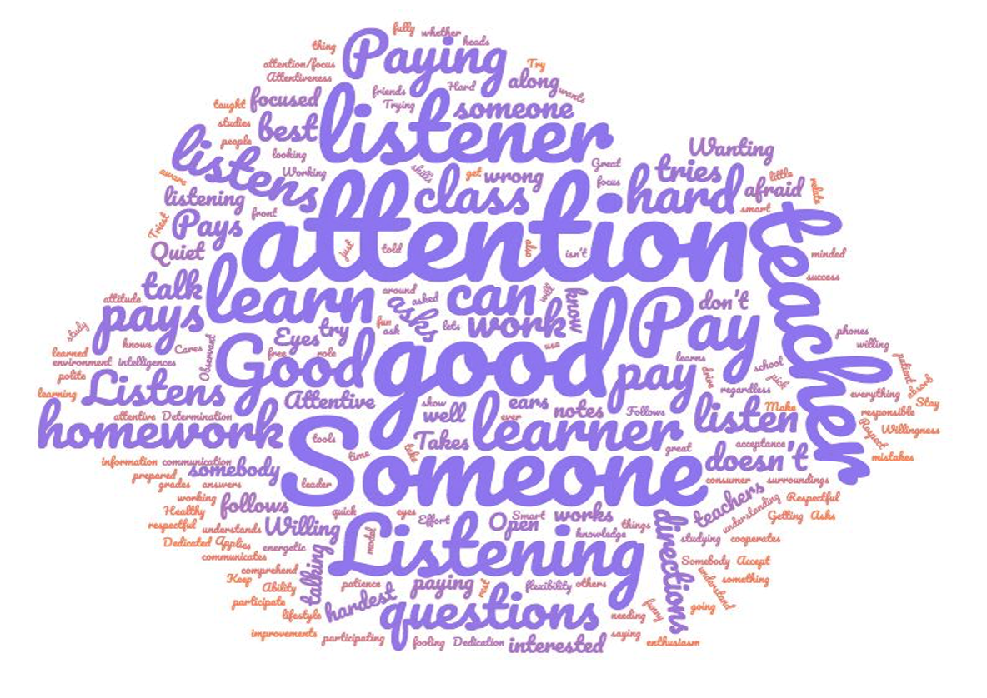
Collaborative Inquiry: Assess
10-12
Notes:
Jenni
10:30 a.m.-11:00 a.m.

Slide 27
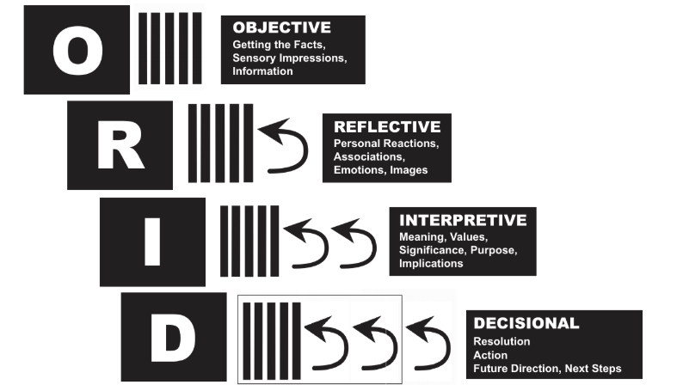
Notes:
Jenni
10:30 a.m.-11:00 a.m.

Slide 28
Objective Level
Purpose:
to examine evidence
to identify factual information
Questions:
What did we measure?
Who was involved?
How many students are represented?
What do we notice?
What catches our attention? (just the facts)
Notes:
Jenni
10:30 a.m.-11:00 a.m.

Slide 29
Reflective Level
Purpose:
to encourage participants to make connections
to encourage free flow of ideas and imagination
Questions:
What surprised you?
What encouraged you?
What discouraged you?
How does this make you feel?
Notes:
Jenni
10:30 a.m.-11:00 a.m.

Slide 30
Interpretive Level
Purpose:
to identify patterns and determine their significance
to articulate underlying insights
DESCRIBE THE BIG IDEA
Questions:
What does the evidence tell us?
What new insights do we have?
What good news is there for us to celebrate?
What doesn’t it tell us and what else might we need to know?
Does the data suggest that students are making progress?
What is the impact?
Notes:
Jenni
10:30 a.m.-11:00 a.m.

Slide 31
Decisional Level
Purpose:
to propose next steps
to develop an action plan
to make decisions
to experience ‘coming together’
Questions:
What are our proposed next steps?
What decisions can we make?
What is our theory of action for moving forward?
Notes:
Jenni
10:30 a.m.-11:00 a.m.

Slide 32
Student Voice
Behavior (e.g. sit still, don’t talk) 122
Attitude (e.g. be respectful) 77
Social skills (e.g. share, help) 58
Intelligence/Academic ability (e.g. smart) 55
Use of learning strategies (e.g. practice) 38
Tidiness 27
Effort (e.g. try your hardest) 25
Task completion (e.g. homework) 20
Speed of completion 12
Notes:
Jenni
10:30 a.m.-11:00 a.m.

Slide 33
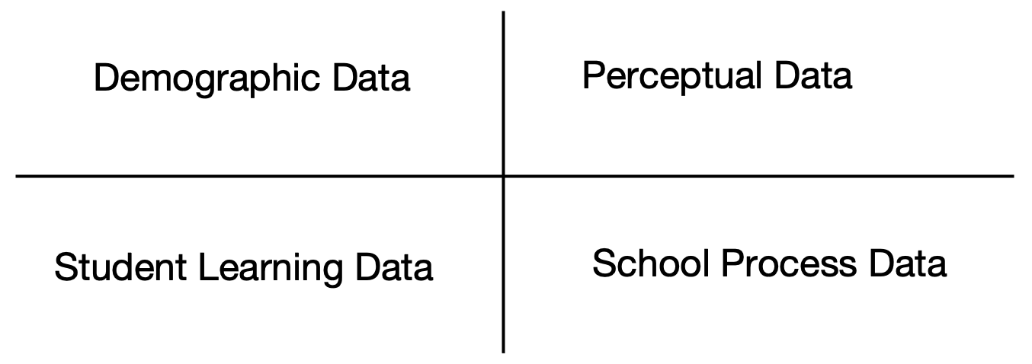
Four Types of Evidence for
School Improvement
What evidence might you gather from each of these categories to help you assess impact?
Adapted from: Victoria Bernhardt
Notes:
Jenni
10:30 a.m.-11:00 a.m.
Breakout

Slide 34
Valid and Reliable Evidence
for School Leaders
Valid – Am I measuring what I think I am measuring? (accuracy)
Reliable – If I were to do this again, would I get the same results? (consistency)
Notes:
Jenni
10:30 a.m.-11:00 a.m.

Slide 35
Valid and Reliable Evidence
for School Leaders
What does evidence look like in relation to your priority and how will you gather it?
Notes:
Jenni
10:30 a.m.-11:00 a.m.

Slide 36
Connections to Your Own Practice
What wonderings do you have now?
How does this connect with what you’re experiencing related to your priorities?
Jenni - Can you expand upon this giving more time for participants to process together?
Notes:
10:25 a.m.-11:00 a.m.
Jenni

Slide 37
Exit Ticket
Notes:
Further the James Clear learning and connect it to taking action around collecting data information
Impact of Evidence
Examine the Placemat - for habit building opportunities. What would an entry point be for that habit?
https://youtu.be/1gdkBt9it84?si=cLJ8cpqNylLP8Nlv 9 min. Video

Slide 38
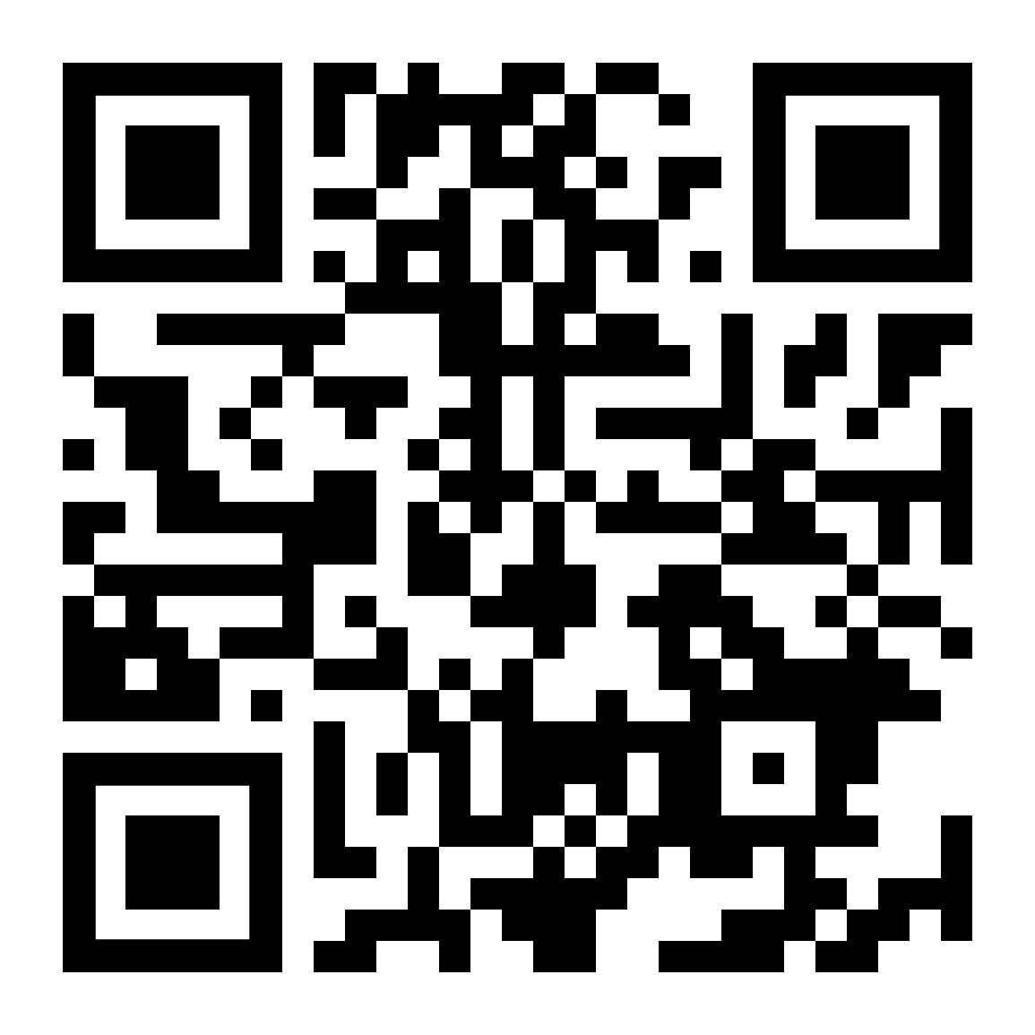
Survey
https://www.surveymonkey.com/r/97V6YH5
Notes:
Further the James Clear learning and connect it to taking action around collecting data information
Impact of Evidence
Examine the Placemat - for habit building opportunities. What would an entry point be for that habit?
https://youtu.be/1gdkBt9it84?si=cLJ8cpqNylLP8Nlv 9 min. Video

Slide 39
Our accomplishments for today-
I can identify actions I can take to promote attainment of my NLL goals (as articulated on my placemat) and begin forming productive leadership habits.
I can identify important elements of the ‘assess’ phase of a collaborative inquiry cycle (infinity loop and placemat).

Slide 40
Looking Ahead- February Session
In relation to your cycle of inquiry….
-Where are we now?
-Where are we going?

Slide 41
Until Next Time…
Notes:
Reminder about in person- secure rooms- location times…….preparation for the in person

