Slide 1

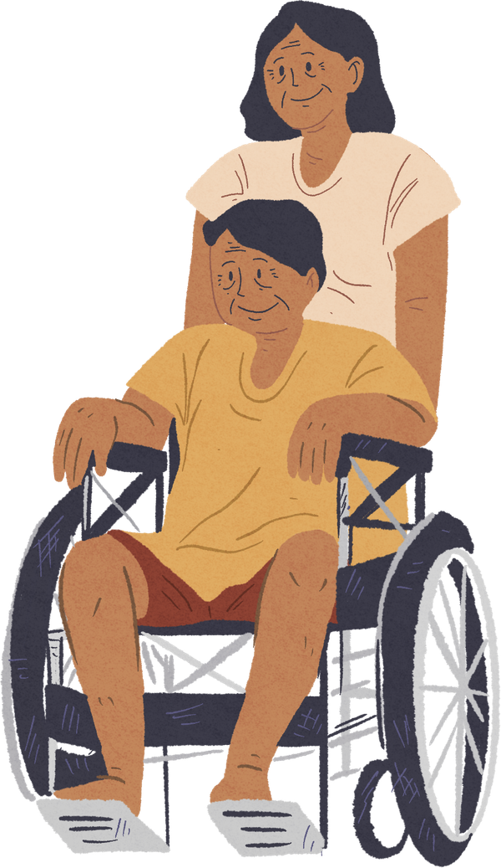

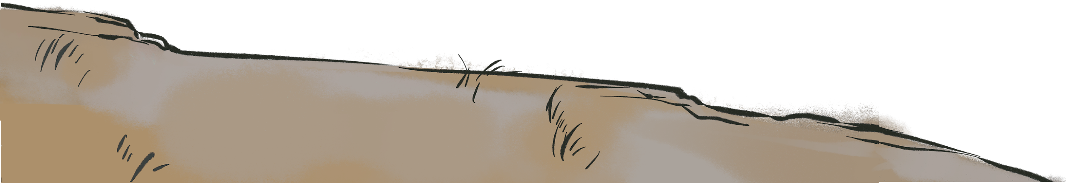


Disability Justice Foundations for Public Health
From Awareness to Action: Disability Justice as an Everyday Practice

Slide 2




Land Acknowledgement
We are hosting this webinar from the ancestral and unceded territory of the Nacotchtank (Anacostan), Piscataway, and Pamunkey People.
www.piscatawaytribe.org
www.pamunkey.org

Slide 3
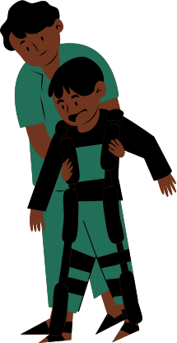
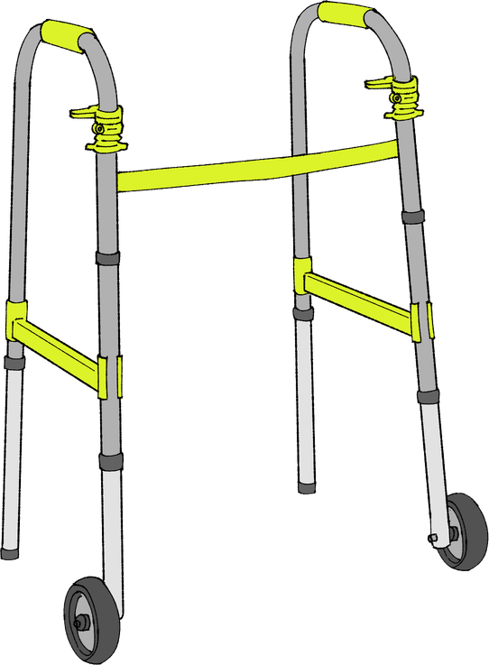
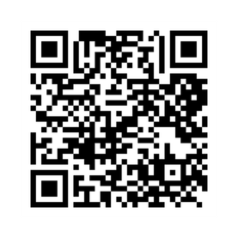
reminders
Disability justice is:
  A public health imperative
  A systems-change framework, not an awareness training
Catch the rest of the series
And webinar 1 recording
Disability Justice: Public Health for Collective Liberation

Slide 4
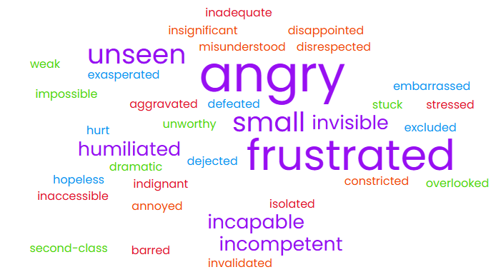
How do you feel when a system, service, or institution makes assumptions about what you can or can’t do?

Slide 5
Acknowledgements
Thank you to the APHA staff who brought this webinar together!
Ki'Ana Speights, Tia Taylor Williams, Rya Griffis , Mary Storstrom, Kate Robb, Shweta Arya, Anush Hakobyan, Katie Avelar, Samiha Ahmed
Speacial thanks to our disability justice advisory board, some of whom will be speaking today and throughout the webinar series!
Thank you to our funder, the Robert Wood Johnson Foundation (RWJF)!

Slide 6


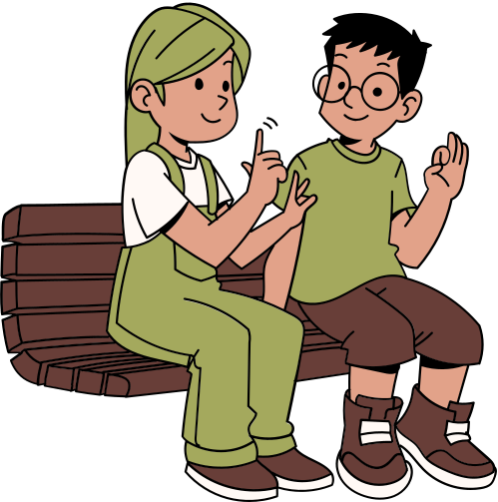


Housekeeping
  Participation norms:
    Cameras optional
    Engagement in the chat is welcomed
    Put questions in the Q&A feature
    Take care of access needs without apology
  This entire webinar series offers continuing education (CE) credit
  Recording, slides and resources will be available by 5/11
  Zoom accessibility features: transcript and ASL interpreters
    Chat Rya Griffis for additional access needs

Slide 7


CE Dislcosure
During the past 24 months, the speakers and moderators had no financial relationship with an ineligible company that might potentially be biased or impact the content of the webinar.

Slide 8
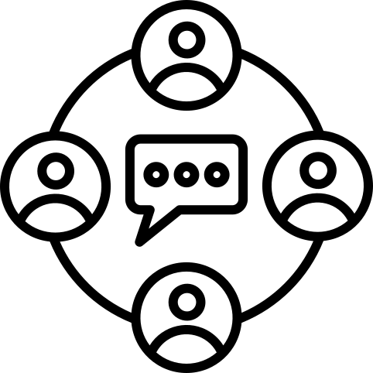
What to expect today
Option for audience engagement
01
Grounding
04
Breakout rooms
02
Centering Lived Experience & Disability Justice in Practice
05
Q&A
03
Disability Justice in Practice
06
Closing reflection

Slide 9
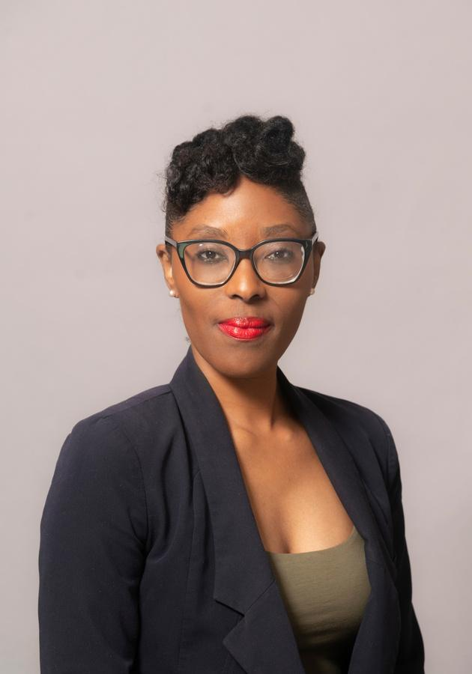
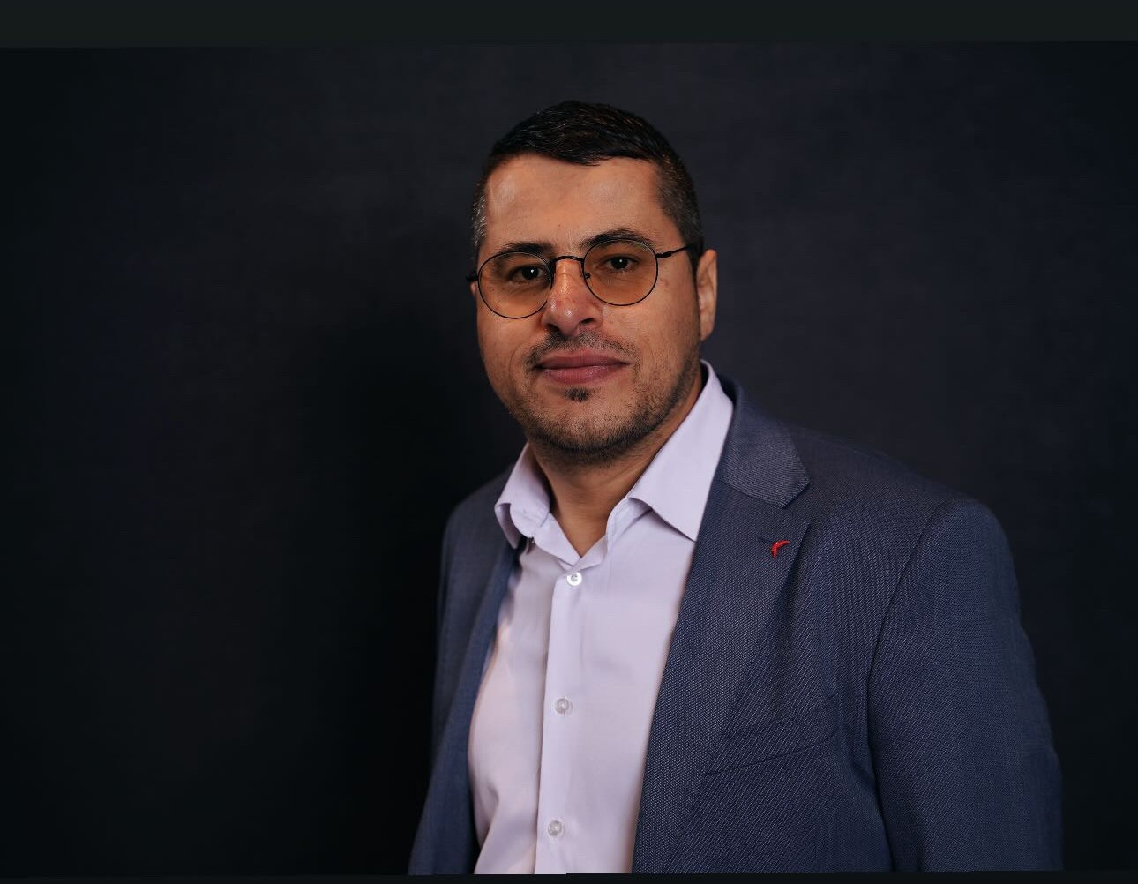
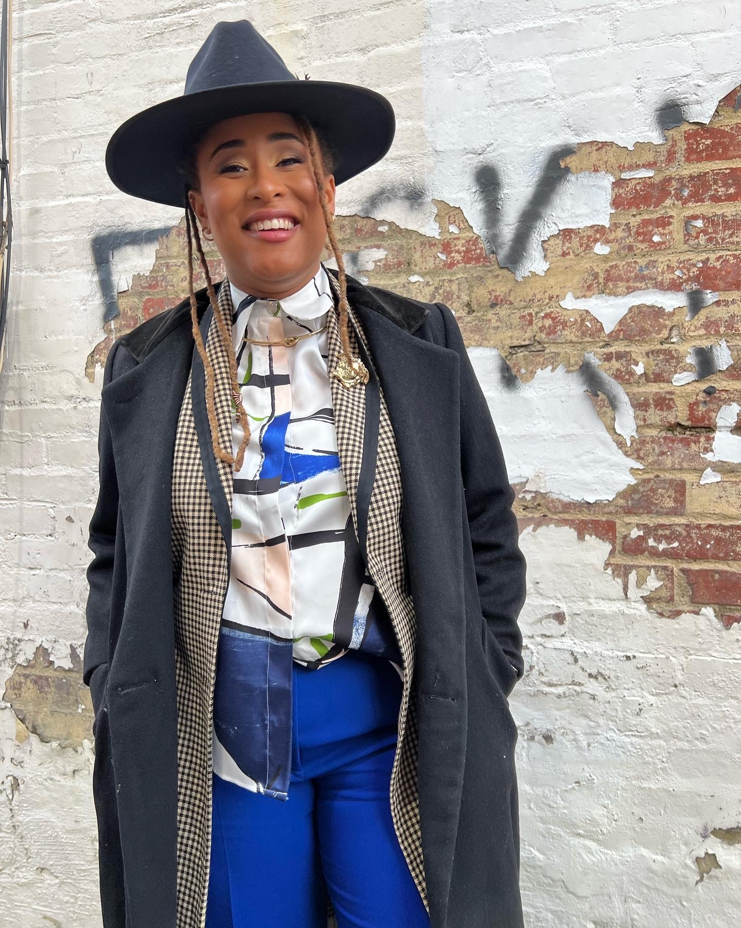
Presenters
Presenters
Dr. Hassanatu Blake
(she/her)
Associate Clinical Professor & Inaugural Director of Global Health Undergraduate Program
Mustafa Rfat, PhD Candidate
(he/him)
Mustafa’s work centers on the intersection of disability, migration, and health equity.
Mariah Barber, MPH, CHES, PhD Candidate
(they/them)
Mariah Barber is an author, certified health education specialist, and researcher

Slide 10

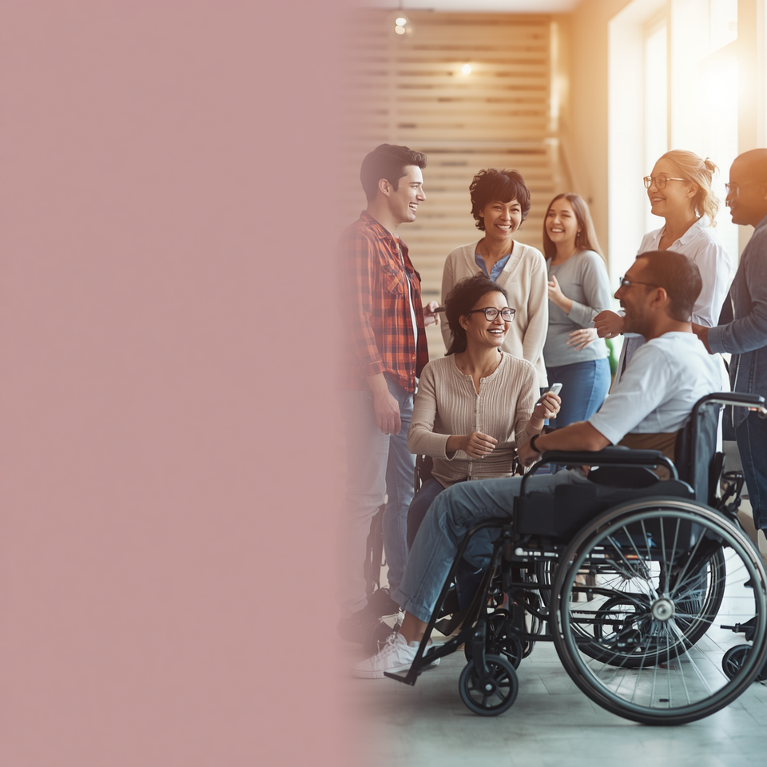

DISABILITY JUSTICE
IN PRACTICE
APHA
Webinar Series
WEBINAR 2 | FACILITATED BY
DR. HASSANATU BLAKE

Slide 11



Live Poll Engagement
OPENING AND
GROUNDING

Slide 12
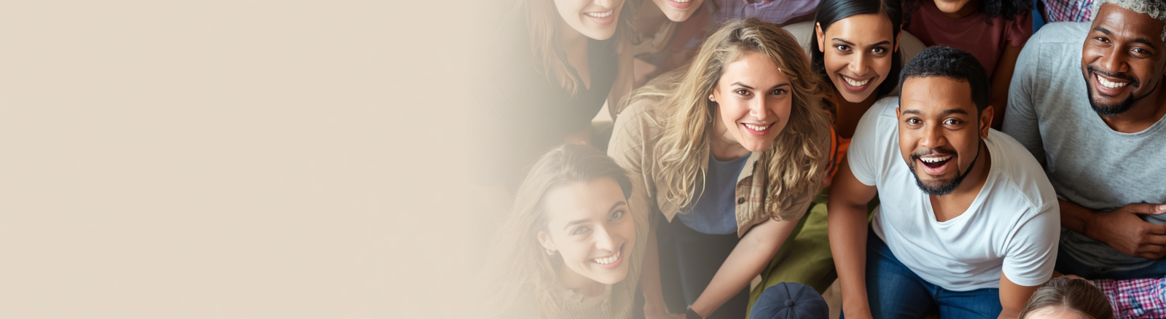

RECAP: KEY TERMS & MODELS FROM WEBINAR 1
01
KEY DEFINITIONS
Disability Justice
Disability Rights
02
MODELS OF DISABILITY
Medical
Social
Disability Justice
Next Slide

Slide 13



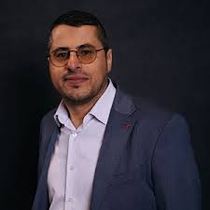

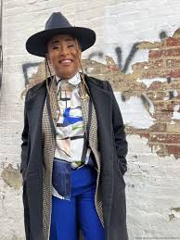

SPEAKER
INTRODUCTIONS
APHA
Webinar
MUSTAFA RFAT
PhD, Candidate and Scholar
MARIAH BARBAR
Founder, Invisible Strengths, MPH, CHES, PhD Candidate and Scholar
Page 4

Slide 14
Partial Justice and language Inaccessibility: Refugees with Disabilities
Mustafa Rfat, MSW, MPA, PhD
Notes:
https://docs.google.com/document/d/1KJVprjY2tEYj9mM1BphYkRg4t1NZBFH09IYJV4D7YC0/edit?tab=t.0#heading=h.mixmeuuameon
https://docs.google.com/document/d/1K4ZdzTNGFOY8_WkuWOZUCVY9nemUJgn2GBZdRdCmVGk/edit?tab=t.mu5fiw7yq6jd#heading=h.cvhei4ly0i5o

Slide 15
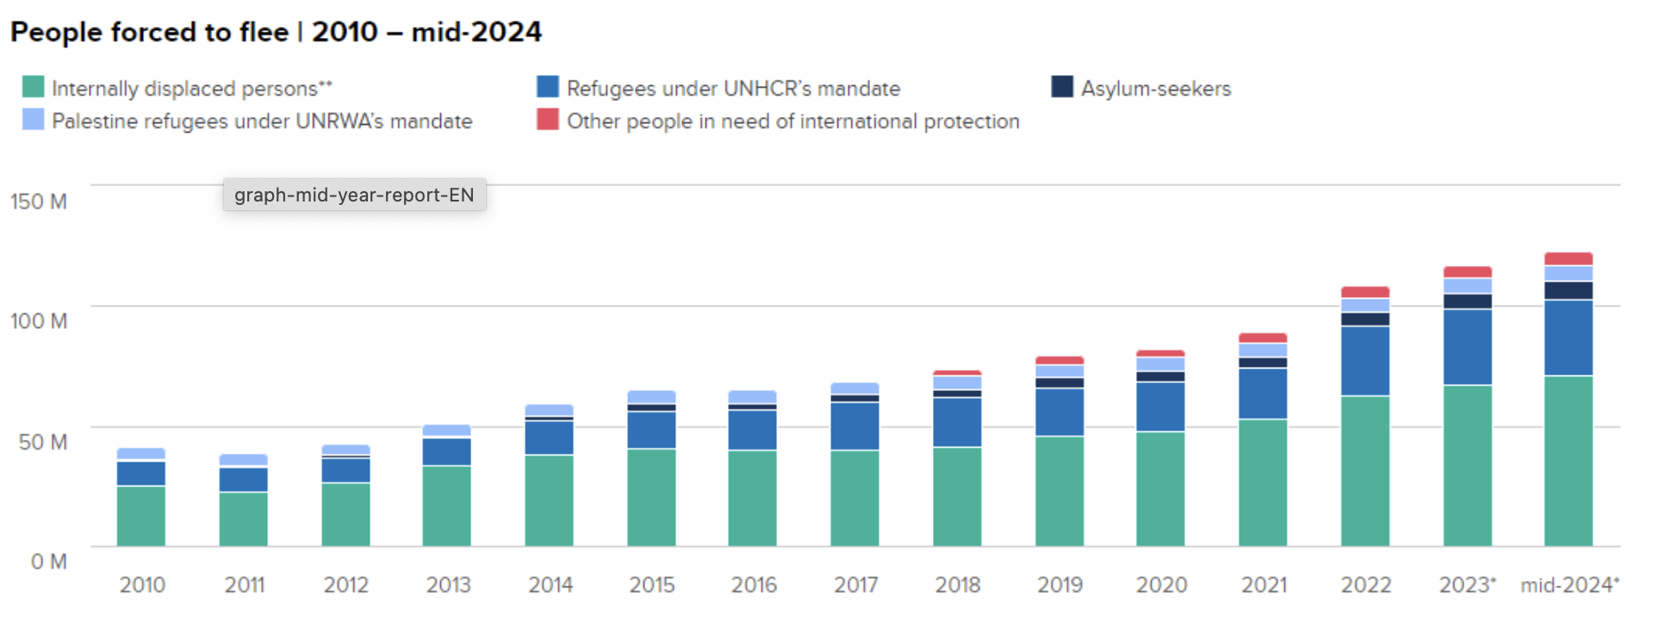
Global Displacement: Key Facts
123.2 million people were forcibly displaced worldwide
43.7 million of them are classified as refugees
Worldwide, more than 1 in every 67 people are forcibly displaced
(UNHCR, 2024)
Notes:
According to the UNHCR Global Trends Report 2021, there were 89.3 million forcibly displaced people worldwide at the end of 2021. This figure includes:

Slide 16
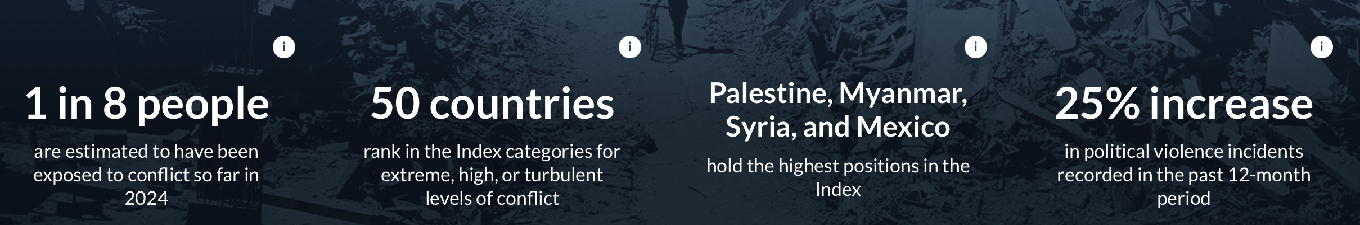
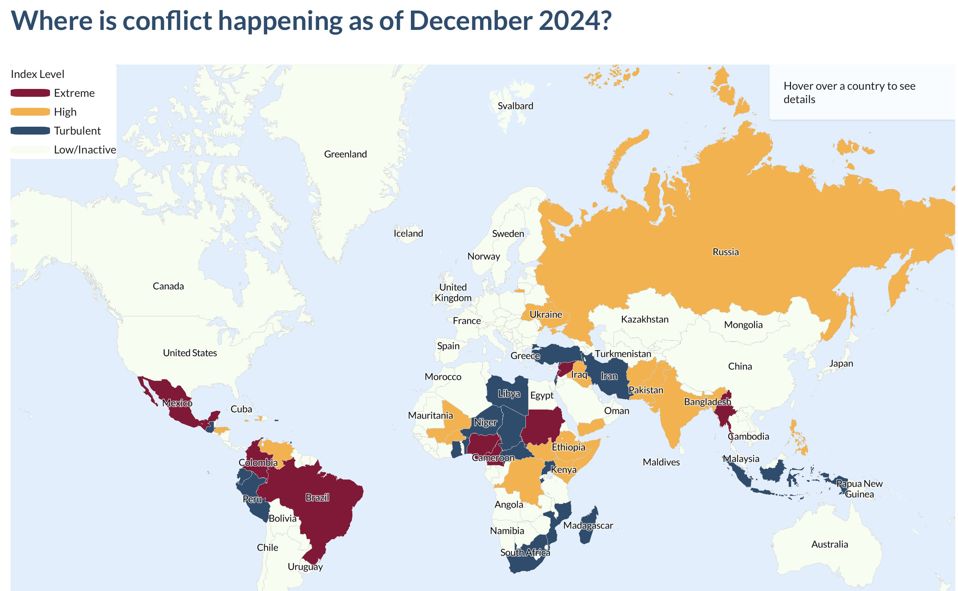
Armed Conflict
Location & Event Data
(ACLED, 2025)
Notes:
Global conflicts double over the past five years

Slide 17
Key Migration Terms in the U.S. Context
Refugees
Forced to flee due to persecution. Granted legal status before entering the U.S.
Asylum Seekers
Seeking protection after arriving in the U.S. Must apply and wait for a legal decision
Undocumented Immigrants
Living in the U.S. without legal immigration status (overstayed visas)
Undocumented Asylum Seekers
Individuals seeking asylum but not yet legally recognized
Notes:
These categories shape access to rights, services, and protections in the U.S.

Slide 18
Legal Foundations of Language Access in the U.S.
1. Civil Rights Laws
Title VI of the Civil Rights Act of 1964
  Prohibits discrimination based on national origin
Executive Order 13166
  Requires federally funded agencies to provide meaningful language access

Slide 19
Legal Foundations of Language Access in the U.S. cont.
2. Disability Rights Laws
  Americans with Disabilities Act
    Mandates interpreters, auxiliary aids, accessible formats
A “qualified” interpreter means someone who is able to interpret effectively, accurately, and impartially, both receptively (i.e., understanding what the person with the disability is saying) and expressively (i.e., having the skill needed to convey information back to that person) using any necessary specialized vocabulary
(ADA, 2022)

Slide 20
Legal Foundations of Language Access in the U.S. cont. 2
2. Disability Rights Laws
  Section 504 of the Rehabilitation Act
    Applies to federally funded programs
    Requires equal access, including communication access
3. Healthcare-Specific Protections
    Section 1557 of the Affordable Care Act
    Explicitly requires: 1- Qualified interpreters 2- Translated materials 3- Accessible communication
Notes:
These laws were not designed to work together. Refugees with disabilities often fall in the gap between them.

Slide 21
Gap Between Policies and Practice
Policies and systems assume people can:
  understand systems
  communicate their needs
  request accommodations
Notes:
policy protections only effective when people can actually seek them ask for them and advocate for them. But when it comes to people who doesn't have the language and who doesn't know what rights exist for them then they are at risk of marginalization and their rights are easily taken away
Rights are not automatic
Systems depend on individuals to activate those rights
Language barriers interrupt that process
“Policy protections are only effective when people can understand their rights, communicate their needs, and advocate for themselves. But for refugees with disabilities, especially those facing language barriers, that process breaks down. And that’s where we begin to see what I call partial access to justice.”

Slide 22
Partial Justice
You are technically included, but practically excluded
Examples:
Interpreter exists → but not in your dialect
Accommodation exists → but you cannot request it
Rights exist → but you cannot understand them
Notes:
policy protections only effective when people can actually seek them ask for them and advocate for them. But when it comes to people who doesn't have the language and who doesn't know what rights exist for them then they are at risk of marginalization and their rights are easily taken away
Rights are not automatic
Systems depend on individuals to activate those rights
Language barriers interrupt that process
“Policy protections are only effective when people can understand their rights, communicate their needs, and advocate for themselves. But for refugees with disabilities, especially those facing language barriers, that process breaks down. And that’s where we begin to see what I call partial access to justice.”

Slide 23
Limited Access to Arabic Sign Language Interpreters
Fatima, a Deaf refugee from Middle East
Quotes:
“They didn’t take me seriously because I could not communicate.” – Fatima
Psychological Impact:
Fatima cried while remembering those moments: “During pregnancy, I didn’t get proper follow-up. It was only after I insisted that they did an ultrasound and found that the baby had died in my womb. There was no interpretation. The doctor could not understand me. I can’t understand the ASL. The same problem is that we are not getting any ASL education.”
Notes:
Emotional trauma during critical medical care

Slide 24
From Disability Rights to Disability Justice
Disability Rights VS Disability Justice
Notes:
“Disability rights create protections. Disability justice asks whether those protections actually work in people’s lives.” “Having policies is not the end goal. The goal is ensuring those policies function in real-world conditions—especially for those most excluded.”
“In the case I just shared, the issue was not the absence of policy. The issue was that the system was not designed for someone who could not communicate within it.”
We need to think about Mexican and afghan and Arabic sign language… we are not doing a favior this is the law of the land….
“When language access is not built into systems, ableism determines who can access their rights—and who cannot.”
Disability justice is about removing the burden of enforcement on the very people who are facing the barriers and how we can… what we need to do is build access into every systems… and we need to think differently about Access should not depend on someone’s ability to advocate.
Communication is not just a service—it is a condition for safety and care…

Slide 25
References

Slide 26
References continued
Armed Conflict Location & Event Data Project. (2025). ACLED Conflict Index. https://acleddata.com/conflict-index/
United Nations High Commissioner for Refugees. (n.d.). Figures at a glance. https://www.unhcr.org/us/about-unhcr/figures-glance:contentReference[oaicite:16]{index=16}
Rfat, M., Zeng, Y., & Trani, J. F. (2023). Exploring the intersectionality of disability and refugee statuses: Reflecting on My Refugee Journey. The British Journal of Social Work, 53(3), 1570-1579.
Riza, E., Kalkman, S., Coritsidis, A., Koubardas, S., Vassiliu, S., Lazarou, D., ... & Linos, A. (2020, April). Community-based healthcare for migrants and refugees: a scoping literature review of best practices. In Healthcare (Vol. 8, No. 2, p. 115). MDPI.
Riggs, E., Brown, S., Szwarc, J., Nesvadba, N., & Yelland, J. (2021). Teach-back in interpreter-mediated consultations: reflections from a case study. HLRP: Health Literacy Research and Practice, 5(3), e256-e261.

Slide 27

Disability 101
Intersectional Lens to Disability Justice
Mariah Barber , Invisible Strengths

Slide 28

Meet the Facilitator:
Mariah Barber,MPH,CHES,
DEAI Certified

Slide 29
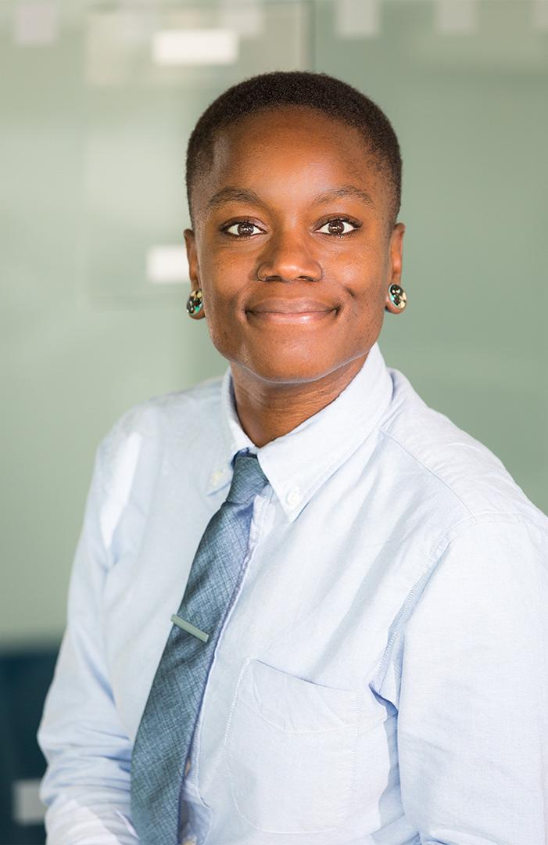

Solution
29
Invisible Strengths is a tool that supports organizations working on health equity to attract, retain and uplift untapped underrepresented talent pools.
Attract
Retain
Uplift

Slide 30
SETTING
THE
TONE

Slide 31
Learning Objectives
Discuss strategies to promote culture change to support the inclusion of individuals with disabilities across organizations and startups
Describe the use of technology to enhance employment opportunities for individuals with disabilities
List strategies to identify and support individuals with disabilities in the workplace and in accelerators

Slide 32

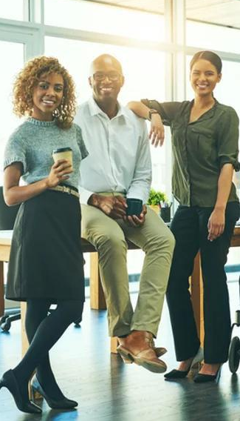
Mission
A social networking application connecting intersectional
( BIPOC/LGBTQIA+ disabled) candidates in the public health field with inclusive work environments.
Notes:
This stands to assist the most marginalized within the disabilities community to find supportive work spaces that affirm their multifaceted identities and provide a diverse pipeline of employees for employers. The platform will also provide tracings tools and tips for employers and employees regarding reasonable accommodations

Slide 33

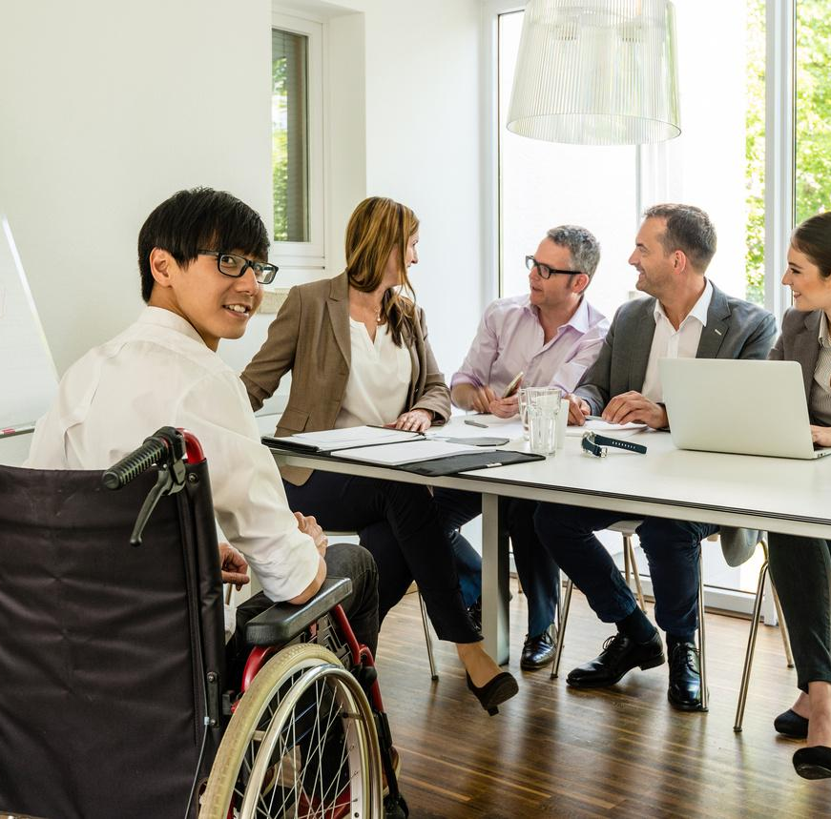
.
INCLUSIVE DESIGN
AFFIRMING LANGUAGE
This is based on customer behavior analysis, including market research
REINVESTING IN MARGINALIZED COMMUNITIES
Impeccable customer service is essential in retaining and attracting new customers. Customer service training and development will produce results down the line.
Health Care Professionals APPROVED
MARKET TESTING
Notes:
GUIDING FRAMEWORK

Slide 34
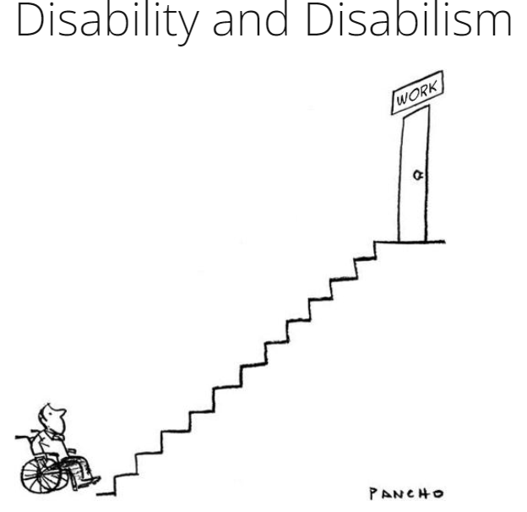
Disability and disabilism

Slide 35
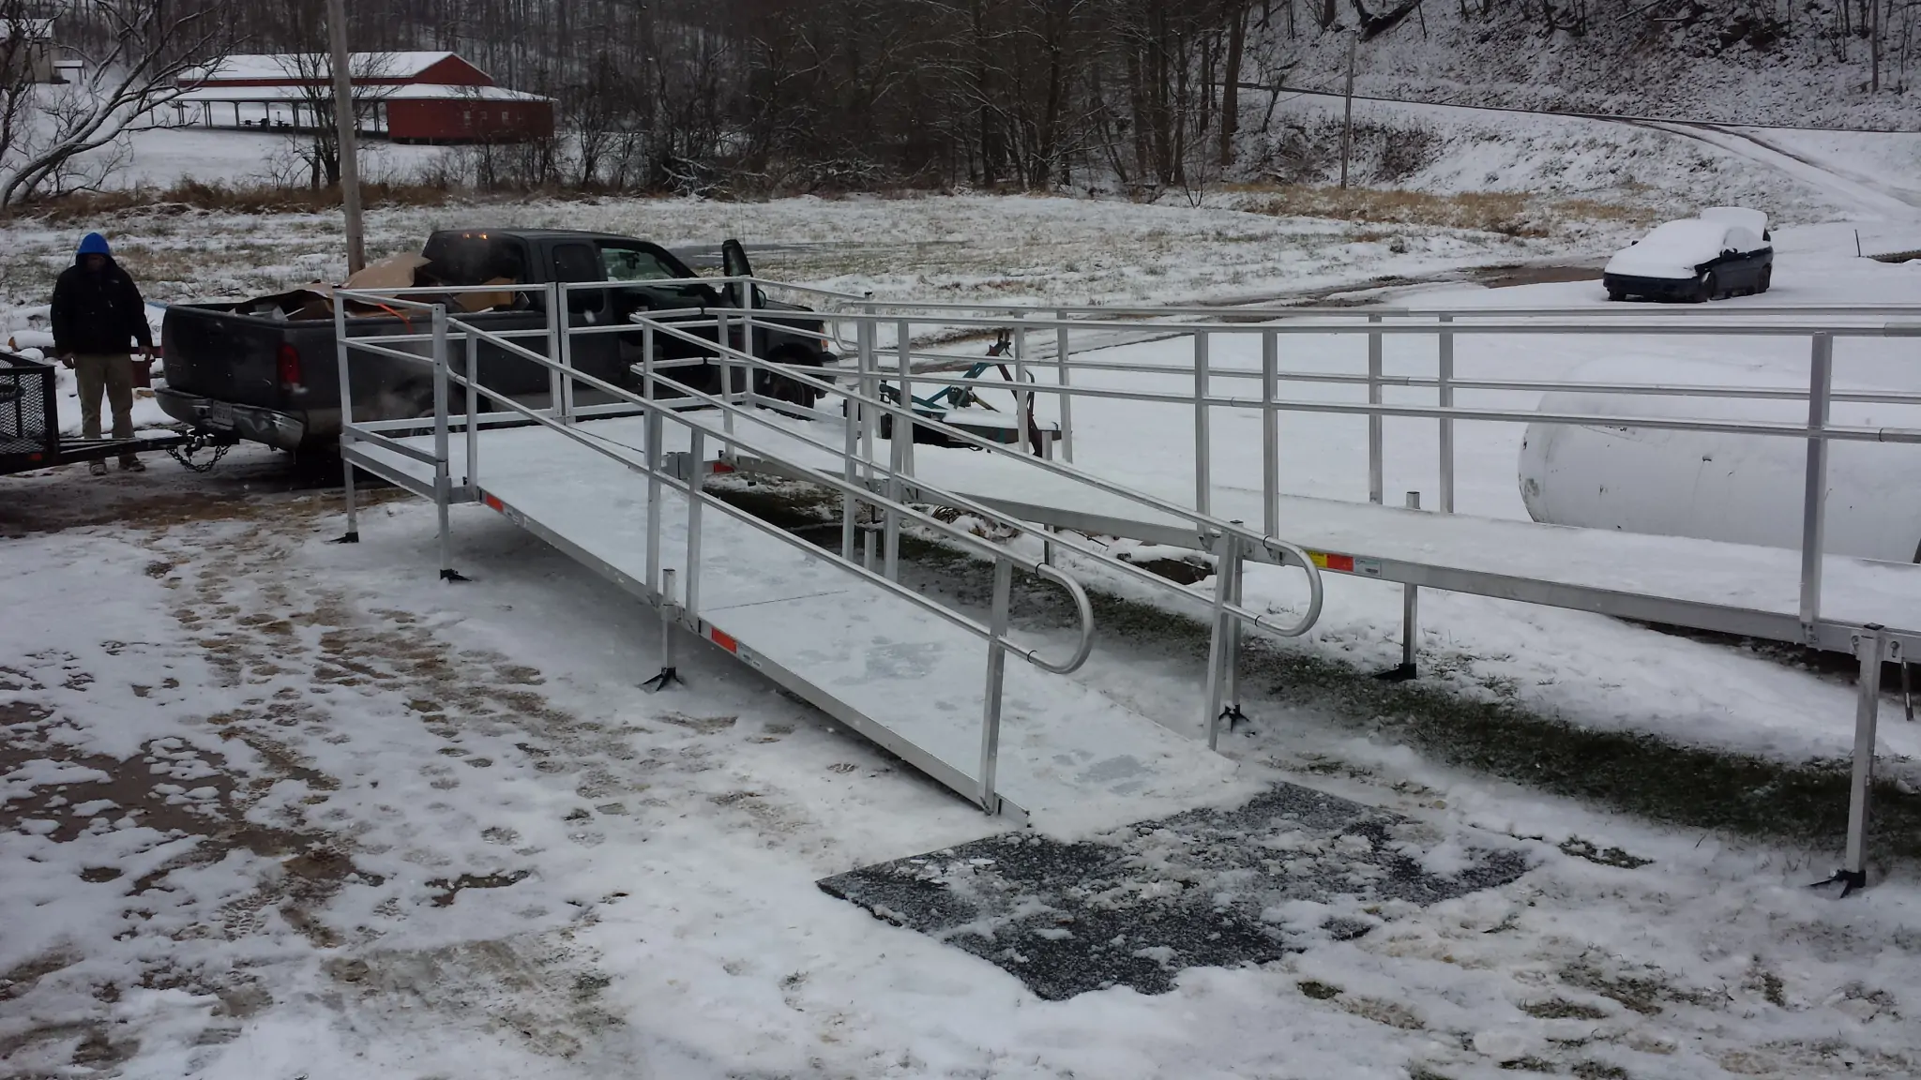

ICE out

Slide 36
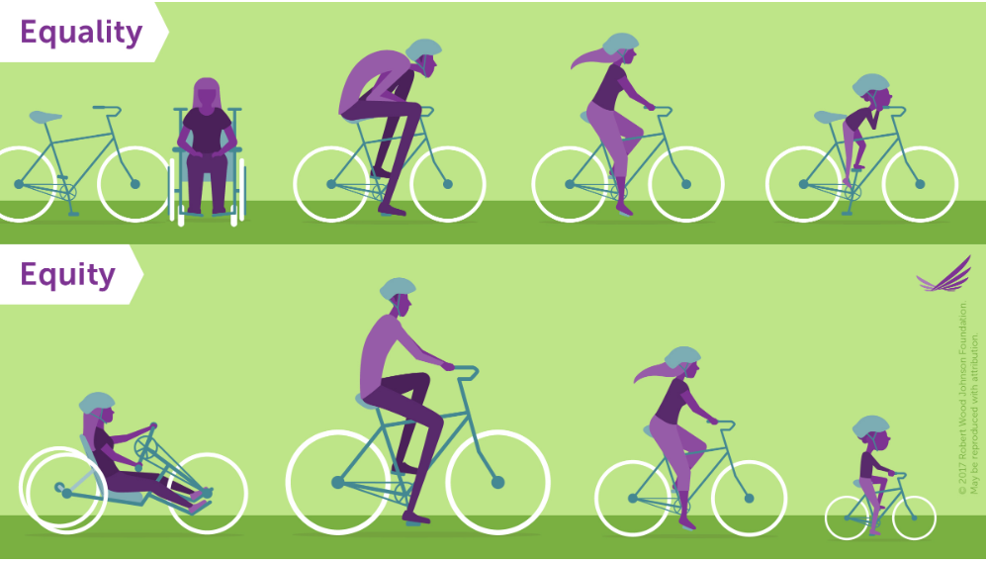
Equality VS Equity

Slide 37
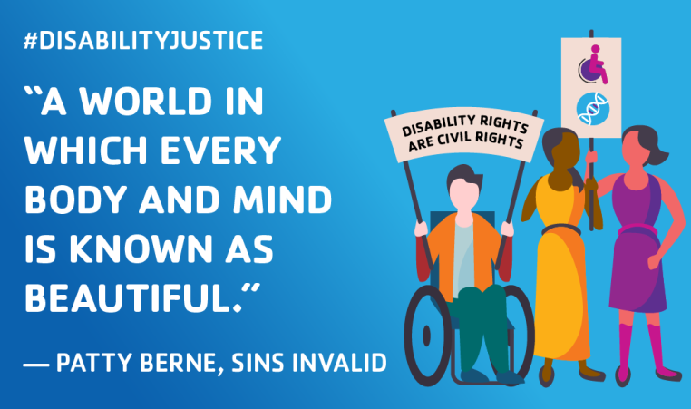
Proactive vs Reactive
Creating inclusive environments

Slide 38
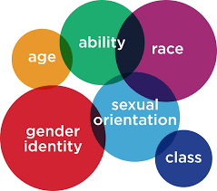
intersectionality

Slide 39

Design thinking

Slide 40
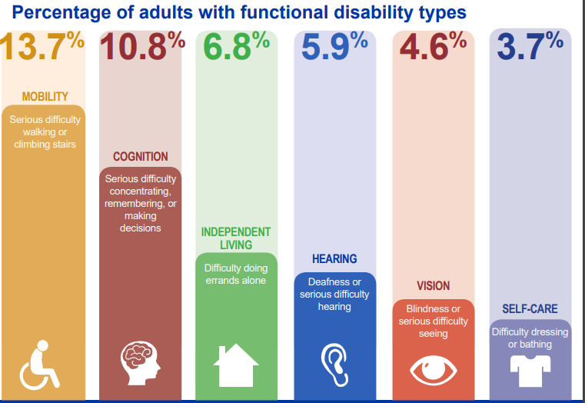
What Are types of Disabilities ?

Slide 41
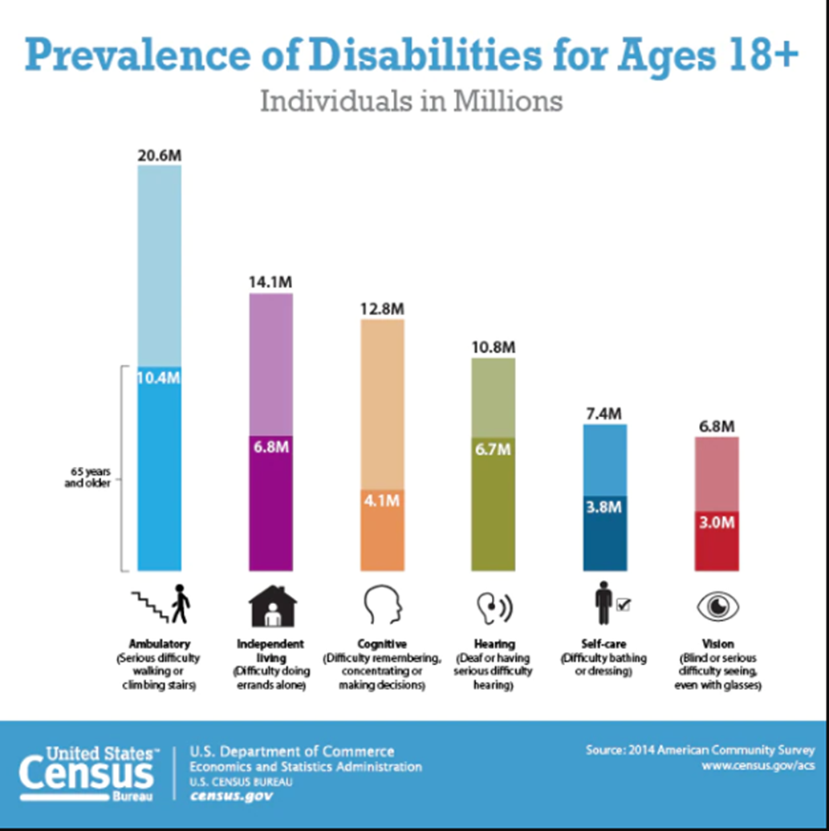
Prevalence of disability

Slide 42
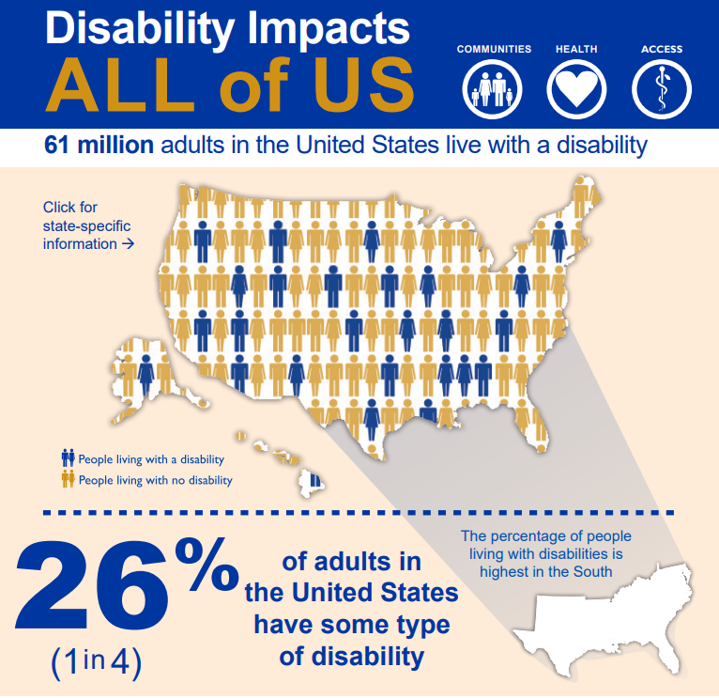
Disability impacts all of us
https://www.cdc.gov/ncbddd/disabilityandhealth/disability.html

Slide 43
How common are mental illnesses?
Mental illnesses are among the most common health conditions in the United States.
More than 50% will be diagnosed with a mental illness or disorder at some point in their lifetime.¹
1 in 5 Americans will experience a mental illness in a given year.²
1 in 5 children, either currently or at some point during their life, have had a seriously debilitating mental illness.³
1 in 25 Americans lives with a serious mental illness, such as schizophrenia, bipolar disorder, or major depression.⁴

Slide 44
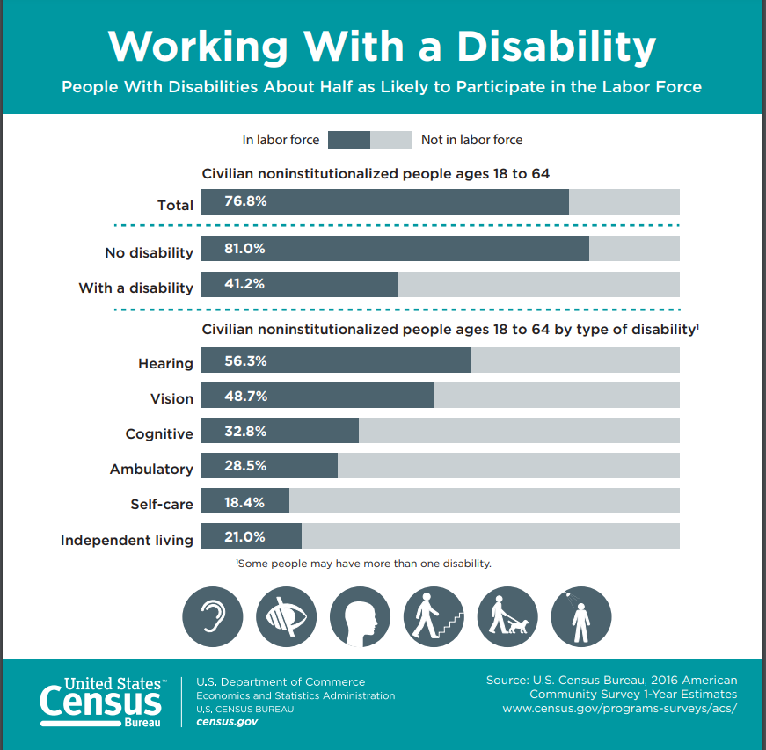
Working with a disability

Slide 45
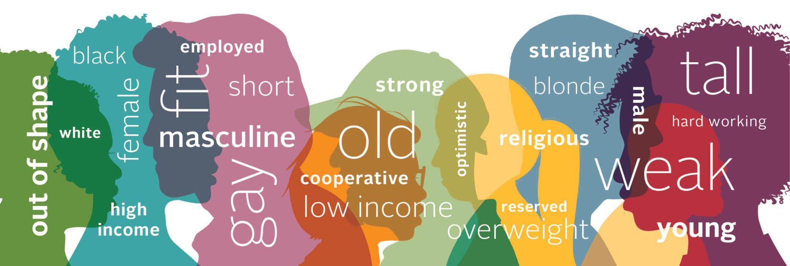
Implicit Bias
Implicit bias results from the brain’s tendency to process information based on generalizations and unconscious associations and feelings, even when these are contrary to one’s conscious or declared beliefs!

Slide 46

Beyond Disclosure
Promoting Facilitators & Eracticating Barriers
Examples
Transparent about available accommodations
Variations of meeting places to include all abilities
Sharing pronouns and abilities
Closed captions

Slide 47

Application
Tying this to What you Do

Slide 48
Washington Post Article on Spoon Theory:
Job Accommodations Network :
Resources

Slide 49
References cont.
Kessler RC, Angermeyer M, Anthony JC, et al. Lifetime prevalence and age-of-onset distributions of mental disorders in the World Health Organization’s World Mental Health Survey Initiative. World Psychiatry. 2007;6(3):168-176.
Key substance use and mental health indicators in the United States: Results from the 2015 National Survey on Drug Use and Health. Rockville, MD: Center for Behavioral Health Statistics and Quality. Substance Abuse and Mental Health Services Administration. 2016.
Merikangas KR, He J, Burstein M, et al. Lifetime Prevalence of Mental Disorders in US Adolescents: Results from the National Comorbidity Study-Adolescent Supplement (NCS-A). Journal of the American Academy of Child and Adolescent Psychiatry. 2010;49(10):980-989. doi:10.1016/j.jaac.2010.05.017.
Key substance use and mental health indicators in the United States: Results from the 2015 National Survey on Drug Use and Health. Rockville, MD: Center for Behavioral Health Statistics and Quality. Substance Abuse and Mental Health Services Administration. 2016
History of the Americans with Disability Act
http://www.adalawproject.org/adaleghistory
https://www.coe.int/en/web/compass/disability-and-disablism
https://www.cdc.gov/ncbddd/disabilityandhealth/disability.html
https://www.who.int/health-topics/disability#tab=tab_1

Slide 50

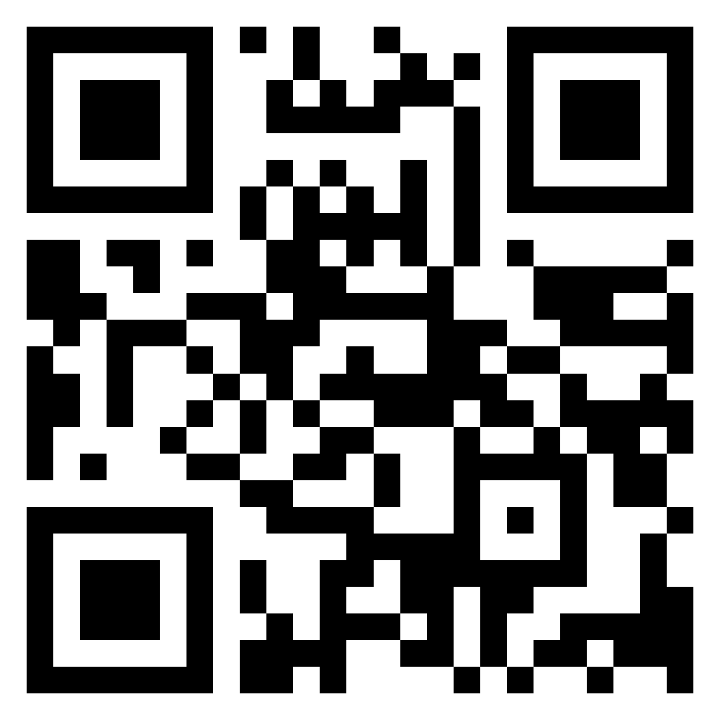


Contact
invisiblestrengthsapp
info@invisiblestrengths.com

Slide 51

BREAKOUT SESSION OVERVIEW & COMMUNITY AGREEMENTS
BREAKOUT GROUPS
COMMUNITY AGREEMENTS
Next Slide

Slide 52
Presenters
Moderators
Mustafa Rfat (he/him) Mustafa’s work centers on the intersection of disability, migration, and health equity.
Mary Kathryn Curcio Stoddard (she/her) Chronic Disease Epidemiologist and Program Evaluator
Marcus D. Johnson (he, him, his) Manager of Advocacy Programs and Initiatives
Dr. Hassanatu Blake (she/her) Associate Clinical Professor & Inaugural Director of Global Health Undergraduate Program
Shannon Stubblefield (they/she) Data and Research Manager
Cierra Olivia Thomas Williams Disability Justice and Public Health Consultant
Derek Schmitz (they/them) Advocate

Slide 53



BREAKOUT DISCUSSION QUESTIONS
APHA
Webinar
Disability Justice in Practice
REFLECT
OBSERVE
ENVISION
01
02
03
QUESTION 1
QUESTION 2
QUESTION 3
How does ableism show up in your professional context or daily work?
What are the access barriers you observe for people with disabilities?
What would Disability Justice-aligned practice look like in your setting?
Next Slide

Slide 54
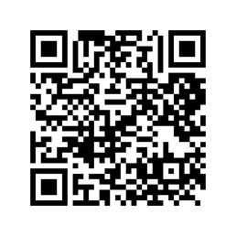
Thank You!
Disability Justice: Public Health for Collective Liberation
Catch the rest of the series

