Slide 1


ISMPP University
Actioning EDI for Our Industry: Turning Principles into Practice
December 11, 2024
Webinar will begin promptly at: ​11:00 AM ET/ 4:00 PM GMT

Slide 2
To activate captions
Access the captions button: In the meeting controls toolbar, click the "Show Captions" icon (usually looks like a "CC")
Select language:
  Click the arrow next to the "Show Captions" button
  Select your preferred language from the "Speaking Language" dropdown menu

Slide 3






















ISMPP would like to thank the following Titanium and Platinum Corporate Sponsors for their ongoing support of the Society

Slide 4

ISMPP announcements
Application deadline for the March CMPP
exam is February 1

Slide 5
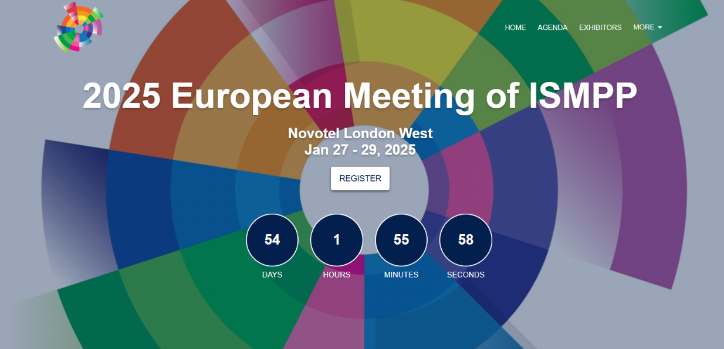

Slide 6
How to ask questions
Feel free to ask a question at any time; however, all questions will be held until the end the of the presentation
To ask a question, open the Q&A window, type your question into the Q&A box.
Click Send
Note: Check Send Anonymously if you do not want your name attached to your question in the Q&A
We will make every effort to respond to all questions live (out loud)

Slide 7
Disclaimer
Information presented reflects the personal knowledge and opinions of the faculty and does not necessarily represent the position of their current or past employers
Notes:
Please take a moment to read our general disclaimer.

Slide 8
Objectives
Understand our roles as medical communication professionals in supporting EDI in the day-to-day delivery of medical communications
Be familiar with resources, including current guidelines, to support putting EDI into daily practice
Have specific examples of immediate actions we can take to make medical communications more accessible and inclusive
Appreciate the broader commitments that will help to further advance the field

Slide 9

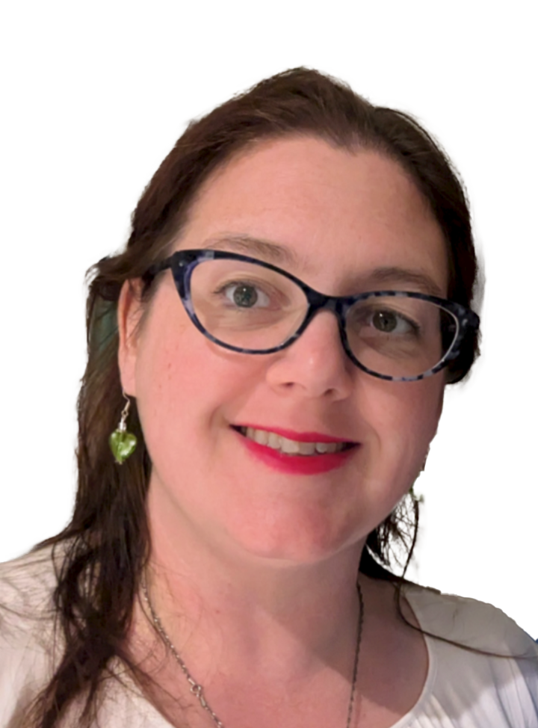

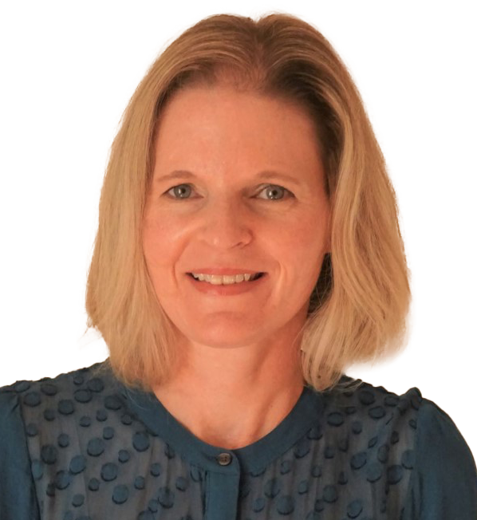


Faculty
MODERATOR
Michele Springer
Deputy Director
of Medical Editing
Emily Messina
Medical Writer
Charlotte Rowan-Green
VP, Medical Director
Nicole Strangman
SVP, Senior Medical
Director

Slide 10
Inclusive language guidelines and tips for incorporating into everyday work
Michele Springer

Slide 11
Why is inclusive language important?
Helps establish respect for all people and promotes inclusion
  Certain groups have been historically under-represented in scientific communications; inclusivity is a step toward amending this
Without inclusive language, communications can perpetuate bias, even unintentionally
It is important to address the whole patient, not just their condition

Slide 12
What is “patient-first language”?
A way of describing people that emphasizes the person and not their disability, condition, or disease
A way of writing that helps avoid stigmatizing language and unintentional blame
DON’T
DO
DON’T
DO
Describe a person using their condition (cancer patient)
Use person terms with nouns (people with disabilities)
Use person-first language (patient with cancer)
Use “the” plus an adjective (the disabled)

Slide 13
Avoid victimizing and patronizing language
Don't use language/terms that imply helplessness or passiveness, such as “afflicted with” or “suffering from”
Avoid euphemistic language or statements like “such an inspiration” or “physically challenged”

Slide 14
Sex vs gender
Sex
Refers to
biological factors
Gender
Refers to social/ cultural factors
Keep in mind that sexual orientation is different from gender or gender identity and should only be reported on when scientifically relevant

Slide 15
Incorporating EDI into everyday communications: sex and age
Choose sex-neutral terms
When reporting on age, avoid terms that could be considered ageist or could imply a negative stereotype
DON’T
DO
chairman, chairwoman,
manhole
chair, chairperson,
sewer hole
DON’T
DO
senior citizens,
the elderly
older adults,
younger patients,
patients younger than 21

Slide 16
Incorporating EDI into everyday communications: race and ethnicity
Race and ethnicity are social constructs, without scientific or biological meaning
In communications, capitalize all racial and ethnic descriptors consistently and be appropriately specific
Avoid "othering" and convenience grouping
Race
Categorizes people based on physical traits; often inherited
Ethnicity
Broader than race; refers to shared culture and is
usually learned

Slide 17
Incorporating EDI into everyday communications: terminology
Recognize when to use “diverse”
Recognize and avoid words that assume a cultural norm or a universal standard, like “exotic”
DON’T
DO
Use with “person” or to mean “underrepresented”
Use to describe a group or whole with elements that differ from one another

Slide 18
It’s all about respect
There are many resources for how to incorporate EDI into your communications
EDI is an ever-evolving topic
  As social standards and preferences change, so does guidance
Embracing EDI in scientific communications is more than
just a practice; it’s a commitment to respecting and valuing
every individual in our pursuit of knowledge

Slide 19
Making materials accessible
Emily Messina

Slide 20
Making materials accessible
How can we ensure the formatting and language in our deliverables is accessible?
We want our materials to be accessible for our peers and the intended audience
  15–20% of people are neurodivergent or disabled
  ~11% of US doctoral scientists and 1-year medical residents report being neurodivergent or having disabilities
Everyone benefits from improved accessibility

Slide 21
How many of you have been to a presentation where you can’t read all the text on the slide?
Yes
No

Slide 22
How many of you have been to a presentation where you had a difficult time hearing or understanding the speaker?
Yes
No

Slide 23
How many of you have been to a poster session where it is difficult to read a poster or have a conversation with the presenter?
Yes
No

Slide 24
Top formatting tips
A balance of text and images allows more people to follow along
If you don’t need it, don’t include it
Use larger fonts and images
  Keep font over ≥16 on slides
Do not rely on color to distinguish features on slides or images
  Direct label where possible
  You can check if your content is color blind accessible for free online: https://www.color-blindness.com/coblis-color-blindness-simulator/
Ensure there is enough color contrast between font and background

Slide 25
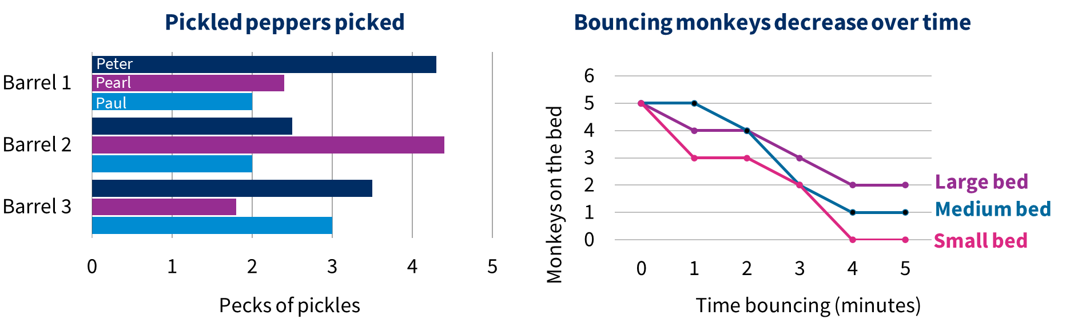
More accessible use of color and labels

Slide 26
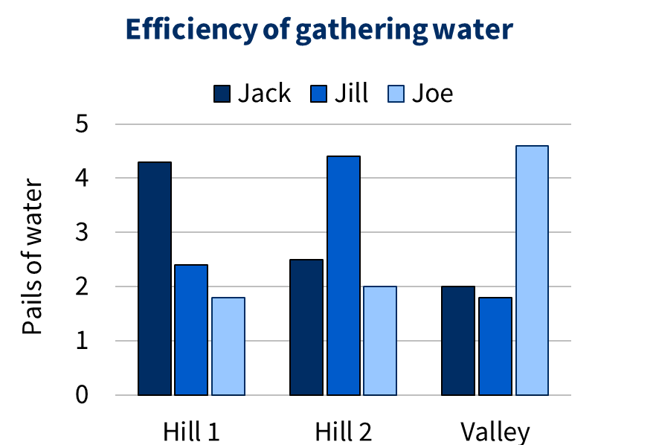
More accessible use of color and labels
High color contrast in a monochromatic scale is more accessible than mixed colors
Gaps between bars improves contrast and accessibility

Slide 27
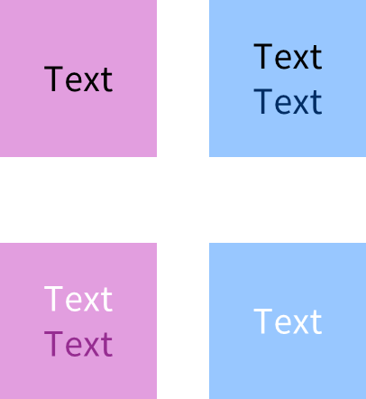
Ensure your text is readable against the background
Text should have a contrast ratio of at least 3:1 with the background
  You can check for free online:
  https://webaim.org/resources/contrastchecker/
Readable
Not readable

Slide 28
Using language specific to audience
Avoid jargon where appropriate
  If using abbreviations, be sure to define
Even in some academic settings, plain language can reduce cognitive load and help you communicate your message
Be consistent with formatting and imagery

Slide 29
Consistent language
This summary describes:
  How many years patients lived
  What side effects the patients experienced
Adverse events
  Nausea
  Extreme tiredness
How long patients survived
  Group A lived longer than group B
How long did patients live?
  Group A lived for X years
  Group B lived for Y years
What side effects did patients experience?
  Nausea
  Extreme tiredness
Mixing language and structure can add confusion
Consistent language and structure is easier to read

Slide 30
Accessibility does not mean “dumbing down”
Accessibility is about clarity
Making our materials accessible improves the experience for everyone
Allows our message to reach more people more efficiently
Accessibility can be applied to all of our deliverables

Slide 31





Consistent imagery
DNA is a double-stranded molecule
DNA contains the genetic information that is passed down from generation to generation
DNA is transcribed into RNA, which is translated into proteins
DNA is a double stranded-molecule
DNA contains the genetic information that is passed down from generation to generation
DNA is transcribed into RNA, which is translated into proteins
transcription
translation
DNA
RNA
protein
Mixing color and imagery can add confusion
Consistency and direct labelling improve accessibility

Slide 32
Driving inclusivity through co-creation
Charlotte Rowan-Green

Slide 33
A quick note on the term patient…
‘Patient’
People-first language
Identify-first language
A person living with a health condition or someone who has participated in clinical trial
Preferred when discussing people with a health condition e.g. people living with dementia
Some individuals may prefer identity-first language e.g. an autistic person
It is always best to consult with the communities you are speaking about/creating for

Slide 34


What is co-creation?
Co-creation is the process
of creation by interacting with others
In medical communications, co-creation can mean working with healthcare professionals or patients and their families to develop materials that are reflective of their needs
https://pifonline.org.uk/resources/involving-users/

Slide 35
Where can co-creation add value?
Preclinical development
Clinical trials
Post-marketing approval
Phase I
Phase 2
Phase 3
Phase 4
Molecule discovery; testing in in vitro and in vivo models
Safety and PK in healthy subjects
Safety in a small patient population
Efficacy and safety in a large patient population
Real-world effectiveness and safety
Patient review of PLSPs
and educational materials
But patients can add value at every step of the drug development journey!

Slide 36






Health information must be accessible and understandable by your intended audience
4 in 10 adults struggle to understand health information¹
6 in 10 adults struggle with health information that includes numbers
and statistics¹
As we move to increasingly digital spaces, we risk excluding many people:
there are 4.7 million people in the UK who cannot access the internet³
Some groups may require more support than others, including those
with cultural and language barriers and people with conditions affecting comprehension (e.g. dementia or a learning disability)
1. https://evidence.nihr.ac.uk/collection/health-information-are-you-getting-your-message-across/ Accessed November 2024; 2. https://charitydigital.org.uk/topics/what-its-like-to-be-digitally-excluded-in-2024-11389#:~:text=This%20may%20be%20their%20choice,people%20cannot%20access%20the%20internet. Accessed November 2024;

Slide 37
It’s important to understand the needs of your audience to avoid misleading them
Low health literacy has been linked to poor general health, increased hospital admissions, low vaccination uptake, & lower life expectancy¹
Here are some examples of when poor health communication led to poor outcomes:²
A woman who sprayed her inhaler on her neck because she had been told to spray it on her "throat"
A man who did not turn up for cancer tests because he did not know Radiology and X-ray department were the same thing
A man with
diabetes who decided to stop taking his medicine because he
had trouble understanding the instructions
A woman who thought chemotherapy would not help because it was given into a vein on the other side of the body to where her cancer was
1. https://evidence.nihr.ac.uk/collection/health-information-are-you-getting-your-message-across/ Accessed November 2024; 2. https://service-manual.nhs.uk/content/health-literacy Accessed November 2024.

Slide 38
What is the average reading age of an adult in the UK?
7 years old
9 years old
11 years old
16 years old

Slide 39
The average reading age of an adult in the UK is 11–14 years old¹
Aim for a reading age of 9–11 years old when creating content for the general public²
1. https://library.nhs.uk/wp-content/uploads/sites/4/2020/08/Health-literacy-how-to-guide.pdf. Accessed November 2024;
2. https://pifonline.org.uk/news/target-reading-age-health-information/ Accessed November 2024.

Slide 40
A practical guide to what health literacy may look like for an average adult in the UK
Skill and Level
In a health setting adults will be able to:
Literacy, typical of
an average
9-year-old
Understand words on a simple poster such as ‘smoking is bad for you’
Understand the words but not necessarily the numbers of a routine appointment letter
Tell a clinician in simple language the degree and type of pain they have
Numeracy typical of
an average
9-year-old
Could understand appointment times in whole hours using 12-hour clock e.g. 9am but not 9.15am or 13.00 hours
Understand simple dosage and medication timings e.g. take one teaspoon 3 times a day
Able to measure their own weight in kilos
Able to take their own temperature but not understand the reading
https://library.nhs.uk/wp-content/uploads/sites/4/2020/08/Health-literacy-how-to-guide.pdf. Accessed November 2024

Slide 41
Plain language summaries: are they fit for purpose?
No lay trial summaries (N=60)
met the recommended reading age¹
Recommendations²
Be accurate, clear and concise
Do not assume any prior knowledge
Use words that are appropriate for the reader
Use short sentences (up to 20 words) and short paragraphs (3 sentences)
Use neutral language
Consider using infographics with explanatory text
Involve your intended audience in developing your summary
% of lay trial summaries
1. Shiely F & Daly A. J Clin Epidemol 2023; 156:105-112; 2. https://www.hra.nhs.uk/planning-and-improving-research/best-practice/writing-plain-language-lay-summary-your-research-findings/#:~:text=Use%20words%20that%20are%20appropriate,using%20infographics%20with%20explanatory%20text Accessed November 2024.

Slide 42



Imagery is powerful and can ensure people feel included
Consult with your intended audience to ensure your imagery is representative
Shows
Diverse representation within intended audience
Appropriate use of clothing, activities, objects or settings relevant to the intended audience
Positive portrayals, incl. health behaviours
Diverse beauty standards whenever possible and appropriate
Includes
Features that can easily be understood by people with disabilities
Depictions of people with a variety of disabilities within the general population
Accurate depictions of people with a disability and their assistive technology
Avoids
Perpetuating stereotypical power or status inequities
A staged or artificial feeling
https://www.cdc.gov/health-communication/php/toolkit/inclusive-images.html Accessed November 2024

Slide 43



What can I do to make my communications more inclusive?
Aim for a reading age of 9 when creating materials for the public
Use Plain English when writing: avoid jargon, use simple sentence structures and the active voice
Include lay reviewers as part of your process: ideally this would be someone from your intended audience, but as a minimum run it by someone with a non-scientific background

Slide 44
Resources

Slide 45

Inclusive language resources
ICMJE
ICMJE race and ethnicity
AMA
JAMA, reporting race and ethnicity
SAGER guidelines, sex and gender
UN, gender-inclusivity
GLAAD, gender identity
CDC, health equity guiding principles
CSE inclusive language
NIH writing respectfully
Inclusive language in scientific style guides
Current guidance on inclusive language for medical and science journals (2022)

Slide 46
Accessibility resources
Color contrast checker
Colorblindness checker
HCA guide to inclusive events
CDC clear communication index
WHO neurodiversity guidance
US statistics on doctoral recipients by disability status
Study of requests for accommodations among first-year resident physicians

Slide 47
Patient-centricity resources
Plain English Campaign
Designing person-focused materials
Cell Press
inclusive visual communication
CDC inclusive images
EUPATIConnect
Cochrane Consumer Network

Slide 48
Audience Q&A

Slide 49
ISMPP University
Actioning EDI for Our Industry: Turning Principles into Practice
December 11, 2024
Webinar will begin promptly at: ​11:00 AM ET/ 4:00 PM GMT

Slide 50

Thank you for attending!
We hope you enjoyed today's presentation.
After closing out of Zoom, please click the CONTINUE button
on your screen to take our short survey. Thank you!
Notes:
Thank you again for attending today’s webinar. Please take a moment to fill out the survey link that will be sent to you.
After closing out of ZOOM, please click the ‘continue’ button on your screen to take a short survey.
Thank you!

Slide 51
Michele Springer
Deputy Director of Medical Editing,
Caudex, an IPG Health Company
Nearly 15 years working in the medical communications industry
Experience in publications, commercial medical communications, and medical affairs
Member of the Council of Science Editors and is
CMPP certified

Slide 52
Emily Messina
Medical Writer, CMC Affinity,
an IPG Health Company
Emily has ~4 years experience in medical communications and over 10 years experience in academia
She is committed to spreading awareness for disability and inclusivity and making medical and educational content accessible for everyone

Slide 53
Charlotte Rowan-Green
VP Medical Director, Caudex,
an IPG Health Company
Charlotte has over 7 years of experience within medical communications
She is an experienced in medical affairs professional, with a passion for patient centricity
She leads the Empowerpath team at Caudex, who are committed to ensuring the patient voice is at the core of medical communications by championing for empathy and accessibility

Slide 54
Moderator: Nicole Strangman
SVP, Senior Medical Director,
Caudex, an IPG Health Company
Nicole has over 17 years of experience in Medical Communications on the agency side
Prior to that she worked at the educational not-for-profit CAST, articulating their framework for promoting accessible and inclusive practices for everyone by understanding diverse learning needs
In her personal time she volunteers for Greater Boston PFLAG, a community supporting families and allies of LGBTQ+ individuals

