Slide 1
What to use it for?
Content Generation
Content Editing & Translating
Calculate
Data Analysis
Research / Explain

Slide 3
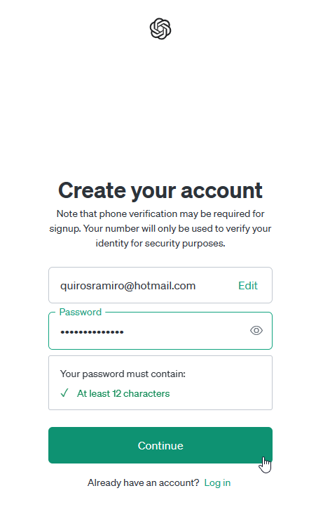
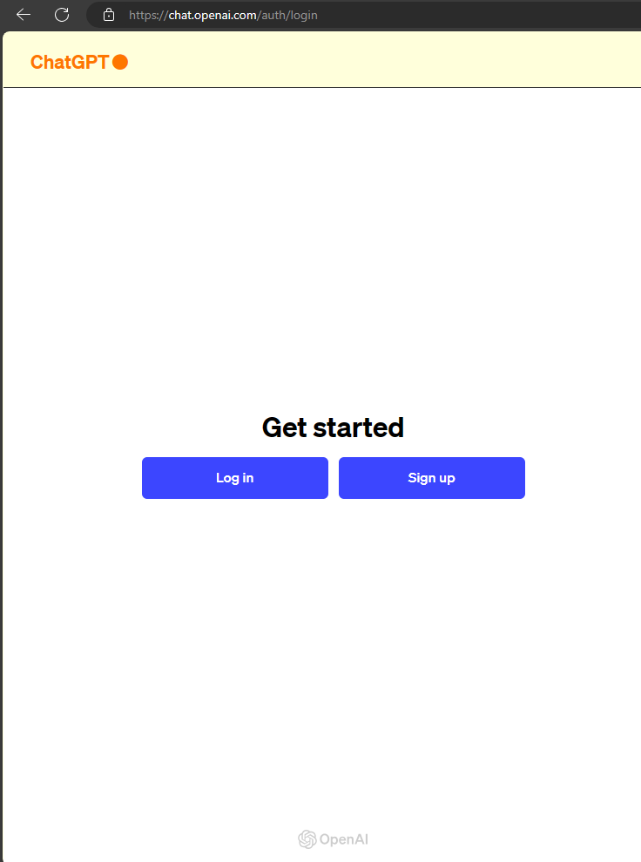
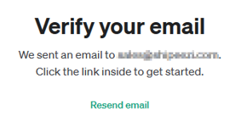
1
2
3

Slide 4
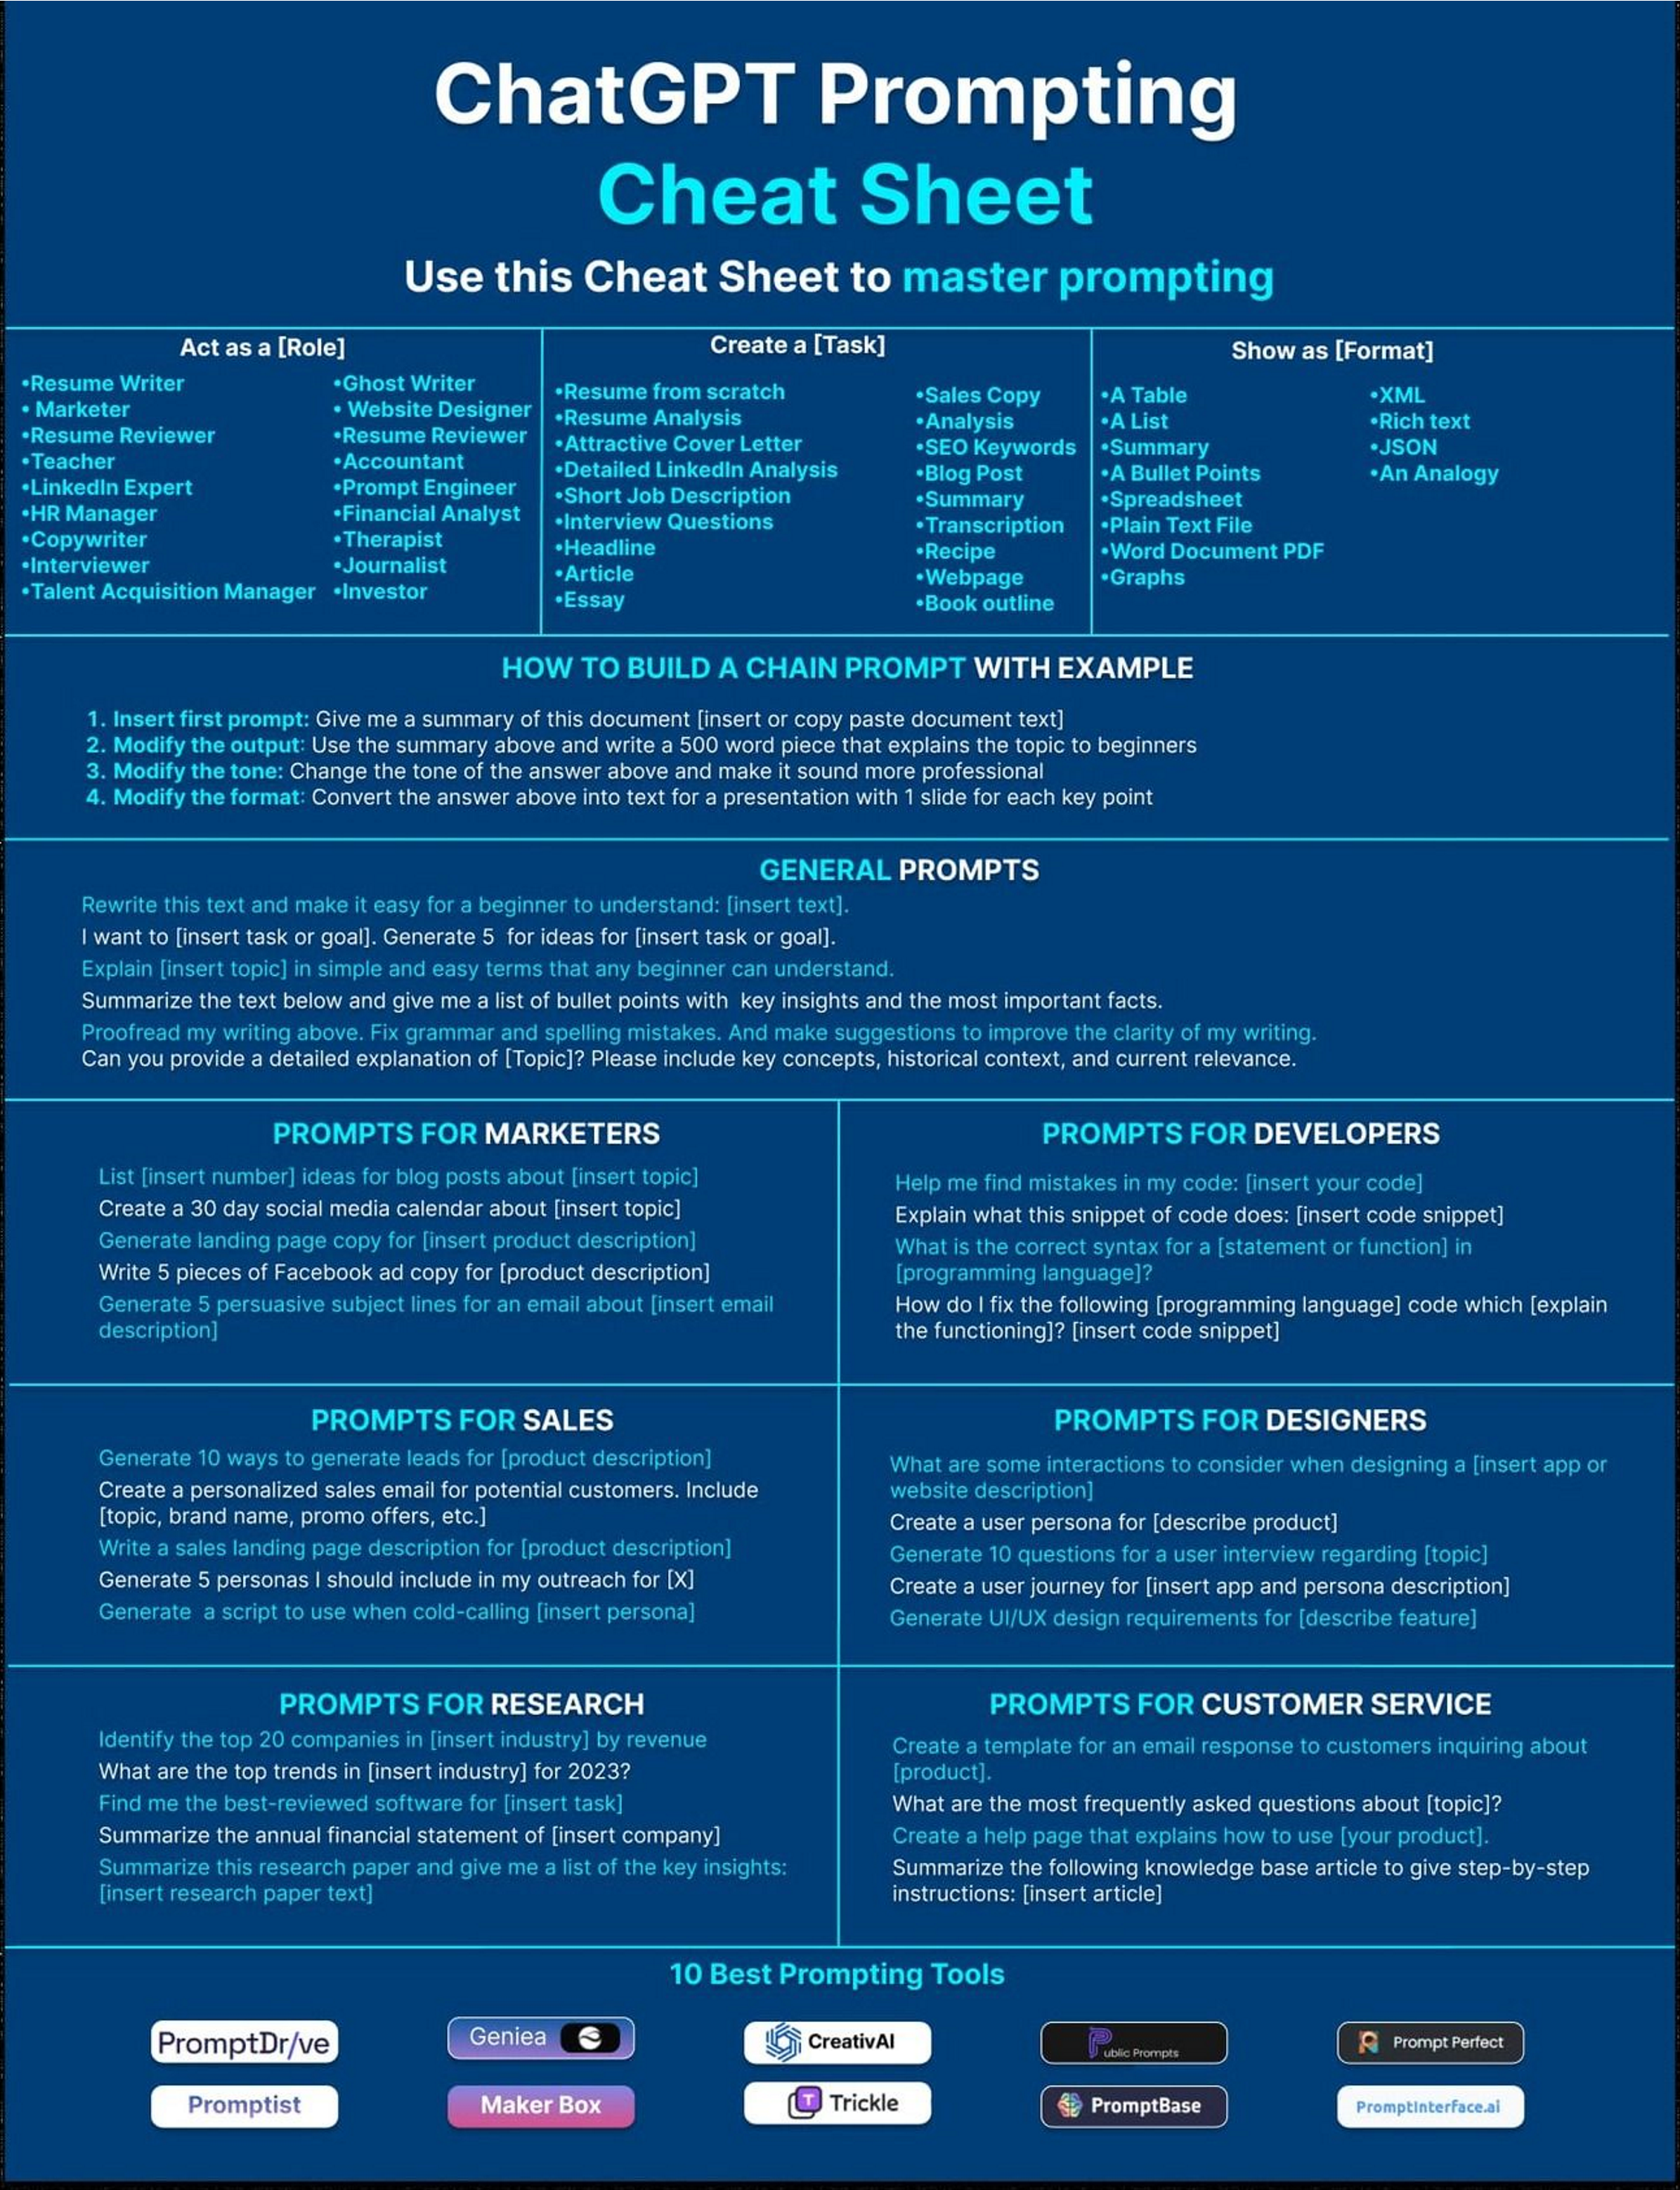
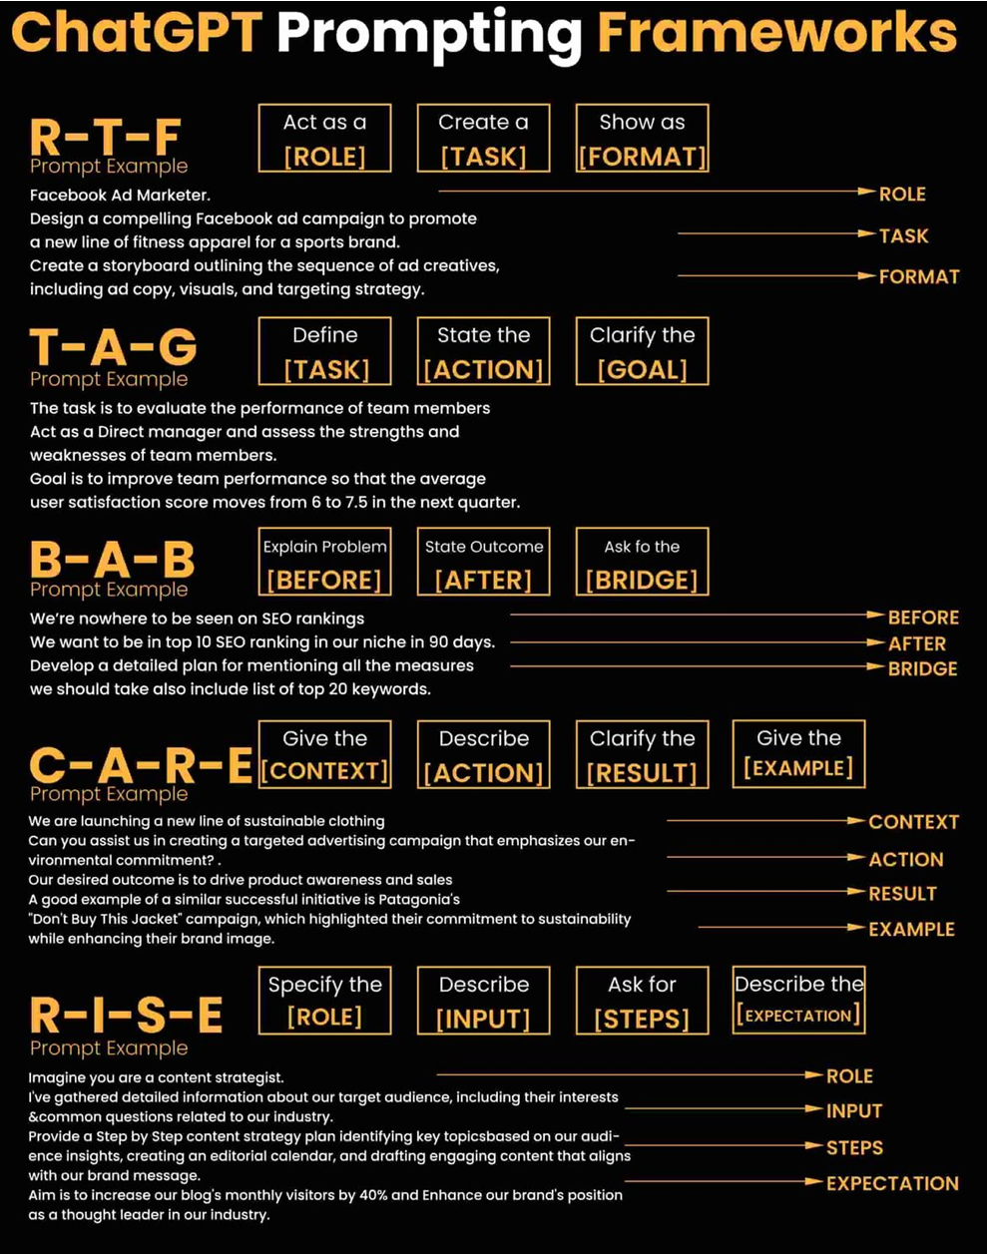

Slide 5
Copilot (Microsoft)
chat.openai.com/
OpenAI API
gemini.google.com/
GPT Prompting (mitenmit.github.io) | Prompt Builder - AI Text Prompt Generator.
Altern | Explore New AI Products and Tools.
TopApps.Ai | Top APPs Powered By Ai.
https://dreamyrooms.vercel.app/ |Redesign any room by applying design themes to pictures.
Spinach | AI Project Manager | Automates repetitive project management tasks.
https://syncly.app/ | Extract insights from customer feedback.
https://www.shortwave.com/ | Email automation.
Fireflies.ai | AI notetaker to transcribe, summarize, analyze meetings
findly.ai | AI-Powered Sales Growth

