Slide 1


ISMPP University
All according to plan: the ACcurate COnsensus Reporting Document (ACCORD) checklist from rationale to implementation
July 31, 2024
Webinar will begin promptly at:
11 AM ET / 4 PM GMT
Notes:
Hi everyone; welcome and thank you for joining today’s ISMPP U, “All according to plan: the ACcurate COnsensus Reporting Document (ACCORD) checklist from rationale to implementation.”
This webinar has been approved for 1.5 ISMPP CMPP Recertification Credit. Please capture a screenshot of the title slide to document for credit. We will show this again at the end of the webinar. You will also be sent a certificate of completion once the webinar concludes.

Slide 2





















ISMPP Would Like to Thank…
2
. . . the following Titanium and Platinum Corporate Sponsors for their ongoing support of the Society:
Notes:
First a sincere thank you to all of ISMPP’s titanium and platinum corporate sponsors for their ongoing support of the Society.

Slide 3

ISMPP Announcements
Application deadline for the September CMPP
exam is August 1
Notes:
And, for those who are seeking to become CMPP-certified or looking to renew your certification, The application deadline for the next exam window is August 1, 2024

Slide 4

ISMPP Announcements
NEW ISMPP Academy
Save the date: November 13-14, 2024
Where: Convene at Commerce Square, Two Commerce Square, Philadelphia, PA 19103
ISMPP Academy is a meeting that will deliver
best practices education to professionals:
• Who work at biotechnology, small pharma, and medical device companies •
• Who are newer to the field •
• Who want to build their expertise •
More details to come!
Notes:
Remember to Save the Date for the new ISMPP Academy, a Fall meeting format in Philadelphia this year, November 13-14. Be on the lookout, registration will open soon.

Slide 5
How To Ask Questions
Feel free to ask a question at any time, however all questions will be held until the end the of the presentation.
To ask a question, open the Q&A window, type your question into the
Q&A box. Click Send
Note: Check Send Anonymously if you do not want your name attached
to your question in the Q&A
We will make every effort to respond to all questions live (out loud)
Notes:
You can submit a question at any time during the presentation by following the instructions on this slide.
The faculty will answer questions at the end of all the presentations.

Slide 6
Disclaimer
Information presented reflects the personal knowledge and opinions of the faculty and does not necessarily represent the position of their current or past employers
Notes:
Please take a moment to read our general disclaimer.

Slide 7
Objectives
By the end of the session, Attendees will be able to explain:
The strengths and weaknesses of different consensus methods and the challenges this presents to reporting guidance
Why and how the ACCORD reporting guideline was developed
How the ACCORD guideline should be used
Notes:
Listed here are the learning objectives for today’s webinar.

Slide 8
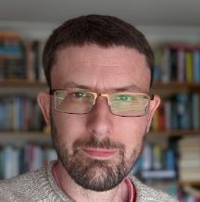
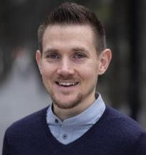
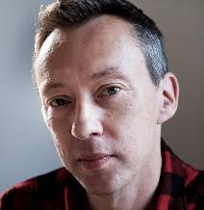
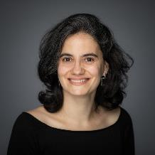
Today’s faculty
Niall Harrison (Chair)
Scientific Services Development Director, OPEN Health
Paul Blazey
Research Manager (University of British Columbia) Editor (Journal of Orthopaedic and Sports Physical Therapy)
Will Gattrell
Medical communications professional
Patricia Logullo
Local Network Lead - with RROX (Reproducible Research Oxford), University of Oxford

Slide 9
Agenda
When | What | Who
10 minutes | Introduction: why was ACCORD needed? | Niall Harrison
12 minutes | Consensus methods and the challenges for reporting guidance | Paul Blazey
10 minutes | The development of ACCORD | Will Gattrell
12 minutes | How to use ACCORD | Patricia Logullo
16 minutes | Discussion / Q&A | Moderated by Niall Harrison

Slide 10



Why ACCORD was needed
Consensus methods are recognised as being more reliable than individual opinions and experiences¹⁻³
The reporting of studies using consensus methods is often of poor quality⁴⁻⁷
Existing reporting guidance focuses on specific methods or study types^{8,9}
ACCORD: ACcurate COnsensus Reporting Document
1. Kurvers RH, et al. Proc Natl Acad Sci U S A. 2016;113(31):8777-82. 2. Surowiecki J. The wisdom of crowds. New York, USA: Anchor; 2004. 3. Woolley AW, et al. Science. 2010;330(6004):686-8. 4. van Zuuren EJ, et al. BMJ Open. 2022;12(9):e065154. 5. Blazey P, et al. Br J Sports Med. 2022;56(6):306-7. 6. Diamond IR, et al. J Clin Epidemiol. 2014;67(4):401-9. 7. Gupta UG. Technol Forecast Social Change. 1996;53(2):185-211. 8. Jünger S, et al. Palliat Med 2017;31:684–706. 9. Kirkham J, et al. PLoS Med. 2016 Oct 18;13(10):e1002148.
10
A comprehensive reporting tool was
needed because numerous methods are
used to assess consensus
Notes:
Consensus is widely used tool in medical research, including in clinical practice guidelines, diagnostic guidelines, disease classification, establishing research priorities, and developing core outcome sets … and developing reporting guidelines
Systematic reviews have found that current reporting of studies using consensus methods is poor, and we know that reporting guidelines can improve reporting quality
Delphi is probably the most widely used method of assessing consensus, but other methods such as NGT and RAND/UCLA appropriateness method are also common
The AGREE-II tool includes 23 items of which only one (‘Formulation of Recommendations’) relates to the method used to obtain consensus (Brouwers 2016)
The COS-STAR statement (Kirkham 2016) is specific to the development of core outcome sets; its methods section includes several items relating to the consensus process, but is specific to this type of study
The CREDES guideline (Junger 2017) is specific to Delphi and designed with a focus on palliative care, and AGREE-II
We therefore identified a need for a reporting tool with broad applicability

Slide 11



Examples of poor reporting
Criteria for participants
Panel composition
Recruitment strategies
Definition of consensus
Analysis procedure
Changes to protocol
Funding source
Other external support
Conflicts of interest
van Zuuren EJ, et al. BMJ Open 2022;12:e065154
Notes:
Lack of detail about methods – other reporting guidelines are about overall studies

Slide 12



ACCORD provides guidance for …
All types of consensus methods
All areas of biomedical research
Researchers anywhere in the world
Reporting consensus studies with greater clarity and transparency may enhance trust in the recommendations made by consensus panels
Notes:
And “all types” is key – leading into Paul’s presentation

Slide 13
Consensus Methods – When, Why and Which?
Paul Blazey

Slide 14
How did I become interested in consensus
Editor at BJSM
Journal with the most published consensus papers of any journal in biomedicine
High impact
Involved in several consensus projects (return to sport, IOC work, hip impingement, etc)
Known lack of rigor in how recommendations are derived
‘If you want to go fast, go alone’
‘If you want to go far, go together’
Notes:
Wanted to work together with ACCORD team to produce reporting guideline which colleagues and I had discussed prior to our awareness that the ACCORD group had already begun making strides towards producing the guidance.
See African Proverb

Slide 15
When to choose consensus methods
Where we lack evidence from research
Where existing research is in conflict or where we disagree on its application
Where we wish to reduce research waste

Slide 16
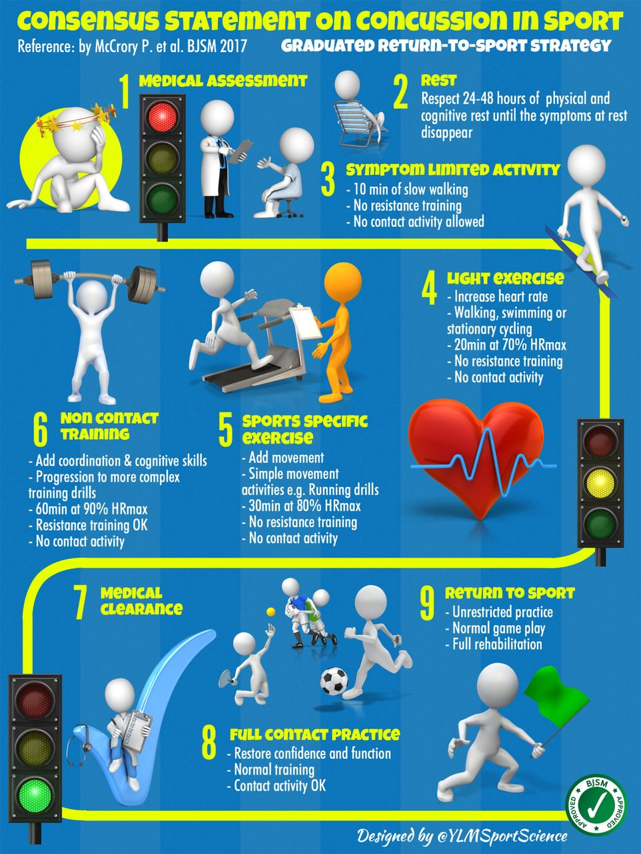

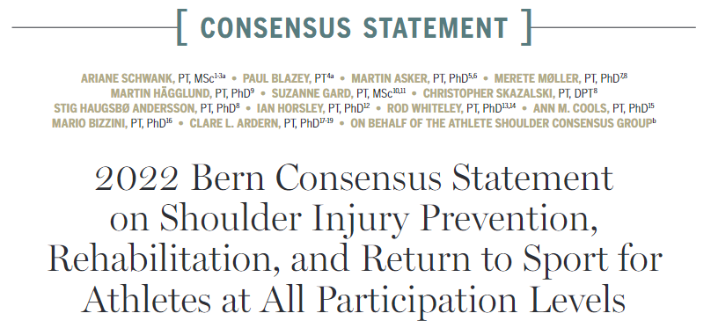

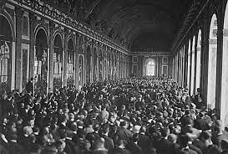
Examples include …
Examples include consensus being used to produce
Definitions, terminology or taxonomy
Practice guidelines
Priorities for future research, and more
Notes:
Consensus in a much wider context than biomedicine includes political and international relations problems. Often unanimous agreement is unrealistic which is important to consider with what I mentioned about reporting consensus methods later.

Slide 17
Audience Poll
Have you ever used consensus methods?
Yes
No
Not sure
Notes:
Orange writing can be removed.
Will be interesting to see familiarity of the audience but also to point out that informal agreement is constantly in use. Consensus generation = negotiation / discussion, just some methods are more formal that others.

Slide 18
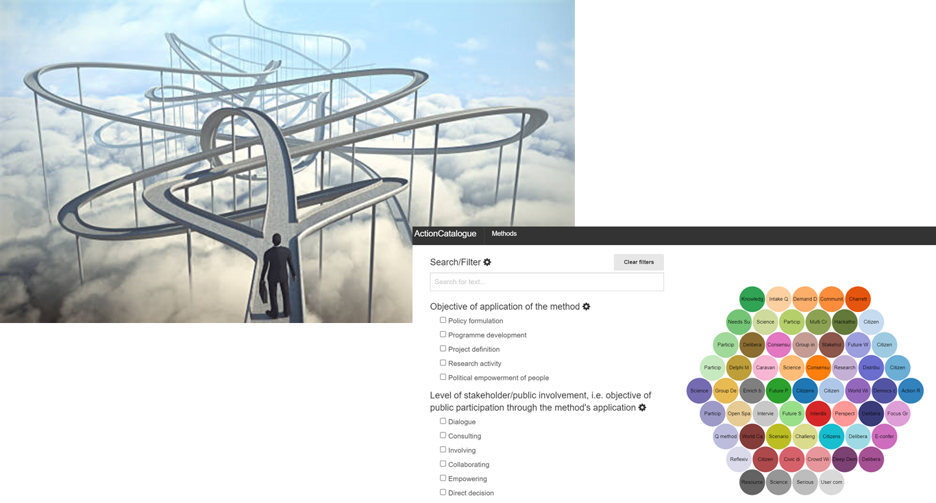
Examples of consensus methods
Most common:
Delphi (or modified-Delphi)
Nominal Group Technique (NGT)
RAND-UCLA
But we could …
Notes:
Note many ways to arrive at agreement
NIH consensus conferences to harness expert opinion from large groups of members (informal or count data)

Slide 19

Delphi (or modified Delphi)
Delphi is a cold-war relic (name courtesy of Greek mythology)
Forecasting tool for cold-war manoeuvres later repurposed by RAND (Dalkey, 1967)
Benefits:
Large/diverse numbers
Anonymity
No travel necessary
Easy to manage & measure agreement
Drawbacks:
Highly dependent upon questions Feedback can lead to ‘groupthink’
Often large time commitment

Slide 20
Key tenets of a Delphi
Three ‘rules’ that need to be adhered to for a method to be a true Delphi
Anonymity
Iteration
Structured feedback
Very (and I mean ‘very’) often at least one is broken without rationale

Slide 21
Nominal Group Technique
Originated in the social sciences in the 1960’s – Delbecq & Van de Ven
‘nominal’ – in name only
Need an effective facilitator (Delbecq vs Glaser techniques)
Benefits:
High number of new ideas
Drawbacks:
Can be dominated by individuals
Often lacks group diversity
Notes:
5 to 12 participants – ideally odd number for majority vote
-> Classically 30 mins of silent idea generation – allows for discussion – round robin feedback (one at a time) -> themes grouped.
Finally ideas voted to the top (anonymous)

Slide 22

RAND-UCLA Appropriateness Method (RAM)
Weighs treatment costs vs benefits
Scores from 1 to 9 (9=benefit, 1=harm)
Multiple scenarios provided
Round 1 anonymous, Round 2 is in person -> ‘Appropriate/Uncertain/Inappropriate’
Benefits:
Rigorous scoring and agreement
Drawbacks:
No forum for new ideas
Needs existing data to create the initial questionnaire & case scenarios (Fitch et al. 2001)
Notes:
Usually has 9 panellists to resolve differences – helps discussion but ‘good enough’ for diversity
Still need a good facilitator

Slide 23
What is often forgotten
Consensus based approaches have mixed ontological (nature of reality) and epistemological (what counts as knowledge) underpinnings
Quantitative and Qualitative, Positivist vs Constructivist
NO Gold Standard – your method will depend on the goal of the exercise, resources, personnel involved, etc.
Notes:
Positivist vs Constructivist underpinnings mean that quantitative researchers need an open mind to interpret consensus approaches
‘normative’ data from “experts” therefore you have to accept that there is no single ‘truth’

Slide 24


Lots of uncertainty
Notes:
Which method to choose, why, how best to employ it, etc…

Slide 25
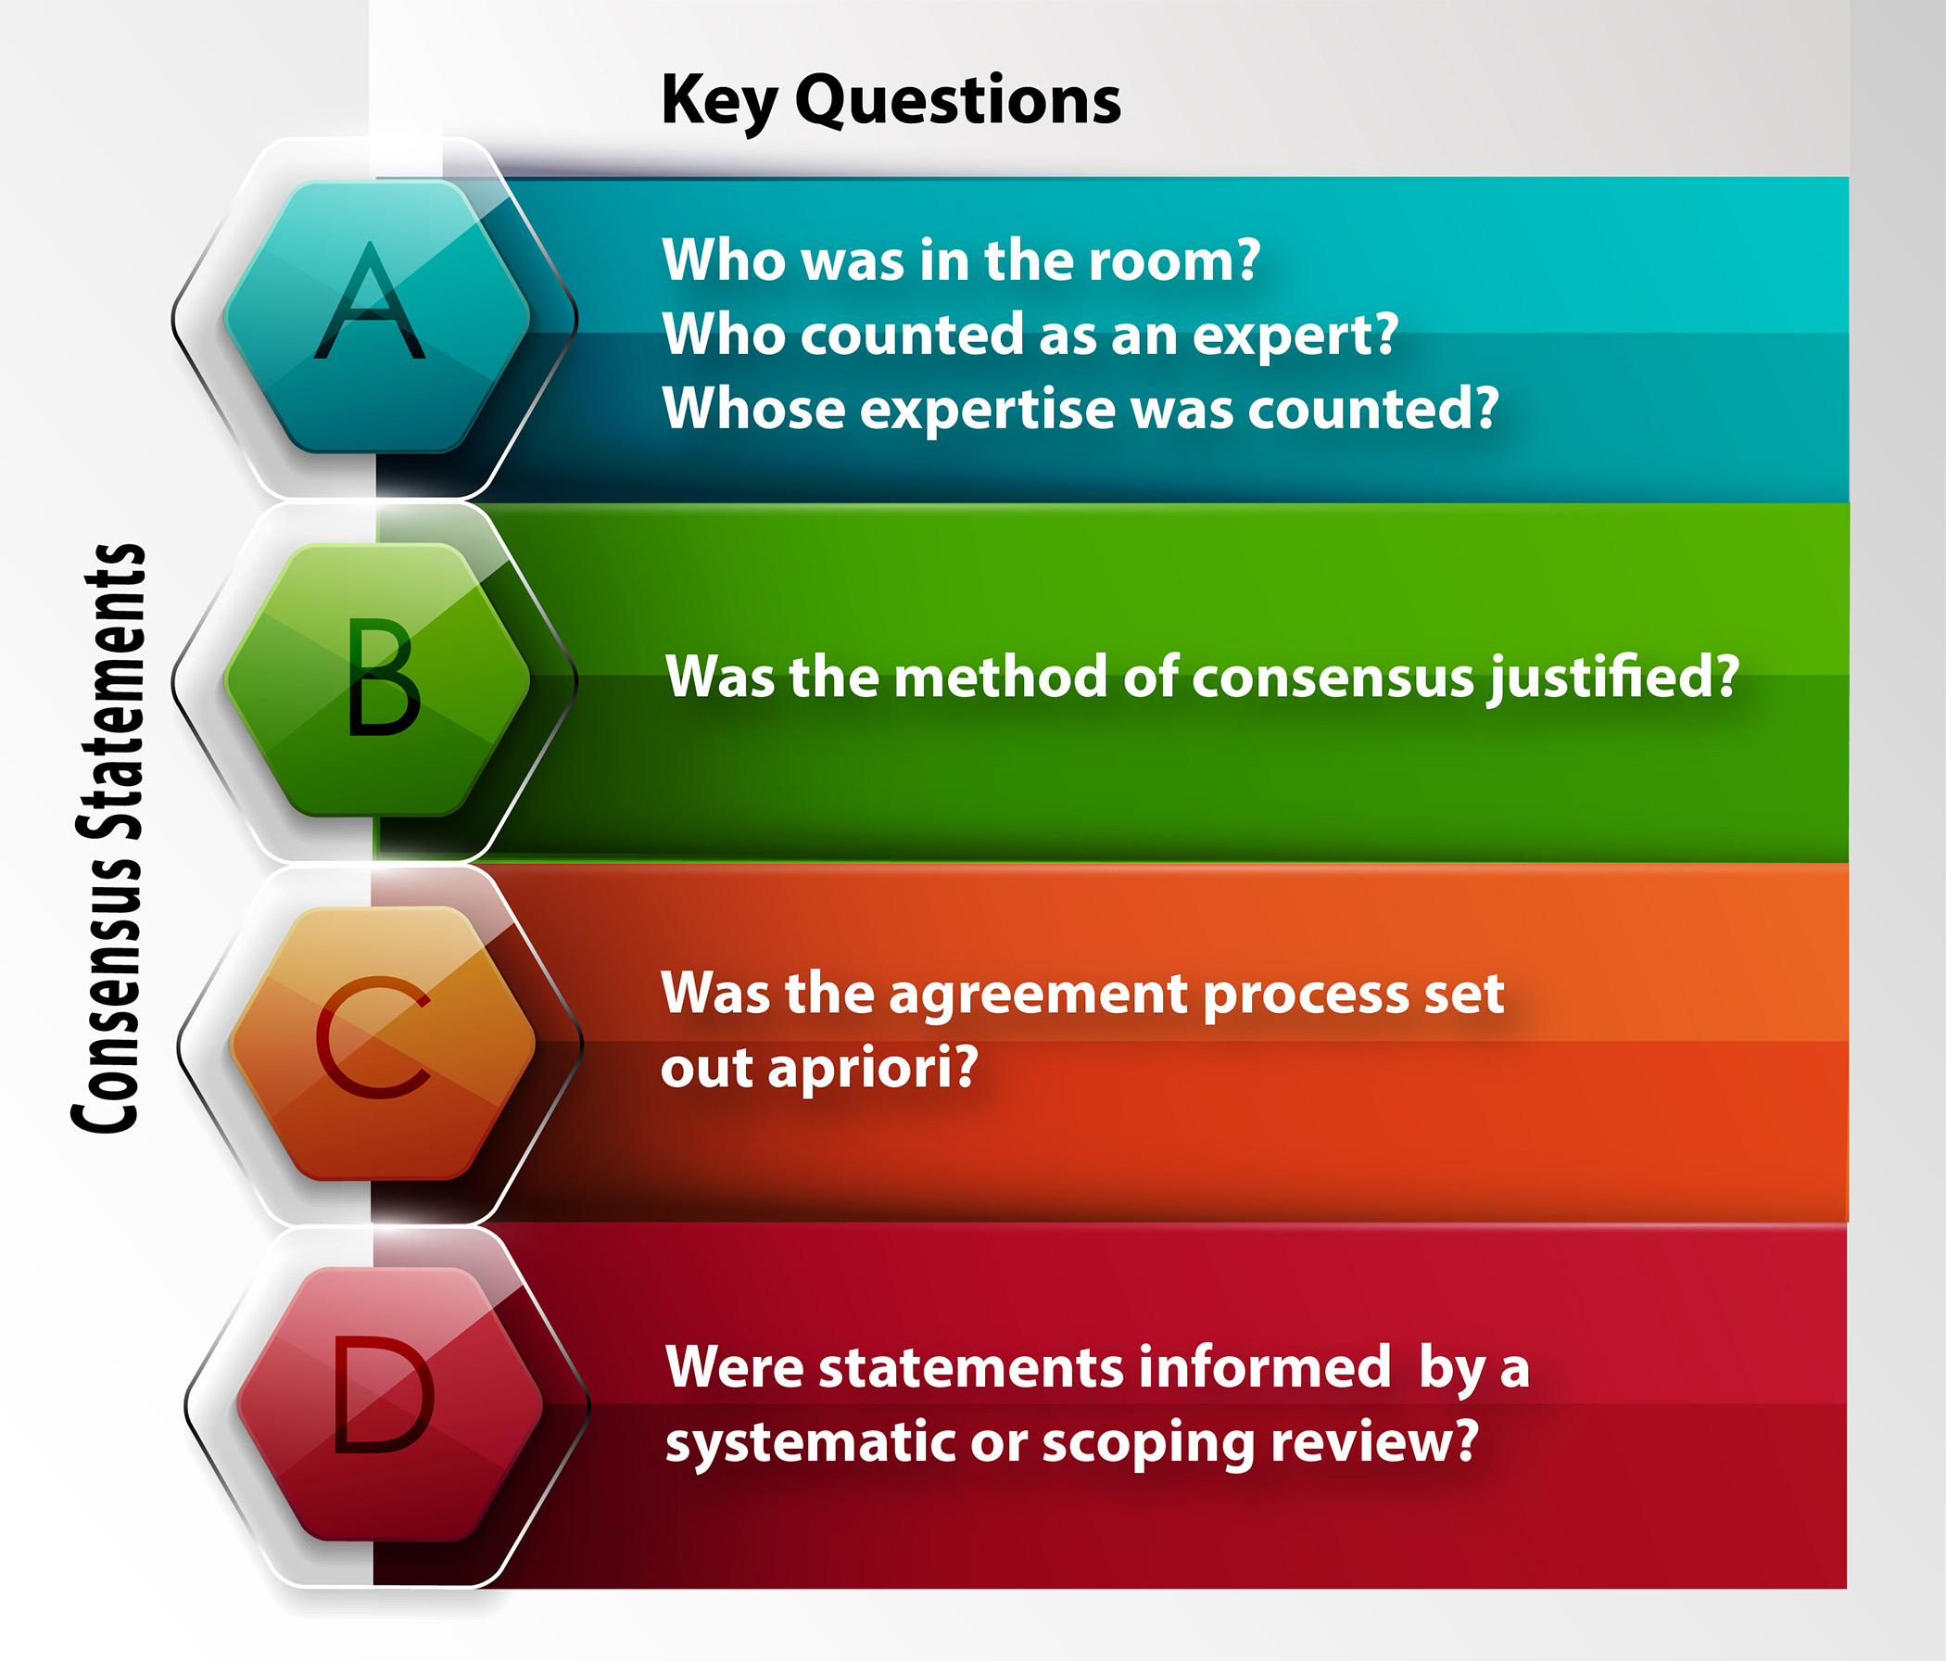
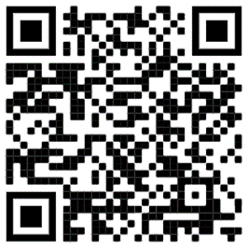
Improving rigor in consensus methods
‘It is time for consensus on consensus statements’
https://bjsm.bmj.com/content/early/2021/10/13/bjsports-2021-104578
Notes:
Our recent editorial helped to outline some of the key concerns over consensus statements.
We outlined in the figure some of the questions you might want to ask yourself when choosing a method and making it rigorous.
I will outline two common concerns that are not addressed in the literature but if ignored can call into question the rigor of your methods.

Slide 26
Did the method match the aim
Most common choice is Delphi (> 80% of medical education studies, but similar across fields)
Lack of discussion in ‘true’ Delphi means that agreement can miss nuance
If you have a highly controversial topic, it’s likely people will want the details

Slide 27
Audience Poll
I want to define the ‘meaning of life’ and I’ve assembled the best experts from every field and across every continent. Which method should I choose?
Delphi
RAND-UCLA
NGT
Other
Notes:
Exercise to highlight that all methods are fine BUT it should be clear WHY you choose one.

Slide 28
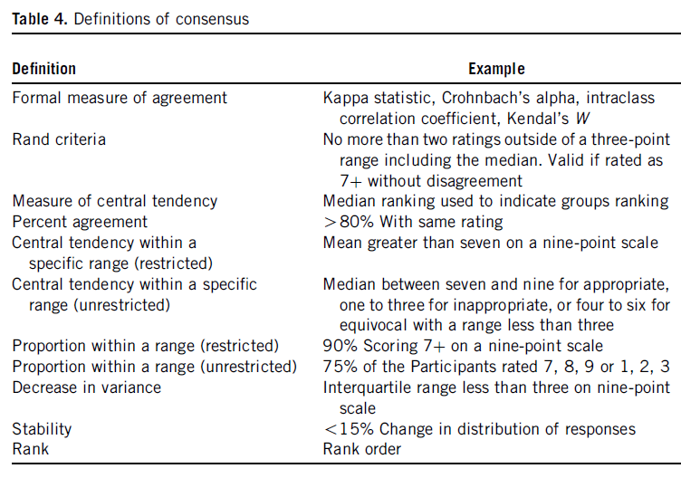
What constitutes agreement?
Should we expect unanimous agreement?
What threshold is enough?
Needs to be reported (and agreed before you start!)
Notes:
Consensus for consensus stake – many studies don’t define what they consider agreement
Heterogeneity of approaches and often not defined beforehand
If defined as a set number of rounds then can artificially give the pretense of agreement and can mislead the audience (some fail to report the level of agreement altogether)

Slide 29

Q. When is consensus achieved?
When everyone gets hungry

Slide 30
Summary
Lots of methods
No gold standard
Heterogeneity of methods means it is vital we understand what decisions were taken and how they were made
Understanding of the level of rigor can help us to make a ‘trust’ judgement on the recommendations

Slide 31
The Development of ACCORD
Will Gattrell

Slide 32
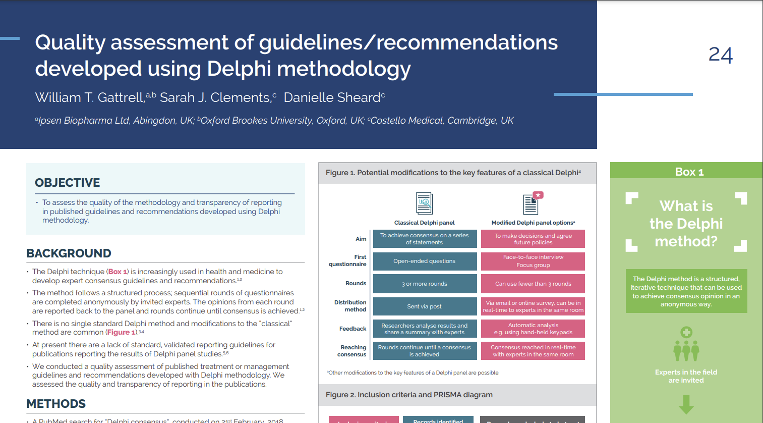
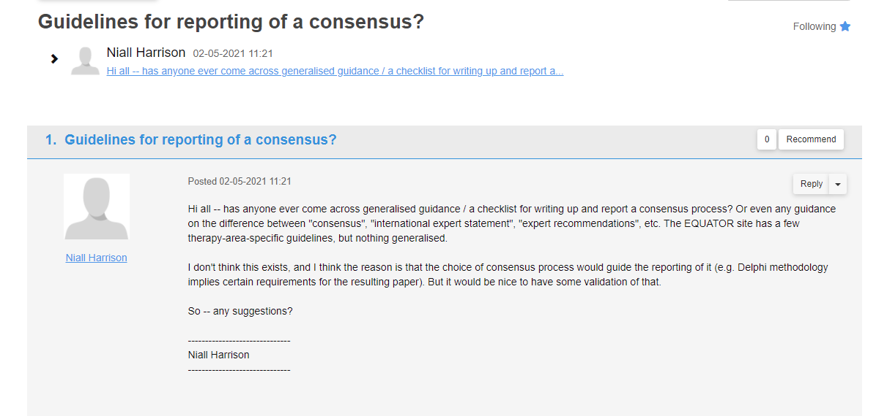
How it all began

Slide 33
How to develop a reporting guideline?
“In this paper we update and expand upon an earlier effort to outline a strategy for developing reporting guidelines… We recognize that there is no single best or correct approach.”¹
Moher D, et al Guidance for Developers of Health Research Reporting Guidelines. PLoS Med 2010 7(2): e1000217
Also see: https://www.equator-network.org/toolkits/developing-a-reporting-guideline/developing-your-reporting-guideline/

Slide 34
Survey of guideline developers (2008)¹
On average, guidelines took 20 months to complete (range: 3–62) plus 11 months to publish (range: 0–30)
Median number of participants was 22 (range: 1–118)
  7% of guidelines were developed by a single person
Only 50% and 57% had implementation strategies to increase uptake by authors and journals, respectively
The authors estimated that the cost of guideline development was ~£50,000 (2008 figure)
1. Simera I, et al. Guidelines for reporting health research: The EQUATOR Network’s survey of guideline authors. PLoS Med 2008 5(6): e139

Slide 35
Project overview and timeline
2021
2022
2023
2024
ISMPP endorsement
EQUATOR
and OSF registration
Protocol published¹
SLR
SLR published²
Draft checklist
Guideline submitted
Guideline published³
Delphi invites
Delphi
surveys
Final checklist
ACCORD website
Pilot study
Journal endorsement
E&E published⁴
Implementation plan
E&E, explanation and elaboration; OSF, open science framework; SC, steering committee; SLR, systematic literature review
Gattrell WT, et al. Res Integr Peer Rev. 2022;7(1):3.
van Zuuren EJ, et al. BMJ Open. 2022;12(9):e065154.
Gattrell WT, et al. PLoS Med. 2024 Jan 23;21(1):e1004326
Logullo P, et al. PLoS Med. 2024 May 6;21(5):e1004390
Notes:
The ACCORD protocol drew on EQUATOR recommendations and set out a number of stages; there were some small adjustments but these remained the framework of the project
The first stage took place between May 2021 and August 2022, and was to define the project methodology, including its scope and the composition of the steering committee and delphi panel
The protocol received endorsement from ISMPP, was registered on the OSF, and ultimately published in research integrity and peer review
Three key benefits – provided clarity on our goals; established a baseline for our approach that we could refer back to (even if we later modified it); and started to raise awareness of the project
The second stage took place between November 2021 and September 2022, and was to conduct a systematic literature review to confirm the need for ACCORD and identify existing relevant research into the quality of consensus reporting
The results indicated a clear need to improve the quality of reporting of consensus methods, particularly around areas such as panel composition, definition of consensus, roles and responsibilities, and conflicts of interest
From the results, a preliminary list of reporting statements was created; retrospective analysis confirmed that this included the majority of topics that would be in the final checklist
The third stage took place between May 2022 and March 2023 and was to agree and refine checklist items
Initial items from the SLR were reviewed and refined by the SC over the course of two surveys
A delphi panel was recruited, aiming for broad range of expertise and geography, and a three-round delphi process was conducted to finalise the checklist
The fourth stage is the creation and dissemination of the final reporting guideline, together with supporting activity, and is ongoing; the E&E has been recently submitted
As we used a consensus process in this project, we have aimed to meet the standards of reporting that we are proposing!

Slide 36

How the checklist evolved
SLR¹
Extraction form (n=30)
Other items (n=26)
56
items
Steering committee
surveys
41
items
36
items
Steering committee
meeting
35
items
Delphi panel
Item origin
10 new items
proposed
25 items
excluded or
lost on merging
7 new items
proposed
7 items
excluded; 5
lost on merging
1 item (PPI)
reinstated
2 items
lost on merging
SLR (n=29)
Steering
committee (n=5)
Delphi
panel (n=1)
SLR, systematic literature review; PPI, public patient involvement
1. van Zuuren EJ, et al. BMJ Open. 2022;12(9):e065154

Slide 37
Implementation plan
Fully open access publications
Supporting materials and workshops
Charter for long-term oversight: updates, translations etc
Website, logo, social media, press release
Identify and target key stakeholders for around adoption
Pilot study

Slide 38
Lessons learned
Developing a reporting guideline is a considerable undertaking
Steering committee and Delphi panel:
  Define expertise and expectations; be inclusive
A high-quality SLR set the project up for success
Communications and transparency:
  Publish protocol, register on EQUATOR network, raise awareness
Long-term project management needed
  Map out the entire process; establish workstreams & run in parallel
The work doesn’t end when the guideline is published
  Implementation plan is crucial to success
SLR, systematic literature review

Slide 39
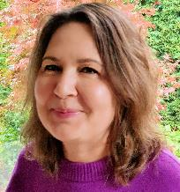
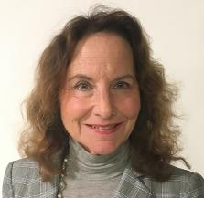
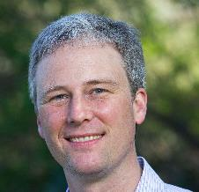
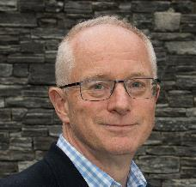
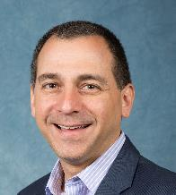
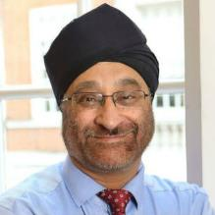

ACCORD steering committee
Will Gattrell
Medical publications professional
Niall Harrison
OPEN Health
Patricia Logullo
University of Oxford and EQUATOR
Esther J. van Zuuren
Leiden University Medical Centre
Amy Price
The Dartmouth Institute for Health Policy & Clinical Practice, Patient Editor, BMJ
Paul Blazey
University of British Columbia, Vancouver, Canada
Christopher C. Winchester
Oxford PharmaGenesis
David Tovey
Journal of Clinical Epidemiology
Keith Goldman
AbbVie
Sir Amrit Pali Hungin
University of Newcastle
Ellen L. Hughes
Camino Communications
39
Notes:
WG and NH founded the ACCORD project, seeking endorsement from the International Society of Medical Publication Professionals (ISMPP) in April 2021. ISMPP provided practical support and guidance on the overall process at project outset but was not involved in checklist development
The ACCORD Steering Committee, established over the following months, was multidisciplinary in nature and comprised researchers from different countries and settings. Potential members were identified via ISMPP, literature research, professional connections and network recommendations.
PB joined the Steering Committee in September 2022 as a methodologist to support the execution of the ACCORD Delphi process and provide additional expertise on consensus methods.

Slide 40
How to use ACCORD
Patricia Logullo

Slide 41
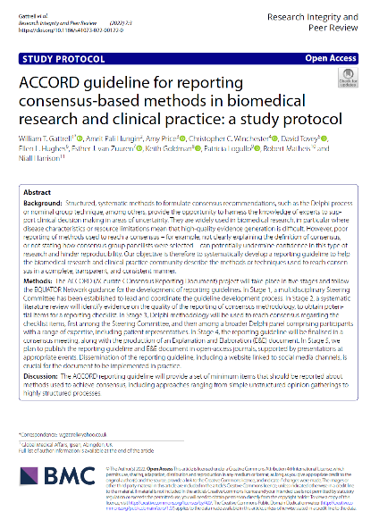
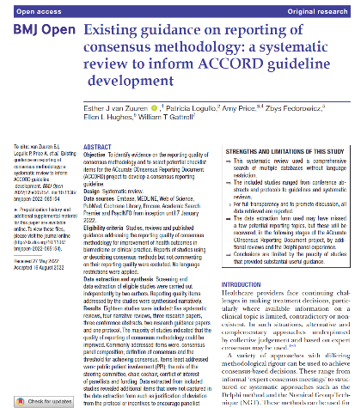
ACCORD: initial publications
Protocol
^{PMID 35672782}
Systematic review
^{PMID 36201247}
Notes:
A reporting guideline developed using open science principles generates several publications. The protocol declares how we planned to develop it. A systematic review gathers the evidence available on reporting. This is valid for ANY reporting guideline, not only ACCORD, but here are the documents that show we were doing our homework! ☺

Slide 42
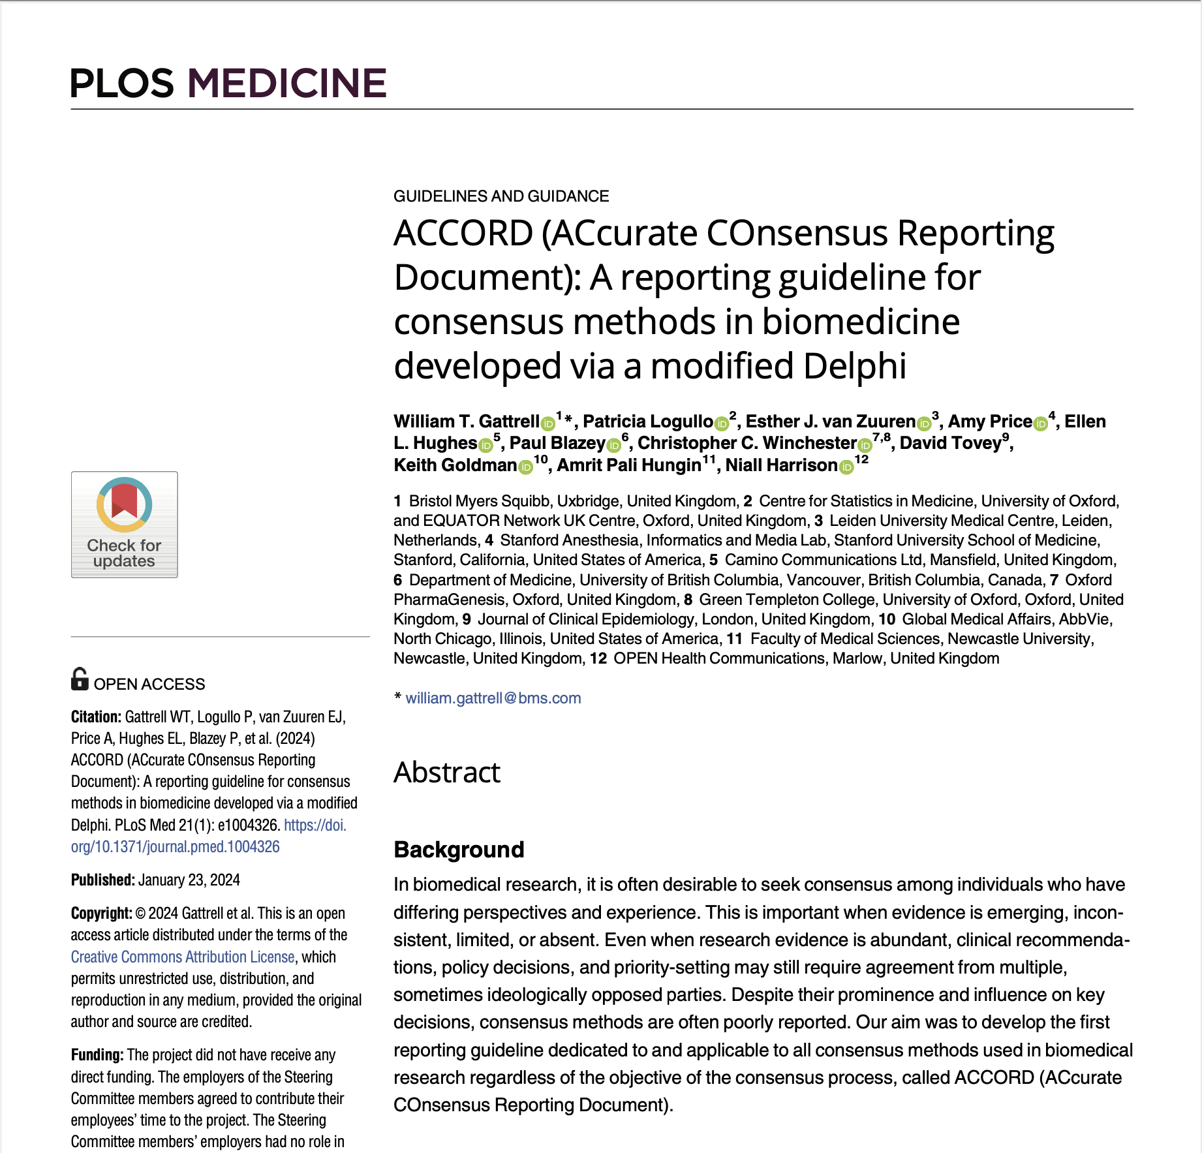
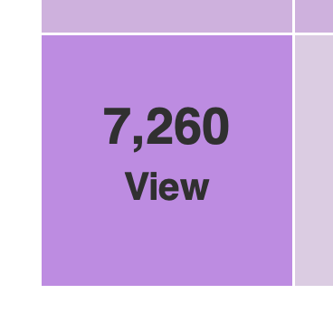
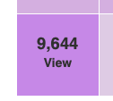
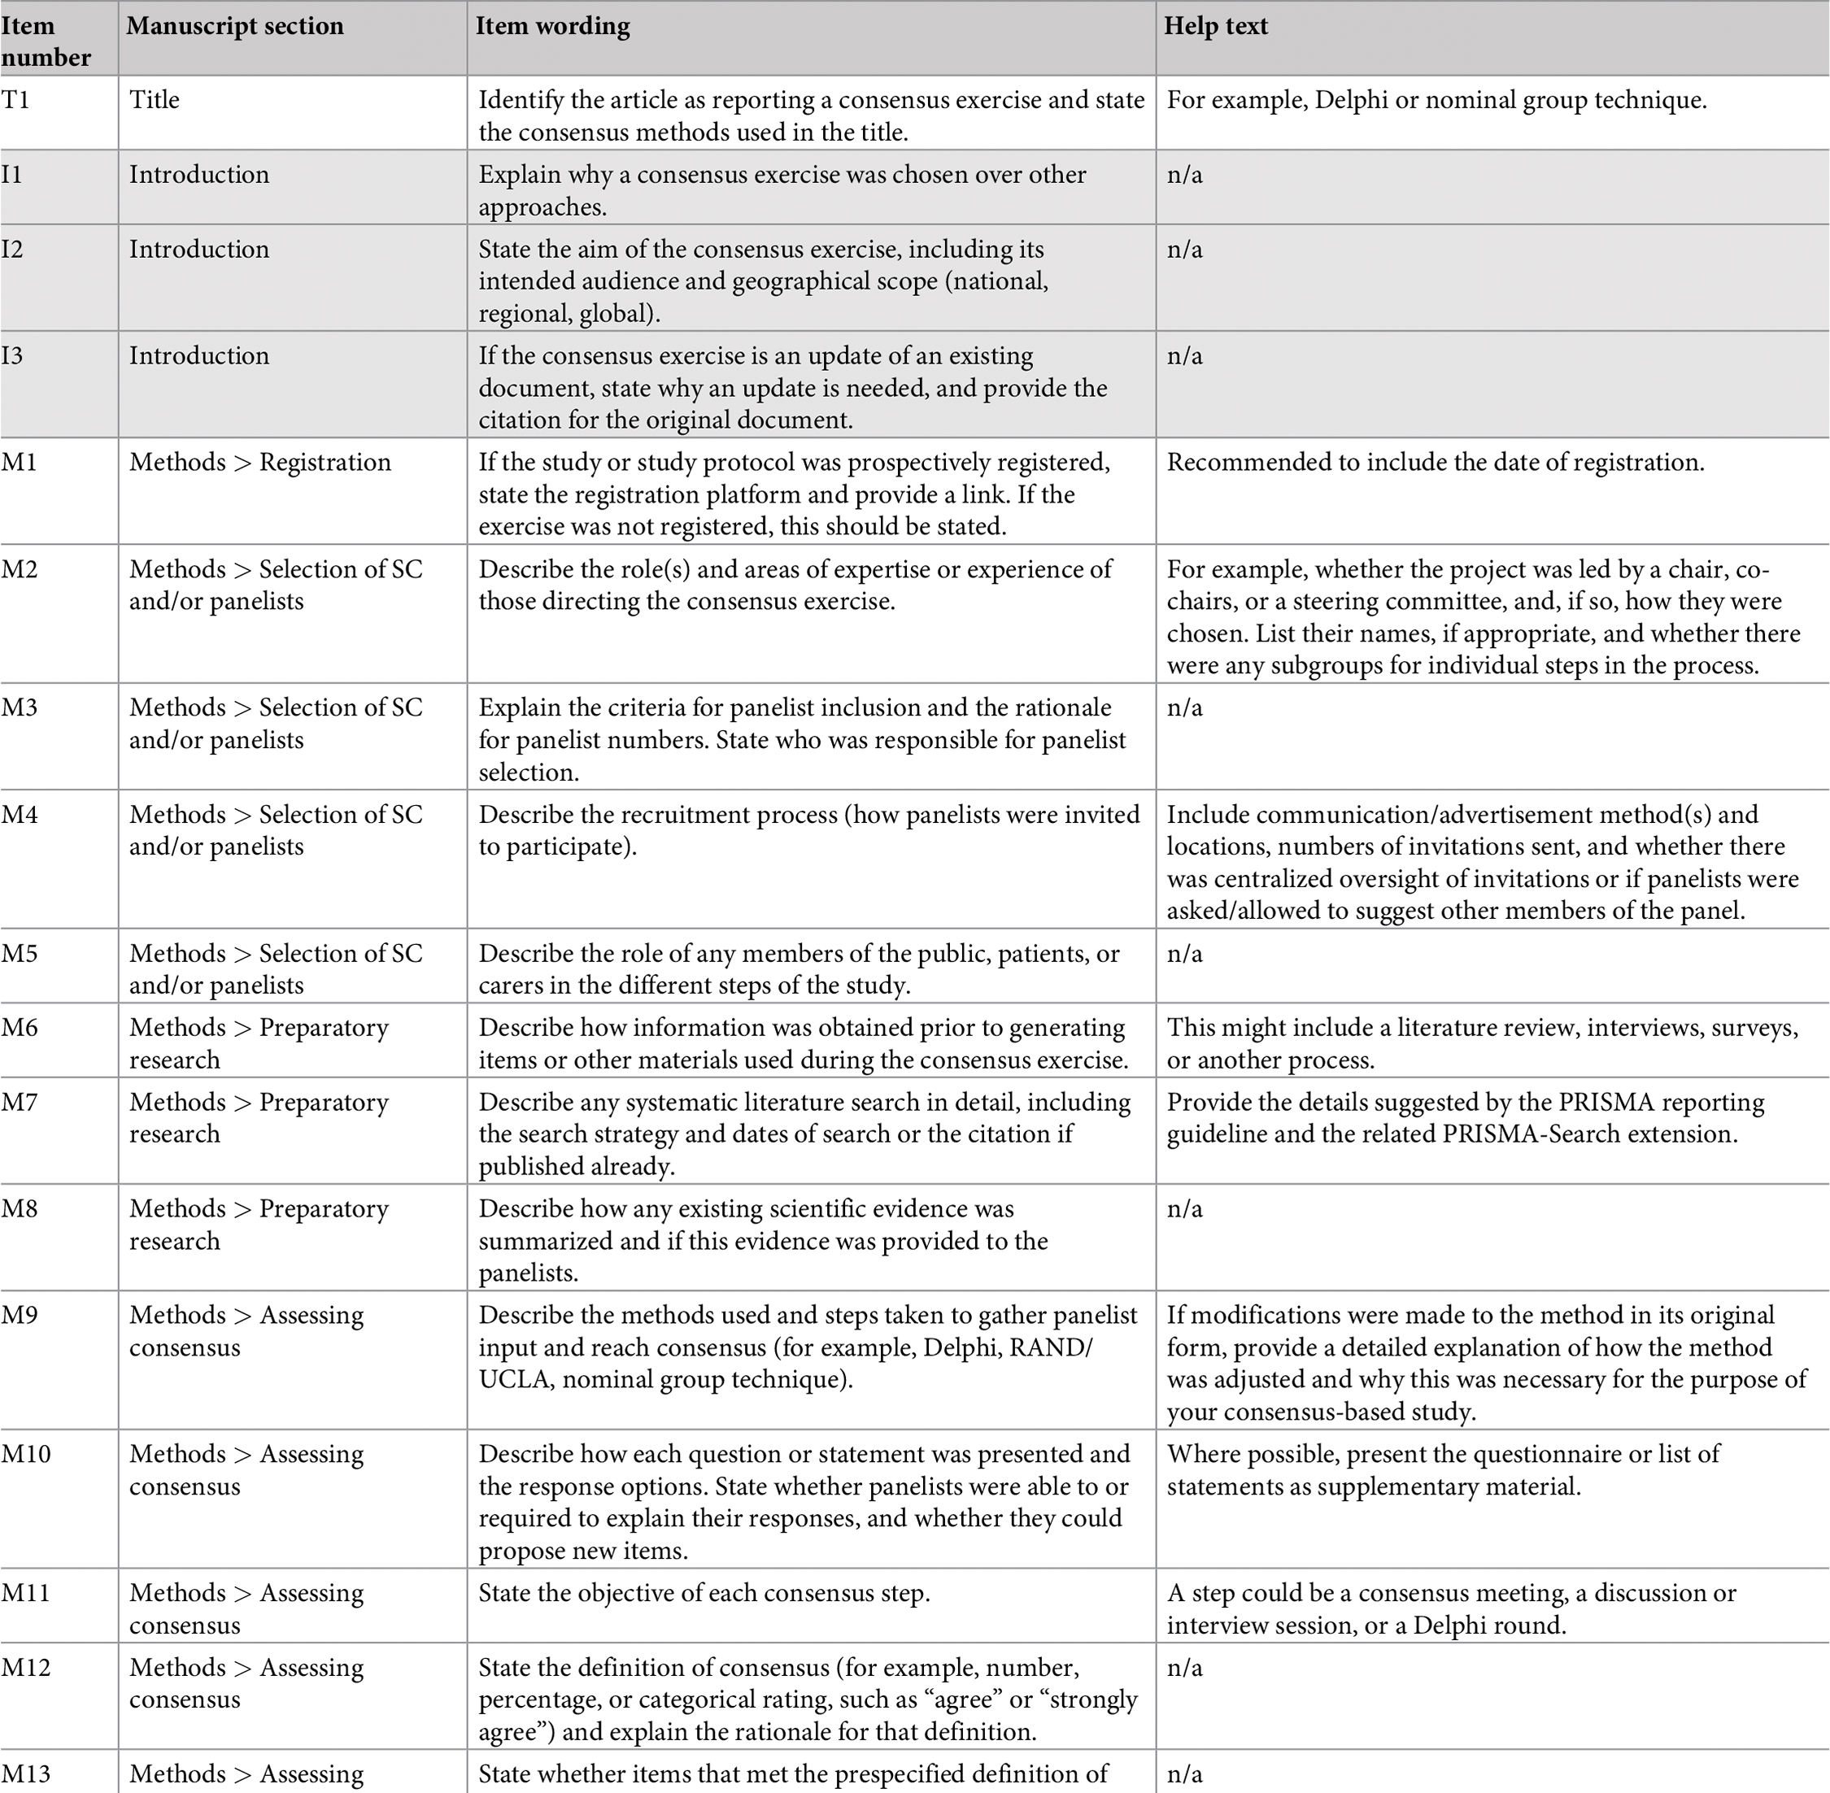
ACCORD: statement publication
Statement
^{PMID 38261576}
Notes:
Then the main document you are all probably familiar with for any reporting guideline is the statement, that briefly tells the story of how it was developed and finally gives you the beloved checklist. All main reporting guidelines we know have a statement paper with the checklist. In May, when I spoke in Valencia for EMWA, we had over 7 thousand views, for a document published in January. Now it is over 9k views. Good job everyone! But we are in the wrong habit of looking ONLY at the checklist. If you use the PMID here in Pubmed you can access it in your phones and computers now. You will get to the checklist in Table 4.

Slide 43
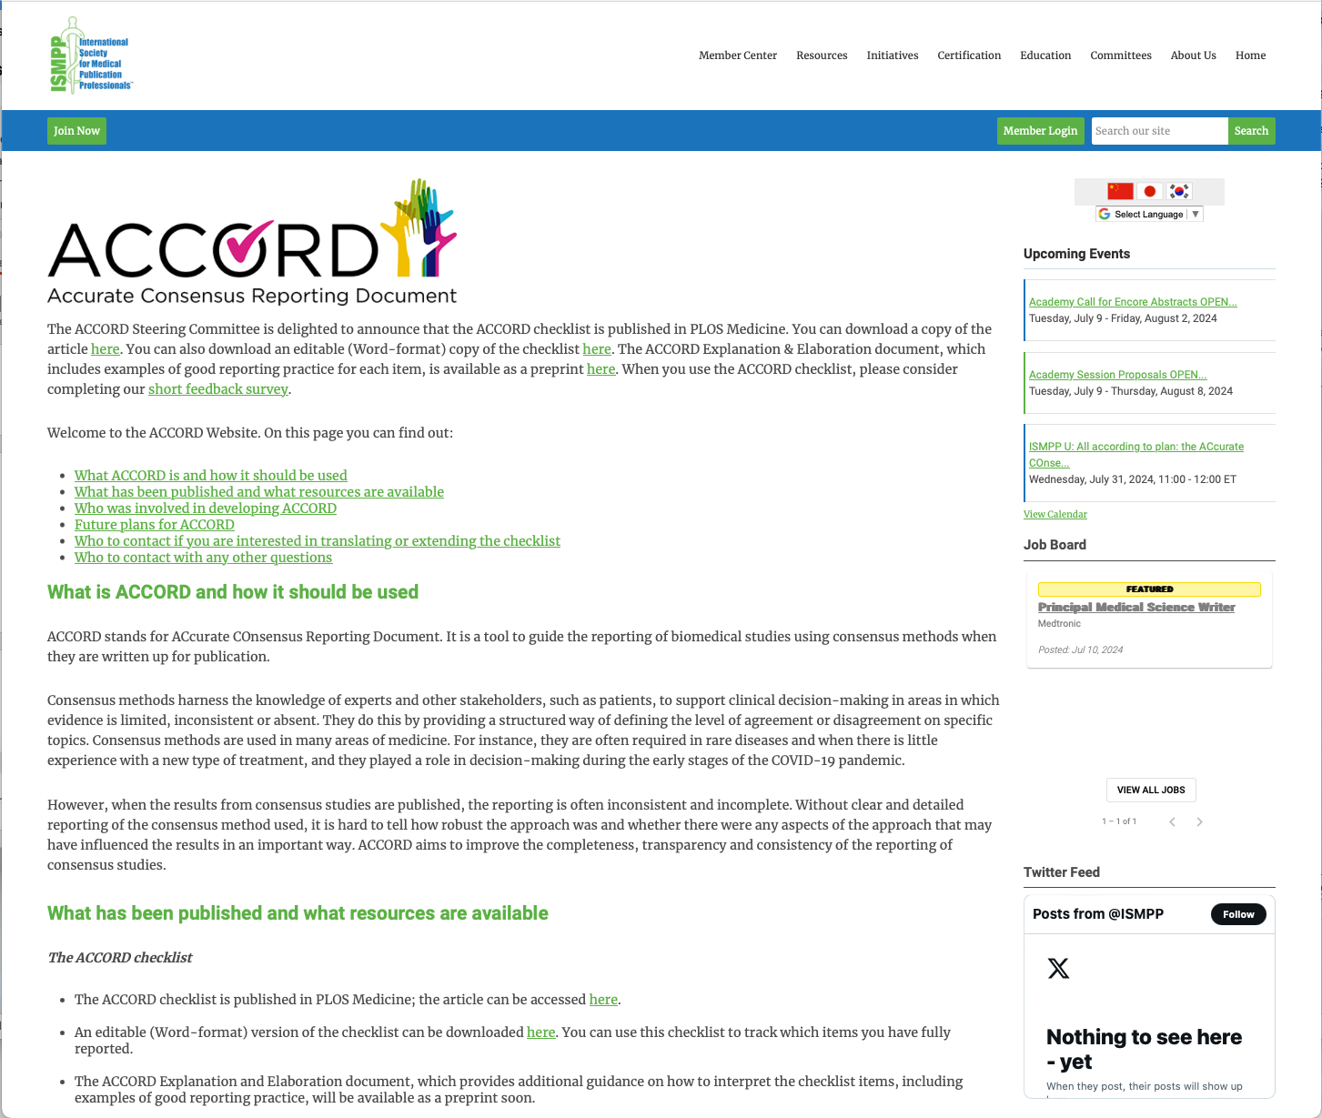
ACCORD website
https://www.ismpp.org/accord
Notes:
Alternatively, and in the future, when you need a fillable checklist in a Word document, you can go to the ISMPP website.

Slide 44
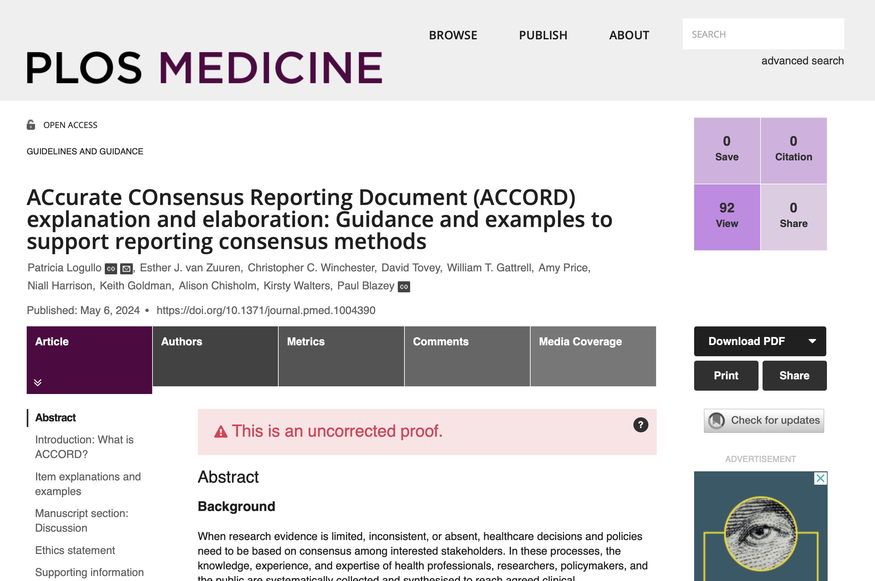
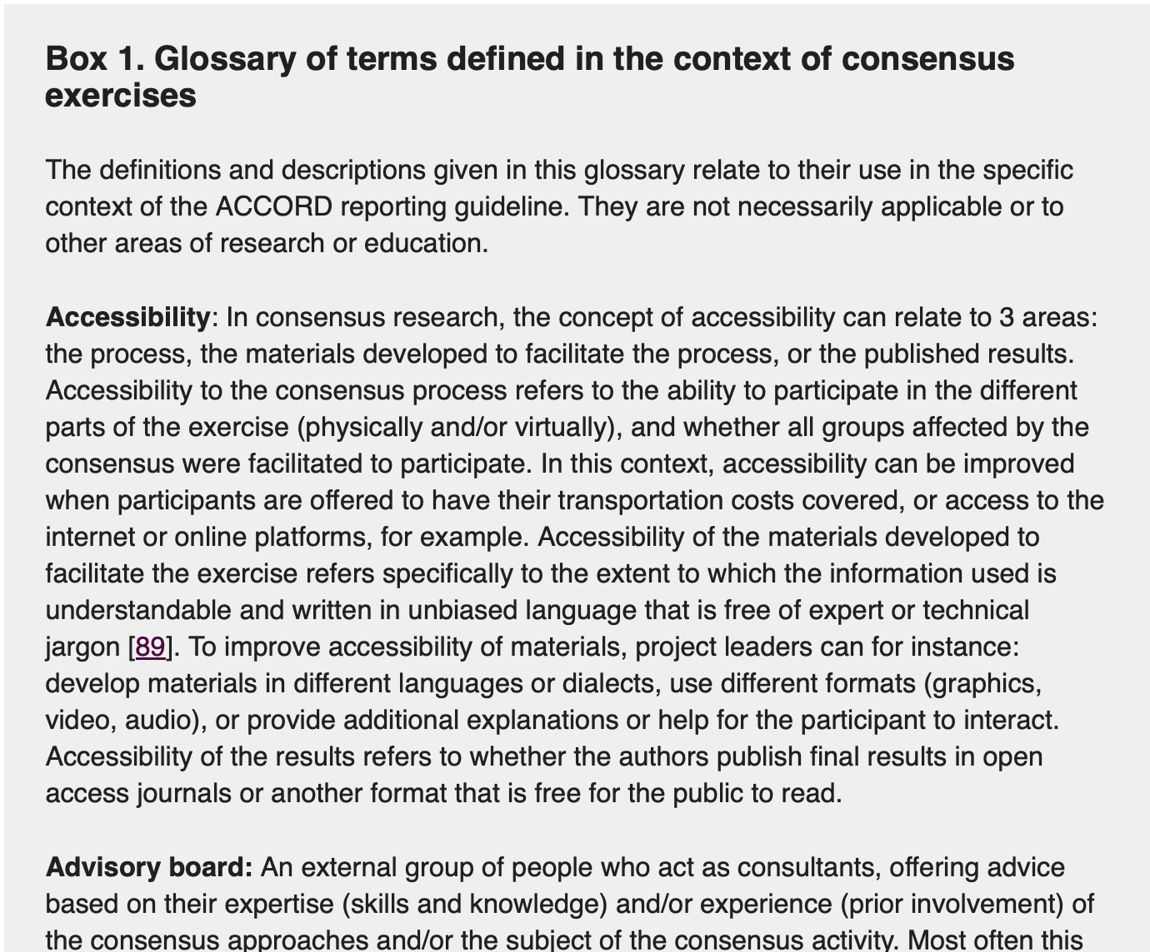
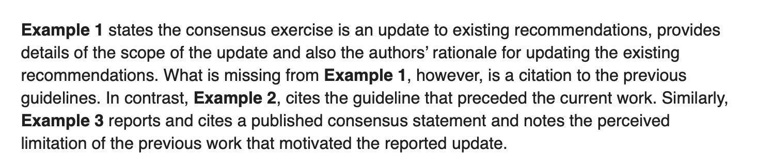
ACCORD explanation and elaboration
Notes:
A document which is very useful, for any reporting guideline, is the E&E, the explanation and elaboration document. It is much longer, but it is very useful for you to find two things: first is an explanation on WHY that item is important to report. When you understand that — if you had any doubt — it makes the reporting job MUCH easier. The other is…. Drum roll… EXAMPLES. The ACCORD E&E is coming, and it will give you both explanations, examples, and a glossary.

Slide 45
Why use the E&E
There is a lot of information inside each checklist item.

Slide 46
For example…
M3. Explain the criteria for panellist inclusion and the rationale for panellist numbers. State who was responsible for panellist selection.
Notes:
Let us look at this particular item of ACCORD. Let us try to find out what is inside it.

Slide 47
What are the pieces of information that need to be reported?
M3. Explain the criteria for panellist inclusion and the rationale for panellist numbers. State who was responsible for panellist selection.
Notes:
Can you tell me (or pop in the chat) what is the first piece of information ACCORD is asking you to report in this item?

Slide 48
M3. Explain the criteria for panellist inclusion and the rationale for panellist numbers. State who was responsible for panellist selection.
Notes:
Yes, exactly, criteria. What was the criteria we used to choose who were going to be included in the panel. What else? Is there something else?

Slide 49
M3. Explain the criteria for panellist inclusion and the rationale for panellist numbers. State who was responsible for panellist selection.
Notes:
Yes, we need to know more about this panel! We need to know the number of panellists. Is it enough? Have we finished reporting? Or is there something else?

Slide 50
M3. Explain the criteria for panellist inclusion and the rationale for panellist numbers. State who was responsible for panellist selection.
Notes:
Bingo! Who selected the panellists. It might be one person in the steering committee, it might have been a joint decision… We need to report the three things.

Slide 51
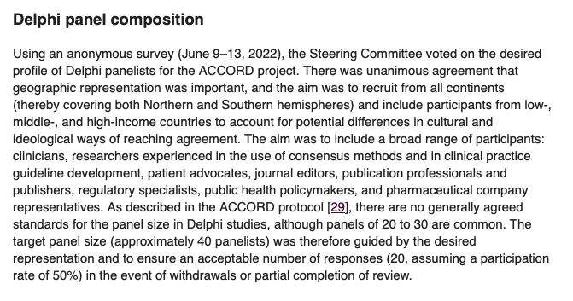
M3 in ACCORD
Notes:
Now let me show you how WE, ACCORD developers, reported this item in our paper.

Slide 52
Audience Poll
Do you think we reported everything we should about our own consensus exercise?
Yes, everything was reported
Almost there
No
Notes:
Exercise to highlight that all methods are fine BUT it should be clear WHY you choose one.

Slide 53
M3 in ACCORD
Notes:
Now let me show you how WE, ACCORD developers, reported this item in our paper. Do you think we are doing our job and reporting M3 completely?

Slide 54
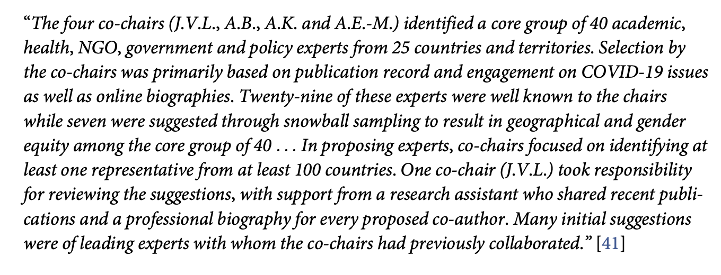
Examples from the E&E

Slide 55
Audience Poll
Do you think these authors reported all three M3 components?
3/3 elements: “who selected” plus “how they selected” (criteria) plus “why these many” (rationale for numbers)
2/3 elements: “who selected” plus “how they selected” (criteria)
1/3 elements: “who selected” only
None
Notes:
Exercise to highlight that all methods are fine BUT it should be clear WHY you choose one.

Slide 56
Examples from the E&E

Slide 57
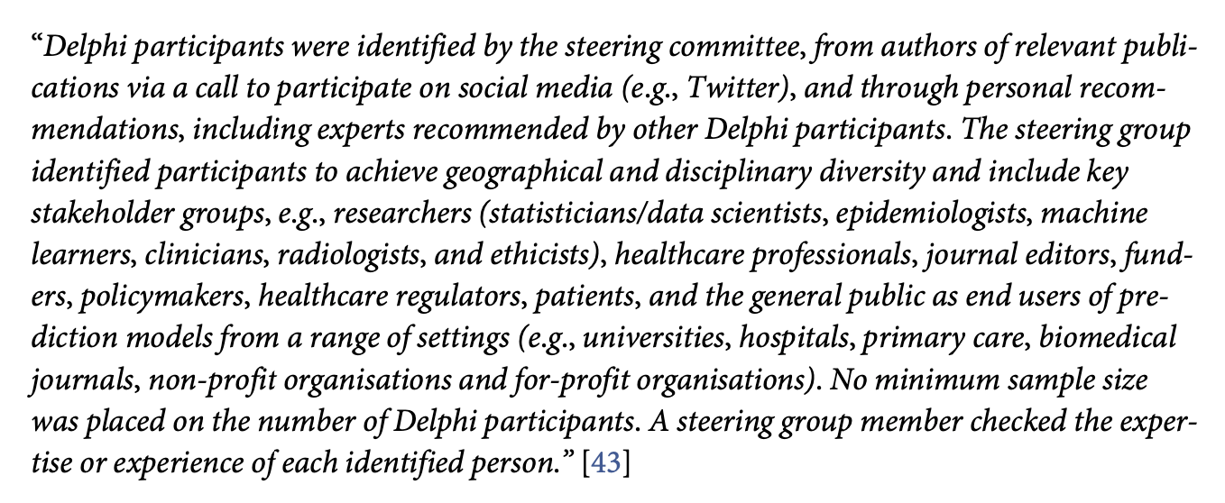
Examples from the E&E
Notes:
IF we have time

Slide 58
Audience Poll
Do you think these authors reported the criteria for panellist selection?
Yes, it is fully reported
Something seems to be missing/incomplete
No, it is unclear how panellists were selected
Notes:
Exercise to highlight that all methods are fine BUT it should be clear WHY you choose one.

Slide 59
Examples from the E&E
Notes:
IF we have time

Slide 60
Audience Q&A
To ask a question, open the Q&A window, type your question into the Q&A box. Click Send.
Notes:
And now it's time to answer your questions. As a reminder, please type them into the Q&A box at the bottom of your screen.

Slide 61
Upcoming ISMPP U Webinars
August 28, 2024:
Best practices: Beginning a new relationship between agency and pharma
September 18, 2024:
Retaining top talent in Medical Communications
Notes:
Here is a snapshot of the upcoming ISMPP U for August, a focus on the best practices to beginning a new relationship between agency and pharma. Registration soon to be open. We hope you will join.
Also be on the lookout for the September ISMPP U, focusing on retaining top talent in Medical Communications. Registration is now open.

Slide 62
ISMPP Podcasts
Multicultural Considerations in Med Comms
Release date: August 6
Notes:
If you liked this topic, here are a few ISMPP podcasts we highlighted.

Slide 63
ISMPP University
All according to plan: the ACcurate COnsensus Reporting Document (ACCORD) checklist from rationale to implementation
July 31, 2024
Webinar will begin promptly at:
11 AM ET / 4 PM GMT
Notes:
If you were unable to take a screenshot at the beginning of the webinar for CMPP credit, please do so now.

Slide 64

Thank you for attending!
We hope you enjoyed today's presentation.
After closing out of Zoom, please click the CONTINUE button
on your screen to take our short survey. Thank you!
Notes:
Thank you again for attending today’s webinar. Please take a moment to fill out the survey link that will be sent to you.
After closing out of ZOOM, please click the ‘continue’ button on your screen to take a short survey.
Thank you!

Slide 65
Faculty Bios

Slide 66

Patricia Logullo, MSc, PhD
Meta-researcher at the University of Oxford, investigating tools to make health research more transparent
Involved in reporting guidelines development, open science culture dissemination, and PPI (patient and public involvement in research)
Background in Scientific Journalism, PhD in Evidence-Based Health, medical writer for > 20 years
CMPP, certified medical publications professional; ISMPP, international society of medical publications professional

Slide 67

Paul Blazey, PhD
Clinician and PhD researcher at the University of British Columbia (Vancouver, Canada)
Completed MSc focused on rigorous consensus development in the Sports Medicine field
Journal editor for the Journal of Orthopaedic and Sports Physical Therapy & the British Journal of Sports Medicine, and co-author of Clinical Sports Medicine 5th and 6th editions
CMPP, certified medical publications professional; ISMPP, international society of medical publications professional

Slide 68

William Gattrell, PhD
Previously was a pubs lead at Ipsen, leading on the company’s Open Access and Plain Language Summary commitments
Published research on the impact of medical writing support and the carbon footprint of congress attendance, and is a co-lead on the ACCORD reporting guidelines
CMPP, certified medical publications professional; ISMPP, international society of medical publications professional

Slide 69
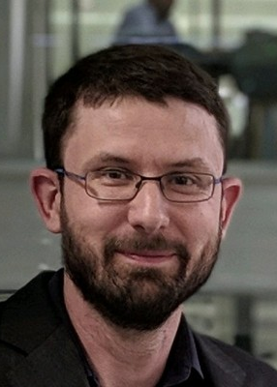
Niall Harrison, PhD
Senior Scientific Director at OPEN Health
Co-chair of ACCORD, a reporting guideline for studies using consensus methods
CMPP, certified medical publications professional; ISMPP, international society of medical publications professional

