Slide 1

AI assisted Competitive Technology Intelligence
…A Case Study…
Srin Achanta, Ph.D.
Search services l Analytics l Visualization l Licensing services l Patent drafting and filing l CloudIP services
www.patent-art.com

Slide 2
AGENDA
CTI – The Need
Defining an effective CTI Program
Role of ML/AI
About SciTech Patent Art
Features & Realized Benefits
Taking a bite

Slide 3
CTI – THE NEED
WHAT IS CTI?
NEED FOR A RE-LOOK
Competitive Technology Intelligence
  …process of gathering information from various sources
  …analyzing the most useful information and
  …drawing meaningful conclusions about your competitor / technology
Capturing technology intelligence can identify threats or reveal significant opportunities
Organizational inefficiency caused by a lack of alignment
  Exploding data-sources
  “Business Intelligence” vs. “Technology Intelligence”
Are you Connecting-the-dots?
  Is it done at all?
  Even if it is done, how often?
Moving intelligent decision making to the front-lines

Slide 4
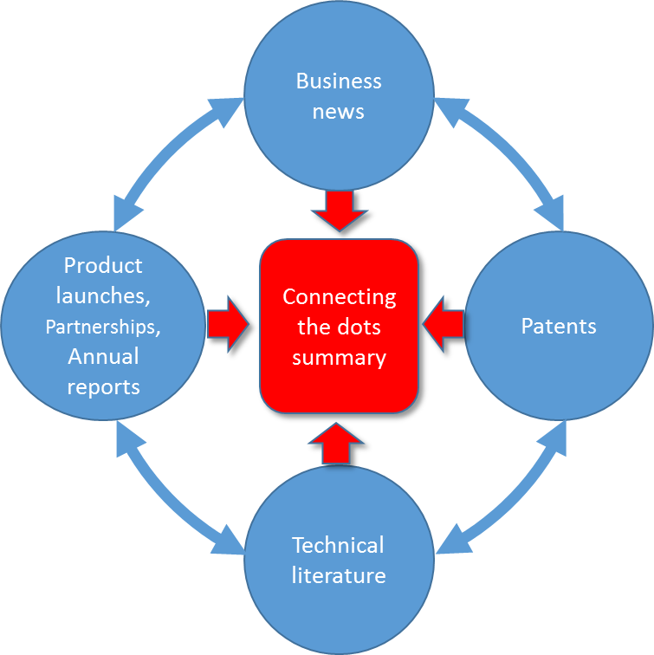
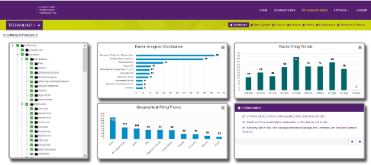
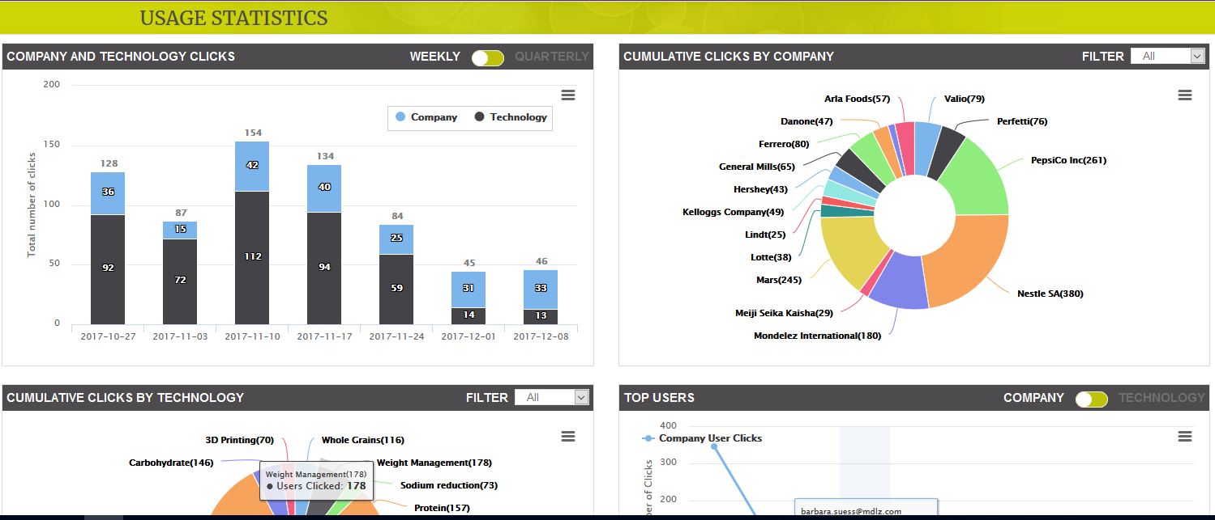
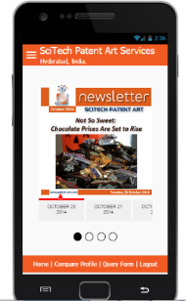
DEFINING AN EFFECTIVE CTI
SCOPE
DELIVERABLES
Competitors, Technologies or both
  Need alignment on priorities
  Add your company as a benchmark
Sources - business news, product launches, investment reports, patents, scientific publications, trade journals, internal reports (optional)
Organizing the information - taxonomy that speaks the language of your company
Connect-the-dots summaries
  Merge insights from all sources
  Analyst discussions
Other insights…trends, technology white-spaces, patent-product matches, etc.
Smart-phone friendly e-mail notifications
AI-based searchable portal with relevant patent + non-patent literature

Slide 5
A SHORT VIDEO
A 2-minute video (with background music) showing a CTI portal with its features

Slide 6
EXECUTION CHALLENGES
Top management alignment on program and funding
Prioritization of companies & technologies for CTI program is needed to ensure ROI
Time & effort investment by SMEs, Business heads, and program leader to ensure the program is successful
Define Taxonomies for companies & technologies using your company language
  Revisit 3-6 months into the program to determine if any modifications are needed
Filtering information – Important, good to know and not required
  Product launches – Inclusion criteria - new products, new formulations, product relaunches, packaging etc.
  Business news – technology announcements, new investments, quarterly & annual reports, awards won
  Scientific literature –conference proceedings, articles from high impact factor journals
  Patent literature – Minimize redundancy and avoid noise to capture first publications
Feedback on information– identifying information not reported to start monitoring
Customization of portal …need to improvise as you go
Detailed discussions with SMEs to report only topics of interest in Connecting the Dots summaries
Partnering with SPA critical to ensure success

Slide 7
BENEFITS REALIZED
Tracking not only peer companies, but also technology spaces of interest can help you see how the technology space is evolving over time
The program will enable you to see what things others have protected so you can develop work arounds early in the development process, lowering your freedom to operate risks and reducing development costs
This program can help you understand who is innovating in the space and look for partners who can springboard your technical needs
You may be able to review the information of peer companies and predict where they might go next
This program will allow the SMEs to be more efficient with their time because all the information is collected and stored in the portal for them to review
When SMEs step outside of the projects they are working on and actually have a chance to see what others are doing, they will become much more creative and will start thinking about cross-technology application
The alerts are a great way to remind them to review the information and also keep very current on the subject

Slide 8
ROLE OF ML / AI IN CTI
COLLECTION
Automation critical to ensure
Cost-effective maintenance of CTI
Effective mining of information collected
Custom scrapers by source
ML/AI assisted
SCREENING
Irrelevant records, duplicates
ML/AI assisted
CATEGORIZATION
Technology-specific, context-specific, client-defined
ML/AI assisted
MINING
NLP-based concept search engines

Slide 9
OUR ML/AI VISION
Custom Assisted Intelligence agents to assist clients in technical, custom-defined tasks
On-going training
Client defines
Task
Domain
Examples
Custom AI agents
Client instance
Client uses and provides feedback
SPA defines
Algorithm
Training data (Optional)
Training methodology
Key issues in generalized AI solutions:
  Un-able to understand context
  Technical terms vary by field
  Poor quality of training data

Slide 10


Taking a bite…
IT + Services Platform
AI built-in
  You train
  SPA trains
Scalable, globally accessible
Customizable
  Access
  User-defined taxonomy
  Interactive charts
  …
Technology 1
Summaries
END USER
Company 1, 2,….
Technology 2,3,…
Insights
Company 10, 11,…
E-mail alerts
.
.
.
.
.
.
Searchable PL + NPL database
A Partner with the right mix of ML/AI, IT & Technical Skills Is Key to Success

Slide 11
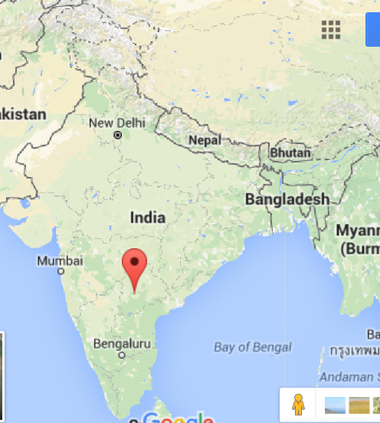
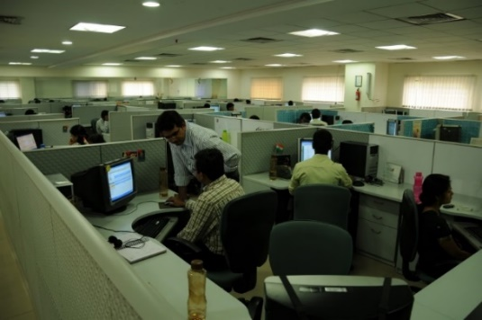
ABOUT SCITECH PATENT ART
Established in 2002
Maintaining confidentiality is core
Over 300 clients in US, Japan & Europe
90+ advanced degree scientists and technologists
AI & Big Data analytics team
Our Difference
Actionable insights
Multi-disciplinary
Intuitive tools

Slide 12
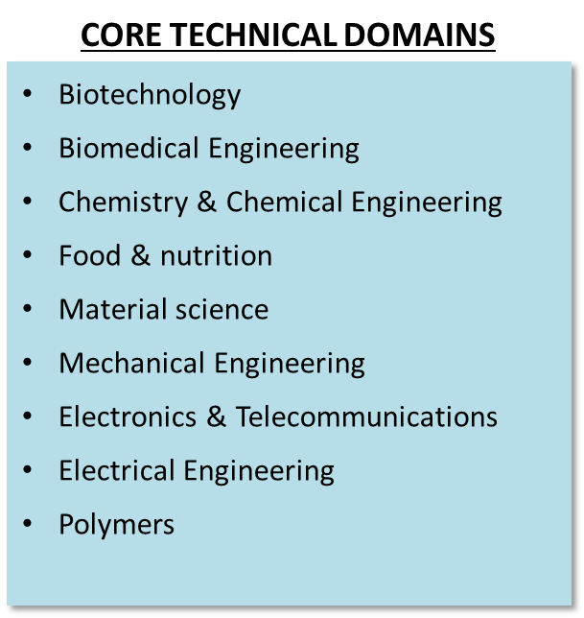
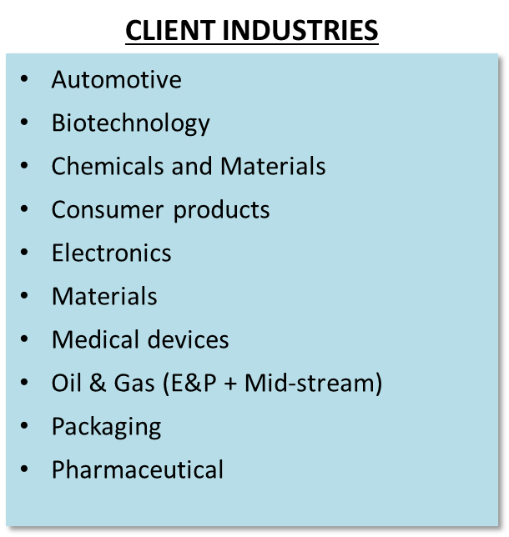
ABOUT SCITECH PATENT ART
SERVICES
IP RELATED
Patentability, invalidation, freedom-to-operate, evidence of use, prosecution support, etc.
R&D SUPPORT
White-space, technology trends, competitor monitoring, open innovation partners, etc.
Primarily English + machine translations as needed
CUSTOM TOOLS
Technology portals, AI tools, custom search engines, custom mapping, etc.

Slide 13
Specialty…non-patent literature
Type of Information
Example Sources
Scientific Literature | Web of Science, GoogleScholar, Journal websites
Technical / Commercial Journals | Chemical Engineering Progress, Chemical Technology, IEEE journal, Formulations & Physical Chemistry based journals, Bioscience biotechnology and biochemistry, Food science, etc.
Conference Proceedings | Track technical presentations at conferences, Inventor presentations or articles, etc.
Clinical Trials | Clinical studies on animals / humans to confirm technology feasibility
Business Literature | OneSource, Nexis, Company websites, etc.
Product Launches | Global New Products Database, company websites, Industry specific forums
Quarterly results / Annual reports | Investor relations presentations to capture technology investments and R&D strategy

Slide 14
ADDITIONAL INFORMATION
Srin Achanta
srinivas@patent-art.com
THANK YOU!

