Slide 1
Are you ready to transform the delivery of your webinars?
Notes:
Perhaps a sexier title!!???
Transform the delivery of your webinars
Unleash your webinar power
Now’s the time! Set your web events apart
DELIVERING EXPERIENCE= DELIVERING EXCELLENCE WITH WEB EVENTS

Slide 2

Agenda
Your challenges & initiatives
  Xyz
  Xyz
Blue Sky eLearn Solutions
  Pre-event, during event, post-event
The critical role of webinars and the importance of a successful delivery
  State of learning industry and events
Solutions to meet challenges
  Pre-event, live event, post-event
Notes:
If this is used for a prospect, first spend 30 minutes on phone only uncovering their needs so this presentation speaks to it.
Then on this slide review their needs and outline our solution. Then only use the appropriate slides in this deck…
My name is Jodi Ray- I’m the Channel Manager at Blue Sky and today will be presenting on the important role of webinars and why it is so critical they are delivered successfully.
And ultimately the solutions Blue Sky eLearn provides to ensure their success every step of the way for a streamlined experience for the all the stakeholders…

Slide 3

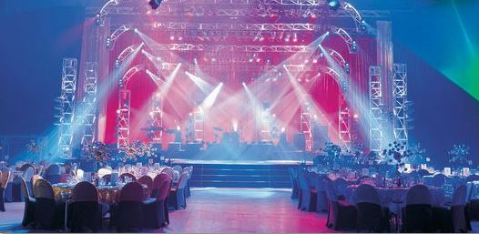
Web based meetings are as important as place-based meetings
Notes:
WHY is an effective online learning program is so important?
our traditional learning system is being disrupted People are face “the other fifty years” once they exit our formal educational systems Thus the importance for“life-long learning”, profession development and continuing education
Web based meetings are as important as place-based meetings.
Offering webinars is a smart way to deliver value to your members throughout the year. A recent internal study showed that over half of an association’s webinar attendees never have attended an Annual Meeting.
Webinars may be the only time many of your members actually interact with your organization on a live basis. Therefore it is important to reflect and protect the member’s impression of your organization.

Slide 4
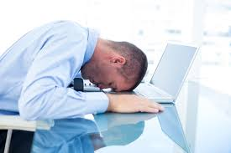
You may not get second chances
Notes:
While many associations would spend significant resources to support a live face-to-face event series of that size, many leave this critical member interaction to using standard off-the-shelf webinar platforms that their staff (who have many other more pertinent responsibilities) have to manage.
Members expect the virtual event to be delivered in the same professional manner as a live keynote session. The common denominator of many failed events is that organizations tried performing a Keynote presentation in a Breakout room. Event failure is dangerous to the Association’s reputation - not to mention the career risk by the manager(s).
If attendees have a bad experience, they may not be back. Not just to the live web event, but to all other offerings. And there are just too many choices out there to find what they are looking for.
Not getting proper technical support- if the attendees have trouble logging in for example and there is not support.
If there is bad audio- nothing worse than listening to a webinar that cuts in and out.
The presenter is not supported properly, and either has on-air fails or is frustrated by not being able to use tools that would help them maximize the effectiveness of their presentation (using Prezi, showing video or walking through an Excel file, drawing on a whiteboard using polls or having to manage their own Q&A)
While on an antidotal basis, we have heard that 25-30% of DIY webinars experience “moderate to severe” quality issues and 1 out of every 20 events are considered “failed”. If a hotel venue gave these stats to a meeting planner, it would be safe to assume that the venue would be regarded as a low quality and high risk establishment for meetings. But hey, it’s cheap!
While the “cheap is expensive” notion is clearly recognized as a cautionary tale in the traditional meetings industry, it is important to adopt a similar mindset for your virtual events. These virtual events may be the only opportunity to make that quality first impression with hundreds of your members. That impression will remain with your members when they receive the invite for your next webinar, next year’s annual meeting invitation and when renewal time comes.

Slide 5

The Promised Land
Easy & Engaging
Streamlined from beginning to end
Reliable & Consistent
An extension of your staff so you can focus on SMEs & marketing
Notes:
It’s crucial the experience for your attendees will be easy and engaging. For example, they need to easily find relevant webinars to attend, to register with no new passwords or complicated logins, to add to the calendar and easily join the day of from any device, to not losing attention during the event to accessing the recording and any possible associated CEUs or certificates with it.
While your content may be stellar or our tools offer awesome engagement opportunities, these “sexy” deliverables are irrelevant if you miss the mark on reliable and consistent delivery on the dozens of different devices, operating systems, and web browser versions in use around the world. Attendees need friendly and responsive technical support-typically the first 5 minutes of the event. They will actively listen if they can hear clearly.
Your presenter needs back up if they’d happen to lose their internet connection and could not move their slides or to ensure their video plays properly or be told to “speak up” if needed or moderate the Q&A so they can focus on effectively answering.
And you as staff want to be sure the event gets recorded properly and you receive complete reports that don’t require a lot of data manipulation.
With a managed event, your staff can focus on getting the right subject matter experts and marketing & strategy behind the events and learning. Then hand it over to reliable partner to ensure each and every event goes smoothly and has a great experience- the organization (staff), the attendees and the presenters.
Beginning to end: Registration & emails= customized, live event, recording, On demand access, ecommerce, receiving CEUS, tracking, reporting

Slide 6







How it All Comes Together
Webinars
Webinars
Websites, Databases
Registration Platform
CRM, etc.
Reporting
Registration
Services
Testing &
Certifications
Revenue

Slide 7
Prior to Event
“By failing to prepare, you are preparing to fail.” Benjamin Franklin
Notes:
We act as an extension of your staff
What does an organization require to provide a world-class virtual event? It’s not just a platform. You need a Virtual Event Team, the appropriate Technology and Value Enhanced Services.

Slide 8
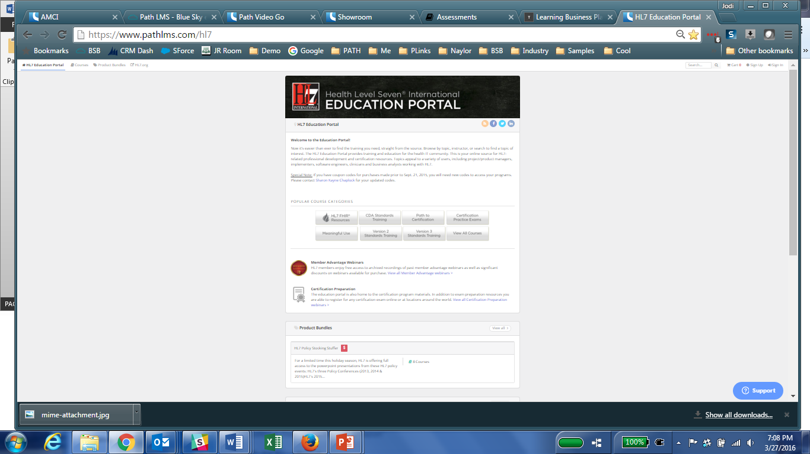
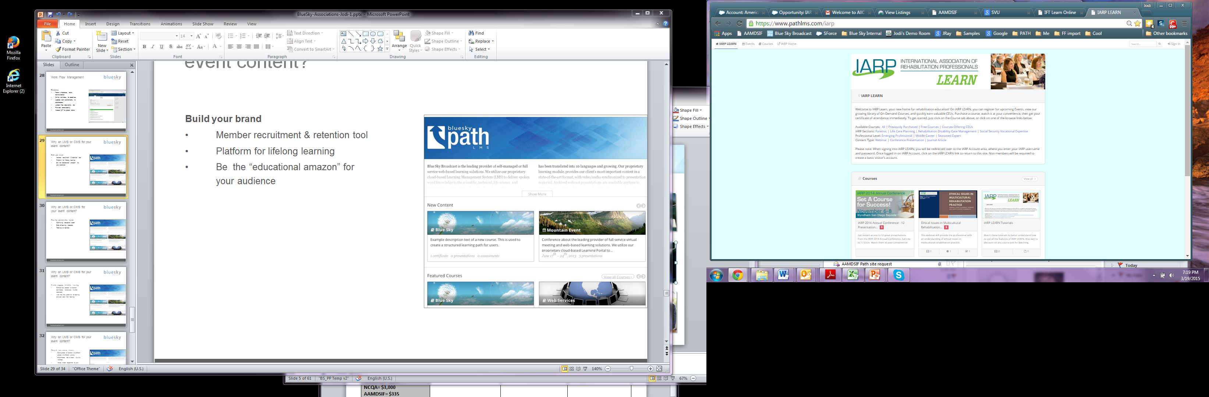
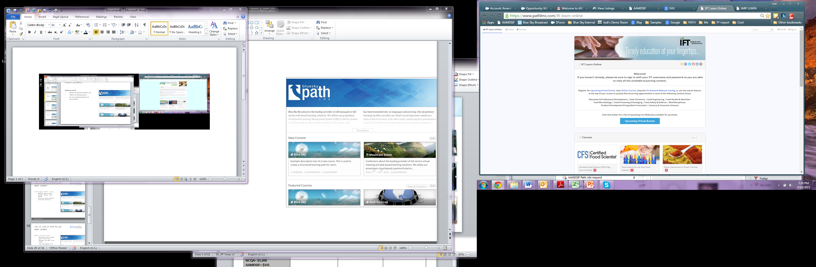

Path: Customizable web event registration and learning platform
Build your brand
Provide engaging learning
Increase Revenue

Slide 9

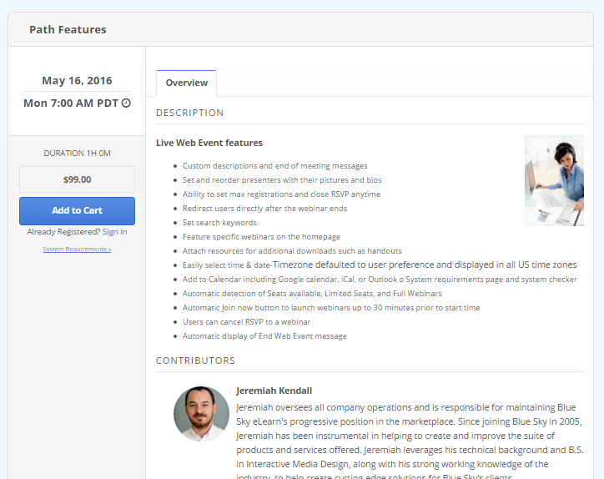
Web Event integration with path
Path: Customize registration & emails
Easily track registrants and attendees
Seamless integration with Adobe Connect platform
Extend brand recognition with customized registration pages and email templates
Increase attendance with automated confirmation, reminder emails and add-to-calendar functionality
Decrease technical support inquiries with system checks
Integrate with your existing database for a streamlined user experience
Notes:
CUSTOMIZABLE Registration & emails
The Path platform, can very effectively manage registrations for webinars, the email confirmations and reminders and then is also the location to launch the live webinar.
Integration- with your AMS for SSO
As an exciting side note-Path also allows for registration for live events and viewing the live stream if there is an embeddable URL- like Ustream or Mediasite.

Slide 10
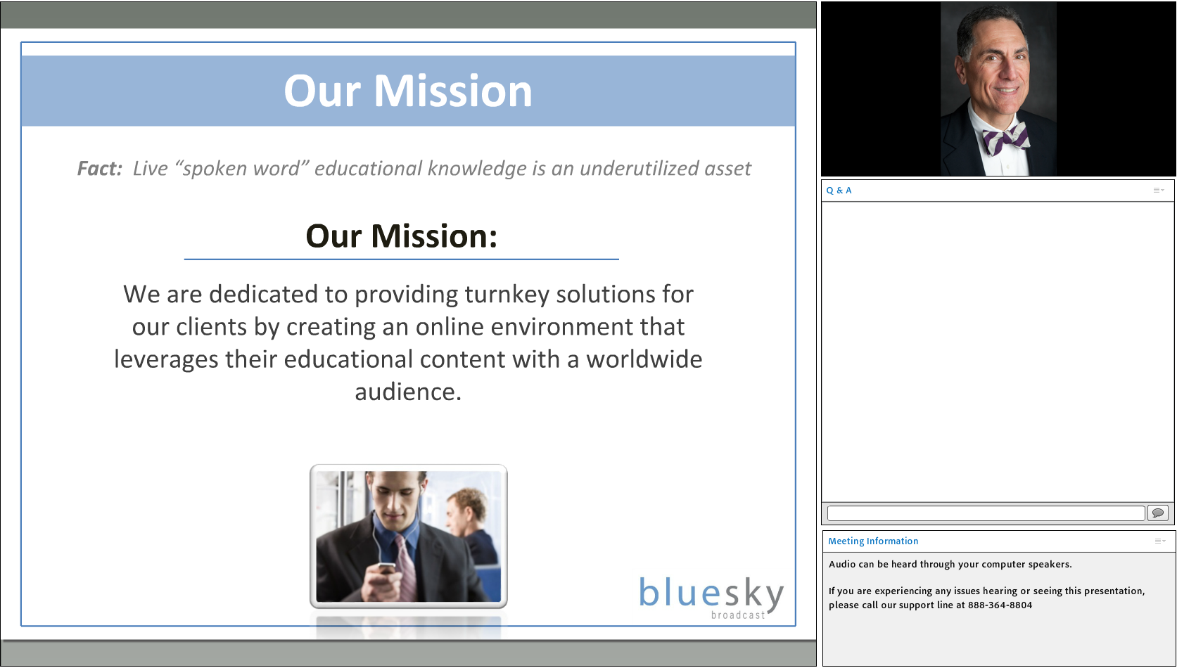
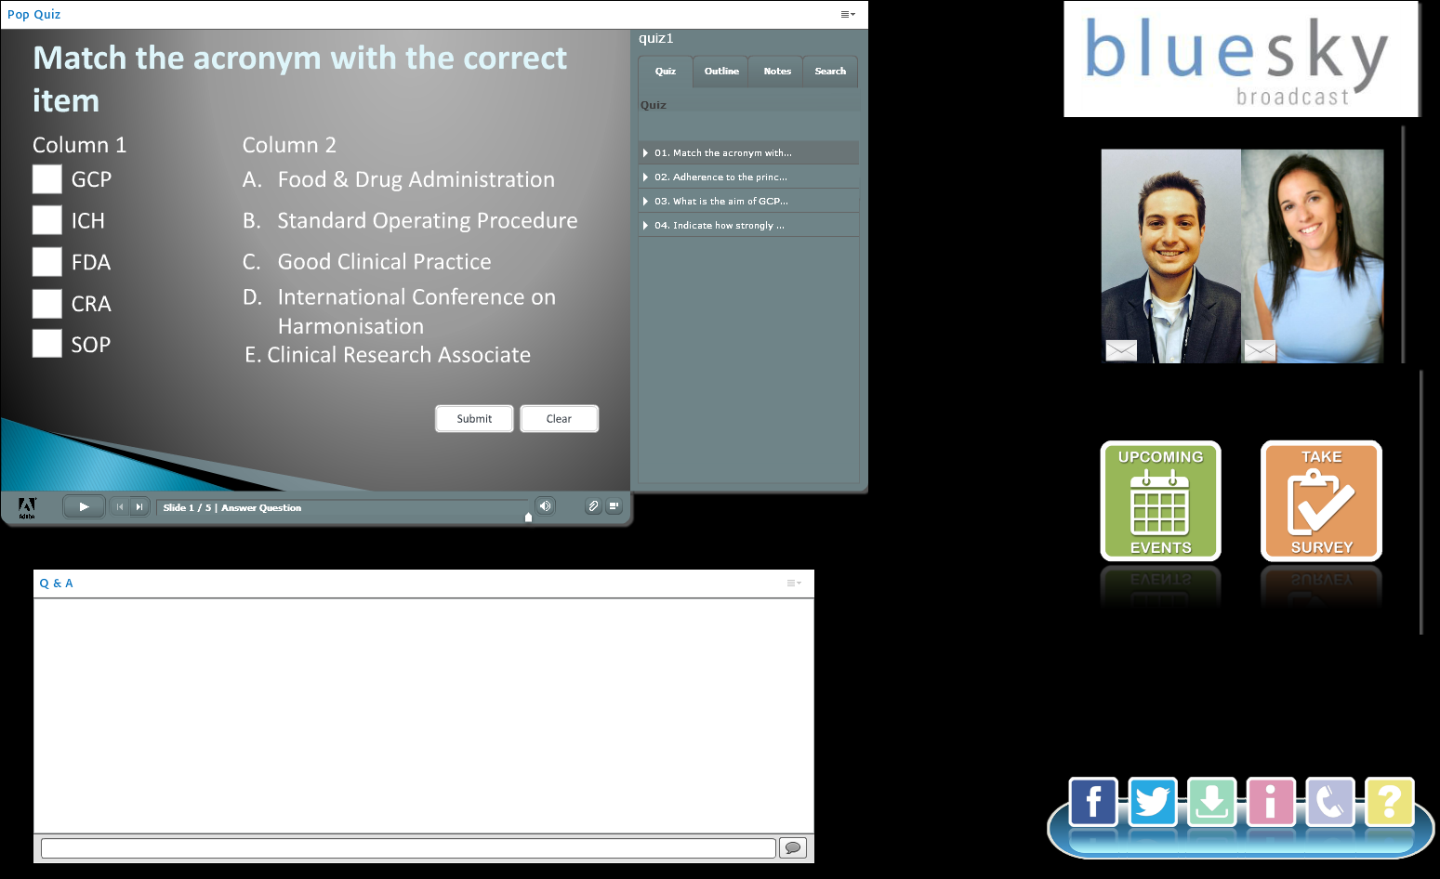
Customized and Branded Live Webinar Room Layouts
The virtual room layout can be customized to meet your specific needs.
Notes:
We consult with your staff to set up a branded room that will deliver the kind of experience you are looking for. We create pods with images or content that can be sized and placed based on your needs or using our best practices.

Slide 11
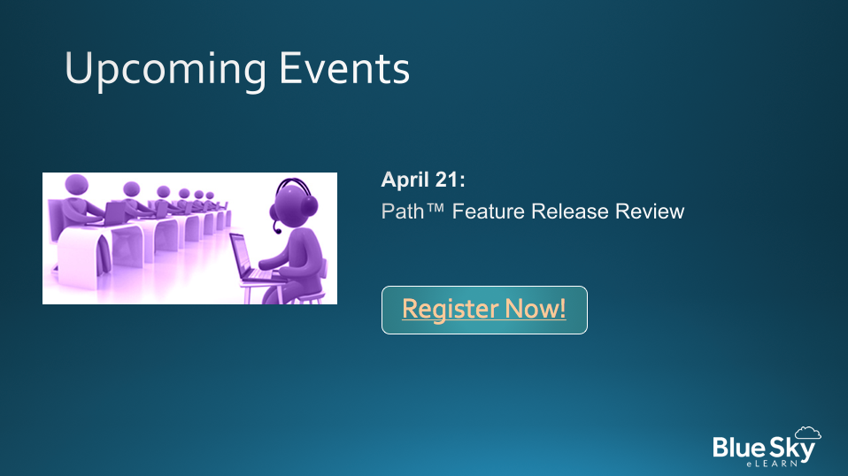
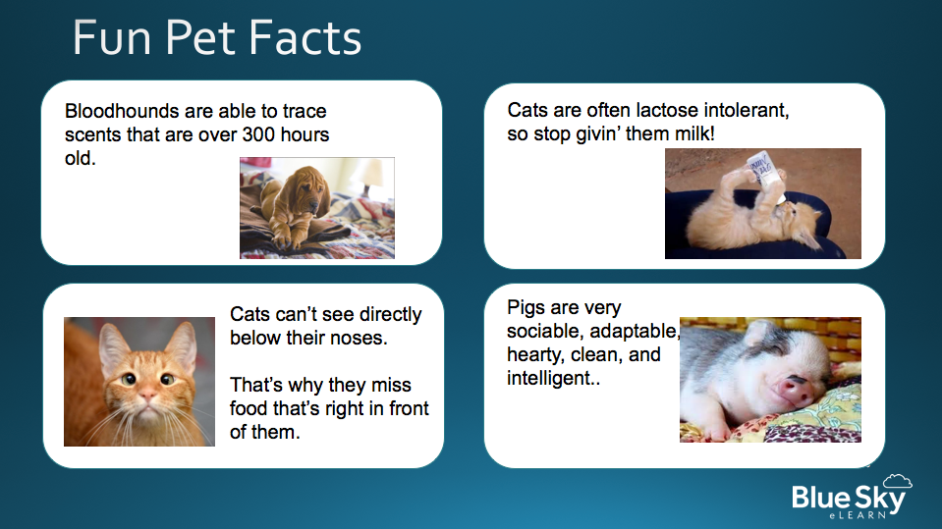
Welcome/Lobby Slides
We recommend having a separate slide deck of “lobby” slides to play on a loop for a few minutes prior to the webinar starting.
  Promote upcoming events
  Play music
  Offer a “countdown”
  Offer a game or “pin your location”

Slide 12
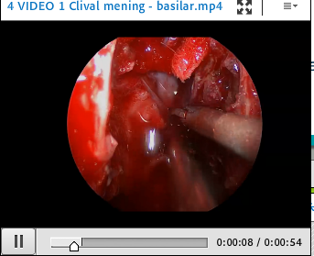
Leverage videos
Webcams
Videos to support the presentation
Video of a previously recorded presentation that can be played back to the audience.
  This “mock live” webinar is a great way to re-use existing content while still having a live audience.
  Live Q&A is typically offered after a mock live webinar.

Slide 13
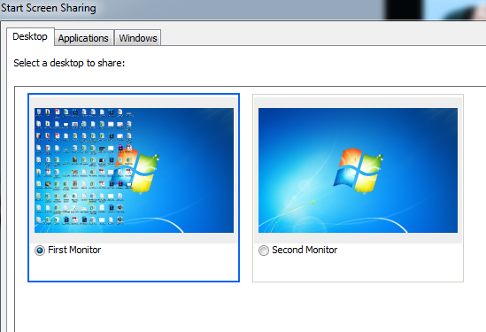
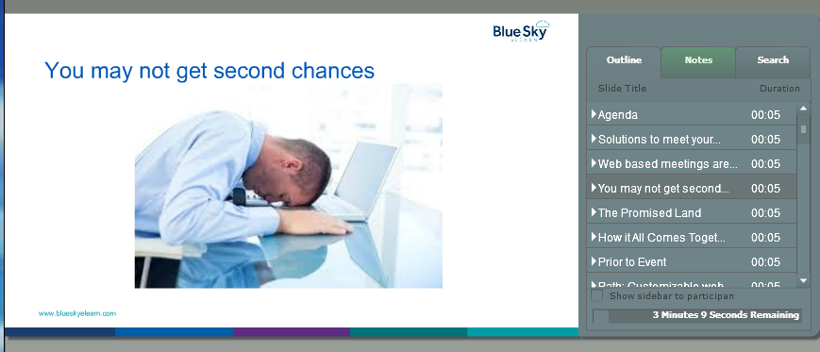
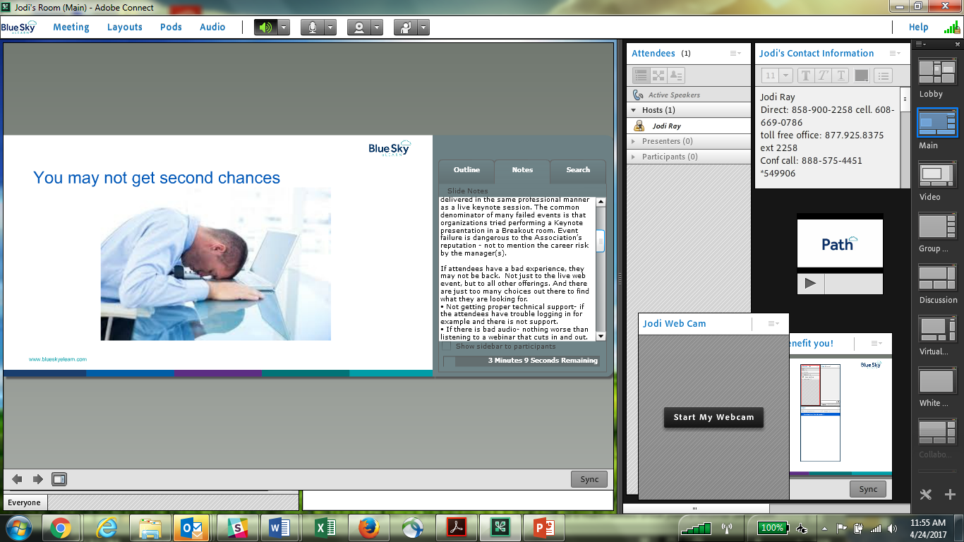
Helpful presenter tools
Presenters can share their screen and select their entire desktop or one of the open applications (like and Excel or PDF document) or windows on your computer
Presenters can see privately their outline of slides and jump to a certain one at any time. They can also view slide notes without being visible to attendees and perform a quick search within their presentation.

Slide 14
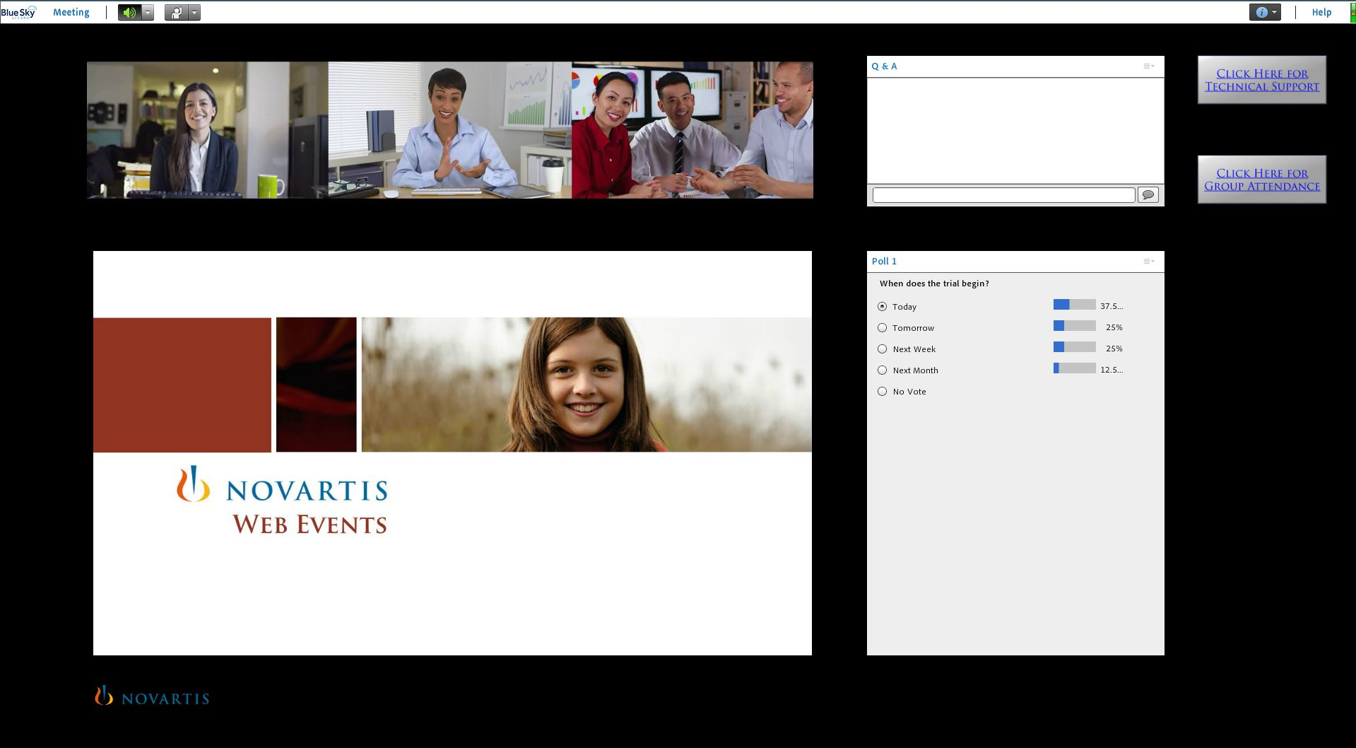
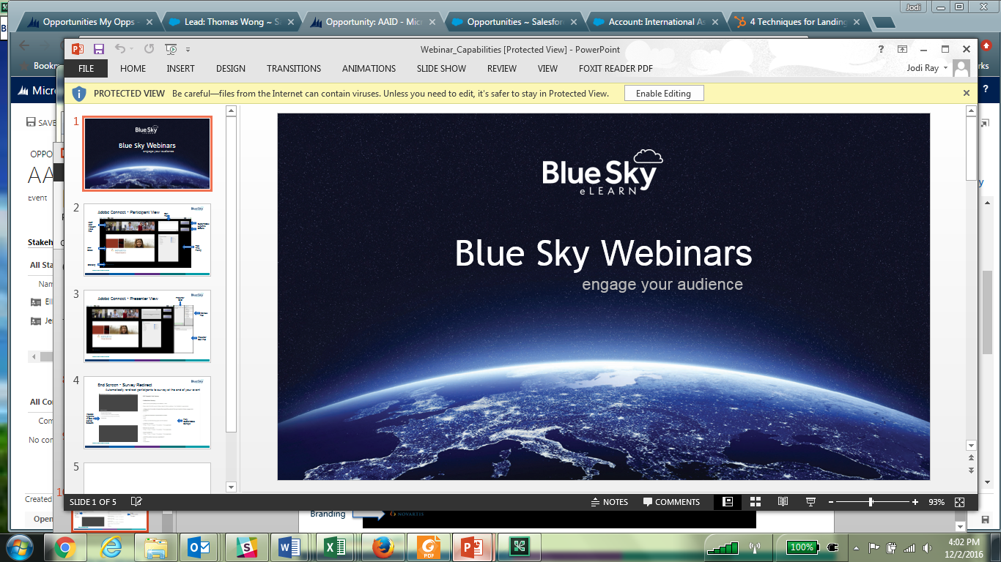

Participant View
Q&A Pod
Multi-User Webcam Video Pod
Customizable Hyperlink Buttons
Real Time Polling
PPT Slides
Branding
Notes:
Talk through all….
Q&A: Participants enter their questions by typing in the text box in the Q&A pod. Questions are only seen by presenters.

Slide 15
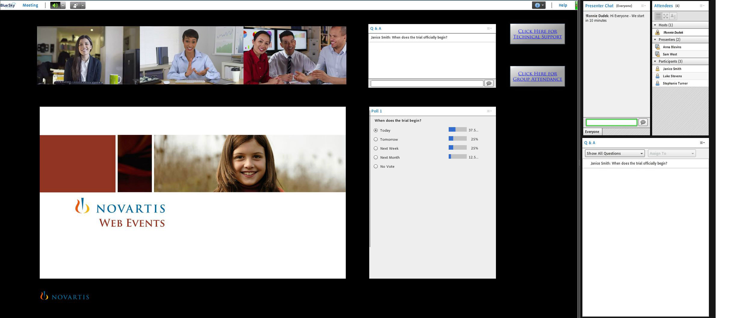
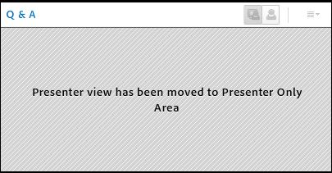
Presenter View
Presenter
Chat
Attendee Pod
Presenter
Q&A Pod
Notes:
Talk through all…..
Q&A: Presenters see the questions entered by participants. Typically, the questions are read aloud to the audience and answered verbally.
If preferred, however, presenters are able to respond to the sender or audience via the chat box at the bottom of the pod.
Though rarely used, questions can be assigned to a presenter to help organize questions coming in from the audience.
Polls: As a presenter, you can view the total votes as percentages and/or numbers. You can choose to make that information viewable to the audience by broadcasting results.

Slide 16
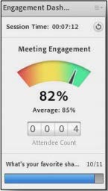
Engagement Enhancements
Breakout Rooms
Interactive Lobby (Games, Music, Map)
Managed Breaks
Interactive Attention Checks
Notes:
Basically, if you pay $500 additional you get the following:
Breakout rooms – provides you the ability to have smaller discussions and collaboration with virtual breakout sessions
Interactive lobby (games, music, map) – get your audience excited engaged before the webinar begins with fun interactions in the webinar lobby
Managed Breaks (office chair yoga, etc.) – provides your audience what may be a much needed break from a webinar (and from sitting at their desks!)
Interactive Attention Checks – measures audience attention and engagement by having timed polls or check boxes pop up throughout a webinar

Slide 17

Presenter Training & Guidance
Ensure presenters are comfortable platform and walk through the flow about 1 week prior to event
Walk through the flow of event and responsibilities
Receive presentation items & optimize for room
Provide green room day of the event.
Notes:
Blue Sky eLearn Virtual Event Team
The Event Manager will be your partner to guarantee a flawless event. Event Managers are with you from the planning stages, content coordination through the completion of the event. Event managers can help with everything from technical issues such as integrated online registration, to email reminders to delivering detailed analytics. They are experts in online engagement strategies that can help keep you members fully engaged during the event.
The event manager will oversee and perform presenter practice sessions and train the presenter on web meeting best practices. They also ensure your webinar room and registration pages are set up exactly the way you like it.

Slide 18
Live Event
Concentrate all your thoughts upon the work in hand. The suns rays do not burn until brought to a focus. Alexander Graham Bell

Slide 19

Support
Attendees
  Phone, email
Presenters
  Moderate, pull in polls or video
Behind the scenes
  Audio, backups

Slide 20
What happens after the event?
"If you don't know where you are going. How can you expect to get there?" Basil S. Walsh

Slide 21

Increase Viewing Post-Event
On Demand
Mobile
Global

Slide 22
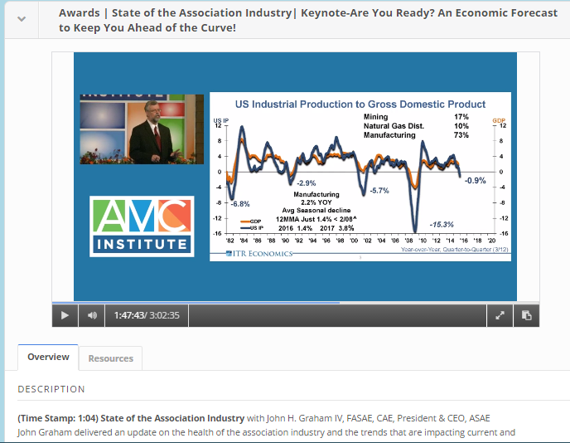
Robust Rich Media Player
Fully responsive so mobile users have a beautiful experience
Attach resources, presenter bios, and commenting
Take notes next to the presentation - easily pick up where you left off
Notes:
One example of this and a flagship feature of Path for a great user experience is the media player. For example, you can upload about 14 different video file, and Path does the magic of transcoding to multiple file formats and then serves it up to the user depending on the type of device accessing it- so for a mobile device, Path serves it up as an MP and the desktop a Flash file. Also, Path detects the users bandwidth connection and gives the highest quality file they can watch- because we all know there is nothing worse than waiting for a video to load or buffer in the middle of it
You can also add resources to the video presentation like attachments and links. You can add a description of the presentation as well as the presenter information- both are made with WYSIWYG capabilities so you can adjust fonts, and add images or embed code for example. The user can take notes next to the presentation and it saves those and time stamps them and includes the ability to download them. Another great feature is Path keeps track of where the user left off So if I was watching a video presentation on my iPAd last night, I can come back to my desktop today and pick up right where I left off. Closed captioning is also an option of those on demand presentations- so LOTS of features to ensure a great user experience.

Slide 23

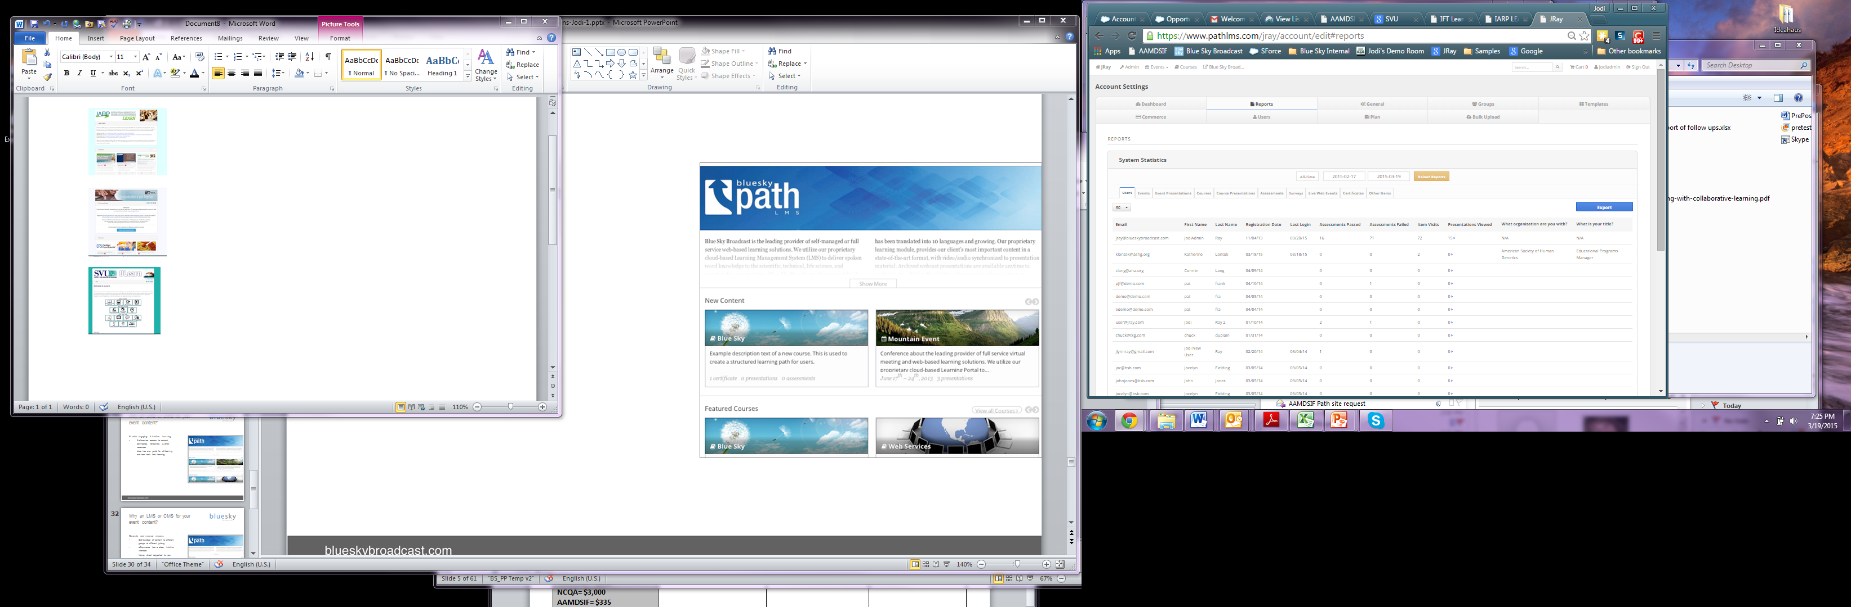
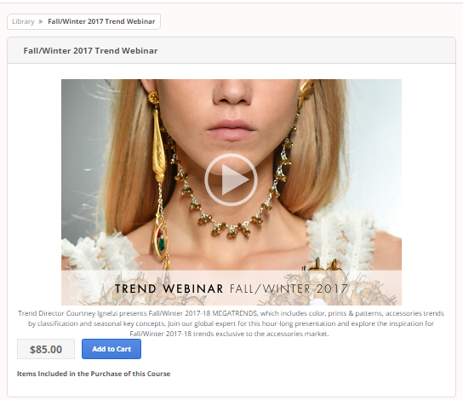
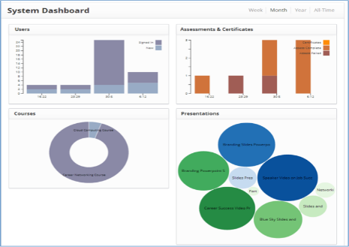
Integrations | Reporting | eCommerce
Notes:
Our eCommerce engine and Reporting I believe is 2nd to none in this industry.
For eCommerce, we have the beautiful user interface but tie in with our clients merchant account so all the $ goes direct into their account & is PCI compliant. It has capabilities like product bundling, subscriptions, coupons, credits, and issuing refunds.
For reporting, there is a nice dashboard to get an at a glance view popular courses and presentations for example; and then very detailed reports filterable by time frame and specific items like a particular test question, all exportable to CSV to manipulate further in Excel to help clients Track & Analyze their learning programs.
Typical Integration Scenarios:
Registration • Single Sign On • E-commerce • Reporting • CE Data
We have over a dozen existing bridges with our client’s AMSs (iMIS, YM, Abila….) and that list is constantly growing with our ability to build custom integrations with our client’s systems where we can “push” data into third-party databases in real-time, as well as connect to other 3rd party API’s to pull data into Path.
This include an SSO with HL as well as activity write back- include writing back course start, completion and certificates/credits earned
We have also developed an open API which is a set of webservices Blue Sky exposes to our clients. This allows both Blue Sky eLearn and/or clients to create, update and retrieve customer information stored in their Path client account by making web service calls to the API.

Slide 24
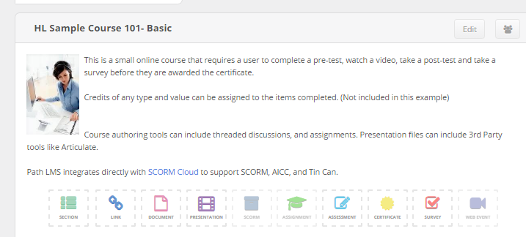
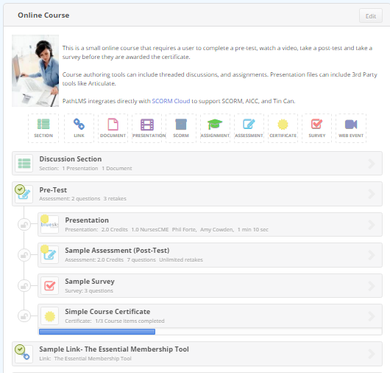
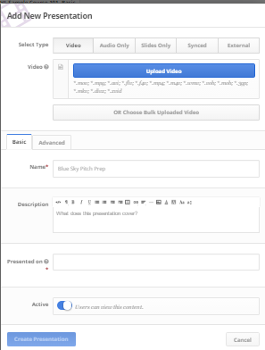
Create Content
Easy course authoring tools
Order & set pre-requisites
Tests (timed, passing scores, retakes, question pools)
Assign Credits; Issue Certificates
Supports SCORM, AICC & Tin Can
Presentations as video, slides, audio, 3rd Party
Notes:
And the administrators will easily be able to create a course, using friendly tools already built into Path, This includes, presentations, tests, surveys, CEUs, Certificates, documents…

Slide 25
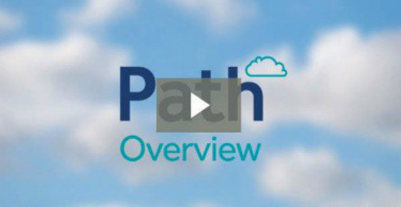
Notes:
Next I would like to show you a short video overview of Path…

Slide 26
Client Stories
“Strive not to be a success, but rather to be of value. Albert Einstein

Slide 27

We have your back
Notes:
Client Case Studies- AACE Intl; NAFSA Intl
Webinar Disaster Success Stories- pick 1 or 2 and tell a story
One client’s event requires a minimum run time of 90 minutes for 1.5 credits of CPE/CLE. There was one particular event where the presenter ended 20 minutes early and there were no questions in the queue to fill time. Our facilitator pulled questions off the internet specific to the program to fill the time needed to satisfy CPE/CLE.
First one that comes to mind. Recent event; there was a speaker replacement at the LAST MOMENT (within an hour of start time) and we had to walk the new presenter through all the presenting training in just a few minutes as well as altering the room to reflect the new speaker (photos/bio/etc)...and he was trying get his head wrapped around the presentation he didn't create, but was about to give. The presentation still started on time!
Another recent event provides their own moderator for introduction, Q&A, and closing. When we reached Q&A portion their moderator failed to read his script so we had to make things up based on prior relationship and experience with the client. They also ended the meeting without performing their closing script, so again we had to improvise and perform a closing informing participants of the post event survey, etc.
While we were running an event, there was a power outage in most of San Diego County, where our offices are located. Our event continued as though nothing happened with our servers and dedicated webinar computers continued to run on battery backups. The event concluded without incident.
We were scheduled to run an event for 30 international people, so 1 AM PT. We were using a virtual room for visuals and a phone line for audio. At 12:50 AM PT, we see the amount of callers on the phone line approaching 100. When asking the client if we were expecting more attendees than originally anticipated, they apologized and said yes, they decided to send this out to their entire international team. They expected 250 attendees! Our smaller virtual room which this was scheduled in, had a max capacity of 100 attendees and our default phone line had 150 max capacity. Being that it was 1 AM PT, we were unable to increase the phone line capacity. This was also a 6-7 hour presentation with several speakers and slide decks. Our operator opened a second phone bridge line, and three way called into the original phone line. Created a second room for participants and loaded the first slide deck for the program in the second room. We changed the landing page to direct to the new room and phone number when that room filled up we began, with our operator mimicking slide changes/polls/videos as they were happening in the original room for the overflow audience. The program was still a success and the client was very thankful we made it happen.
One of the most common occurrences, happens weekly, last minute deck changes. Receiving a new slide deck 10 minutes prior to start time, or being informed of a new video they want to include and us having to scramble the jets to get it ready for the program.

Slide 28
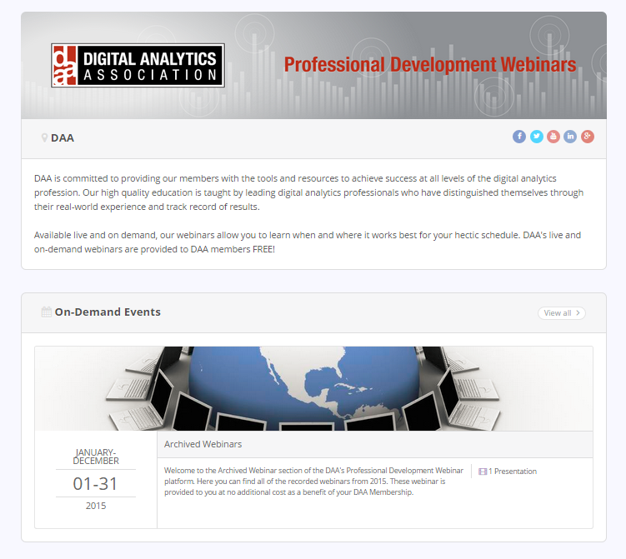
Client Feedback
“I’ve been so impressed by Blue Sky’s customer service. Our moderator was exceptional – the best I’ve ever heard. We even had a mic issue at the start and she handled it GREAT! My project manager has always answered all my questions and gotten back to me very quickly. So happy we picked Blue Sky!”
-Jackie Conn, Professional Development Manager, Digital Analytics Association

Slide 30
Do you see value? What is next?
Jodi Ray
Channel Manager
Phone: 858-900-2258
jlynnray@gmail.com

Slide 31
Pricing
"Price is what you pay. Value is what you get." - Warren Buffett

Slide 32
Webinar Pricing
Yearly subscription= $1,500 (includes Registration & dedicated team)
Starts at $975 per 90 minute event up to 150 attendees
Engagement Plus= add $500 (breakout Rooms, Interactive Lobby (Games, Music, Map), Managed Breaks and Interactive Attention Checks

Slide 33
Path Learning Platform Pricing
One time fee starts at $3,500 for Path license, training and provisioning.
Yearly Fees start at $5,940 ($495/mo)
  Includes up to 500 unique active users/month
  Includes up to 250 GB bandwidth/month

Slide 34
MORE?!
Jodi Ray
Channel Manager
Phone: 858-900-2258
jlynnray@gmail.com

Slide 35
Blue Sky eLearn Managed Webinar Services- 3 year agreement | Units | Rate | Additional
Managed Webinars Includes VoIP audio, back up teleconference line, professional moderator, live technical & customer support desk and live backups and redundancies. Includes a dedicated event facilitator, pre-event greenroom, live Q&A management, pre-event lobby, customized operator scripting, speaker training and interactive whiteboards. Includes recording event with front and back end edits and uploading into your Path site or providing you with an MP4 file. Includes back up phone line.
Yearly Subscription Fee Path eReg -Includes confirmation/reminder emails (with add to calendar), 24/7 admin access to reports, better tracking of user activity, secure access via login and password. Dedicated Team – Includes Project Manager, a Client Success Manager and full technical support for participants. | 12 months (3 year agreement) | $1,500/year | Manual Registration= $500/event Path Registration= $150/event
Per Event Fee Up to 60 minutes -up to 150 attendees | 7-20 Webinars/year 20+ Webinars/year | $975/event $895/event $795/event | Extra 30 minutes- add $150
Per Event Fee Up to 60 minutes- 151 to 600 attendees | 7-20 Webinars/year 20+ Webinars/year | $1,425/event $1,325/event $1,225/event | Extra 30 minutes- add $250
Per Event Fee Up to 60 minutes -601 to 1600 attendees | 7-20 Webinars/year 20+ Webinars/year | $2,400/event $2,300/event $2,200/event | Extra 30 minutes- add $500

Slide 36
Additional Services- Blue Sky eLearn | Units | Rate
Engagement + Upgrade | Per Event | +$500
Includes: Breakout Rooms, Interactive Lobby (Games, Music, Map), Managed Breaks and Interactive Attention Checks
Remote Presentation Capture – Slide and audio capture remotely from BSB. Includes 90 minutes of recording time with technician through webinar platform. Presentation module development included. With webcam/video for single presenter | Per 60 Minute Recording (Extra 60 minutes) | $650 ($150) $1,000 ($200)
Add Webcam video-WEBINARS (For live event/not recording) | 1 presenter/ event Multiple presenters/event | +$250 +$500 For recording, add:
Rush/Off-Hour Webinar Services – Less than 48 hour notice or Event occurring on a weekend or US recognized Holiday | Per Event | +$250
Recording Services of 3rd Party Webinars – Blue Sky Technician recording the Webinar. Will log in as an attendee and create a standard archive. Post editing for audio balancing and proper fading at beginning/ending of session. | 60 Min Audio 60 Min Video | $150 $250
Telecom Service Charges Live Operator Assisted Webinar with operator moderated Q&A Advertised phone line | Per person, per hour fee Per person, per hour fee | +$10 +$5
Closed Captioning / Synchronized Transcripts - Includes transcription, captioning or synchronization and document of transcripts Transcription - $250/hour of content; Closed Captioning - $250/hour of content | Per hour of content | +$500

Slide 37


Path Integration
Typical Integration Scenarios:
Registration • Single Sign On • E-commerce • Reporting • CE Data
    We have existing bridges and build custom integrations with our client’s systems so we can “push” data into third-party databases in real-time, as well as connect to other 3rd party API’s to pull data into Path.
    We have developed an open API which is a set of webservices Blue Sky exposes to our clients. This allows both Blue Sky eLearn and/or clients to create, update and retrieve customer information stored in their Path client account by making web service calls to the API.

Slide 38
Flexible & Reliable Access
Platforms Supported | Windows 10, 8.1 (32-bit/64-bit), 8.0 (32-bit/64-bit), Windows 7 (32-bit/64-bit) Mac OS X 10.8, 10.9, and 10.10 Ubuntu 14.04; Red Hat Enterprise Linux 6; OpenSuSE 13.1 Citrix XenApp 7.5 Mobile Apple supported devices: iPhone 5S, iPhone 5, iPhone 4S, iPad with Retina display, iPad 3, iPad 2, iPad mini, and iPod touch (4th and 5th generations) Apple supported OS versions summary: iOS 6 and higher Android supported devices: Motorola DROID RAZR MAXX, Motorola Atrix, Motorola Xoom, Samsung Galaxy Tab 2 10.1, Samsung Galaxy S3 and S4, Nexus 7 tablet Android supported OS versions summary: 2.3.4 and later
Browsers Supported | Microsoft Internet Explorer 8 or later, Windows Edge browser, Mozilla Firefox, Apple Safari, and Google Chrome The Adobe Connect Add-in is required for screen-sharing by presenters
Notes:
… How reliable and consistent is operation on the dozens of different devices, operating systems, and web browser versions in use around the world?
If your system does not allow Flash or there are restrictions, you will need a one-time download of an add-in to enable the “Flashless” experience.
System Check
Detailed Requirements
Or: Install and enable Flash (instructions)
Users can now attend Adobe Connect sessions even if Flash is blocked or not available on their systems. They can do so by using the Adobe Connect Add-in. Users who try joining a session on a ‘Flashless’ environment will be prompted to install the add-in.
This is a quick download and install, which is a one-time activity only for the user, and the add-in will be launched whenever the user enters an Adobe Connect session.

Slide 39

The White Glove Way=
EXPERIENCE
Easy & Engaging
Notes:
Our technology and the services wrapped around them, give staff and end users the kind of EXPERIENCE that sets them apart from others and ensures success.
To deliver this exceptional online learning experience, Blue Sky eLearn focuses on several essentials- 1) Making it Easy and Making it Engaging. Why this focus???
Let’s start with staff. Because if staff are frustrated and stressed, then likely they are not making the best use of time to deliver effective learning or even sending learners to the educational programs. Staff need to quickly and cost-effectively implement quality education. And then they need to pull analytics and reports for ROI and identify learning gaps to make improvements.
The organization also needs to count on simple, transparent and flexible pricing to avoid surprises and be confident adjustments can be made as needs change.
End-users- want to access their education anytime, anywhere; and they don’t want to remember another PW or go multiple locations to access content or credits. End users also want to quickly find the content that is applicable to them (such as Live webinars, recorded webinars, or self-paced courses) and then easily make the purchase if applicable. Also, with so many distractions and options, the users need to be kept engaged- both live and on demand for the learning to be the most effective.
Managed-

Slide 40
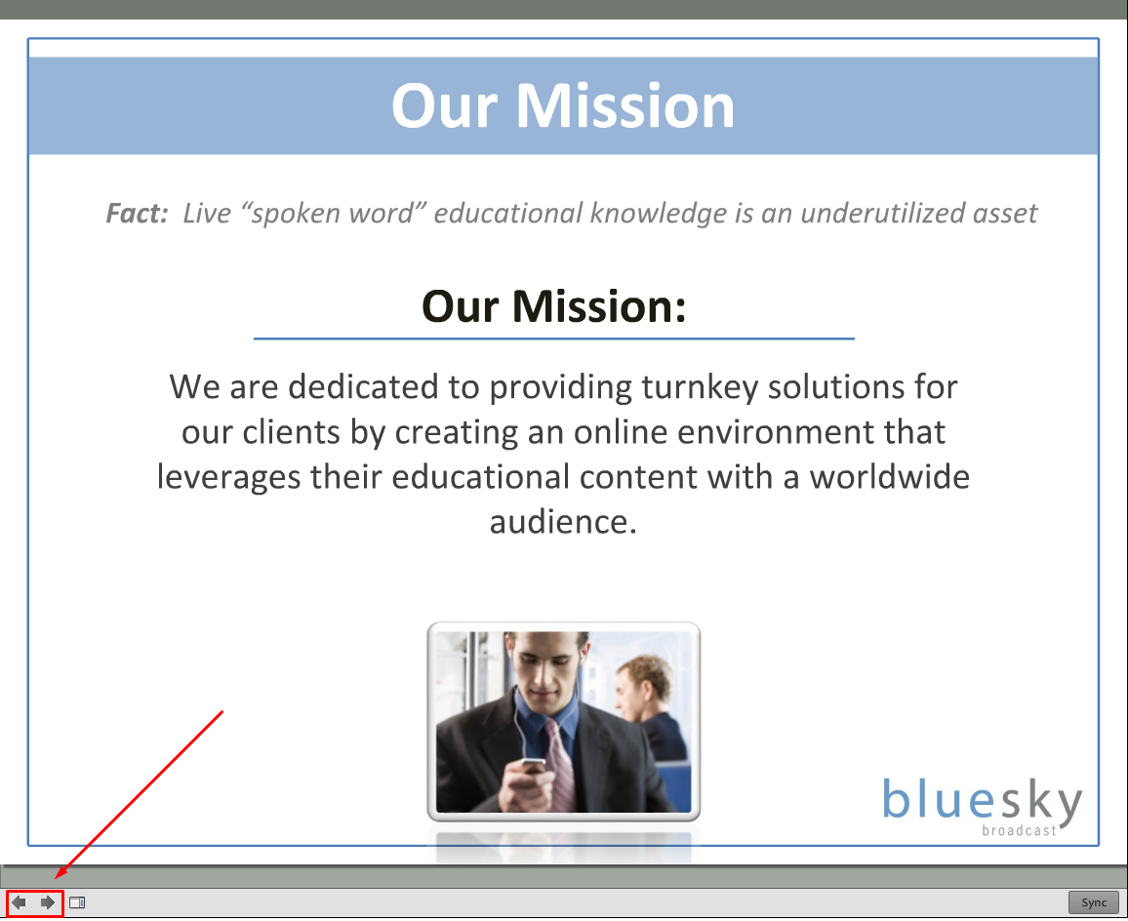
Advancing Slides
Presenting slides is easy with Connect! Simply click on the right arrow on the bottom left of the slide pod to advance. The left arrow will go backward.
You can also use your left and right arrow keys on your keyboard to control the slides once the slide pod is activated.

Slide 41
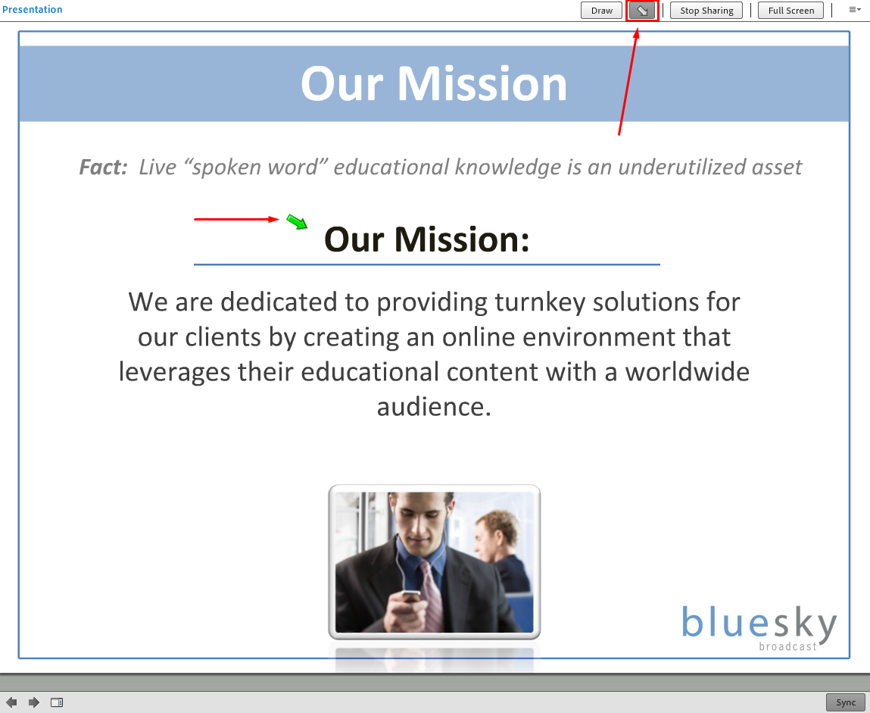
Pointer Arrow
A pointer arrow is available for presenters to show the audience their “mouse” and point to features on the slides
Just click the pointer arrow button above the slide to turn on. When you click and drag your mouse, the green arrow will follow. Click the button again to turn off.

