Slide 1
MEDICARE FOR RHEUMATOLOGISTS DURING THE COVID CRISIS AND BEYOND:
Coalition of State Rheumatology Organizations
Via Webinar
May 6, 2020; 5:00-6:00 PM Pacific

Slide 2
WE WILL DISCUSS
Brief Look at COVID-19
Financial Support for Physicians
Increased Use of Telemedicine types & Sites for COVID (telehealth, virtual visits, visits, e-visits, telephone visits)
CDC Weighs in on elective vs emergent
Many audits and TPE stopped for now
Some Things Don’t Change 2020
Clear Documentation Still Important
Electronic Med Records/Problematic
Screening Tests for Endocrinologists
NCDs / LCDs for Rheumatologists
Looking at Changes 2021
Documentation Simplification
Appropriate Utilization Criteria / Imaging
Evaluation and Management Changes
Q&A

Slide 3
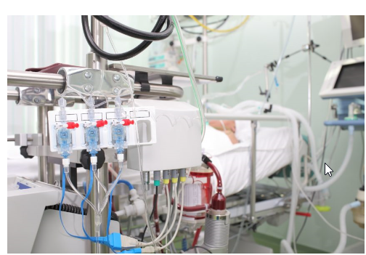
COVID-19 EMERGENCY
“It was the best of times, it was the worst of times, it was the age of wisdom, it was the age of foolishness, it was the epoch of belief, it was the epoch of incredulity, it was the season of Light, it was the season of Darkness, it was the spring of hope, it was the winter of despair… ” – Charles Dickens, A Tale of Two Cities, 1859.

Slide 4
NORIDIAN HOT LINE
To support our providers in JE and JF, a COVID-19 Hotline has been established to help with COVID-19 related inquiries. The hotline number is: 866-575-4067. Customer services reps will be available Monday-Friday from 8 a.m.-6 p.m. CDT. The hotline will answer questions on provisional billing privileges and enrollment flexibilities afforded by the COVID-19 waiver for health care facilities and providers, as well as Part A, B, and DME payments related to COVID-19 emergency
CMS ON LINE EMERGENCY PAGE: https://www.cms.gov/About-CMS/Agency-Information/Emergency/EPRO/Current-Emergencies/Current-Emergencies-page

Slide 5
CMS Flexibilities to Fight COVID-19
Since the beginning of the COVID-19 Public Health Emergency, the Trump Administration has issued an unprecedented array of temporary regulatory waivers and new rules to equip the American healthcare system with maximum flexibility to respond to the 2019 Novel Coronavirus (COVID-19) pandemic. These temporary changes will apply immediately across the entire U.S. healthcare system for the duration of the emergency declaration. (4-29-20)
https://www.cms.gov/files/document/covid-19-physicians-and-practitioners.pdf

Slide 6
https://covid19treatmentguidelines.nih.gov/introduction/

Slide 7
https://www.cdc.gov/coronavirus/2019-ncov/hcp/clinical-guidance-management-patients.html

Slide 8
ELECTIVE AND NON-EMERGENT SERVICES DURING COVID-19
What to Take Into Consideration
Current and projected COVID-19 cases in the community and region
Ability to implement telehealth, virtual check-ins, and/or remote monitoring
Supply of personal protective equipment available at the practice location and in the region
Staffing availability
Medical office/ambulatory service location capacity
Testing capability in the local community*
Health and age of each individual patient and their risk for severe disease
Urgency of the treatment or service
CDC Priority of Who To Test (see next table)
https://www.cdc.gov/coronavirus/2019-ncov/hcp/clinical-criteria.html

Slide 9
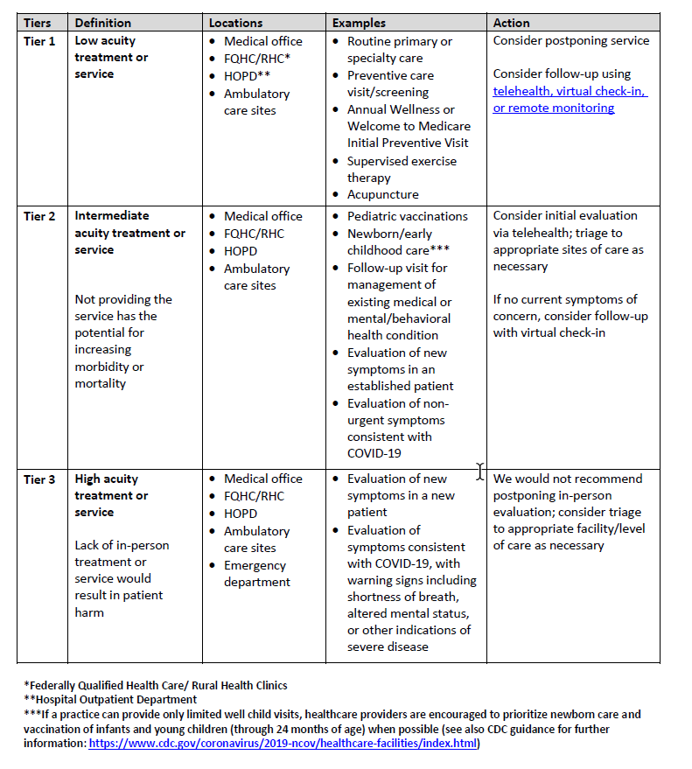

Slide 10
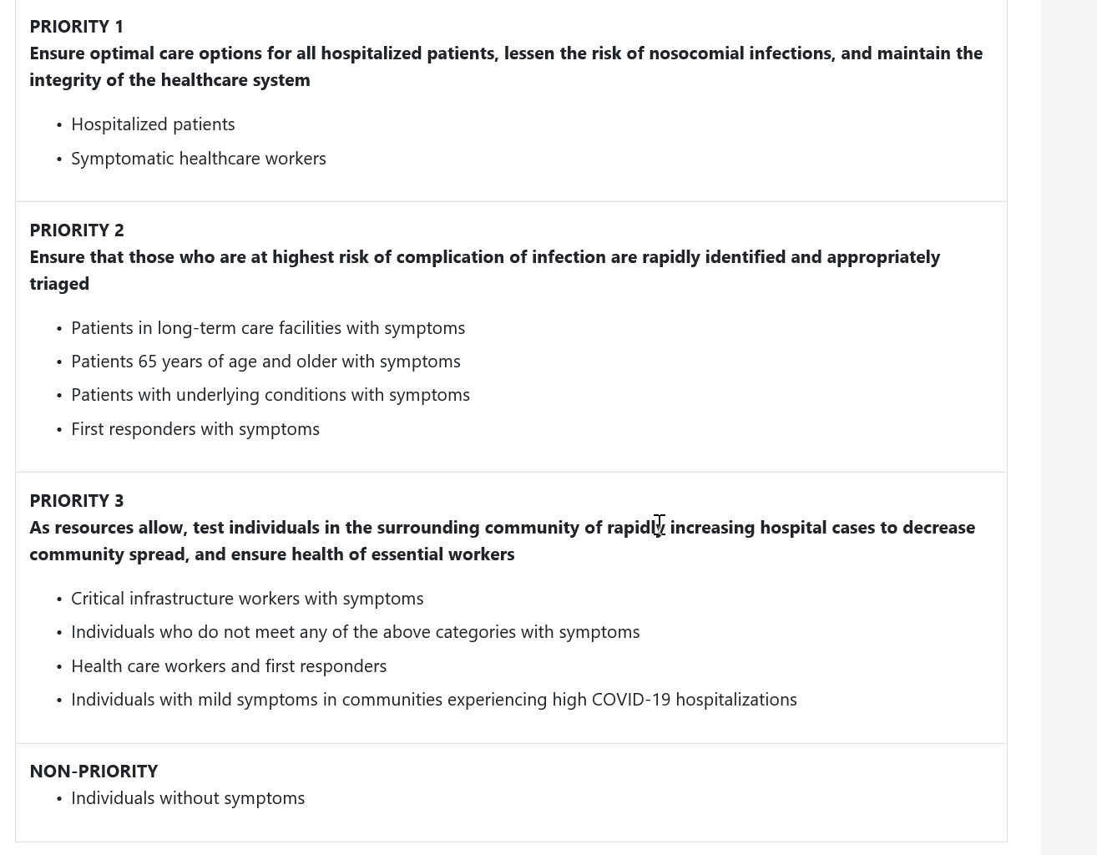
CDC PRIORITY TREATMENT LIST

Slide 11
CARES Act Provider Relief Fund
On March 27, 2020, the President signed the bipartisan CARES Act that provides $100 billion in relief funds to hospitals and other healthcare providers on the front lines of the coronavirus response. This funding will be used to support healthcare-related expenses or lost revenue attributable to COVID-19 and to ensure uninsured Americans can get testing and treatment for COVID-19.
Recognizing the importance of delivering funds in a fast and transparent manner, $30 billion is being distributed immediately – with payments arriving via direct deposit beginning April 10, 2020 – to eligible providers throughout the American healthcare system.
These are payments, not loans, to healthcare providers, and will not need to be repaid.
Is this different than CMS Accelerated / Advance Payment Program?
Yes. The CMS Accelerated and Advance Payment Program has delivered billions of dollars to healthcare providers to help ensure providers and suppliers have the resources needed to combat the pandemic. The CMS accelerated and advance payments are a loan that providers must pay back. Read more information from CMS.
All relief payments are being made to providers and according to their tax identification number (TIN).
https://www.hhs.gov/provider-relief/index.html

Slide 12
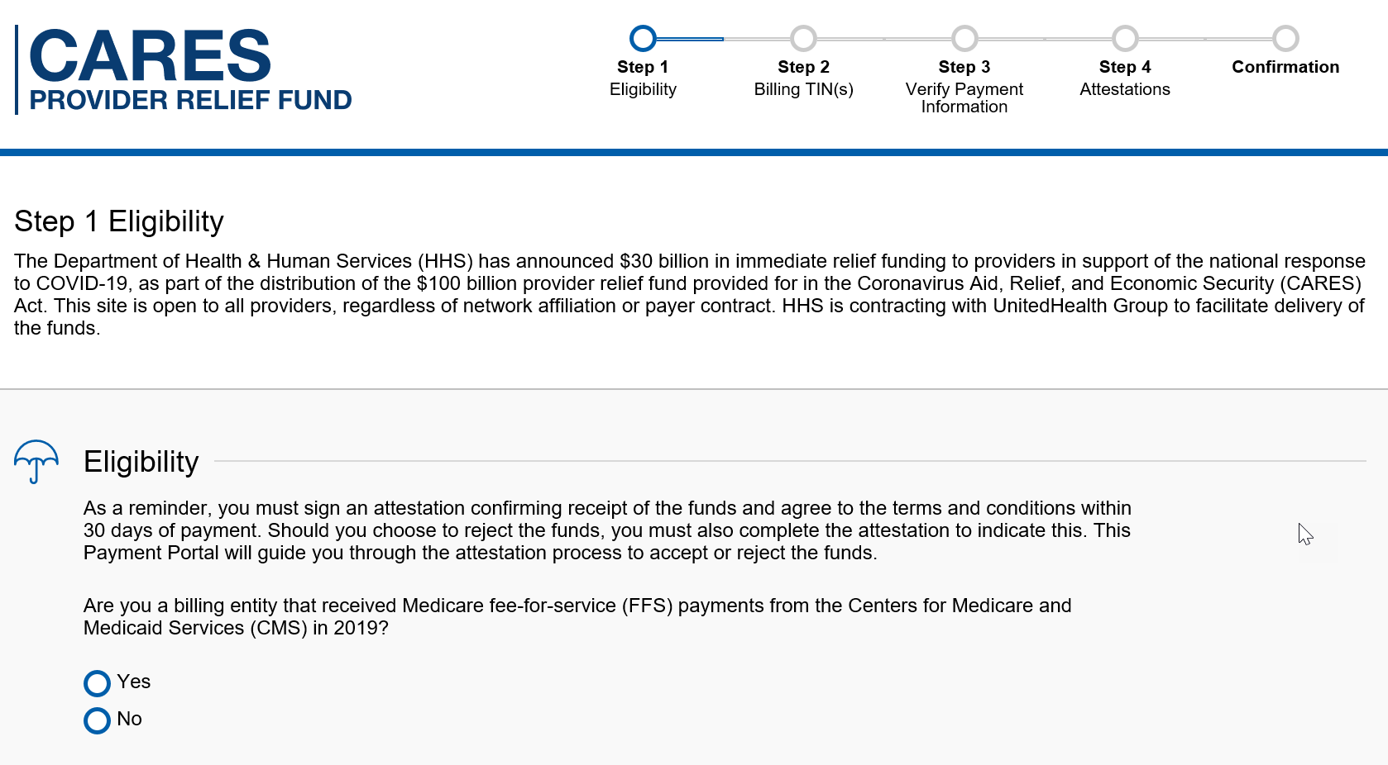
https://covid19.linkhealth.com/#/step/1

Slide 13
PHASE TWO PROVIDER RELIEF
All providers with a Medicare billing TIN are now eligible to apply for a portion of this $20 billion by submitting data about their annual revenues (through IRS tax filings) and estimated COVID-related lost revenue for March & April 2020 via Provider Relief Fund General Distribution Portal.
The U.S. Department of Health and Human Services (HHS) on April 23, 2020, announced a $20 billion phase two round of funding for health care providers from the $175 billion CARES Act Provider Relief Fund. HHS is dispersing the additional $20 billion to providers based on a percentage of each provider’s 2018 net patient revenue from all payors, not just Medicare fee-for-service payments. The funds are grants and do not need to be repaid.
For more information, see the HHS FAQ and application guide
AMA guidance to help physicians

Slide 14
Accelerated/Advance Payment Program for Medicare Providers
Funds have been provided through expansion of the Accelerated and Advance Payment Program to ensure providers and suppliers have the resources needed to combat the pandemic.
The streamlined process implemented by CMS for COVID-19 has reduced processing times for a request of an accelerated or advance payment to between four to six days
Payments are available to Part A providers, including hospitals, and Part B suppliers, including doctors, non-physician practitioners and durable medical equipment (DME) suppliers. While most of these providers and suppliers can receive three months of their Medicare reimbursements, certain providers can receive up to six months

Slide 15
Accelerated/Advance Payment Program for Medicare Providers
Advance and accelerated payments are a loan providers must pay back.
CMS will begin to apply claims payments to offset the accelerated/advance payments 120 days after disbursement.
Part B suppliers will have up to 210 days to complete repayment of accelerated and advance payments, respectively. Interest rates occur if not repaid
The fact sheet on the accelerated/advance payment process and how to submit a request can be found here: Fact Sheet.
Providers can also contact their Medicare Administrative Contractor for any questions.
https://www.cms.gov/files/document/Accelerated-and-Advanced-Payments-Fact-Sheet.pdf
PROGRAM HALTED 4-27-20—SEE Provider Relief Fund DETAILS

Slide 16
MIPS: Quality Payment Program and Quality Reporting Program/Value Based Purchasing Program COVID-19 Relief
On March 22, 2020, CMS announced relief for clinicians, providers, hospitals and facilities participating in quality reporting programs in response to the 2019 Novel Coronavirus (COVID-19). This memorandum and factsheet supplements and provides additional guidance to health care providers with regard to the announcement.
CMS has extended the 2019 Merit-based Incentive Payment System (MIPS) data submission deadline from March 31 by 30 days to April 30, 2020. This and other efforts are to provide relief to clinicians responding to the COVID-19 pandemic.
In addition, the MIPS automatic extreme and uncontrollable circumstances policy will apply to MIPS eligible clinicians who do not submit their MIPS data by April 30, 2020 deadline.
You can find a copy of the memo here: Memo
You can find a copy of the fact sheet here: Fact Sheet

Slide 17
CMS OFFERING MIPS, QPP CREDIT for COVID-19 DATA
Clinicians may now earn credit in the Merit-based Incentive Payment System (MIPS), a performance-based track of QPP that incentivizes quality and value, for participation in a clinical trial and reporting clinical information by attesting to the new COVID-19 Clinical Trials improvement activity
To view a database of privately and publicly funded clinical studies currently being conducted visit: https://clinicaltrials.gov/
In order to receive credit for the new MIPS COVID-19 Clinical Trials improvement activity, clinicians must attest that they participate in a COVID-19 clinical trial utilizing a drug or biological product to treat a patient with a COVID-19 infection and report their findings through a clinical data repository or clinical data registry for the duration of their study
https://www.cms.gov/newsroom/press-releases/trump-administration-champions-reporting-covid-19-clinical-trial-data-through-quality-payment

Slide 18
COVID MIPS UPDATE
https://qpp-cm-prod-content.s3.amazonaws.com/uploads/966/QPP%20COVID-19%20Response%20Fact%20Sheet.pdf

Slide 19
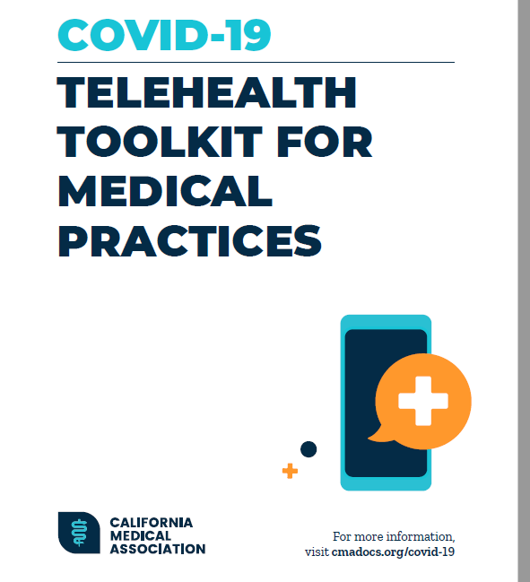
https://www.cmadocs.org/Portals/CMA/files/public/ CMA%20COVID-19%20Telehealth%20Overview.pdf

Slide 20
CMS TELEHEALTH VIDEO-RELATED TO COVID-19
https://www.youtube.com/watch?v=bdb9NKtybzo&feature=youtu.be

Slide 21
TELEHEALTH DURING COVID-19
Visits conducted between a provider and patient using two-way telecommunication systems with audio and video capabilities.
Two-way, real-time interactive audio/video telecommunication capability is needed.
Bill professional claims for all telehealth services with DOS on and after March 1, 2020, and for the duration of the PHE to Medicare with:
Place of service (POS) equal to what it would have been had the service been furnished in-person (example: POS 11 for office)
Modifier 95 should be applied to claim lines for services furnished via telehealth
The complete list of all Medicare telehealth services can be found here
https://www.cms.gov/Medicare/Medicare-General-Information/Telehealth/Telehealth-Codes

Slide 22
TELEHEALTH TAKEAWAY
Effective for services March 6, 2020 and for duration of the COVID-19 Public Health Emergency, Medicare will make payment for Medicare telehealth services to patients in broader circumstances.
These visits are considered the same as in-person visits and are paid at the same rate as regular, in-person visits.
Starting March 6, 2020 and for duration of COVID-19 Public Health Emergency, Medicare will make payment for professional services furnished to beneficiaries in all areas of the country in all settings.
While they must generally travel to or be located in certain types of originating sites such as a physician’s office, skilled nursing facility or hospital for the visit, effective for services starting March 6, 2020 and for the duration of the COVID-19 Public Health Emergency, Medicare will make payment for Medicare telehealth services furnished to beneficiaries in any healthcare facility and their home.
The Medicare coinsurance and deductible would generally apply to these services. However, HHS Office of Inspector General is pro-viding flexibility for healthcare providers to reduce or waive cost-sharing for telehealth visits paid by federal healthcare programs.
To the extent the 1135 waiver requires an established relationship, HHS will not conduct audits to ensure that such a prior relationship existed for claims submitted during this public health emergency.

Slide 23
VIRTUAL CHECK IN
Brief (5-10 minutes) checks in with practitioner via telephone or other telecommunications device to decide whether an office visit or other service is needed. May include remote evaluation of recorded video and/or images submitted by an established patient.
Healthcare Common Procedure Coding System (HCPCS) codes G2010 and G2012 may only be reported when they do not result in an in-person or telehealth visit.
Bill the appropriate code with the POS where service would normally take place.
No modifier required. If you submit these services with modifier 95, claim may deny.

Slide 24
VIRTUAL VISIT TAKEAWAY
Virtual check-in services can only be reported when the billing practice has an established relationship with the patient.
This is not limited to only rural settings or certain locations.
Individual services need to be agreed to by the patient; however, practitioners may educate beneficiaries on the availability of the service prior to patient agreement.
HCPCS code G2012: Brief communication technology-based service, e.g. virtual check-in, by a physician or other qualified health care professional who can report evaluation and management services, provided to an established patient, not originating from a related e/m service provided within the previous 7 days nor leading to an e/m service or procedure within the next 24 hours or soonest available appointment; 5-10 minutes of medical discussion.
HCPCS code G2010: Remote evaluation of recorded video and/or images submitted by an established patient (e.g., store and forward), including interpretation with follow-up with the patient within 24 business hours, not originating from a related e/m service provided within the previous 7 days nor leading to an e/m service or procedure within the next 24 hours or soonest available appointment.
Virtual check-ins can be conducted with a broader range of communication methods, unlike Medicare telehealth visits, which require audio and visual capabilities for real-time communication.

Slide 25
E-VISITS
In all types of locations including the patient’s home, and in all areas (not just rural), established Medicare patients may have non-face-to-face patient-initiated communications with their doctors without going to the doctor’s office by using online patient portals. These services can only be reported when the billing practice has an established relationship with the patient…
Medicare Part B pays for E-visits or patient-initiated online evaluation and management conducted via a patient portal. Practitioners who may independently bill Medicare for evaluation and management visits (for instance, physicians and nurse practitioners) can bill the following codes
99421: Online digital evaluation and management service, for an established patient, for up to 7 days, cumulative time during the 7 days; 5–10 minutes
99422: Online digital evaluation and management service, for an established patient, for up to 7 days cumulative time during the 7 days; 11– 20 minutes
99423: Online digital evaluation and management service, for an established patient, for up to 7 days, cumulative time during the 7 days; 21 or more minutes.

Slide 26
E-VISITS (NON-E&M)
Clinicians who may not independently bill for evaluation and management visits (E.G., physical therapists, occupational therapists, speech language pathologists, clinical psychologists) can also provide these e-visits and bill the following codes:
G2061: Qualified non-physician healthcare professional online assessment and management, for an established patient, for up to seven days, cumulative time during the 7 days; 5–10 minutes
G2062: Qualified non-physician healthcare professional online assessment and management service, for an established patient, for up to seven days, cumulative time during the 7 days; 11–20 minutes
G2063: Qualified non-physician qualified healthcare professional assessment and management service, for an established patient, for up to seven days, cumulative time during the 7 days; 21 or more minutes.

Slide 27
E-VISIT TAKEAWAYS
These services can only be reported when the billing practice has an established relationship with patient.
This is not limited to rural settings. There are no geographic or location restrictions for these visits.
Patients communicate with their doctors without going to the office by using online patient portals.
Individual services need to be initiated by the patient; however, practitioners may educate beneficiaries on the availability of the service prior to patient initiation.
The services may be billed using CPT codes 99421-99423 and HCPCS codes G2061-G206, as applicable.
Medicare coinsurance and deductible would generally apply to services (but not forced).

Slide 28
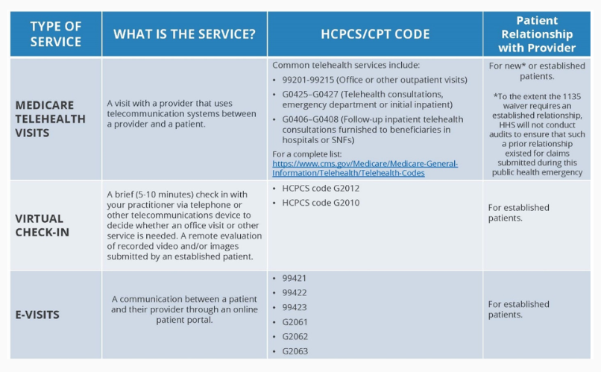
SUMMARY OF VARIOUS NON-FACE TO FACE VISITS
https://www.cms.gov/newsroom/fact-sheets/medicare-telemedicine-health-care-provider-fact-sheet

Slide 29
COVID THERAPY CODES UPDATE
CMS is designating the below listed codes collec-tively termed as communication technology-based services (CTBS) as “sometimes therapy” to permit physicians and NPPs, including nurse practitioners, physician assistants, and clinical nurse specialists to furnish these services outside a therapy plan of care when appropriate. When furnished by psychologists, licensed clinical social workers, or other practitioners, these CTBS codes are never considered therapy services and can’t be reported with GN, GO, or GP therapy modifier.
The following three CPT codes, using their short descriptors, are added for telephone assessment and management services:
CPT code 98966 (Hc pro phone call 5-10 min)
CPT code 98967 (Hc pro phone call 11-20 min)
CPT code 98968 (Hc pro phone call 21-30 min)

Slide 30
COVID THERAPY CODES UPDATE
HCPCS code G2010 (Remote image submit by pt)
HCPCS code G2012 (Brief check in by MD/QHP)
HCPCS code G2061 (Qual non MD est pt 5-10 min)
HCPCS code G2062 (Qual non MD est pt 11-20 min)
HCPCS code G2063 (Qual nonMD est pt 21 min)
When any of the above-listed CTBS codes are furnished by therapists, they’re always furnished under a therapy plan of care and require the associated therapy modifier of GP, GO, or GN, for physical therapy, occupational therapy or speech-language pathology.

Slide 31
TELEPHONE ONLY SERVICES
Non-face-to-face E&M services provided using telephone audio only.
Current Procedural Terminology® (CPT®) codes include:
98966-98968 (Non-face-to-face non-physician telephone services)
99441-99443 (Non-face-to-face physician telephone services)
Bill appropriate code with the POS where the service would normally take place.
No modifier is required. If you submit these services with modifier 95, the claim may deny.
https://www.cms.gov/newsroom/fact-sheets/medicare-telemedicine-health-care-provider-fact-sheet

Slide 32
OFFICE TELEHEALTH CODING UNDER COVID-19 EMERGENCY
On an interim basis, we are revising our policy to specify that the office/outpatient E/M level selection for these services when furnished via telehealth can be based on MDM or time, with time defined as all of the time associated with the E/M on the day of the encounter; and to remove any requirements regarding documentationof history and/or physical exam in the medical record.
This policy is similar to the policy that will apply to all office/outpatient E/Ms beginning in 2021under policies finalized in the CY 2020PFS final rule.
Federal Register / Vol. 85, No. 66 / Monday, April 6, 2020 / Rules and Regulations 19269 …CMS Interim Final Rule COVID

Slide 33
DOCUMENTING REASONABLE & NECESSARY:
Only the actual physician who is treating the patient knows what is reasonable and necessary for that patient being evaluated and treated.
The only way a Noridian reviewer can determine if something is (was) reasonable and necessary on a claim is to review the complete documentation submitted

Slide 34
LOOKING AT EMR CLAIMS
EMR Must be up to date for each visit—not cloned
Reasonable and Necessary still rules in 2019 for each visit and each service
Review of systems: must be coherent & Decision Making Most Important
Helpful if explained / listed / or documented in chart
Important to list changes in care or diagnoses since last visit
Lab review helps decision making
Excess verbiage on some EHR still does not give extra value, nor unnecessary E&M points. Services must be reasonable and necessary
EMRs take time to learn---by doctor or scribe, and some doctors are uncomfortable with electronic records and the time it takes to fill them out
Get me outta here

Slide 35
TARGETED PROBE AND EDUCATION
CURRENT MEDICAL REVIEW PROCESS!!
CMS authorized Medicare Contractors to conduct the Targeted Probe and Educate (TPE) Pilot review process. The TPE review process includes three rounds of a prepayment probe review with education.
If there are continued high denials after three rounds, the Medicare Contractor will refer the provider/supplier to CMS for additional action, which may include 100% prepay review, extrapolation, referral to a Recovery Auditor, etc.
Note, discontinuation of review may occur at any time if appropriate improvement is achieved during the review process.
PROGRAM HELD DURING COVID-19 EMERGENCY

Slide 36
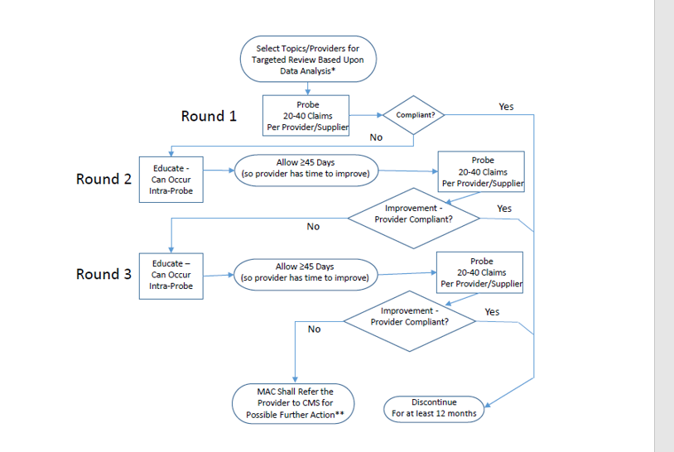
TARGETED PROBE
AND EDUCATION

Slide 37
NATIONAL / LOCAL COVERAGE DETERMINATIONS ARE CHANGING
Created by CMS or under CMS control
Usually have open/transparent process
Presented at MEDCAC open meetings at CMS that anyone can attend and comment
Written notice and comment always allowed and responded to—usually by societies / companies
Must be followed by MACs, auditors and administrative law judges
In future, older NCDs may change or retire
When science and practices change
After formal reconsideration with literature
NCDs give CPT and ICD-9 codes for auto-editing

Slide 38
NCDs AFFECTING RHEUMATOLOGY
Acupuncture
Apheresis (Therapeutic Pheresis)
Arthroscopic Lavage and Arthroscopic Debridement for the Osteoarthritic Knee
Bone (Mineral) Density Studies
Collagen Meniscus Implant
Lumbar Artificial Disc Replacement (LADR)
Osteogenic Stimulators
Percutaneous Image-Guided Lumbar Decompression for Lumbar Spinal Stenosis
Thermal Intradiscal Procedures (TIPs)
Transcutaneous Electrical Nerve Stimulation (TENS) for Chronic Low Back Pain (CLBP)
Transcutaneous Electrical Nerve Stimulators (TENS)
Vertebral Axial Decompression (VAX-D)

Slide 39
LOCAL COVERAGE DETERMINATIONS
Local Coverage Determination (LCD) More Transparent
Rationale must be given for any new coverage changes
Literature explained in policy---increased number journals
Sent to CMS 21 days prior to publication---medical input accepted
Contractor Advisory Committee: will be changing
Initial CAC is evidentiary with Subject Matter Experts reviewing
Contractors take information from SME and write draft policy
Draft policy explained at Open Meeting—open to all for comment
CAC / Open meetings can be live meetings and / or webinars
Guidelines. white papers & journals from societies important
National or Local Coverage Determinations explained in detail on Noridian website and CMS website—we tell you how to code
Changes will still be possible for LCDs
Individual Considerations for patients with specific situations
Reconsiderations of local policy possible with submission of appropriate peer reviewed literature or society white papers
We value your opinions, but when asking for changes, SHOW US THE DATA…in God we trust, everyone else needs data

Slide 40
LCDs AFFECTING RHEUMATOLOGY
Facet Joint Injections, Medial Branch Blocks, and Facet Joint Radiofrequency Neurotomy
Immune Globulin Intravenous (IVIg)
Lumbar Epidural Injections
Lumbar MRI
Nerve Blockade for Treatment of Chronic Pain and Neuropathy
Percutaneous Vertebral Augmentation (PVA) for Osteoporotic Vertebral Compression Fracture (VCF)
Spinal Cord Stimulators for Chronic Pain
Total Hip Arthroplasty
Total Knee Arthroplasty
Trigger Point Injections
Recently CMS has requested Medicare Contractors to work together to have multiple jurisdictional Local Coverage Policies for consistency of coverage across the country.

Slide 41
FIGHTING BACK: RESPONDING TO ANY REQUEST FOR RECORDS
Have a set office process for dealing with all ADRs (Additional Record Requests)
Have one individual responsible for sending all records as part of the set office process
Experienced office person, or clinical person, or both
Have a check off sheet that involves
Legibility (can add typed / printed addendum)
Correct name, date, physician listed in request
Signature (signature sheet or attestation if needed)
Correct address to send records
Timeliness of records being sent
Know how and where to get hospital records
Send by certified mail (or equivalent)

Slide 42
APPEALS PROCESS
Initial Determination from Noridian ($1)
Redetermination from Noridian ($1)-120 days/file
Qualified Independent Contractor (QIC) ($1)-180 days/file
Administrative Law Judge (ALJ) ($170)-60 days/file
Department Appeals Board (DAB) ($170)-60 days/file
Federal Court ($1670)-60 days/file

Slide 43
EVALUATION AND MANAGEMENT: 2020 AND BEYOND
For CY 2020, CMS will continue the current coding and payment structure for E/M office/outpatient visits and physicians should continue to use either the 1995 or 1997 E/M guidelines to document E/M office and/or outpatient visits billed to Medicare. Major change in 2021
For CY 2020, CMS has implemented several policies to provide immediate burden reduction, while other changes to documentation, coding, and payment would be implemented in CY 2021.
For E/M office/outpatient visits, for both new and established patients, practitioners need not re-enter in the medical record information on patient’s chief complaint and history that has already been entered by ancillary staff, physicians in training or beneficiary.
Indicate in medical record that the physician reviewed and verified this information; and sign & date record or chart.

Slide 44
SUMMARY OF AMA REVISIONS: 2021
Effective Jan 2021- for office based E&M
Eliminate history and physical as elements for code section:
While the physician’s work in capturing the patient’s pertinent history and performing a relevant physical exam contributes to both the time and medical decision making, these elements alone should not determine the appropriate code level.
The Workgroup revised the code descriptors to state providers should perform a “medically appropriate history and/or examination”

Slide 45
SUMMARY OF REVISIONS 2021
Allow physicians to choose whether their documentation is based on Medical Decision Making (MDM) or Total Time:
MDM: The Workgroup did not materially change the three current MDM sub-components, but did provide extensive edits to the elements for code selection and revised/created numerous clarifying definitions in the E/M guidelines. (See below for additional discussion.)
Time: The definition of time is minimum time, not typical time, and represents total physician/qualified health care professional (QHP) time on the date of service. The use of date-of-service time builds on the movement over the last several years by Medicare to better recognize the work involved in non-face-to-face services like care coordination. These definitions only apply when code selection is primarily based on time and not MDM.

Slide 46
SUMMARY OF REVISIONS
Deletion of CPT code 99201: The Panel agreed to eliminate 99201 as 99201 and 99202 are both straightforward MDM & only different by history and exam elements.
Creation of a shorter Prolonged Services code:
The Panel created a shorter prolonged services code that would capture physician/QHP time in 15-minute increments.
This code would only be reported with 99205 and 99215 and be used when time was the primary basis for code selection.
CMS has accepted the revisions proposed by AMA

Slide 47
AND MORE IN 2021….FROM CMS
Implementation of add-on codes that describe additional resources inherent in visits for primary care and particular kinds of non-procedural specialized medical care, (though they would not be restricted by physician specialty).
These codes would only be reportable with E/M office/outpatient level 5 visits, and
Their use generally would not impose new per-visit documentation requirements; and
Adoption of a new “extended visit” add-on code for use only with E/M office/outpatient level 5 visits to account for the additional resources required when practitioners need to spend extended time with the patient.

Slide 48
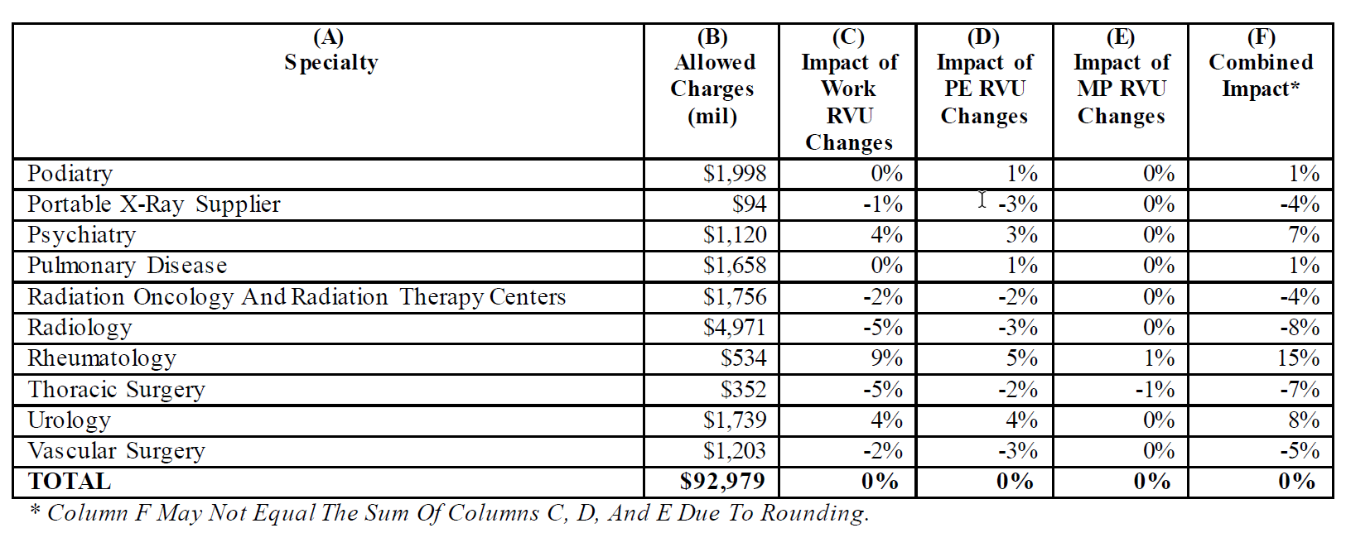
https://s3.amazonaws.com/public-inspection.federalregister.gov/2019-16041.pdf Page 1187, Table 111

Slide 49
SOME FUTURE THOUGHT
Newer biologic pharmaceuticals for rheumatology therapy and diagnostic tests arriving in the market
New less invasive surgical techniques developing
Artificial intelligence assisting diagnoses via mathematic algorithms or literature searches
Changes in medical school programs and teaching methods across the country
More virtual and telemedicine likely to continue
More gadgets for self monitoring by patients
Sub, sub, subspecialties emerging
Increase in NPPs and various medical jobs: scribes, assistants, therapists, coders, etc.
Non physicians running / owning practices
But before banging your head, everything is still subject to change by law or custom

Slide 50
CAT GOT YOUR TONGUE?
Ask all your questions---maybe I can answer some
Arthur.Lurvey@Noridian.com

