Slide 1
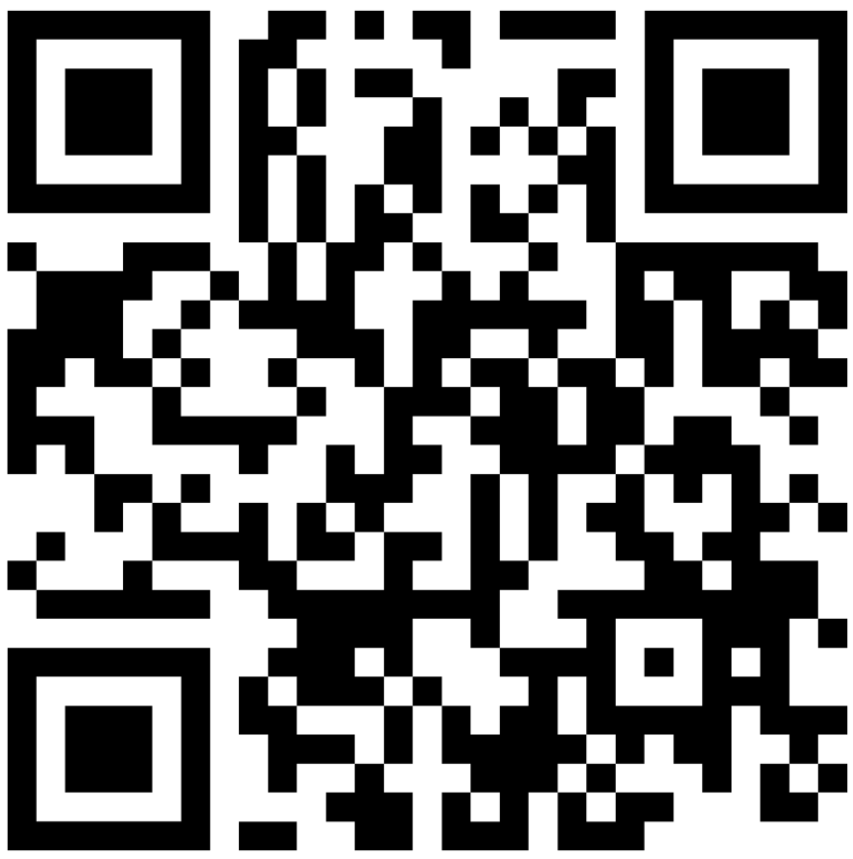
Attendance Discussion AWSP Grade Level Committee
Krissy Johnson, Assistant Director, Attendance & Engagement, OSPI
Shelby Lockhart, Attendance & Reengagement Lead, ESD 105
Malorie Kahl, Attendance & Reengagement Coordinator, ESD 123
Sunday, October 29, 2023
Notes:
8:30am (5 minutes)
AWSP Introductions
OSPI/ESD Team Intro – Who are we? How are we showing up today?

Slide 2
Why are we focused on attendance?
Notes:
8:35am (10 minutes) In addition to it being our job😊, we firmly believe that attendance is essential to student learning and success. We define attendance as “accessing instruction”. When our students are not accessing instruction, and the suite of supports, extracurriculars and relationships, that our schools offer, they are missing out on an opportunity for a successful future.

Slide 3
What is chronic absenteeism?
OSPI measures Chronic Absence and reports the inverse on Report Card as: “Regular Attendance”
10% or more of school days
Chronic Absenteeism
Excused
Unexcused
Notes:
Truancy is unexcused absences

Slide 4
Chronic absence in prek – 2nd grade: less likely to read at grade level by 3rd grade ->
4 times more likely than proficient peers to not graduate
Chronic absence in any 2 years between 8th – 12th grade: 50% chance of not finishing high school
Regular attendance is critical to student success
Attendance in the Early Grades: Why it Matters for Reading
Utah Data Alliance – Chronic Absenteeism Research Brief
Notes:
In fact, what we know about attendance is that when students miss 10% or more of their school days in kindergarten and 1st grade, they are significantly more likely to not be reading at grade level by the third grade. And reading at grade level by the third grade as you all know, is a significant building block to future success, so much so that a student not reading at grade level by the third grade is four times more likely to not graduate than their peers. The impact of not attending in middle and high school is also significant, a student who is chronically absent any two years between 8th and 12th grade is 50% more likely to not graduate from high school.

Slide 5
Talk to a partner (2 min.)
Do you know:
Your chronic absence rate from last school year?
Your enrollment last year?
Your withdrawn students (who don’t re-enroll elsewhere)?
Were these higher or lower than the year before? ​
Can you predict next year's data?

Slide 6
Post-pandemic Attendance & Enrollment Highly Impacted
Regular Attendance 67% (21-22)
K-12 enrollment down 3.9% from pre-pandemic
Missing Students: 34,306 students withdrawn unknown/dropout (22-23)
Comprehensive Education Data and Research System (CEDARS)
OSPI Report Card
Notes:
We want kids here for their sake, we also have lost a lot of funding due to nonattendance.
not enrolled elsewhere by end of the school year (22-23)
~$374 million in school funding lost
33% of students missed 18 days or more.

Slide 7
Why do students miss school?

Slide 8
Absenteeism has many influencing factors
Physical illness
Experiencing homelessness
Anxiety or depression
Student
Community
School
Family
Caring for siblings
Transportation
Do not feel welcome or belong at school
Have fallen behind in learning
Unsafe or challenging home environment
Notes:
Why are students absent? So, you all know that. You also know, that attendance is an indicator that can tell us any number of things! When a student is absent it could be because they have to go to the dentist, it could be because they are feeling anxiety or depression, the student might have responsibilities at home like taking care of their siblings, transportation may be a big issue, parents might be undervaluing regular attendance because they just don’t know the research and how many days missed are putting their students at risk, students could be experiencing bullying at school, or maybe they don’t feel socially connected, and staying home feels safer than braving the loud, busy, crowded comprehensive high school where they don’t have many friends or an adult who notices when they’re gone. Students might be getting trafficked.
Don’t take my explanation to mean that we don’t believe students and parents have choice or influence over their attendance, it’s just that the context of their experience matters greatly to their attendance, which is a behavior, we can think about it like we think about behavior, as communication, what are the needs they are trying to communicate, and what can we do to understand them and meet them?

Slide 9
What are you learning about why students are absent?
Notes:
Popcorn

Slide 10
“Be Curious, Not Judgmental”
Notes:
Stay curious. What we know about attendance is that the reasons a student is absent can because of multiple factors, some of those can originate in the school building, some of those might be at home. But we don’t know until we explore it with the student and family. We have an opportunity to stay curious. Not make assumptions.
Balancing accountability with support. We do believe that everyone has responsibility, including students, parents, but also educators, administrators, and us.

Slide 11
We have a Tier 1 System Challenge
Notes:
Tier 1 System Challenge. We are used to talking about attendance as a kid and family issue. When right now in our state, our attendance data is telling we’ve got a whole system tier 1 challenge. Remind them of data. Which means we need to figure out how to improve our system to support student to attend and engage. We can’t do it kid by kid. Not only do we not have the capacity for that, we have to get honest with ourselves about why students aren’t coming, and the only way to do that is to talk to kids and families, and use the data we have in an organized manner to address tier 1.

Slide 12
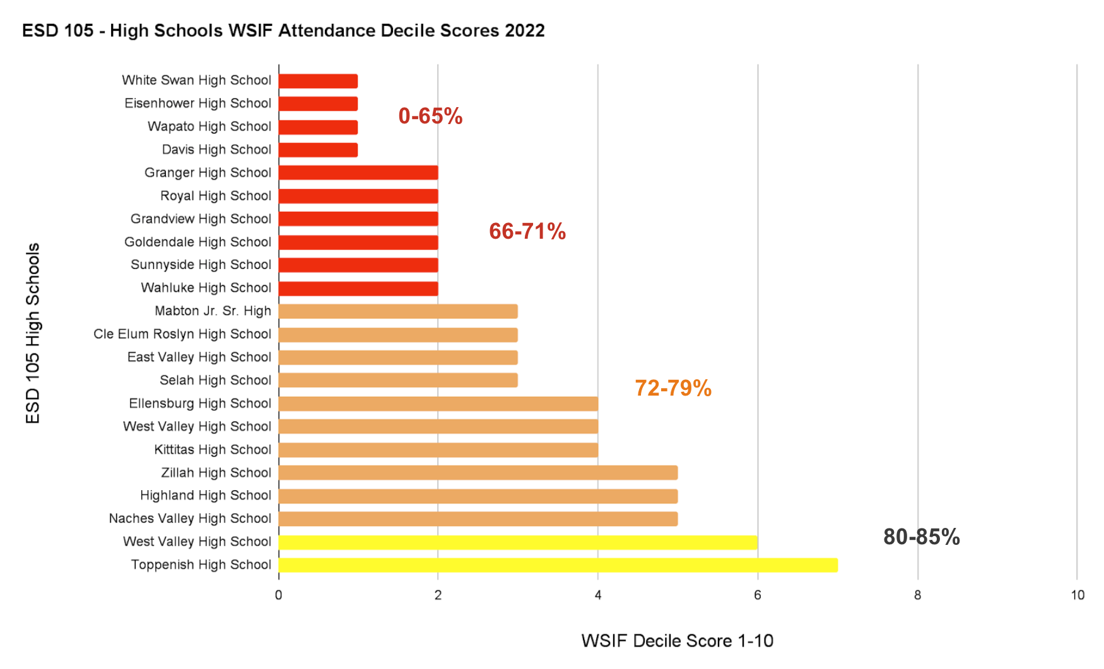
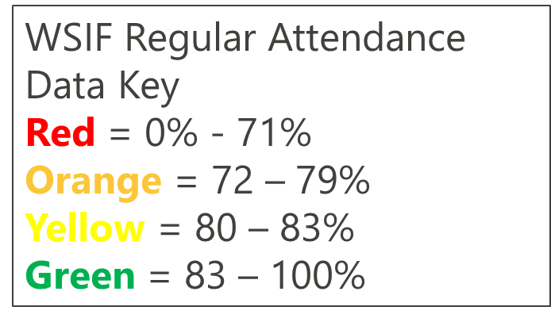
Regional Secondary Tier 1 Attendance Systems
Notes:
Krissy mentioned the state-wide data earlier, here’s a snapshot of secondary schools in one region.

Slide 13
Self-Assess
1. On Paper
2. Turn and Talk
3. Fist to 6
Do you have access to chronic absence data (missing 10% excused and unexcused)?
Do you have a team that looks at Tier 1 schoolwide attendance trends?
Do you have a team that addresses group interventions based on barriers (Tier 2)?
Do you have a team that supports individual students with more intense interventions (Tier 3)?
Do you have a continuum of supports (interventions) with clear roles and action steps assigned when students meet certain thresholds of absences?
Does your continuum of support (interventions) & messaging about attendance focus on building relationships & helping to address barriers (or do they lean on blame, shame or threat)?
Notes:
5 minutes. How many of you have your tier 2 & 3 in place, and are missing your tier 1?

Slide 14
Attendance Improvement Theory of Action

Slide 15
Theory of Action This is what we know about Attendance Improvement…
If we focus on:
Teaming
Then we will:
Increase student attendance, engagement and learning
Data
Tiered supports
Student, family, and community partnership

Slide 16
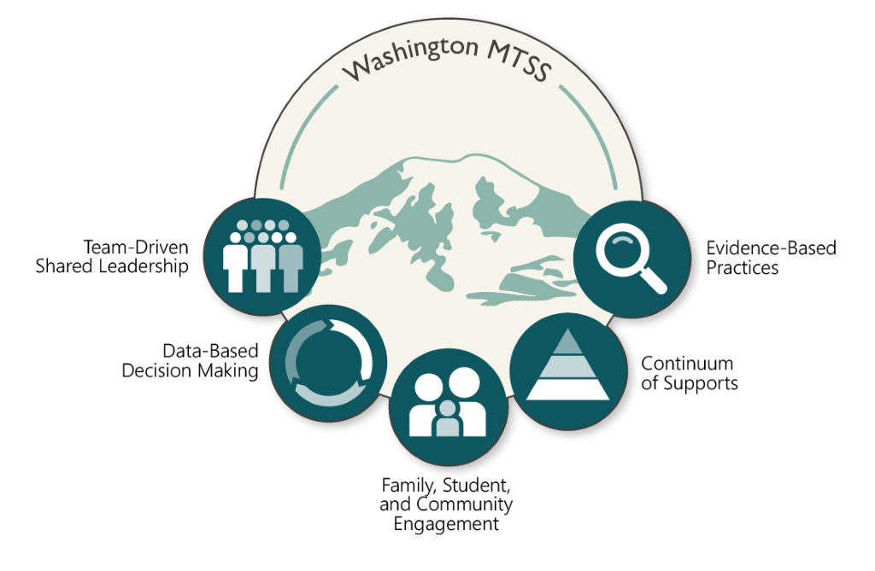
Washington MTSS
Attendance critical part of MTSS

Slide 17
Washington MTSS

Slide 18
Teaming for Better Attendance
Team(s) Functions
Analyze schoolwide and student group attendance trends
Organize an attendance continuum of support
Tier 1 - Establish universal prevention each month
Tier 2 - Define and Monitor Intervention Groups
Tier 3 - 1:1 Case Management
Leveraging student voice
Tips
Functions may not be the fulfilled by the same team
Functions may fit or be added to existing teams
Teams might be 2 people!
Principal’s Role
Authorize, sponsor and support teaming on attendance.
Notes:
Team can be embedded
Mobilize the school and greater community to address attendance
This aligns with the AWSP Leadership framework – which calls out Planning with Data and Closing the Gap

Slide 19
Real-World Examples: Teaming
Percent of Students Attending 85% or more days in 5 SPS Elementary Schools
The principal of Stevens Elementary attributes their growth in attendance to their attendance team.
 | 2021-2022 | 2022-2023 | Change since previous year
Stevens | 55% | 75% | + 20%
School A | 63% | 63% | 0%
School B | 62% | 62% | 0%
School C | 60% | 73% | 13%
School D | 53% | 69% | 16%
Source: SPS Chronic Absence Data from Data Tools as of 5/19/2023; includes students in the “Satisfactory”, “At-Risk”, and “Chronic” categories
Notes:
ABCD schools are in the same district.

Slide 20
Washington MTSS

Slide 21
The Three A’s of Data Literacy – Principal’s Role
Access
Broadening access to democratize data
Analysis & Sense-making
Know the levels: coarse to fine
Action Planning
Lead the change through progress monitoring
Help people make sense

Slide 22
Data-based Decision Making
Guiding questions to keep asking:
Who is missing?
Why are they missing?
What other information do we need to answer these two questions?
Are we ready to hear it's us, not them?
This Photo by Unknown Author is licensed under CC BY-SA

Slide 23
Team Data Literacy Capacity
What other data sources (besides attendance) can help you answer these questions?
Qualitative data (empathy interviews, student voice, focus groups, surveys, etc.)
Screening data (SEB, Academic, Attendance, Incident)
Health, safety data, transportation Data
Systems/practices fidelity data (PBIS, Attendance, Shape)
Students and families are critical contributors to this knowledge

Slide 24
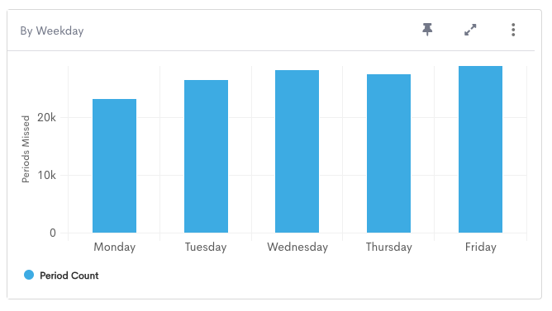
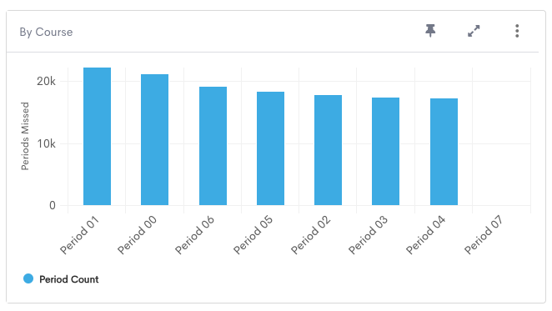
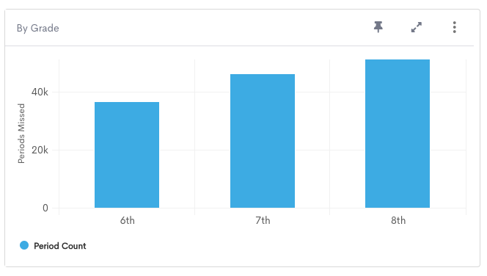
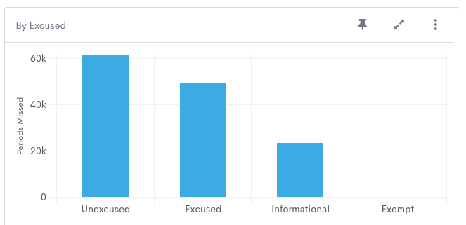
Tier 1 Attendance Data – Prevention
PBIS/Attendance Teams
Big 3 - Who, When, Why
Precision Problem Solving
Notes:
Shelby

Slide 25
Data
Prevention & Barriers
Interventions

Slide 26
Washington MTSS
Notes:
Allyson

Slide 27
Guiding Question
Is this practice beloved or predatory?
Does this practice maintain dignity or does it shame?
Notes:
As a leader: always asking yourself is this practice

Slide 28
Tier 1 Attendance Strategies
Awareness & communication
Do parents know how to excuse absences?
Are schedules and attendance expectations communicated clearly and consistently?
Impact of attendance on the whole child is widely understood – families, students, and educators
Clear expectations of teachers
Incentives, celebrations & fun competitions)
Connection to caring adult in the school
Notes:
Awareness & communication notes:
Personalized communication to families when students are absent that sustains dignity like “Welcome back” and “We missed you” messages

Slide 29
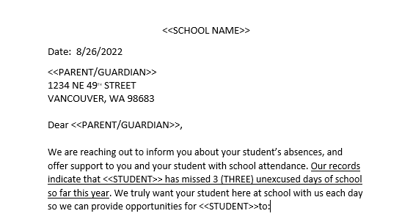
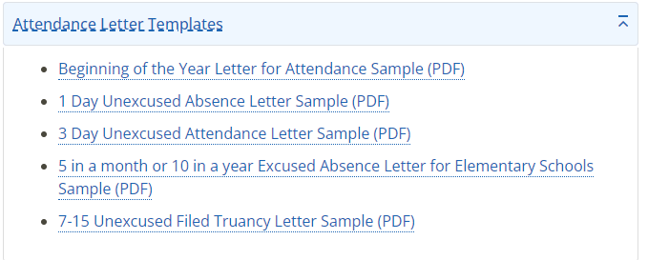
Tier 1 – Real World Examples
Human-Centered Attendance Communications
OSPI Letter Templates
Resource: OSPI Attendance Resources & Materials
Notes:
Universal means data driven too.
As a leader this practice is: supportive or harmful. Is it shame and blame or supportive

Slide 30
Welcoming communication
Front office communication
Welcome back environment after school breaks
Follow up post-cards
How to Talk to Parents about Attendance-Communication that Works

Slide 31
Nudge Letters
Notes:
It is a researched based method to impact change. What are you nudging?

Slide 32
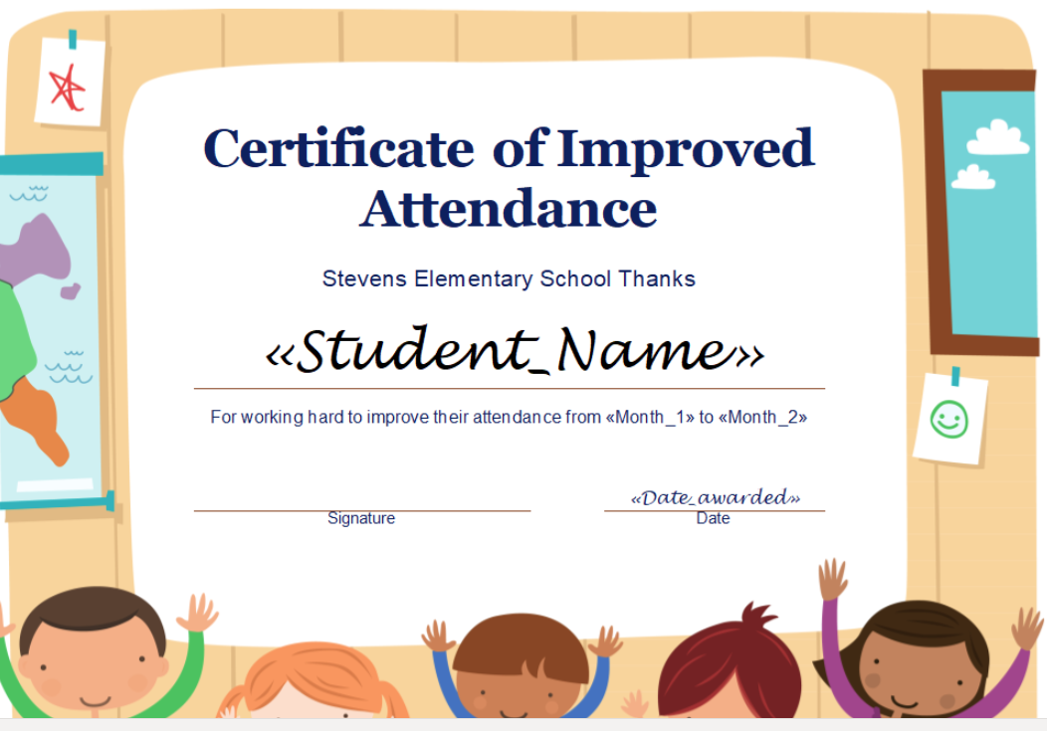
Tier 1 – Real World Examples
Improved Attendance Awards & Incentives
Attendance Challenges
Notes:
No perfect attendance, recognize improved attendance, lots of opportunities for individuals and whole classrooms or grades
Asking students what would incentive them?

Slide 33
Tier II & III
Tier II
Community barriers identified and addressed
Student success plan that includes attendance
Relationship mapping -> Champions, peer mentors
CICO
Tutoring
Tier III
Family visits
Intensive mentoring
Interagency case management
Housing stability supports
Individualized success plans
Community Engagement Boards
Mental Health Referral
The type of barriers drives the type of interventions.

Slide 34
Tier 2 Leadership Moves
Start with data to identify group barriers – and stay at the group level, not kid by kid, are we seeing that this intervention
What data did you use to identify the barrier and intervention?
What data did you use to assess the intervention?
You said you were going to do CICO, did the staff do it? Assess the fidelity before deciding it doesn’t work for the kids.

Slide 35
Leadership moves for braiding attendance into existing initiatives
Notes:
Give participants space to share – reminding that attendance shouldn’t be a siloed continuum; PBIS is a great place.

Slide 36
OSPI Guidance

Slide 37
Where do attendance requirements come from?
Statute
Chapter 28A.225
Legislature
Administrative Rule
Chapter 392-401 WAC
OSPI
Elementary Attendance & Truancy Required Steps
Secondary Attendance & Truancy Required Steps
Truancy screener guidance
Notes:
Give examples of what’s included
CEDARS is not a regulation authority – meaning it cannot create new policy or “musts” regarding practice with students – it does however tell you what data you need to report.

Slide 38
Everything else is local control
For example:
Withdrawing students
Tardies
Makeup work
Responses to excused absences
If it’s a requirement, we will use language like “must”
If it’s not in statute or rule, it’s a recommendation
WSSDA model board policy can be adopted and altered by your Board
There’s a lot of practice that isn’t covered by any of these

Slide 39
Hot topic: Excessive Excused Absences
Districts have authority to create policies addressing excused absences.
Recommendations:
Does not solely place responsibility on the students (e.g. Dr.’s note after 15 excused absences)
District actions and interventions that seek to understand barriers and provide support
Consider truancy only after made reasonable effort to address excused absences (or there’s valid reasons for continued absences.)
Resource: Attendance & Truancy FAQ
Notes:
If you have a team who has access to data and is supporting a continuum of tiered supports, then a policy that articulates when you’re going to stop excusing absences doesn’t have to be used as much.

Slide 40
Off the Shelf Resources for Monday Morning

Slide 41
ESD Attendance & Reengagement Coordinators
ESD | Name | Email
ESD 101 | Allyson Fritz | afritz@esd101.net
ESD 105 | Betsy Ledesma | betsy.ledesma@esd105.org
ESD 112 | Claire Pearson-Walker | claire.pearsonwalker@esd112.org
ESD 113 | Casondra Gerlich | cgerlich@esd113.org
ESD 114 | Jeff Allen | jallen@oesd114.org
PSESD | Anthony Brown | abrown@psesd.org
ESD 123 | Malorie Kahl | mkahl@esd123.org
ESD 171 | Rebecca I’Anson | rebeccai@ncesd.org
ESD 189 | Heather Huntington | hhuntington@nwesd.org
OSPI | Krissy Johnson & Jenna Millett | Attendance@k12.wa.us.
Notes:
Krissy

Slide 42
Professional Learning Opportunities Found on the OSPI YouTube Attendance playlist
Truancy 101 Webinar
Boosting your Teaming for Better Attendance
Leveraging Your Data to Implement Effective Tiered Interventions
Withdrawing Students Guidance & Webinar

Slide 43
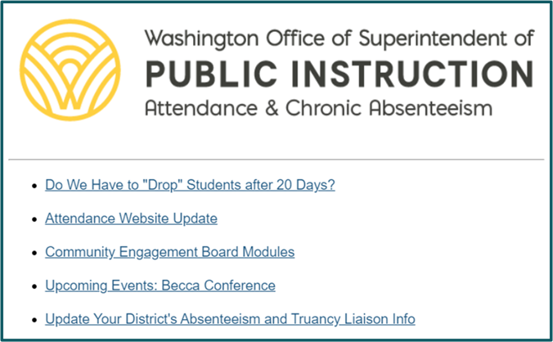
Attendance Newsletter & Webpage
Attendance Newsletter
Guidance & policy updates
Webinars and conferences
Resources, local examples
OSPI Attendance webpage
Notes:
Attendance Newsletter
Guidance & policy updates
Webinars and conferences
Resources, local examples
Website
Attendance Awareness Materials
Best Practices
Policy, Guidance, & Data Reporting

Slide 44
Anxiety, Depression and other Common Mental Health Concerns
First Approach Skills Training (FAST) tools:
brief, evidence-based behavioral therapy
for youth and families with common mental health concerns
in settings such as schools where longer-term treatment is not typically provided
to be used by caregivers, school staff, and youth as a first approach
for anxiety, depression, challenging behavior, sleep tips, technology and more
Free handouts and workbooks

Slide 45
Ways to Engage

Slide 47
Re-envisioning Truancy Project
How to get involved
Listening Session with Principals: Nov. 7 @ 1pm
Learn more at Office Hours: 11/2 or 11/3
Sign up for project updates
Goal
Talk with youth & families with lived experience and partners in education to make recommendations to OSPI for future funding, legislation or other state-wide changes.

Slide 48
Other Opportunities to Shape Absence Policy
Volunteer for a workgroup that will shape:
Withdrawing policy
Model board policy excused absences
Re-envisioning truancy
Sign up here

