Slide 1
Adding Sustainability to the NPD Toolbox
ROR Report Out
Debbie Kalish, Ingersoll Rand
Sue Burek, Stanley Black & Decker
Amy Costello, Armstrong Flooring
Larry Schwartz, IP Business-Tech Solutions
John Taylor, Schneider Electric
October 3, 2017

Slide 2
AGENDA
Background
Objectives
Surveys
Interviews
Tools
Sustainability checklist
Supplier Screening/Scorecard
Conclusions

Slide 3
Introductions
Co-Chairs
Debbie Kalish Ingersoll Rand
John Taylor Schneider Electric
Mentor
Sue Burek Stanley Black & Decker
SME
Larry Schwartz IP Business-Tech Solutions
Core team members
Amy Costello Armstrong Flooring

Slide 4
Adding Sustainability to the NPD Toolbox
Objective: To overcome the gap between a high level view on the importance of sustainability
…to a practical “how to do it”
Integrating sustainability into the New Product Development process

Slide 5
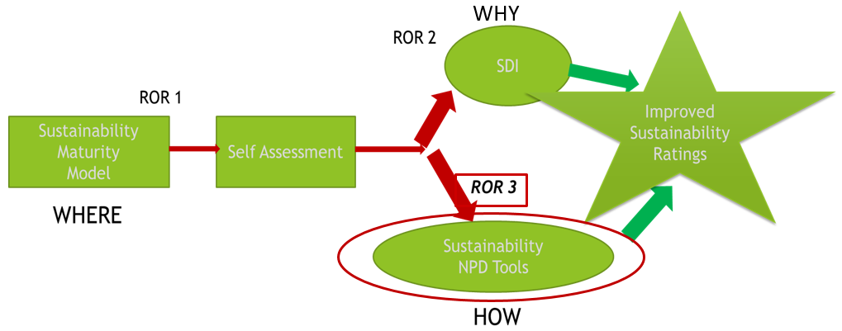
Background
Over the past 3 years, 2 ROR groups have examined how sustainability can be factored into R&D. An earlier (2010) ROR examined sustainability in R&D and was focused mostly on insuring EH&S compliance requirements were met.
The first ROR, Sustainability Maturity Model (SMM) proposed a sustainability maturity model that allowed companies to visualize where they were in the sustainability continuum.
A second ROR, Sustainability Driven Innovation (SDI), examined sustainability as a methodology for companies to drive innovation.

Slide 6
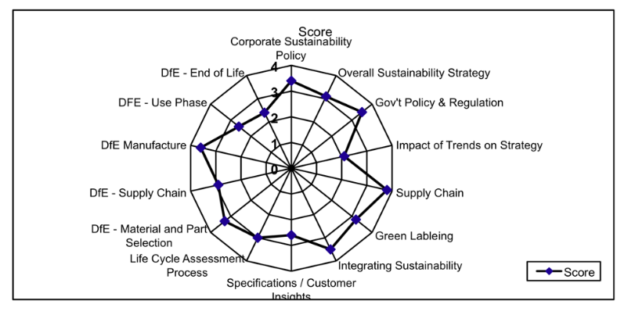
Sustainability Maturity Model Conclusions
Conducted analysis between financial metrics
and sustainability maturity model score
Resulting correlation coefficient indicates a
linear relationship could exist between sustainability
maturity and increased operating margins
Large distribution in responses (highest= Telecom, lowest= “Other”)
Corporate sustainability policy and gov’t policy generally lead the maturity growth
Design lags strategy
Strong evidence that sustainability is the next category to improve financial performance by using sustainability to drive innovation

Slide 7
Sustainability Driven Innovation (SDI) Summary
A process companies employ to create business value
Perceived and real barriers and gaps exist
Objectives, priorities, and innovation practices correlate with successful SDI
SDI is one approach to integrate sustainability into a company
Building sustainability into company-specific value creation levers can serve as a universal starting point

Slide 8
New Project: Adding Sustainability to the NPD Toolbox
Approach
Test hypothesis of the need to be prescriptive on how to incorporate sustainability into companies’ New Product Development (NPD) process
Conduct research via:
Literature
Survey
Interviews

Slide 9
New Project: Adding Sustainability to the NPD Toolbox
Objectives
Help companies integrate sustainability into NPD
Identify and develop tools for best practices within phase gate processes
Publish RTM Article: “Integrating Sustainability into New Product Development”

Slide 10
Surveys
Our literature review revealed that a few innovative companies have figured out how to integrate sustainability into NPD either by SDI or creating their own proprietary product. This led us to conduct surveys.
We conducted 2 surveys,
2016 IRI Annual Meeting (Internal)
Industry Partner Survey (External)
We had a total of 69 respondents (38 Internal IRI/31 External)
About 50% of the surveys were completed by Director Level or Higher
73% said sustainability was important to top management
Overall the results from the 2 were similar and the analyses were performed on the combined set

Slide 11
Survey Respondents: Sustainability in NPD IS SUSTAINABILITY INCLUDED IN NPD?

Slide 12
Survey Respondents: Sustainability in NPD WHY SUSTAINABILITY?

Slide 13
Survey Respondents: Tools for Sustainability
ARE SUSTAINABILITY TOOLS USED TO
SUPPORT NPD?
ARE TOOLS USED TO SUPPORT NPD?
Most have NPD tools………………………………. but few have sustainability tools for NPD

Slide 14
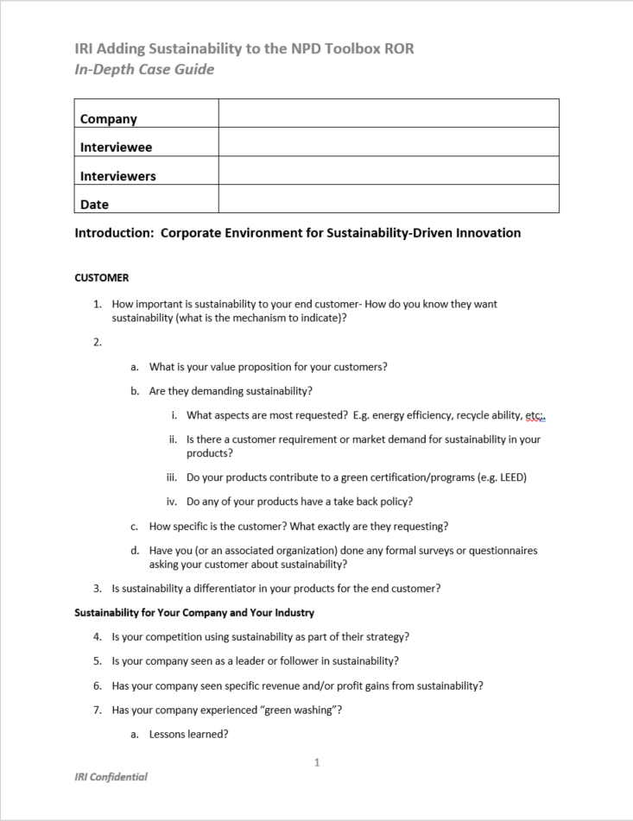
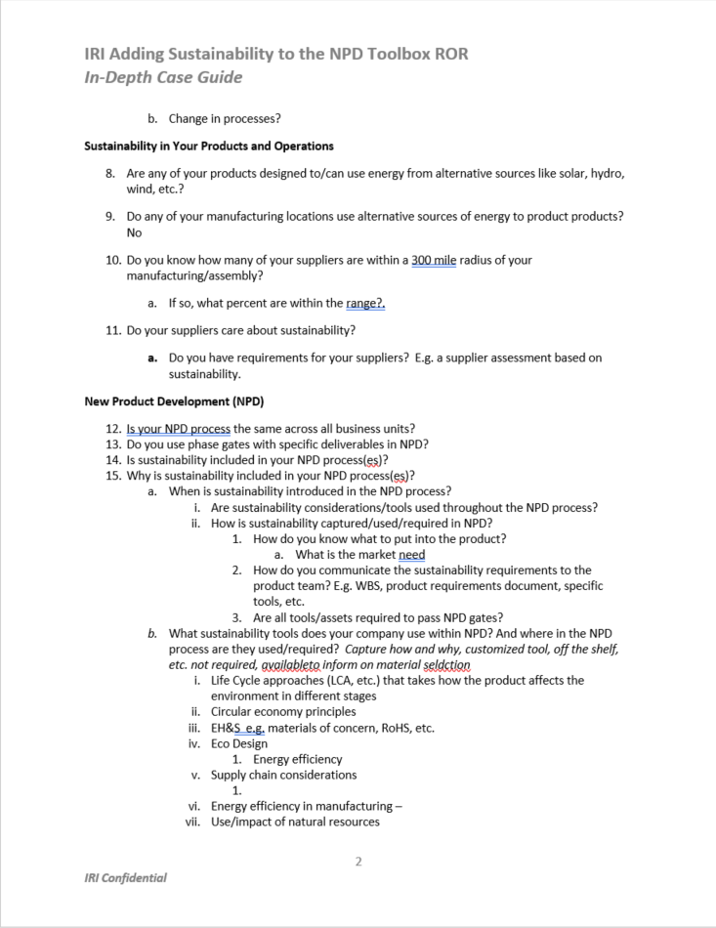
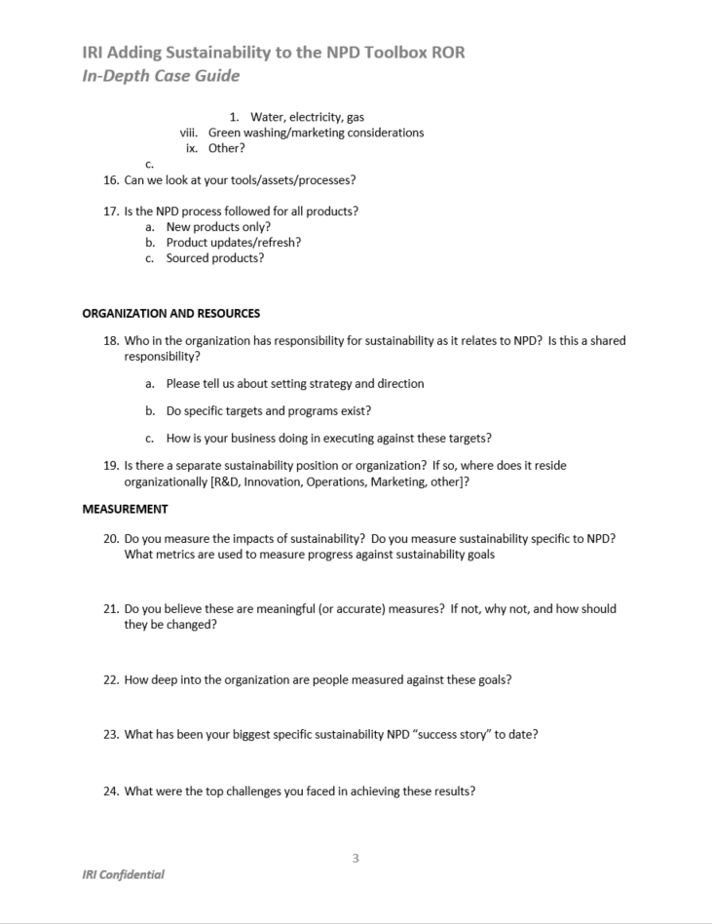
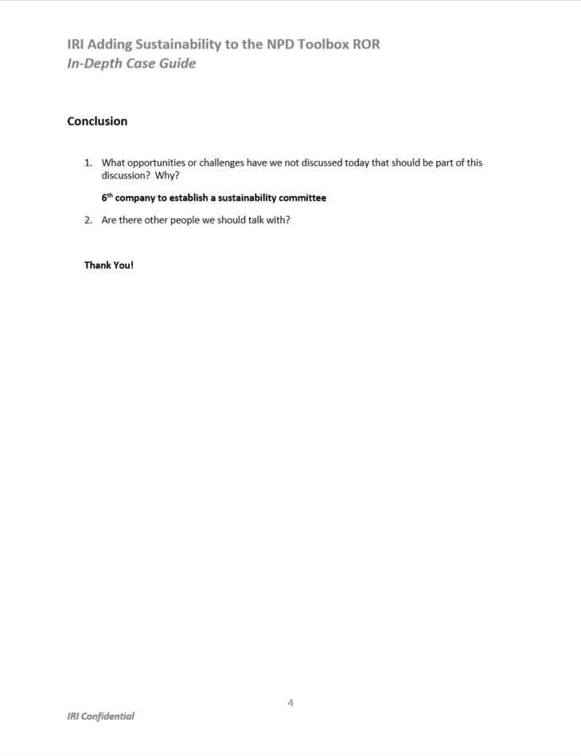
Interviews
22 formal interviews
3 Privately held, 19 publicly traded
Industries: consumer goods, chemical/manufacturing, utility and consultancy
Included B2C and B2B
Based in North America, Asia and Europe
Annual revenues of ~$250M - $250B

Slide 15
Interview Demographics Industry, Size, Customers

Slide 16
Interview Examples
A European chemical company strongly believes that sustainability is an important business and innovation driver and will lead to more future-proof business as well as differentiation with respect to competitive positioning. The company uses sustainability workshops at the start of NPD, prior to the formal start of their formal NPD process. LCAs are performed with considerations for traditional environmental impacts as well as social impacts. LCA study results contribute to the decision to continue a product further in NPD.
An industrial paint manufacturer took a more holistic approach when identifying through their LCA process that a better performing but less environmentally friendly product was a better solution for their customer because the more apparently environmentally hazardous product actually reduced the overall environmental performance (potential impact over its lifetime) in the customer’s application.
An international energy company supplying both fossil fuels and renewable energy products has a totally different NPD process for the 2 areas of the business. The conventional business has NPD processes focusing on compliance while the renewable area has a rigorous NPD process that includes cradle to cradle concepts.

Slide 17
Interview Key Takeaways
Product sustainability can most easily be accomplished by including sustainability in product design process.
Sustainability must be part of corporate culture to be successful.
Companies covered the full range of the maturity continuum
Companies, regardless of their place on the maturity continuum, reported specific revenue or profit gains from sustainability.
Beginning | Incorporate environmental compliance in NPD process. Including check list to ensure that compliance is met
Improving | Introduce sustainability into NPD sporadically to achieve a specific product objective
Succeeding | Regularly introduces sustainability into early stages of NPD process based on voice of customer
Leading | Customer focused sustainable NPD that included KPI which result in measurable business value

Slide 18
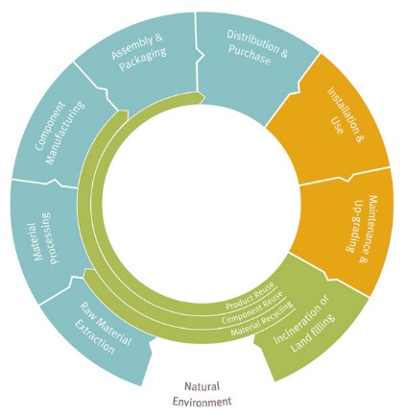
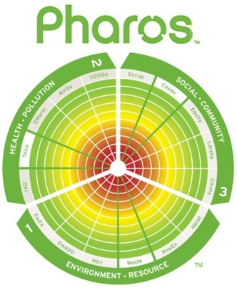
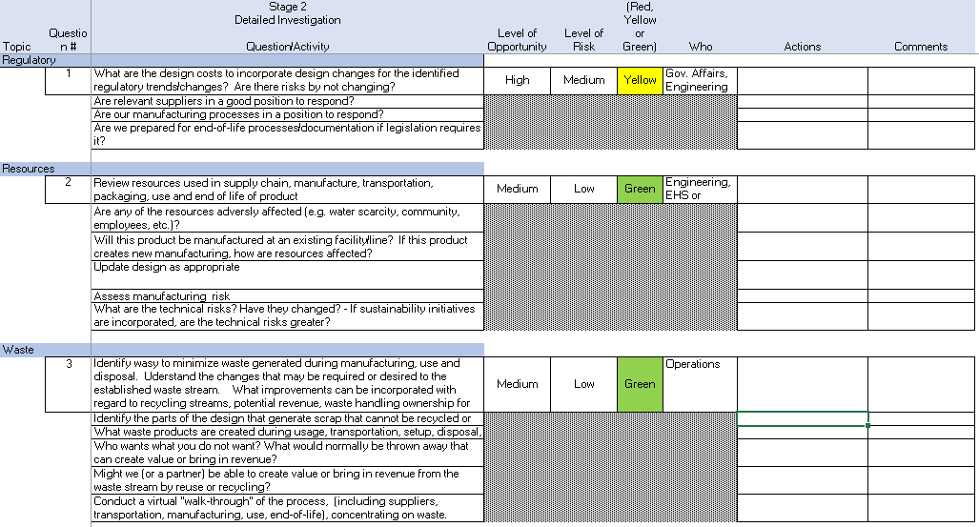
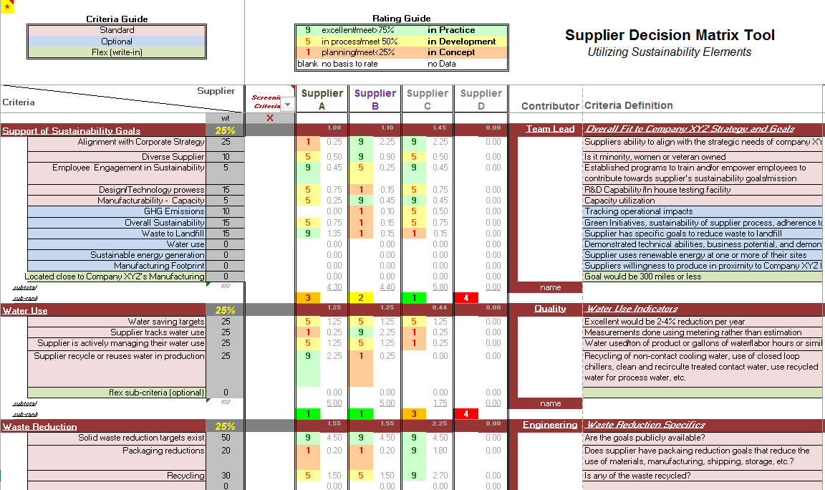
Tools for Sharing in Toolbox
LCA is most common tool
Many incorporate some type of chemical and materials library/reference tool: Pharos or other Chemical Screening Tool
EcoDesign Strategy Wheel: Okala’s Ecodesign Strategy Wheel
Several use some type of sustainability checklist: New Product Sustainability Checklist
Often use a supplier scorecard: Supplier Screening/Scorecard

Slide 19
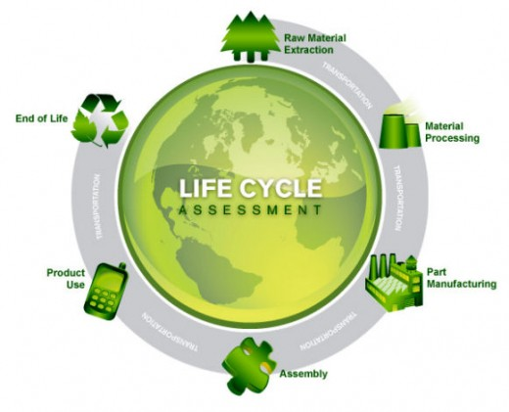
Tool Box Tools Utilizing External Sources/Support
2 Types of Life Cycle Assessment (LCA):
Streamlined or Screening LCA – companies contract for proprietary custom tools
Extensive LCAs companies conduct internally or externally using LCA database in accordance with ISO 14025 and/or EN15804

Slide 20
Chemical Screening Tools
Tool | Catalogue | Framework | Expert Analysis
CleanGredients | X
GreenScreen |  |  | X
GreenWERCS | X
Pharos™ Chemicals and Material Library | X
SciVera Lens |  |  | X
US EPA Safer Choice Chemicals List | X
Okala Ecodesign Strategy Wheel |  | X
Higgs Index |  | X
USEPA Design for Environment |  | X
Living Building Challenge Red List | X

Slide 21
Conclusions
Companies have introduced sustainability addressing compliance, however to bring greater business value, sustainability must be integrated in NPD.
All companies, regardless of size, can incorporate sustainability into their NPD process.
Approach must be aligned to overall corporate strategy and customer focused.
Effective environmental NPD processes introduce environmental sustainability at the product concept stage
Common tools are integrated to include environmental sustainability considerations

Slide 22
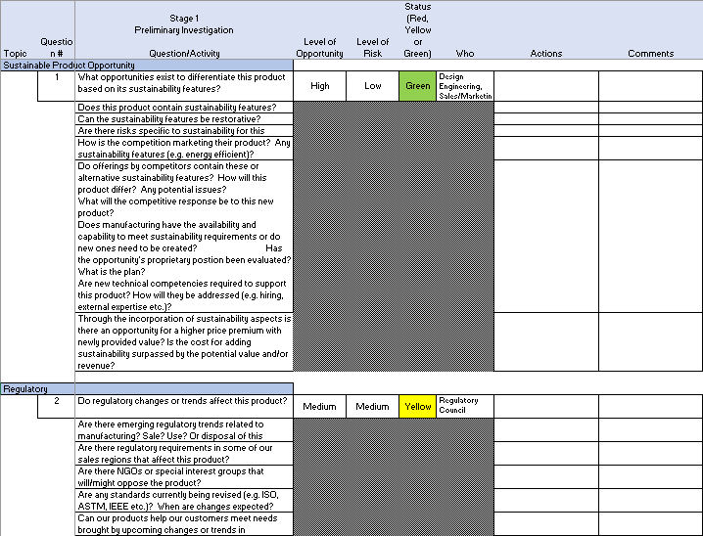
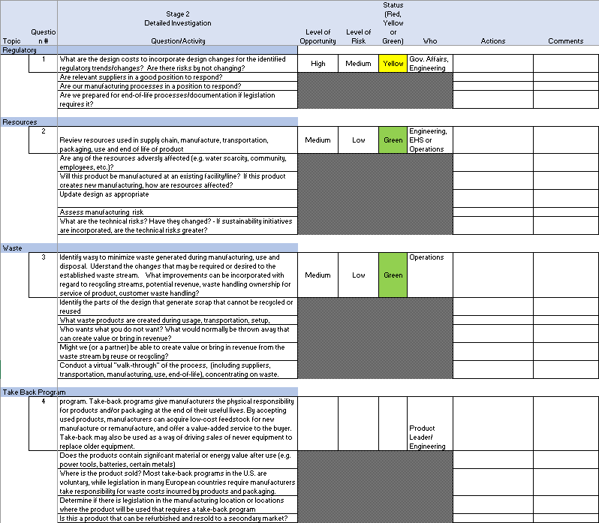
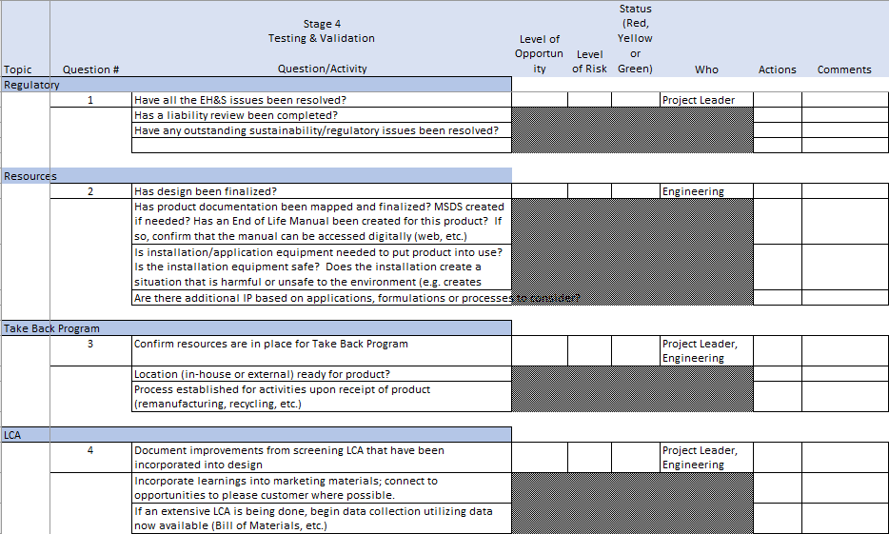
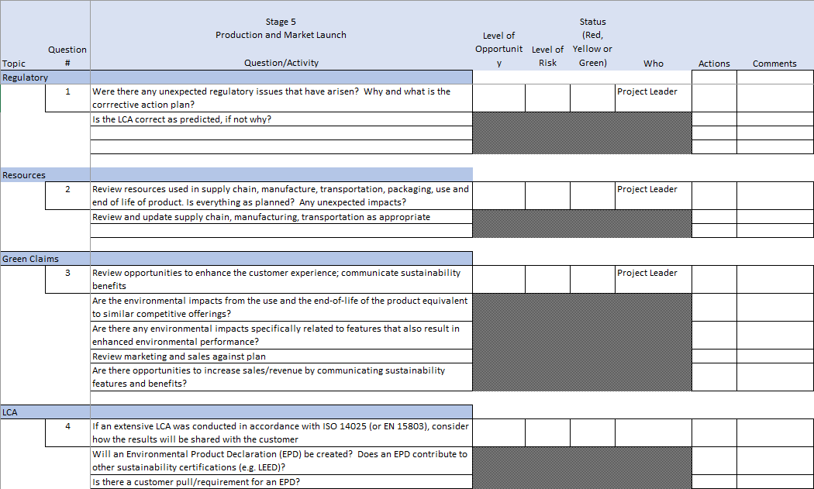
Walk Through
Sustainability Checklist

Slide 23
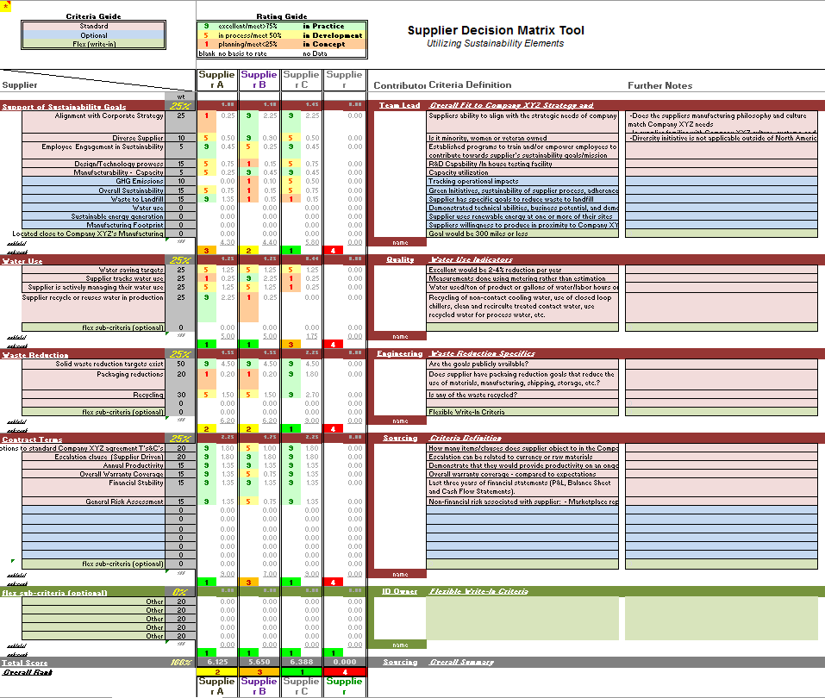
Walk Through
Supplier Screening/Scorecard

Slide 24
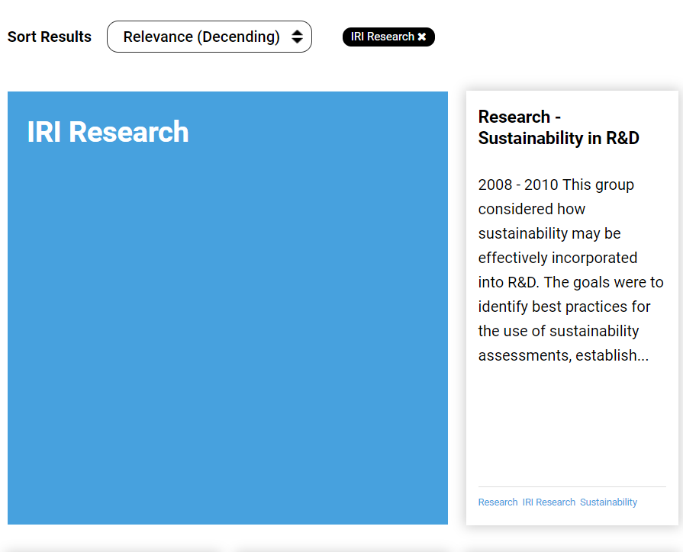
Accessing Resources
http://www.iriweb.org/articles/Integrating_Sustainability_into_NPD

Slide 25
Appendix

Slide 26
Survey Respondent Industry, Size, Customers

Slide 27
Sustainability Checklist
Stage 1
Preliminary Investigation

Slide 28
Sustainability Checklist
Stage 2
Detailed Investigation

Slide 29
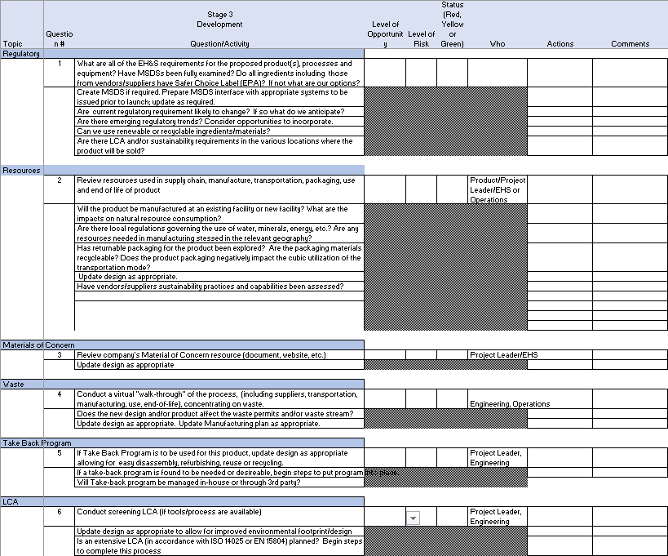
Sustainability Checklist
Stage 3
Development

Slide 30
Sustainability Checklist
Stage 4
Testing
And
Validation

Slide 31
Sustainability Checklist
Stage 5
Production
and
Market Launch

Slide 32
Supplier Screening Scorecard
Support
of
Sustainability Goals

Slide 33
Supplier Screening Scorecard
Water Use
and
Waste Reduction

Slide 34
Supplier Screening Scorecard
Contract Terms

Slide 35
Supplier Screening Scorecard
Flexible sub-criteria
(optional)

