Slide 1


ISMPP University
Copyright confusion: demystifying Creative Commons licenses for industry-funded research
October 23, 2024
Webinar will begin promptly at:
11 AM ET / 4 PM GMT
Notes:
Hi everyone; welcome and thank you for joining today’s Open Access ISMPP U, titled: Copyright Confusion: demystifying Creative Commons licenses for industry-funded research.
Please take a moment to capture a screenshot for CMPP credit. You will also be sent a certificate with credit attached after the webinar.

Slide 2












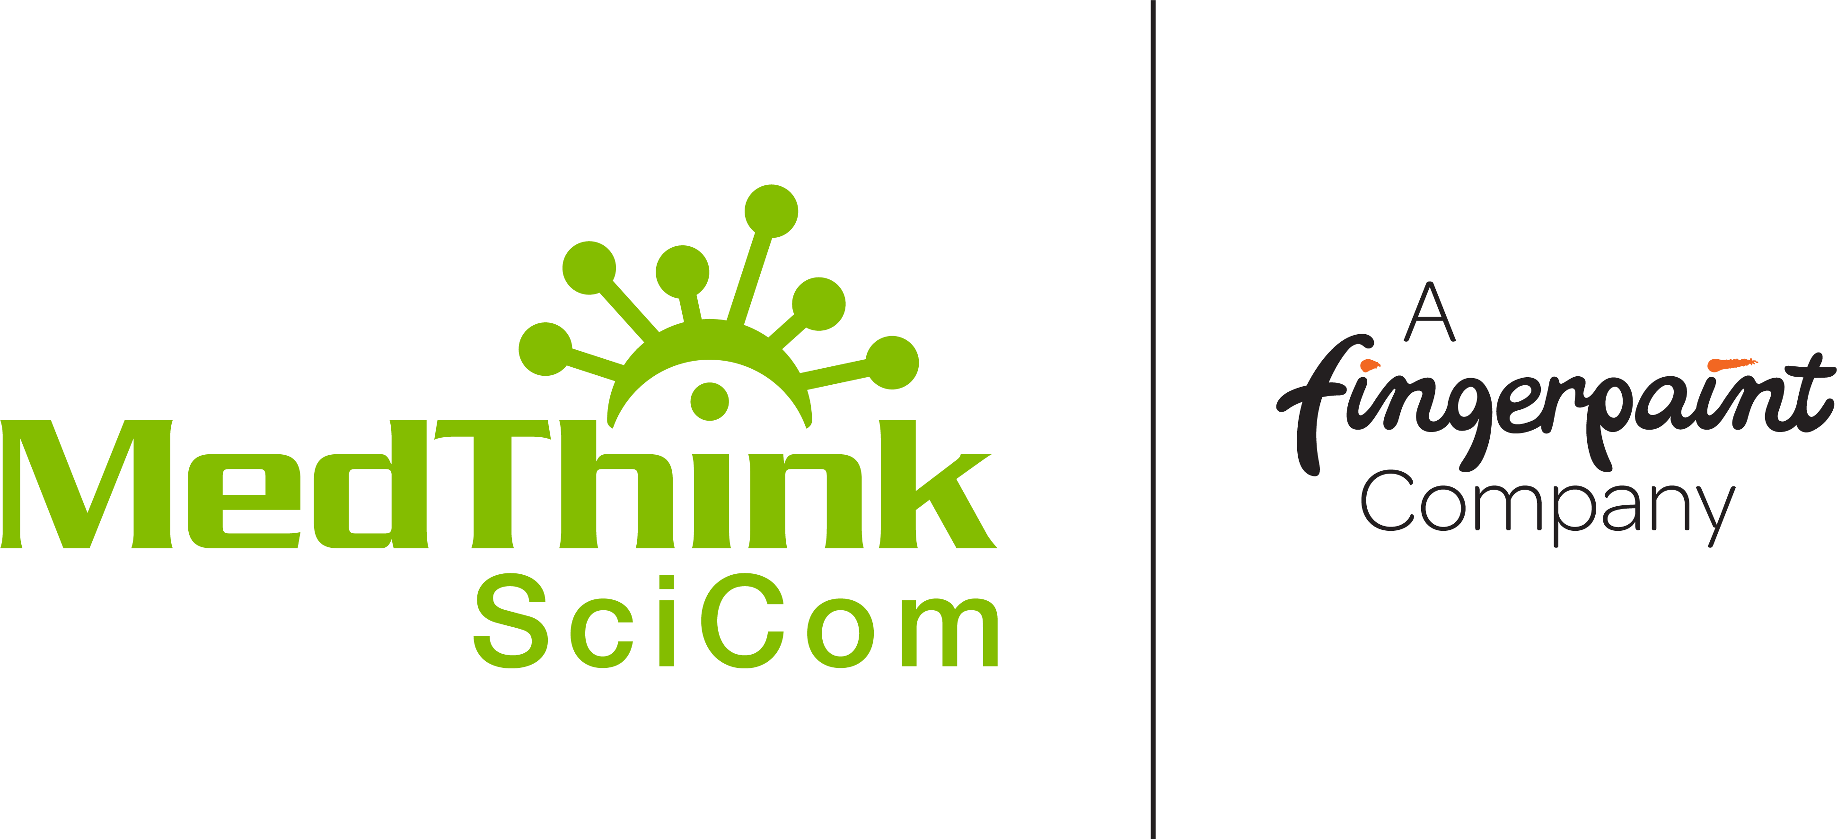
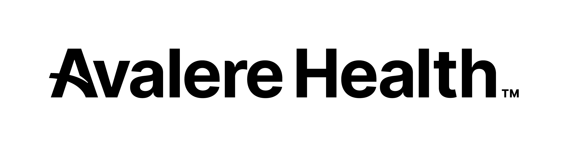

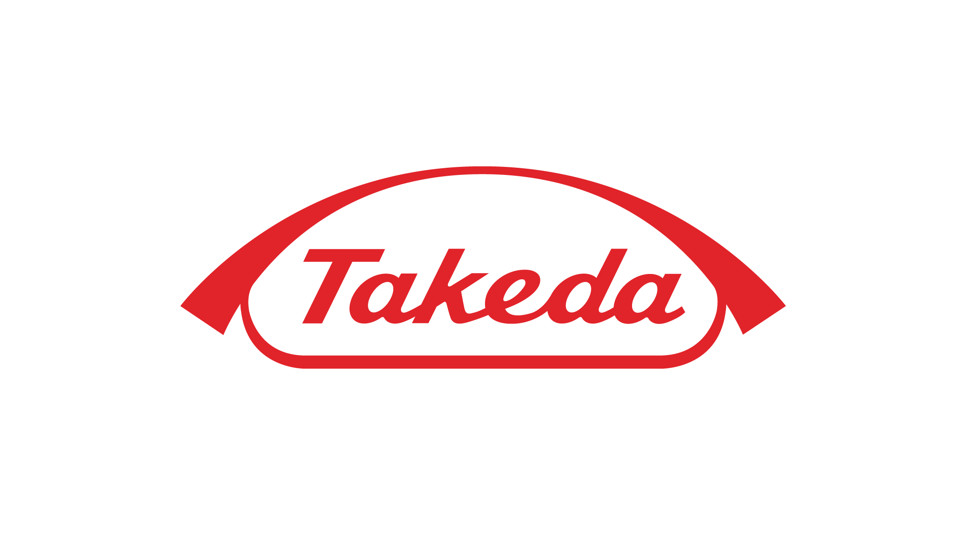




ISMPP Would Like to Thank…
2
. . . the following Titanium and Platinum Corporate Sponsors for their ongoing support of the Society:
Notes:
First a sincere thank you to all of ISMPP’s titanium and platinum corporate sponsors for their ongoing support of the Society.

Slide 3
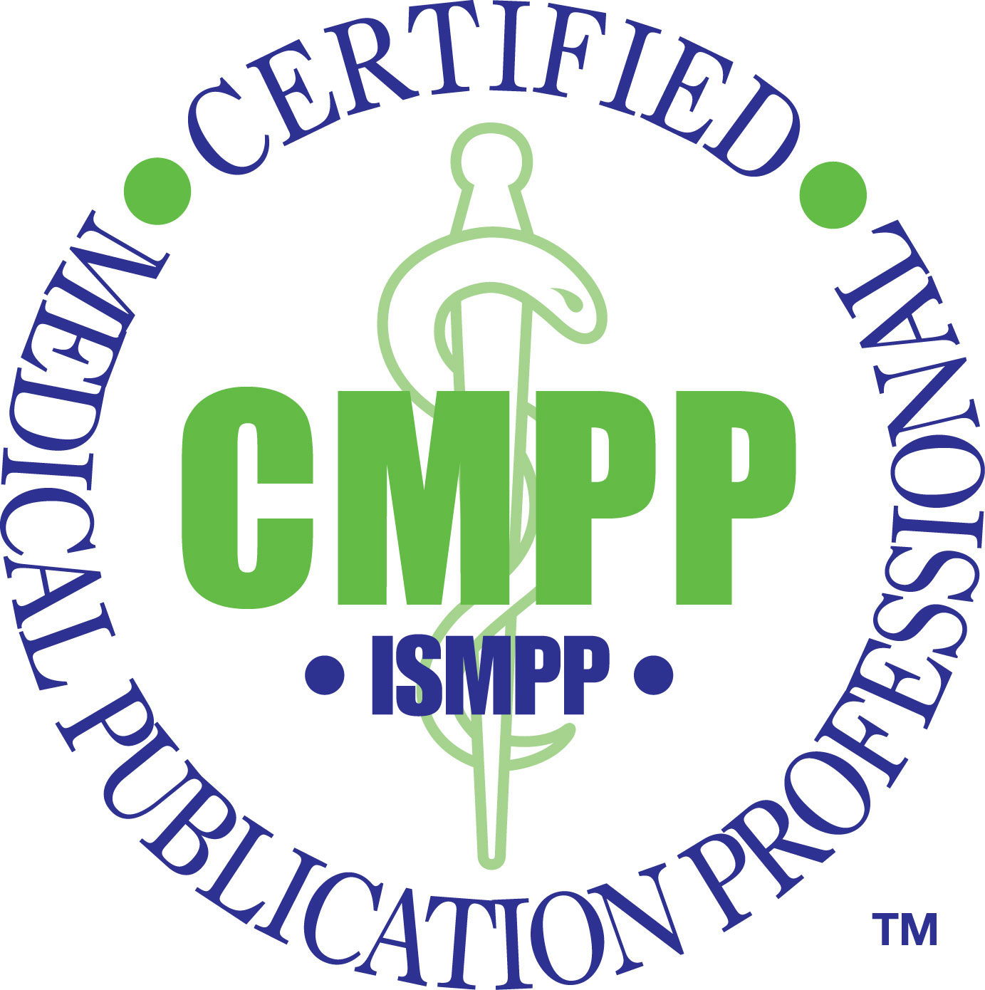
ISMPP Announcements
Application deadline for the March CMPP
exam is February 1
Notes:
And, for those who are seeking to become CMPP-certified or looking to renew your certification, the application deadline for the next exam window is 1 February 2025

Slide 4

ISMPP Announcements
NEW ISMPP Academy
Save the date: November 13-14, 2024
Where: Convene at Commerce Square, Two Commerce Square, Philadelphia, PA 19103
ISMPP Academy is a meeting that will deliver
best practices education to professionals:
• Who work at biotechnology, small pharma, and medical device companies •
• Who are newer to the field •
• Who want to build their expertise •
Registration is open!
Notes:
Remember to Save the Date for the new ISMPP Academy, a Fall meeting format in Philadelphia this year, 13-14 November. Be on the lookout, registration is now open.

Slide 5
How To Ask Questions
Feel free to ask a question at any time, however all questions will be held until the end the of the presentation.
To ask a question, open the Q&A window, type your question into the
Q&A box. Click Send
Note: Check Send Anonymously if you do not want your name attached
to your question in the Q&A
We will make every effort to respond to all questions live (out loud)
Notes:
You can submit a question at any time during the presentation by following the instructions on this slide.
The faculty will answer questions at the end of all the presentations.

Slide 6
Disclaimer
Information presented reflects the personal knowledge and opinions of the faculty and does not necessarily represent the position of their current or past employers
Notes:
Please take a moment to read our general disclaimer.

Slide 7
Objectives
By the end of the session, attendees will:
Understand how Creative Commons (CC) licenses are used in the context of scientific research publications
Understand how CC license selection affects content reuse for industry-funded research articles
Be better equipped to select an appropriate CC license when submitting research for publication
Notes:
Listed here are the learning objectives for today’s webinar. (please read them aloud or summarize if you feel comfortable)

Slide 8
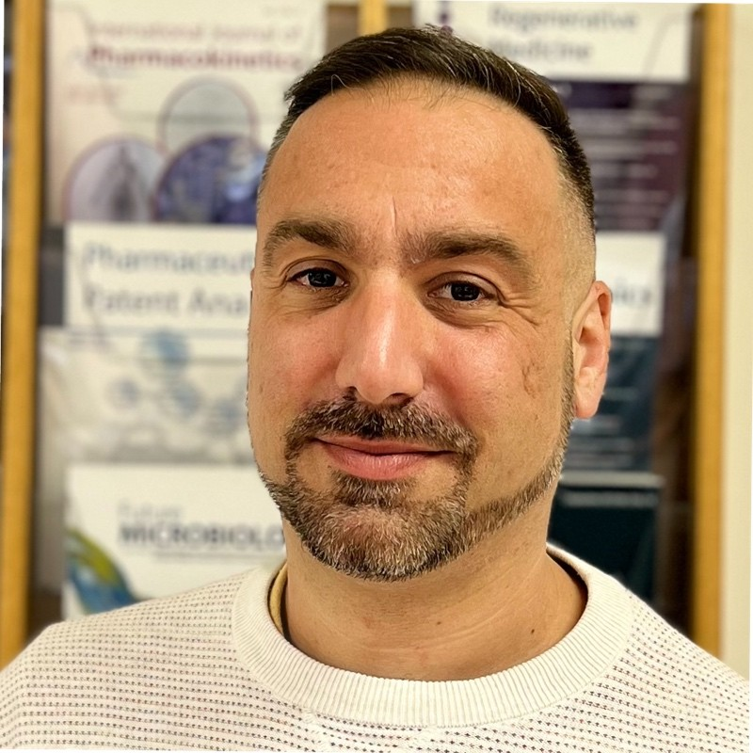
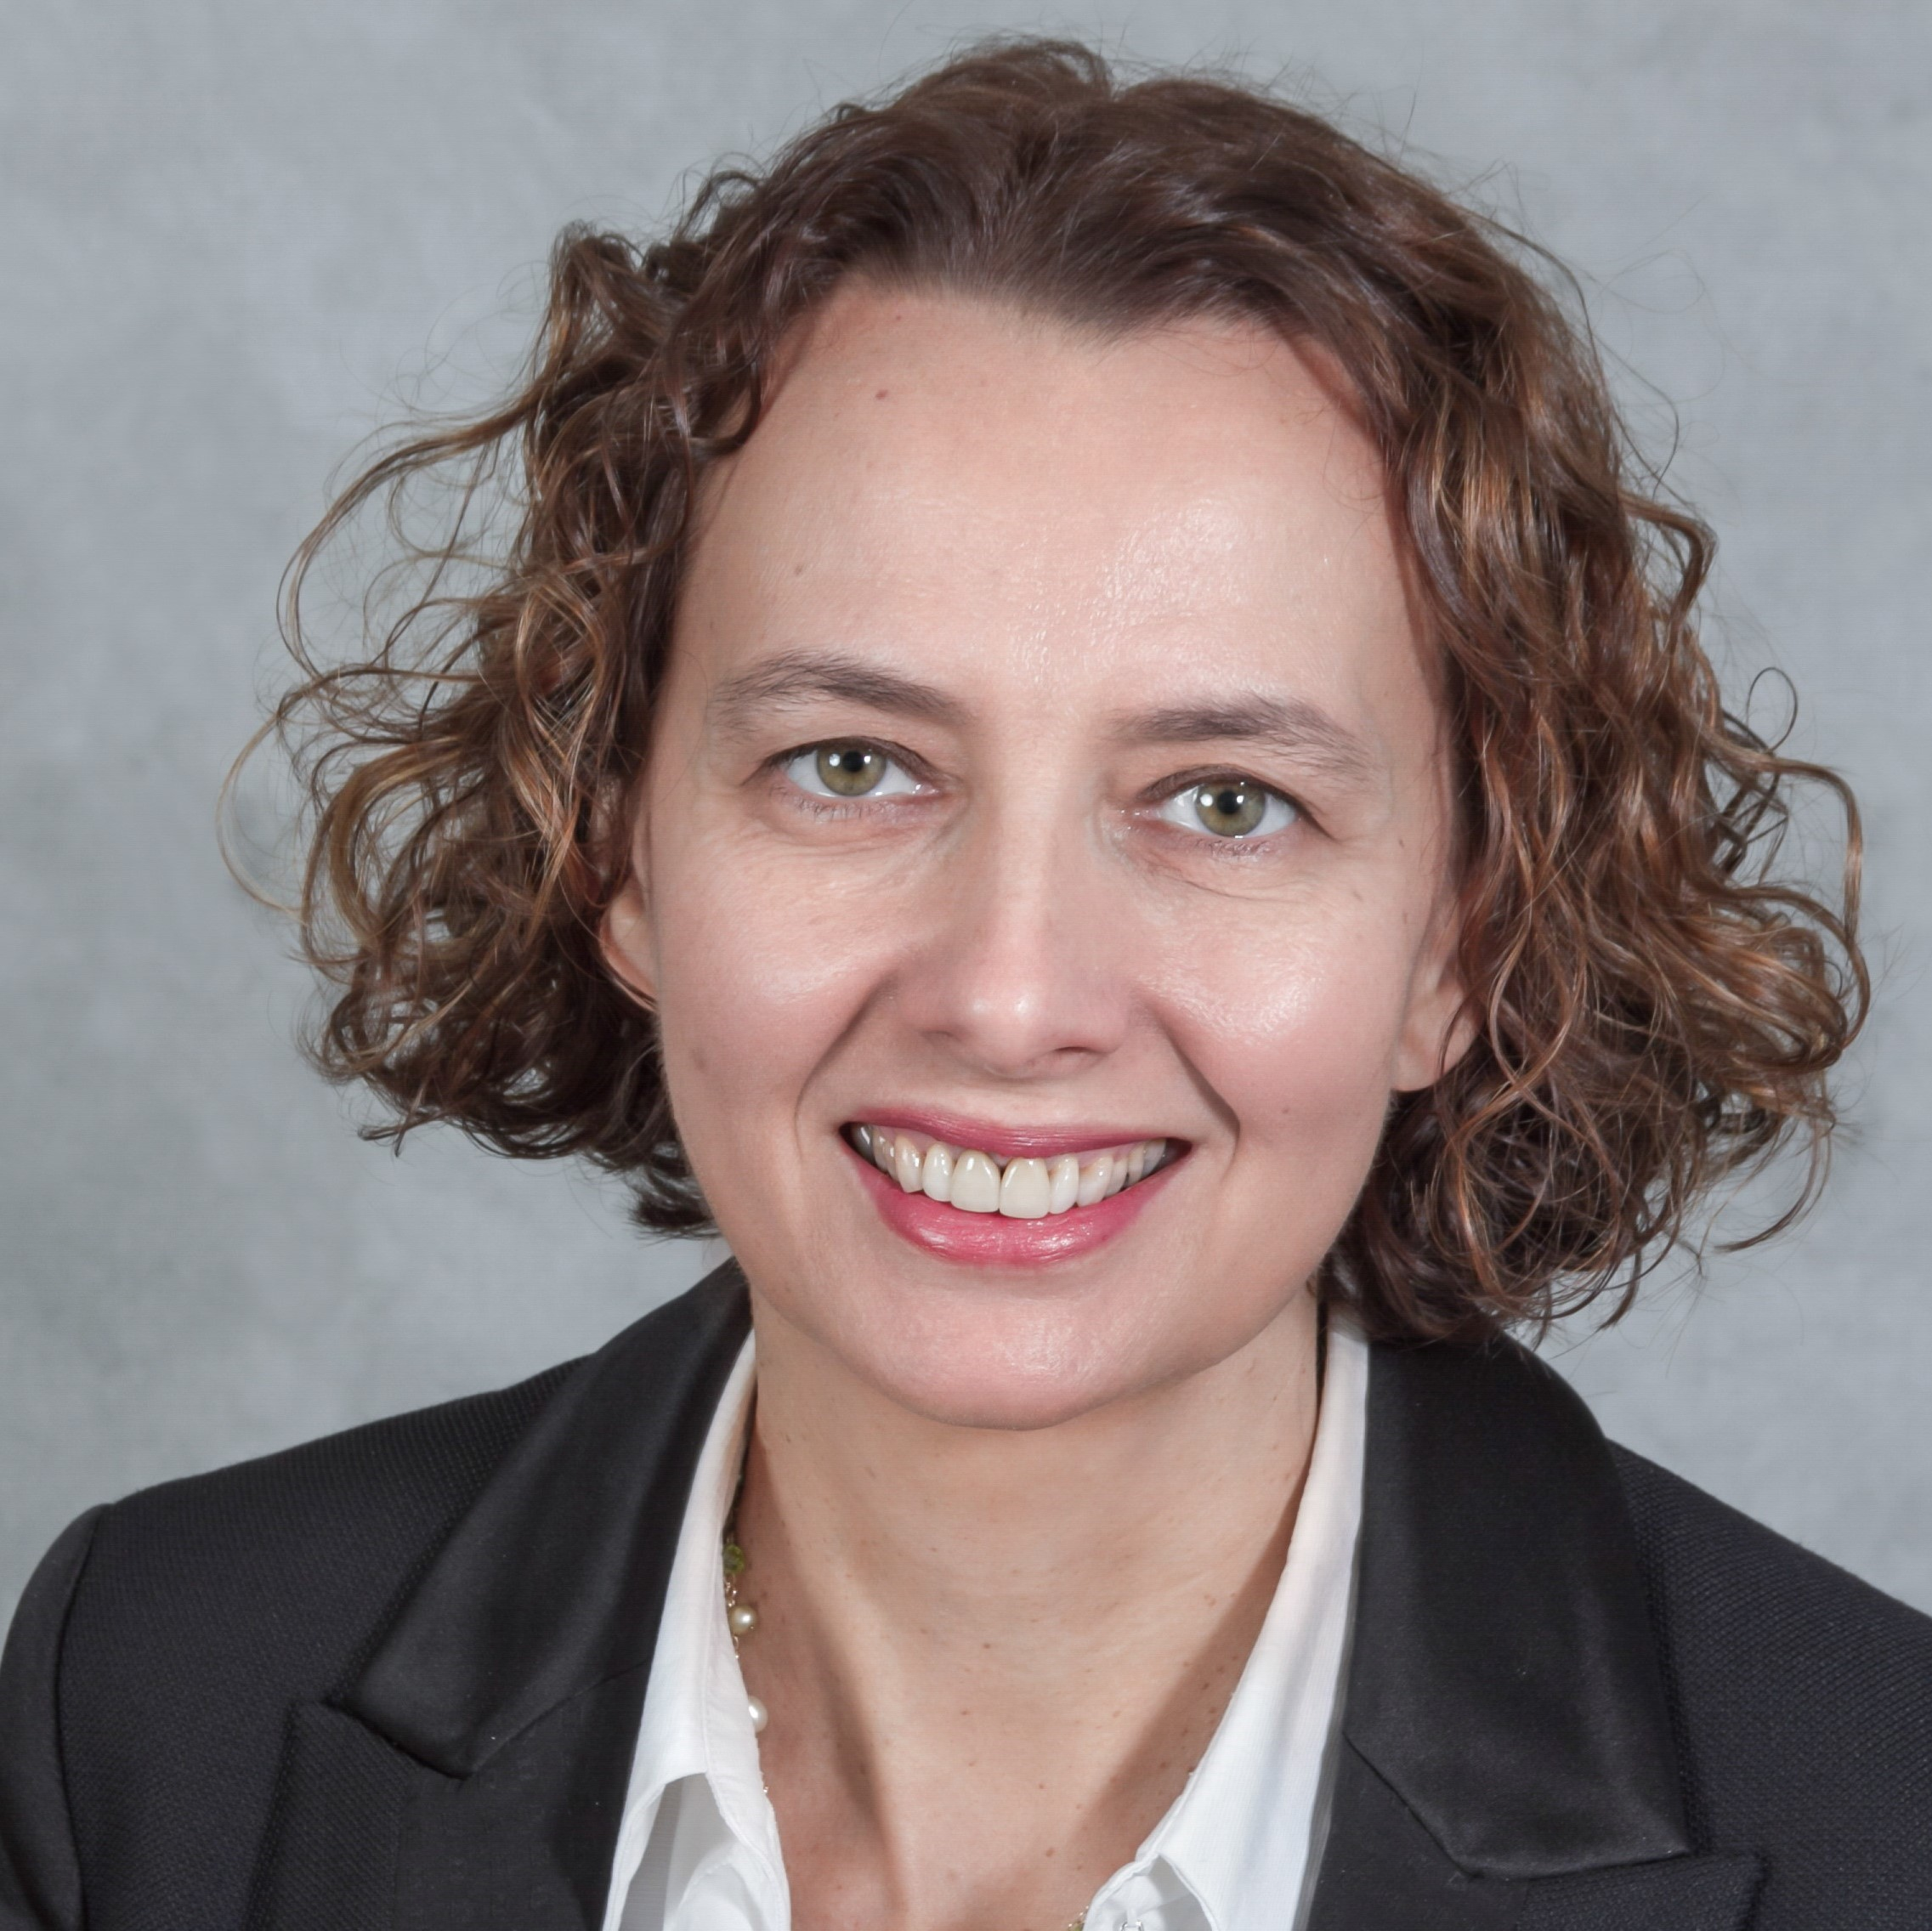
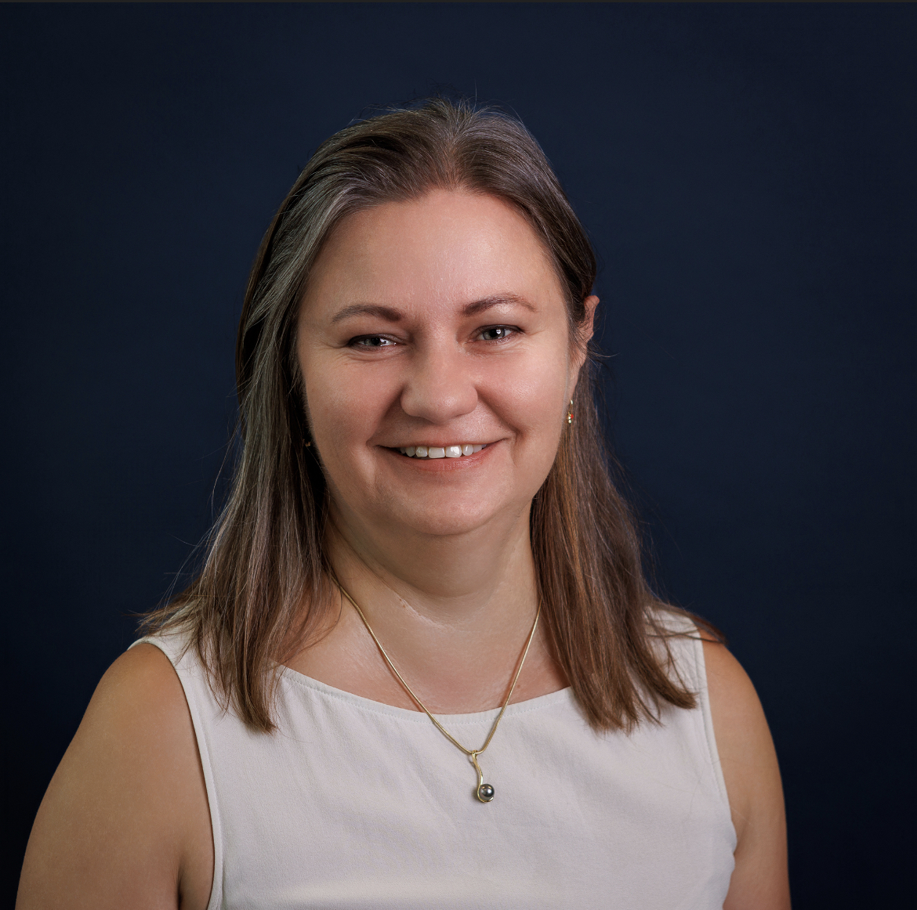
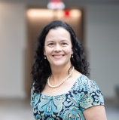
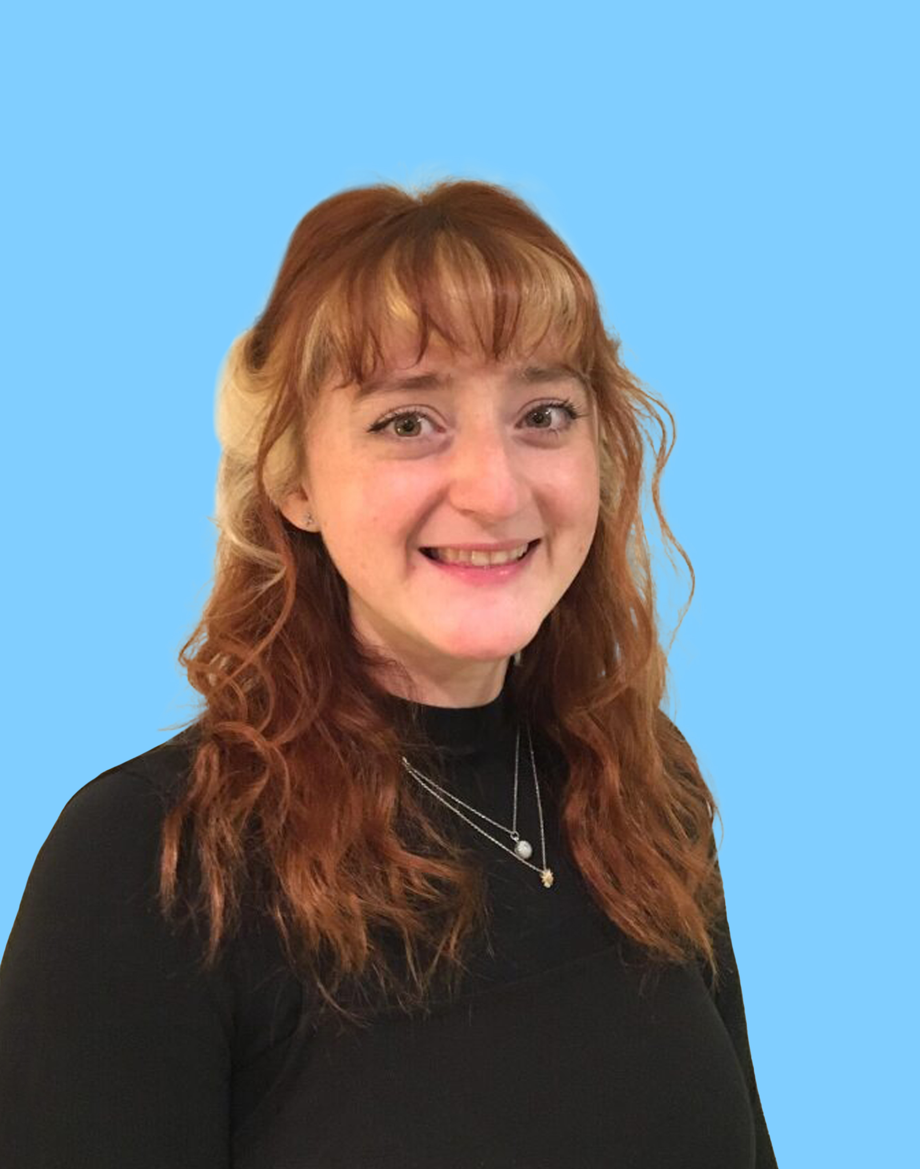
Faculty
Sam Cavana
Head of Publishing Services
Taylor & Francis
Valérie Philippon
Global Head of Scientific Communications,
Medical Information & Medical Learning
UCB
Slávka Baróniková
Head Scientific Publications
Alfasigma
Sonia Schweers
Director, Medical Policy Governance
Bristol Myers Squibb
Sophie Nobes
(Moderator)
Senior Medical Writer
Oxford PharmaGenesis
Notes:
I’m delighted to introduce today’s speakers

Slide 9
What are Creative Commons licenses and how do they work?
Sam Cavana
Head of Publishing Services
Taylor & Francis

Slide 10
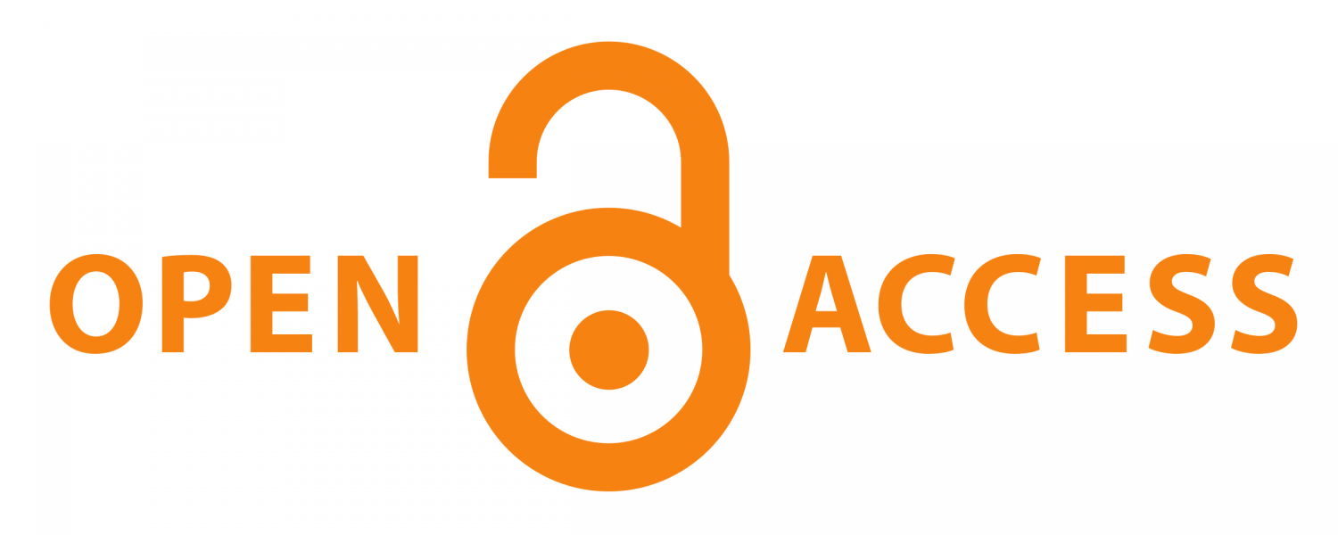




Copyright licenses
10
CC BY
  Free to share, copy, redistribute, adapt, remix and transform for any purpose
CC BY-NC
  Free to share, copy, redistribute, adapt, remix and transform for non-commercial purposes
CC BY-ND
  Free to share, copy, redistribute; but if you remix, transform or build upon you may not distribute the modified material
CC BY-NC-ND
  Free to copy and redistribute the material in whole in any medium or format, but only non-commercially
*All content must have citation to original source, unless in public domain.
BY, Attribution; CC, Creative Commons; NC, Non-Commercial; ND, No-Derivatives
Notes:
I am sure that you are aware of these open access licenses, but I wanted to quickly go over the most commonly used ones used in our industry.
Read through licences
In all instances of these licences including ones not shown, when referencing content you must have the citation to the original source, unless in the public domain.
If you need further clarification on what is needed for citation , there is information on the creative commons wiki https://wiki.creativecommons.org/wiki/License_Versions#Detailed_attribution_comparison_chart

Slide 11
The pharma perspective
Case study 1
Valérie Philippon
Global Head of Scientific Communications,
Medical Information & Medical Learning
UCB

Slide 12
Measuring open access in pharma-supported articles
Semi-automated process; repeated for each pharmaceutical company for 2019 and 2020
Searched the Lens (www.lens.org) using the term “[Institution; Medicine; [year]”
DOIs obtained for all papers returned in the Lens search
Publication type provided from Embase
Open access status provided from Unpaywall
Only ‘articles’ included
Companies with <10 total articles removed from the analysis
The search engine’s semantic search technology links the company name to authors with an affiliation to the company
Publisher and journal name is also returned for each DOI submitted to Unpaywall
Excluded:
Chapter
Conference abstract
Conference poster
Editorial
Erratum
Letter
Review
Short Survey
Excluded:
Gilead
Teva
Bevan E et al. Measuring open access to pharmaceutical company-supported articles – an improved and semi-automated method [poster]. Presented at the 2022 European Meeting of ISMPP, 25–26 January 2022, online. Awarded ‘Best Original Research’.
API, application programming interface; DOI, digital object identifier

Slide 13
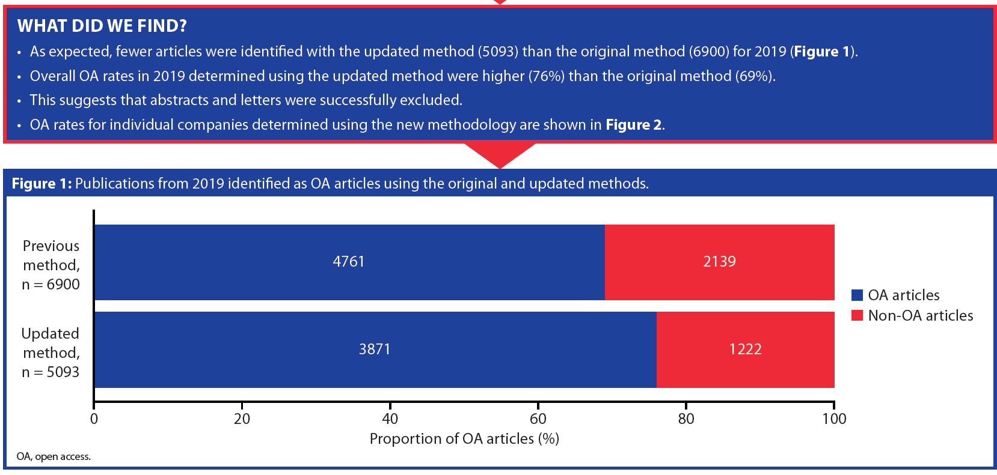
2019 publications identified as OA
Bevan E et al. Measuring open access to pharmaceutical company-supported articles – an improved and semi-automated method [poster]. Presented at the 2022 European Meeting of ISMPP, 25–26 January 2022, online. Awarded ‘Best Original Research’.
OA, open access

Slide 14
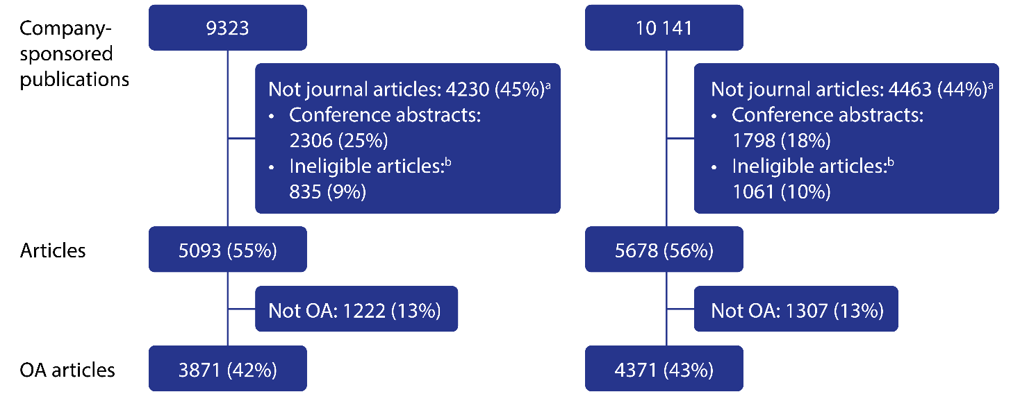
Publications analyzed
ªAll % values represent proportion of total publications identified in the initial search.
^{b}Ineligible articles are conference papers, letters, reviews, editorials, errata, notes (as categorized by Embase).
Bevan E et al. Measuring open access to pharmaceutical company-supported articles – an improved and semi-automated method [poster]. Presented at the 2022 European Meeting of ISMPP, 25–26 January 2022, online. Awarded ‘Best Original Research’.
OA, open access

Slide 15
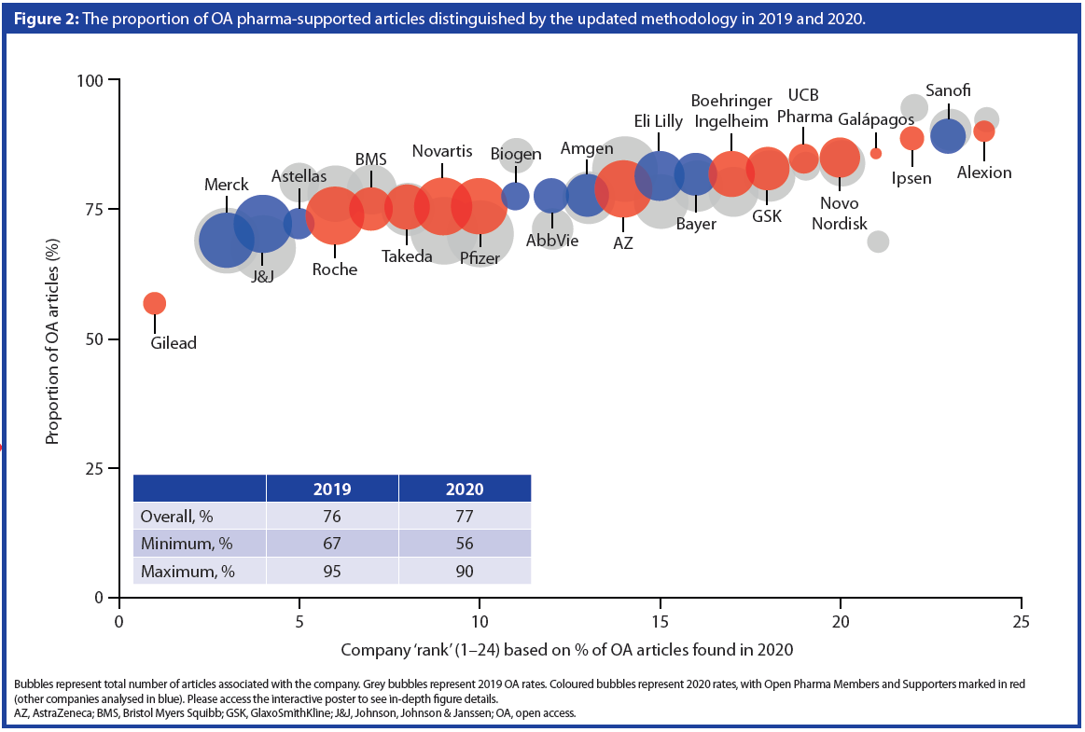
2019 & 2020 open access pharma-supported articles
Bevan E et al. Measuring open access to pharmaceutical company-supported articles – an improved and semi-automated method [poster]. Presented at the 2022 European Meeting of ISMPP, 25–26 January 2022, online. Awarded ‘Best Original Research’.
OA, open access

Slide 16
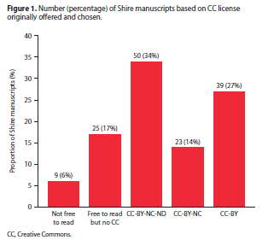
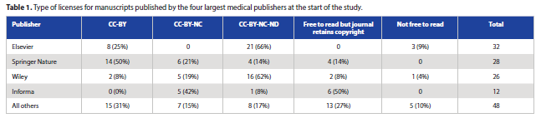
Case study 1 – obtaining retrospective open access publishing: a Shire experience
A list of manuscripts published in peer-reviewed journals by Shire from Jan 2015 to Dec 2017 was established and public availability determined
For all the manuscripts that were NOT OA under a CC-BY license, individual publishers were asked to confirm their policy on providing retrospective OA and types of licenses available for pharma-supported articles
  146 articles published by 24 individual publishers
Rains C et al. Obtaining retrospective open access publishing: a Shire experience [poster]. Presented at the 2020 European Meeting of ISMPP, 21–26 January 2020, London, UK.
BY, Attribution; CC, Creative Commons; NC, Non-Commercial; ND, No Derivatives; OA, open access

Slide 17
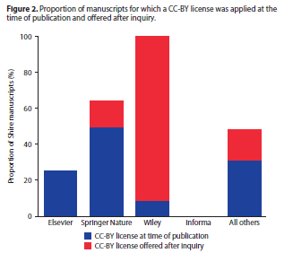
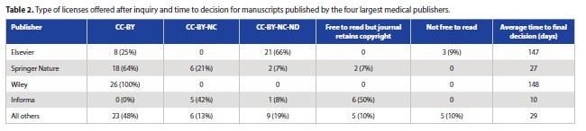
Case study 1 – obtaining retrospective open access publishing: a Shire experience
Publishers were contacted and asked to provide broader access for those articles not available OA
There was a range of response times with an average overall time to final decision of 40 days
  3 publishers allowed retrospective OA conversion for an additional fee supplemental to their standard article processing charge
  7 allowed retrospective OA conversion with no additional fee
  4 publishers did not allow retrospective OA conversion
  4 publishers did not provide CC licenses; these publishers retained copyright, but the manuscripts were freely available on their websites
In total, 10 publishers permitted 35 of the published articles to be converted
retrospectively to a CC-BY license, and 6 articles to be converted from
subscription-based non-OA to either a CC-BY-NC-ND or a CC-BY-NC license
Rains C et al. Obtaining retrospective open access publishing: a Shire experience [poster]. Presented at the 2020 European Meeting of ISMPP, 21–26 January 2020, London, UK.
BY, Attribution; CC, Creative Commons; NC, Non-Commercial; ND, No Derivatives; OA, open access

Slide 18
The pharma perspective
Case study 2
Slávka Baróniková
Head Scientific Publications
Alfasigma

Slide 19
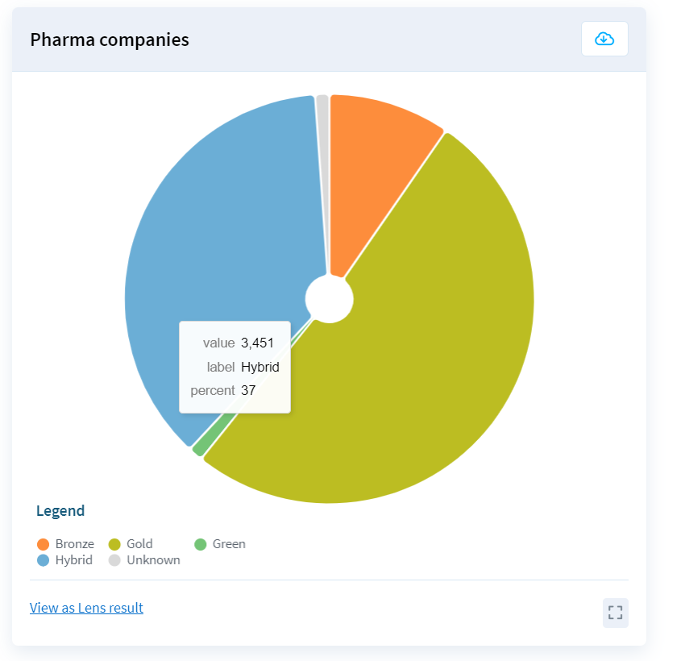
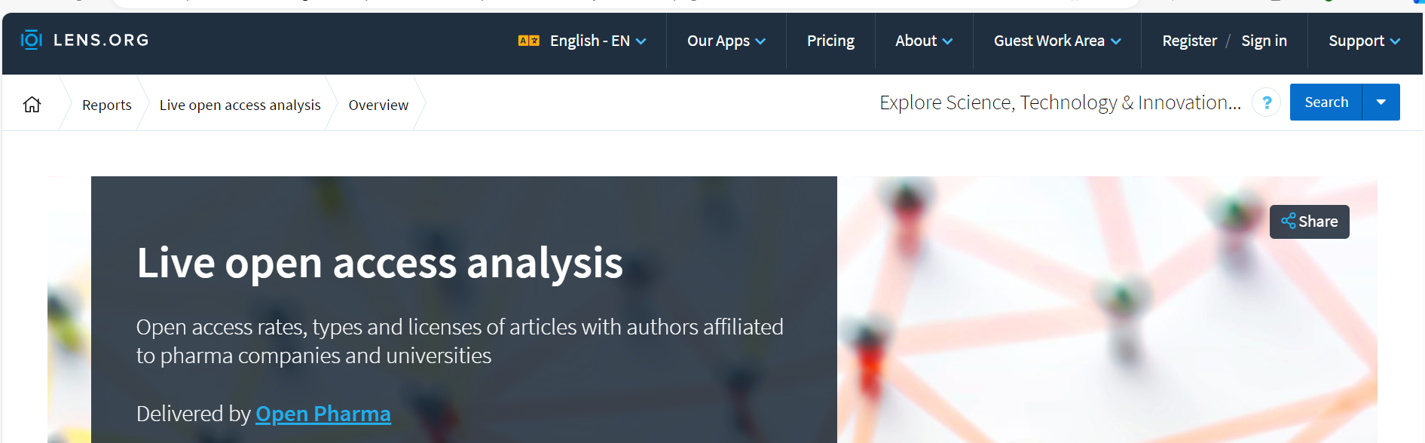
Different open access possibilities …
Pie charts show the proportion of recent medical articles published under different OA models, categorized by whether authors were affiliated to either pharma companies or universities^{a,b}
https://www.lens.org/lens/report/view/**Live-open-access-analysis**/14572/page/14573
Gold OA articles are permanently and freely available to everyone. Gold OA articles are published in a repository that specifies access rights. Bronze OA articles are free to read without an explicit open license. Hybrid OA articles are published in subscription-based journals and authors can pay for gold OA.
ªData are presented for articles published during the 12 months prior to the current date.
^{b}OA data for articles published in the past 6 months may be affected by embargo periods and lags in data feeds.
Lens.org. Live open access analysis. 2024. Available from: https://www.lens.org/lens/report/view/**Live-open-access-analysis**/14572/page/14573 (Accessed 18 October 2024).
OA, open access

Slide 20
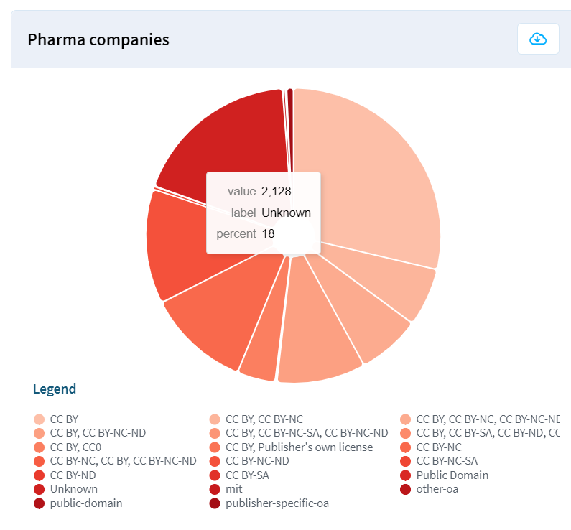
… various open access licenses
Pie charts show the proportion of medical articles published under specific OA licenses, categorized by whether authors were affiliated to either pharma companies or universities^{a,b,c}
Connect with your copyright specialist/librarian to understand article OA licenses
ªOnly the top 20 license types are presented.
^{b}Data are presented for articles published between 12 and 24 months prior to the current date.
^{c}Articles can have multiple OA license types as a result of different versions and data sources.
Lens.org. Live open access analysis. 2024. Available from: https://www.lens.org/lens/report/view/**Live-open-access-analysis**/14572/page/14573 (Accessed 18 October 2024).
BY, Attribution; CC, Creative Commons; NC, Non-Commercial; ND, No Derivatives; OA, open access; SA, Share-Alike

Slide 21
Case study 2 – a hybrid open access article story
Article published in a subscription-based journal with the option to purchase Gold (immediate) open access license
CC-BY license purchased
After publishing, the copyright was still assigned to the journal
No OA license (CC-BY) stated on the HTML, nor article pdf version
Content usage options/permissions stated on the company document delivery & content management platform was restricted to the Internal use and Regulatory/Legal body submission & payment for the article
was required
BY, Attribution; CC, Creative Commons OA, open access

Slide 22
Do you …
… check open access status/license after the article is published?
yes
no

Slide 23
Do you …
… know who to contact internally, in case there is a discrepancy with the open access status after the manuscript is published?
yes
no

Slide 24
What would you do?
Leave as it is, no action
Retrieve the purchased OA license and contact journal representative to remedy the situation
Contact company legal/copyright representative to solve the OA license issue
Contact librarian with the information that permissions are not correct in the company document delivery & content management system
OA, open access

Slide 25
Case study 2 – a hybrid open access article story cont’d
Contacted journal representative, signed OA license agreement provided
Requested to update OA license on the published article
Requested the journal to amend the feed to document delivery and content management platforms with correct content usage options/permissions
Contacted librarian to inform company document delivery and content management platform representative about permissions discrepancy
OA, open access

Slide 26
It is always good to …
Keep info/copies of article OA/copyright license agreements in your electronic publications management system
Know who your librarian/copyright specialist is
Check after the article is published:
  Author's names & affiliations
  Open access status
  Title
  DOI link
  Indexing in Medline/PubMed
DOI, digital object identifier; OA, open access

Slide 27
The pharma perspective
Case study 3
Sonia A. Schweers
Director, Medical Policy
Bristol Myers Squibb

Slide 28


Friday afternoon fire for Monday training
The medical team of a pharmaceutical company wants to include a figure about a study's design in an internal medical training deck
Company sponsored the study and paid for writing/editing and graphical support for the authors
Published in an
open access article under a
CC-BY-NC-ND license
Included authors who worked for the company
The team would like to modify the figure before including it in the training deck
BY, Attribution; CC, Creative Commons; NC, Non-Commercial; ND, No-Derivatives
Notes:
The medical team of a pharmaceutical company wants to include a figure about a study design in an internal training deck. The figure was recently published in an open access article that included authors who work for the company. The article was published under a CC BY-NC-ND license, and the team would like to modify the figure before including it in the training deck.
Excerpts of the publishing agreement signed by the corresponding author (on behalf of the authors) read

Slide 29
The agreement
Excerpts of the publishing agreement signed by the corresponding author (on behalf of the authors) read:
“You hereby grant the publisher, during the full terms of the copyright and any extensions or renewals, an exclusive license to all rights of copyright in and to the Article that you do not grant under the CC-BY-NC-ND license, and all rights therein, including but not limited to the right to publish, republish, transmit, sell, distribute and otherwise use the Contribution in whole or in part in electronic and print editions of the Journal and in derivative works throughout the world, in all languages and in all media of expression now known or later developed, for commercial purposes, and to license or permit others to do so. These rights do not conflict with the rights granted to users under the terms of the applied license.
You retain the right to reuse the Article, as long as you do not create derivatives. These rights apply without needing to seek permission from the publisher.
Third parties will be entitled to re-use the Article, in whole or in part, in accordance with the conditions outlined in the Creative Commons Deed, Attribution 4.0, No Derivatives (CC BY-NC-ND; further details from www.creativecommons.org), which allows Open Access dissemination of your work, but does not permit commercial exploitation or the creation of derivative works, except where a CC-BY license has been used.”
BY, Attribution; CC, Creative Commons; NC, Non-Commercial; ND, No-Derivatives

Slide 30
Is permission required to modify the figure for use in the internal deck?
Yes
No
Unsure

Slide 31
What should the team do next?
Modify and use the figure in the internal deck - no one will
ever know
Ask the company author for permission to modify the figure
Consult with their in-house copyright expert
Unsure

Slide 32
Could the figure be used by Sales &
Marketing in their promotional materials?
Yes
No
Unsure

Slide 33
The result
The team were advised by their in-house attorney to use the figure
without modification.
This recommendation was based on several factors:
The CC license type of the original content (CC BY-NC-ND) permits use without the creation of derivatives, so the content must be used as is
1
While the company itself is a commercial entity, the intended application is for internal educational use, which is typically considered a non-commercial use. Therefore, the content can be reused within the conditions of the license
2
3
The original publication includes authors who work for the company, so this also falls
within the allowed use for authors
BY, Attribution; CC, Creative Commons; NC, Non-Commercial; ND, No-Derivatives
Notes:
The team reached out to their in-house copyright attorney to seek advice on this specific use case. They were advised to use the figure without modification for internal medical training after seeking permission from the author.
The in-house copyright attorney also advised that other applications – for example, proactive sharing with healthcare professionals or use by Sales & Marketing – would risk falling under commercial use, which would require the team to request permission from the journal
An alternative approach was to redraw the figure, but this would incur costs.
It is worth noting that the definition of ‘commercial use’ is quite broad but remains open to interpretation; in addition, CC licenses can only be enforced by the legal system of the country in question

Slide 34
Key takeaways
Ensure that both the authors and the funders have a copy of the open access agreement and license to publish
Review the terms and conditions of the open access agreement in full
Work with publishers to understand your options

Slide 35
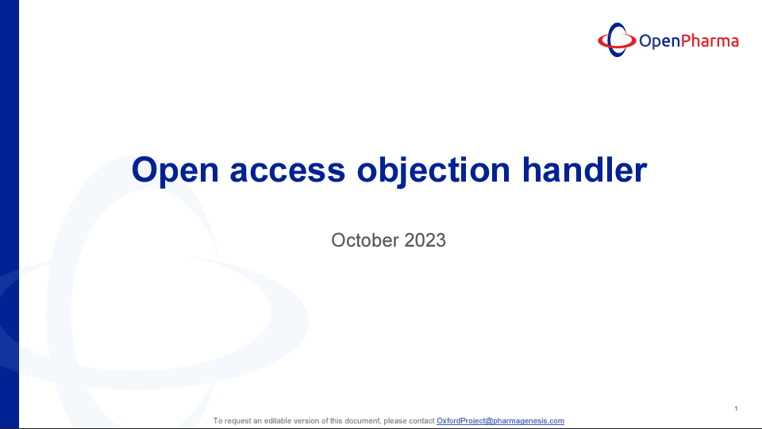
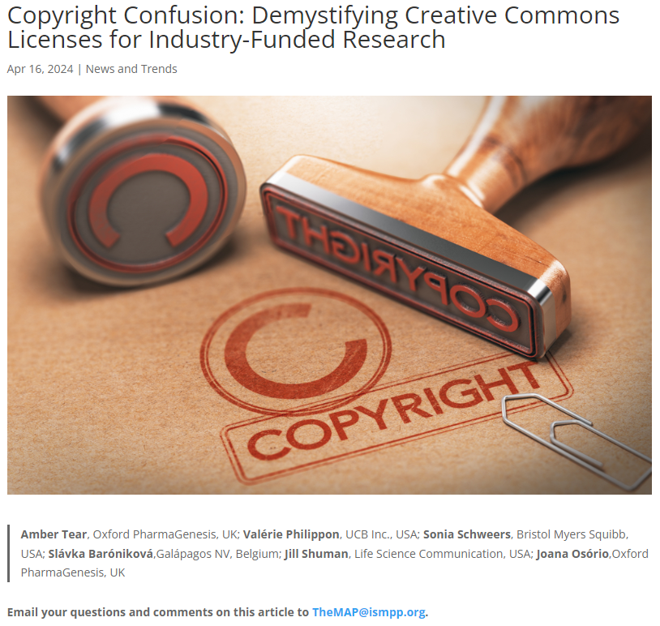
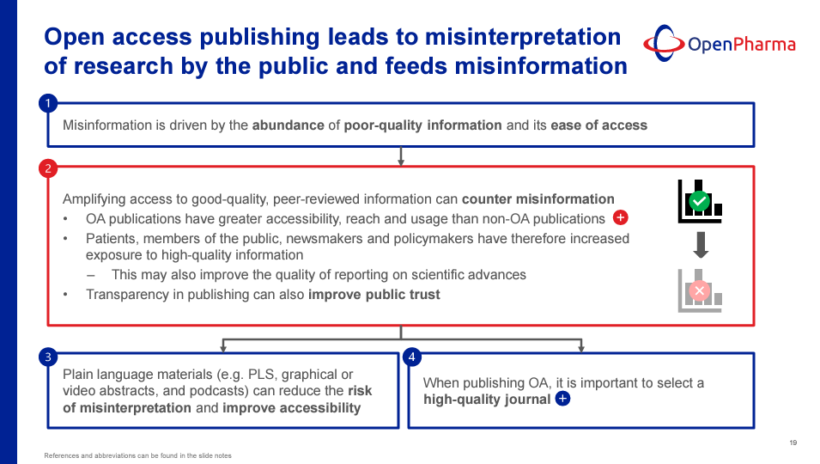
Useful resources
Open Pharma open access objection handler www.openpharma.blog/wp-content/uploads/2023/11/Open-access-objection-handler_01Nov23.pdf
Copyright Confusion: Demystifying Creative Commons Licenses for Industry-Funded Research https://www.ismpp-newsletter.com/2024/04/16/copyright-confusion-demystifying-creative-commons-licenses-for-industry-funded-research/

Slide 36
Audience Q&A
To ask a question, open the Q&A window, type your question into the Q&A box. Click Send.
Notes:
And now it's time to answer your questions. As a reminder, please type them into the Q&A box at the bottom of your screen.

Slide 37
Upcoming ISMPP U Webinars
November 13, 2024:
Can health literacy best practices in publications fuel innovation in patient-friendly electronic package information (ePI)?
December 2024:
Breaking Barriers: Promoting Equity, Diversity, & Inclusion when Communicating to HCPs and Patients
Notes:
Here is a snapshot of the upcoming ISMPP U for November centering on EPI. Registration is now open.
Also be on the lookout for our December ISMPP U around promoting equity, diversity, and inclusion when communicating with HCPs and Patients. Registration will open soon.

Slide 38
ISMPP University
Copyright confusion: demystifying Creative Commons licenses for industry-funded research
October 23, 2024
Webinar will begin promptly at:
11 AM ET / 4 PM GMT
Notes:
If you were unable to take a screenshot at the beginning of the webinar, please do so now

Slide 39

Thank you for attending!
We hope you enjoyed today's presentation.
After closing out of Zoom, please click the CONTINUE button
on your screen to take our short survey. Thank you!
Notes:
Thank you again for attending today’s webinar. Please take a moment to fill out the survey link that will be sent to you.
After closing out of ZOOM, please click the ‘continue’ button on your screen to take a short survey.
Thank you!

Slide 40
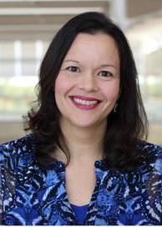
Sonia Schweers, PharmD
Director, WW Medical Compliance, Bristol Myers Squibb
Founding member of the Authorship Taskforce and helped develop the vision and strategy for the taskforce
Part of the authorship steering committee and an author of the authorship recommendations recently published
CMPP, certified medical publications professional; ISMPP, international society of medical publications professional

Slide 41
Sam Cavana
Head of Publishing Solutions at Taylor & Francis
Worked in commercial permissions, reuse and editorial roles
15+ years of experience in the publishing industry
CMPP, certified medical publications professional; ISMPP, international society of medical publications professional

Slide 42
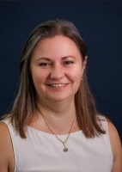
Slávka Baróniková, PhD
Senior Director of Publication at Alfasigma
Pharmacist with a PhD in Pharmacognosy
20 years experience in pharma, including scientific publishing, research integrity, transparency, and collaborative research across various therapeutic areas
Active contributor to scientific communication research and education as a Member of ISMPP and Open Pharma, and as EMWA conference director
CMPP, certified medical publications professional; ISMPP, international society of medical publications professional

Slide 43
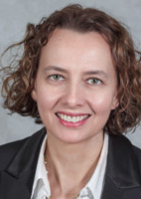
Valérie Philippon, PhD
Global Head, Scientific Communications & Managed Access Programs at UCB
Over 25 years of industry experience in Research, Development and Medical Affairs
Held a variety of Medical Affairs roles with increasing responsibilities successively at Idenix, Vertex, AVEO Oncology, Cubist Pharmaceuticals, Shire, Takeda and UCB
Long-term member of the Healthcare Businesswomen Association and was the Chair of the International Society for Medical Publication Professionals (ISMPP) Board of Trustee in 2021-2022
CMPP, certified medical publications professional; ISMPP, international society of medical publications professional

Slide 44
Sophie Nobes
Senior Medical Writer at Oxford PharmaGenesis
Co-lead of the Open Pharma open access working group
Experienced medical writer with a background in education and outreach
CMPP, certified medical publications professional; ISMPP, international society of medical publications professional

