Slide 1
Session Chair Training
February 28, 2024

Slide 2
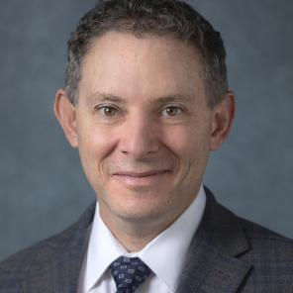
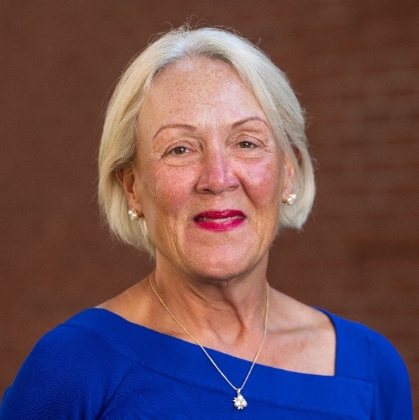
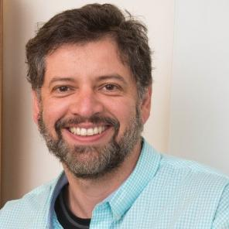
Welcome
Ophir Klein IADR President
Pamela Yelick IADR Vice-President
Alexandre Vieira AADOCR President
Use the Q&A to submit questions at any point. We will have set times through the webinar to address questions.

Slide 3
Presenter Guides
All Chairs and presenters are encouraged to review ALL related materials on the General Session website at iadr.org/2024iags/presentations. Chair guides can be found on this page for Oral and Poster chairs.

Slide 4
Download the IADR Meeting App
www.iadr.org/2024iadrapp
Notes:
The app is where you can view all the abstracts for your session

Slide 5
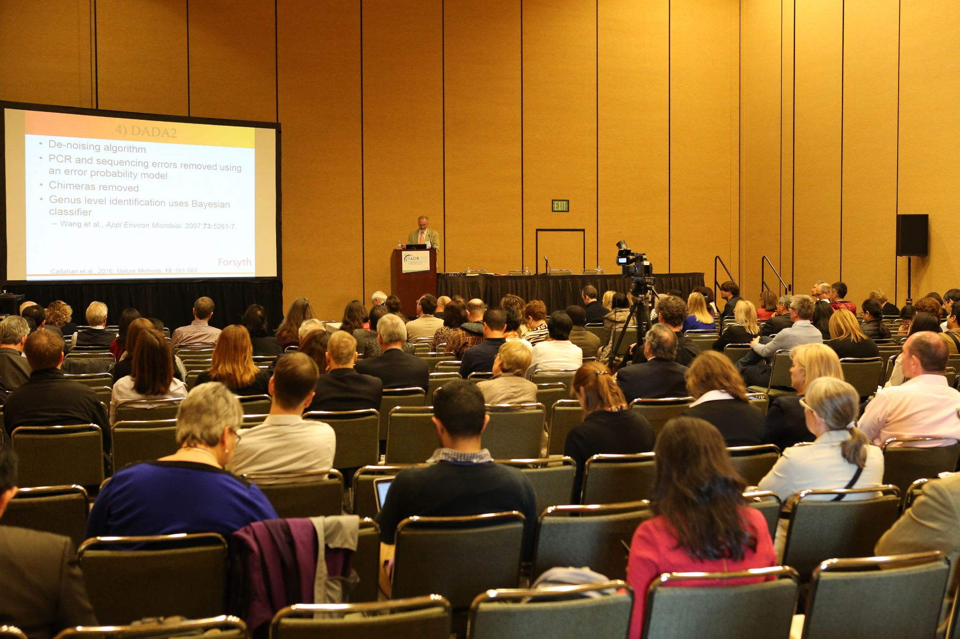
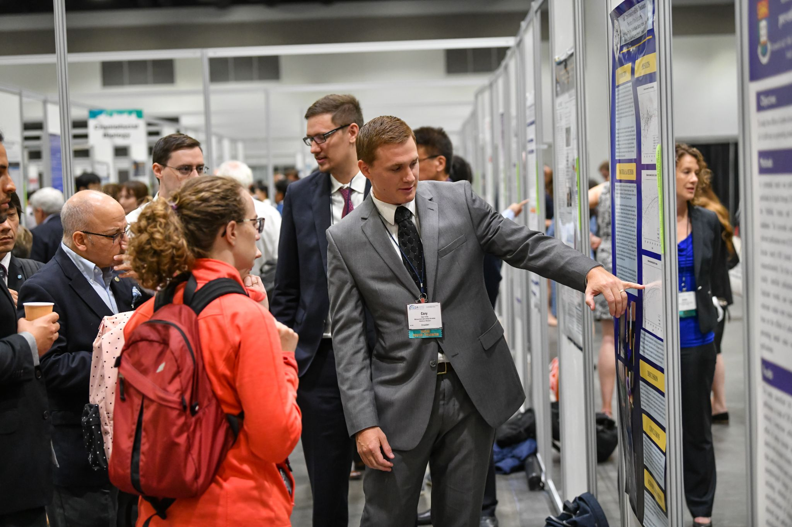
Types of Sessions
In Session Rooms
Oral Presentations (Abstract Based)
Symposia
Hands-on Workshops
Poster & Exhibition Hall
Poster Presentations (Abstract Based)

Slide 6
Oral Chair Arrival
Chairs are asked to arrive 10-15 minutes before the start of the session, be at the front of the room, and introduce yourself to presenters.
In each room near, on or near the podium will be a purple folder. Inside this folder is a list of all presenters in your session.
The app is the most accurate resource.

Slide 7
Oral Session Chair Expectations
All presenters have uploaded ahead of time online or in the Speaker Ready Room. Slides will be synced to the room computer starting 2 hours before the start.
Follow the order of presentations listed in the materials.
Keep speakers on time.
If a presenter does not show, hold that time. You are welcome to have additional discussion or Q&A in this time.
Facilitate an orderly discussion period.

Slide 8
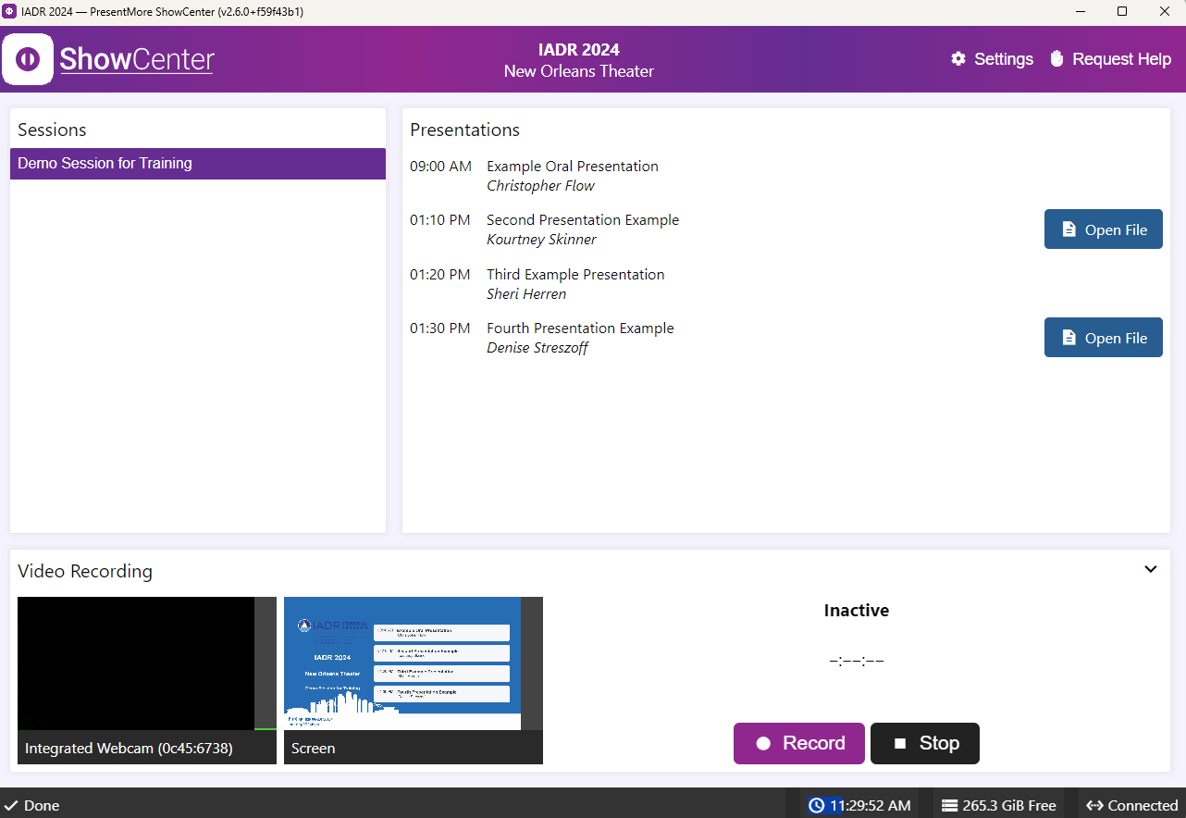
Oral Session Show Center
IADR is using the same Speaker Management system in New Orleans as was used onsite at both 2023 meetings.
BRIEF DEMO

Slide 9
Types of Sessions
In Session Rooms
Oral Presentations (Abstract Based)
Symposia
Hands on Workshops
Poster & Exhibition Hall
Poster Presentations (Abstract Based)

Slide 10
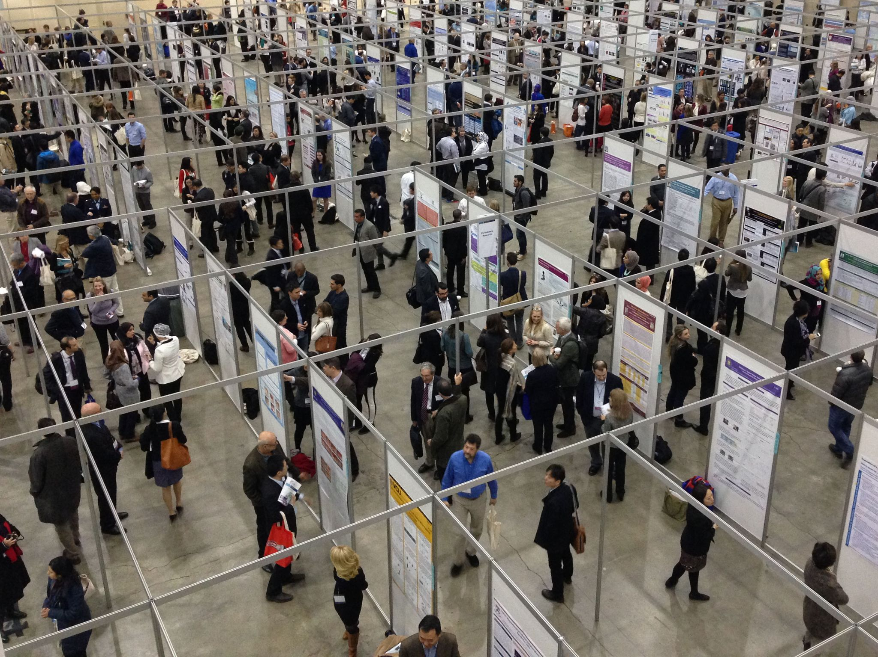
Poster & Exhibition Hall
Welcome back to posters!
Arrive just before the start of the poster session block. Introduce yourself to the presenters.
During the 75-minute session time, ensure presenters have interaction at their posters.
Take note of any poster no-shows (blank boards or boards with no live presenter).

Slide 11
ALL CHAIRS
After Session is Complete
Complete the Survey Link for Oral/Poster Chairs. This link will be emailed to you and can be found in the Chair Guidelines linked from the IADR Chair Guidelines section on the General Session website.
This can be done on your phone or computer. Please complete within 2 days of your session.

Slide 12
Reminder: IADR Professional Conduct at Meetings Policy
The IADR Professional Conduct at Meetings Policy outlines expectations for all those who participate in the IADR/AADOCR/CADR General Session & Exhibition as well as the consequences for unacceptable behavior.
We expect all participants at the meeting to create a safe and positive experience for all fellow attendees.

Slide 13
Questions on Chairing Oral or Poster Sessions?
Submit any questions you may have in the Q&A Module.
Can also email meetings@iadr.org with any
support questions about the General Session.

