Slide 1
ISMPP University
Introducing LearningBUILDER™ - ISMPP's New Certification Management Platform Dedicated to the CMPP™ Credential!
November 20, 2024
Webinar will begin promptly at:
11 AM ET / 4 PM GMT
Notes:
Hi everyone; welcome and thank you for joining today’s ISMPP U, “Introducing LearningBuilder – ISMPP’s New Certification Management Platform for the CMPP Credential”

Slide 2






















ISMPP Would Like to Thank the following TITANIUM and PLATIMUM Corporate Sponsors for their ongoing support of the Society:
Notes:
First a sincere thank you to all of ISMPP’s titanium and platinum corporate sponsors for their ongoing support of the Society.

Slide 3

ISMPP Announcements
Application deadline for the March CMPP exam is February 1.
Applications will open in January in LearningBuilder.
Notes:
For those who are seeking to earn the CMPP credential or to recertify via exam, the application deadline for the next exam window (March 1-31) is February 1, 2025. Applications will open in January in LearningBuilder.

Slide 4
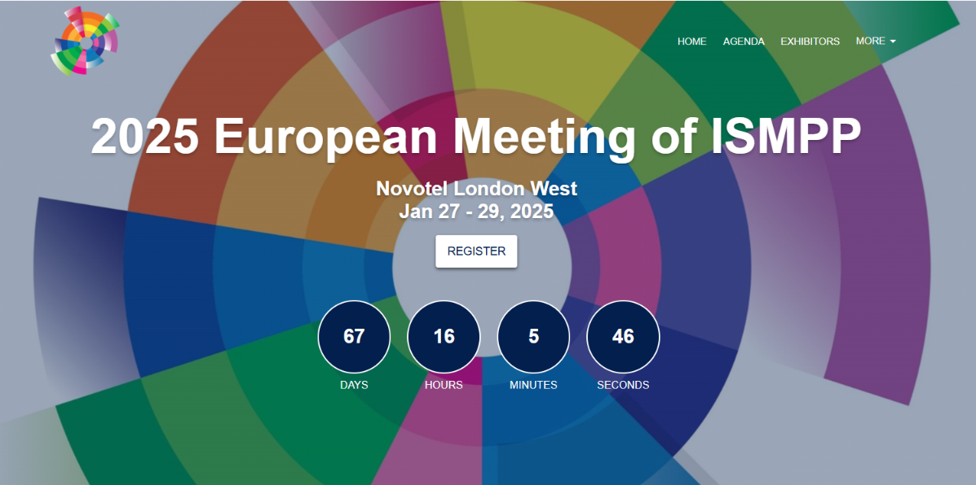
Notes:
Also, just a reminder that registration is now open for the 2025 European Meeting of ISMPP, where this year, sessions will focus on “core values for an integrated age.” The meeting this year will be held in London from January 27-29. Looking forward to it.

Slide 5
How To Ask Questions
Feel free to ask a question at any time, however all questions will be held until the end the of the presentation.
To ask a question, open the Q&A window, type your question into the
Q&A box. Click Send
Note: Check Send Anonymously if you do not want your name attached
to your question in the Q&A
We will make every effort to respond to all questions live (out loud)
Notes:
You can submit a question at any time during the presentation by following the instructions on this slide.
We will answer questions at the end of the presentation.

Slide 6



Faculty and Special Guest
Special Guest
Moderator
Cassie Cobb
Manager, Education Content
ISMPP
Danita Sutton, PhD, ISMPP CMPP™
Director, Credentialing
ISMPP
Billy O’Shaughnessy
Implementation Analyst
Heuristic Solutions
Notes:
My name is Cassie Cobb, I am a manager of education content at ISMPP and today's moderator.
Our faculty includes Danita Sutton, a familiar name to many of you, Director of Credentialing at ISMPP.
Also joining us is Billy O’Shaughnessy, Implementation Analyst from Heuristics. Billy’s team has spent the last 10 months building the LearningBuilder platform for ISMPP. He is here to help answer any of the very technical questions some of you may have about the new platform
Thank you for joining today, Billy!

Slide 7
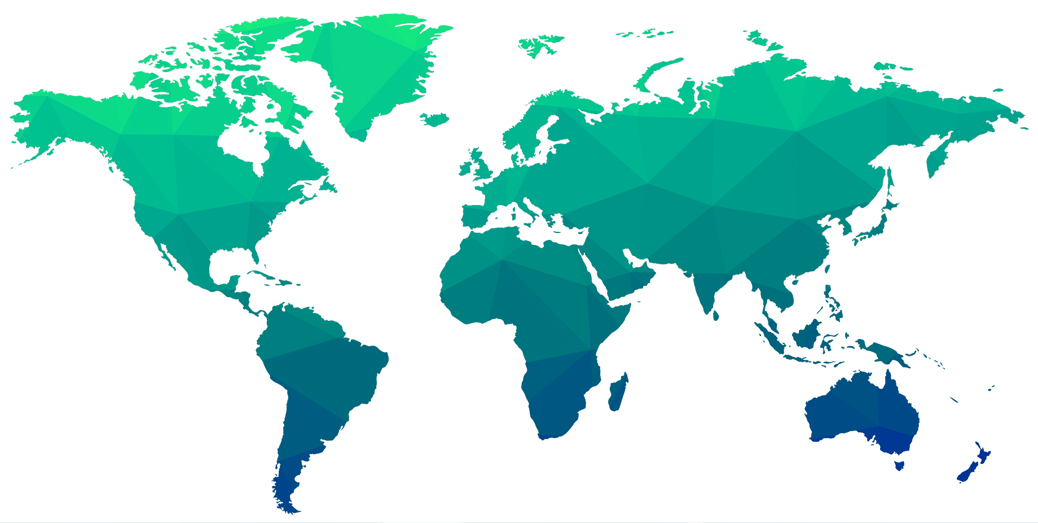

CMPPs Are Represented Around the World
There are currently 1,849 CMPPs in 33 countries on 6 continents!
Sweden
29
UK
1
Canada
558
8
Belgium
15
10
Netherlands
956
Ireland
8
16
Germany
Korea
France
2
Austria
China
Japan
USA
1
28
Switzerland
23
1
Portugal
6
3
1
Greece
34
Spain
Italy
Hong Kong
Taiwan
2
54
1
Saudi Arabia
1
2
UAE
India
1
Philippines
3
25
Singapore
1
Malaysia
Brazil
1
7
Indonesia
34
South Africa
Australia
13
New Zealand

Slide 8

Introducing LearningBUILDER™: A New & Improved CMPP™ Experience
Today’s Objectives:
Demonstrate how to navigate and manage your CMPP profile
Explain the fields in the certification and recertification applications
Describe how to use the credit tracking function to document and monitor your CE activities
Provide insight into the strict policy adherence that this type of automated system applies
Notes:
Beginning January 1, all your CMPP activity will occur in LearningBuilder, so my objective today is to familiarize you with the LearningBuilder environment.
Specifically, I will:
Read objectives list

Slide 9
The New CMPP™ Management Platform Launches in January!
LearningBUILDER™- state-of-the-art certification management solution
Convenient 365/24/7 access to site (although recommended, membership not required for access)
User-friendly certification & recertification application processes
Routine reminders for application deadlines and certification expirations
Notes:
So, what is so special about LearningBuilder…read slide

Slide 10

Credit Tracking Made Faster and Easier
Automated running total of all CE credits by year and category
Easy upload of activity documentation
Request for credit is part of credit tracker function
Bulk upload by ISMPP for attendees of ISMPP U webinars and meeting sessions (eliminating need for individuals to upload this information)
Notes:
The credit tracking feature I am sure will be a welcome improvement for many CMPPs. LearningBuilder makes tracking your CE activities faster and easier!
Read slide

Slide 11
LearningBuilder Terminology
Applicant = Applied to take the exam
Candidate = Approved to take the exam
Practitioner = Medical Publication Professional with any status (eg, Applicant, Candidate, CMPP)
Recertification Application = Credit tracker and includes application in final year of certification cycle
Notes:
Before we get into specifics, I want to mention a few things you should be aware of regarding LB terminology.

Slide 12
How Do I Access LearningBuilder?
Go to “My CMPP Login” at www.ismpp.org/Certification
If you are an ISMPP Member, click on the ISMPP MEMBER link
  You will be directed to the ISMPP member login page
  After you log in, LearningBuilder will launch
If you are not a member, click on the NON-MEMBER link
  You will be directed to the Login page of LearningBuilder
  You can view your Profile and use the credit tracking function in the Recertification application
You MUST use the ISMPP MEMBER login link if you plan to submit your Certification or Recertification Application; if you are not a member, you will be prompted to pay your Membership fee
Notes:
To access LB, read slide

Slide 13
Your CMPP™ Profile and Account
Notes:
Let’s have a look at what your CMPP Account and Profile will look like in LB.

Slide 14
Your Demographic Information
Your demographic information is synchronized from your Member Profile on the ISMPP website
Demographic changes/updates (name, primary email, phone, or address) can ONLY be made in MemberClicks and are copied to LearningBuilder
LearningBuilder uses the demographic data in MemberClicks for the Certification and Recertification applications
Notes:
Your demographic information (name, primary email, phone, address, organization, etc) is derived from your information in MemberClicks (the ISMPP AMS which you know as the ISMPP website). LB integrates with MemberClicks to synchronize this information.
Demographic changes/updates (name, primary email, phone, or address) can ONLY be made in MemberClicks and are copied to LearningBuilder
LearningBuilder uses the demographic data in MemberClicks for applications

Slide 15
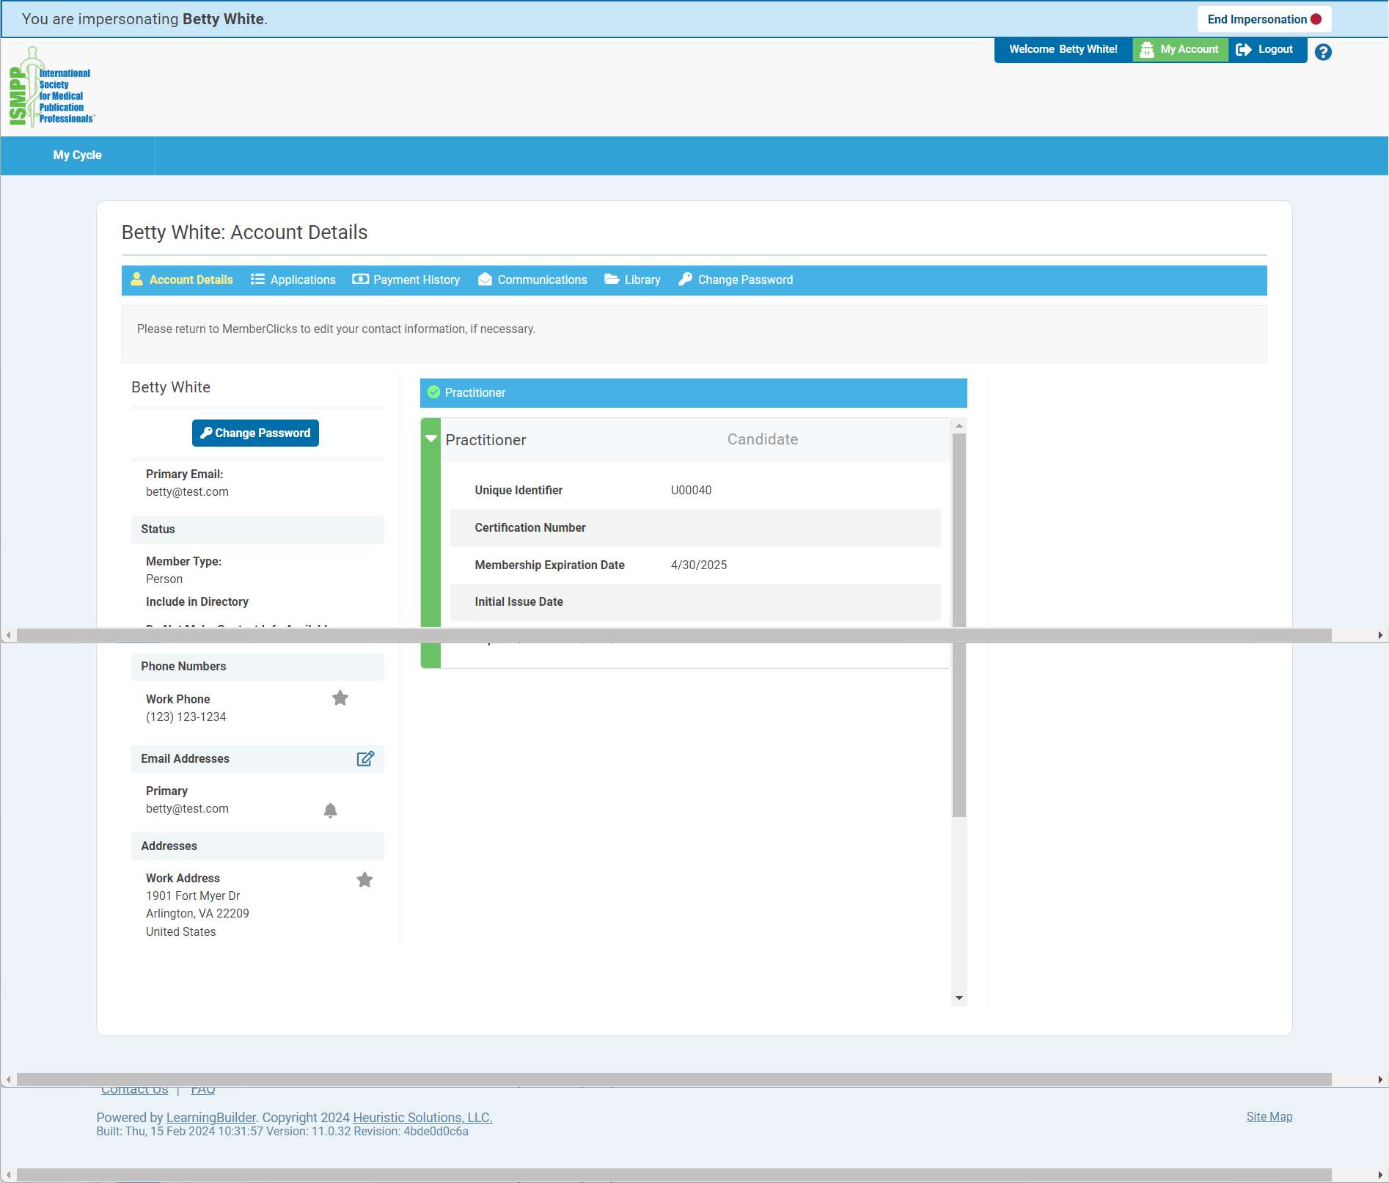
LearningBuilder Profile
Notes:
This is a screenshot of a profile page in LB.
Top right, you have an Account button. When clicked, it pulls up this profile page
In the middle of the page, the menu bar has the following:
Account details = Main view (this view) when you click Account above
Applications = your relevant apps (certification, Mentor volunteer, Mentor request, recert)
Payment history
Communications = messages from LB. Communications is a history of all emails LB has ever sent to your account
Library = contains all previously uploaded documents
Change pw
Down the left side is your demographic information. Again, this is taken from MC
The middle box contains your relevant CMPP information:
Status = Applicant, Candidate, CMPP
Certification number, issue date, end date (is expiration) and your ISMPP membership expiration

Slide 16
Certification Application
Notes:
Now I will demonstrate how to complete a certification application.

Slide 17
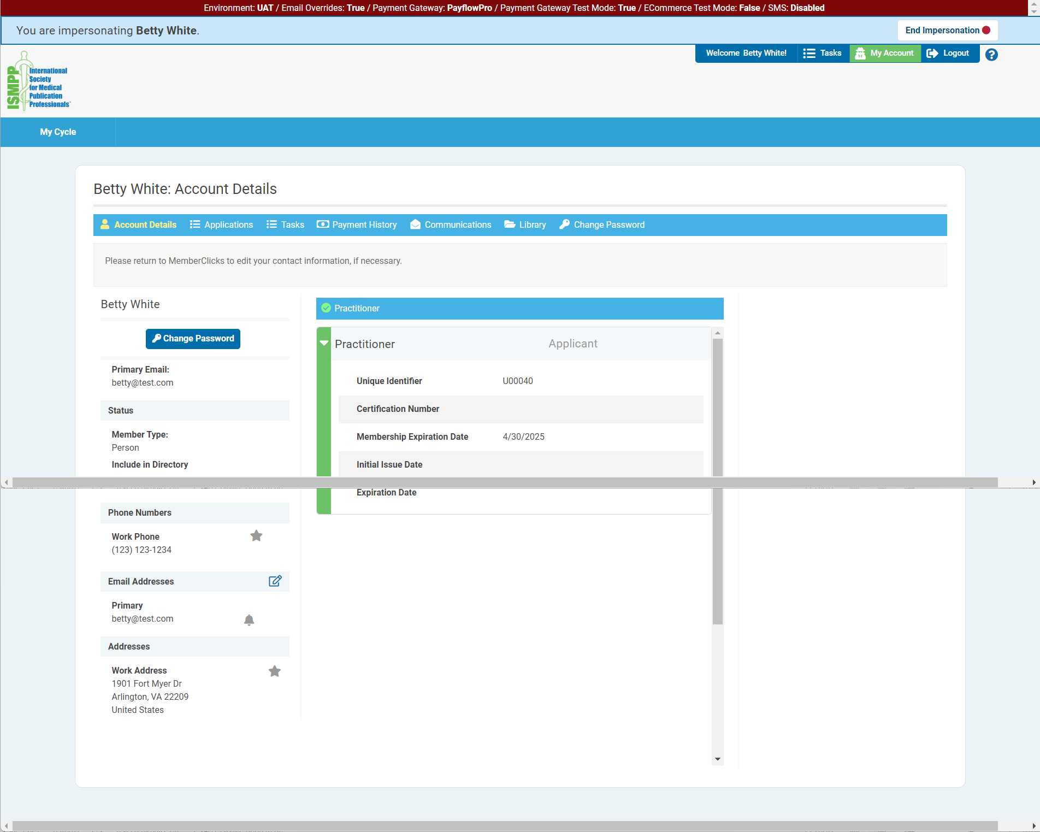
Where Is the Certification Application?
Notes:
To access the certification application, click on “Applications” in the menu bar.

Slide 18
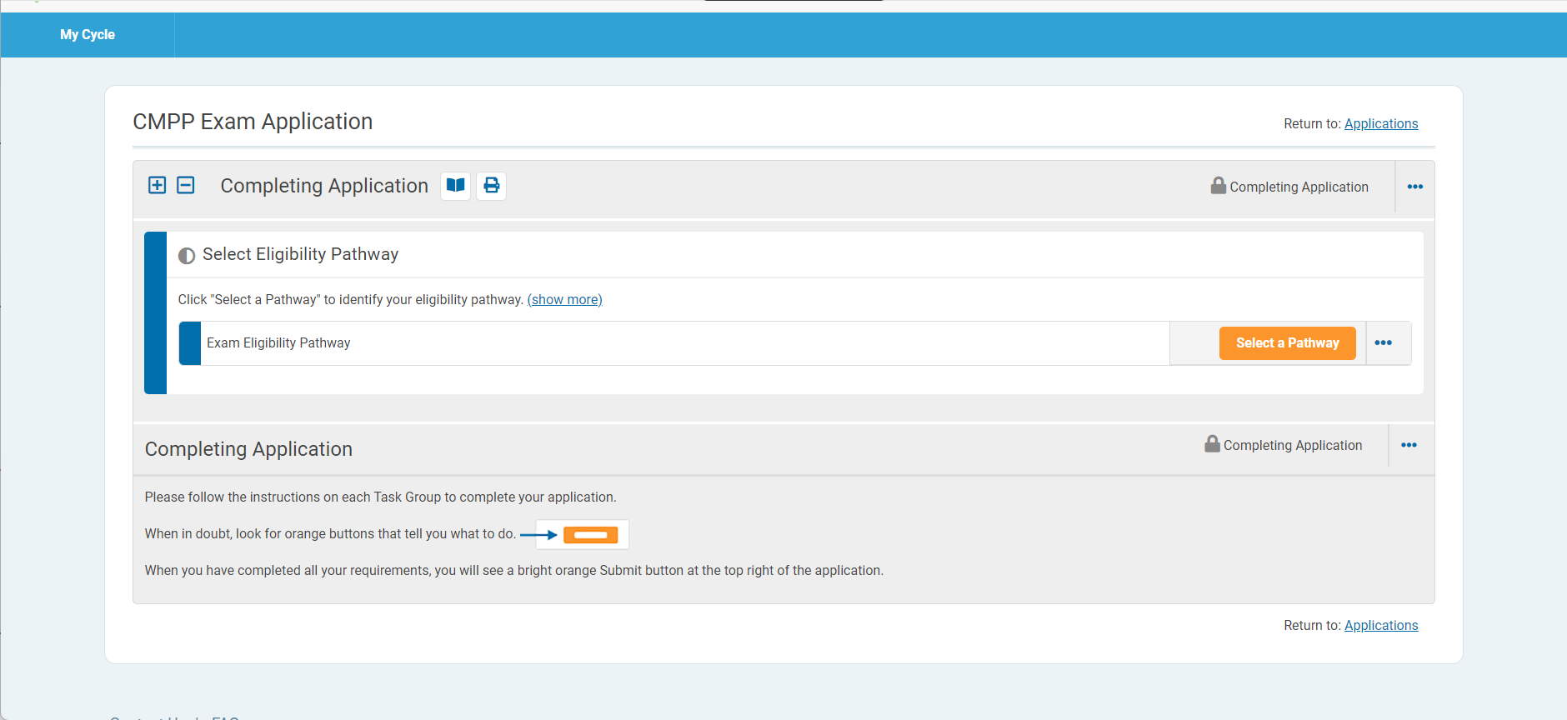
Select Eligibility Pathway
Notes:
The first step is to select your eligibility pathway:
Bachelor’s degree or higher and 4,000 hours (equivalent of 2 years industry experience)
High school diploma or equivalent and 10,000 hours (equivalent of 5 years in industry)
Note that throughout LB, Orange buttons are used to advance to the next step in the process

Slide 19
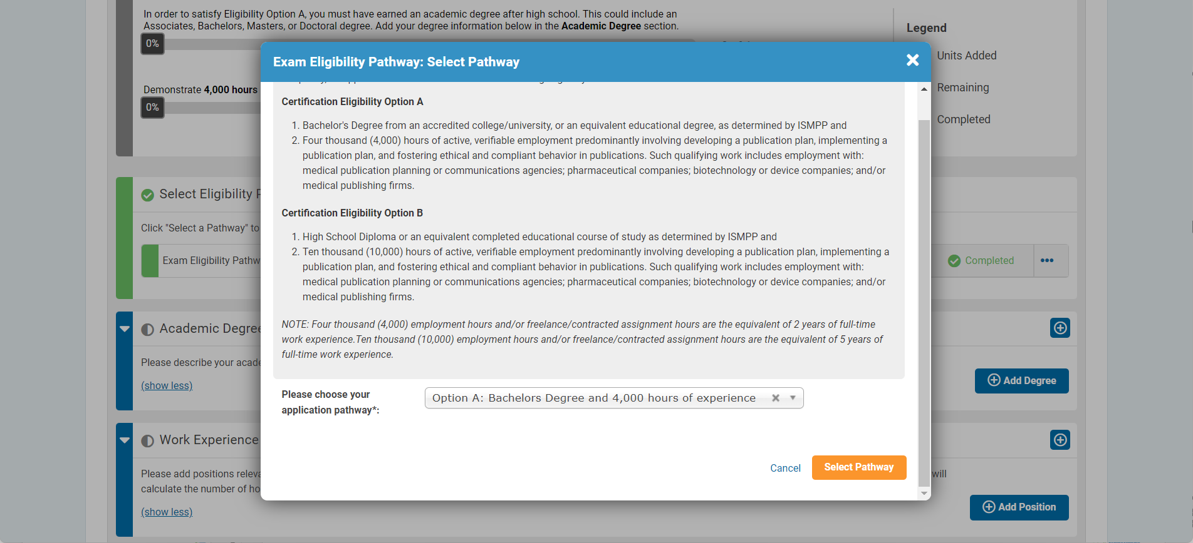
Eligibility Pathway Options
Notes:
When you click on “Select a Pathway”, this window opens for you to choose your pathway.

Slide 20
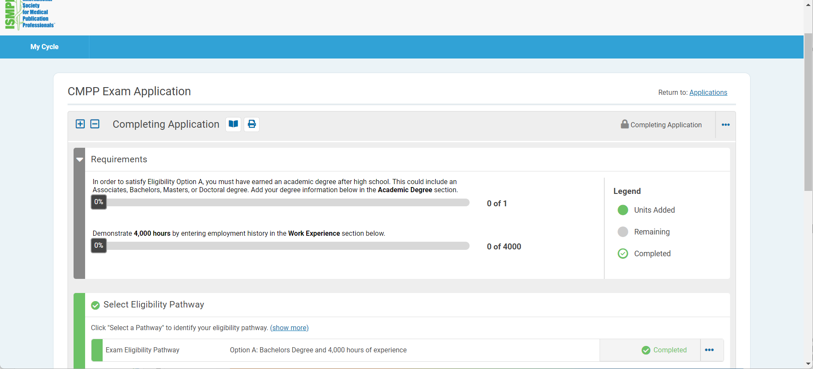
Eligibility Pathway Progress Bars
Notes:
The first pathway was chosen, requiring 4,000 hours of industry experience.
Here are the progress bars to show you have provided degree information and the second bar showing your progress toward the 4,000 hours of industry experience. It may take more than 1 job history entry to reach the required 4,000 hours.

Slide 21
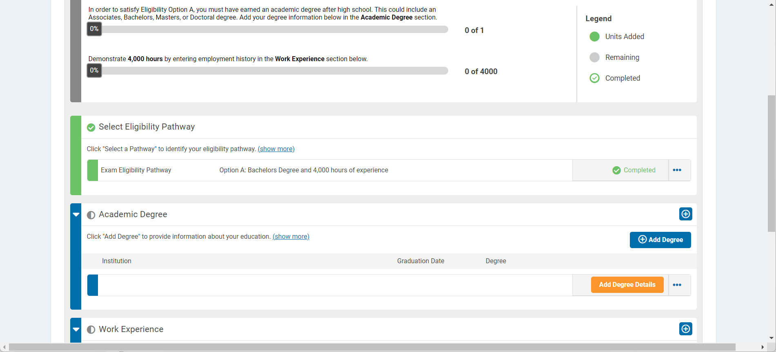
Academic Degree
Notes:
Next, you add your academic degree.

Slide 22
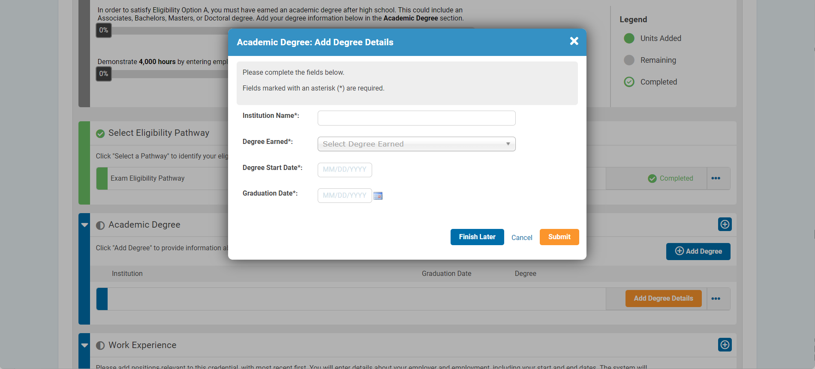
Degree Details
Notes:
In this window, you enter your degree details.

Slide 23
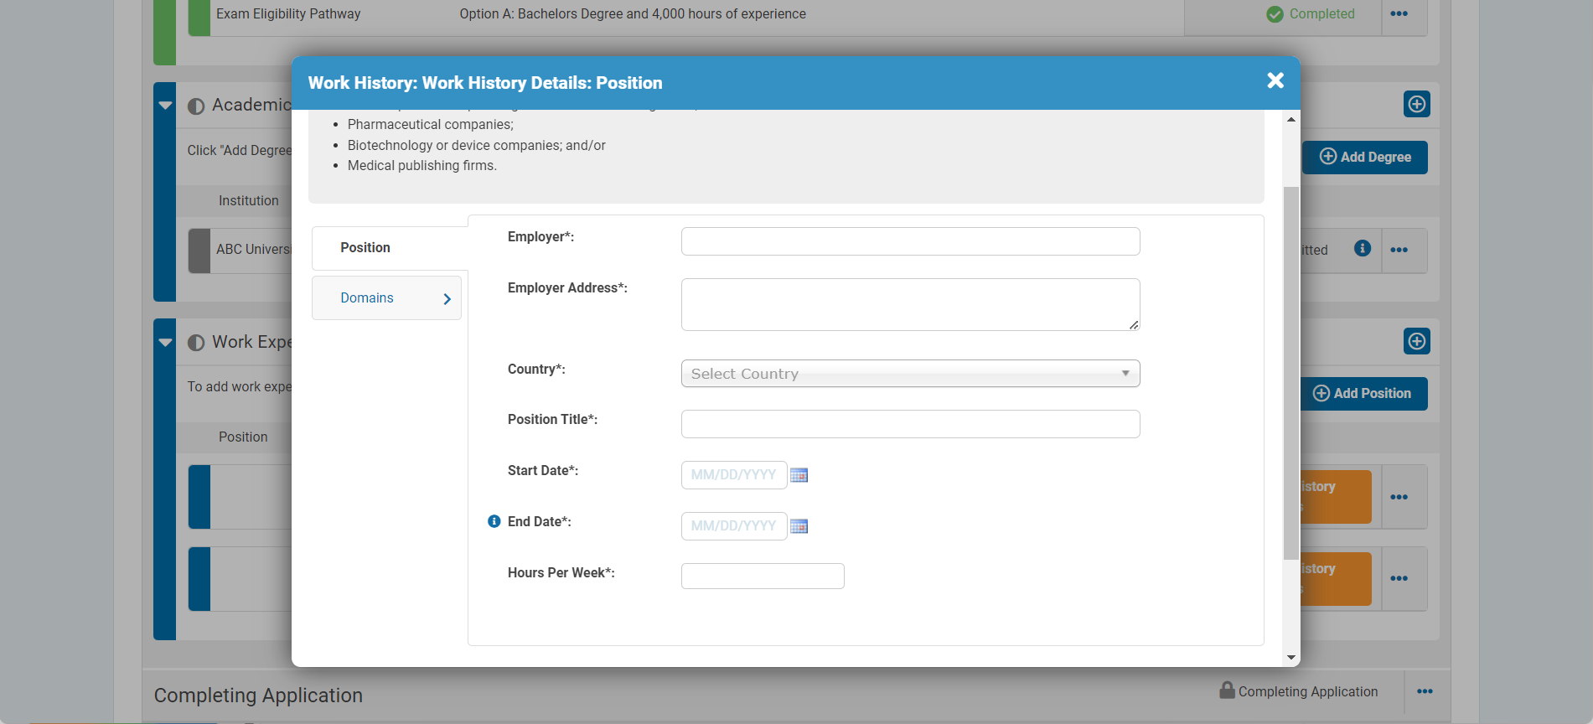
Work Experience
Notes:
After clicking on Work Experience, enter your details in this window, including:
Employer
Address
Your title
Dates of employment
Hours/week

Slide 24
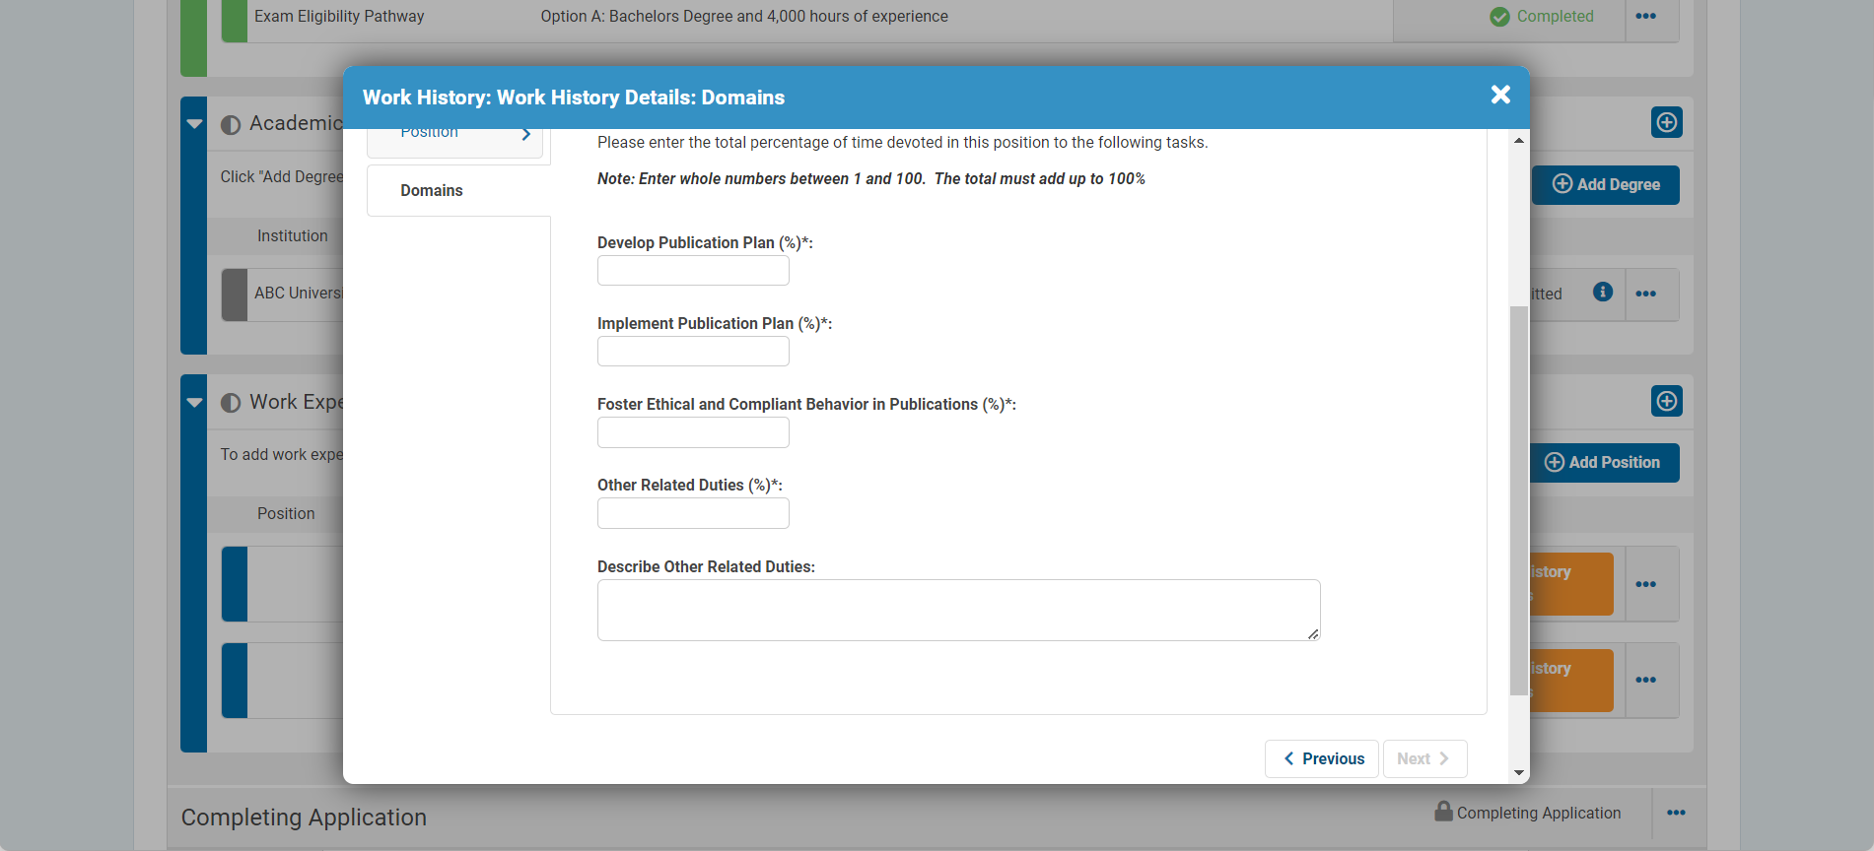
Work History: Domains
Notes:
In the next window, you enter percentage of time spent in each domain in this position:
Dev Pub Plan
Implement Pub Plan
Foster Ethical and Compliant Behavior
Other.
Text box to describe other responsibilities

Slide 25
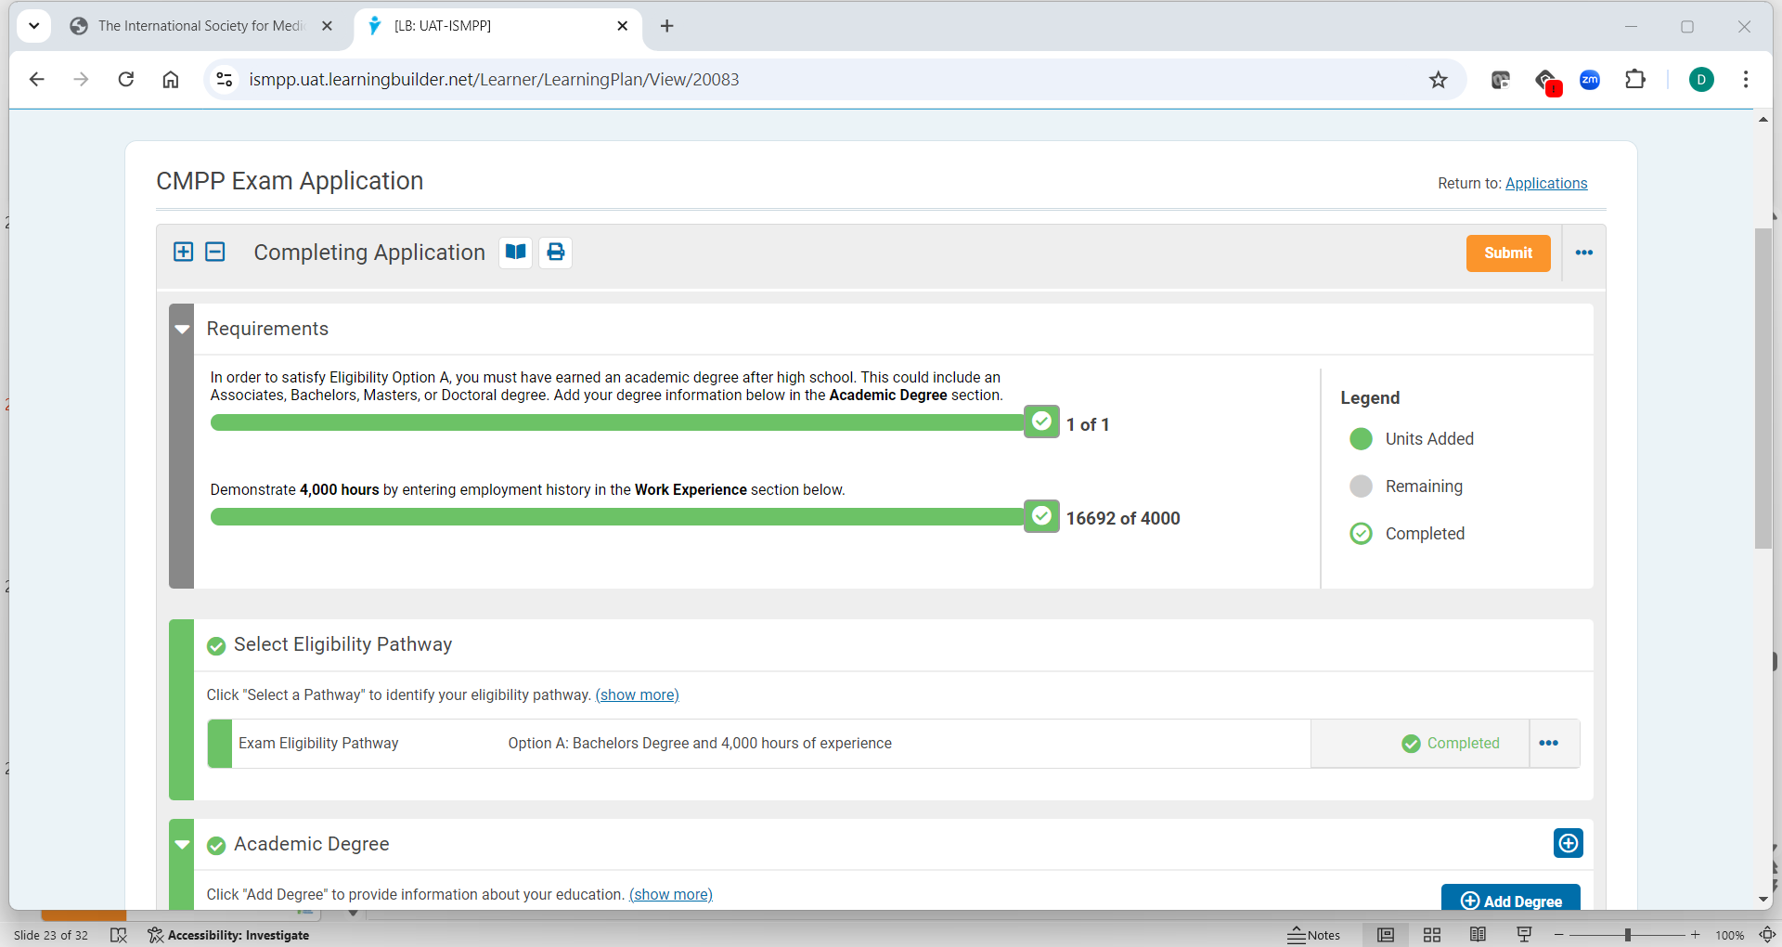
Bars Show Progress on Application
Notes:
As you enter your degree and work experience, the bars show your progress. If your progress bar is not completely filled, you need to add another position in your work history to satisfy the 4,000 hours of experience required
When both bars are completed, you may submit your application.

Slide 26
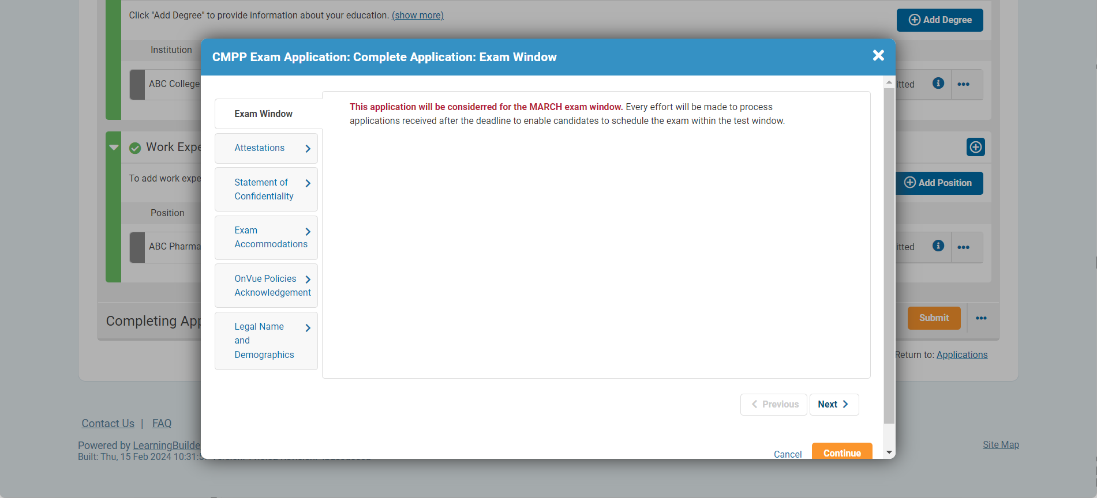
Attestations and More
Notes:
After submitting your application, you must complete fields in several tabs:
Exam Window – confirm your exam window (March or September)
Attestation – Candidate agreement and release
Statement of Confidentiality – you agree to keep all exam information and content confidential
Exam Accommodations – requested here with upload of relevant documentation
OnVUE policies acknowledgement – agree to all online exam rules and regulations, with the result of exam termination if rules are violated
Legal Name and Demographics – Name on application must EXACTLY match name on your ID(s) to be allowed to take the exam. You also must provide your gender and birth date for Pearson ID purposes

Slide 27
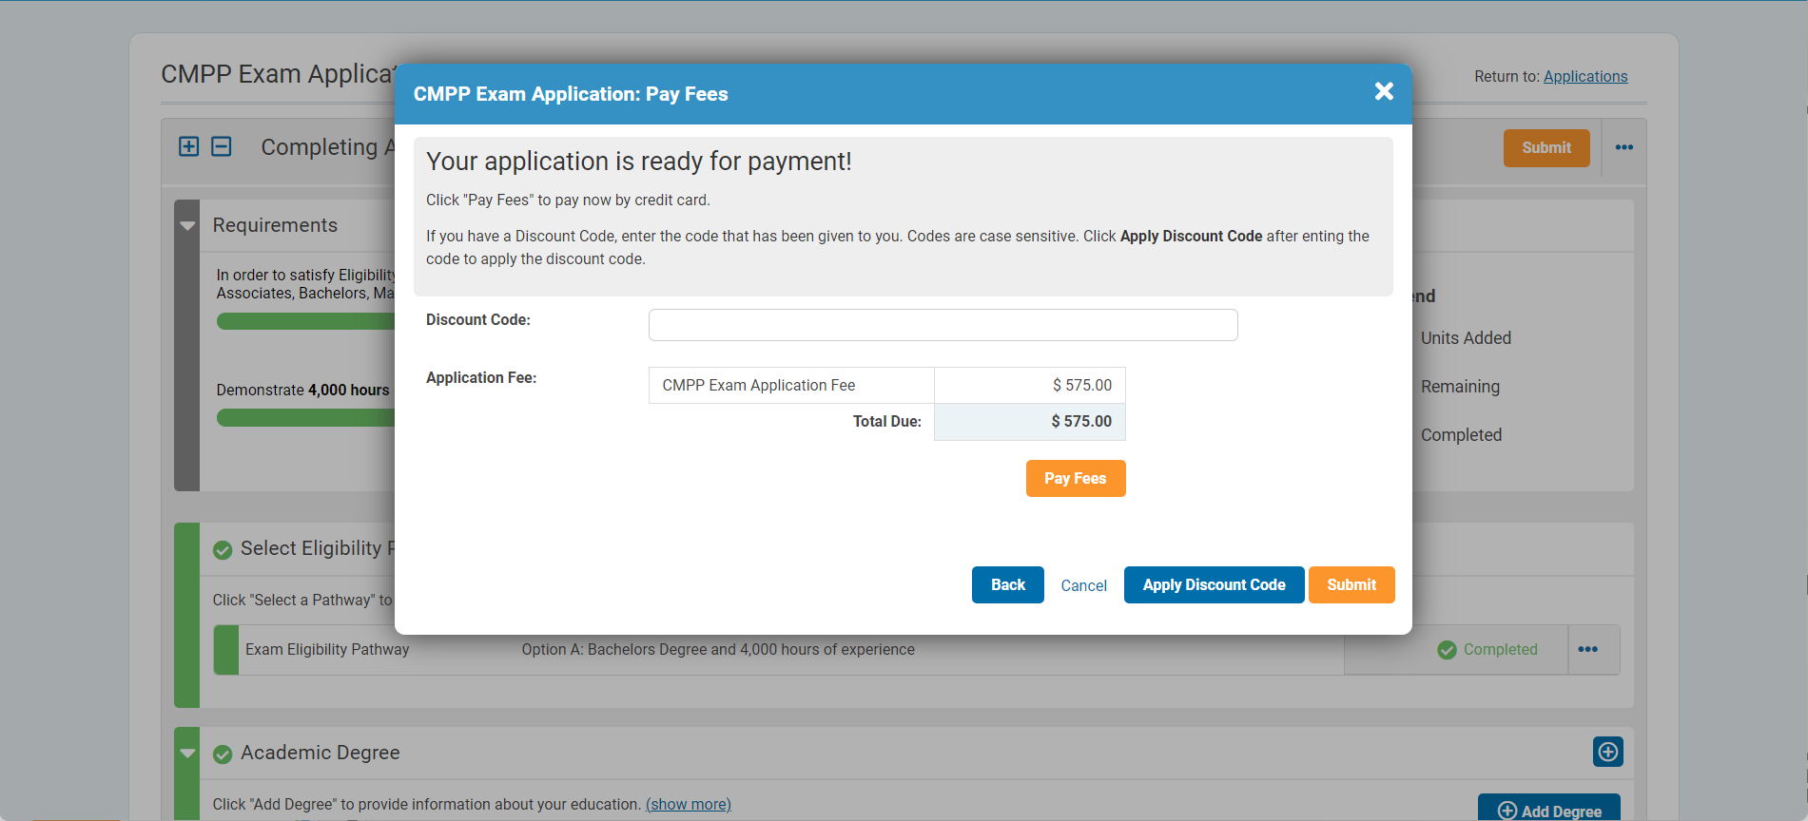
Fee Payment
Notes:
The next window allows you to submit payment.
If you have a discount code, it is entered here.
Applicants will receive an email to their primary email address (which will also show in their “Communications”) when they submit payment. A copy of the receipt can be downloaded from Payment History.
The application will then be reviewed for approval.

Slide 28
CMPP Exam
After you submit your certification application, you will receive a message indicating that your application is approved
3-4 days after approval of the exam application, Pearson authorization to test is sent to the candidate
These messages will also appear in “Communications” in LearningBuilder
Exam results are posted in LearningBuilder
LearningBuilder integrates with Credly for issue of digital badges
Notes:
After you submit your certification application, you will receive a message indicating that your application has been approved
After approval of the CMPP exam application, the Pearson authorization to test message is sent to the candidate 3-4 days later.
This message will also appear in “Communications” in the toolbar in LB.
Exam results are posted in your Communications in LB.
LB will integrate with Credly for the issue of digital badges or updates to expirations on digital badges.

Slide 29
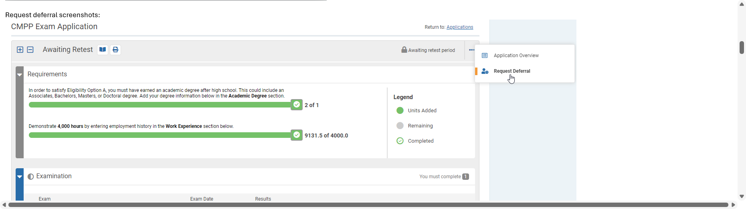
Exam Deferral
Notes:
Once your exam application is approved, you may defer your exam to the subsequent test window by clicking the “defer” button at the top right of your application.

Slide 30
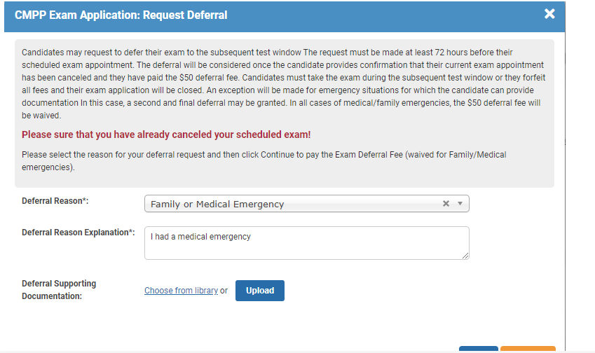
Deferral Screen
Notes:
In the defer window, you will need to upload documentation if you request to waive your deferral fee due to a medical/family emergency.

Slide 31
CMPP Mentor Program
Notes:
The CMPP Mentor Program now “lives” in LB

Slide 32

CMPP Mentor Program in LearningBuilder
Both Request a Mentor and Mentor Volunteer forms can be found in the “Applications” menu item in the tool bar
Exam “Candidates” (application has been submitted and approved) may request a Mentor
  Mentor assignments and communications come from LearningBuilder
“CMPPs” may volunteer to become a mentor by submitting the mentor application in their “Applications” menu on the tool bar
Notes:
The CMPP Mentor Program is now in LB. Both Request a Mentor and Mentor Volunteer forms can be found in “Applications” menu item in the toolbar in LB.
Once a practitioner has “Candidate” status – their application has been submitted and approved – they may request a mentor.
Mentor assignments and communications occur in LB.
“CMPPs” may volunteer to become a mentor by submitting the mentor application in their “Applications” menu item in the tool bar.

Slide 33
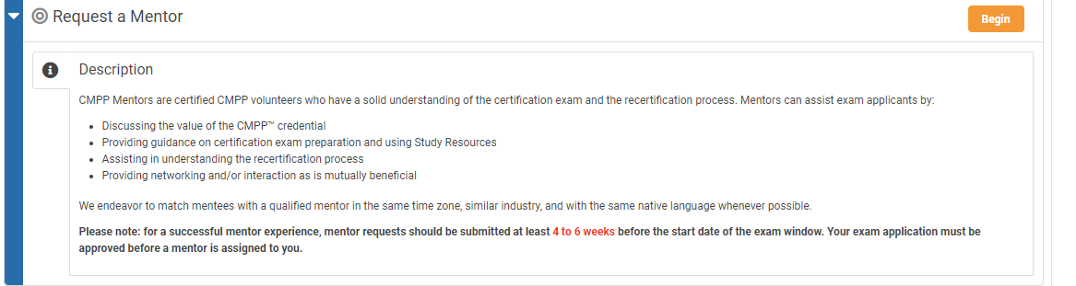
Request a Mentor
Notes:
When you click on the Mentor Application in the Applications tool bar, this menu opens. Click Begin to request a mentor.

Slide 34
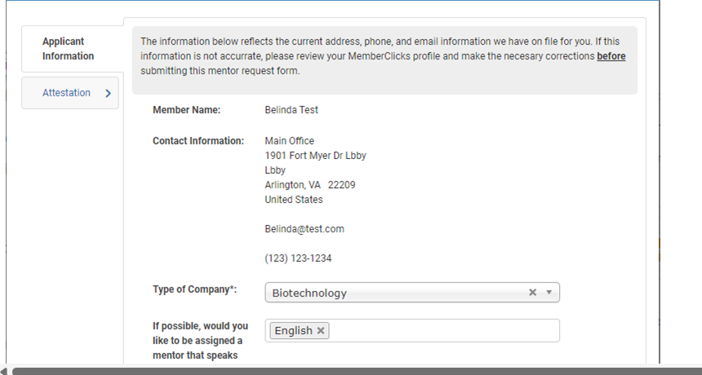
Request a Mentor Information
Notes:
This window collects information for your mentor request. Your member name and contact information are taken from your LearningBuilder profile
You will enter the following:
Type of company you work for
If you would like a mentor who speaks a language other than English
Your test window (March or September)

Slide 35
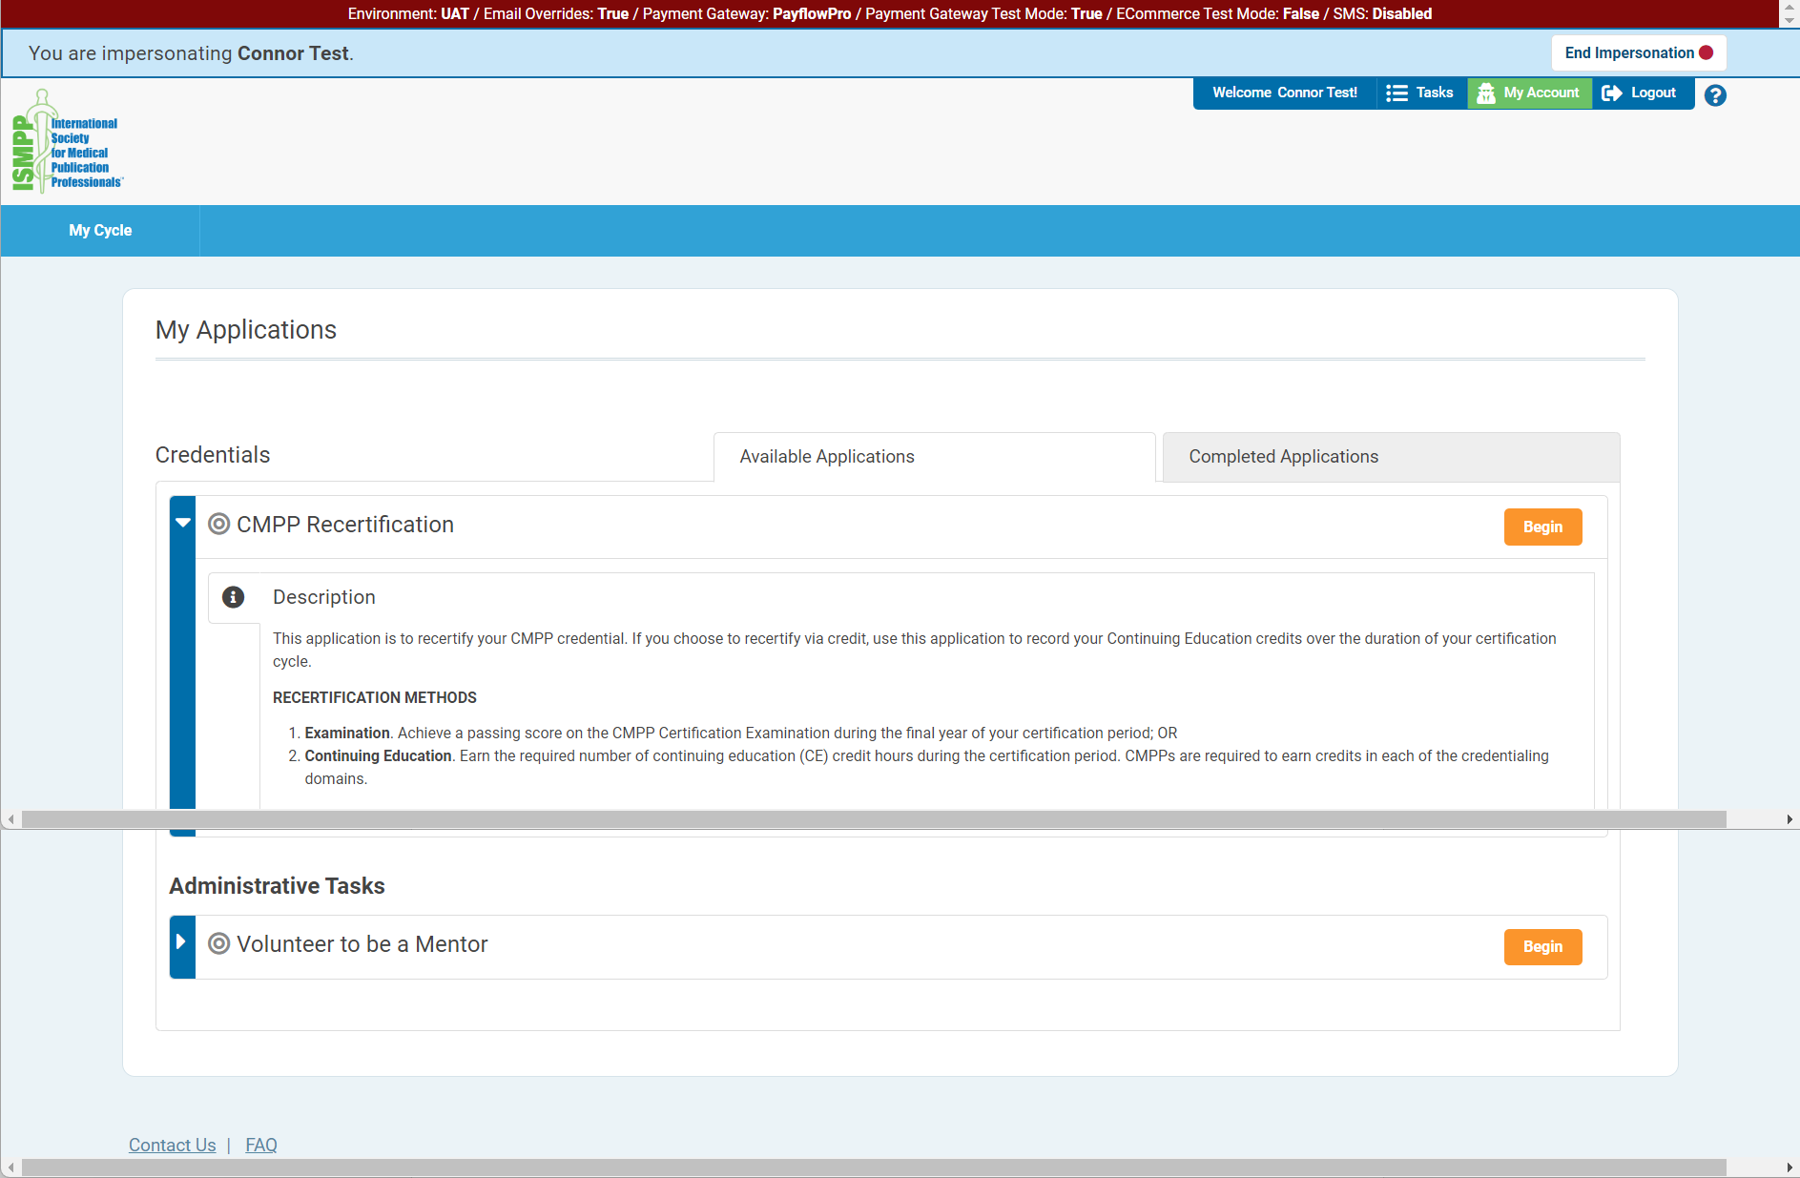
Volunteer to Be a Mentor
Notes:
The Mentor Volunteer form may now be found in your “Applications” on the menu tool bar. Open the Volunteer to be a Mentor application.

Slide 36
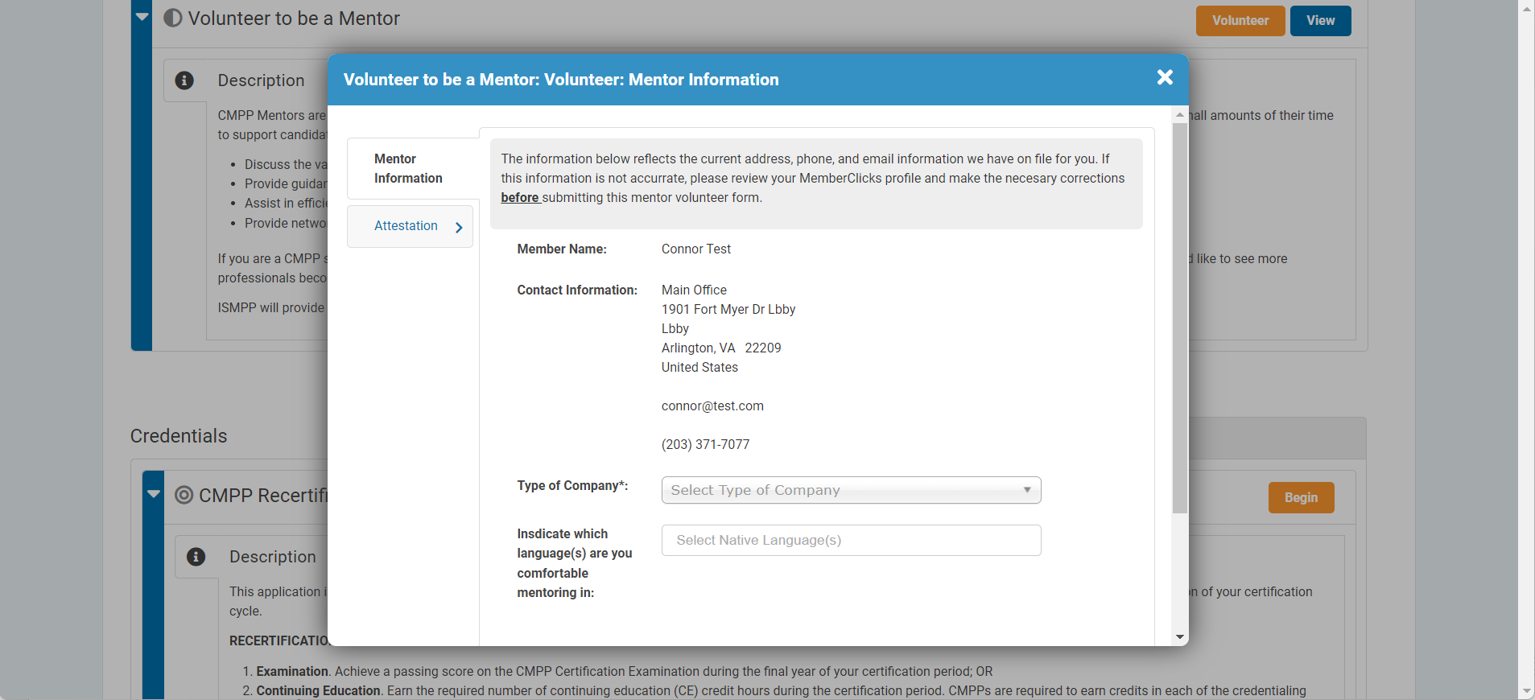
Mentor Form
Notes:
Your demographic information will appear in the box, since it is pulled from MC.
You will enter the type of company you work for and indicate any languages other than English in which you are comfortable mentoring.

Slide 37
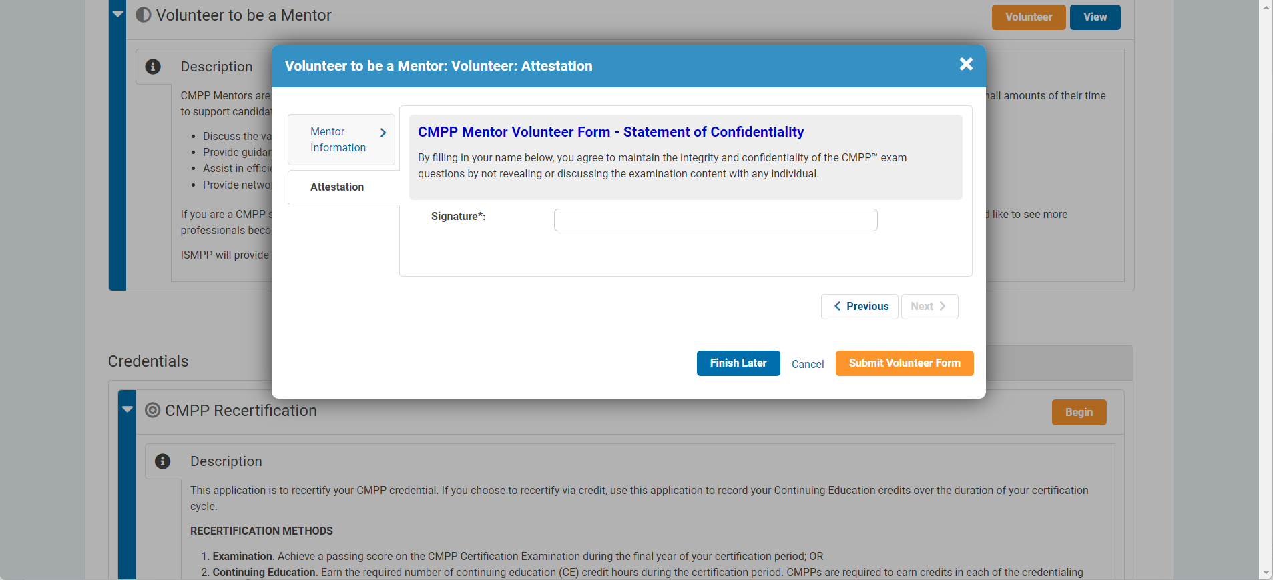
Mentor Attestation
Notes:
The next window allows you to attest to the statement of confidentiality.
After you submit your mentor volunteer form, you will receive a message in LearningBuilder regarding next steps in the process.

Slide 38
Recertification Application
+ Credit Tracker
Notes:
Now we will have a look at the CE credit tracker, which is part of the Recertification application in LB.
Note that this is different from our current process in that:
You recertify by exam using the Recertification application function.
Your credit tracker “lives” in the Recertification application.

Slide 39
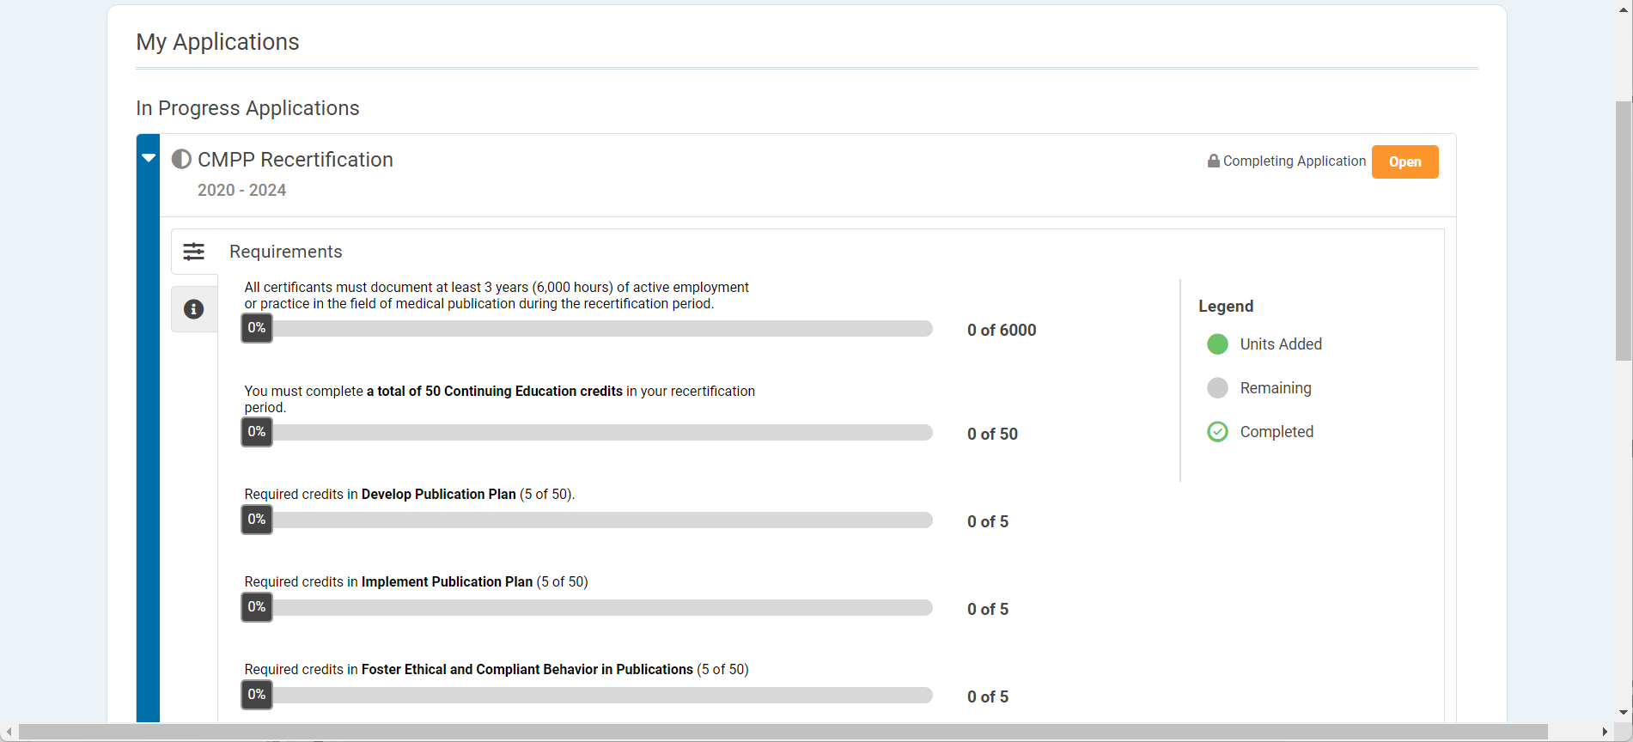
Recertification Application and “Credit Tracker”
Notes:
If your status is “CMPP”, the Recertification Application – this screen – will automatically open when you login to LearningBuilder.
The Recertification application will show as “In Progress” under “Applications” for all CMPPs.

Slide 40
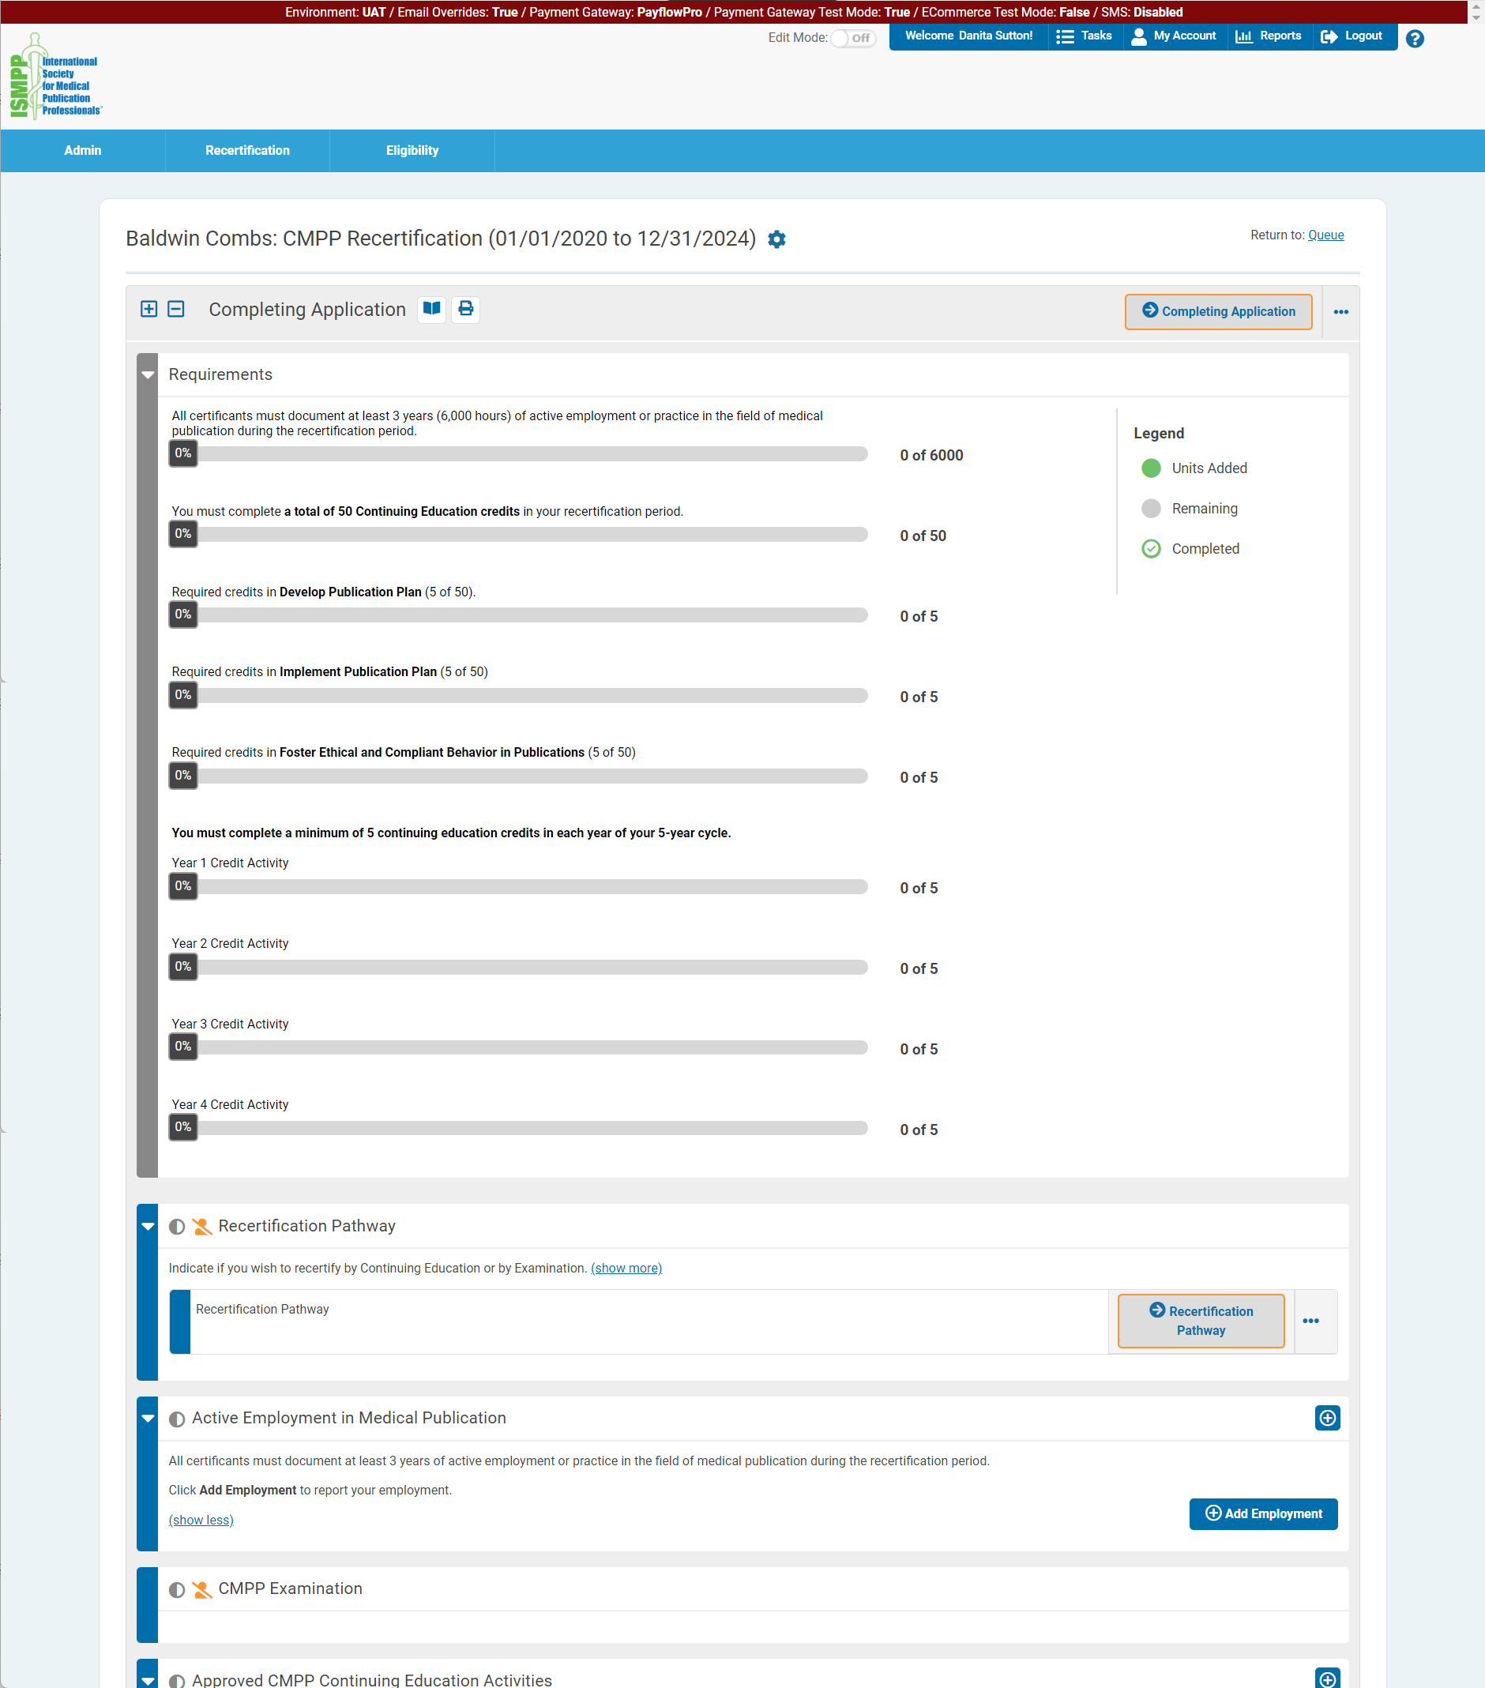
Recertification via Credit Requirements
Progress Bars
Total of 3 years active employment
Total of 50 CE credits
5 credits in Dev. Pub. Plan
5 credits in Implem. Pub. Plan
5 credits in Foster Ethical & Compliant Beh.
Minimum of 5 credits in each year (Years 1 – 5)
Notes:
CMPPs can enter CE credits any time during their certification cycle. You do NOT need to select a recertification pathway to do so.
In you plan to recertify by continuing education, your progress in fulfilling your recertification requirements is tracked in LB. There are several columns at the top of your screen to show your progress in all recertification requirements.
Total of 3 years active employment, which you enter in Work History
Total of 50 CE credits over 5 years
5 Credits in each of 3 domains – dev pub plan, implement pub plan, foster ethical and compliant behavior
Minimum of 5 credits during each year of cycle.
The bars show percent completion as you add activities to your tracker.

Slide 41
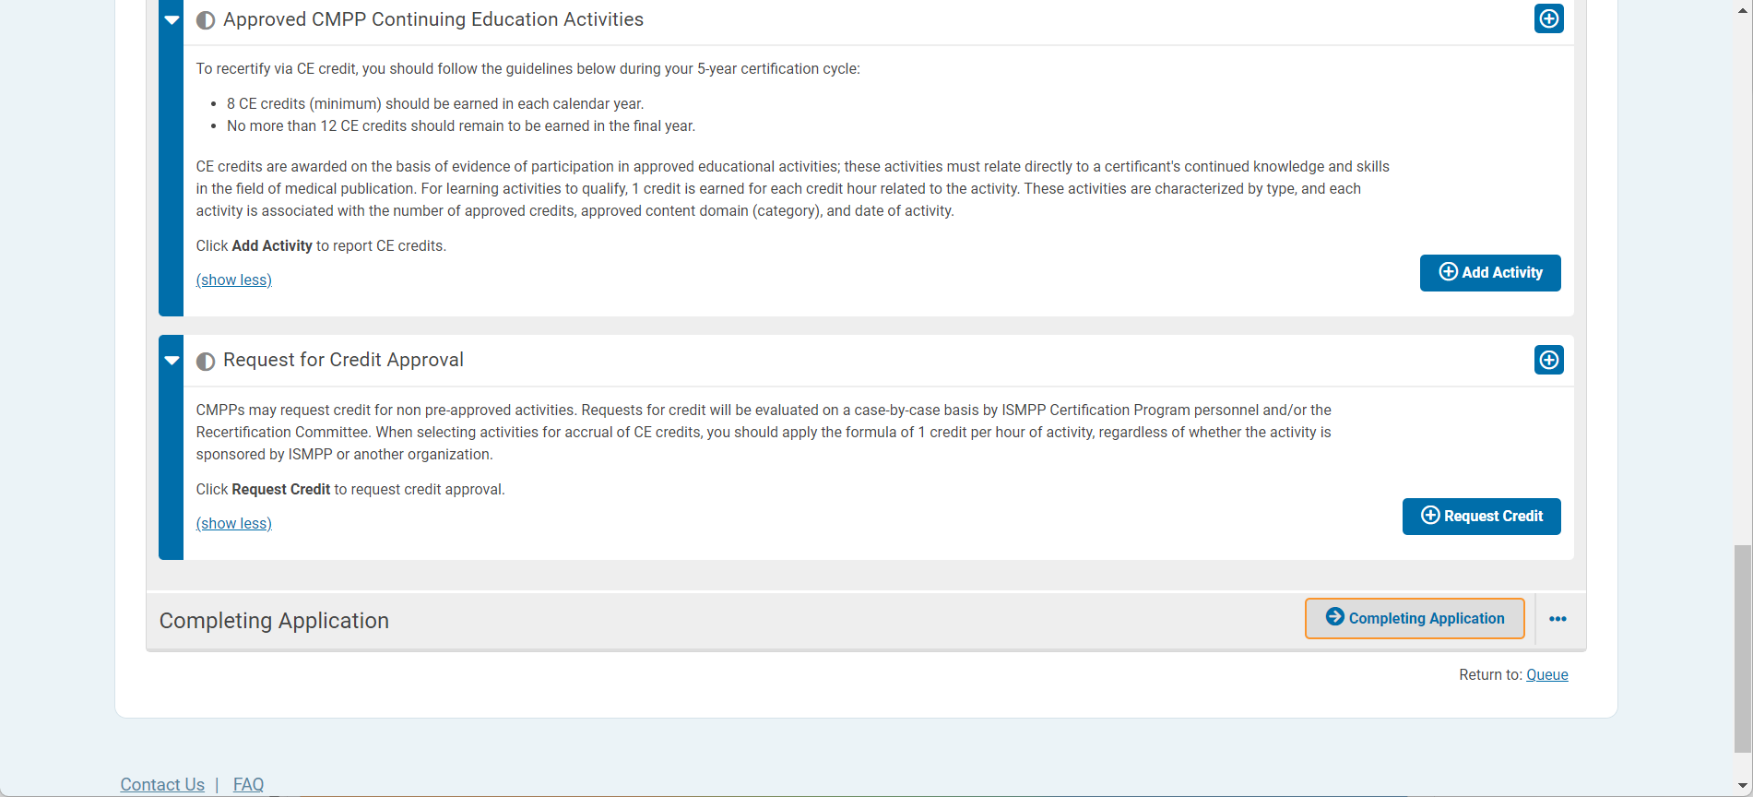
Add CE Activity
Notes:
To add an activity, go to “Approved CMPP Continuing Education Activities”.
Click Add Activity

Slide 42
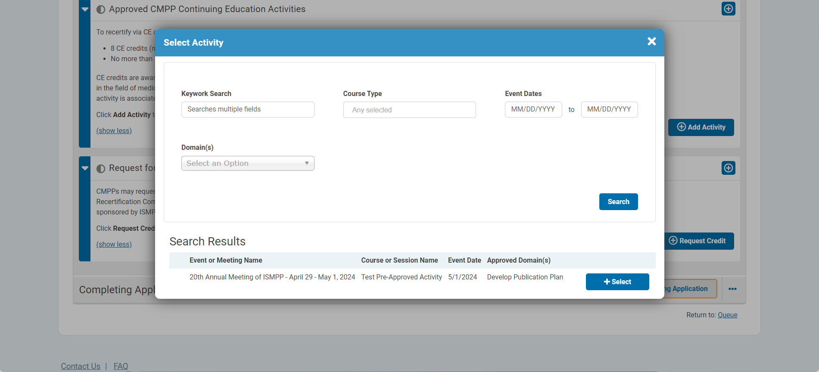
Adding a CE Activity: List of Pre-approved Activities
Notes:
You may add an activity using this screen. This is the equivalent of the “List of Approved CE Activities”.
You may search for activities by many criteria:
Keyword
Course type (eg, ISMPP U, ISMPP Annual meeting, etc)
Dates
Domain
You then click on the relevant activity in Search Results.

Slide 43
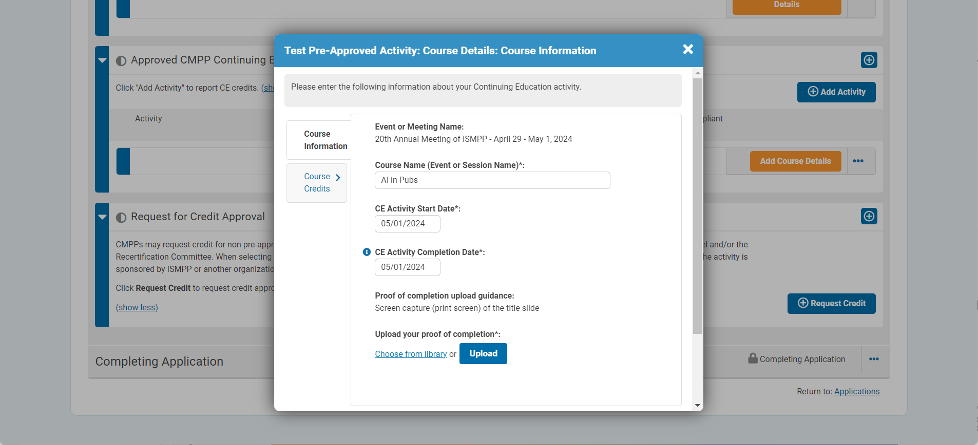
Course Information and Documentation
Notes:
After clicking on your selected activity, the information associated with the selected activity will appear in this window.
All you must do is upload documentation of proof of attendance. Note if you do not upload documentation, you will not be able to submit the activity.

Slide 44
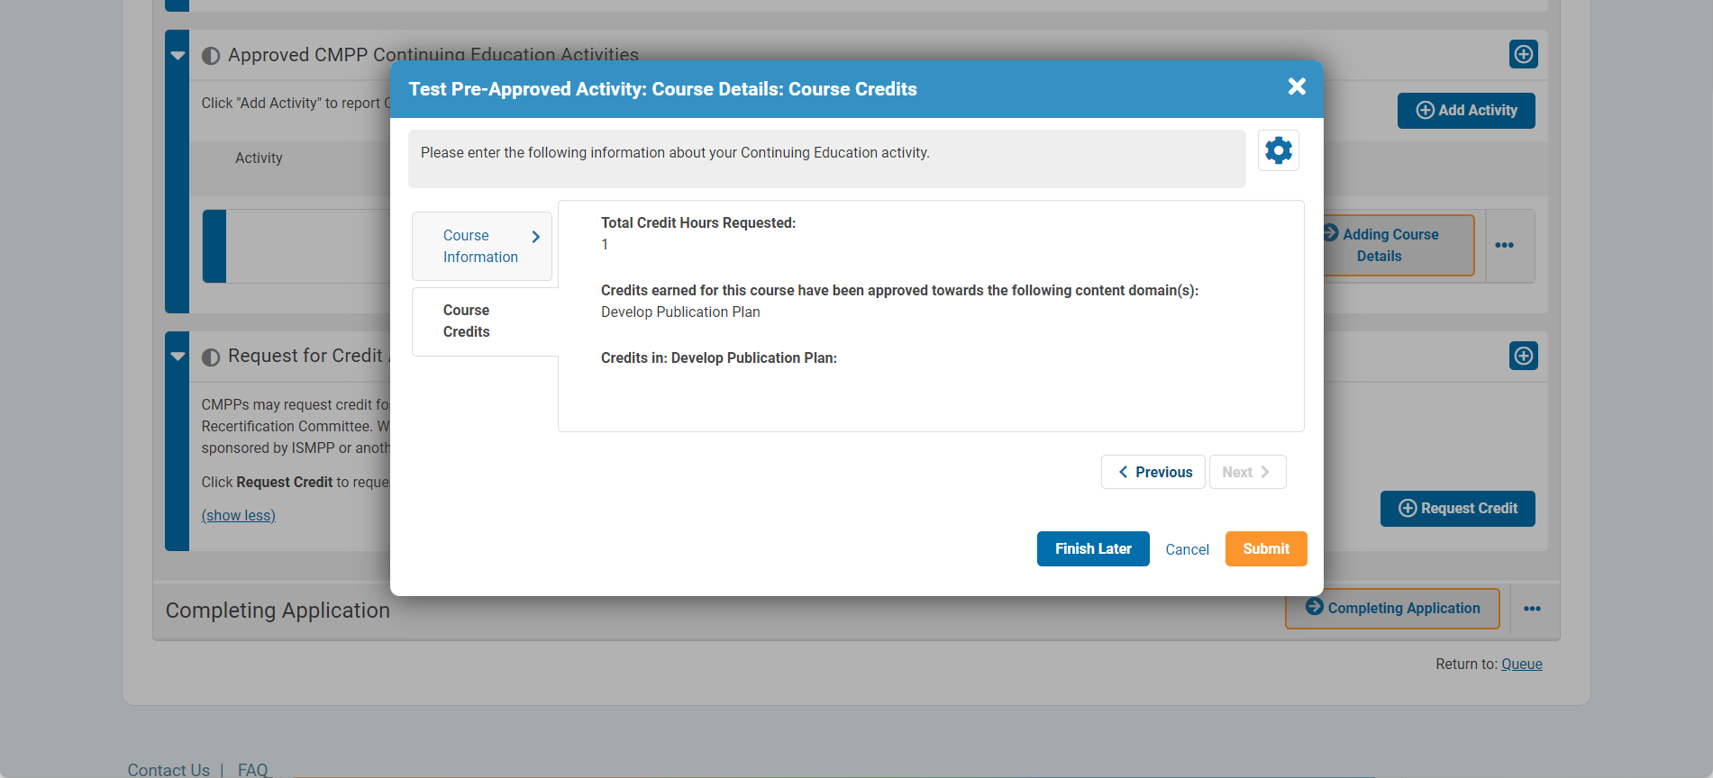
Course Credits
Notes:
The next window will display the number of course credits assigned to this activity as well as the assigned domain.
Once you click “Submit”, the activity will be added to your tracker.

Slide 45
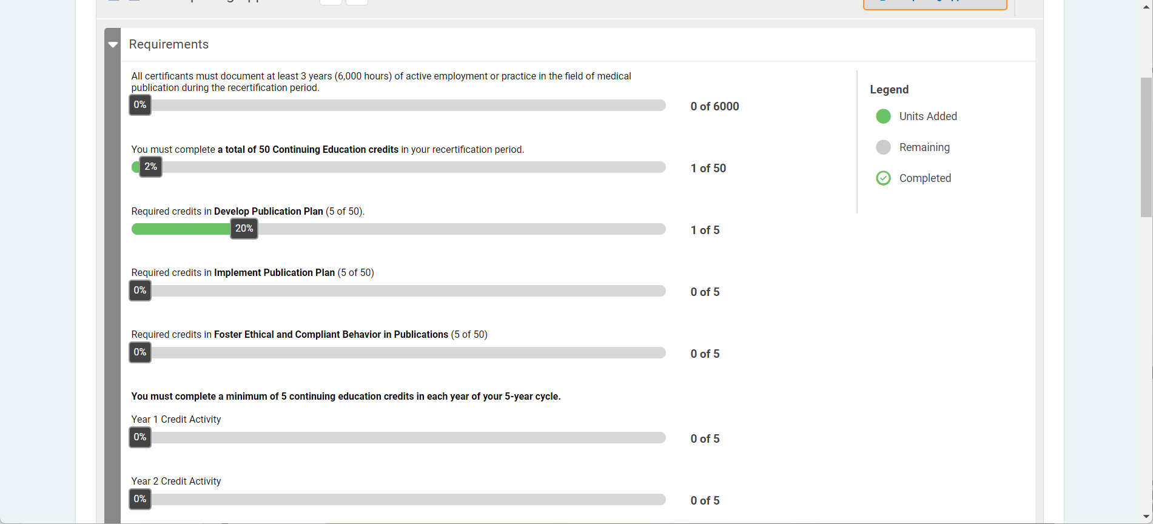
Progress after Activity Added
Notes:
Here you see that 1 of 5 credits appears in the progress bar, which is now 20% completed. In addition, you will see 1 credit added in the bar depicting the year the activity was completed. Finally, you will also see progress in the bar showing the total of 50 credits you have earned.

Slide 46
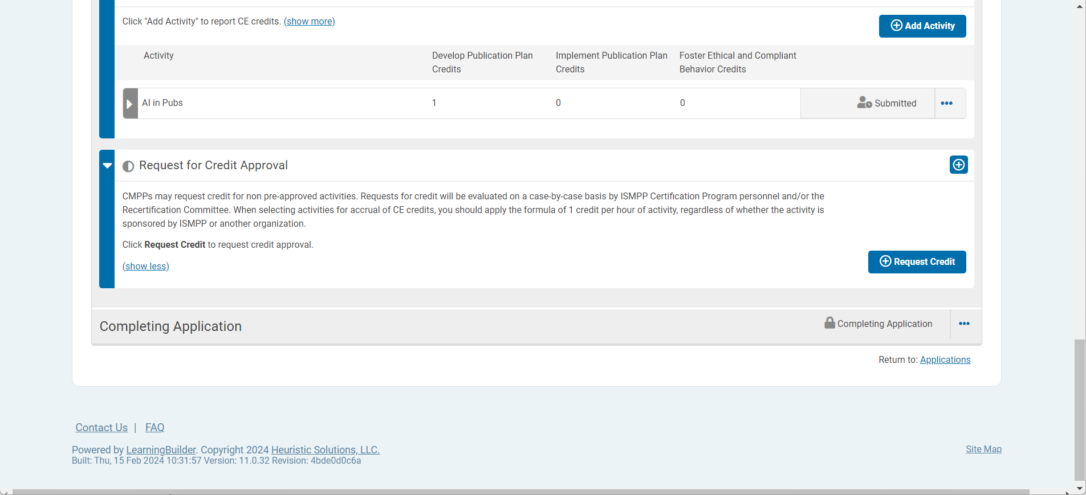
Request for Credit Approval
Notes:
You may also use the section “Request for Credit Approval” to request credit for an activity not on the pre-approved list of activities.
Simply click “Request Credit”.

Slide 47
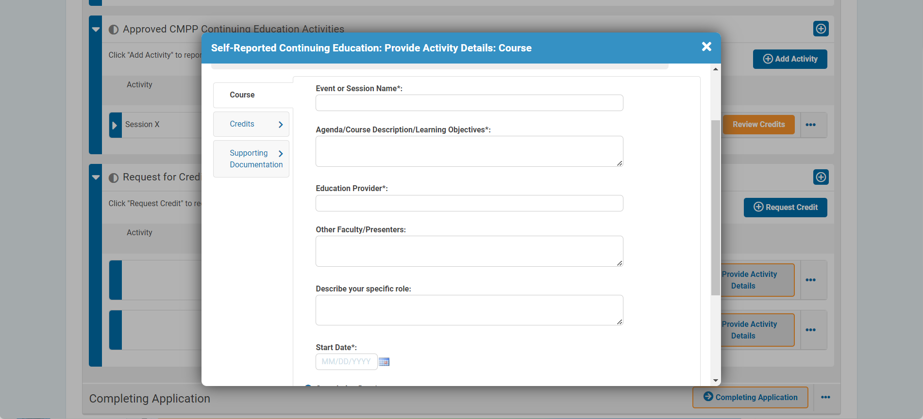
Course Activity Details
Notes:
In this window, you enter the following information (similar to current request for credit approval form):
Course/session name
Provide agenda/course description/learning objectives
Educational provider
Other faculty
Your specific role
Dates

Slide 48
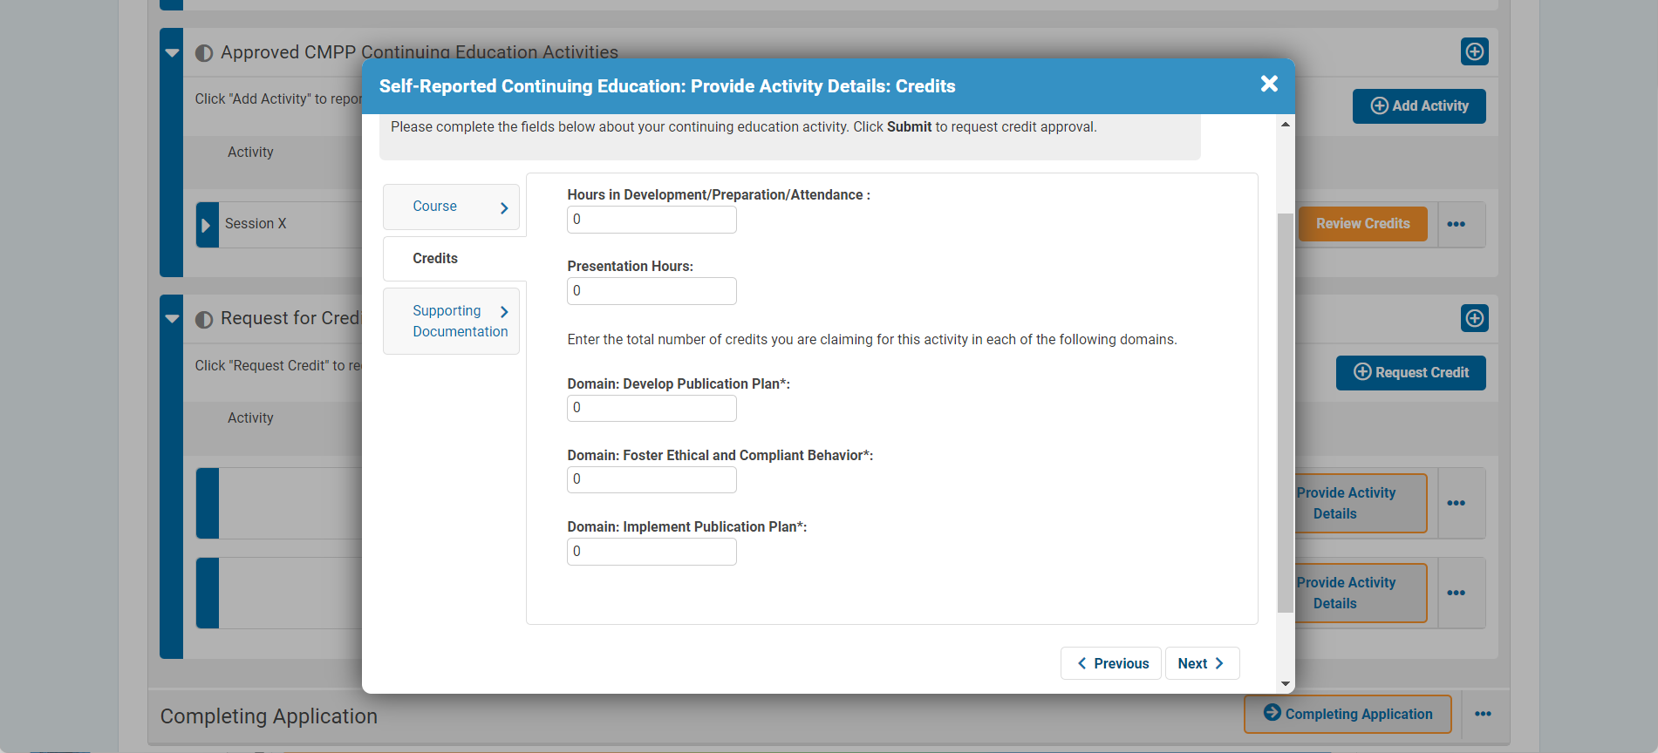
Activity Credits
Notes:
On the next screen you enter:
Prep time hours
Presentation time hours
Hours in the relevant domain.

Slide 49
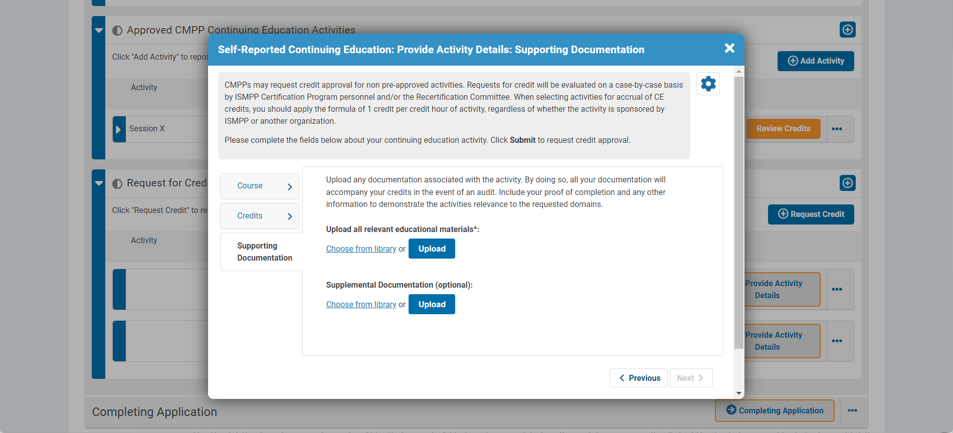
Supporting Documentation
Notes:
In the final window, you upload supporting documentation.
Note that if you do not upload any documentation, you will not be able to submit the activity.

Slide 50
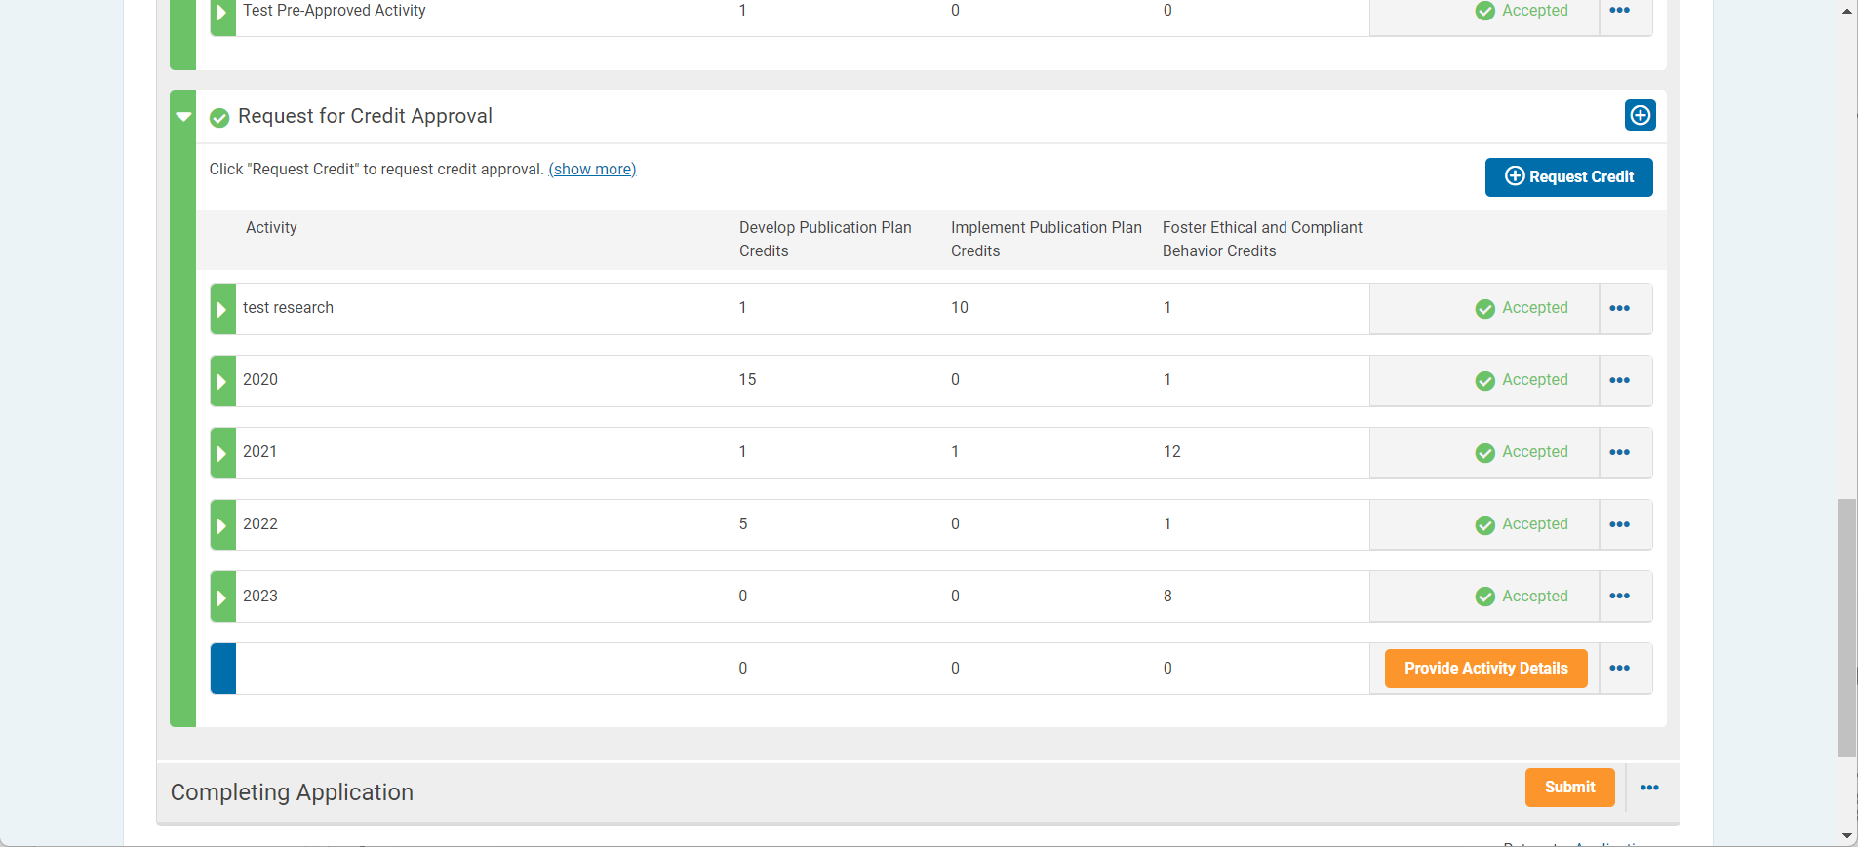
Activity Approved
Notes:
After your activity request has been submitted, the Recertification Committee will review your activity.
Once approved, the activity will be automatically entered into your tracker. No actions required by you.

Slide 51
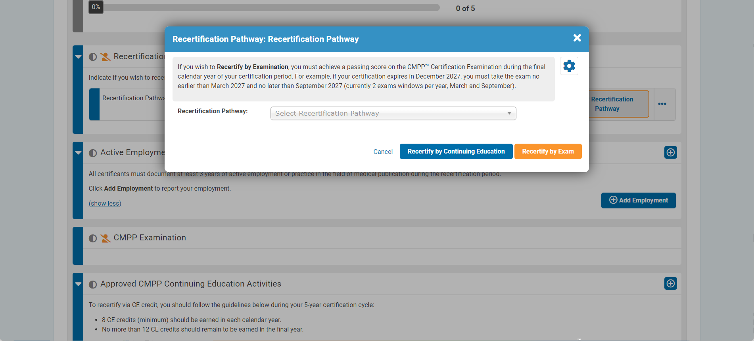
Recertification Pathway
Notes:
You must choose your recertification pathway in the Recertification application - either recertify by exam or recertify by continuing education. – before you submit your recertification application during the final year of your certification cycle.
If you have chosen to recertify via exam, the attestation window will open (similar to that for the certification application) followed by the payment window. The process is then the same as that for those who completed the certification application.

Slide 52
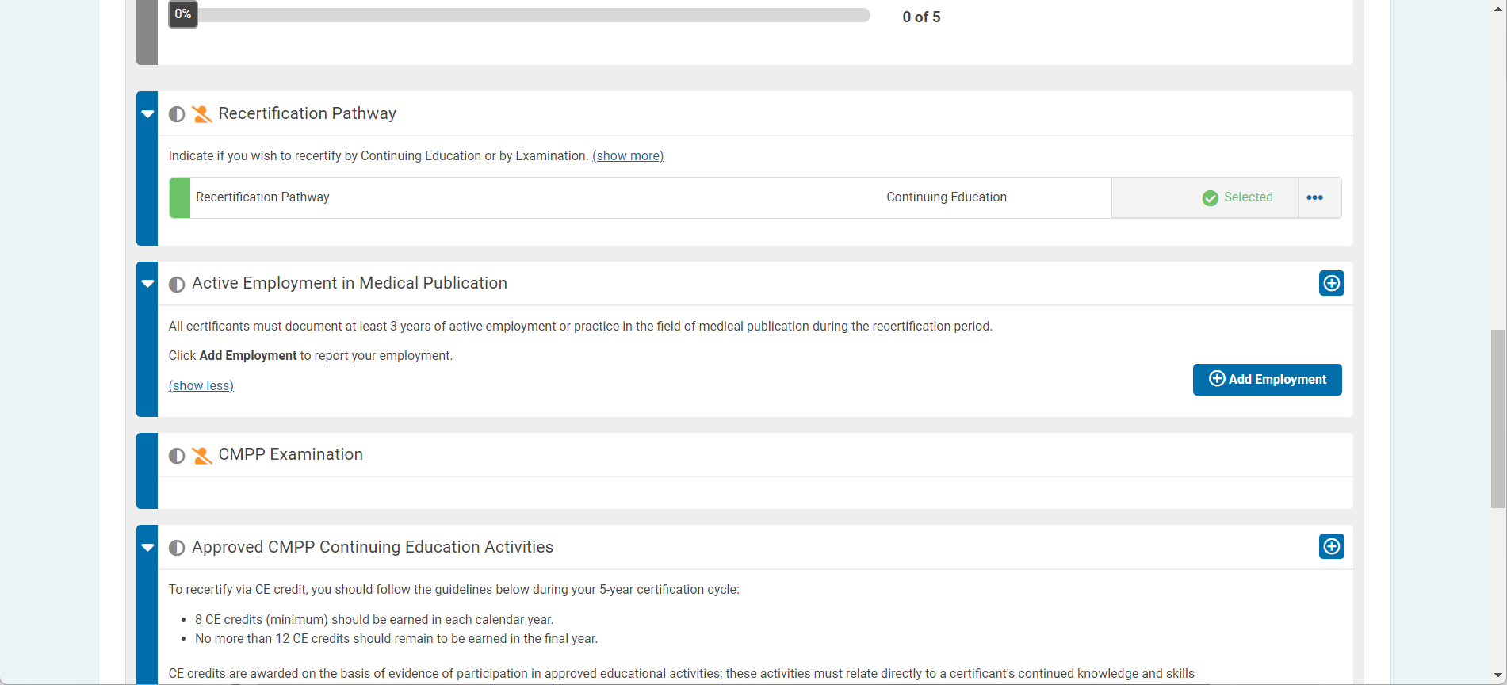
Continuing Education Pathway
Notes:
Here you see the Continuing Education pathway was chosen.

Slide 53
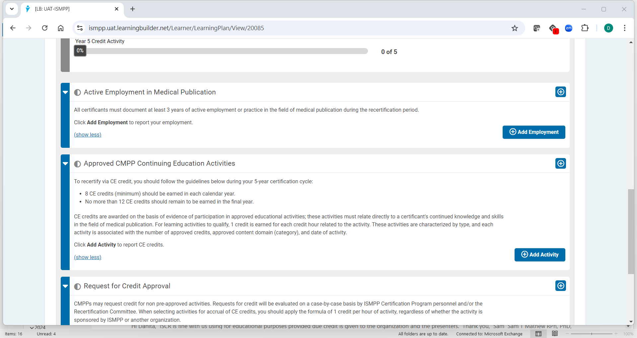
Work History Required for Both Pathways
Notes:
Whether you choose to recertify by exam or continuing education, you will need to document a minimum of 3 years of work experience in the industry during your recertification cycle. This window allows you to enter that information.

Slide 54
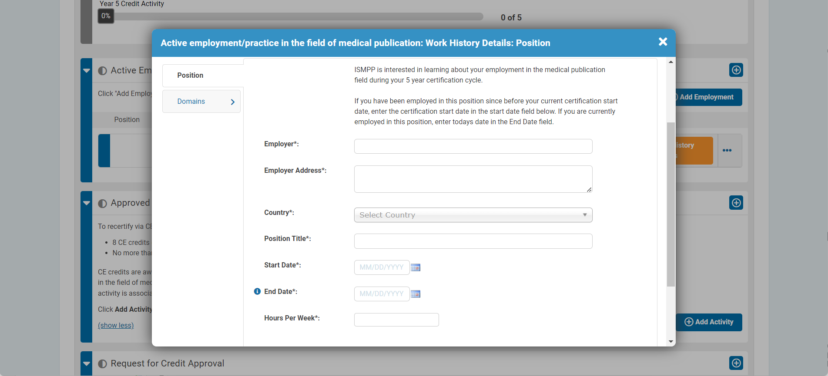
Work History Fields
Notes:
In this window, you will enter details of each position required to show 3 years, or 6,000 hours, of industry experience, including:
Employer
Address
Country
Position title
Dates
Hours worked per week
LB will then calculate the hours of experience from that position for an equivalent of 6,000 hours or 3 years.

Slide 55
Recertification Application
Available to submit during final year of certification/recertification cycle, once your ISMPP membership fee is paid
Notes:
You will be able to click “Submit” during your final year of your certification cycle, but only when all the requirements have been met and you have paid your ISMPP membership fee.
Note that if you do not submit your recertification application by December 31 of the final year of your cycle, LB will allow you to submit your application by February 28 upon payment of a late fee in addition to the recertification application fee.
If you do not recertify by exam during the last test window of the year your certification expires (September), or do not submit your recertification application by February 28, your certification will expire.

Slide 56
ISMPP Certification Policy
Notes:
Before we take questions, just a few final notes on our certification policy relative to LB.

Slide 57

CMPP Policy and LearningBuilder
Owing to the automated process, exceptions cannot be made to CMPP policies
Certification and recertification applications cannot be submitted unless all requirements are satisfied, including payment of membership fee
Documentation must be uploaded for each activity in tracker to submit activity
Requirements by year and credit domain must be satisfied to submit recertification application
Strict adherence to deferral policy
  1 exam deferral permitted then application is closed
This Photo by Unknown Author is licensed under CC BY
Notes:
As you might imagine, automation can only be achieved by applying rules. These rules in some cases do not allow exceptions to be made to CMPP policies.
Some relevant examples:
You will not be able to access the certification or recertification applications if you are not an ISMPP member. You will be required to pay your membership dues on the ISMPP website before accessing the applications.
Certification and recertification applications cannot be submitted unless all requirements are satisfied.
For example, to submit your recertification application, you must have satisfied credit requirements by year and domain
LB will enforce strict adherence to the CMPP deferral policy. Only 1 deferral is permitted, then the application is closed.

Slide 58
Special Thank You
Cassie Cobb
Rob Matheis
Heuristics Team (Billy O’Shaughnessy & Karen Cantor)
Certification Board
All CMPPs around the world
Notes:
I want to express my sincere gratitude to:
First Cassie Cobb for going on this journey with me of user testing and learning a completely new way of thinking about a certification program. She also provided incredible support all along the way
Rob Matheis, President and CEO of ISMPP, for entrusting me to implement this solution and always patiently listening and providing support
The Heuristics team, in particular Billy and Karen, who were not only amazing to work with but have a strong working knowledge of the certification space. They have a unique ability of making this process actually enjoyable
To the Certification Board, who is always encouraging and supportive of my new certification ideas adventures
And finally, and most importantly, to all our CMPPs who make the Certification Program the great success it is today!

Slide 59
Audience Q&A
To ask a question, open the Q&A window, type your question into the Q&A box. Click Send.
Notes:
And now it's time to answer your live questions. As a reminder, please type them into the Q&A box at the bottom of your screen.

Slide 60
Upcoming ISMPP U Webinars
December 11, 2024:​
Actioning EDI for Our Industry: Turning Principles into Practice
Notes:
Be on the lookout for our December ISMPP U around promoting equity, diversity, and inclusion when communicating with HCPs and Patients. Registration will open soon.

Slide 61
ISMPP University
Introducing LearningBUILDER™ - ISMPP's New Certification Management Platform Dedicated to the CMPP™ Credential!
November 20, 2024
Webinar will begin promptly at:
11 AM ET / 4 PM GMT
Notes:
Hi everyone; welcome and thank you for joining today’s ISMPP U, “Introducing LearningBuilder – ISMPP’s New Certification Management Platform for the CMPP Credential”

Slide 62

Thank you for attending!
We hope you enjoyed today's presentation.
After closing out of Zoom, please click the CONTINUE button
on your screen to take our short survey. Thank you!
Notes:
Please take a moment to fill out the survey link that will be sent to you.
After closing out of ZOOM, please click the ‘continue’ button on your screen to take a short survey.
Thank you!

Slide 63
Danita Sutton, PhD, ISMPP CMPP™
Danita is Director of Credentialing for the International Society for Medical Publication Professionals (ISMPP). In her past, she served as one of the first chairs of the Certification Board, and is proud to have been among the subject matter experts who developed the first ISMPP CMPP™ certification exam.
She joined the ISMPP staff in 2019 after a 25-year career in the medical communications/publications industry, where over the years she held the positions of medical writer, medical director, and medical communications consultant for her own company Proficiency Science. She earned a BA in Biochemistry from Smith College and a PhD in Pharmacology from Yale University. She has held the ISMPP CMPP™ credential since 2009.
CMPP, certified medical publications professional; ISMPP, international society of medical publications professional

