Slide 1

TCEQ’S
State of Texas Environmental Electronic Reporting System (STEERS) and ePermits
Radhika Aduri, IT Specialists TEAM
WATER Quality DIVISION
Notes:
TCEQ’S
Electronic Permitting System

Slide 2
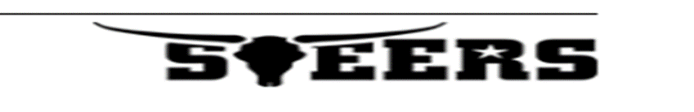
Electronic Reporting System
STEERS is a vehicle to collect data electronically
  STEERS provides a common framework and security for multiple agency programs that enable the regulated community to submit, reports, permits, and registrations electronically.
  Online application tool for public to be able to submit permit requests for various program types to TCEQ.
  TCEQ created the ePermits system to automate the process of creating and managing authorizations, registrations and permits.
  For some transactions, TCEQ in turn reviews when needed these general permit applications and processes them accordingly.
Notes:
Who can use STEERS?
YOU (own or behalf of a company) having a need to get permits.
Have access to computer/Internet, a valid email account.
Complies with STEERS Participation Agreement.(SPA)

Slide 3
Why Was It Developed?
ePermits is actually two separate systems and the main reason to develop the system was two-fold:
  Internally – to allow TCEQ staff to create and maintain electronic applications.
  Externally – to allow customers to select, complete, and submit an electronic application.
    Less time, effort and cost.
Federal Electronic Reporting Rule and General Permits - The following general permits require applicants to submit applications via ePermits.
  Stormwater Multi-Sector General Permit
  Concrete Batch Plant
  Stormwater Construction General Permit – Beginning Sept. 1, 2018
Notes:
ePermits is actually two separate systems and the main reason to develop the system was two-fold:
Internally – to allow TCEQ staff to create and maintain electronic applications (processing paper forms).
Externally – to allow customers to select, complete, and submit an electronic application.
The following general permits require applicants to submit applications via epermits.
Multi-Sector General Permit (TXR05)
Concrete Batch Plant (TXG11)
Construction General Permit (TXR15) – Beginning Sept 1, 2018
Why STEERS?
Save money, time and paper.
Set up your own permit applications as needed.
Pay permit fees online - credit card/ Electronic Check.
Print documents from home/ office.
Access permits anytime.
Receive notice of approvals immediately.
Share the application with other STEERS users.

Slide 4
Why Was It Developed…?
TCEQ Staff
  Less paper applications to process.
  Clean and synchronized data in TCEQ databases for easy data flow into EPA’s ICIS.
  Time can be spent to assist customers using ePermits.
  Ideal to electronically transfer permit data to EPA database.
With ePermits in place, as of now:
  TCEQ has received and processed electronically:
    34175 Construction General Permits (since last issued 03/05/2013)
    3224 Multi-Sector General Permits (since last issued 08/14/2016)
    800 Aggregate Production Operations (in the last year)
    500 Concrete Batch Plants (since last issued 11/07/2016)
Notes:
TCEQ Staff
Less paper applications to process.
Clean and synchronized data in databases.
More time is required on customer service to assist customers using ePermits.
Ideal to electronically transfer permit data to EPA’s ICIS database.
Through ePermits - TCEQ processes thousands of registrations and permit applications each year.
With ePermits in place, as of now:
TCEQ has received and processed electronically:
34175 Construction General Permit NOIs
3224 Multi-Sector General Permit NOIs (first 5 years)
800 Aggregate Production Operations annually
500 Concrete Batch Plant

Slide 5
What Programs/Applications are in ePermits ?
Water Quality Division electronic permits/registrations
    Aggregate Production Operation Registrations.
    Construction General Permit TXR150000
    Multi-Sector General Permit TXR050000
    CAFO General Permit TXG920000
    Pesticide General Permit TXG870000
    Concrete Batch General Permit TXG110000
Applications for various permitting needs:
    Create New Authorizations - NOIs
    Modify Existing Authorizations – NOCs
    Renew Authorizations - NORs
    Terminate Authorizations - NOTs
    Share/Access In-Progress Authorizations
    View Application documents and submissions– including Certificates and Letters.
Notes:
Water Quality Division currently handles electronic versions related to:
Aggregate Production Operation Registrations.
Construction General Permit TXR150000
Multi-Sector General Permit TXR050000
CAFO General Permit TXG920000
Pesticide General Permit TXG870000
Concrete Batch General Permit TXG110000
And serves the regulated community; for customers looking for various permitting needs with a quick and easy process.
Create New Authorizations - NOIs
Modify Existing Authorizations – NOCs
Renew Authorizations - NORs
Terminate Authorizations - NOTs
Share/Access In-Progress Authorizations
View Application documents and submissions– including Certificates and Letters.
We highly encourage permittees with these programs to use ePermits for all their application needs.

Slide 6
Welcome to STEERS
https://www3.tceq.texas.gov/steers/
Step 1: For new users, creating a STEERS account is the first step in submitting an online permit application.
  Accounts are created for the individual user, and not for a facility or entity.
  Each STEERS account must have a unique e-mail address.
  Applicant information like names, address, company email and phone number are asked to create a new account.
  All STEERS user accounts are renewable every 2 years.
Step 2: Select STEERS Program to Add or Modify.
  Add the program of interest from the list of ePermits/Registrations or eReporting programs that STEERS houses.
Notes:
Step 1: For new users, creating a STEERS account is the first step in submitting an online permit application.
Accounts are created for the individual user, and not for a facility or entity.
Each STEERS account must have a unique e-mail address.
Applicant information like names, address, company email and phone number are asked to create a new account.
New accounts are probationary and have limited access until STEERS receives a signed hard-copy SPA or the SPA is signed electronically using the account holder's valid Texas Driver’s License.
All STEERS user accounts are renewable every 2 years.
Upon successfully being approved using SPA -authenticated access with login credentials to sent to you email address.
Step 2: Select STEERS Program to Add or Modify.
Upon validating the email address, system would ask to add Programs of interest.
STEERS supports various
Drop down list with the all the supported program types is shown.

Slide 7
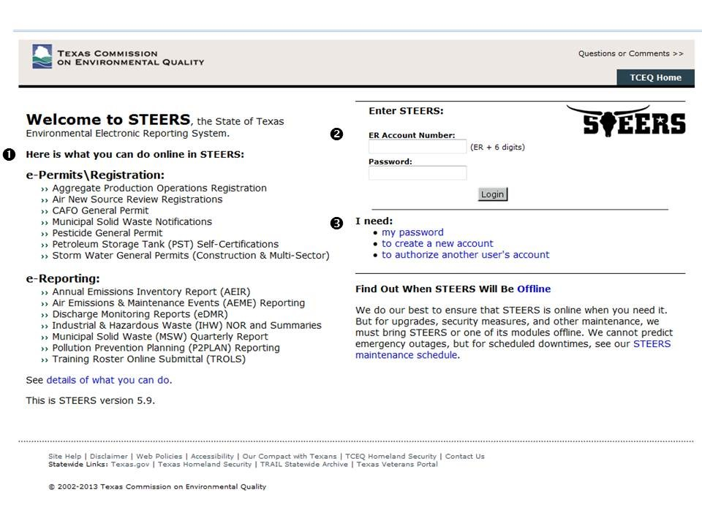
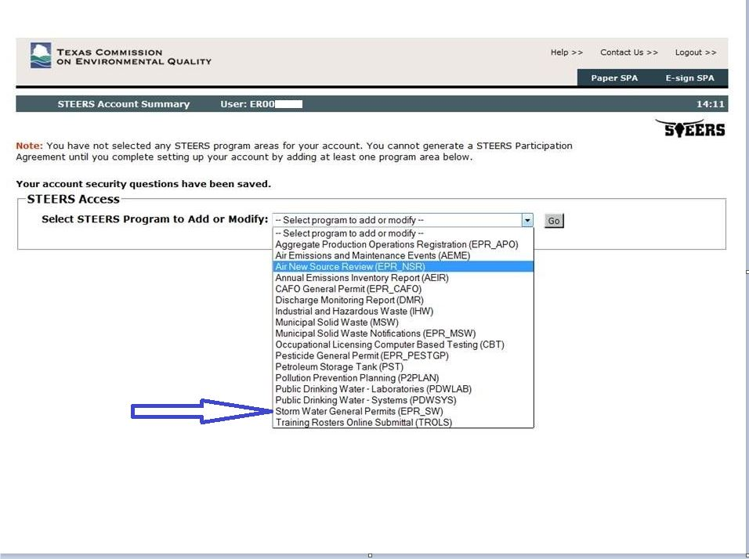
Creating STEERS Account
Notes:
Step 1: For new users, creating a STEERS account is the first step in submitting an online permit application.
Step 2: Select STEERS Program to Add or Modify.
Choose Storm Water General Permits (EPR_SW)

Slide 8
Access Type - Roles
Step 3: Next, you will select your role and define the type of access you will have to prepare this authorization.
Your access options are:
  Read Only - view only. You will only be able to view submitted applications. You will not be able to see applications in progress.
  Edit – view, create, delete, modify and pay. You cannot sign for or submit this application.
  Preparer – view, create, delete, modify, pay and submit. You cannot sign for this application.
  Sign and Submit – view, create, delete, modify, pay, sign and submit.
Select the appropriate relationship and authorization statement.
Notes:
Step 3: Next, you will select your role and define the type of access you will have to prepare this authorization.
Your access options are:
Read Only - view only. You will only be able to view submitted applications. You will not be able to see applications in progress.
Edit – view, create, delete, modify and pay. You cannot sign for or submit this application.
Preparer – view, create, delete, modify, pay and submit. You cannot sign for this application. After it has been signed by a person authorized to enter into this agreement for the company under the applicable standards referred to in 30 TAC, you may then pay and submit this application.
Sign and Submit – view, create, delete, modify, pay, sign and submit. You will be able to begin and complete an application and you may sign and submit this application.
Select the appropriate relationship and authorization statement.
I will choose Sign an Submit to be able to begin and complete the CGP application.

Slide 9
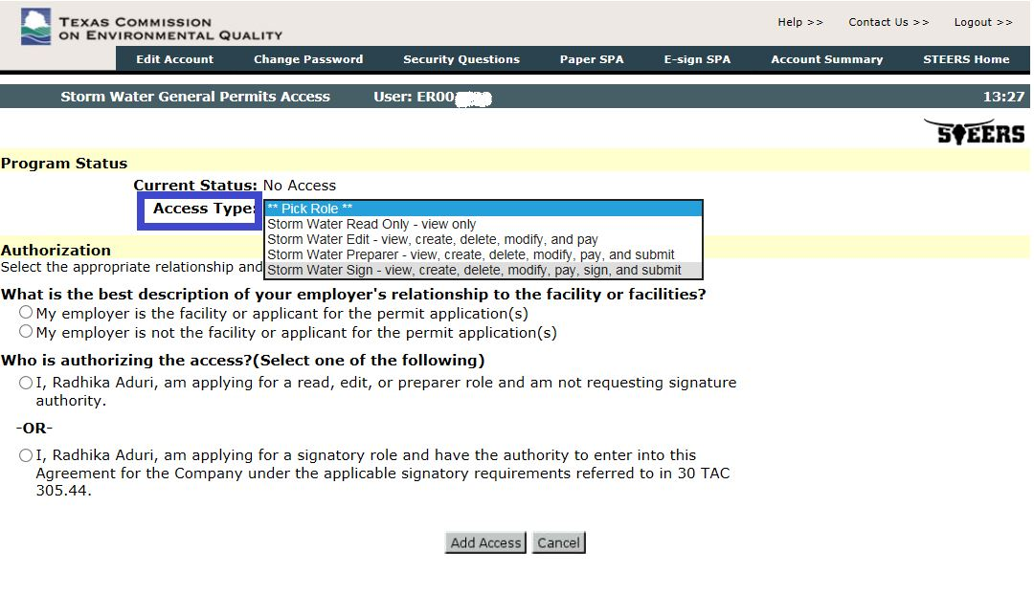
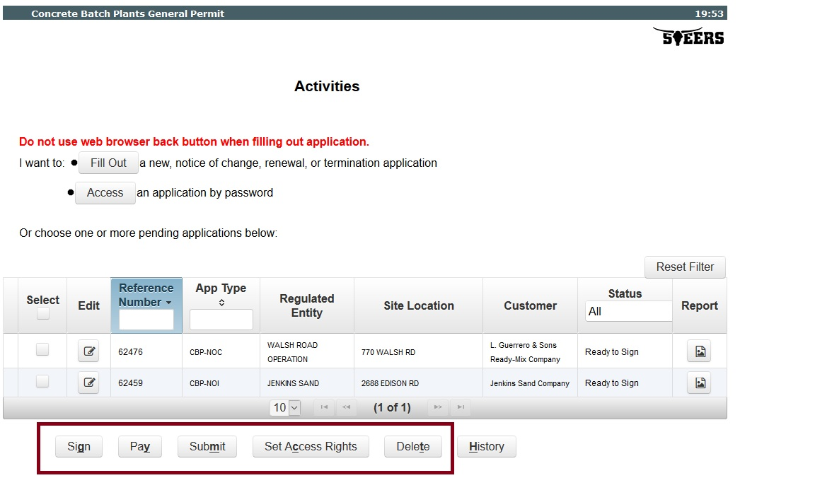
Set Access Type
Notes:
First Screenshot – Setting Access Type Roles after adding the program type.
Note: In the right screenshot above – the buttons Sign, Pay and Submit are solely visible based on these privileges that are set during the account set up. Often we have customers saying that the application is ready to sign, ready to submit but I do not see an option to do so or a button to do so. And that is because of the roles that was set. So, please be clear and careful then this is done. Determine who needs what type of access and then continue.

Slide 10
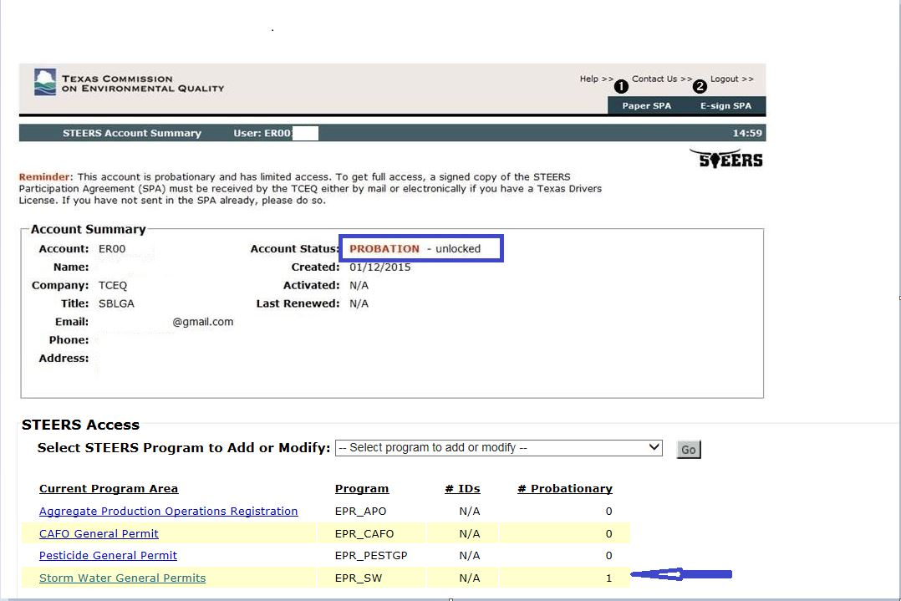
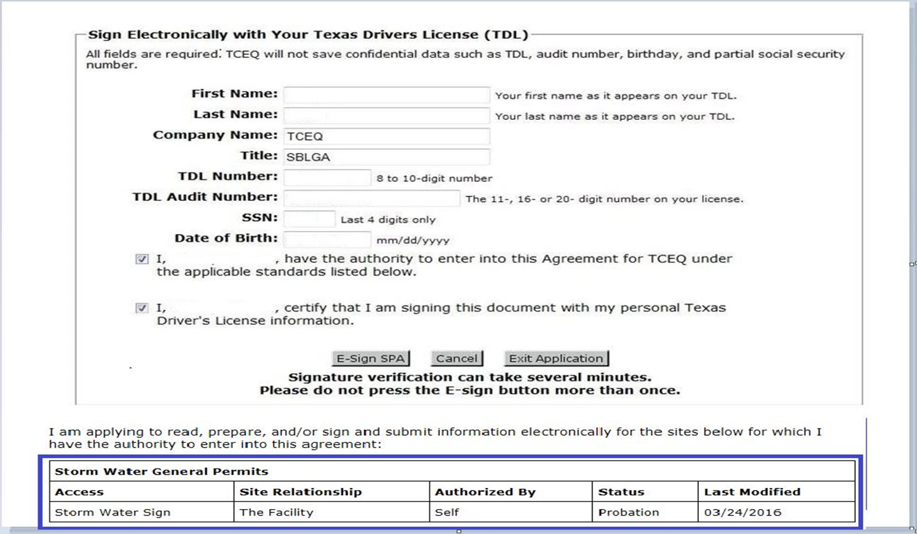
STEERS Participation Agreement (SPA)
Notes:
This account is probationary and has limited access (is not yet authorized to submit a permit application) until a signed copy of the STEERS Participation Agreement has been received by the TCEQ.
Select the type of SPA to submit by selecting from the two options in the top right corner. – Paper SPA or E-Sign SPA.
Selecting E-Sign SPA to electronically submit the agreement requires valid Class C Texas Drivers License.
Signing electronically will activate your account and all program area which you have direct authority to enter into the agreement.
An electronic signature or hard-copy signature must still be provided for the program “Storm Water General Permit”. Enter your driver license information, read and check both boxes, and click
“E-Sign SPA”.
You will receive the message: “This page confirms the submittal of your electronically signed STEERS Participation Agreement (SPA) to the TCEQ. You will also receive a confirmation e-mail.”
Note: if the DL provided in the SPA is expired, you will have an issue with using ePermits. Please ensure that you resubmit the SPA with the new number.

Slide 11

Successfully Completed
STEERS Account
  ER001234
Added Stormwater General Permit Program
Signed e-SPA
Now Ready to Create an application
This Photo by Unknown Author is licensed under CC BY-NC-ND
Notes:
You have successfully created a STEERS account, added Storm Water General Permit Program , signed an SPA and are ready to begin your General Permit application
STEERS Questions : Please visit the STEERS help line associates or SBGLA for any questions on the account set up.

Slide 12
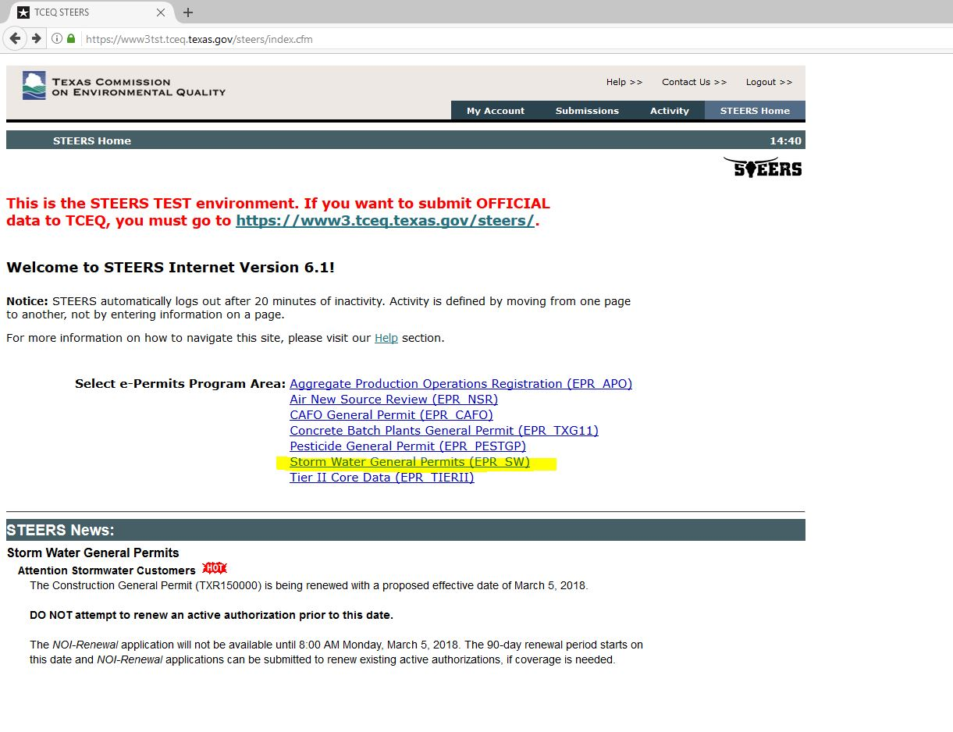
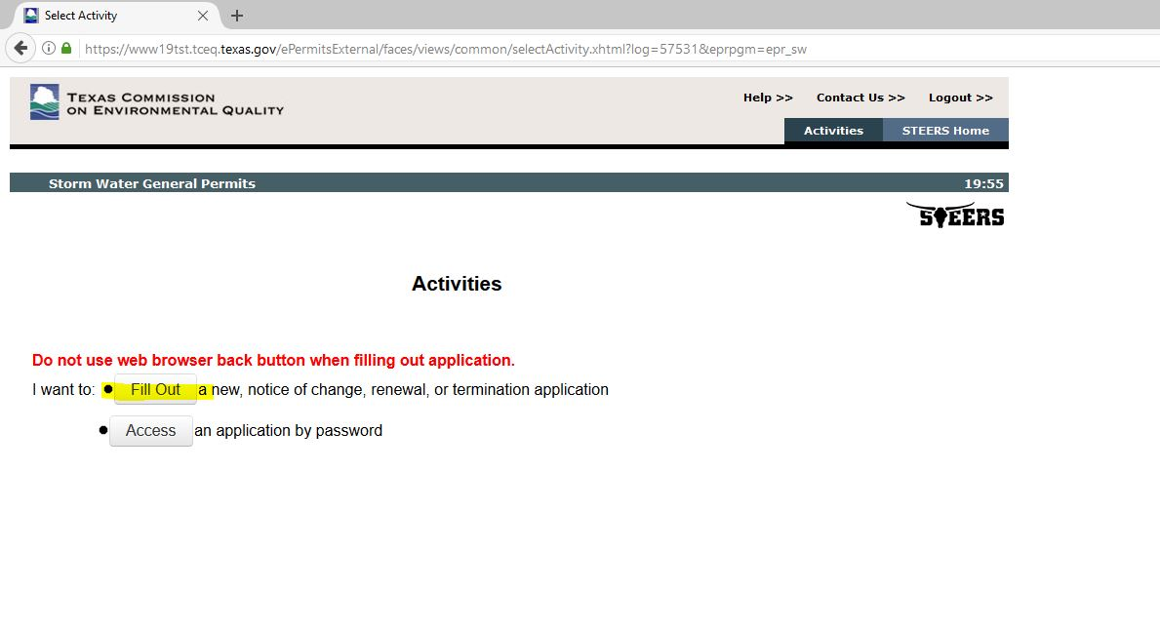
Prepare CNOI – Renewal Application
Select Program Area
Choose Fill Out
Notes:
When you log into STEERS, you will be directed to the STEERS Home page. From the home page you can navigate to the different areas of STEERS.
This is where you will see the newly added Program Area – Storm Water General Permits (EPR_SW).
To begin an application, select the program -Storm Water General Permits (EPR_SW).
Note: If you do not see the program area, it is highly likely that you have not signed the SPA.
Next, on the second screenshot – Under the “I want to:” list, select one of the following options:
Select “Fill Out” to start a new application, renewal, revision or permit termination application
Or
Select “Access” to gain access to an application that has already been started and has been issued a password.
Remember STEERS is highly authenticated site. Customer activity is tracked in 20 minutes slot – if there is no activity or if its idle for that long, it would logout the user.
Customer need to login again to continue with his or her application process.

Slide 13
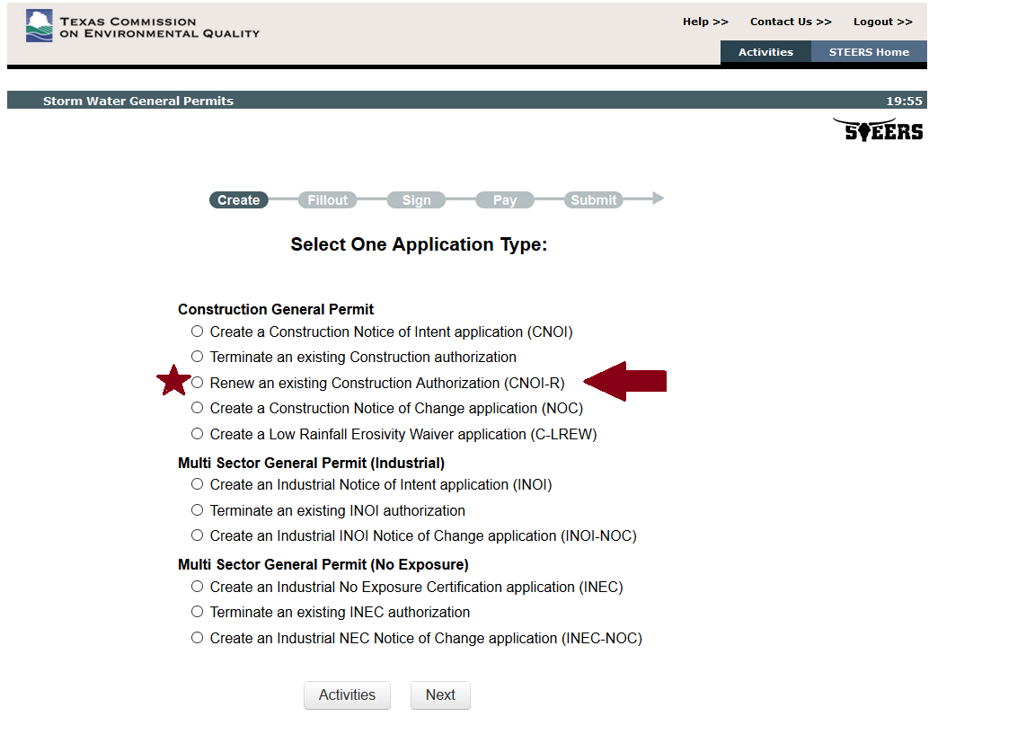
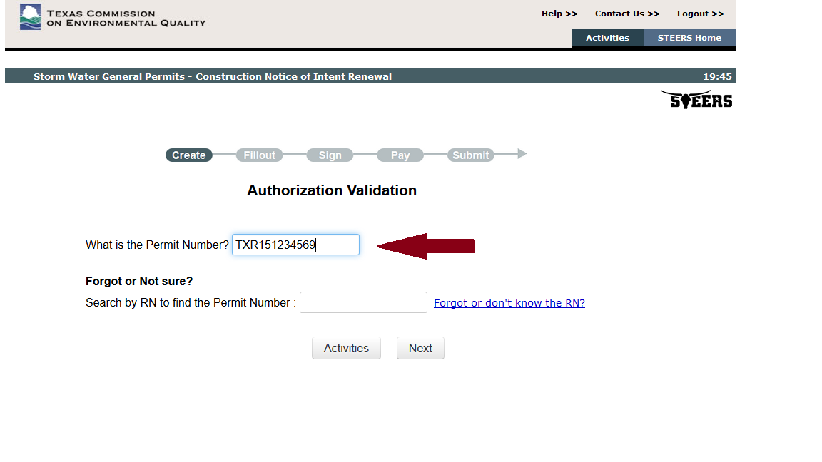
Prepare CNOI – Renewal Application - 1
Select Application Type
Site Information (Regulated Entity)
Notes:
Once we choose the Storm Water General Permits (EPR_SW) at the Select your Program Type screen, this is where we select what type of permit is this going to be.
Construction General Permit – (CGP) has the following available.
New - Notice of Intent application - (CNOI).
Cancel - Terminate an existing INOI authorization - (CNOT)
Modify - CNOI Notice of Change application – (NOC)
Renewal - CNOI Renewal (CNOI-R)
Create a Low Rainfall Erosivity Waiver Application (C-LREW)
In this demo – we will see how to renew an existing Construction GP .
Across the top of the screen, the application status bar will guide you through completion of the application from creation, filling the application out, signing the application, paying and finally, submitting.
Note that until you submit the application, the agency will not receive or process it. You must pay and then return to the application to submit it before you will receive the confirmation of submission email.
Select Application Type: Choose Renew an existing Construction Authorization.
What is the Permit Number: Enter the permit number to be renewed.
Or if you look by RN – all authorizations registered under that RN will display. Choose the one to be renewed and move on.

Slide 14
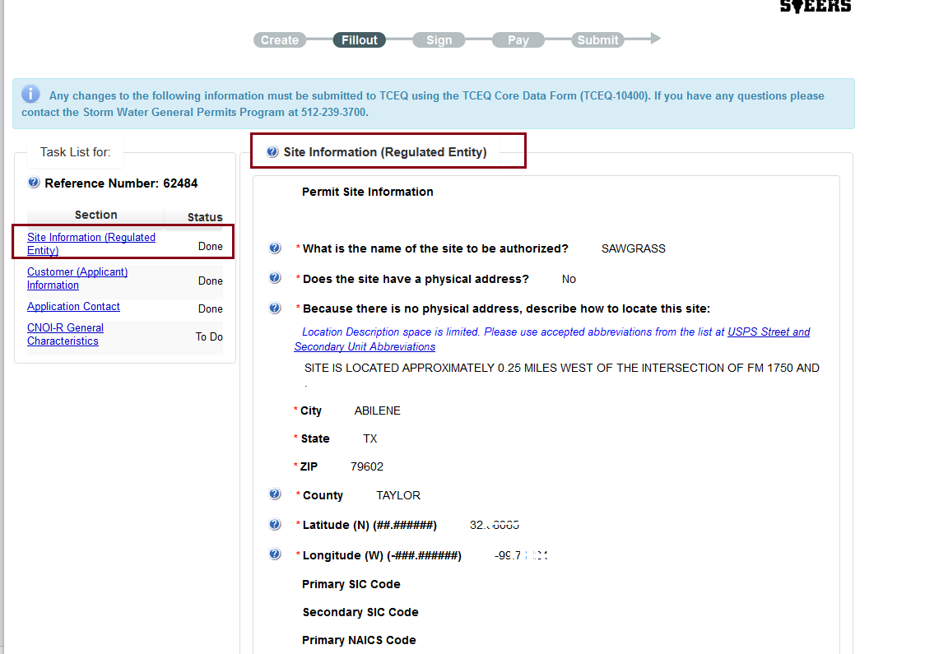
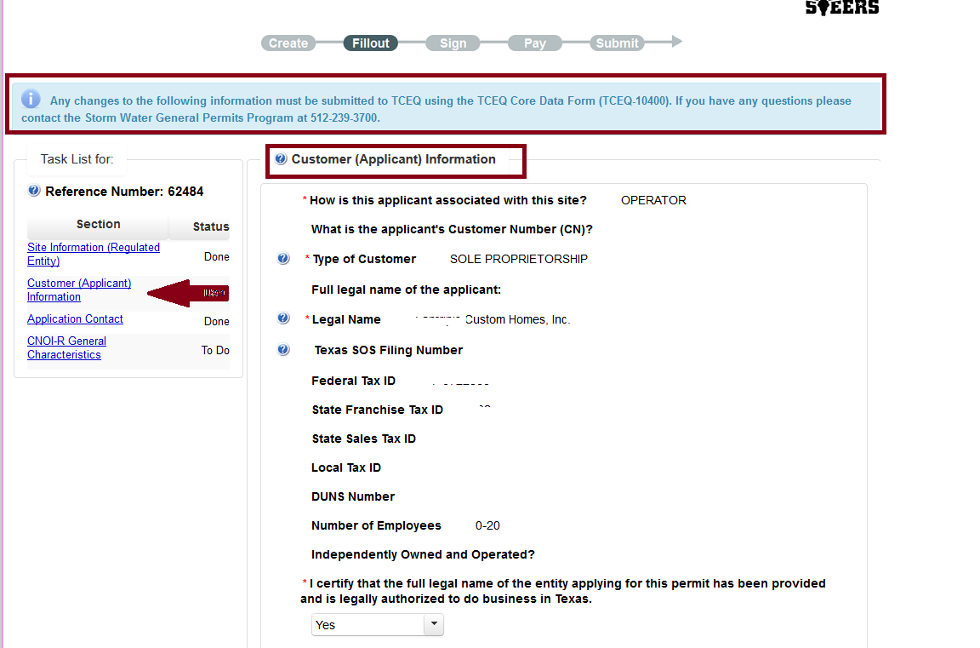
Prepare CNOI – Renewal Application-2
Site Information (Regulated Entity)
Customer (Applicant) Information
Notes:
Following which will be the
Site Information
Is all READ only - no information on this screen can be changed as it is part of the original NOI. You need to agree to the details and proceed.
Customer (Applicant ) Information
Verify the CN – again, all this information is READ only – verify and proceed by certifying that the above information is all correct and valid. If you notice any incorrect or old information, Central Registry and Program Area numbers are shown at the top for easy access. You may contact them at any time
Pinned Guided Task list is shown at all times during data entry. Note that until one section is completed and set to “Done” customer cannot fill the next section. It has to be sequentially completed.
Any error messages shown must be fixed before moving forward.
In the event an error occurs – sometimes it is shown next to the field and sometimes to the top of the page. Make sure you scroll up to view it.
Central Registry and Program Area numbers are shown at the top for easy access.

Slide 15
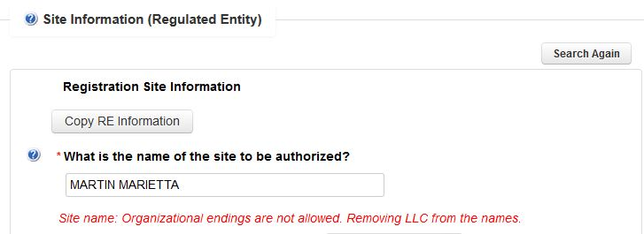
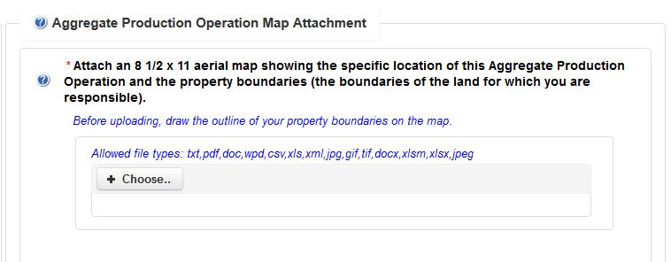
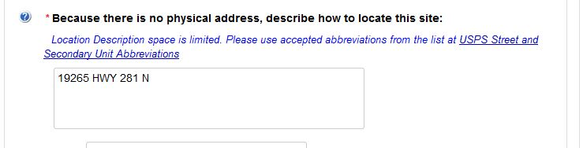
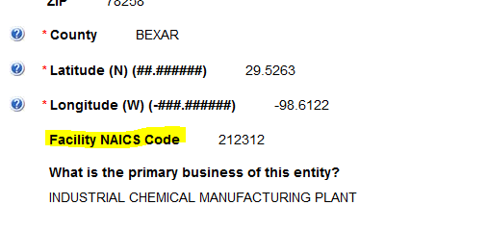
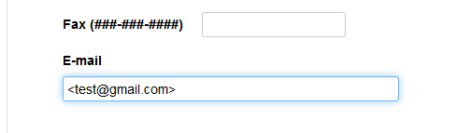
STEERS Version 6.1
RN/CN Level Changes
No organizational ending for New RE and Site Names. (LLC, LP, etc..)
USPS link available for helpful location description conventions.
Facility NAICS code added at the site level.
Multiple formats allowed as part of attachments.
Email field can now validate wild characters
Notes:
Under RN/CN sections - Apart from the existing functionality that ePermits already has *help text, Lat/Long Viewer, Surface Quality Viewer etc..), The latest version of ePermits (March 2018) is now enhanced with many more flexible features from the last release and here are some of those changes.
1. No organization endings for RE and Site Name. This applies only to new RE and Sites created, which means existing sites with such endings will remain so and should be cleaned up by the program area as they now do.
ePermits now restricts customers from entering organizational ending such as below – for RE and Site Names. (such as Company, LLC, INC, LP, Limited Partnership etc..) with an exception of CO for County.
COMPANY
COMPANIES
CORPORATION
PROFESSIONAL CORPORATION
PROFESSIONAL CORP
INC
INCORP
INCORPORATED
L P
LP
LIMITED PARTNER
LIMITED
LTD
LTD CO
LIMITED PARTNERSHIP
LLC
L L C
PROFESSIONAL LLC
PROFESSIONAL LIMITED LIABILITY COMPANY
PARTNERSHIP
CORP
2. As we now flow our TCEQ data electronically to EPA’s integrated database, and since EPA database does not accept location description more than 255 chars, we tried to encourage users by giving them genuine suggestions to clearly describe their location in the absence of physical description.
3. Facility NAICS Code – this is just a non mandatory fields added as part of other programs request within agency.
4. Email validations – In the past – there were a few failures during ePermits transactions because if the customers accidently enters any wild chars (#$%^&*!~) more often – and so system automatically removes them.
5. Multiple formats allowed as part of attachments – Most APO registrations and Sector AD attachments in the past only allowed a few formats – now we allow majority of the attachments types – such as (png, jpeg…)

Slide 16
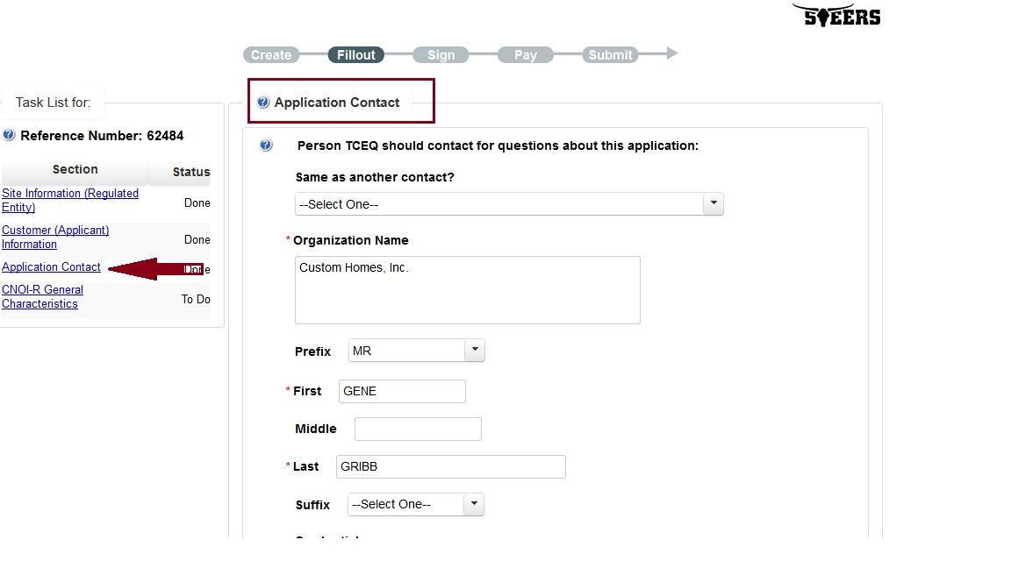
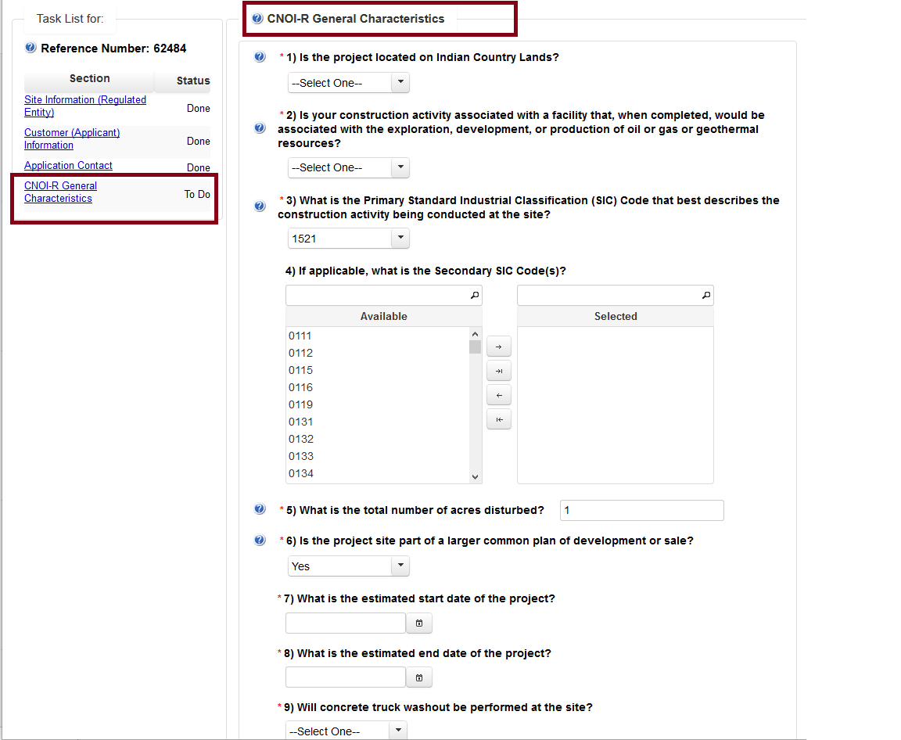
Prepare CNOI – Renewal Application - 3
Application Contact
General Characteristics
Notes:
Continuing after the Customer (Applicant) Information is the
Application Contact
Read and Modify as needed
General Characteristics.
Read and Modify as needed.
Most information can be carried forward from one contact to other – this is a notable advantage of using ePermits compared to paper – where the customer has to keep filling the same information over and again under various sections.
Help text and accessible URL’s handy during data entry.

Slide 17
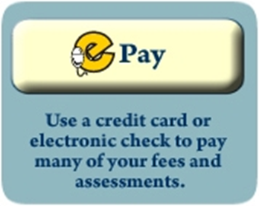
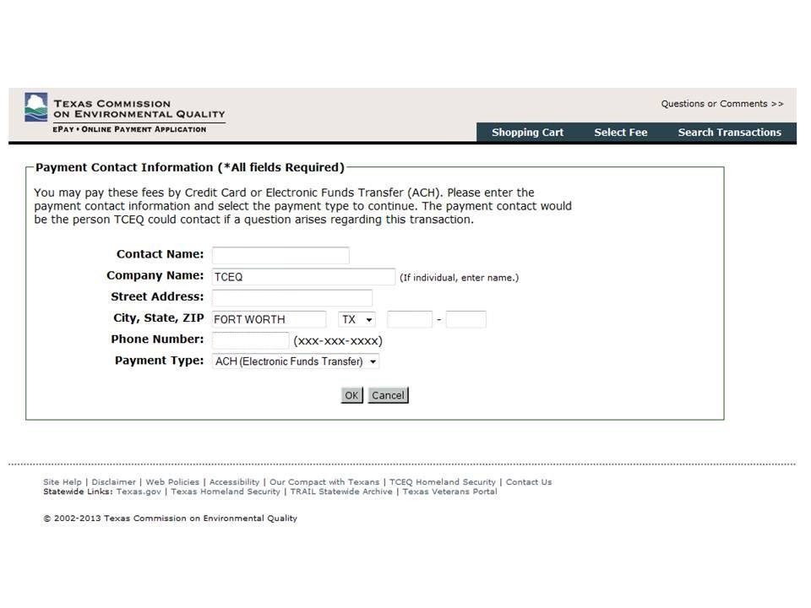
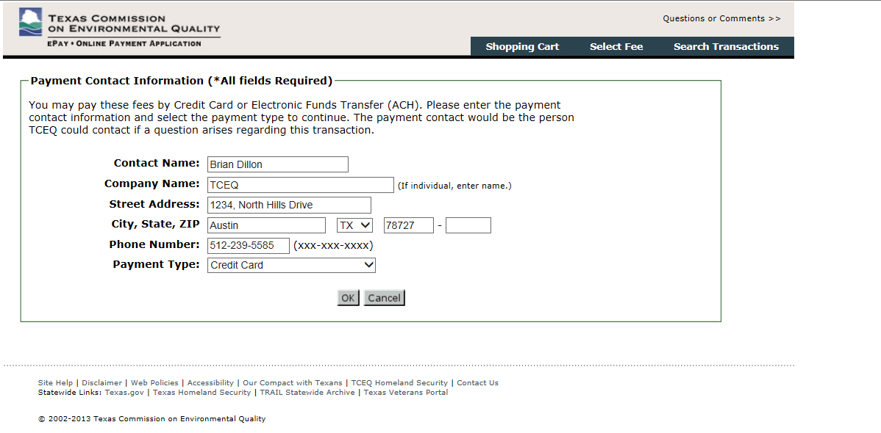
ePay – Payment Types
Electronic Check (ACH)
Credit Card
Notes:
Once the application is complete, system mentions that user that it takes them to another tceq portal for payment called ePay
Customer has 2 options to pay, ACH or Credit Card. He can use either option to proceed.

Slide 18
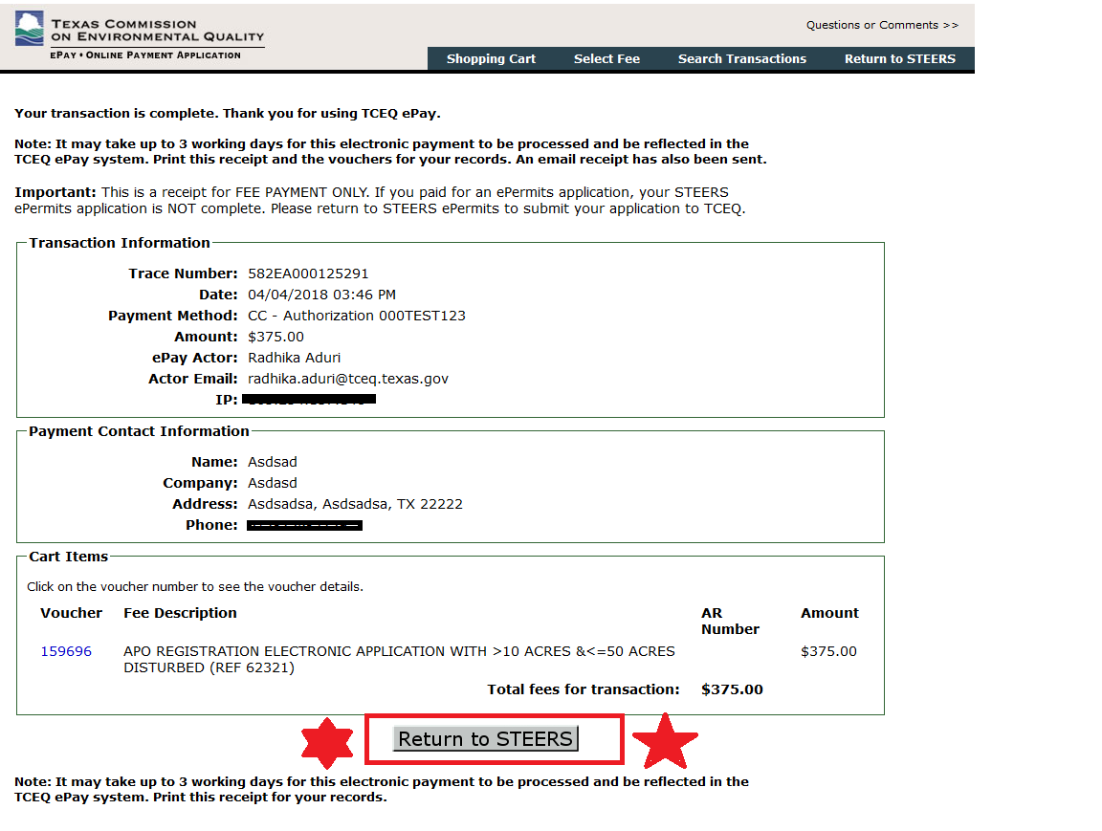
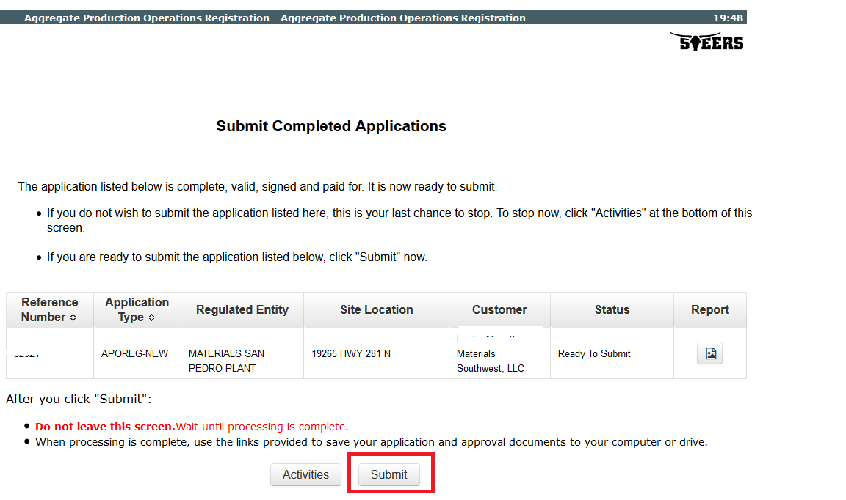
Prepare CNOI – Renewal Application - 4
Payment
Submit Application
Notes:
Once the application is complete – the application would be ready to be signed, paid and submitted.
Every payment transaction in ePermits in carried via ePay portal. Customer would be indicated that they will be leaving the ePermits for payment. However this navigation is very unnoticeable and seamless, however the customer must come back to STEERS to submit it.
And so the button underneath is displayed clearly to indicate that and the message at the top.
NOTE: Most customers often think that payment is the end of the permit application process and forget to submit it and resulting in not sending their application to the agency on time and loosing the coverage. We tried various ways to inform this to the customer by warning messages, intermediate pages etc.. And now in the future – we will be sending an email every 2 weeks or so to applicants – who paid but have not submitted, hoping that they would do it immediately.
SUBMIT – once the application is paid – return to STEERS and submit it. At all times notice that the Copy of Records – COR is shown for visibility.

Slide 19
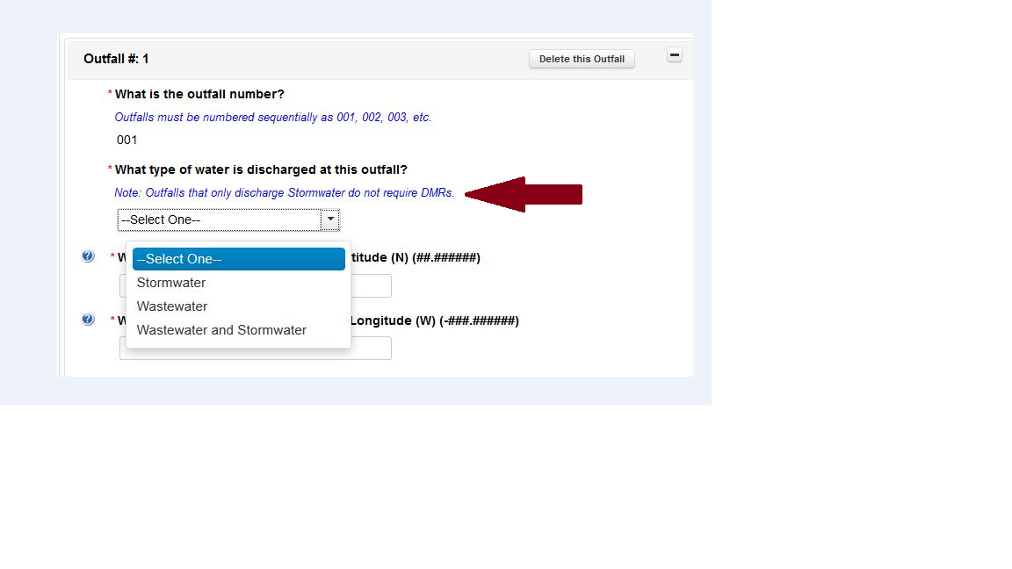
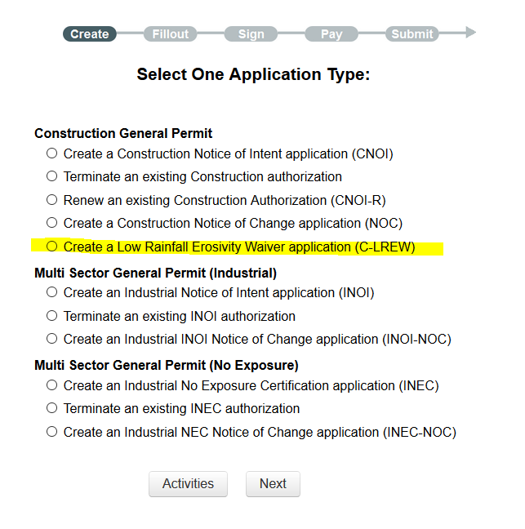
STEERS Version 6.1- Program Level
  TXG110000– Discharge Type – Outfalls that only discharge
    “Stormwater” - do not require DMRs.
  TXG110000 and TXR050000 - NOC option to change outfall information.
  All 12-digit TXR15#s will be renewed seamlessly and provided with a new 9 digit TXR15# upon renewal.
  Low Rainfall Erositivity Waiver is now available in ePermits under Stormwater for no fee.
  EPA mandated fields added to the application details.
  As per EPA mandate; TXR05 NOI is now required to have DMR contact.
  Customers can now terminate their applications irrespective of their CN Status.
Notes:
Continuing enhancements – now under Program Level Changes
Starting Sept 2017 – TXG11 and TXR05 – both became 100% electronic. Customers had to submit all applications via ePermits unless an electronic waiver was provided.
Concrete Batch Plants General Permit (TXG11) – Discharge Type - Often customers got confused choosing Stormwater and Stormwater and Wastewater combinations resulting in subsequent NOCs. For that, we have added informational message.
TXR05 - per EPA mandate; TXR05 NOI is now required to have DMR contact and so both paper and epermit application will collect DMR contact details. And so NOC reason for Change in DMR contacts is also added.
TXG11 and TXR05 - NOC option to change outfall information, (this is restricted to add new outfall or deleting an existing one. One cannot modify an existing outfall.)
All 12-digit TXR15 can be renewed seamlessly. The existing 12-digit number would be expired and will be given a new 9 digit TXR15 number upon renewal.
Low Rainfall Erosivity Waiver is now available in ePermits under Stormwater program. Customer can now apply for LREW NOI, NOC and do a NOT via ePermits for no fee.

Slide 20
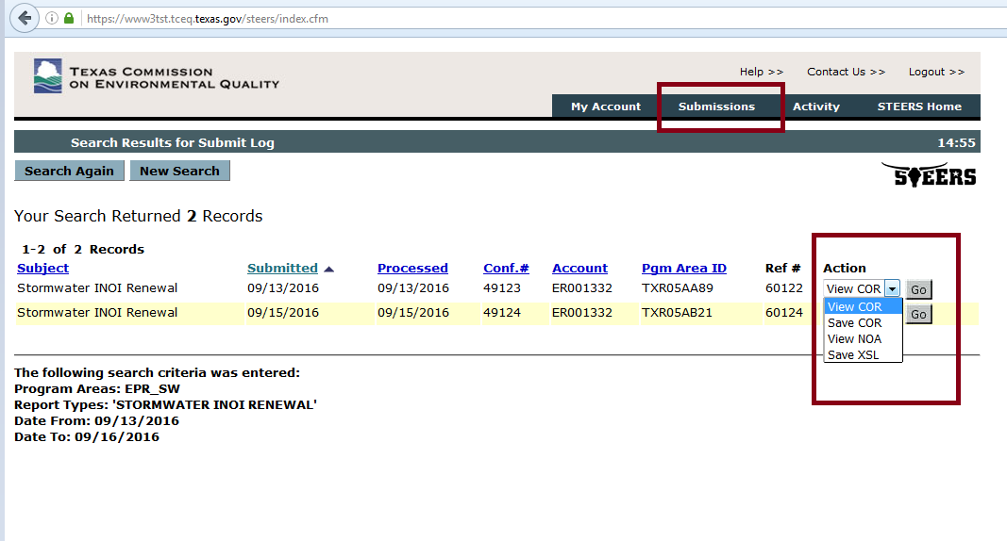
Inside STEERS - Submissions
Notes:
All your submissions are stored at a repository – called Submissions.
Customer can always search and look for their Notice of Authorizations and related documents at this location such as Copy Of Records (COR) and NOA’s which is your authorization certificate and approval letter.
Also has the option to view or save these records.

Slide 21
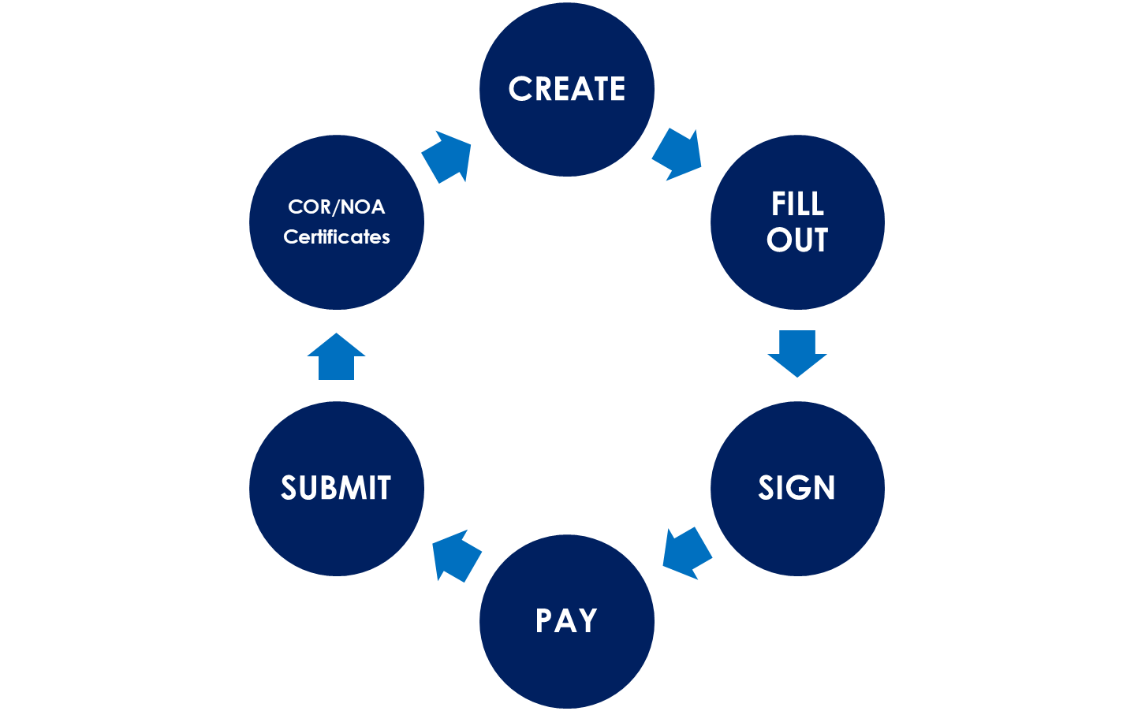

Permit Application Cycle
Submit Complete
Ready to Sign
Ready to Submit
Ready to Pay
Notes:
Irrespective of the program type you choose, most of the permit application process goes though a series of sequential phases, which is strictly binded by the rule that application must follow.
Customers must first create the application, Fill out, Sign, Pay and Submit.
At the end of each phase, the application is saved and customer can revisit the application at a later time to complete it or complete all the phases in one sitting.
Irrespective of how the customer does, it follows the one way rule of going through CREATE and SUBMIT in order to successfully complete the permit application.
NOTE: PLEASE DO NOT STOP AFTER PAY – You will have to proceed and submit it. Your application is not completed until you hit SUBMIT.
Once the permit is submitted and processed – Customer can access Copy of Records and other Notice of Approval Documents.

Slide 22
CNOI- R
TXR151234
Permit application
ER001234
Copy of Records
Notice of Intent (CNOI-R) Approval Letter
Access Permit
CNOI- R Certificate
Notes:
Conclusion:
As you see if you have a STEERS account –
You can apply for many types of permits online.
Access permits at any time.
All your documents pertaining to the permit – are always stored and accessible when needed.
Every activity on the application or STEERS can be viewed.
Many more automated features and helpful link handy to complete the application in less time.
The use of STEERS for notification, registration, and certification is strongly encouraged, as it streamlines the permitting process for both the customer and the TCEQ. Using STEERS shortens the permitting process and provides the customer immediate confirmation that their application has been received.

Slide 23
Key Features of ePermits
One time account set up and authenticated sessions.
Seamless permit application process for any program type or general permit type - New, Renew, Modify, and Terminate
Costs less than paper applications
Sharing applications made easy.
Guided Task list details each section that needs to be entered by the user
Copy information from an existing application with minimal data entry
Email and phone validations for better application experience.
Help links to complete the application in a single session.
Customer Validations and potential duplicate checks
Efficient search functionality and filtering techniques
Timely communication with customers
Notes:
Strictly follows Signature Authority Standards in federal and state rules
One time account set up and authenticated sessions.
User can create just one account and apply for any program type and for any type of applications without any limit.
Seamless permit application process for any program type or general permit type - New, Renew, Modify, and Terminate
Users can get immediate acknowledge in most cases unlike paper forms which normally takes 1-2 months. Now with 2018 version - user can terminate their application if the CN is not valid.
Guided Task list details each section that needs to be entered by the user
Copy information from an existing application with minimal data entry
Help links to complete the application in a single session.
Lat and Long Viewer, Surface quality viewer, appropriate URLS to get Core data forms or to reach out CR.
Customer Validations and potential duplicate checks
Accurate validations for CN and RN. Checks for duplicates.
Efficient search functionality and filtering techniques

Slide 24
Challenges
User Characteristics
  Internet availability and customers’ ability to use computers.
  Customers are expected to have some knowledge of the program areas they use.
  STEERS Participation Agreement (SPA) – requires a valid Texas drivers license, if not paper SPA needs to be submitted.
Data Integrity
  Data is directly entered by the customer. The customer has a vested interest in entering the data correctly in the system.
  Data must meet several minimum validation standards before it can be submitted to the agency.
  Customer Validations against Secretary of State (SOS) and Comptrollers(CPA) databases.
Notes:
User Characteristics
Internet availability and customers’ ability to use computers.
Customers are expected to have some knowledge of the program areas they use.
STEERS Participation Agreement (SPA) – requires a valid Texas drivers license
Data Integrity
Data is directly entered by the customer. The customer has a vested interest in entering the data correctly in the system.
Data must meet several minimum validation standards before it can be submitted to the agency.
Customer Validations against Secretary of State and Comptrollers databases.

Slide 25

Best Practices
Make sure you provide valid email addresses .
Please do not ignore Automated STEERS email messages.
  Customers have paid the application and have not submitted.
  When STEERS archives the applications as part of the STEERS system maintenance.
  Reminders during general permit renewal time.
Check respective webpages for information.
Make sure proper statutory authorities are set while creating the account.
  Sign and Submit.
Notes:
With many programs getting 100% electronic in the near future with EPA mandates, here are some best practices that one can follow to apply electronically without any hassles
Make sure you provide valid email addresses. All communications from TCEQ happens through this email.
Please do not ignore Automated STEERS email messages. STEERS send messages when
Customers have paid the application and have not submitted.
When STEERS archive the applications as part of the STEERS system maintenance.
Reminders during renewal time.
STEERS account is unique and cannot be shared.
Make sure proper statutory authorities are set while creating the account. (Sign, Submit, and Pay)

Slide 26
Best Practices…
During renewal time 90 days is given for the customers to renew and it is strongly suggested to renew at the earliest.
Failure to renew will result in submitting a Notice of Termination (NOT) and then a new Notice of Intent (NOI).
When filing for an NOI, always make sure you search to for Site/Regulated entity and Customer before creating new data.
Report to TCEQ immediately through Core Data Form, if the CN name is changed with SOS or CPA.
Notes:
Every 5 years when the permit gets renewed (Except for APOs – which expire annually) – 90 days is given for the customers to renew and it is strongly suggested to renew at the earliest.
During renewal time 90 days is given for the customers to renew and it is strongly suggested to renew at the earliest
Failure to renew will result in submitting a NOT and then a new NOI with all the information to be inputted all again.
Report to TCEQ immediately, if the CN name is changed in SOS.
When filing for an NOI, always make sure to see if the RN/CN already exists
If CN name is changed in SOS, be sure to inform Central Registry by submitting a Core Data Form immediately. Failure to do will result in not able to complete the transaction in ePermits as the system recognizes the CN name mismatch in SOS and CR.
Error Occurred while processing your application is mostly missing physical attribute details such has Lat/Long, Location description too long.

Slide 27

Questions
Notes:
Questions

Slide 28

Contact
STEERS Questions
512-239-6925
steers@tceq.texas.gov
Stormwater Processing Center (CGP & MSGP)
512-239-3700
SWPermit@tceq.texas.gov
Applications and Review Team (APO, TXG11, CAFO, PEST)
512-239-4671
WQ-ARPTeam@tceq.texas.gov
Notes:
For epermitting questions related to the Construction General Permit or the Multi-Sector General Permit, contact the Stormwater Processing Center.
For STEERS questions, contact STEERS helpline

