Slide 1


ISMPP University
Applying GPP 2022 in APAC: A Roundtable Discussion
July 12, 2024
Webinar will begin at: ​
11 July, 10:00 PM NYC
12 July, 07:30 AM Mumbai
12 July, 10:00 AM Beijing
12 July, 11:00 AM Tokyo​
12 July, 12:00 PM Sydney​
Notes:
This webinar has been approved for 1 ISMPP CMPP Recertification Credit. You may continue to collect a screenshot for CMPP certification but you will now be sent a certificate of attendance after every ISMPP U that you can also upload into the credit tracker. ​
​
This webinar is being recorded and will be made available on the ISMPP website within 24 hours after the webinar.

Slide 2





















ISMPP Would Like to Thank…
. . . the following Titanium and Platinum Corporate Sponsors for their ongoing support of the Society:
Notes:
First a sincere thank you to all of ISMPP’s titanium and platinum corporate sponsors for their ongoing support of the Society.

Slide 3

ISMPP Announcements
Application deadline for the September CMPP
exam is August 1
Notes:
And, for those who are seeking to become CMPP-certified or looking to renew your certification, The application deadline for the next exam window is August 1, 2024

Slide 4

ISMPP Announcements
NEW ISMPP Academy
Save the date: November 13-14, 2024
Where: Convene at Commerce Square, Two Commerce Square, Philadelphia, PA 19103
ISMPP Academy is a meeting that will deliver
best practices education to professionals:
• Who work at biotechnology, small pharma, and medical device companies •
• Who are newer to the field •
• Who want to build their expertise •
More details to come!
Notes:
Remember to Save the Date for the new ISMPP Academy, a new Fall meeting format in Philadelphia this year, November 13-14. Be on the lookout, registration will open soon.

Slide 5
Poll Question
Which of the following topics would you be most interested to learn about in a future webinar?
Use of digital extenders (videos, visual abstracts, summaries, etc.) in publications
The patient voice and engaging patients in the APAC region
Expert opinion publications and how they are perceived in the APAC region
Generative AI in publications (e.g., translations)

Slide 6

How To Ask Questions
Feel free to ask a question at any time, however all questions will be held until the end of the presentations.
To ask a question, open the Q&A window, type your question into the
Q&A box. Click Send
Note: Check Send Anonymously if you do not want your name attached
to your question in the Q&A
We will make every effort to respond to all questions live (out loud)
Notes:
You can submit a question at any time during the presentation by following the instructions on this slide.
The faculty will answer questions at the end of all the presentations.

Slide 7
Disclaimer
Information presented reflects the personal knowledge and opinions of the faculty and does not necessarily represent the position of their current or past employers
Notes:
Please take a moment to read our general disclaimer.

Slide 8
Objectives
Learn to identify practical approaches for navigating the publication landscape in APAC, based on real-world experience shared through a series of case study discussions
Enhance understanding of GPP 2022 as well as its implementation and associated challenges in the APAC context, through an in-depth panel discussion
Notes:
Listed here are the learning objectives for today’s webinar.

Slide 9



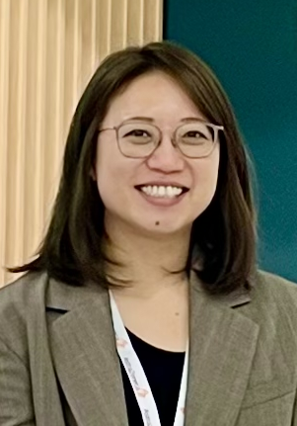
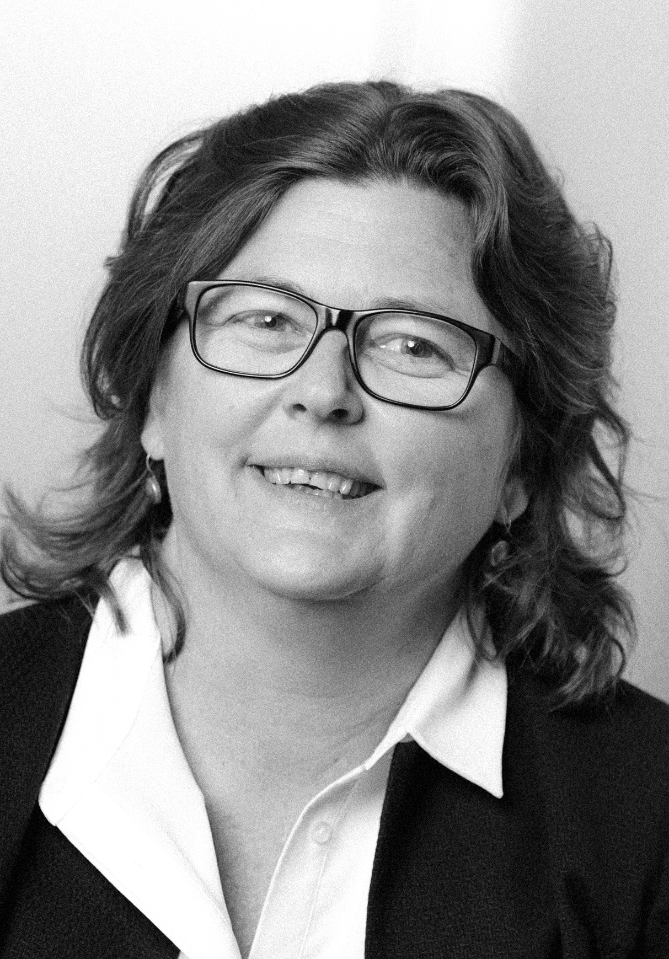
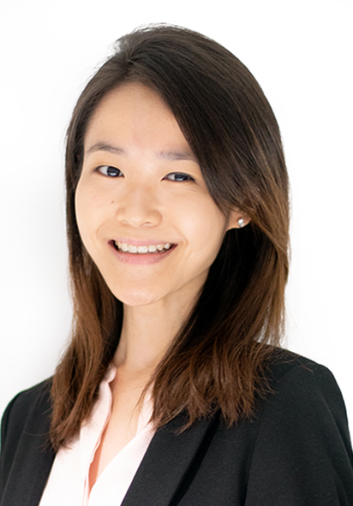
Faculty
Malvika Katarya
Regional Publications Associate Director, Greater China and Intercontinental, GSK
Jonathan Lee
Senior Manager, Regional Publications, Growth and Emerging Markets, Takeda Pharmaceuticals
Blair Hesp
Principal Consultant at First in Human Communications, Managing Director at Kainic Medical Communications, New Zealand
Hui Chin Teoh
Publication Manager, Boehringer Ingelheim (China)
Serina Stretton
EVP Scientific, Envision Pharma Group
Moderator:
Sharon Lee
Consultant (Medical Communications), Costello Medical, Singapore

Slide 10
Involvement of patients in publications
Malvika Katarya
Regional publications lead, GSK Vaccines
Greater China and Intercontinental region
GSK

Slide 11
Disclosures
I am an employee of GSK and hold financial equities in GSK
All opinions expressed here are my own and do not represent those of my employer
I am a member of ISMPP and the APAC education taskforce

Slide 12
Working with patient authors
Value of working with patient authors
  Patient authors can include patients, caregivers, and support network members eg patient advocacy group members
  Patients have valuable insight to offer on their condition
  Inclusion of patients increases focus on patient-specific research priorities, which may be under-represented in literature
  Patient authors can make publications more accessible– eg their involvement in plain language summaries can ensure complex medical literature is well understood by an informed but non-expert audience
Evolving landscape of the medical/scientific community
  Greater awareness of the benefits of involving patients in study design/analysis, increased inclusivity in access to information
  Reflected in updates to guidelines (eg GPP 2022) as more patient-authored publications are developed
    Authorship recognizes patient contribution as a true partnership in the project

Slide 13

Example 1: Inclusion of patient and HCP insights attitudes towards meningococcal vaccination
During the COVID-19 pandemic there was a decline in pediatric vaccinations, including meningitis vaccines
GSK carried out an online survey to understand how parents' attitudes and behaviors towards pediatric immunization changed during the pandemic
  ~5000 parents from UK, France, Germany, Italy, Brazil, Argentina, Australia and USA participated
Healthcare professionals and survivors of invasive meningococcal disease were invited to discuss the survey results and share their personal experiences at GSK World Meningitis Day
These experts also reviewed the results and shared their insights in a peer-reviewed manuscript and digital enhancer (audio interview)
The opportunity
Pandemic’s influence on parent’s attitudes and behaviors towards meningococcal vaccination
Human Vaccines and Immunotherapeutics
Tan LJ, et al. HVI 2023;19:2179840
Digital enhancer: Audio conversation between patient authors
Approach to working with patient authors
Four patient authors were involved, bringing diverse perspectives, without or without advocacy experience
Publications process was adapted and made more inclusive for patient authors
Eg the kick-off call for patient authors with a scripted presentation, live captions, facility for lip-reading and translation to other languages
Factor in any additional time or effort required to make the process inclusive for patients and for them to fully participate as an author
Plan early to set up appropriate contracts with patient authors that include publication clauses and take into consideration local ethics requirements
Takeaways

Slide 14
Example 2: Plain language summary of publication –
A simplified and accessible explanation of results
Results from the Phase II, B-Clear study of bepirovisen (published in NEJM in 2022) indicated there was a potential to achieve a functional cure against chronic hepatitis B (CHB)
However the data were complex and not easily accessible beyond Subject Matter Experts. Healthcare providers and patients requested GSK for a simplified version
GSK decided to publish a standalone plain language summary publication with a PAG member as a co-author
The
opportunity
Plain Language Summary of the Efficacy and Safety of Bepirovirsen in Patients with Chronic Hepatitis B Infection
Future Virology
Yen M-F, et al. Future Virology 2023;18:917-932
Features to make the article understandable
for non-experts:
Different colored sections with easy-to-understand titles
Pronunciation guide
Layperson summary
Elaboration of disease pathology and biological processes
Infographic style presentation of results
Approach to working with patient authors
Potential author identified after cross-functional discussions – relative of a patient with CHB, previously engaged as a faculty member for CHB symposia
No specific arrangements were required
A patient author with prior experience working with industry may understand more easily the industry expectations and processes
Takeaways

Slide 15
Patient engagement landscape in Asia Pacific
Limited number of patient authored publications in the region
Caveat that the challenges mentioned apply not just to engaging patients as authors, but more generally for engagements with patients.
  These may not be unique to Asia Pacific, but are more likely to be prevalent in this region
There are few formalized patient organizations and limited scope for patient advocacy
  The greater focus is on patient-to-patient support networks – offering connection, resources and sharing experiences
  The level to which Patient advocacy is established varies across Asia Pacific countries
Limited numbers of patients who are willing to participate and share their experiences
  Cultural context in Asia - hesitancy to talk about topics such as disease or chronic illness
  Patients may be reluctant to be featured or named, which limits the type and impact of engagement
  On the other hand, ‘over-engagement’ of limited patients may give an incomplete picture of burden or impact of disease
Consider company-specific and local regulations in the development and use of the materials, so that this is done compliantly

Slide 16
Challenges and suggestions for working with patient authors
Awareness and planning
Supporting delivery
Patients may have limited experience of scientific publications
Patients may have limited experience as authors
Patients may require additional support to fulfill author role
Use all available tools and means to support patient authors
Patients may need assistance with technical tools
Provide additional support where needed in using publication platforms/tools
Technical terminology may need to simplified
Provide a glossary of terms if needed
Involve patient authors early in study or publication planning
Utlilize available external resources and guides
Allow for extended timelines
Obtain contact details of a delegate
Consider additional meetings or discussions to explain the study and results in further detail
Encourage patient authors to ask questions before agreeing to participate
Provide guidance and context about scientific publications in general and about industry-sponsored publications
Provide clear guidance and understanding of authorship role and expectations
Topics could include: Basics of publication development and submission, value of peer review, explanation of process and company-specific policies
Allow for flexibility in obtaining their feedback

Slide 17
Recommendations for engaging patients
  Consider patient authorship for appropriate projects and in line with policies on patient engagement
  Involve patients early in the research and publication process
  Algin with relevant cross-functional stakeholders and work in partnership with them (eg publications, medical team, patient engagement team)
  Make the publications process as inclusive as possible, so that patients are fully empowered to share their perspective
  Early in publication planning, carefully consider target congresses/journals which are open to inclusion of patient authors

Slide 18
Vendors Qualifying For Authorship in APAC
Jonathan Lee, PhD CMPP
Senior Manager, Regional Publications, Growth and Emerging Markets, Takeda Pharmaceuticals

Slide 19






The situation
Smaller budgets in the APAC region often mean that engaging a single vendor to manage both study execution and publication development provide economies of scale for the sponsor
Global
Asia-Pacific
Region
Budgets

Slide 20


The situation
Global
Asia-Pacific
Study execution
team
Medical writing team
But what happens if members of the vendor team are involved in the acquisition or analysis of data for the work?
  This may fulfil criterion 1 of the ICMJE authorship criteria
  Substantial contributions to the conception or design of the work; or the acquisition, analysis, or interpretation of data for the work; AND

Slide 21
The situation
Does this mean that the sponsor needs to offer the vendor team member the opportunity to be an author?
What happens if the vendor asks to be included and cites fulfilment of criterion 1?

Slide 22
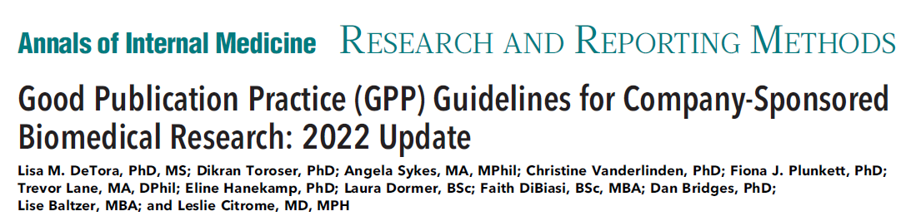
GPP principles to consider
Paid employment in any role that contributes to study conduct, analysis, or publication development (including professional medical writing) is not a disqualification from authorship.
Authorship criteria should be applied consistently to all contributors, including patients and professional medical writers, regardless of their affiliation, professional role, or level of educational attainment.
Authorship is not to be automatically conferred (or denied) based on a present job role or function.

Slide 23
How can we navigate this situation?
Potential conflict of interest if vendor-author is being paid to execute a study AND develop the publication
Separation of contracts for (1) study execution and (2) publication development
  Important to include list of vendor team members involved in delivery of each separate contract
  Study team should not be the same as the publication development team
Early discussion with vendor team to clearly define how potential authorship qualification will be managed
Clear documentation of everything!

Slide 24
The situation
Smaller budgets in the APAC region often mean that engaging a single vendor to manage both study execution and publication development provide economies of scale for the sponsor
But what happens if members of the vendor team are involved in the acquisition or analysis of data for the work?
  This may fulfil criterion 1 of the ICMJE authorship criteria
Does this mean that the sponsor needs to offer the vendor team member the opportunity to be an author?
What happens if the vendor asks to be included and cites fulfilment of criterion 1?

Slide 25
GPP principles to consider
(GPP 2022 supplement, section G)
Paid employment in any role that contributes to study conduct, analysis, or publication development (including professional medical writing) is not a disqualification from authorship.
Authorship criteria should be applied consistently to all contributors, including patients and professional medical writers, regardless of their affiliation, professional role, or level of educational attainment.
Authorship is not to be automatically conferred (or denied) based on a present job role or function.

Slide 26
How can we navigate this situation?
Potential conflict of interest if vendor-author is being paid to execute a study AND develop the publication
Separation of contracts for (1) study execution and
(2) publication development
  Important to include list of vendor team members involved in delivery of each separate contract
  Study team should not be the same as the publication development team
Early discussion with vendor team to clearly define how potential authorship qualification will be managed
Clear documentation of everything!

Slide 27
Ethics in Publications for Both Journals and Authors
Blair Hesp, PhD NZDipBus CMPP
First In Human
Dunedin, New Zealand

Slide 28

What happened?
APAC client with a product approved
in the APAC and the US
Generated clinical data in a study performed in APAC countries
Used anonymised individual patient data generated in that study in case study-based theoretical research
All authors were company employees

Slide 29
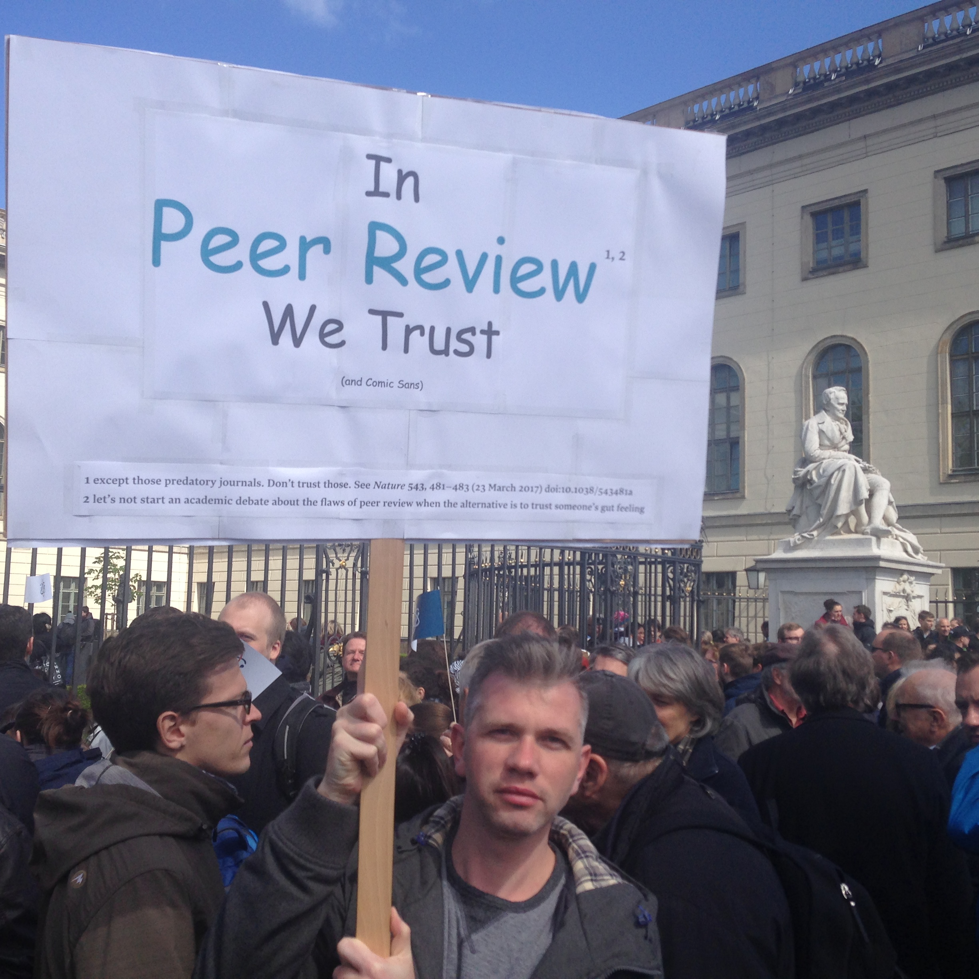
What happened during peer review?
Peer reviewer: “Ah, just wondering why there
is no ethical approval statement in this manuscript?”
Authors: “We don’t need one.”
Entire journal editorial board: “Oh, yes you do!”
Medical writer to Authors: “Can you please confirm that you do have ethical approval to conduct this study now?”
Sarahmirk, CC BY-SA 4.0 <https://creativecommons.org/licenses/by-sa/4.0>, via Wikimedia Commons

Slide 30

How was this handled by the authors?
Client: “Let’s have a meeting and I’ll walk you through our ethical approval”
Writer: “Could you please send the document in advance so we can review it”
Client: “OK……..”
…..medical writer’s phone rings……
Client: “Go to page 7 and you can see that everything
is approved.”
Medical writer: “Ah, I don’t think so…….”

Slide 31


How did we respond?
Author action:
Insert a non-specific statement claiming ethical approval
Our actions:
Withdrew permission to be acknowledged for providing medical writing support
Recommended that the manuscript, and another related manuscript based on the same data set be retracted
Refused to work with the client again

Slide 32


What about the actions of the journal?
The professional medical writer disappeared
from the acknowledgements after ethical
issues were raised
The editorial board comments were not published as part of the open peer review reports

Slide 33
Panel Discussion
Hui Chin Teoh
Publication Manager, Boehringer Ingelheim, China
and
Serina Stretton PhD CMPP
EVP Scientific, Envision Pharma Group

Slide 34
Audience Q&A
To ask a question, open the Q&A window, type your question into the Q&A box. Click Send.
Notes:
And now it's time to answer your questions. As a reminder, please type them into the Q&A box at the bottom of your screen.

Slide 35
Upcoming ISMPPEevents
July 31, 2024:
Accurate COnsensus Reporting Document (ACCORD) checklist: a reporting guideline for consensus methods
August 2024
Starting a new relationship between agency and pharma
Notes:
Here is a snapshot of the upcoming ISMPP U for July, a focus on the ACCORD supplement. Registration is open. Also be on the lookout for the August ISMPP U, developed by the ISMPP U committee, focusing on starting a new relationship between agency and pharma.

Slide 36
ISMPP University
Applying GPP 2022 in APAC: A Roundtable Discussion
July 12, 2024
Webinar will begin at: ​
11 July, 10:00 PM NYC
12 July, 07:30 AM Mumbai
12 July, 10:00 AM Beijing
12 July, 11:00 AM Tokyo​
12 July, 12:00 PM Sydney​
Notes:
This webinar has been approved for 1 ISMPP CMPP Recertification Credit. You may continue to collect a screenshot for CMPP certification but you will now be sent a certificate of attendance after every ISMPP U that you can also upload into the credit tracker. ​
​
This webinar is being recorded and will be made available on the ISMPP website within 24 hours after the webinar.

Slide 37

Thank you for attending!
We hope you enjoyed today's presentation.
After closing out of Zoom, please click the CONTINUE button
on your screen to take our short survey. Thank you!
Notes:
Thank you again for attending today’s webinar. Please take a moment to fill out the survey link that will be sent to you.
After closing out of ZOOM, please click the ‘continue’ button on your screen to take a short survey.
Thank you!

Slide 38
Faculty Bios

Slide 39
Malvika Katarya, ISMPP CMPP™
Regional Publications Associate Director, Greater China and Intercontinental at GSK
In her current role, Malvika oversees the management of publications for the Greater China and Intercontinental region, covering Asia Pacific, East Asia, and Canada
She is a medical communications professional with 7 years of experience in medcomms and the pharmaceutical industry, with an interest in both scientific publications, and the use of digital tools and omnichannel communications

Slide 40
Jonathan Lee, PhD, ISMPP CMPP™
Senior Manager, Regional Publications, Growth and Emerging Markets, Takeda Pharmaceuticals
In his current role, Jon oversees the management of publications for a region that spans Asia, the Middle East, Africa and Latin America. This geographical remit has provided him with a wealth of insights on publication practices at the regional level both within and outside of Asia
He is a co-author on several publications which discuss the cultural and communication differences in Asia-Pacific (APAC), including the APAC adaptation of GPP 2022
Jon is a Certified Medical Publication Professional (CMPP) and is the current APAC Trustee on the ISMPP Board of Trustees

Slide 41
Blair Hesp PhD, NZDipBus, ISMPP CMPP™
Principal Consultant at First in Human Communications and Managing Director at Kainic Medical Communications, a multi-award winning medical communications agency
Lead author of APAC adaptations of GPP3 and GPP 2022
An active contributor to ISMPP, the Australasian Medical Writers’ Association and the Asia-Pacific MedComms Network who has previously been named the most innovative person in marketing and communications in New Zealand

Slide 42
Hui Chin Teoh
Publication Manager at Boehringer Ingelheim based in Shanghai, China
10+ years of experience in scientific communications in both agency and industry
Responsible for developing and implementing publication strategies for stroke and mental health related products in China
Advocates for publication best practice and passionate about fostering a collaborative environment to deliver quality publications

Slide 43
Dr. Serina Stretton, PhD, ISMPP CMPP™
EVP Scientific, Envision Pharma Group
Serina is a certified medical publication professional with more than 20 years’ experience working with authors and clients globally and in the Asia Pacific region
In her current role, Serina oversees medical communications teams for Japanese and global clients
Serina has published peer-reviewed research on publication misconduct, is a past-Convenor of the Medical Writing Interest Area Committee for ARCS Australia, and past-member of the Global Alliance for Publication Professionals

Slide 44
Moderator: Sharon Lee, PhD, ISMPP CMPP™
Consultant (Medical Communications), Costello Medical, Singapore
In her current role, Sharon supports projects in both publications and medical affairs across multiple therapy areas and with clients across different functions in the pharmaceutical industry
Sharon is a Certified Medical Publications Professional (CMPP), with 5 years of medical communications experience, and a particular interest in enhanced publication content and medical education

