Slide 1
Best Practices in Adult Learning
Trainer: Kristen Wall, MA, EdD
Notes:
Title option 1

Slide 2
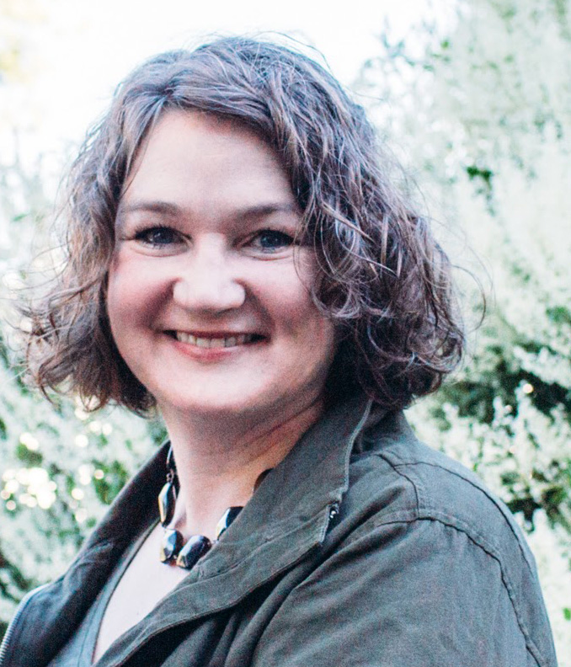
Introduction
Kristen Wall, MA, EdD
Consultant with Blue Sky eLearn
Notes:
Worksheet: opportunities to reflect, create a list of tools you can use to supplement the materials you are provided

Slide 3
Working with Adult Learners
Pros of working with adult learners | Challenges of working with adult learners
Generally willing to participate Have life experience, not starting with a blank slate Can learn from each other | Sometimes monopolize the conversation Sometimes unwilling to participate Have trouble focusing due to other responsibilities

Slide 4
Reflection
What would you add to this list of the pros and challenges of working with adult learners?

Slide 5
Knowles’ Adult Learning Principles
Know What They Want
Have Experience
Are Ready to Learn
Need Immediate Relevance
Are
Motivated
Adults…

Slide 6
Bloom’s Taxonomy
CREATING
EVALUATING
ANALYZING
APPLYING
UNDERSTANDING
REMEMBERING

Slide 7
21st Century Bloom’s Taxonomy
CREATING
EVALUATING
ANALYZING
APPLYING
UNDERSTANDING
REMEMBERING

Slide 8
Delivery Models
In-Person
Instructor-Led Training
Synchronous
eLearning
Asynchronous
eLearning

Slide 9
Make The Content Your Own
Name, head shot
Your bio
Review the script – what do you know? What will you add?
Start with 3-5 stories

Slide 10
Replicable Template
5-10 minutes
Introduction and anticipatory set (hook)
8-15 minutes
Content
5-10 minutes
Interaction and engagement
8-15 minutes
Content
5-10 minutes
Interaction and engagement
5-10 minutes
Additional Resources/Conclusion/Upcoming Events
Notes:
Think about a training you have delivered or have attended. As we go through the replicable template, think about how you would use this tool…

Slide 11
Replicable Template
5-10 minutes
Introduction and anticipatory set
Bloom's: Remembering
Capitalize on what learners already know.
What do you already know?
What do you want to learn?
What questions did you bring?
Why is the speaker/module worthy of your time?
What are the Learning Outcomes?
What resources will be made available after this event?
Notes:
About Blue Sky

Slide 12
Let’s Practice
5-10 minutes
Introduction and anticipatory set
Bloom's: Remembering
What are some examples of an anticipatory set?
How do you "set the stage" for the learner?
What does this look like for virtual training ?
What does this look like for live training?
Notes:
About Blue Sky

Slide 13
Replicable Template
8-15 minutes
Content
Bloom's: Understanding and Applying
Cover 2-3 Learning Outcomes
Why is this important?
Describe the thought process
Ideas for how this change might be implemented
Case studies, examples, stories
Notes:
About Blue Sky

Slide 14
Let’s Practice
8-15 minutes
Content
Bloom's: Understanding and Applying
Instructional ideas
Zoom-based apps
What content would you deliver?
What tools would you use?
What does this look like for virtual events?
What does this look like for live training?
Notes:
About Blue Sky

Slide 15
Replicable Template
5-10 minutes
Interaction and engagement
Bloom's: Understanding and Applying
How will you implement what you've learned so far?
Webinar: Poll questions
eLearning: drag-and-drop, clickable hot spots
F2F: Small group discussions
Notes:
About Blue Sky

Slide 16
Let’s Practice
5-10 minutes
Interaction and engagement
Bloom's: Understanding and Applying
Instructional ideas
Zoom-based apps
What activities would you have the learners do?
What tools would you use?
What does this look like on Zoom ?
What does this look like for live training?
Notes:
About Blue Sky

Slide 17
Replicable Template
8-15 minutes
Content
Bloom's: Analyze and Evaluate
Cover 2-3 Learning Outcomes
Why is this important?
Describe the thought process
Ideas for how this change might be implemented
Case studies, examples
Notes:
About Blue Sky

Slide 18
Let’s Practice
8-15 minutes
Content
Bloom's: Analyze and Evaluate
Instructional ideas
Zoom-based apps
What content would you deliver?
What tools would you use?
What does this look like on Zoom ?
What does this look like for live training?
Notes:
About Blue Sky

Slide 19
Replicable Template
5-10 minutes
Interaction and engagement
(Bloom's: Create)
How will you implement what you've learned?
What would you tell a co-worker about this event?
Offer a scenario, ask what they would do
Poll questions
eLearning: drag-and-drop, clickable hot spots
Small group discussions
Notes:
About Blue Sky

Slide 20
Let’s Practice
5-10 minutes
Interaction and engagement
Bloom's: Create
Instructional ideas
Zoom-based apps
What activities would you have the learners do?
What tools would you use?
What does this look like on Zoom ?
What does this look like for live training?
Notes:
About Blue Sky

Slide 21
Replicable Template
5-10 minutes
Additional Resources/Conclusion/Upcoming Events
Direct learners to additional resources, not just an e-mail address or the website
Webinars, F2F: Have the PPT deck immediately available for download
For webinars and F2F, announce upcoming events (and who should attend)

Slide 22
Let’s Practice
5-10 minutes
Additional Resources/Conclusion/Upcoming Events
Instructional ideas
Zoom-based apps
What activities would you have the learners do to help them draw conclusions and wrap up the session?
What tools would you use?
What does this look like on Zoom ?
What does this look like for live training?

Slide 23
Suggested Techniques – Virtual
Think-pair-share
Role play
Case studies
Problem-based learning
Create a quiz
Use the whiteboard function in Zoom
Zoom apps:
Kahoot
Scribble Together
Mentimeter

Slide 24
Suggested Techniques – F2F
Think-pair-share
Role play
Case studies
Problem-based learning
Create a quiz
Large Post-It notes
Pictures/quotations for understanding
Line up, scale of 1-10
Large crowds: stand up, raise your hands, turn on your cell phone flashlight, etc.

Slide 25
Quotations Activity
“Doh!” – Homer Simpson
“Nothing in life is to be feared. It is only to be understood.” –Marie Curie
“Geology is the study of pressure and time. That’s all it takes, pressure and time.” – Shawshank Redemption
“Today is a good day to try.” – The Hunchback of Notre Dame (Disney)
“I’m a damsel, I’m in distress, I can handle this. Have a nice day.” – Hercules (Disney)
“I am a slow walker, but I never walk back.” -- Abraham Lincoln
Notes:
For large crowds, turn this into a poll question…

Slide 26
Length of Training
1, 2, 3, 4 hours of content – what is the same? What is different?
How do you help manage energy levels?
Breaks – reading the audience, contentious discussion
No pressure on breaks to network
Family check-in time (breaks)
Introverts

Slide 27
Co-Training
What does it look like to train with someone else?
Practice together
Anticipate responding to issues
Identify clear roles and responsibilities
Carefully plan transitions – write a script!

Slide 28
Thank you! Once you close this presentation, go back to the Learning Management System to download this PowerPoint deck and explore the other LEAD to Succeed materials.

