Slide 1


ISMPP University
ISMPP AI Position Statement and Call to Action – The Time to Act is Now!
November 8, 2023
Webinar will begin promptly at: ​
11 AM ET / 4 PM GMT
Notes:
Hi everyone; welcome and thank you for joining today’s ISMPP U on “ISMPP AI Position Statement and Call to Action – The Time to Act is Now.”
This webinar has been approved for 1 ISMPP CMPP Recertification Credit. You may continue to collect a screenshot for CMPP certification but you will now be sent a certificate of attendance after every ISMPP U that you can also upload into the credit tracker. ​
​
This webinar is being recorded and will be made available on the ISMPP website within 24 hours after the webinar.

Slide 2





















ISMPP Would Like to Thank…
1
. . . the following Titanium and Platinum Corporate Sponsors for their ongoing support of the Society:
Notes:
First a sincere thank you to all of ISMPP’s titanium and platinum corporate sponsors for their ongoing support of the Society.

Slide 3

ISMPP Announcements
The next CMPP exam is March 1, 2024
  Application deadline of February 1
Notes:
The application deadline for the next exam window is February 1

Slide 4

ISMPP Announcements
2024 European Meeting of ISMPP
Innovation: The New Tradition
23-24 January 2024
Novotel London West
Registration is open!
Notes:
Registration is open for the 2024 European Meeting of ISMPP

Slide 5
European Meeting AI Task Force Sessions
2024 European Meeting of ISMPP:
January 23, 2024, 8:15 - 9:45 AM: ISMPP AI Task Force Satellite Session: Integrating AI in Medical Communications: Building Trust, Understanding and Adoption – separate registration – seats filling fast!
January 24, 2024, 2:55 - 3:40 PM: ISMPP AI Task Force Plenary Session: Title, TBD
Notes:
The ISMPP AI task force will also have content at this year's European Meeting of ISMPP.
Firstly, an AI Satellite Session at the European Meeting. There is a separate registration to the main meeting and it fills fast – so take a look ASAP.
And we’ll also have a plenary session as part of the core programme. Keep an eye out for more information.

Slide 6
How To Ask Questions
Feel free to ask a question at any time, however all questions will be held until the end the of the presentation.
To ask a question, open the Q&A window, type your question into the
Q&A box. Click Send
Note: Check Send Anonymously if you do not want your name attached
to your question in the Q&A
We will make every effort to respond to all questions live (out loud)
Notes:
You can submit a question at any time during the presentation by following the instructions on this slide.
The faculty will answer questions at the end of all the presentations.

Slide 7
Disclaimer
Information presented reflects the personal knowledge and opinions of the faculty and does not necessarily represent the position of their current or past employers
Notes:
Please take a moment to read our general disclaimer.

Slide 8
Session objectives
Understand the principles of the ISMPP AI Position Statement and Call to Action and their rationale
Gain knowledge of how to apply the ISMPP AI Position Statement and Call to Action to their own practices and to that of their organization and beyond
Recognize stakeholders’ responsibilities in deploying and utilizing AI in their environments
Notes:
Listed here are the learning objectives for today’s webinar.

Slide 9


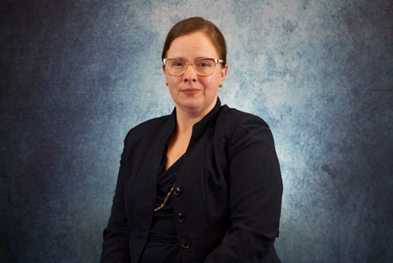



Faculty
Matt Lewis
Global Chief Artificial and Augmented Intelligence Officer, Inizio Medical
Keith Goldman
Executive Director, Global Scientific Publications, AbbVie
Jennifer Ghith
Senior Director, Omnichannel Strategy and Innovations Lead, Global Scientific Communications, Pfizer
Amy Foreman-Wykert
Executive Director, Scientific Communications, Inflammation Therapeutic Area, Amgen Inc.
Valerie Moss
Chief Scientific Officer, Prime
Moderator: Jason Gardner
SVP, Head of Medical, Real Chemistry

Slide 10

AI Task Force Objectives & Activities
Develop education, guidance, tools/resources on:
Innovations and developments with AI, including generative AI, that have the potential to impact medical publications, medical communications, and scientific publishing
Implications – both positives and challenges – to medical publication, medical communication, and scientific publishing practices and the profession
Activity #1
ISMPP AI
Position Statement and Call-to-Action
Activity #2
Skill Development: AI & Pub Professionals
Activity #3
Impact of AI: What Pub Professionals Need to Know
Activity #4
Library
of
AI Tools

Slide 11
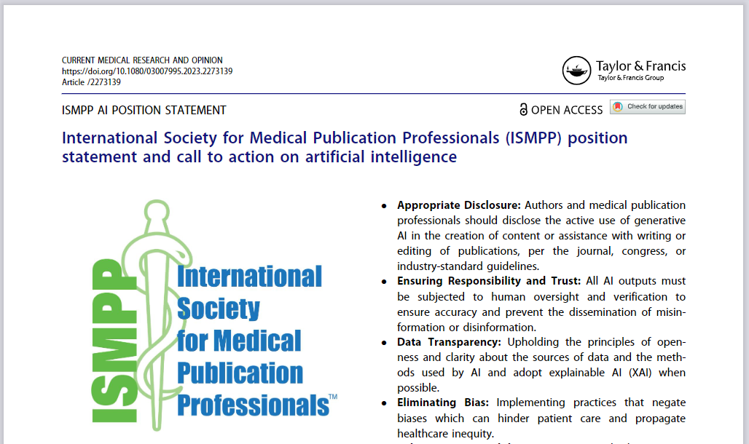




(2023) International Society for Medical Publication Professionals (ISMPP) position statement and call to action on artificial intelligence, Current Medical Research and Opinion,
DOI: 10.1080/03007995.2023.2273139

Slide 12
Authored by the ISMPP AI Task Force
Keith Goldman, AbbVie, co-chair
Matt Lewis, Inizio, co-chair
Amy Foreman-Wykert, Amgen
Jason Gardner, Real Chemistry
Anna Geraci, ISMPP
Jenny Ghith, Pfizer
Richard Graves, Sorcero
David Hogben, IPG Health
Valerie Moss, Prime Global
Chirag Jay Patel, Cactus Global
Michael Platt, CEA/CCO
New Members of the ISMPP AI Task Force​
​
Andy Shepherd,
Scientific Director, Envision Pharma​
Josh Nicholson,
Co-founder and CEO, scite.ai​
Monica Mody,
Vice President, Medical Communications, Bristol Myers Squibb​

Slide 13

Purpose
The International Society for Medical Publication Professionals (ISMPP) acknowledges the pivotal role of artificial intelligence (AI) in reshaping the landscape of medical publishing and communications.
As science and technology advance, so does the potential of AI in these fields.

Slide 14
Scope
This position statement focuses on guiding professionals within the realm
of medical publishing and communications in the appropriate use of AI.
Anchored in ISMPP’s Mission Statement and the overall guiding principles of Good Publication Practice, it aims to illuminate the inherent value of AI and to establish best practices that foster a safe, ethical, and productive AI environment.

Slide 15

Ethical Use of AI and Accountability
1.
Appropriate AI Utilization: Adhering to best practices including announcing AI use in medical publishing and communications. This encompasses local, national, and international standards such as the International Committee of Medical Journal Editors (ICMJE), as well as specific journal and congress guidelines.

Slide 16
Ethical Use of AI and Accountability
2.
Driving Accountability: Encouraging professionals to be accountable and responsible for AI-powered outputs and ensuring ethical use of AI.

Slide 17
Ethical Use of AI and Accountability
3.
Ensuring Responsibility and Trust: All AI outputs must be subjected to human oversight and verification to ensure accuracy and prevent the dissemination of misinformation
or disinformation.

Slide 18
Ethical Use of AI and Accountability
1.
Appropriate AI Utilization: Adhering to best practices including announcing AI use in medical publishing and communications.
This encompasses local, national, and international standards such
as the International Committee of Medical Journal Editors (ICMJE),
as well as specific journal and congress guidelines.
Driving Accountability: Encouraging professionals to be accountable and responsible for AI-powered outputs and ensuring ethical use of AI.
Ensuring Responsibility and Trust: All AI outputs must be subjected to human oversight and verification to ensure accuracy and prevent the dissemination of misinformation or disinformation.
2.
3.

Slide 19

Data Privacy and Transparency
1.
Maintaining Confidentiality: Ensuring the privacy and confidentiality of business, scientific, and patient data when using AI, thereby safeguarding the interests of members, coauthors, and other stakeholders involved in medical communications.

Slide 20
Data Privacy and Transparency
2.
Data Transparency: Upholding the principles of openness and clarity about the sources of data and the methods used by AI and adopt explainable AI (XAI) when possible.

Slide 21
Data Privacy and Transparency
1.
Maintaining Confidentiality: Ensuring the privacy and confidentiality of business, scientific, and patient data when using AI, thereby safeguarding the interests of members, coauthors, and other stakeholders involved in medical communications.
Data Transparency: Upholding the principles of openness and clarity about the sources of data and the methods used by AI and adopt explainable AI (XAI) when possible.
2.

Slide 22

Eliminating Bias and Enhancing Accessibility
1.
Appropriate Disclosure: Authors and medical publication professionals should disclose the active use of generative
AI in the creation of content or assistance with writing
or editing of publications, per the journal, congress, or industry-standard guidelines.

Slide 23
Eliminating Bias and Enhancing Accessibility
2.
Eliminating Bias: Implementing practices that negate biases which can hinder patient care and propagate healthcare inequity.

Slide 24
Eliminating Bias and Enhancing Accessibility
3.
Enhancing Accessibility: Using AI to bridge patient accessibility gaps, focusing on addressing health literacy challenges and breaking language barriers in medical science.

Slide 25
Eliminating Bias and Enhancing Accessibility
1.
Appropriate Disclosure: Authors and medical publication professionals should disclose the active use of generative AI in the creation of content or assistance with writing or editing of publications, per the journal, congress, or industry-standard guidelines.
Eliminating Bias: Implementing practices that negate biases which can hinder patient care and propagate healthcare inequity.
Enhancing Accessibility: Using AI to bridge patient accessibility gaps, focusing on addressing health literacy challenges and breaking language barriers in medical science.
2.
3.

Slide 26

Advocacy and engagement
1.
Respecting the Academic Integrity of AI: Recognizing the fundamental science behind AI and treating it as a legitimate academic field that has guidelines and findings relevant to medical publishing and communications.

Slide 27
Advocacy and engagement
2.
Educating About AI: Facilitating understanding among professionals and the broader public about the legitimate role, advantages, and limitations of AI in medical communications.

Slide 28
Advocacy and engagement
3.
Addressing AI Misconceptions: Actively countering inaccurate perceptions about AI, particularly in the context of life sciences and medical communications.

Slide 29
Advocacy and engagement
1.
Respecting the Academic Integrity of AI: Recognizing the fundamental science behind AI and treating it as a legitimate academic field that has guidelines and findings relevant to medical publishing and communications.
Educating About AI: Facilitating understanding among professionals and the broader public about the legitimate role, advantages, and limitations of AI in medical communications.
Addressing AI Misconceptions: Actively countering inaccurate perceptions about AI, particularly in the context of life sciences and medical communications.
2.
3.

Slide 30



Call to Action for ISMPP Members
In the rapidly evolving world of medical communications, AI will play a transformative role.
It is vital for ISMPP members to lead by example in harnessing AI responsibly.
Education and Training: Stay up to date with AI advancements. Recognize that AI is revolutionizing scientific communication. All ISMPP members are encouraged to improve their AI literacy, understanding its potential and associated risks, and engage with ISMPP AI education and training.
Implementation and Use: Ensure that AI is integrated responsibly, transparently, and fairly, always prioritizing confidentiality. Align the usage of AI with ISMPP’s Code of Ethics to foster patient accessibility, ensure timely publication, and combat publication bias.
Advocacy and Community Engagement: Engage within and beyond your organizations. Given ISMPP members' unique position bridging medical science, healthcare professionals, and patients, it’s crucial to actively participate in AI policy formation due to its broader societal impacts

Slide 31
Audience Q&A
To ask a question, open the Q&A window, type your question into the Q&A box. Click Send.
Notes:
And now it's time to answer your questions. As a reminder, please type them into the Q&A box at the bottom of your screen.

Slide 32
Upcoming ISMPP U Webinars
November
29, 2023
Best Practices in the Development and Dissemination of Scientific Communication Platforms
December
6, 2023
AI in the APAC Region
December
13, 2023
Patients as a Key Stakeholder for Scientific Conferences
Notes:
Also, be on the lookout for ISMPP’s next ISMPP U

Slide 33
ISMPP University
ISMPP AI Position Statement and Call to Action - The Time to Act is Now!
November 8, 2023
Webinar will begin promptly at: ​
11 AM ET / 4 PM GMT
Notes:
If you were unable to at the beginning, please take a moment to take a screenshot for CMPP credit.

Slide 34

Thank you for attending!
We hope you enjoyed today's presentation.
After closing out of Zoom, please click the CONTINUE button
on your screen to take our short survey. Thank you!
Notes:
Thank you again for attending today’s webinar. Please take a moment to fill out the survey link that will be sent to you.
After closing out of ZOOM, please click the ‘continue’ button on your screen to take a short survey.
Thank you!

Slide 35
Faculty Bios

Slide 36
Matt Lewis, MPA
25 years in life experiences, with roles in small pharma, private and public-side organizations, not-for-profit professional society, patient advocacy, agency and consultancy organizations
Therapeutic area depth in oncology/hematology, neuropsychiatry and rare disorders
Founded the Inizio Medical Analytics and Innovation team, with an emphasis on advanced analytics, digital consulting and software as a service digital transformation partnership
Practice lead for augmented intelligence across Inizio Medical; lead on the Generative AI workstream for MAPS, lead AI author for HCA’s AI Roadmap (published in CMRO)
Executive Lead for Inizio’s Mental Health and Wellbeing Business Employee Resource Group
CMPP, certified medical publications professional; ISMPP, international society of medical publications professional

Slide 37
Keith Goldman, MCP, ISMPP CMPP
23 years in medical publishing, scientific communications, and launch leadership
Spearheaded Artificial Intelligence use in Publications at AbbVie
Established Scientific Platforms concept and repository at Allergan
Expertise in innovative approaches to strategic publication planning
Leadership approach shaped by 10 years with Disney Parks & Events
CMPP, certified medical publications professional; ISMPP, international society of medical publications professional

Slide 38
Jennifer Ghith, MBA, MS, ISMPP CMPP
> 15 years of experience in Industry and scientific communications
Leads implementation of cross-portfolio omnichannel strategies that amplify emerging data across publications, congresses and digital platforms
5 years of experience with AI, with research published in peer-reviewed journals and presented at national as well as international meetings
ISMPP Board of Trustees member, MAPS Digital Focus Area Working Group Member, MBA Candidate
CMPP, certified medical publications professional; ISMPP, international society of medical publications professional

Slide 39
Amy Foreman-Wykert, PhD
18 years of experience in scientific publication writing, editing, planning, and team leadership
Fosters innovation and best practices to advance scientific communication capabilities
Participant in Amgen AI task force
CMPP, certified medical publications professional; ISMPP, international society of medical publications professional

Slide 40
Valerie Moss, PhD, ISMPP CMPP
25 years in medical communications, with a passion for science and innovation
Oversees Prime’s excellence team to ensure our commitment to scientific accuracy and integrity
A leader of Prime’s AI working group and provided oversight of our Generative AI standard operating procedure
CMPP, certified medical publications professional; ISMPP, international society of medical publications professional

Slide 41

Jason Gardner, PhD, ISMPP CMPP
Excited about embracing AI responsibly in all that we do, while still putting people at the centre of the strategic process
Passionate in bringing clarity to communications – for all audiences
Using insights-driven approaches to research optimal formats and channels of communication
Chair of the program committee for the forthcoming ISMPP annual meeting (spoiler alert – AI might feature on the agenda!)
CMPP, certified medical publications professional; ISMPP, international society of medical publications professional

