Slide 1

Texas Disposal Well Rules
And Seismicity
Leslie Savage, P.G.
Paul Dubois, P.E.
May 2018

Slide 2
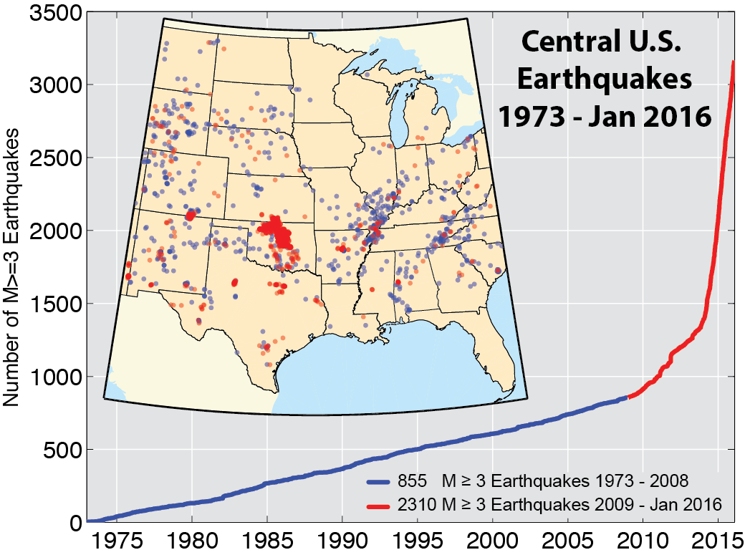
Seismic Activity in Central U.S.
Cumulative number of earthquakes with a magnitude of 3.0 or larger in the central and eastern United States, 1973–2016. The long-term rate of approximately 29 earthquakes /year increased sharply starting around 2009 (from USGS)

Slide 3
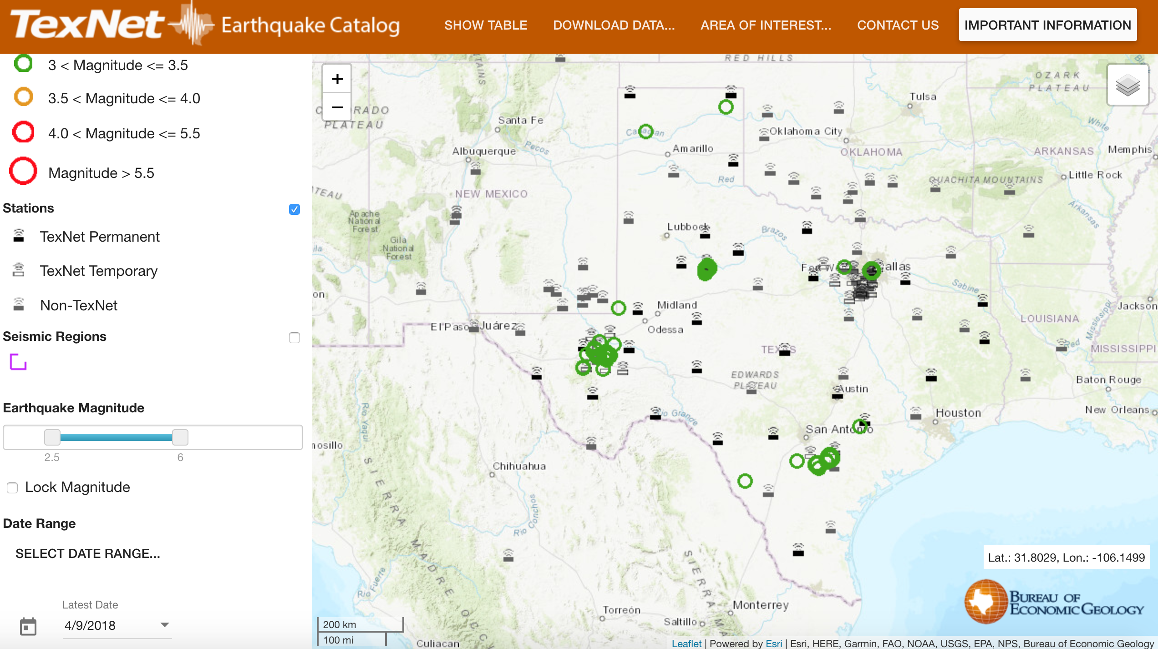
Seismic Activity in Texas
TexNet: Launched Oct. 2017 and has a complete catalog beginning
Jan. 2017; significant accomplishment by the Bureau of Economic (BEG)

Slide 4
Texas Seismicity Overview
Earthquakes recorded in Texas since 1882 (Spindletop discovered in 1901)
Natural vs. induced?
Correlation ≠ Causation
Can be induced by fluid extraction
Can be induced by fluid injection
  Hydraulic fracturing
  Enhanced recovery
  Disposal

Slide 5
Oil & Gas Activity in Texas
Production
  Thousands of fields in Texas
  315,000+ active wells
  Billions of barrels of oil & water produced
  Billions of cubic feet of gas produced
Injection
  110,000+ UIC wells permitted since 1930’s
  26,000+ active enhanced recovery injection wells
  8,000+ active disposal wells

Slide 6
Underground Injection Control (UIC)
Permitting, monitoring & testing of wells injection wells
Class II
  Enhanced recovery
  Disposal of oil and gas wastes
Class III – Brine mining
Class V - Geothermal

Slide 7
Underground Injection Control (UIC)
Program Goals:
Confine fluids to the permitted strata
Protect groundwater (USDWs)
Protect surface water
Protect strata productive of hydrocarbons

Slide 8
Key Observations
Majority of faults stable
“Faults of Concern” characterized by
  Optimal orientation for movement
  At or near critical stress
  Sufficient size and accumulated stress/strain, such that fault slip has potential to cause significant event
Identifying “Faults of Concern” challenging – generally not effectively mapped in the US

Slide 9
Texas Seismicity Overview
Hired seismologist April 2014
Amended disposal well rules November 2014
  Survey of historical seismic activity in proposed area
  Additional information
  More intense application review
  Special permit conditions
  Clarified authority to modify, suspend or cancel permit

Slide 10
Texas Disposal Well Rules
Amended disposal well rules November 2014
  Survey of historical seismic activity in area
    Survey of a circular area of 100 square miles (circle with a radius of 9.08 km/5.6 miles) centered around the proposed disposal well location for seismic activity
    If historic seismic activity in survey area or conditions that may increase the risk that fluids will not be confined to the injection interval, operator must provide additional information

Slide 11
Texas Disposal Well Rules
Additional Geologic Data
  Structure/isopach maps, geologic/seismic cross sections
  Relevant geologic data for area/disposal zone
Review additional information
  Proposed maximum daily injection volume
  Depth of injection interval to faulted basement rock
  Mapped known faults in the area
  Relevant articles, map or other research

Slide 12
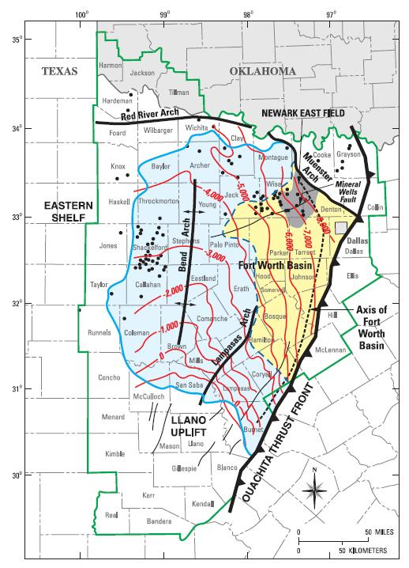
Structure Map
Fig 5. Sub-Sea Structure Map of Top of Ellenburger Formation from: “Geology of the Barnett and Marcellus Shales” by Lauren Hudson
Proposed Disposal Well
est Top Ellenburger = -5775 + 975kb = 6750’ sub kb

Slide 13
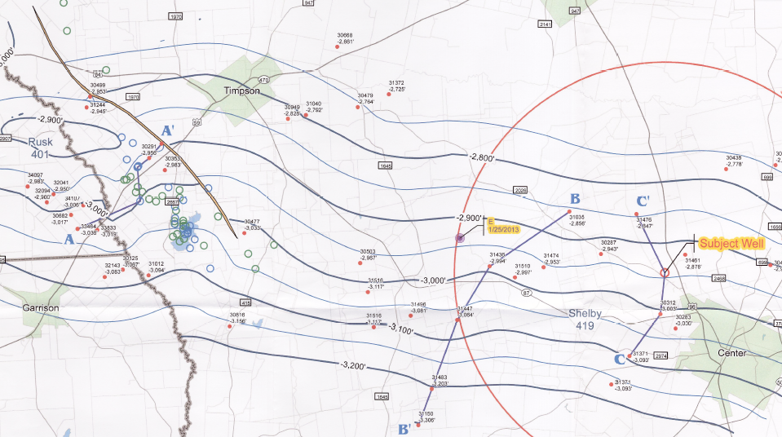
Structure Map with Epicenters
M 4.1 Earthquake, occurred 1/25/2013 spotted by USGS
Contours on Top of Travis Peak
Fault & Earthquakes
Proposed Disposal Well
Same M 4.1 Earthquake, occurred on 1/25/2013, re-spotted by UTIG

Slide 14
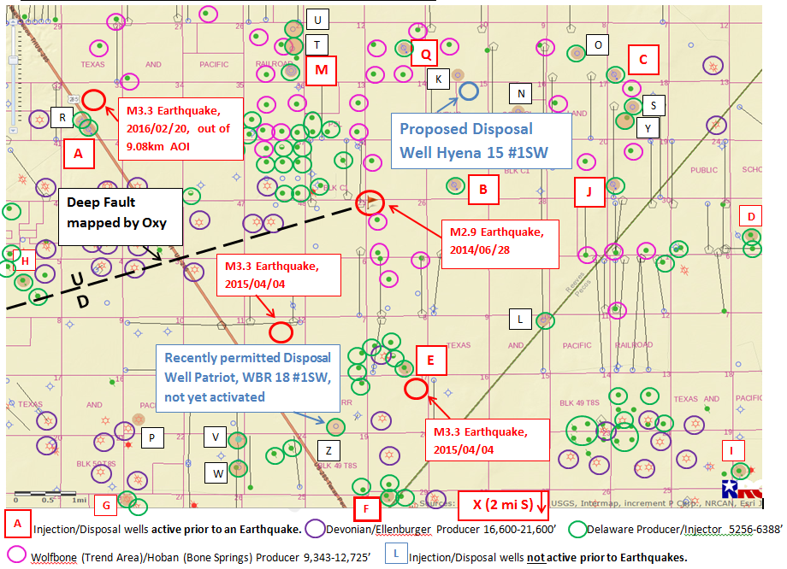
Additional Review

Slide 15
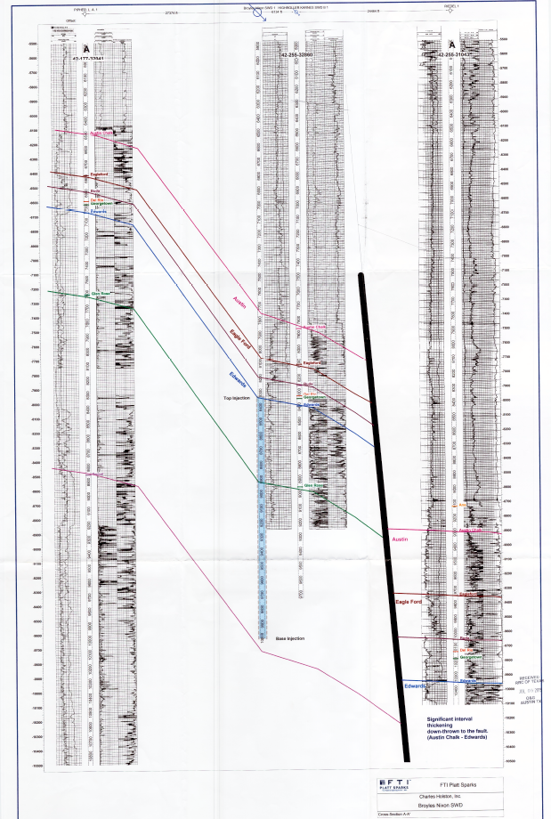
Geologic Cross Section
Disposal Interval
Unfaulted rock
faulted rock

Slide 16
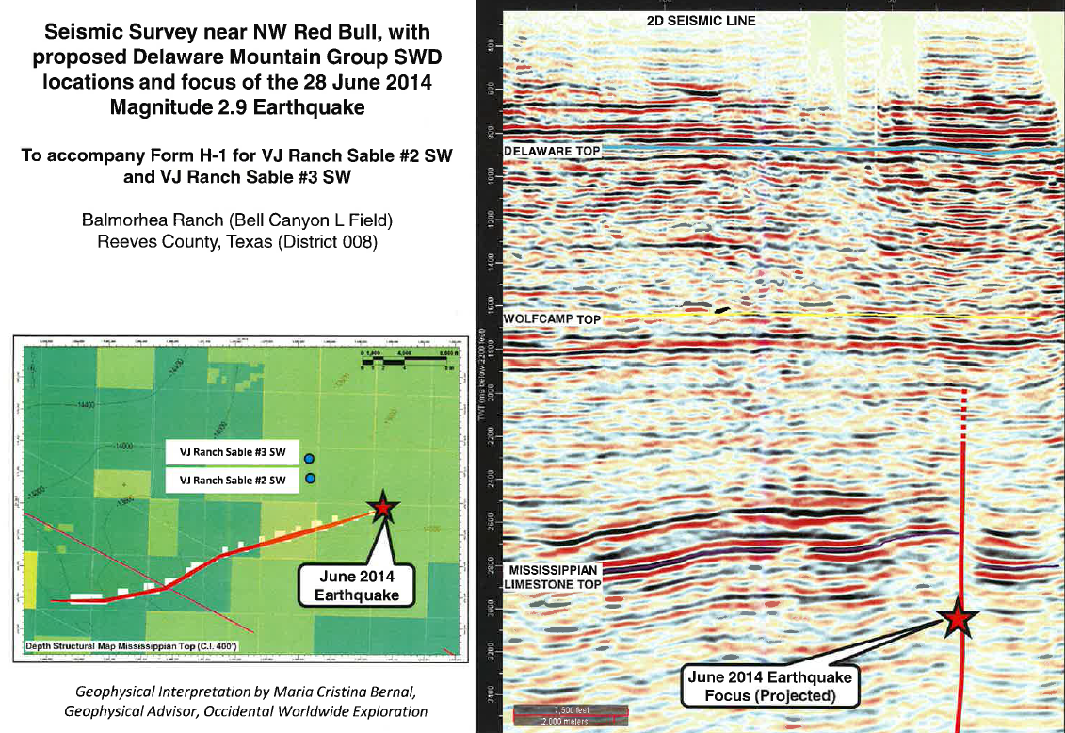
Seismic Cross Section
Unfaulted Disposal Zone
Un-faulted rock
Faulted rock

Slide 17
Texas Disposal Well Rules
Mitigating hazard
  Evaluate hazard and determine whether hazard can be mitigated
  Discuss hazards with operator
    Request additional information
    Discuss modification of application or conditioning of permit to mitigate risk
  Operator hazard management plan

Slide 18
Texas Disposal Well Rules
Mitigating Hazard
  Possible special permit conditions
    More frequent monitoring & reporting of injection rate and pressure
    Reduced volume and/or pressure
    Plugback to increase distance from basement rock/faults
    Seismic monitors
    Permit expiration date
  Deny application

Slide 19
Texas Disposal Well Rules
Application Activity as of April 11, 2018
  Received 189 disposal well applications or amendments in which survey included seismic event(s)
    92 Permitted with special conditions
    9 Permitted without special conditions
    36 Returned or withdrawn
    10 scheduled for hearing due to protests
    42 pending review

Slide 20
Texas Disposal Well Rules
Clarified authority to modify, suspend, or cancel existing permit
  If disposal well suspected of or shown to be causing seismic activity
  Notice and opportunity for hearing

Slide 21
TexNet – Bureau of Economic Geology
House Bill 2, 84th Texas Legislature (2016–17), Section 16 provides funding for TexNet:
  “…for the purchase and deployment of seismic equipment, maintenance of seismic networks, modeling of reservoir behavior for systems of wells in the vicinity of faults, …”

Slide 22
Current Actions
Working with the BEG on data/products that can be shared and used in our decisions
Developing set of guidelines in Permian Basin for permitting based on current research
Basic and applied research from BEG/TexNet and others and others will be the foundation of regulatory action.

Slide 23
TexNet Seismic Monitoring System
Denser seismic monitoring array will result in:
  Increase detection of smaller events
  More accurate location of suitably oriented, critically stressed faults
  More accurate location of epicenter/hypocenter
  Better definition of suitably oriented, critically stressed faults

Slide 24
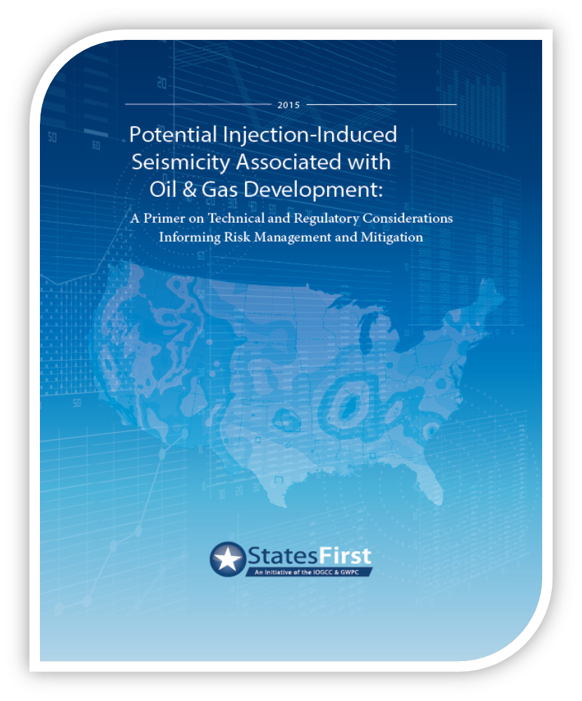
State Primer on Induced Seismicity
Emphasis on potential induced seismicity associated with Class II disposal wells
Solely informational - not intended to offer recommended rules or regulations
http://www.statesfirstinitiative.org
Text
  bullet
    sub bullet

Slide 25
Summary
Induced seismicity
Actions by RRC and the BEG
Challenges to address
  Current state of seismicity in Texas
  Knowledge of faults in Texas
  Understanding of induced earthquake mechanics
  How do we manage permitting in the context of earthquakes
Benefits, challenges, and opportunities with publically available research
Continued research is critical

