Slide 1
What is the health budget process?
UICC Master Course on UHC and Financing for cancer control Module 1, Webinar 2
“We unite and support the cancer community to reduce the global cancer burden, to promote greater equity, and to ensure that cancer control continues to be a priority in the world health and development agenda.”

Slide 2
Overview
01 | Steps in the health budgetary process
02 | Different actors roles and responsibilities

Slide 3
Steps in the health budgetary process
01

Slide 4
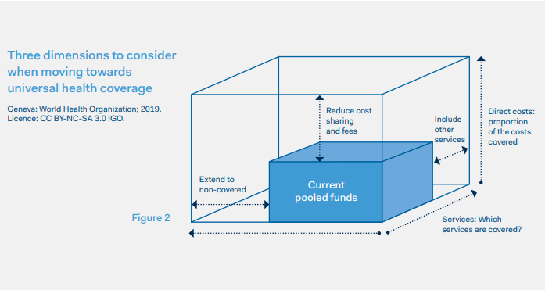
Context
Sustainable Development Goal 3.8 tasks governments to:
achieve universal health coverage (UHC), including financial risk protection, access to quality essential health care services, and access to safe, effective, quality, and affordable essential medicines and vaccines for all
The way health budgets are formed, allocated and actioned at the core of the UHC agenda.

Slide 5
Budgeting cycle
Budgeting: the process of defining the allocation of resource to produce the best outputs (for a given level of revenue).
Valuable indication of political commitment
Strong engagement by Ministries of Health (MoHs) and other stakeholders will increase the chance of health receiving the resources it needs.
Poor understand and engagement can de-link policy making, planning, costing and budgeting
Resources not used as intended
Weaker accountability
Focus is national, but similar steps undertaken at regional and local levels.

Slide 6
Budgeting cycle
Definition & formulation
Negotiation & approval
Execution
Evaluation

Slide 7
Step 1: Development & formulation
MoF develops economic and revenue forecasts
MoH identifies and costs health priorities
MoH submits proposal to MoF
Negotiation to develop draft budget
Budget submitted to parliament
Process starts with the Ministry of Finance who assesses national fiscal space and develop budget ceilings in line with anticipated economic situation and policy goals
MoH responsibility to translate sectoral policy goals to cost estimates
Can trial different costing scenarios in line with budget ceiling
Cost estimates put forward to Ministry of Finance who mediate between different line ministries to develop budget proposal

Slide 8
Step 1: Definition & formulation
Budgeting capacities vary and Ministry of health often use historical budgets.
Costing is dependent on reliable data, can be made more difficult by:
lack of access to and use of data by relevant health units
poor classification of public expenditure for health
weak financial management reporting.
Ministry of Health needs robust and costed plan before negotiations with the Ministry of Finance
May need to work with other sectors to gather this information.
Valuable to think through impacts of investment on fiscal space
Budget proposals often not in the public domain - national health accounts can be a valuable resource.
Roles of CSOs:
Research health needs of cancer patients and survivors
Increase policy maker awareness of issues
Make case for cost-effective interventions in budget proposals
Participate in local budget-setting processes
Track how investment is changing over time

Slide 9
Step 2: Negotiation & approval
Draft budget submitted to Parliament:
Potential for Parliamentarians to propose amendments
Responsibility for adoption.
Not always voted on by whole of Parliament – some countries will have appropriations committee (or sub-committees on health and other topics).
Period of greatest public participation:
Potential for public consultations
Media reporting
Roles of CSOs:
Working with champion Parliamentarians to protect funding/ amend lines
Supporting MoH to advocate with Parliamentarians
Participating in public consultation (or calling for greater public participation and review)
Engaging with media to share impacts of proposed budget on cancer

Slide 10
Step 3: Execution
Processes governments use to transfer funds from treasury to MoH and sub-recipients:
Amount of funding transferred
Timing of transfers
Where MoH public financial management (PFM) capacities limited it becomes more difficult to use resources e.g. to select services, monitor quality, management of payment relationships etc.
WHO notes that budgets may not be implemented as intended. Countries have mechanisms to respond but should be clearly clear justified and monitored.
Roles of CSOs:
Monitoring implementation/ budget spend by engagement with authorities and service providers
Track impact of services on cancer patients and general population e.g. surveys

Slide 11
Step 4: Evaluation
Internal and external reviews by ‘supreme audit institution’ (SAI)
Focus on compliance with financial rules and procedures
Examine whether working towards agreed targets
Increasingly looking at efficiency of fund use
Can include data beyond budget spend e.g. beneficiary assessment survey, scorecards, opinion polls etc.
Evaluations provide valuable data to help understand:
If the current health budget is adequate?
What priority given to health within the overall budget?
Track whether progress is being made in real terms
What impact spending has on health equity.
Roles of CSOs:
Researching impact of budget on cancer services
Collecting information under- or over-spend
Developing recommendations for the next budget

Slide 12
Annual cycles
Each year up to 3 budget cycles taking place:
Evaluation of previous year
Execution of current year
Preparation for following year
Valuable to understand when different steps taking place as will shape your advocacy opportunities:
Official windows of opportunity often narrow
Valuable to build relationships with stakeholders and decision makers to capitalise on opportunities
Fiscal year may not be the same as the calendar year

Slide 13
Major actors
02

Slide 14
Who are the major players?
National health budget
Ministry of Health
Ministry of Finance
Parliamentarians
Civil society organisations
Academia
Patients, families and communities

Slide 15
Ministry of Health
Budget development
Collecting data on the health needs of a population and key trends.
Understanding fiscal space for health to estimate the potential for increasing health investment.
Drafting credible, well-defined health budget proposals.
Engaging in budget negotiations and advocating for adequate/sound health budget allocation.
Execution
Technical support
Administrative support
Oversight of budget:
Ministry of Health often lack the skills for effective PFM, so decisions may end up sitting with the Ministries of Finance
Engaging local authorities to understand bottlenecks

Slide 16
Other actors
Ministry of Finance
Development of medium- and long-term financial planning
Ensuring financial sustainability of government
Disbursement of funds
Academia
Provide robust evidence base:
Support Ministry of Health to develop proposals and modal the impacts of different investments
Collect and analyse data on the impact of public spending on cancer incidence and mortality.
Patients
Share lived experience of cancer services
Engage with Parliamentarians and Members of Government to hold them accountable to their commitments.
Parliamentarians
Approve, amend or introduce new laws relating to health
Hold Ministers of Health and Finance accountable for policy choices, budgetary allocations and expenses

Slide 17
Key messages
Budget cycle can be divided up into 4 stages: definition, negotiation, execution and evaluation.
Each stage has unique tasks associated with it, providing different opportunities for cancer control advocacy.
Valuable to understand timelines and actors involved in order to determine when your advocacy will be most impactful.
Ministries of Health often value support from CSOs as there is a need for robust evidence-based and support to navigate political processes
Important to be aware of budget process as domestic investment critical to UHC

Slide 18
Resources
Some of the resources and papers used in this presentation:
Strategizing national health in the 21st Century: a handbook. Chapter 8: Budgeting for health (WHO, 2016) https://apps.who.int/iris/bitstream/handle/10665/250221/978924154974-chapter8-eng.pdf?sequence=11&ua=1#:~:text=A%20health%20budget%20is%20the,involved%20in%20health%2Drelated%20activities.&text=This%20is%20centrally%20important%20to,translate%20into%20expanded%20health%20coverage
Health budget fact sheet (WHO) https://www.who.int/health-topics/health-budget#tab=tab_1
Health sector budget advocacy (Save the Children): https://www.who.int/pmnch/media/news/2012/201205_health_sector_budget_advocacy.pdf
Nutrition budget advocacy (Action Against Hunger, Save the Children & SUN network): http://sun-csn-assets.s3.amazonaws.com/resources/files/000/000/050/original/Budget_Advocacy-_Nutrition_Handbook.pdf
Health Financing policy: The Macroeconomic, fiscal and public finance context (World Bank): https://openknowledge.worldbank.org/handle/10986/23734
Producing a Citizens’ Guide to the Budget: Why, What and How? (International Budget Partnership): https://www.internationalbudget.org/publications/producing-a-citizens-guide-to-the-budget-why-what-and-how/

Slide 19
Thank you
Rosie Tasker
Global Advocacy Manager
Tasker@uicc.org
www.uicc.org

