Slide 1
Water Rights: Change of Ownership
Megan Brown
Water Availability Division
Water Rights Compliance Assurance Team
Notes:
Water Rights Compliance Assurance Team (WRCAT)

Slide 2
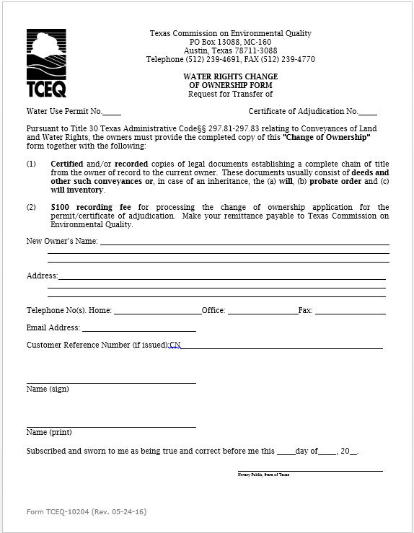
This is an image of the Water Rights Change of Ownership Form. The following is required information on the Change of Ownership Form: Water Right Number New Owner Name Mailing Address Phone Numbers
Notes:
This is an image of the Water Rights Change of Ownership Form. The following is required information on the Change of Ownership Form: Water Right Number New Owner Name Mailing Address Phone Numbers
Signature block
Notary signature block
Only notarized forms can be accepted

Slide 3
Overview
What is a Water Right
Change of Ownership Process
Texas Administrative Code (Rules)
Water Use Reports
Notices of Violation
Contact Information
Questions

Slide 4
What is a Water Right? Texas Water Code (TWC) §11.002(5)
A right acquired under the laws of Texas to impound, divert, or use state water.
Notes:
If you use state water in any way, then you need a water right.
There are a few exceptions as it pertains to impoundments through the TWC §11.142.
A water right is still required to divert from a TWC §11.142 exempt reservoir for non-exempt purposes.

Slide 5
What is State Water?
State Water
The water of the ordinary flow, underflow, and tides of every flowing river, natural stream, and lake, and of every bay or arm of the Gulf of Mexico, and the stormwater, floodwater, and rainwater of every river, natural stream and watercourse in the state.

Slide 6
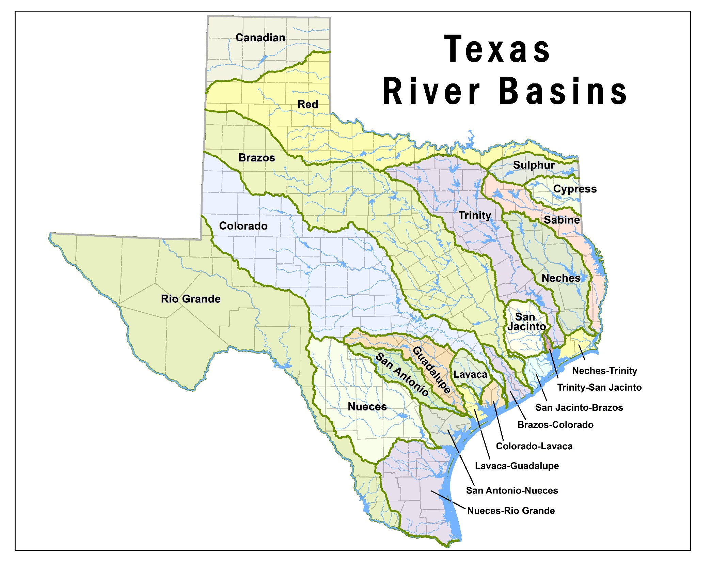
Texas River Basins
Notes:
Map of Texas River Basin.

Slide 7
Water Rights By Basin
Basin | # of WRs
01 Canadian | 38
02 Red River | 290
03 Sulphur | 66
04 Cypress | 103
05 Sabine | 237
06 Neches | 247
07 Neches-Trinity | 108
08 Trinity | 746
09 Trinity-San Jacinto | 17
10 San Jacinto | 142
11 San Jacinto-Brazos | 64
12 Brazos | 1402
Basin | # of WRs
13 Brazos-Colorado | 67
14 Colorado | 1407
15 Colorado-Lavaca | 30
16 Lavaca | 57
17 Lavaca-Guadalupe | 5
18 Guadalupe | 412
19 San Antonio | 270
20 San Antonio-Nueces | 20
21 Nueces | 262
22 Nueces-Rio Grande | 85
23 Rio Grande | 885
Total Water Rights | 6,960
Notes:
Total number of water rights in each basin as of February 14, 2017.
Canadian 38
Red River 290
Sulpher 66
Cypress 103
Sabine 237
Neches 247
Neches-Trinity 108
Trinity 746
Trinity-San Jacinto 17
San Jacinto 142
San Jacinto-Brazos 64
Brazos 1402
Brazos-Colorado 67
Colorado 1407
Colorado-Lavaca 30
Lavaca 57
Lavaca-Guadalupe 5
Guadalupe 412
San Antonio 270
San Antonio-Nueces 20
Nueces 262
Nueces-Rio Grande 85
Rio Grande 885
Total 6960

Slide 8
Change of Ownership for a Surface Water Right
TWC §11.040
(a) A permanent water right is an easement and passes with the title to land.
(b) A written instrument conveying a permanent water right may be recorded in the same manner as any other instrument relating to a conveyance of land.
Change of Ownership Form No. 10204
Water Right Number
New Owner Name
Mailing Address
Phone Numbers
Must be notarized to be accepted.
Notes:
The following is required information on the Change of Ownership Form:
Water Right Number
New Owner Name
Mailing Address
Phone Numbers

Slide 9
Title 30 Texas Administrative Code (TAC)
§297.81
General Rules of Conveyance
§297.82
Duty to inform the Executive Director
§297.83
Recording Conveyances of Water Rights

Slide 10
Title 30 TAC §297.81
Irrigation water rights convey proportionately with the land, unless specifically withheld.
Exceptions:
An irrigation authorization is issued to a non-landowner, making it personal to the permitee.
If the irrigation water right is held by a Water Corporation, Water District, River Authority or Governmental Entity. The water right must be specified in the conveyance document.
Notes:
The irrigation authorization cannot pass with the land if it is issued to a non-landowner.

Slide 11
Title 30 TAC §297.81
An irrigation water right may be conveyed separately from the land, however, prior to use, an amendment requesting to alter the Place of Use, Diversion Point or Purpose of Use may be required.

Slide 12
Sidebar - Amendments
Authorization changes to a water right are handled by the Water Rights Permitting Team (WRPT).
If a new owner wishes to amend a water right, the change of ownership must be completed first.
WRCAT and WRPT work together to process these applications.

Slide 13
Title 30 Texas Administrative Code
§297.81
General Rules of Conveyance
§297.82
Duty to inform the Executive Director
§297.83
Recording Conveyances of Water Rights

Slide 14
Title 30 TAC §297.82
An owner of a water right or his or her agent shall promptly inform the Executive Director of any transfer of water right or change of the owner's address.
This could mean the buyer of a water right or the seller of the water right.

Slide 15
Title 30 Texas Administrative Code
§297.81
General Rules of Conveyance
§297.82
Duty to inform the Executive Director
§297.83
Recording Conveyances of Water Rights

Slide 16
Title 30 TAC §297.83
Water right conveyance documents must be recorded with the County Clerk.
Copies of the recorded instruments evidencing a complete chain of title from the owner of record and the applicant must be submitted along with:
The completed Change of Ownership Form
A $100 recording fee as per Title 30 TAC §295.139(d)

Slide 17
You Might be an Owner! Please submit the following information…
Pursuant to Texas Administrative Code §297.81-83, Relating to Conveyances of Land and Water Rights, before a Change of Ownership can be completed, please provide the following:
Recorded copies of legal documents establishing a complete chain of title from the owner of record to you. These documents usually consist of deeds and other such conveyances or, in case of inheritance, the (a) will, (b) probate order and (c) will inventory. Please include a copy of the metes and bounds (legal description of the land) and plat map.
Notes:
Establish a complete chain of title, but if the documents are not properly recorded, we cannot complete the change of ownership.

Slide 18
Examples of Documents Submitted
Warranty Deeds
Special Warranty Deeds
Bill of Sale
Water Rights Transfer Deed
Partition Deed
Gift Deed
Quitclaim Deed
Will, Probate Order, Will Inventory
Deed of Trust
Trust Agreement
Covenants & Restrictions
Certificate of Merger
Certificate of Formation
Notes:
These are some of the common documents we see, but there are as many types of conveyance documents as there are lawyers to write them.

Slide 19
Value of a Plat Map
Plat Map – Plat map is a document drawn to scale, showing the divisions of a piece of land.
Provides a recent or updated visual of the land conveyed in a deed or set of deeds.
Can aid in processing a change of ownership if the land descriptions are unclear or the land has changed over time.
Notes:
When ever possible, supply a Plat Map.

Slide 20
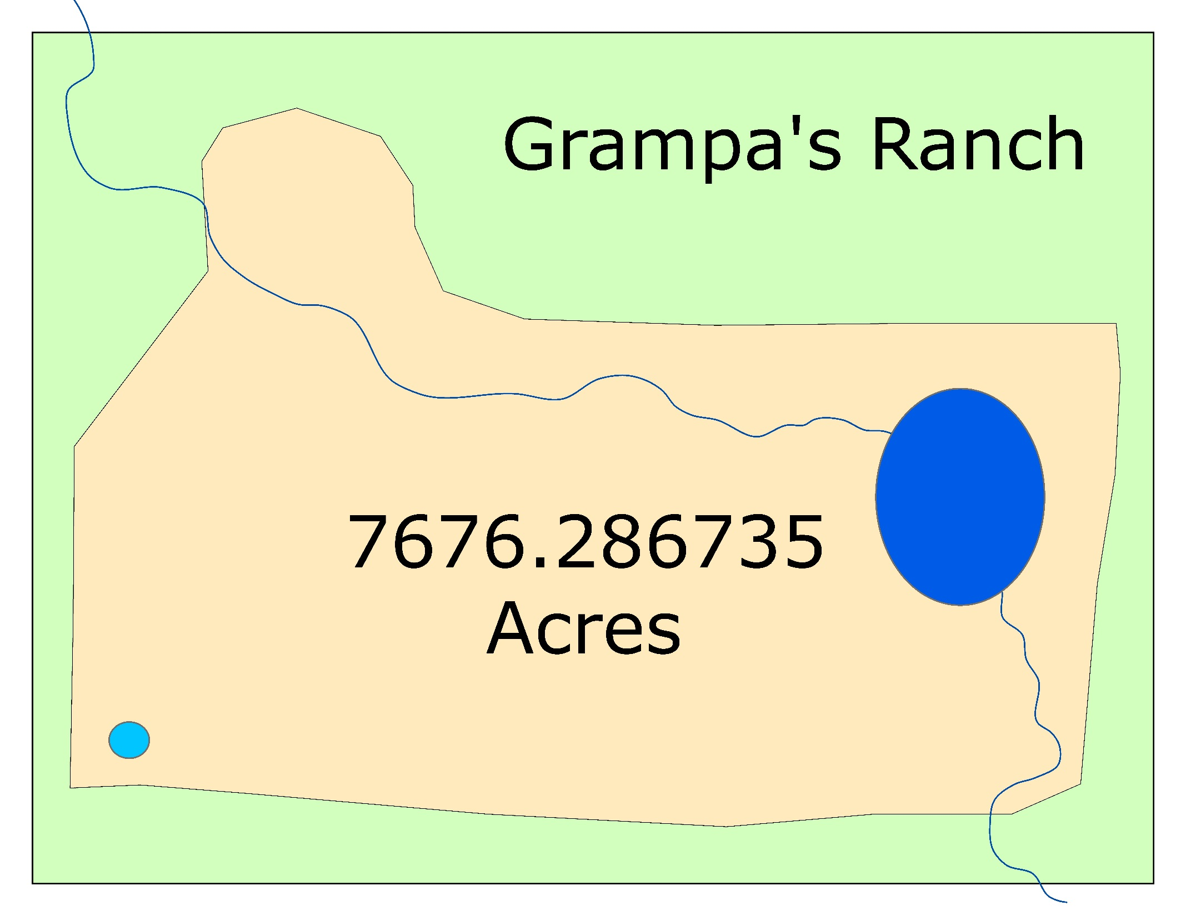
Grampa’s Ranch 1
Notes:
Fictional Map depicting “Grampa’s Ranch” with a river running through an impoundment on a large portion of property. There is a large on-channel reservoir and an off-channel reservoir. The river runs though the east and north sections of the land.
Hypothetical: This Water Right authorizes the maintenance of a 100 acre-foot on-channel reservoir on River Creek; the maintenance of a 20 acre-foot off-channel reservoir; and the diversion and use of 200 acre-feet of water per year from the on-channel reservoir and River Creek to irrigate 1000 acres out of a 7676.287-acre tract.

Slide 21
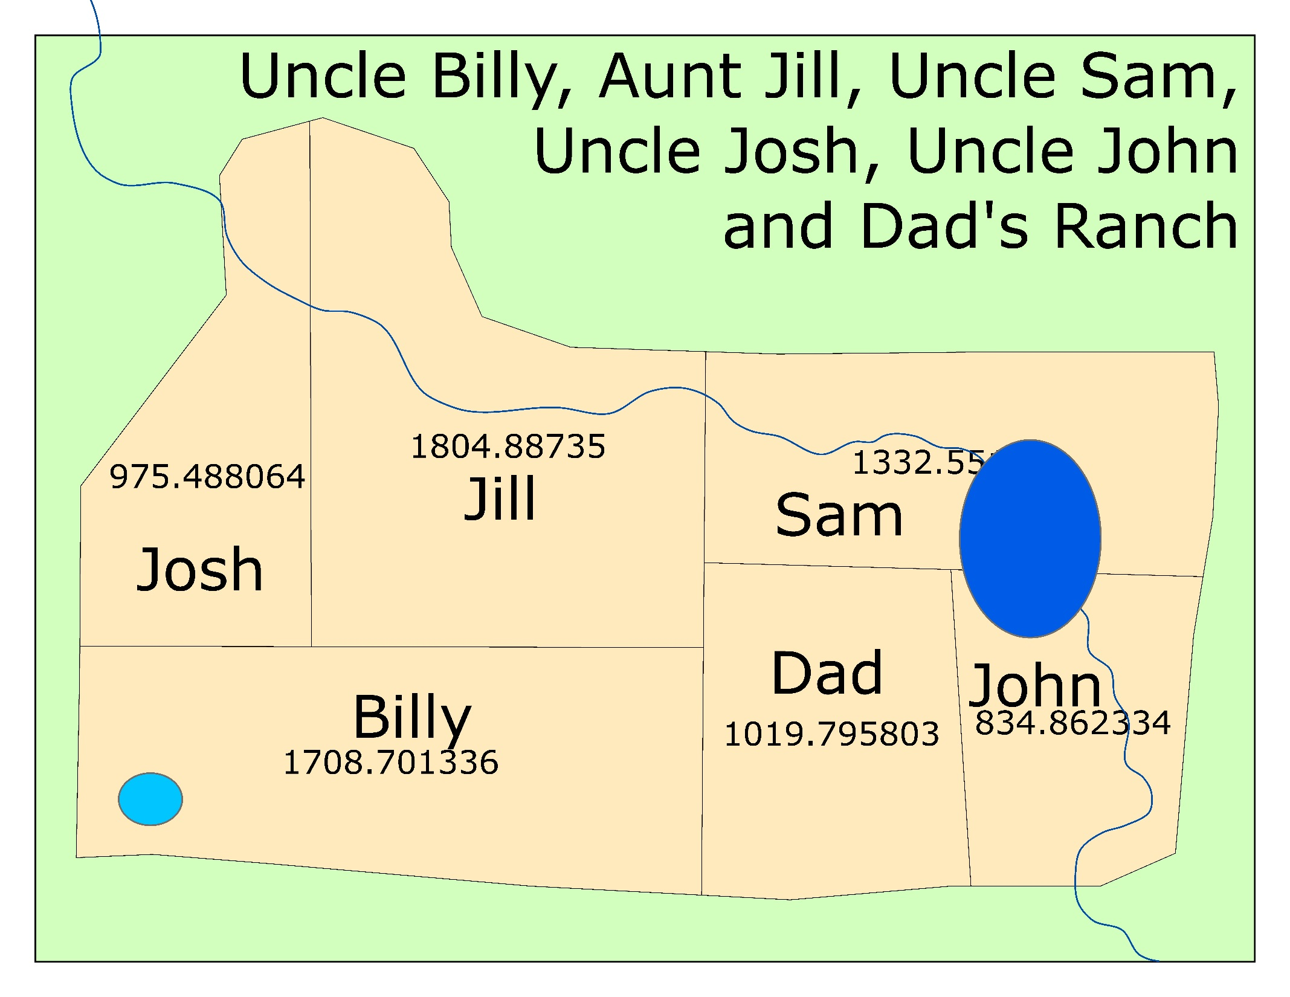
Grampa’s Ranch 2
Notes:
Fictional Map depicting second iteration of “Grampa’s Ranch” now divided among six heirs.
All heirs have inherited a proportionate amount of the water right. Sam and John inherited land inundated by the on-channel reservoir and therefore the maintenance of the dam and reservoir. Billy has inherited the maintenance of the off-channel reservoir. Four of the six heirs have access to the river.

Slide 22
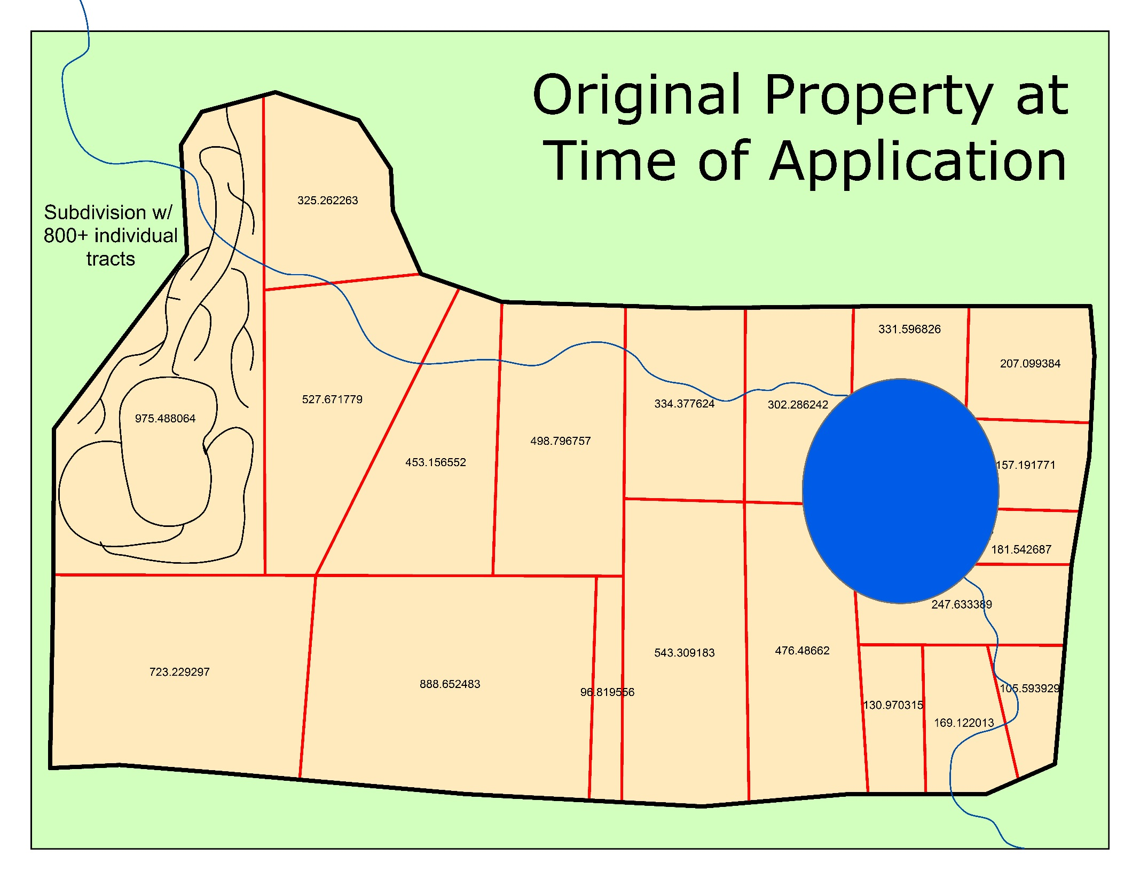
Grampa’s Ranch 3
Notes:
Fictional Map depicting third iteration of “Grampa’s Ranch” now divided among a third generation of heirs with several sections appearing to have been sold. One portion has been developed into a subdivision with more than 800 individual owners.
The on-channel reservoir has increased in size and the off-channel reservoir has been drained or lost to evaporation.
Documents WRCAT would need might be: Will, Probate Order and Will Inventory; Executor’s Deeds; Warranty Deeds; Subdivision Covenants and Restrictions.

Slide 23
What Causes a Delay
Incomplete Change of Ownership packages
missing or un-notarized application form
Missing fee (§295.139)
Standard practice is one fee per application per water right
Documents that have not been recorded with the County Clerk (§297.83)
Incomplete contact information
Including a plat map is always a good idea
Unclear conveyance documents
Acreage values that have changed over time

Slide 24
Take-Away
Submit a complete, recorded chain of title, along with
A completed, notarized Change of Ownership Form, and
A $100 recording fee.
Please make your remittance payable to the Texas Commission on Environmental Quality.
Also, if available, a map of the land being conveyed.

Slide 25
Annual Surface Water Use Reports
Title 30 TAC §295.202
Water rights holders must report their water use from the previous year..
TWC §11.031 and §11.032
mailed out the first business day in January.
Must be returned by March 1st.
Water Supply Contract holders must also report their use.
Water rights located in a Watermaster area will report use directly to the Watermaster and do not submit an annual report to TCEQ headquarters
Notes:
If you contract surface water from water right holder, both parties will need to submit a form.

Slide 26
Annual Surface Water Use Reports
In prior years, there was one form for all water rights
The forms have changed for 2017
A Frequently Asked Questions (FAQ) guide has been made available on the TCEQ website
Forms are now generated in 8 different formats based on authorized uses of the water right

Slide 27
Common Use Types
Agriculture, Irrigation
Municipal/Domestic
Industrial/Mining
Domestic and Livestock (D&L)
Recreation

Slide 28
Example: Agriculture, Irrigation
Notes:
This is an example of the agriculture water use report. The uses are listed at the top of the columns.
In this example, the uses are Agriculture-irrigation and Agriculture-wildlife, aquaculture, stock raising, and/or other agriculture.

Slide 29
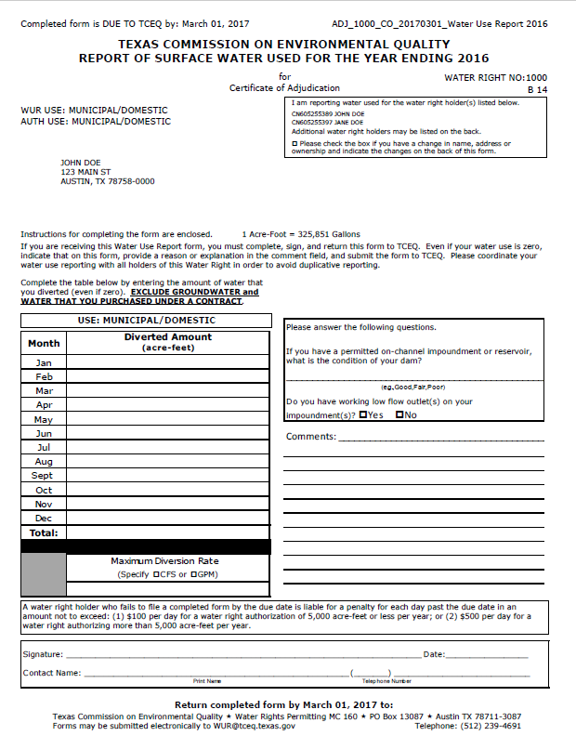
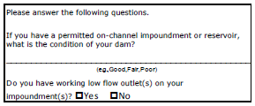
Example: Municipal/Domestic Use
Notes:
This is an example of the municipal/domestic form.
The customer numbers/owners for this water right are listed in the box at the top of the form.
When completing the form, please exclude groundwater and water purchases under contract
Answer the questions regarding the condition of your dam (example: good, fair, poor) and whether you have working low flow outlets on your impoundment

Slide 30
Example: Industrial, Mining
Industrial and Mining use the same form.
Notes:
Industrial and Mining use the same form.
This form asks for the amount diverted, and the amount of water actually consumed.

Slide 31
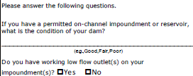
Example: Domestic and Livestock
Notes:
This is an example of the domestic and livestock form. It is the same as the municipal form.

Slide 32
Example: Recreation
Notes:
This is the Other-Recreation form. This example is issued to water rights without diversion authorization, so diversion information is not required.
This form also has the dam condition and working low flow outlet questions.

Slide 33
Less Common Use Types
Flood Control
Water Quality
Recharge
Wildlife/Conservation
Other

Slide 34
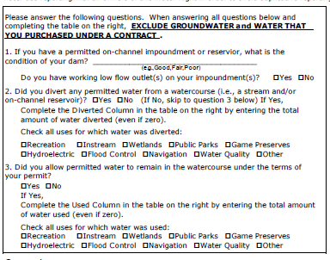
Example: Flood Control, Water Quality
For reporting year 2017 the “Used” field is being renamed to “Remained in Watercourse Amount”
Notes:
This is an example of a form for Other- Flood control, recreation, water quality.
There is a series of questions to answer regarding dam condition, low flow outlets, diversion, and non-diverted water.
For reporting year 2017 the “Used” field is being renamed to “Remained in Watercourse Amount”

Slide 35
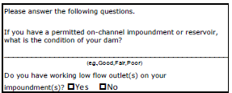
Example: Recharge
Notes:
This is an example of the form used for Recharge authorizations. It is similar to the Municipal/Domestic form.

Slide 36
General Water Use Report Form Online
Generalized form available online
https://www.tceq.texas.gov/permitting/water_rights/wr-permitting/water-right-permits-annual-water-use-report
Applicable to all use types
10 pages long
First 2 pages required for all reports
Additional pages as applicable to the water right
All 10 pages may not apply in a given situation

Slide 37
Returning Water Use Reports
Forms mailed to the address on file are generated specifically for each water right based on unique authorizations and should be first choice for usage reporting
In the event that your reports arrive or become damaged, you may call WRCAT to have another copy of the form mailed, faxed, or emailed to you or
Download the general use form 10316 from the TCEQ website, however, this form will have no indication on which portions apply to your specific water right

Slide 38
Water Usage Reporting in Watermaster Areas
Water rights located in a Watermaster area will report use directly to the Watermaster
These water rights do not submit an annual usage report to TCEQ headquarters

Slide 39
Texas Watermaster Areas
Notes:
Map of the Texas Watermaster Areas.

Slide 40
Number of Water Rights within the Watermaster Areas
Watermaster Area | # of WRs
South Texas | 1064
Concho | 228
Brazos | 1173
Rio Grande | 873
Total | 3338
Notes:
Total number as of February 14, 2017.
South Texas
1064
Concho
228
Brazos
1173
Rio Grande
873
Total
3338

Slide 41
Ways to Submit Your Water Use Report
By Mail:
PO Box 13087, MC-160, Austin, Texas 78753
By Email
WUR@tceq.texas.gov
By Fax
512-239-2214

Slide 42
Frequently Asked Questions
We made no diversions this year, how do I report this?
How do I report if I am no longer the owner of the property/water right?
I only have a recreational water right, why did I receive the Water Use Report Form?
Do I have to have this form notarized?
What happens if I don’t meet the March 1st deadline?

Slide 43
How do I report if I am no longer the owner of the property/water right?
Notes:
Check the box at the top right of the form and report on the back of the form if you are no longer the owner or there has been an address change.
If a change of ownership is required, submission of a Change of Ownership Form, Recording fee, and chain of title documents such as deeds or probate records will be required.

Slide 44
March 1st Deadline
Texas Water Code §11.031(b)
Effective September 1, 2013 a person who fails to submit a Water Use Report Form by March 1st can be fined:
(1) up to $100 a day for water right authorizations of 5,000 acre-feet or less per year;
(2) up to $500 a day for water right authorizations greater than 5,000 acre-feet per year.
If you did not receive a report to fill out:
Call the Water Rights Compliance Assurance Team
512-239-4691

Slide 45
Goal of the Water Use Report
Assembling the best available usage information statewide
This data is made available to the public on the TCEQ Website
Having the best available information allows decision makers to make the best informed decisions regarding available water

Slide 46
Failure to Submit the Report by March 1st
Notice of Violation (NOV)
Process begins around May 1st
Step 1: Call owner, attempt to get the Water Use Report.
Step 2: Prepare and send the NOV Letter.
Step 3: Prepare and send a Notice of Enforcement (NOE) Letter.
Step 4: Prepare packet to submit to the Office of Compliance.
Becomes a Notice of Enforcement (NOE)
Once the NOV becomes an NOE, the issue is with the Compliance and Enforcement Team where the fines and penalties are applied
Notes:
Before the NOV process begins, we send out a courtesy letter with the WUR in April that is Due May 1st. for those who do not respond to either, we begin contacting non-reporters and send out the first round of NOV letters May 31st (June 1st), due June 30th.

Slide 47
Contact Information
For Water Right Changes of Ownership, Water Use Reports and Amendments to a Water Right please call:
512-239-4691
For general information on water rights permitting, please go to:
www.tceq.texas.gov/permitting/water_rights/wawr_permits.html

Slide 48
Questions?

