Slide 1
RSV-The Current Landscape After Increased Vaccine Availability
Denver Niles, MD, D(ABMM)

Slide 2
Objectives
Discover the current rate of RSV positivity in the community and how laboratories are testing for it
Establish the current state of available vaccines for RSV and the populations appropriate for each
Identify the recent landscape of vaccine technologies used for RSV
Identify ways in which respiratory season has changed post available vaccines for RSV

Slide 3
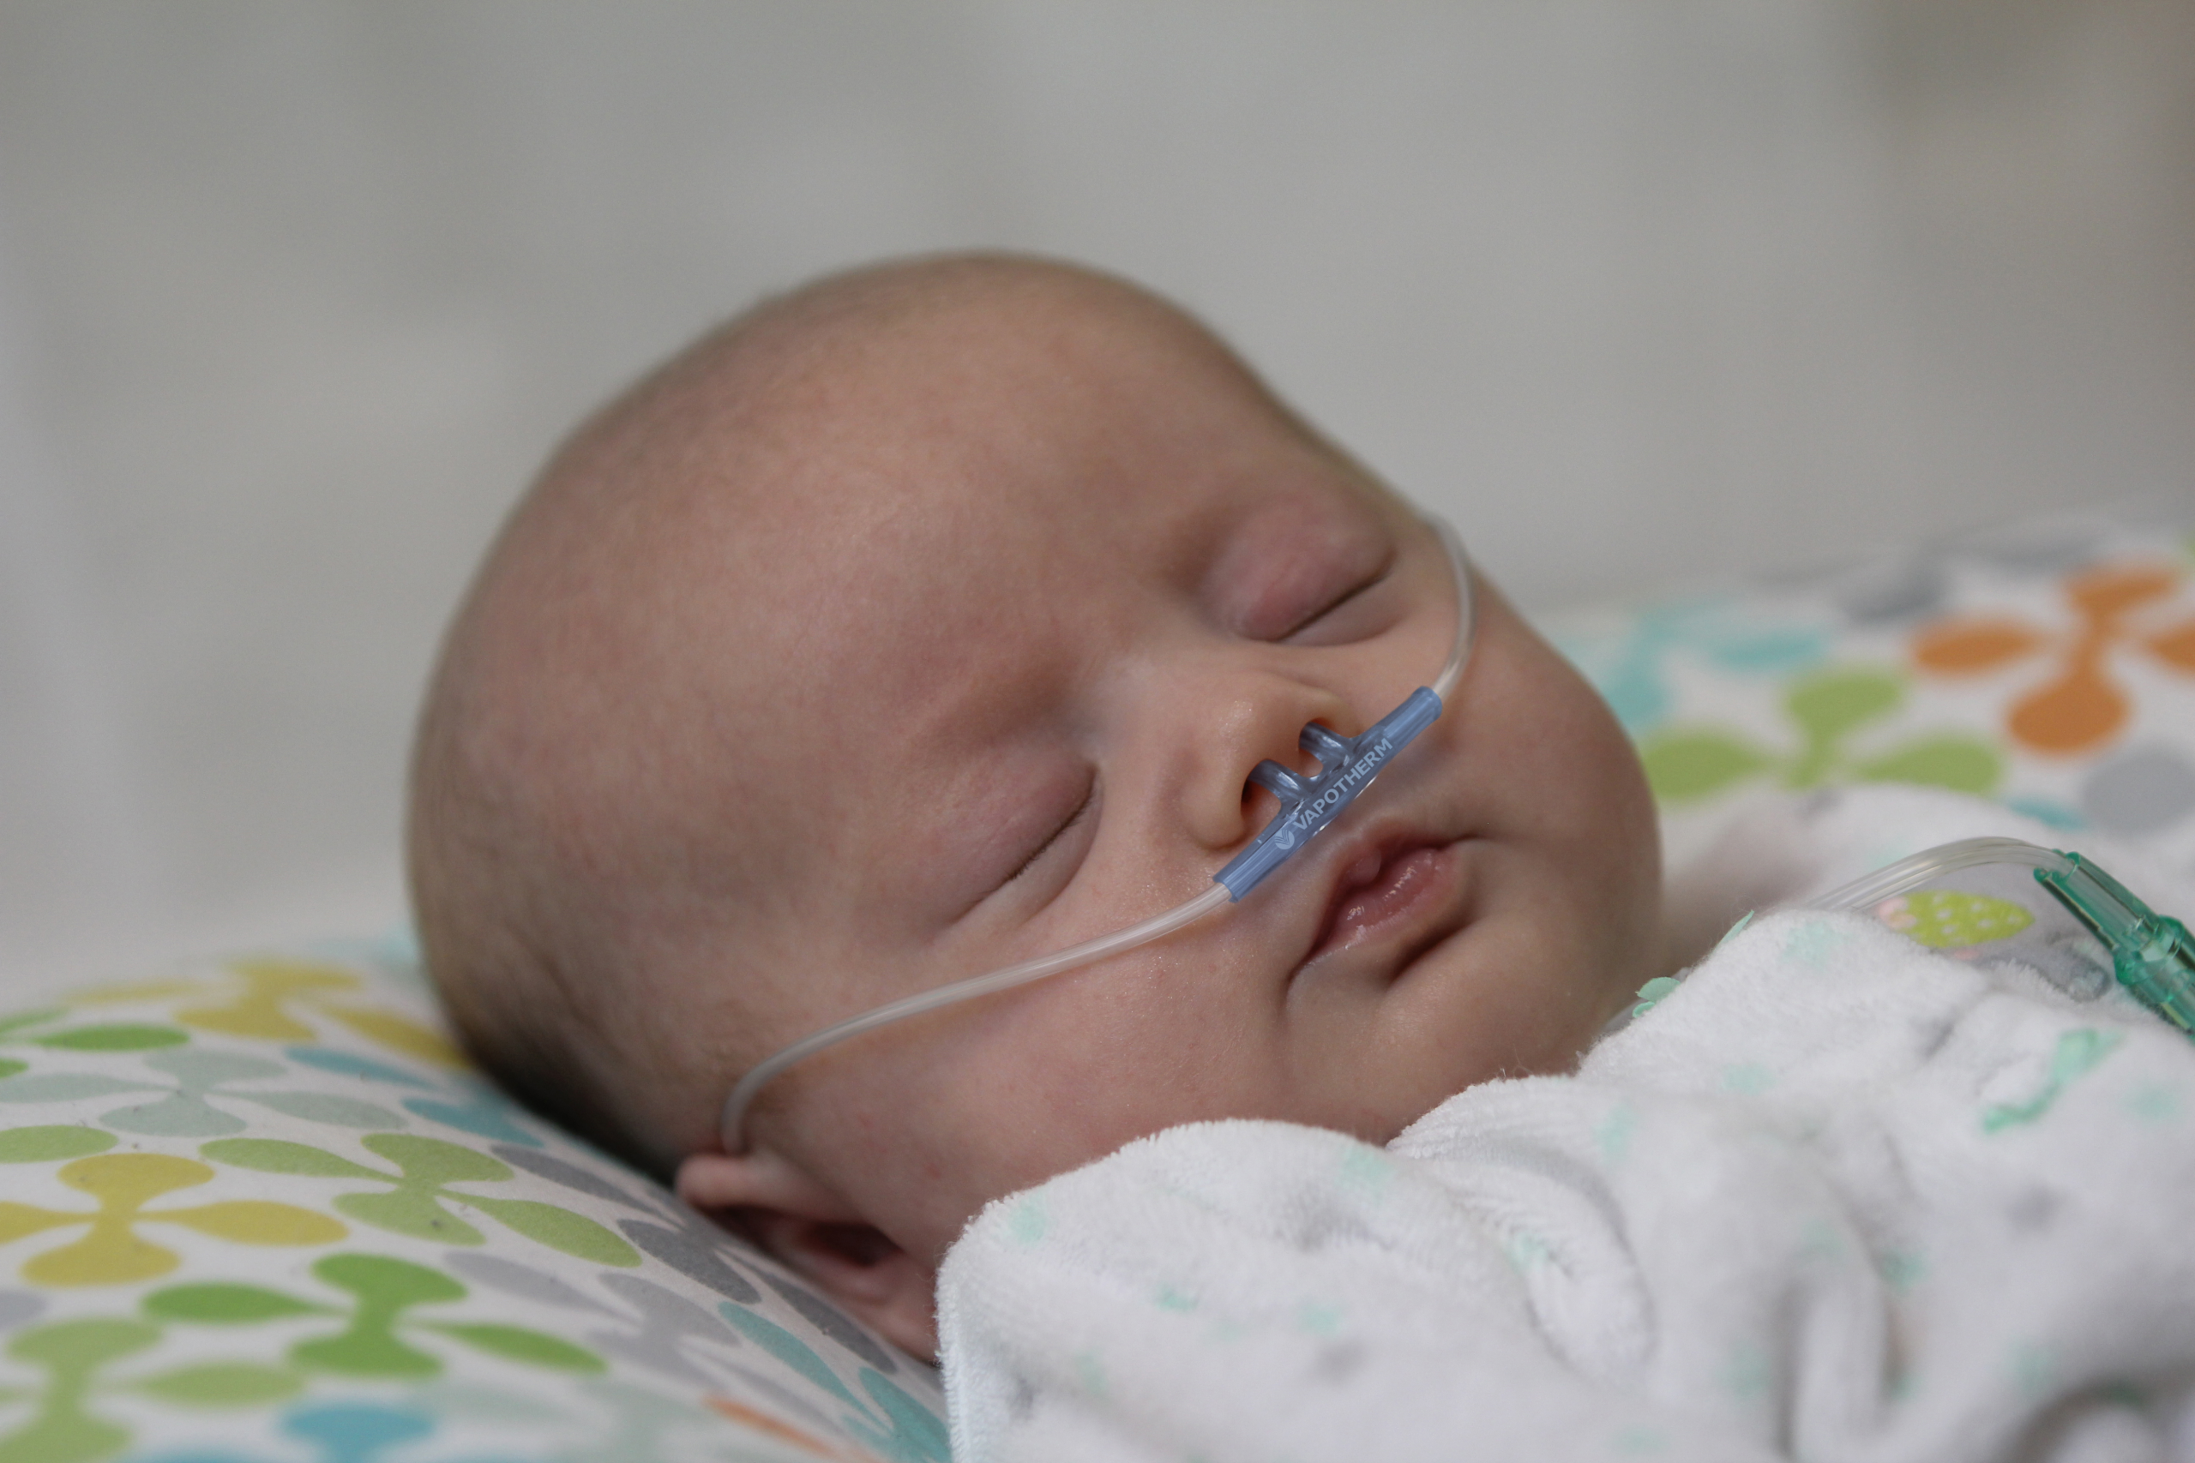
Case #1
A previously healthy 1-month-old female presents in December with 3 days of cough, rhinorrhea, and decreased feeding, now with increased work of breathing.
On exam: febrile, tachypneic (RR 62), oxygen saturation 89% on room air, with nasal flaring, retractions, and diffuse wheezing.
Nasopharyngeal multiplex PCR detects respiratory syncytial virus (RSV).
She is admitted for supportive care, requiring high-flow nasal cannula, and improves over several days without antibiotics.

Slide 4
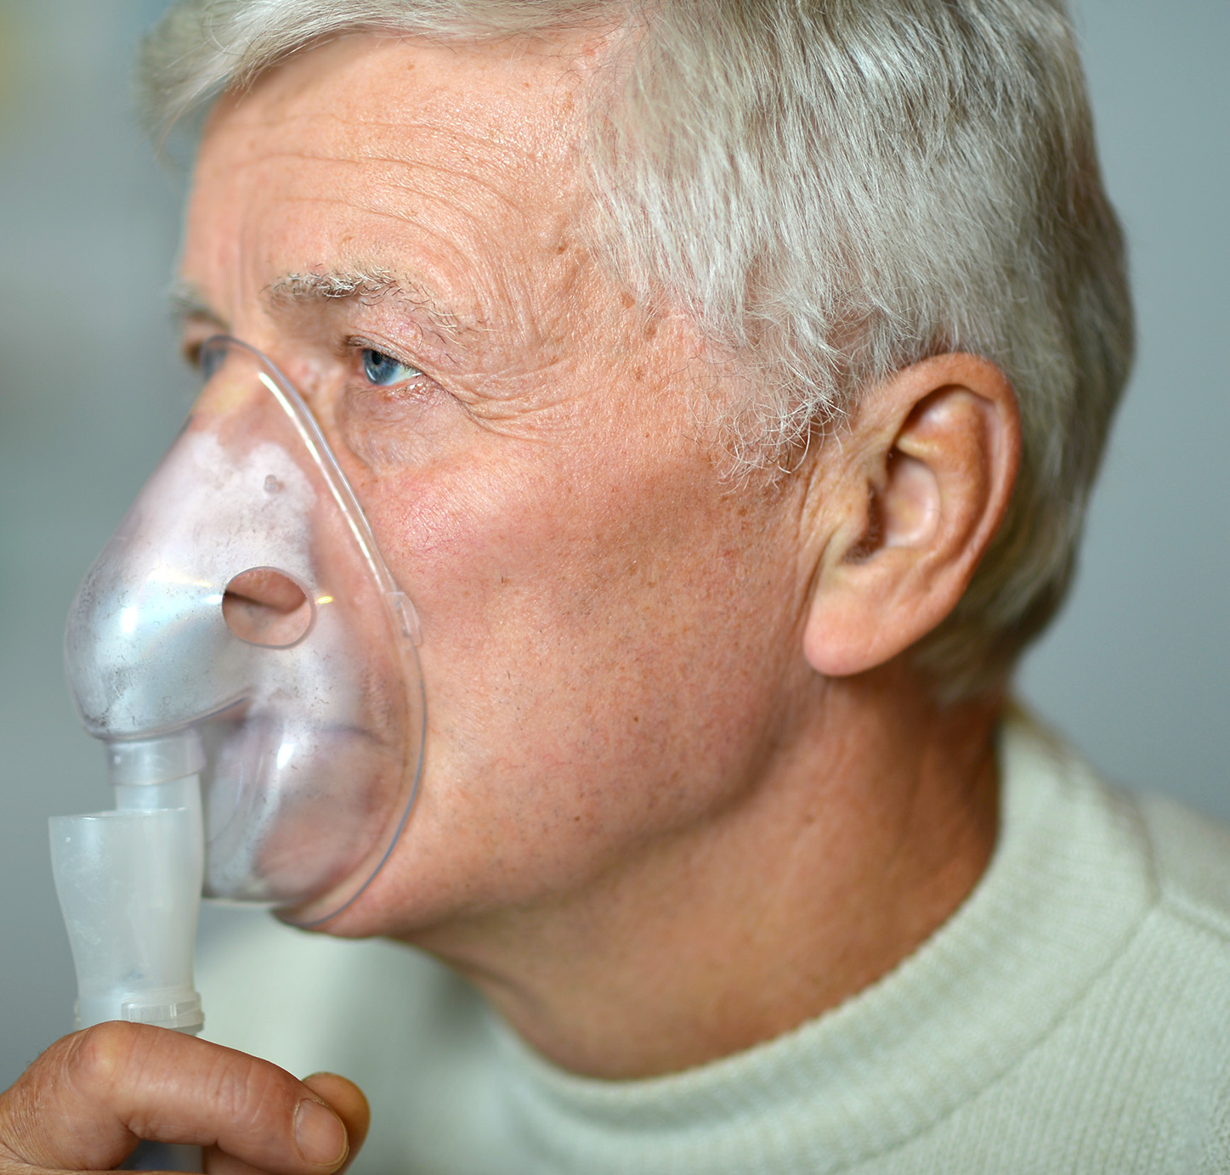
Case #2
A 72-year-old male with COPD and hypertension presents in January with 4 days of cough, dyspnea, and fatigue. He reports worsening shortness of breath and decreased exercise tolerance.
On exam: afebrile, tachypneic, oxygen saturation 90% on room air, with diffuse wheezing and prolonged expiratory phase.
A nasopharyngeal multiplex PCR detects RSV.
He is admitted for hypoxemia and COPD exacerbation, requiring supplemental oxygen and bronchodilator therapy. Antibiotics are discontinued after negative bacterial workup.

Slide 5
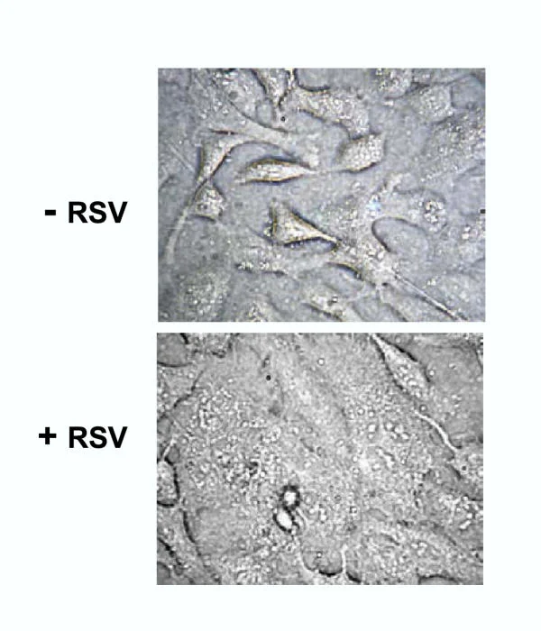
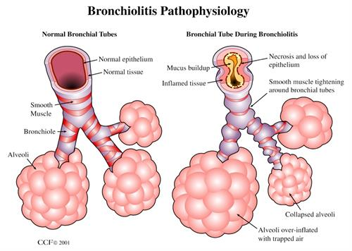
RSV pathophysiology
RSV entry and selective infection
Syncytium Formation
Inflammatory Obstruction
V/Q Mismatch and Air Trapping
Photo Credit: Cleveland Clinic
BMC Microbiol. 2004 PMID: 15256003

Slide 6
Pre-vaccine landscape – Before 2023
Pediatric global burden (2019 estimates):
  33.0 million RSV-associated acute lower respiratory infection episodes in children <5 years
  Leading cause of hospitalization in children <1
    1.4 million hospitalizations (1.0–2.0 million) in infants 0-6 months
  101,400 RSV-attributable deaths (84,500–125,200)
    45,700 deaths (38,400–55,900) in infants 0-6 months
Lancet. 2022. PMID: 35598608

Slide 7
Healthcare utilization due to RSV
2.1 million outpatient visits annually among children under 2 years
132,000 per year for infants, with rates highest among Medicaid-insured infants (55.9 per 1,000 live births)
Mean hospitalization cost in 2019 $21,513
J Infect Dis. 2022 PMID: 35968879
Pediatrics. 2023 PMID: 37357729

Slide 8
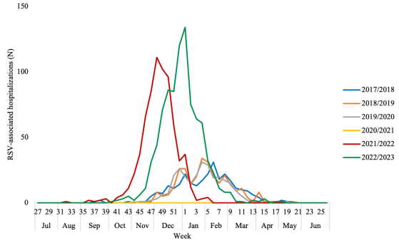
Pre-vaccine landscape – prevalence
Seasonal surge October through April
Overlapping symptoms with influenza and SARS-CoV-2 → clinical diagnosis may be insufficient
Int J Infect Dis. 2024. PMID: 39222708

Slide 9
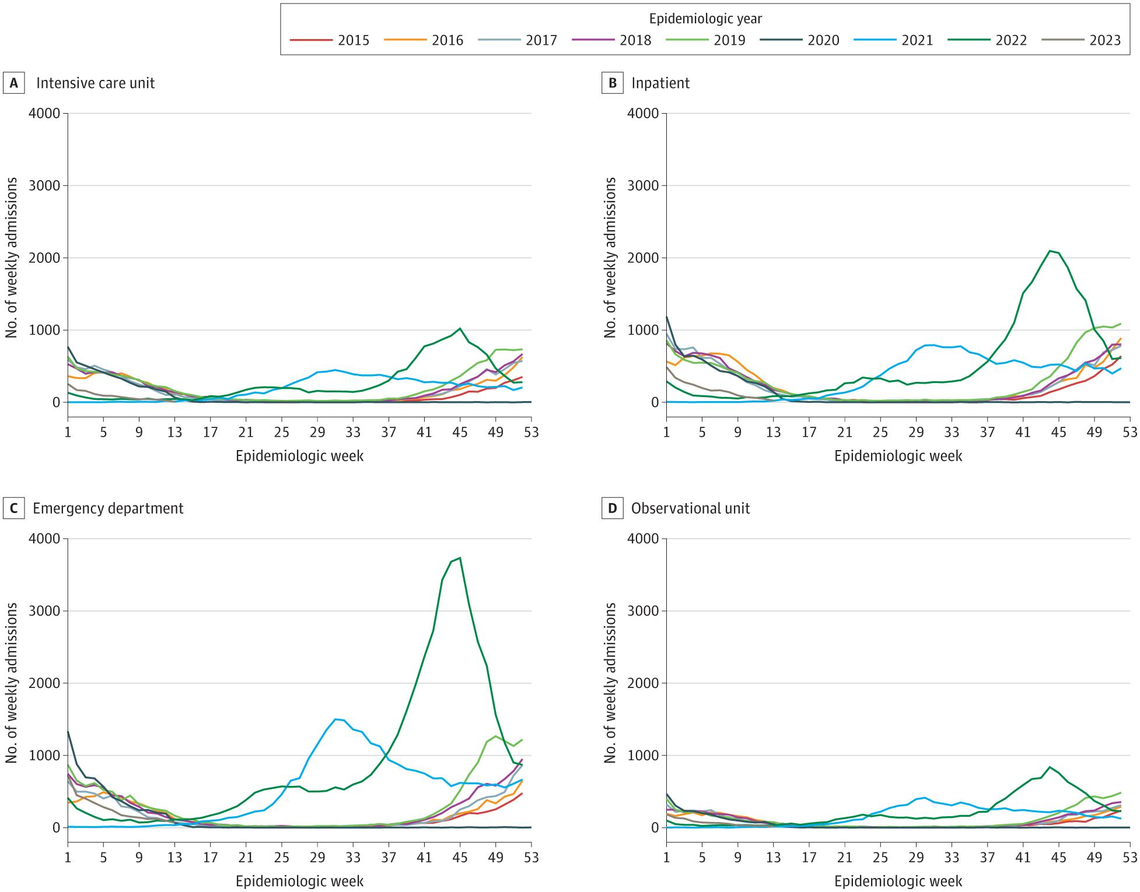
COVID-19 Disruption of RSV seasonality
JAMA Netw Open. 2024 PMID: 38635270

Slide 10
When to test?
Test
Hospitalized patients
Immunocompromised
Infants/children with moderate to severe disease
Unclear diagnosis during respiratory season
Don’t Test
Mild illness
Classic bronchiolitis/healthy infant
Testing that does not change isolation/treatment decisions
Bottom Line: Test only if the result will change management, infection control, or stewardship decisions

Slide 11



Testing approaches
Point-of-Care
Near real-time NAAT
Batch Testing
Reduce unnecessary admission
Anticipatory guidance
Admission decision making
Isolation decisions
Antimicrobial de-escalation
Confirm etiology of fever/respiratory changes
Antimicrobial de-escalation

Slide 12
RSv prevention-
Approaches to prevention
2023
Old Approach
palivizumab
Current Approach
maternal vaccination
long-acting monoclonals
adult vaccines

Slide 13
Pre-2023: palivizumab
Palivizumab (Synagis) was licensed by the FDA in June 1998
Humanized mouse IgG1 monoclonal antibody targeting the RSV fusion protein
Efficacy:
  Impact-RSV trial (1996-1997): 54.7% relative risk reduction in RSV hospitalizations among preterm infants (10.6% placebo vs 4.8% palivizumab, P<0.001)
  Cardiac trial (1998-2002): 45.3% relative risk reduction in infants with hemodynamically significant congenital heart disease (9.7% placebo vs 5.3% palivizumab, P<0.003)
Pediatrics. 2023. PMID: 37357729

Slide 14
Pre-2023 palivizumab
  Core candidate groups (<12 months):
    Premature Infants: Born at ≤28 6/7 weeks of gestation
    Chronic lung disease (CLD): Need for supplemental oxygen and/or respiratory support at ≥36 weeks postmenstrual age
    Congenital Heart disease:
  Special Populations (<12 months)
    Children with anatomic airway defects or neuromuscular disorders
    Children with severe immunodeficiency
  2nd year prophylaxis (12-24 months)
    CLD infants who continue to require supplemental O2 or chronic systemic corticosteroids
Pediatrics. 2023. PMID: 37357729

Slide 15

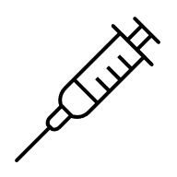


Pre-2023 palivizumab
  Major Limitations
    Cost
    Monthly injections through RSV season (up to 5 months)
    Restricted eligibility
    Limited population impact
Pediatrics. 2023. PMID: 37357729

Slide 16
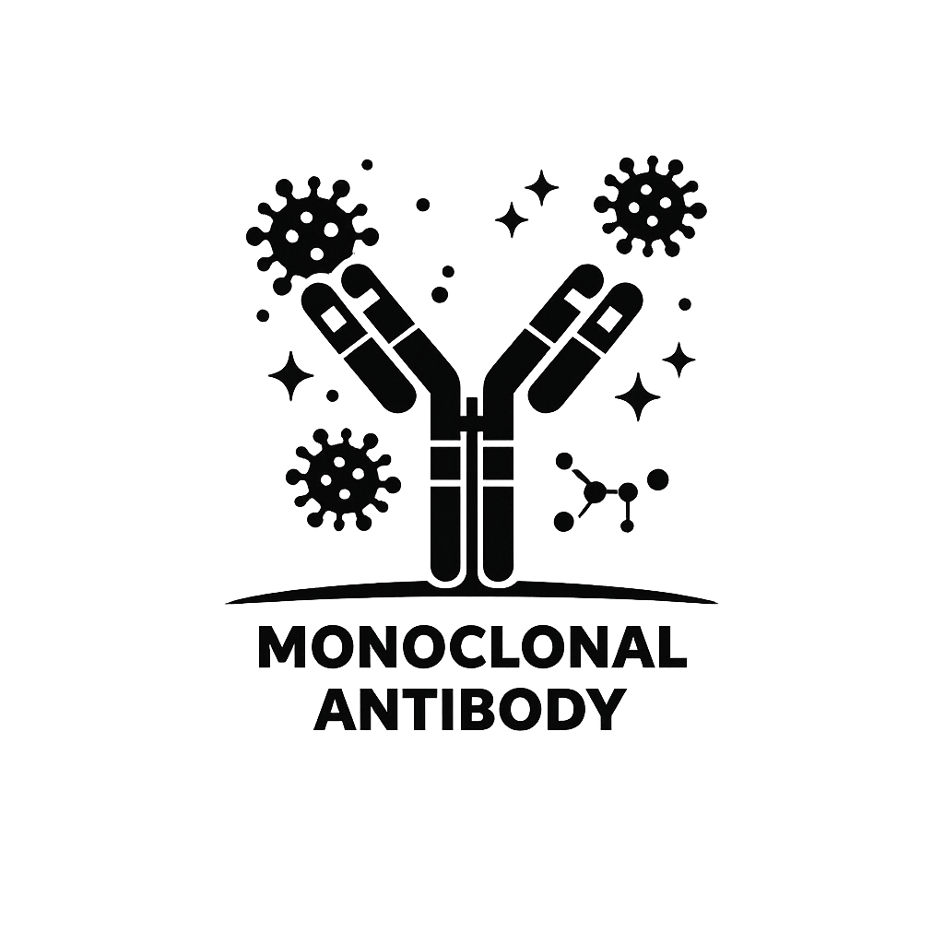
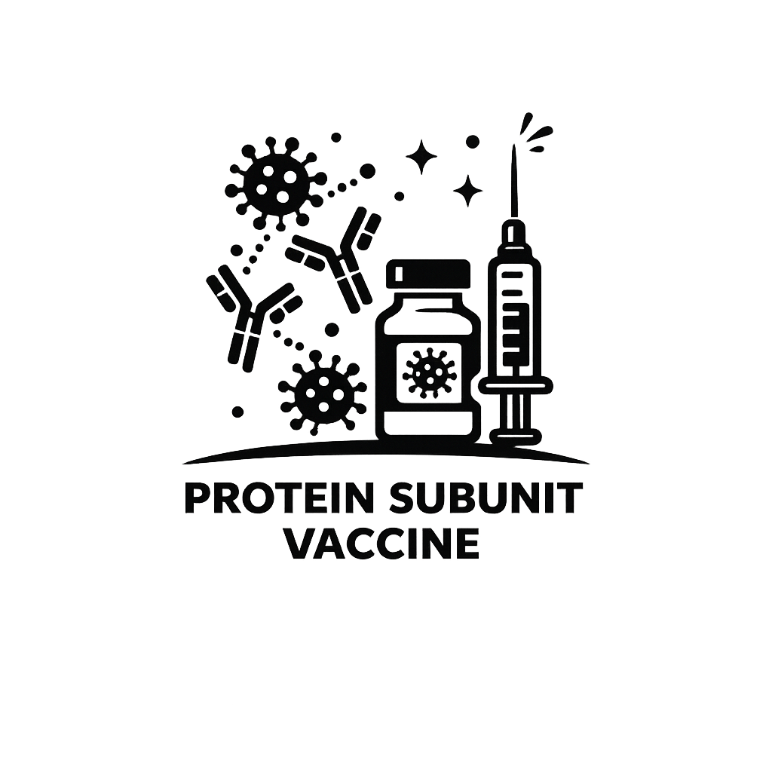
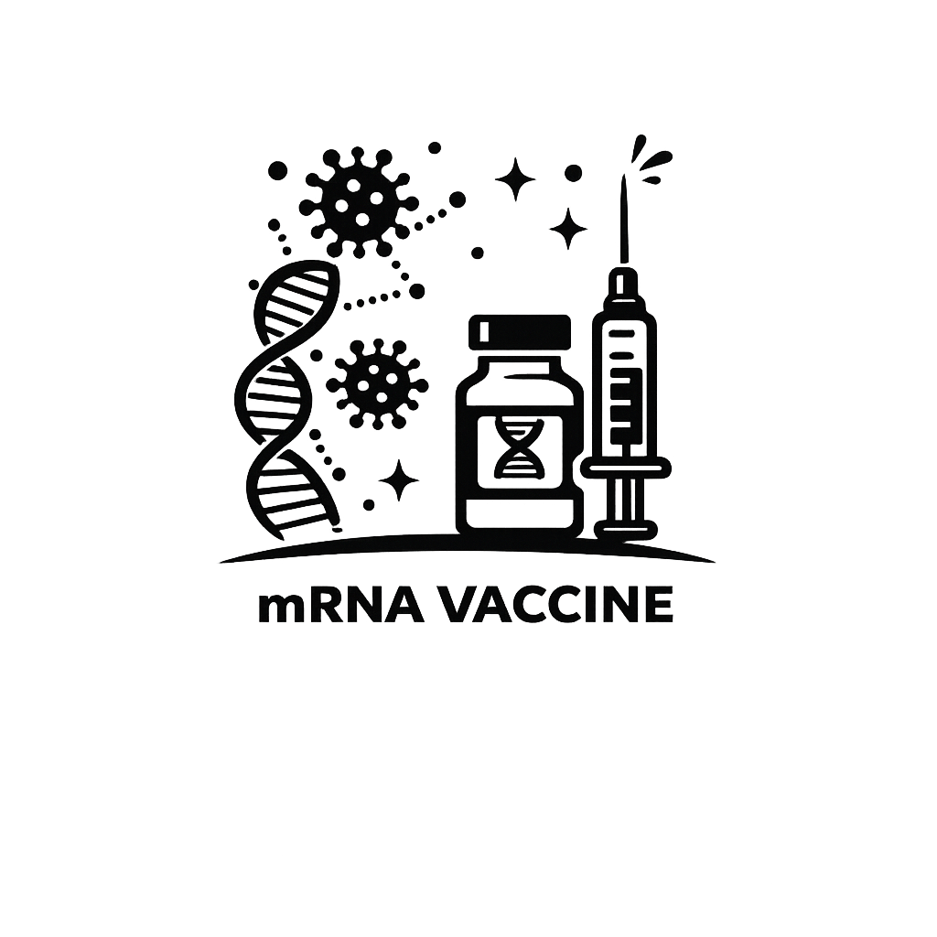
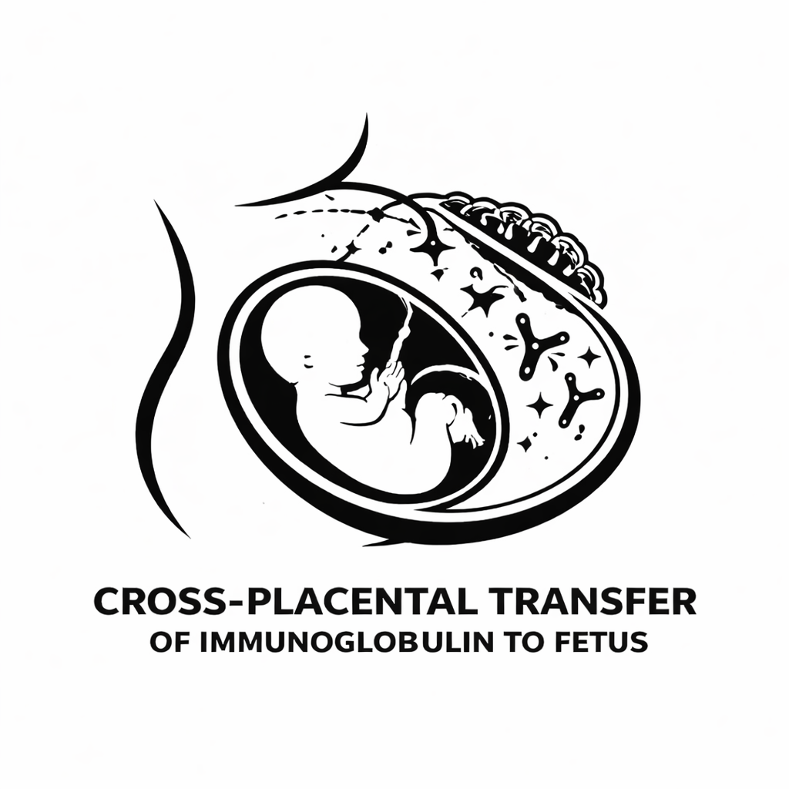
Current vaccine landscape
Infants/Toddlers
Pregnant Women
Older Adults
RSVPreF (Abrysvo)
RSVPreF3 (ArexvyY)
MResvia
nirsevimab (Beyfortus)
clesrovimab (Enflonsia)
RSVPreF (Abrysvo)
Prevent disease in
high risk adults
Prevent disease in infants

Slide 17
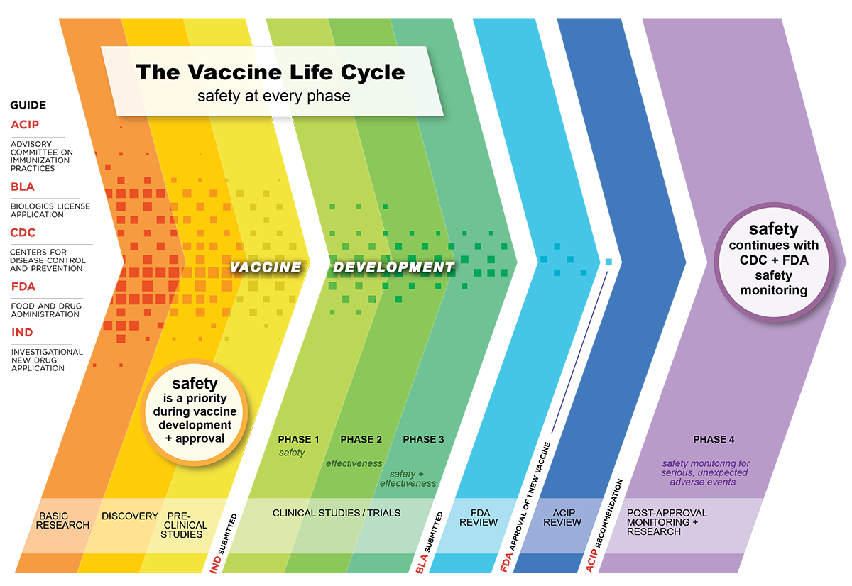
Credit: CDC

Slide 18
Protein subunit vaccine technology

Slide 19
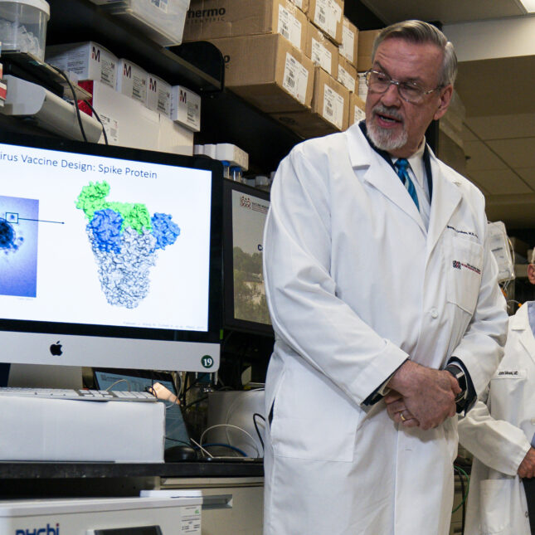
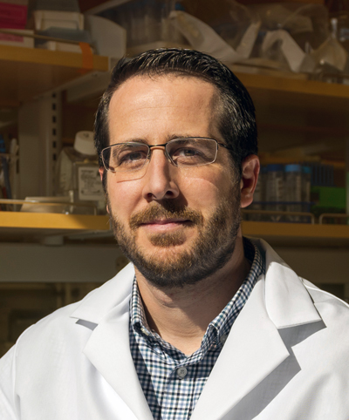

RSV vaccine development timeline
Scientific Breakthrough
2018-2023
GSK and Pfizer clinic trials- phase 1 and 2 shows massive antibody production/good safety profile
1966-1967
Formalin-inactivated RSV trial fails
2000’s
RSV Fusion (F) protein studied
2013
Drs. McLellan and Graham lock F protein in pre-fusion (lollipop) state (DS-Cav1)
2023
Prefusion F protein subunit and mRNA vaccines approved for elderly and pregnant women
1970-1990’s
Dark Age for RSV vaccine development

Slide 20
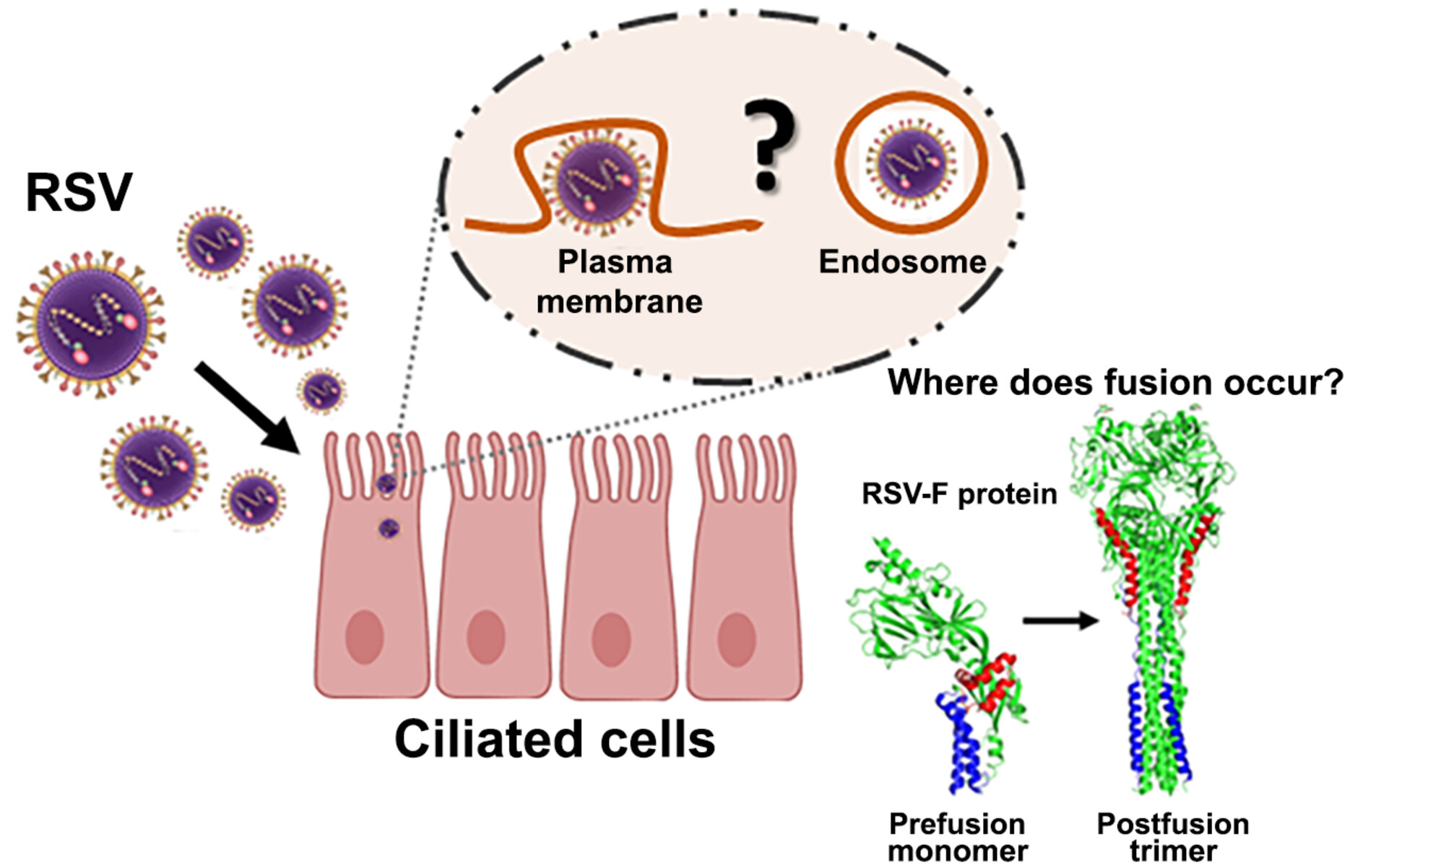
How rsv enters host cells
Attachment (G protein)
Pre-fusion (pre-F)
Fusion
Mol Microbiol. 2023 PMID: 37537859

Slide 21
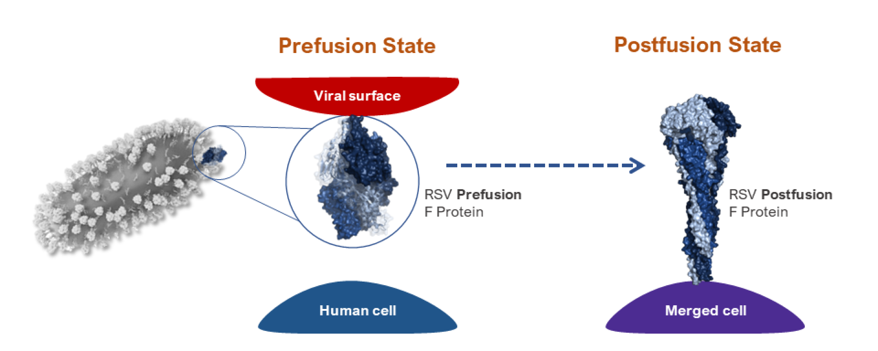
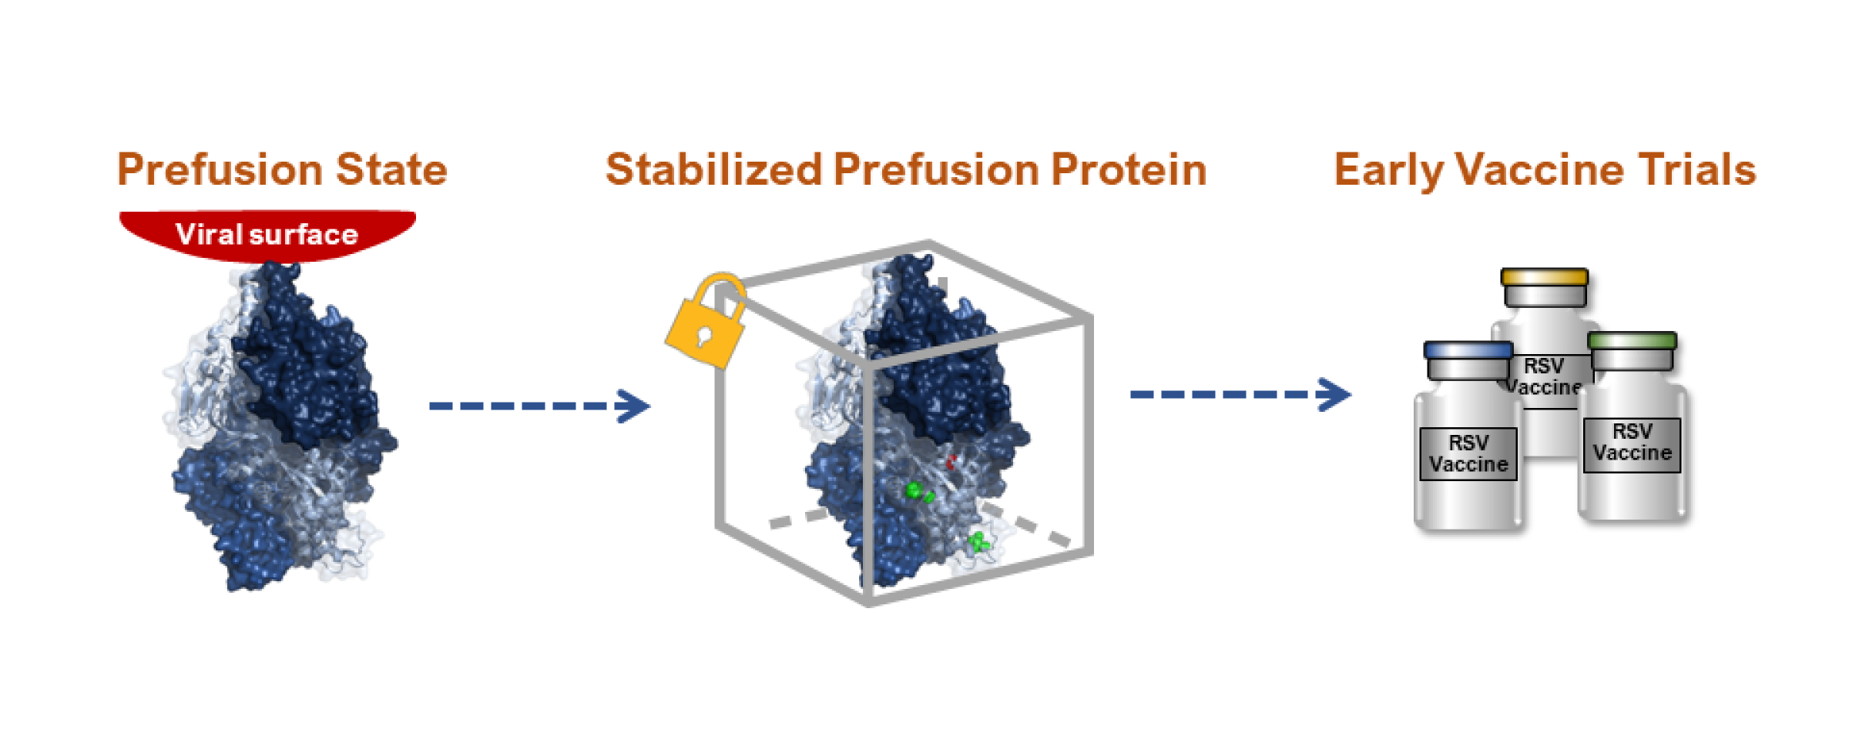
Vaccine technology- protein subunit
Stabilizing mutations keep the F protein in prefusion state. Purified manufactured. No viral replication necessary (excellent safety profile)
F protein in prefusion (lollipop configuration) state converts to more stable postfusion state. Highly potent neutralizing epitopes (site Ø or site V) are in the prefusion state
Credit: National Institute of Allergy and Infectious Diseases (NIAID)

Slide 22
Rsv PROTEIN SUBUNIT VACCINE COMPARISON
Feature | Arexvy (RSVPreF3) | Abrysvo (RSVpreF)
Manufacturer | GSK | Pfizer
Technology | Adjuvanted Protein Subunit | Bivalent Protein Subunit (Non-adjuvanted)
Antigen Type | Recombinant RSV-A Pre-fusion F protein | Recombinant RSV-A & RSV-B Pre-fusion F proteins
Adjuvant | AS01E (boosts immune response) | None
Approved: Older Adults | Ages 60+ (All) | Ages 60+ (All)
Approved: 50–59 Adults | High-risk only | High-risk only
Approved: 18–49 Adults | High-risk only (Approved March 2026) | High-risk only (Approved Oct 2024)
Approved: Pregnancy | No | Yes (Weeks 32–36 of pregnancy)
Efficacy (Severe LRTD) | ~94.1% (Initial Season) | ~88.9% (Initial Season)
Efficacy (Total LRTD) | ~82.6% | ~66.7%

Slide 23
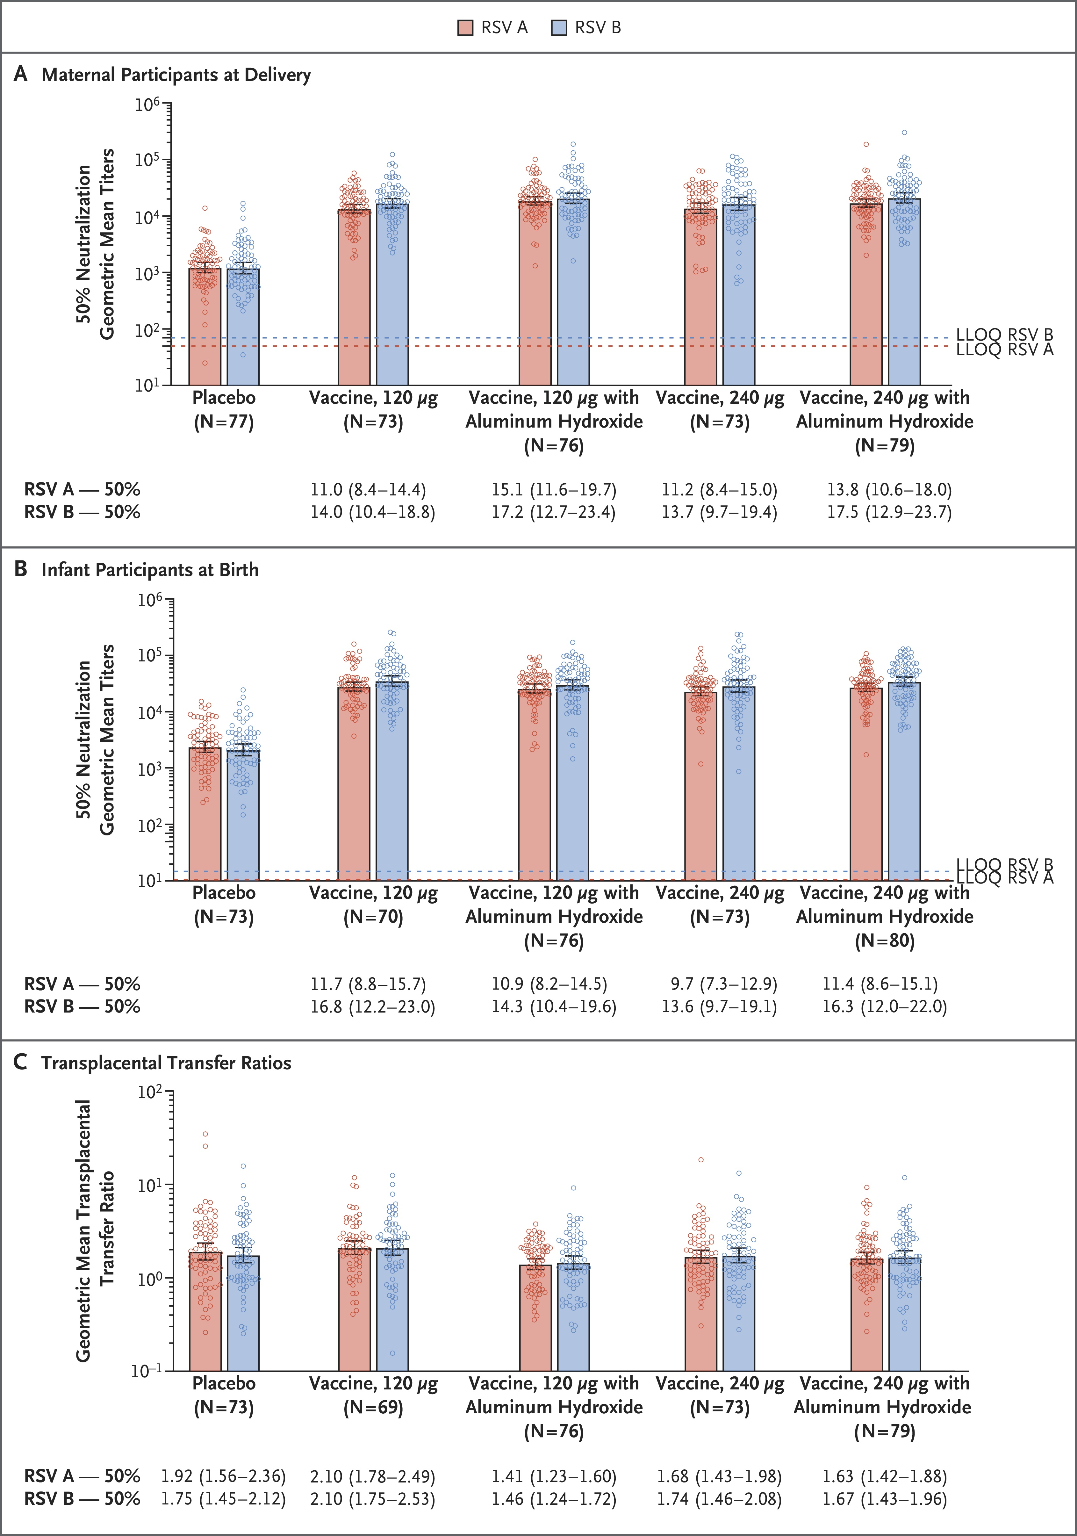
Rsvpref3 in pregnancy trial
N Engl J Med. 2022. PMID: 35476650

Slide 24
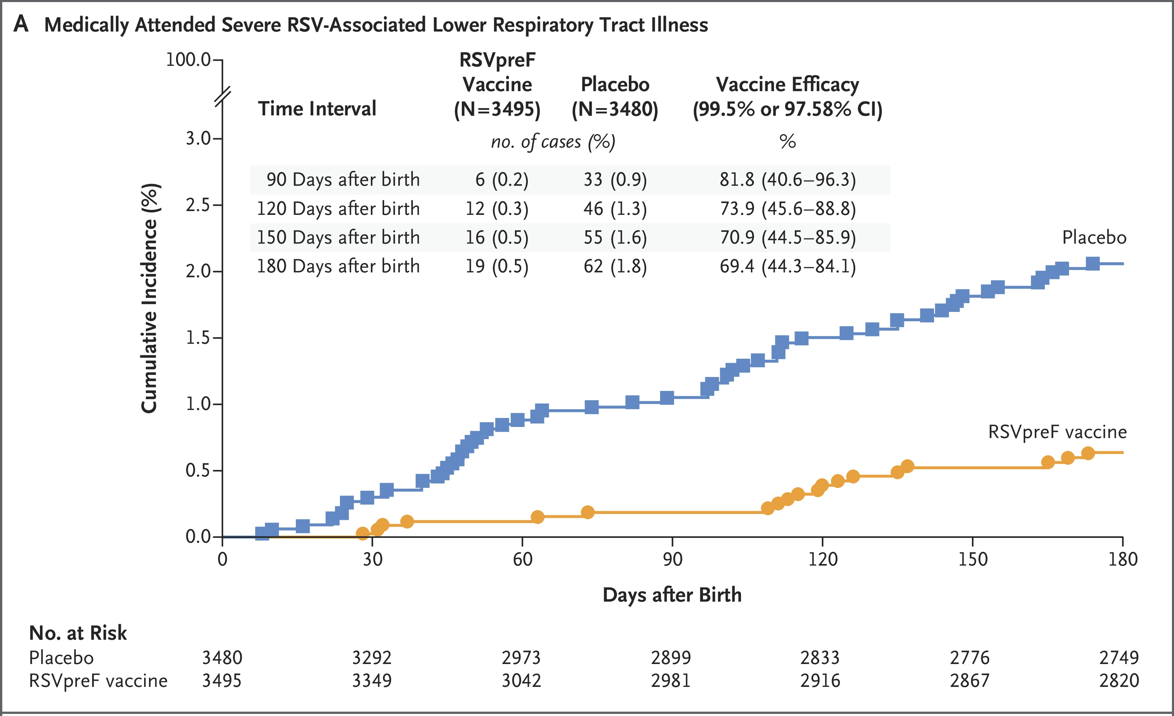
Rsvpref (matisse) in pregnancy trial
N Engl J Med. 2023. PMID: 37703562

Slide 25
MRNa VACCINE technology

Slide 26
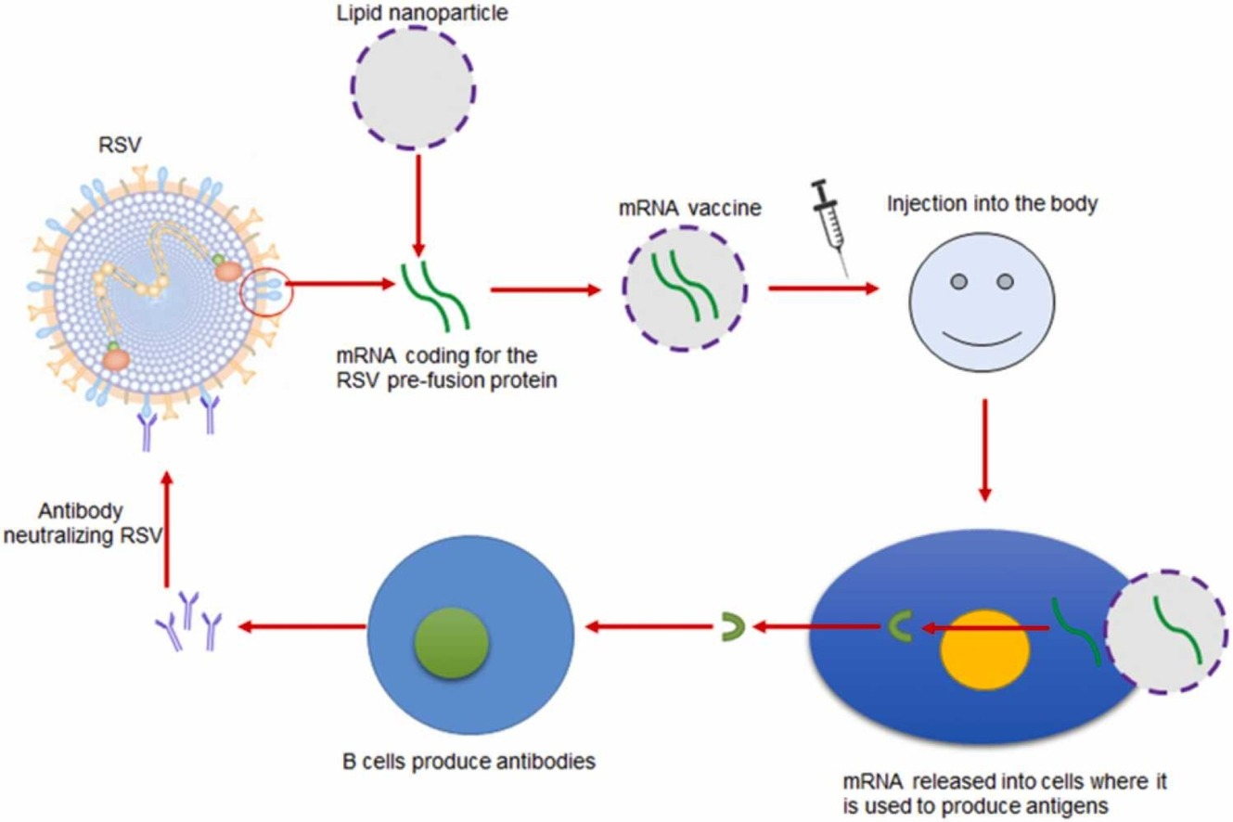
Vaccine technology- Mrna vaccine
Cytokine Growth Factor Rev. 2022. PMID: 36280532

Slide 27
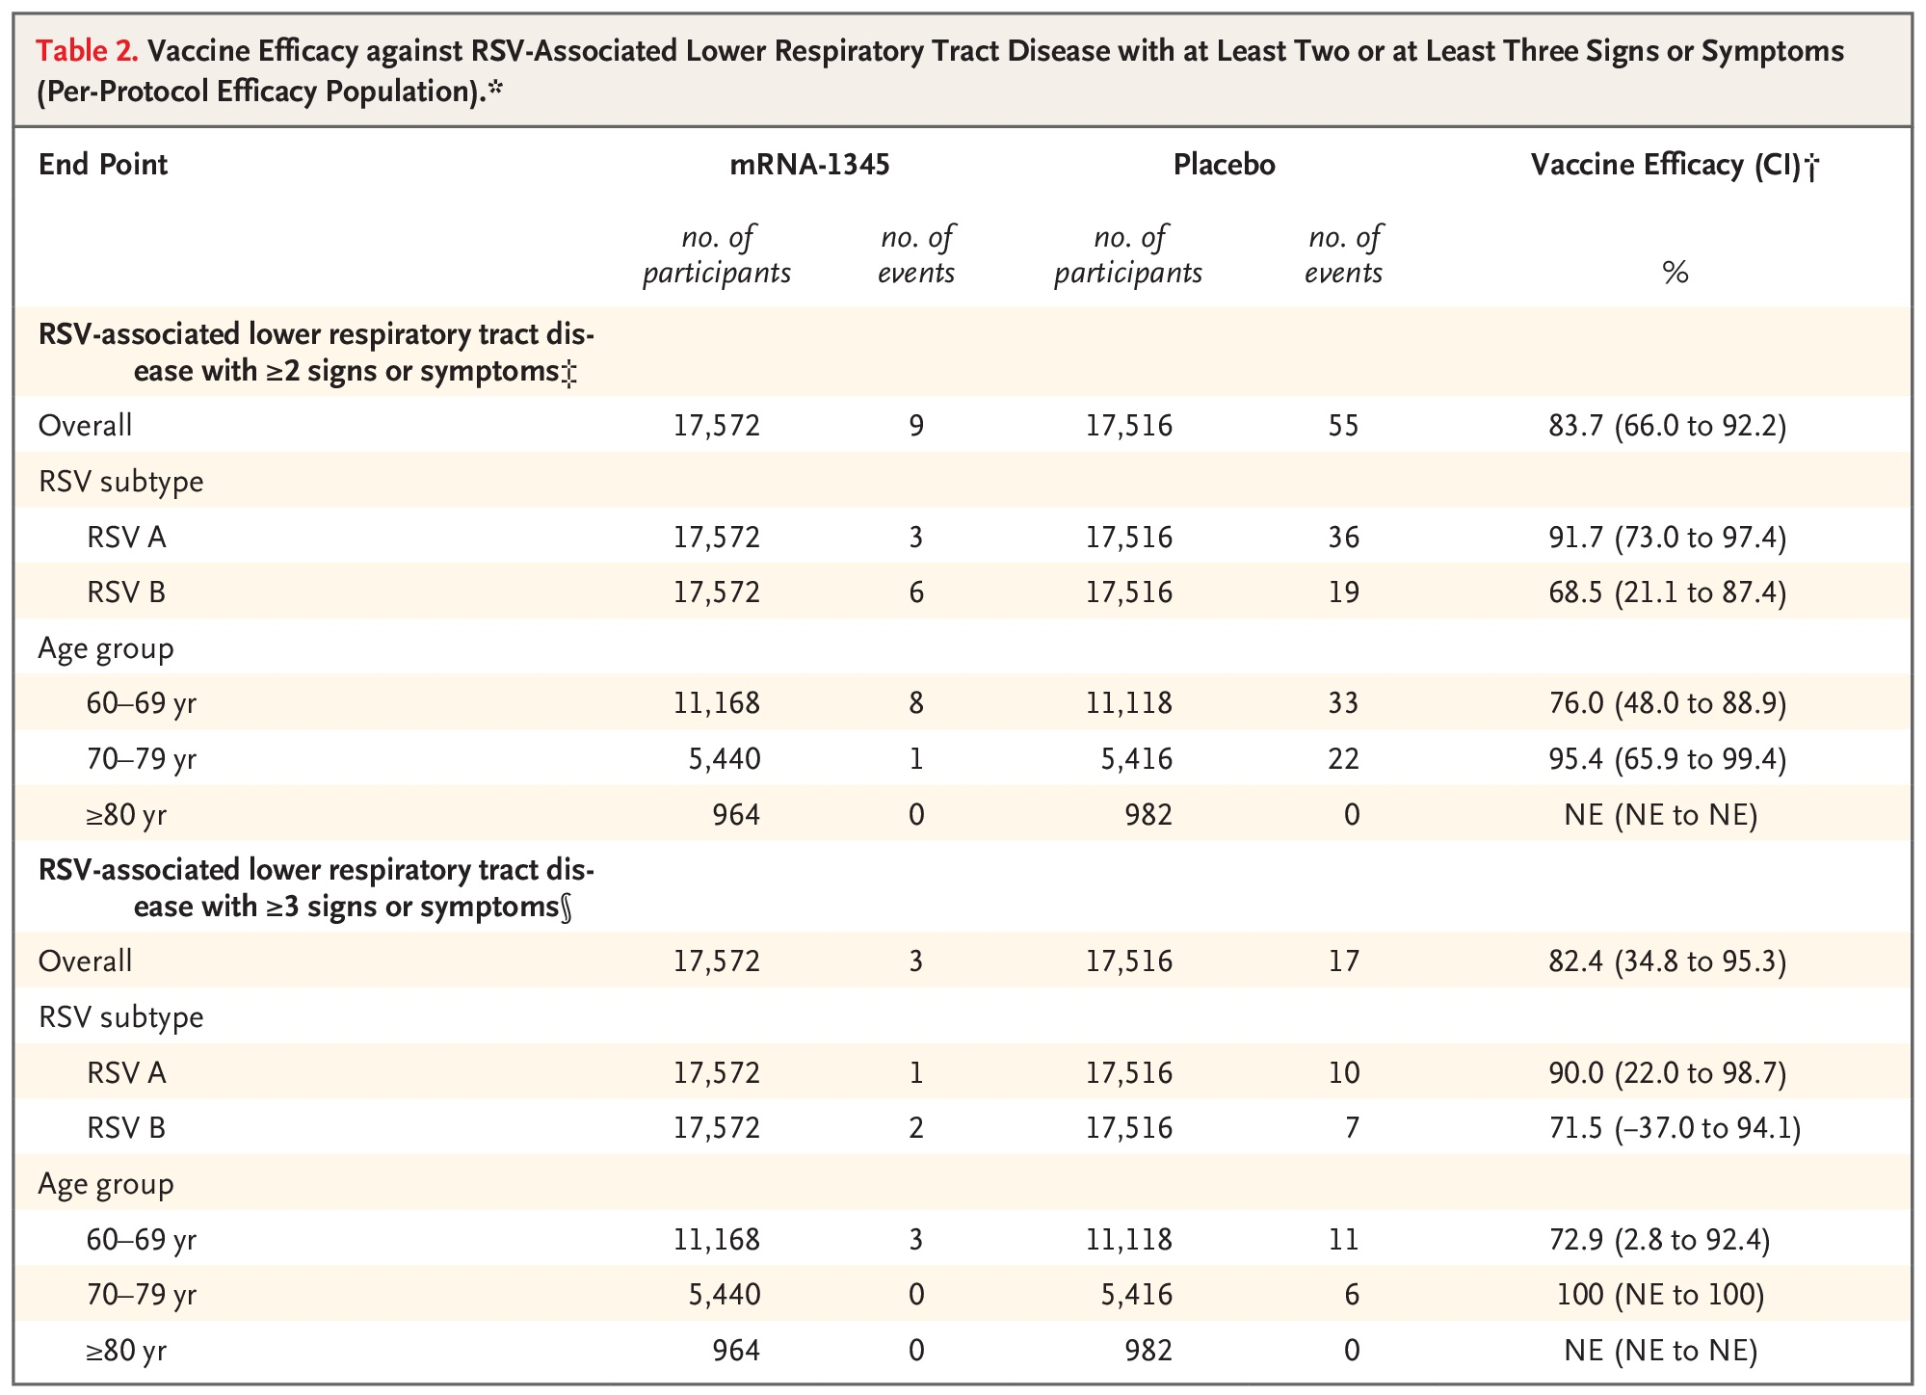
MRNA VACCINE TRIAL
N Engl J Med. 2023 PMID: 38091530

Slide 28
Monoclonal antibody technology

Slide 29
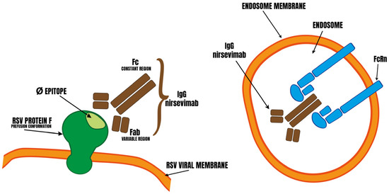
Vaccine technology- monoclonals antibodies
Step 1:
nirsevimab binds strongly to epitope Ø of the RSV fusion protein
Step 2: Fc fragment has high affinity for FcRn, protecting it from degradation in the the endosome
Curr Issues Mol Biol. 2024 PMID: 39329969

Slide 30
RSV Prevention- infants/toddlers
Feature | Beyfortus (nirsevimab) | Enflonsia (clesrovimab)
Manufacturer | Sanofi / AstraZeneca | Merck
Dosing Logic | Weight-based | Fixed-dose
Target Population | All infants <8 months; High-risk children 8–19 mths* | All infants <8 months
Duration | At least 5 months (covers 1 season) | At least 5 months (covers 1 season)
Binding Site | Targets Site Ø on the RSV F-protein | Targets Site IV on the RSV F-protein
2nd Season Use | FDA-approved for high-risk toddlers in their 2nd season | Not currently indicated for 2nd season use (as of early 2026)

Slide 31
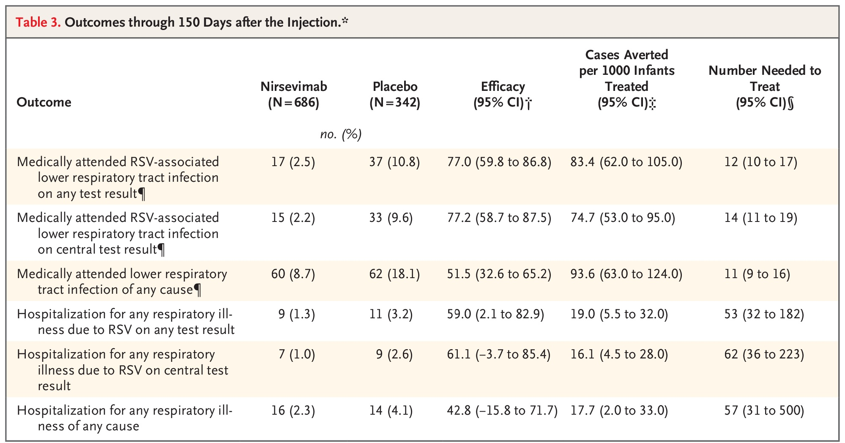
Nirsevimab (melody) trial
N Engl J Med. 2023 PMID: 38091530

Slide 32
Landscape of rsv post- vaccination and neutralizing antibodies

Slide 33
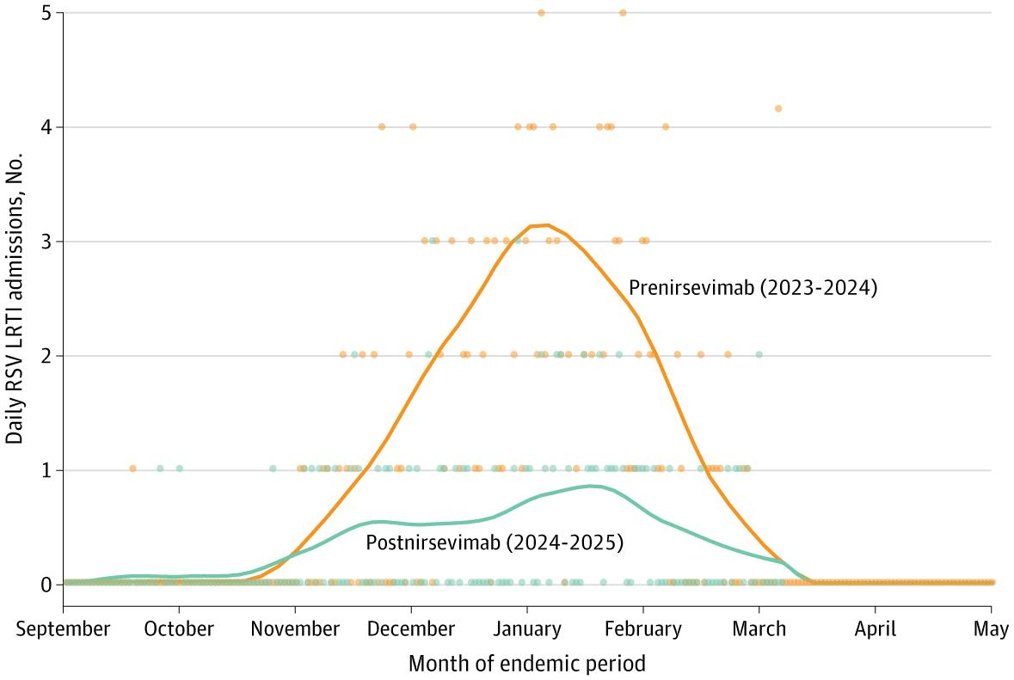
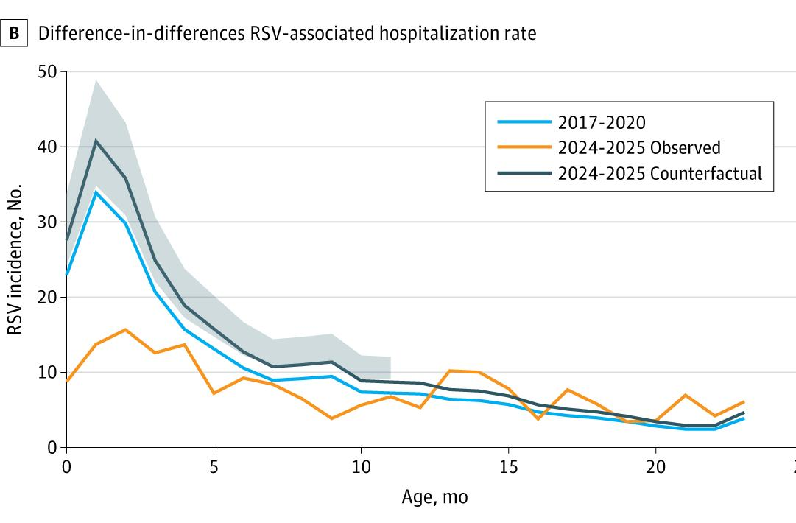
Hospitalizations Postnirsevimab
JAMA Netw Open. 2025. PMID: 41264267
JAMA Pediatr. 2026. PMID: 41428480

Slide 34
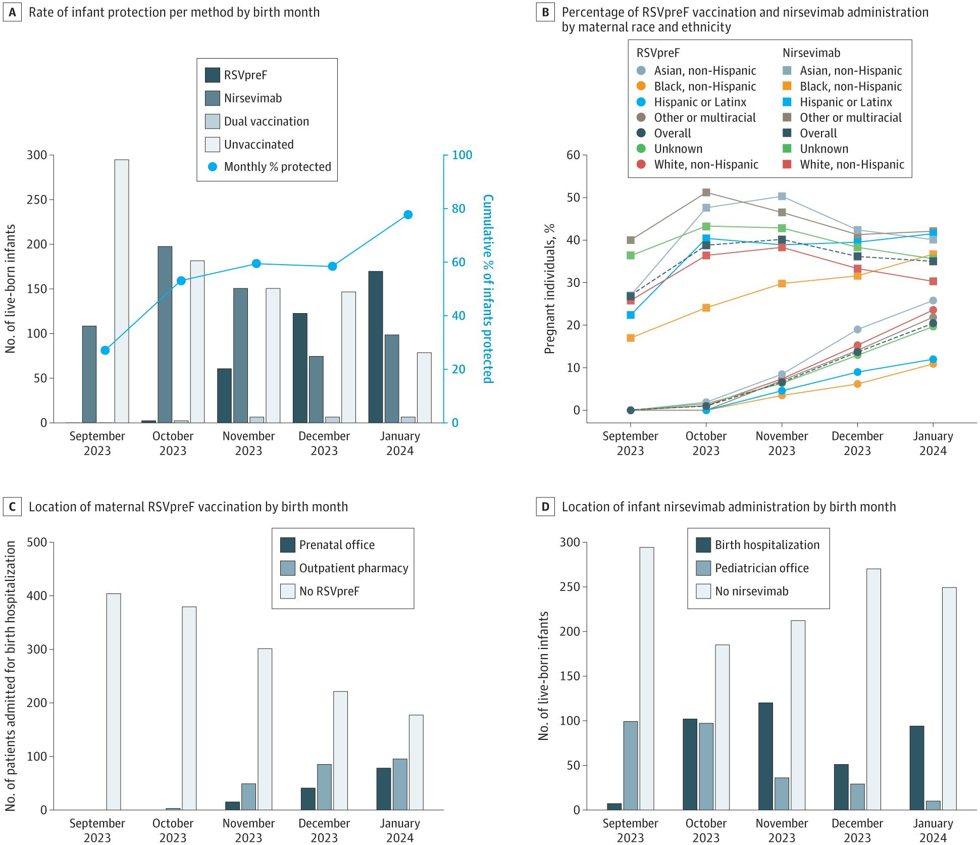
Rsv immunization coverage and uptake
JAMA Netw Open. 2025. PMID: 39969883

Slide 35
Rsv immunization coverage and uptake
JAMA Netw Open. 2025. PMID: 39969883

Slide 36
Implementation barriers
Provider recommendation gaps
Lack of workflow integration
Insurance and reimbursement gaps
Perceived safety concerns of new vaccines

Slide 37
Global access challenges
Single-dose formulation, cold chain requirements not suitable for low- and middle-income countries
Lack of trial data for populations with high HIV and malaria prevalence
Year-round RSV circulation requires different implementation strategies
Regulatory delays and pricing concerns

Slide 38
RSV vaccine recommendations

Slide 39
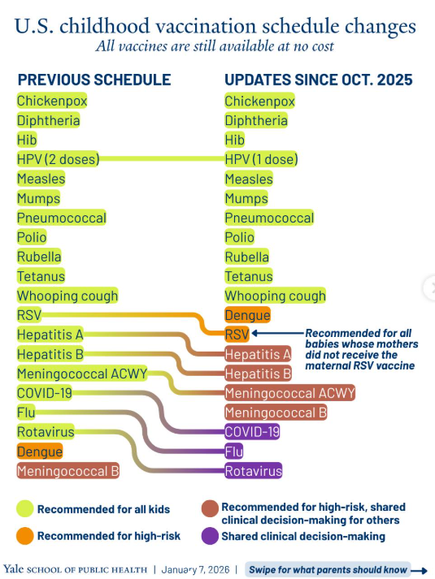
Updated CDC recommendations

Slide 40
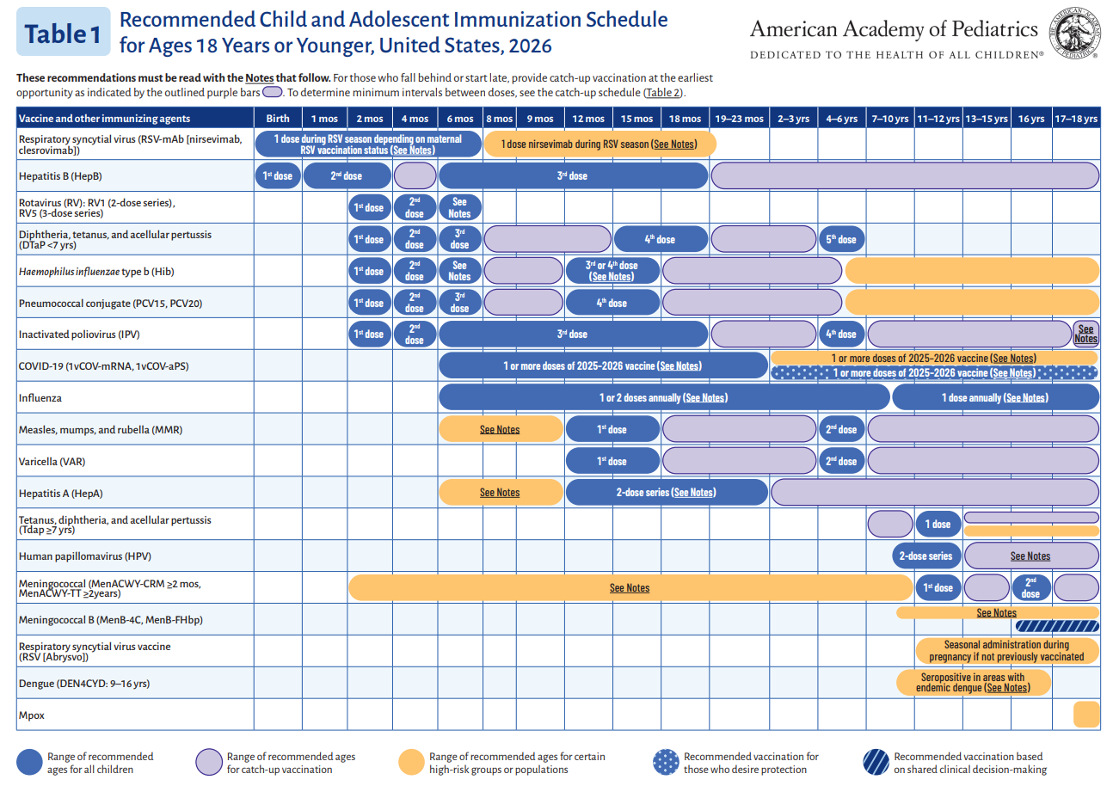

Slide 41
Summary
RSV burden is highest in young infants
Pre-2023 prevention (palivizumab) was effective but limited
Prefusion F protein is the key scientific breakthrough
Real-world data show reduced RSV hospitalizations with current vaccine landscap
Impact depends on uptake, access, and equitable implementation

Slide 42
Questions?

