Slide 1

Dentist-Scientists in DC:
NSRG-MRSP Info and
Alumni Panel

Slide 2
Overview:
MRSP Information
Alumni Panel introduction
Q/A session
Closing Remarks

Slide 3


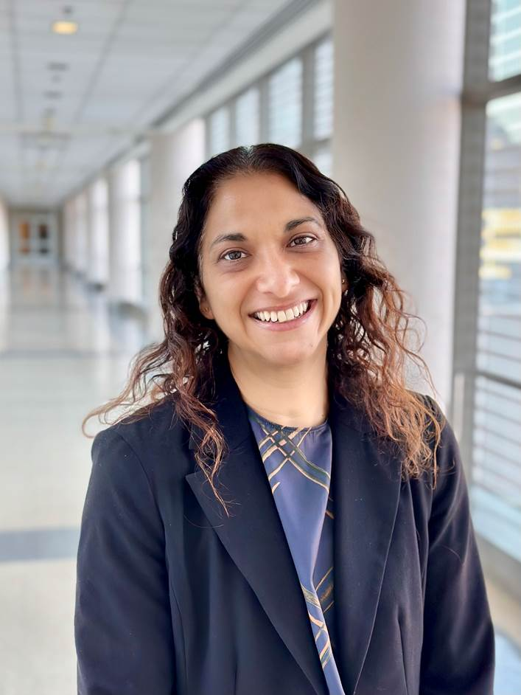
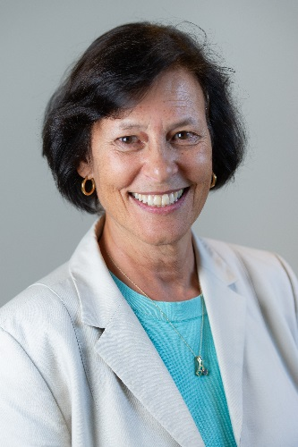
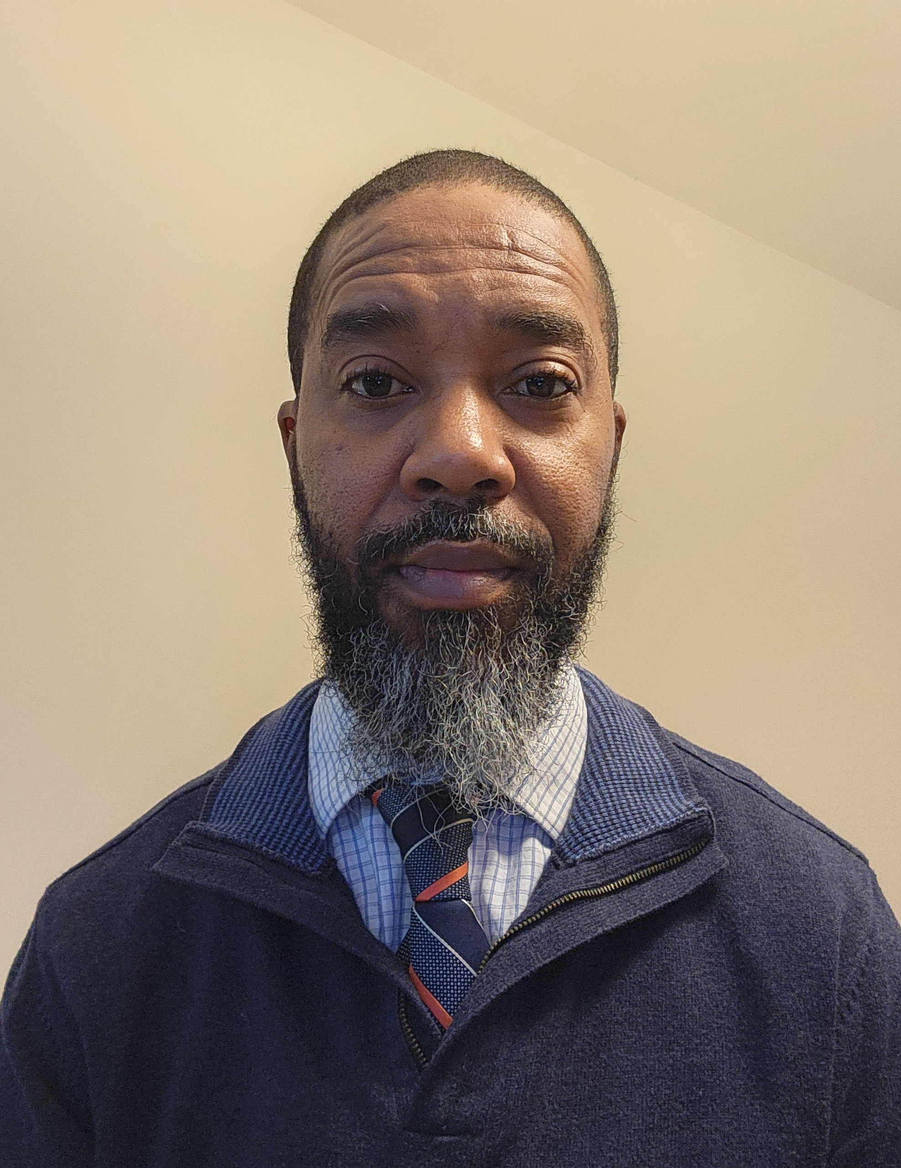

Medical Research Scholars Program
National Institutes of Health
Office of Clinical Research Training and Medical Education
NIH Clinical Center
Dina Parekh, M.D.
Director
Susan Leitman, M.D.
Academic Director
Kenny Williams
Administrator

Slide 4
NIH-Funded Research Workforce
Source: NIH IMPAC, Data produced by NIDCR Office of Science Policy and Analysis.
Notes:
Data source: QVR (IMPACII)
Inclusion criteria:
All NIH ICs, competing projects only, RPG Equivalent programs only: R00, R01, R03, R15, R16, R21, R33, R34, R35, R36, R37, R50, R56, R61, RC1, RC2, RC3, RC4, RF1, RL1, RL2, RL9, P01, P42, PM1, PN1, RM1, UA5, UC1, UC2, UC3, UC4, UC7, UF1, UG3, UH2, UH3, UH5, UM1, UM2, U01, U19, U34, U3R, DP1, DP2, DP3, DP4, DP5.
Talk about leadership roles. . . .
*Degree information is not mutually exclusive. If a PI has multiple degrees they will be counted more than once.

Slide 5
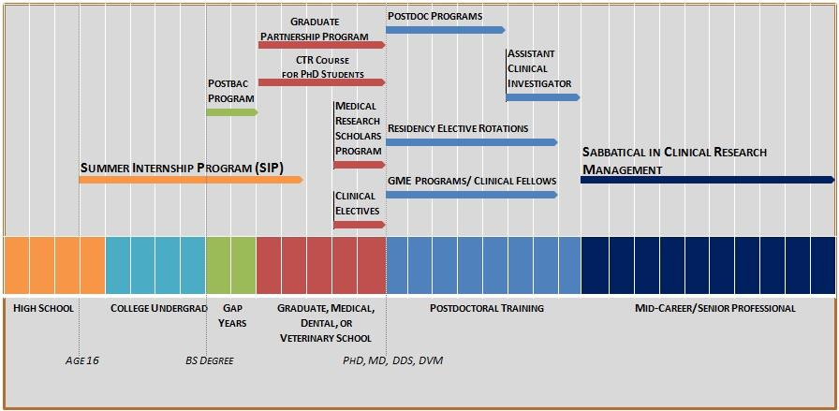
NIH Biomedical Research Pipeline

Slide 6
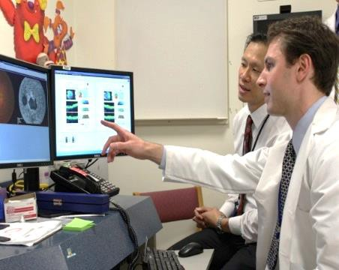
NIH Medical Research Scholars Program
“Not a research program… but a career development program for students heading toward careers in biomedical research that is centered around a robust investigation experience”

Slide 7
NIH Medical Research Scholars Program
Comprehensive year-long residential research program
U.S. medical, dental, and veterinary students
  after 2nd, 3rd, or 4th year
Co-sponsored by NIH and private partners
Mentored basic, translational, or clinical research projects
Any of the 27 Institutes or Centers at NIH-Bethesda or satellite campuses

Slide 8
’23-’24 Class Profile
The premier pre-doctoral training program, shaping the future of health by inspiring careers in biomedical research as clinician-scientists
Class size
  52 Scholars
Gender
  29 women (56%)
  23 men (44%)
Diversity
9 (17%) URM

Slide 9
NIH MRSP Scholar Benefit Package
12-month stipend (~$50,400)
Relocation expenses to and from Bethesda
On/Off-Campus housing options
Domestic conference travel allowance
Health insurance
Personal education fund for scientific courses and textbooks

Slide 10
2024-2025 NIH Medical Research Scholars Program Timetable
Date | Event
October 1 | Application Opened
January 5, 5PM ET | Application and References Deadline (applications must be complete)
Mid February | Notification of Selection for Interview
March 5 and 6 | MRSP Interviews (virtual)
March 15 | Notification of Selection to Participate
March 22 | Deadline to Accept Offer
April 19 | Pre-Arrival Visit for 2024-2025 Scholars
July | Scholars arrive at NIH to begin their year (several arrival dates offered to accommodate home school schedules)

Slide 11
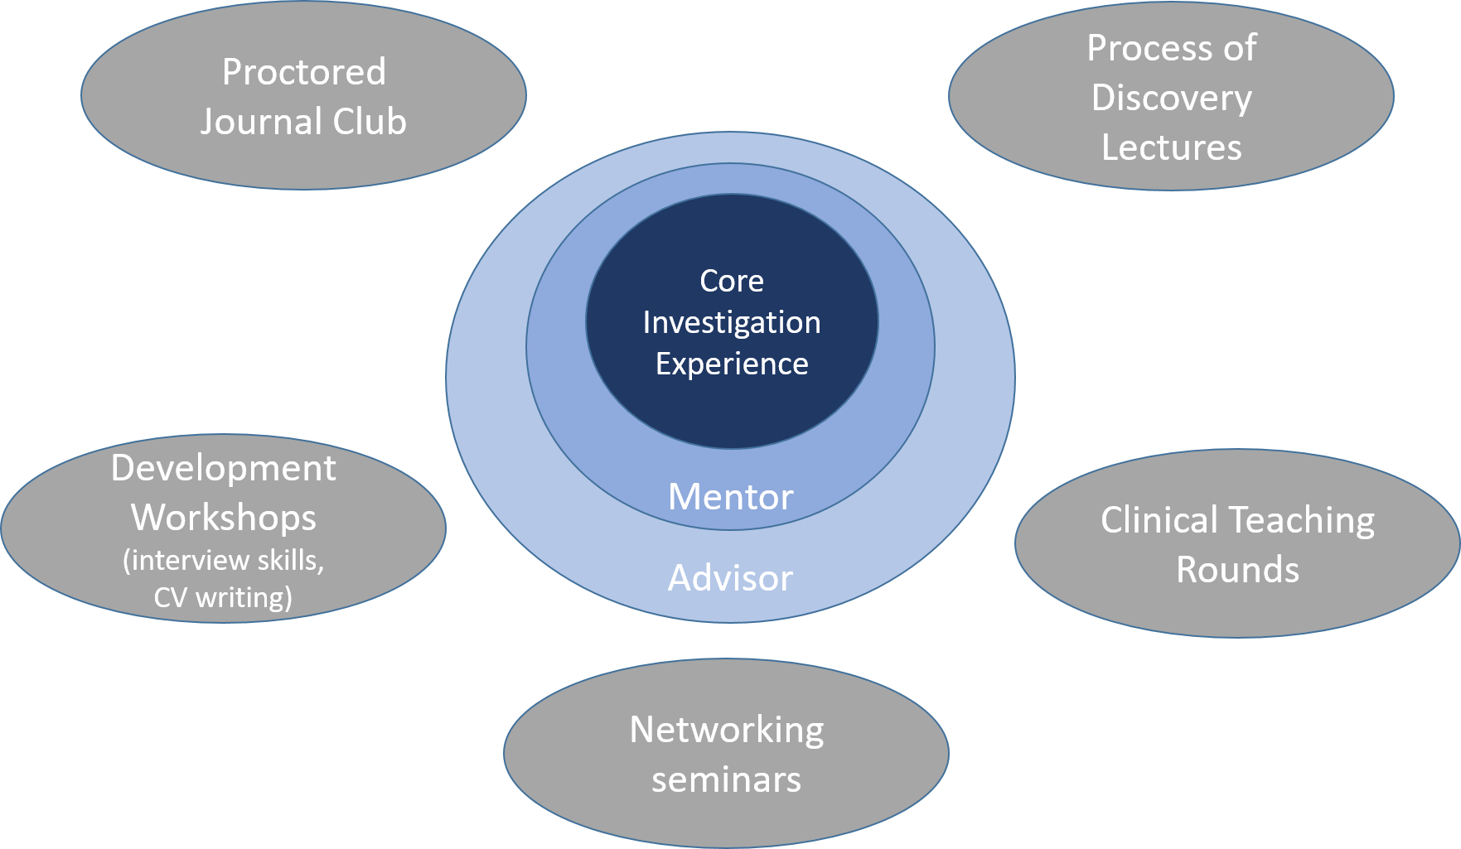
The Curriculum
Mentoring, advising and a curriculum…centered around a robust investigation experience…..
Notes:
Process of Discovery
Lectures on seminal basic and clinical research topics that highlight the continuum of discovery, including issues in emerging technologies, science policy, and bioethics
Clinical Teaching Rounds
Select master teacher/investigators present their research in a case-centered forum with participating patients, discussing not just the science of medicine, but the art of clinical care
Proctored Journal Club
Workshops (CV writing, interview skills, Work-Life balance)
On-going Seminars by world renowned researchers (Clinical Center Grand Rounds, Demystifying Medicine)

Slide 12
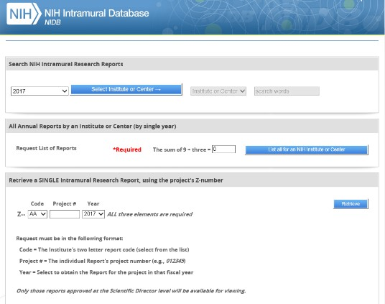
Mentorship:
A committed research mentor is the key element to a successful research experience
After Scholars are accepted, they are given access to lists of pre-approved mentors.
Scholars also receive advice and guidance from the MRSP Academic Director and their MRSP Advisor.
Accepted Scholars are encouraged to research mentors in advance using the NIH Intramural Database

Slide 13

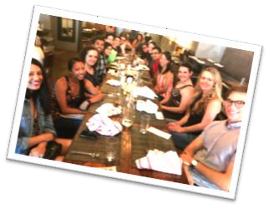
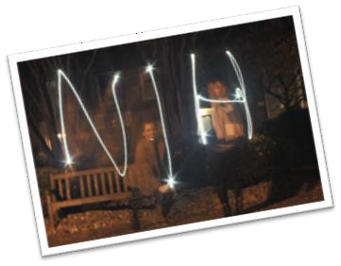
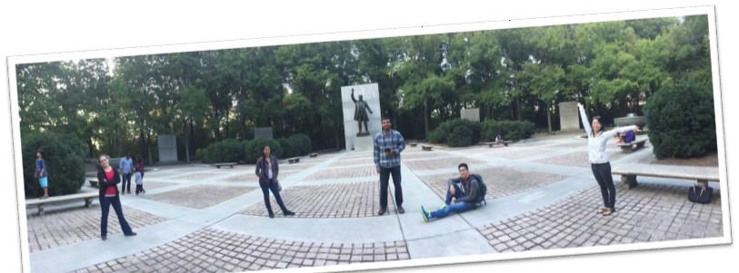
Beyond the Research:

Slide 14
Recommendations for a competitive application
Clear interest in research
  Your interest and potential are the most important criteria
Strong and detailed letters of recommendation
  Dean’s letter: not just “in good standing,” but insightful comments on your past achievements and future promise
  Your two professional references are from people who can speak to your attributes and research potential
Focused cover letter/personal statement
  Excellent writing is essential. Grammar matters!
  Use this as your opportunity to describe your motivations to pursue biomedical research as your career path
Start application early

Slide 15
Our Dental Scholars
Since the start of the NIH Medical Research Scholars Program (MRSP), 18 dental students have participated
22%
17%
Pursing additional degrees, 5
Academic Professors,
3
17%
In private practice, 9
Past scholars' current positions:
44%

Slide 16
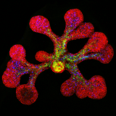
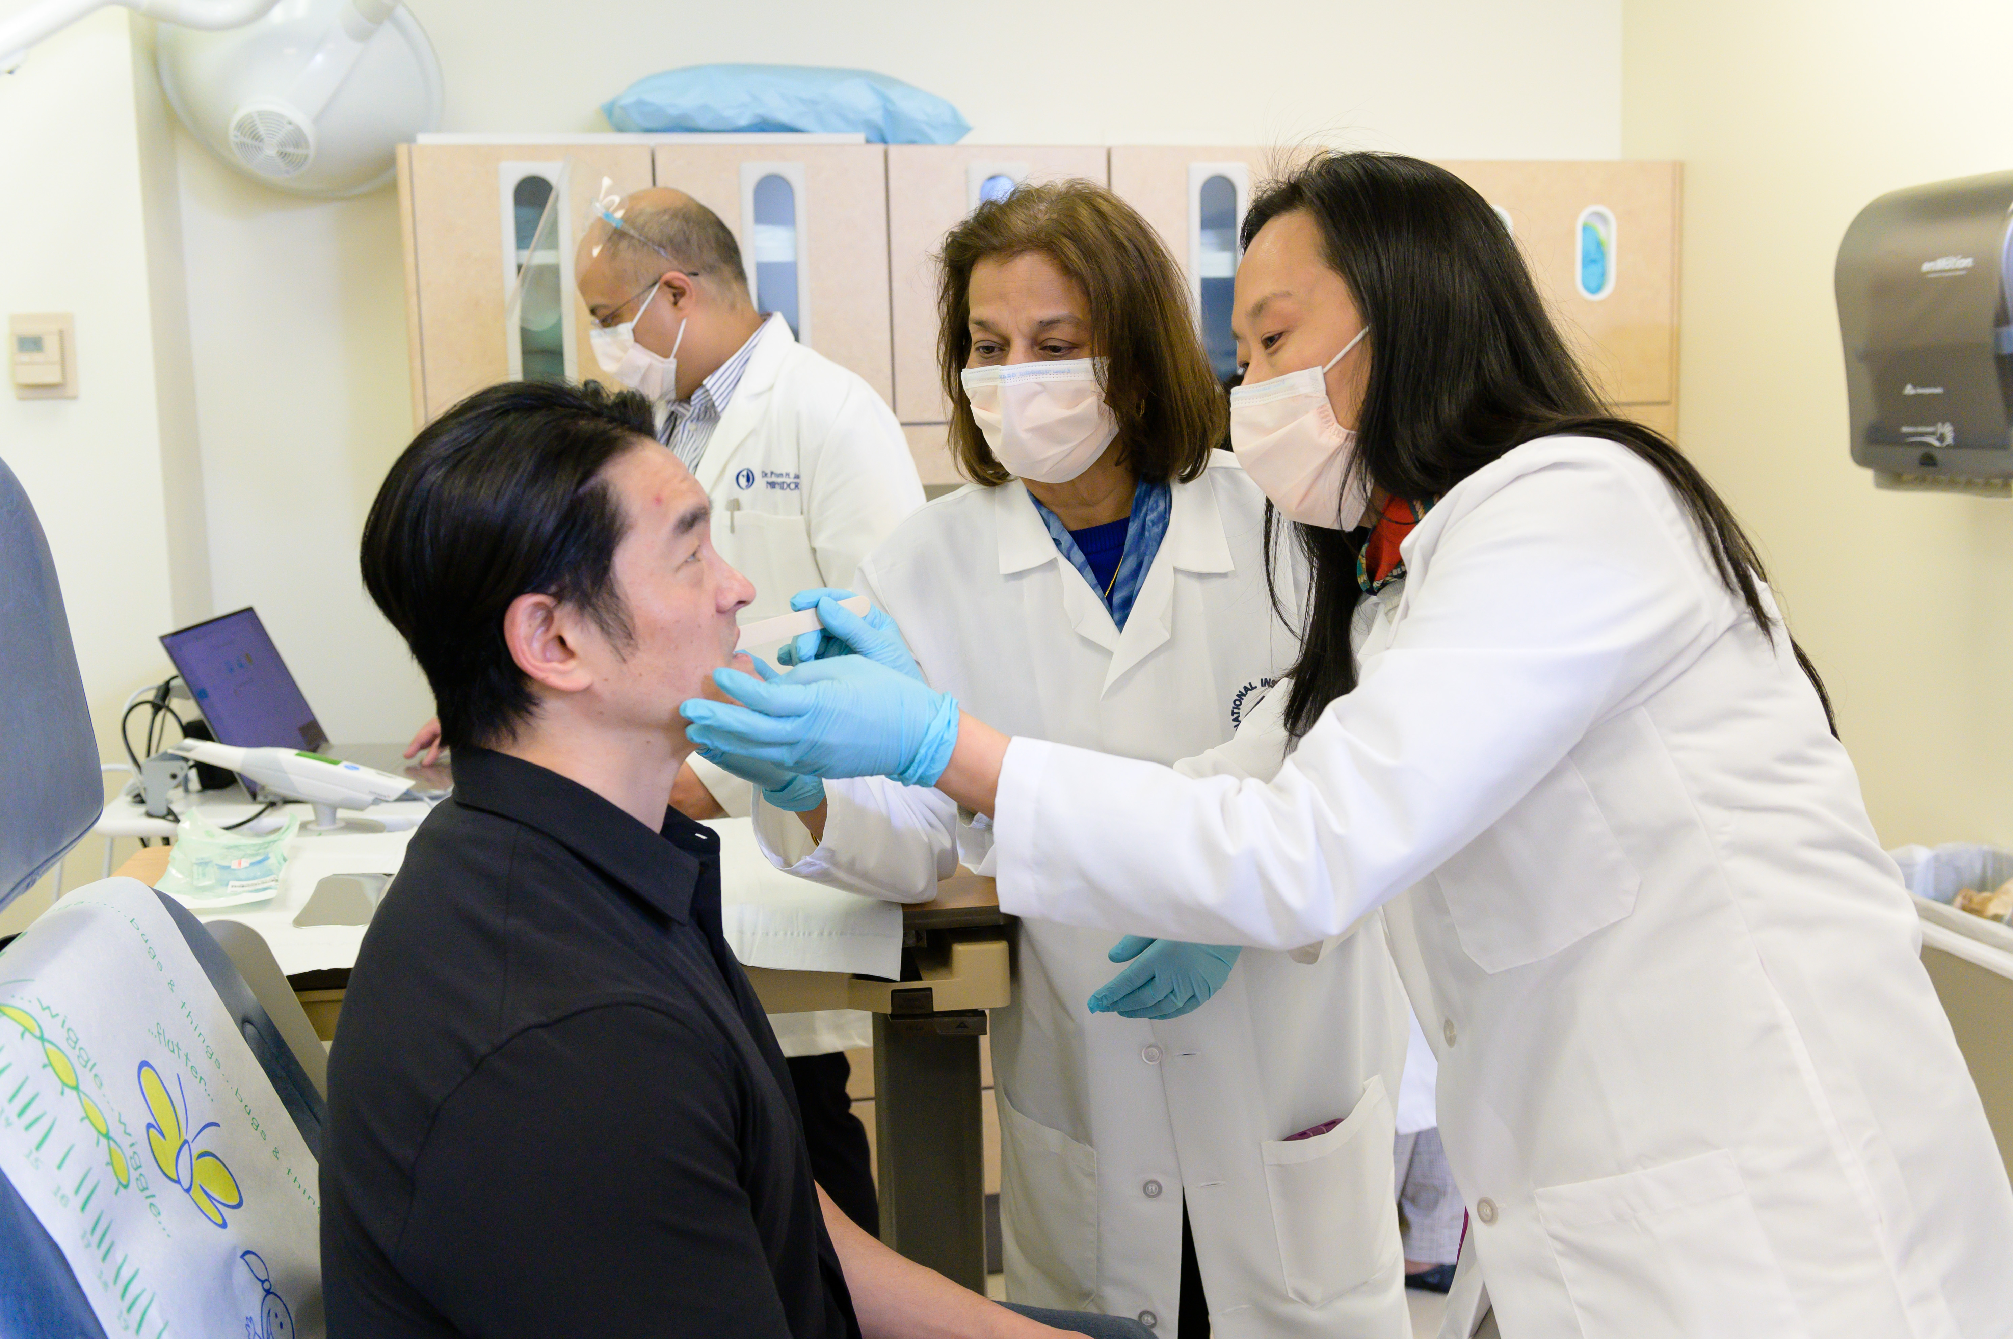
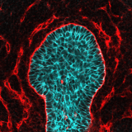
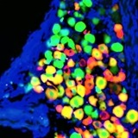
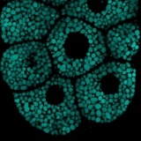
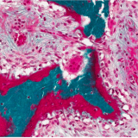
NIDCR Intramural Research – What do Scholars Investigate?
Mechanisms of Development & Stem Cell Fate
Epithelial & Salivary Gland Biology
Immunology, Inflammation & Microbiology
Sensory Biology & Pain
Skeletal, Matrix, & Mechanobiology

Slide 17
2012-2013 | Culture and Expansion of Adult Salivary Gland Progenitor Cells
2012-2013 | Failure of Molar Tooth Eruption and Root Formation in MT1-MMP Knockout Mice
2014-2015 | Role of Fibronectin and Btbd7 in Oral Squamous Cell Carcinoma
2015-2016 | Investigating Endothelial to Mesenchymal Transition of Phosphaturic Mesenchymal Tumors
2016-2017 | In Vivo Analysis of Stromal Osteogenic Capacity in a Murine Model
2016-2017 | Molecular and Cellular Etiology of Tumors Responsible for Tumor-Induced Osteomalacia
2017-2018 | Development of Lymphatics in the Mouse Craniofacial Region
2017-2018 | Fibrin Accumulation in the Oral Mucosa Leads to Severe Periodontal Bone Loss
2018-2019 | The BTB Domain Family of Proteins and its Emerging Role in Cell Migration
2019-2020 | Effects of the Pan-fibroblast Growth Factor Receptor Inhibitor BGJ398 on Dentoalveolar Development
2020-2021 | Characterization of Oral Microbial Communities in Patients with Leukocyte Adhesion Deficiency-1 through 16S Ribosomal RNA Sequencing
2021-2022 | Salivary Correlates with Clinical and Patient-Reported Assessment: Developing a Validated Salivary Biomarker Panel for Clinical Trials in Oral Chronic Graft vs Host Disease
2022-2023 | The Condyle Conundrum: Investigating Temporomandibular Joint Disorders in Loeys-Dietz Syndrome in a Murine Model
What do MRSP Dental Scholars investigate?

Slide 18
MRSP Yr | School | Yr | Residency Field | Residency Institute | Current
2012-13 | U Minnesota | 3 | DDS/PhD Dental Scientist Prog | Harvard | Asst Prof, UPenn Dental
 | Tufts | 3 | Endodontics | Tufts | Asst Clin Prof, Endodontics, Tufts
 | Boston U | 4 | Orthodontics | U Michigan | Orthodontics Practice
 | U Michigan | 3 | General Dentistry | Carolinas MC | General Dentistry Practice
2014-15 | Harvard | 4 | Oral & Maxillofacial Surgery | UNC | General Dentistry Practice
 | UCSF | 3 | Orthodontics | Wash Hosp Ctr | Orthodontics Practice
2015-16 | U Michigan | 2 | Oral & Maxillofacial Surgery | U Michigan | General Dentistry Practice
2016-17 | Tufts | 3 | Oral & Maxillofacial Surgery | UTHealth Houston | General Dentistry Practice
 | U Michigan | 3 | OMFS Combined DDS/MD | U Alabama | Completing Residency, 2024
2017-18 | U Iowa | 4 | Endodontics, MS | U Iowa | Asst Prof, Endodontics, U Iowa
 | Tufts | 3 | Periodontics, MS | UCLA | Periodontics/Implants Practice
2018-19 | U Alabama | 3 | NIH-OxCam PhD Scholar | Oxford, UK | Pursuing PhD
 | U Mississippi | 3 | Oral & Maxillofacial Surgery | Macomb-Oakland | Completing Residency
2019-20 | East Carolina | 3 | Periodontics/Oral Biol, DDS/PhD | SUNY Buffalo | Pursuing PhD (NIH-DSPP)
 | U Penn | 2 | Pediatric Dentistry | Boston Children’s | Completing Residency
2020-21 | SUNY Buffalo | 3 | Periodontics/Oral Biol, DDS/PhD | U Michigan | Pursuing PhD (NIH-DSPP)
2021-22 | Indiana U | 2 | NIH-IU PhD Partnership Program | IUSD | Pursuing DDS-PhD

Slide 19
Introduction of Panelists

Slide 20
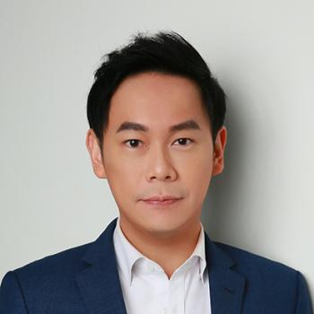
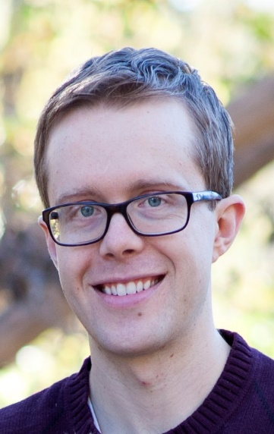
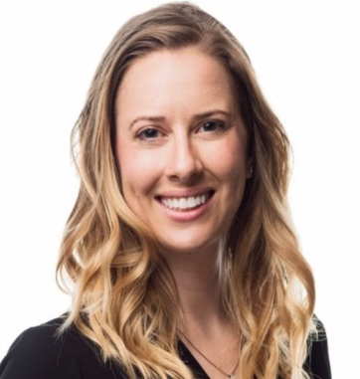
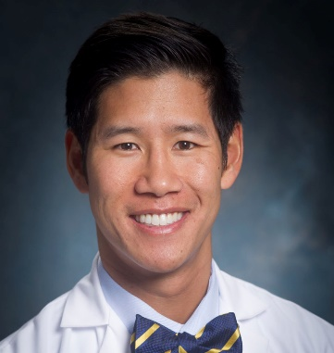
  Stanley Liu, MD, DDS
  Current Location: Stanford
  Position: Associate Professor (Otolaryngology)
  Kyle Vining, DDS, PhD
  Current Location: Penn Dental
  Position: Assistant Professor (Penn Dental School)
  Molly Bodendorfer, DDS
  Current Location: Private Practice
  Position: Orthodontist
  John Le, MD, DDS
  Current Location: UAB
  Position: OMFS Resident

Slide 21
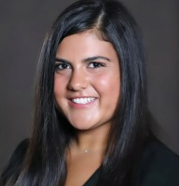
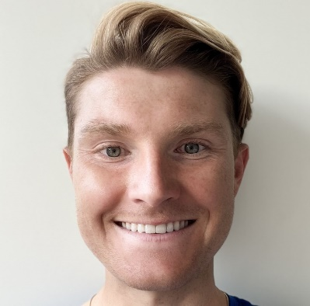
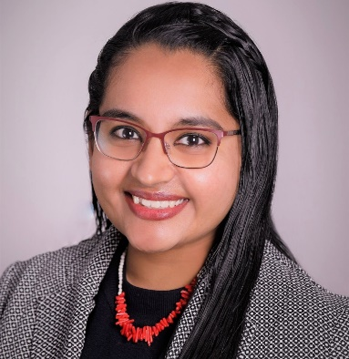
  Victoria Maglaras, DDS
  Current Location: U of Michigan
  Position: Perio, PhD Resident (K12 recipient)
  David Cruz Walma, PhD
  Current Location: Oxford university and UAB
  Position: DDS-PhD (NIH OxCam recipient)
  Drashty P Mody, BS
  Current Location: NIDCR (Bethesda), Indiana University Dentistry
  Position: DDS-PhD Student (NIH GPP recipient)

Slide 22
Q/A TIME!

Slide 23
For More Information
Medical Research Training Program:
https://clinicalcenter.nih.gov/training/mrsp
NIDCR Research:
https://www.nidcr.nih.gov
For more information contact us:
MRSP@mail.nih.gov
Follow us!
@CCMedEd#NIHMRSP

