Slide 1
Outline – 45 mins total
Welcome, - 10mins
Welcome to day 2, intro self – 1min
Themes from Day 1 (1 slides - 5 mins)
RTI futures work – 1 mins
Foresighting mindset – 2 mins
SPRING process – 7 mins
where we were at – 1 slide 1 min
How we created alternative futures – 1 slide - 5 mins
Where we are now in process 1 slide 1 mins
A look back 15 mins
(10 yrs) to look forward (7 slides) -10 mins
Why alternated futures - ? 1 slide 3 mins
Exercises 10 mins
Future bias – 5 mins
Who will you be in 10 years? – 5 mins
Mindset – 4
Suspend - 2 mins
Guardrails – 2
Notes:
Yes do intro hosts – day 1
Yes intro – “guides to the futures” or “will see you in the future”
Yes standup – get them moving ,
Optimistic /pessimistic
Start – what is your role in your organization

Slide 2
Envisioning Alternate Futures
Methods & Mindsets

Slide 3
Themes/Drivers from Day 1
We have been here before – tech, economic, ethical cycles at play
There are multiple transformations going on – tech, AND demographic, globalism, privacy, security
AI is now combining established learning approaches, but not “broad AI” yet, far from AGI
Adoption of AI will require – data infrastructure, AND explainability, transparency, governance

Slide 4
Themes/Drivers from Day 1
AI will change work and tasks – thus redefine or reinvent jobs
Companies must change – skills, agility, culture, organizational intelligence
This change will be hard – but it will take human effort to do it (not tech)
Intelligent organizations will learn to see and leverage:
Unique strengths of humans and machines
Find strategic combinations of these to create opportunity
Augment (not replace) humans and use experiential learning to upskill

Slide 5
SPRING Foresight Process
We were here!
FRAME
EXPLORE
ENVISION
ACT
Framing
Orienting
Scanning
Interpreting
Visioning
Planning
Action
Jan - Feb
March - June
July - October
SPRINGBOARD
November+
Conference @ RTI
Excursions, Interviews, Learning Modules, Working Sessions
Notes:
Ask Pioneers to stand up!

Slide 6
Foresighting mindset
Foresighting is…
Sensing change
Exploring what is, or may be, possible
Logical, internally consistent
Believable stories about the future
Bringing diverse perspectives
Foresighting is not…
Stating what is known
Exact extrapolations, nor is it prediction
Fantasy or without evidence
About confirming beliefs or assumptions
A singular point of view
Foresighting is hard because…
Cognitive “anchoring” in the past
We assume the future will be like the present
We have to confront our personal bias, our confirmation bias
Of anxiety about change
Foresighting can be made easier by…
Frameworks, scanning research
Experiencing trends and seeing drivers
Scenarios and alternative futures
Metaphors and story telling
Tools to focus your efforts
Repeatedly questioning your assumptions

Slide 7
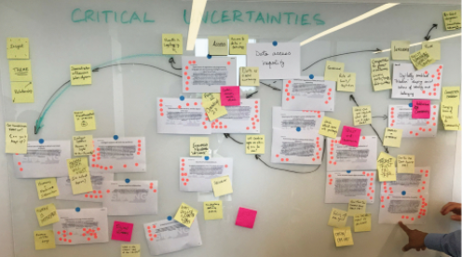
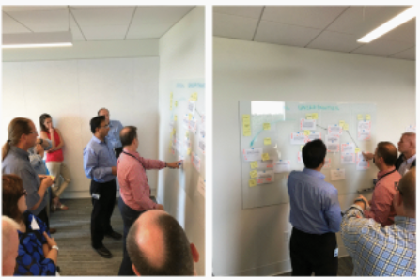
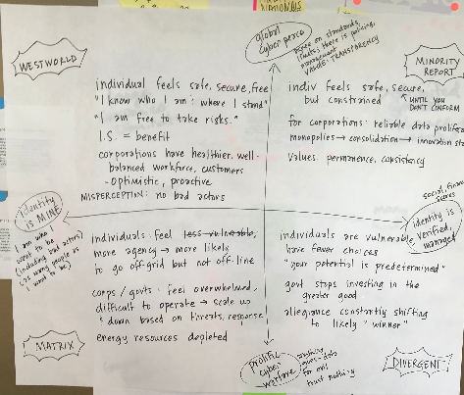
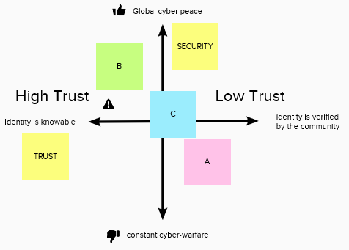
Pioneer working session
Review 65 drivers of change
Assess highest impact drivers
Focal Issue
ID critical uncertainties & themes
Trust
Influence
Ethics
Governance
Access
Digital Orgs
Drivers of Change
Critical Uncertainties
Assess axes of uncertainty
Shaping Scenarios
Use shaping scenarios to craft alternate futures narratives
Test internal logics and plot lines
Build shaping
scenarios
Alternate Futures
Notes:
There are many paths to foresighting and creating scenarios – there is no one right path. You may recall we are using an “intuitive logics” approach
We have chosen a path that matches our sequence, fits our topic and inputs to date, suits the size and kind of group we have today, and is effective for a one-day session – we have combined both interpretive and visioning
You will get to experience working with research insights and converting them through select activities into scenarios we can use

Slide 8
SPRING Foresight Process
We are here!
FRAME
EXPLORE
ENVISION
ACT
Framing
Orienting
Scanning
Interpreting
Visioning
Planning
Action
Jan - Feb
March - June
July - October
SPRINGBOARD
November+
Conference @ RTI
Excursions, Interviews, Learning Modules, Working Sessions

Slide 9
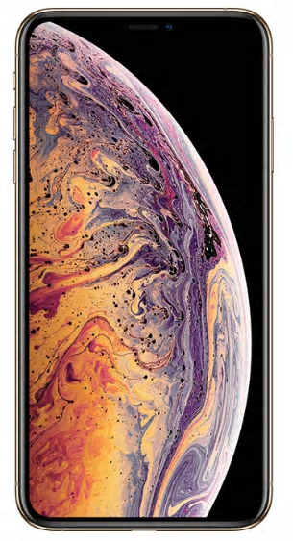
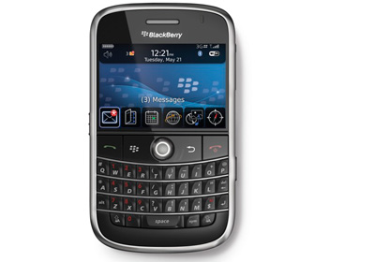
A look back….about 10 years
Notes:
Top phone of 2008 Blackberry – top phone today iPhone X
Facebook had about 100 M users, to day it has 2.3B users and unanticipated influence on culture, politics, and privacy
Pace for app picked up a lot - There were no virtual reality apps in 2008 but in Pokémon Go reached 50M users in 19 days (Facebook took 3 yrs to reach that)
No there are apps for everything – changing the way we play, navigate, bank, communicate, date, buy things,

Slide 10
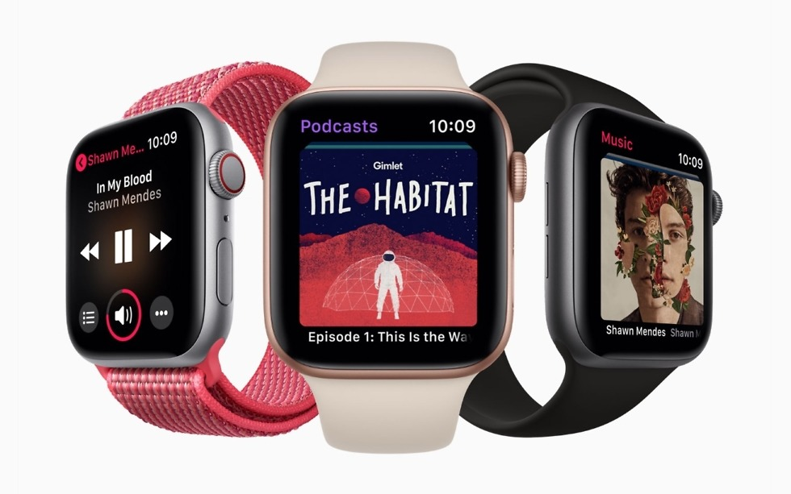
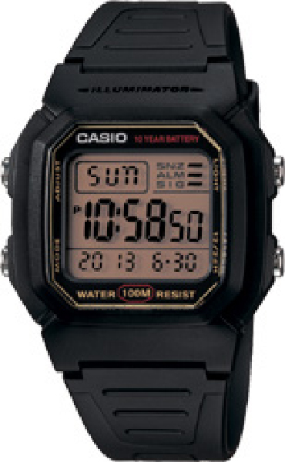
A look back….about 10 years
Notes:
Casio watch circa 2008 , and today – we have smart watches
,

Slide 11
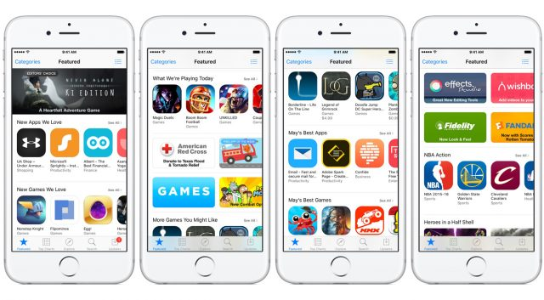
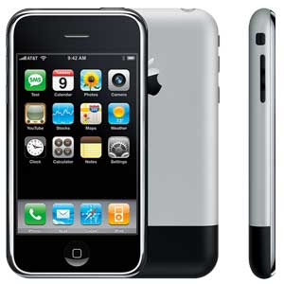
A look back….about 10 years
Notes:
iPhone released just over a decade ago – with about a dozen apps –
Now there are apps for everything – changing the way we play, navigate, bank, communicate, date, buy things,
how has this changed you life?

Slide 12
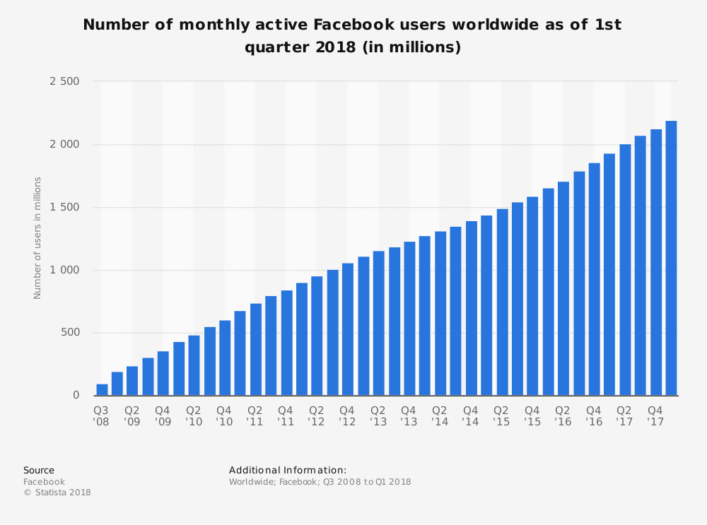
A look back….about 10 years
Notes:
Facebook had about 100 M users, to day it has 2.3B users and unanticipated influence on culture, politics, and privacy
Pace for app picked up a lot - There were no virtual reality apps in 2008 but in Pokémon Go reached 50M users in 19 days (Facebook took 3 yrs to reach that)
,

Slide 13
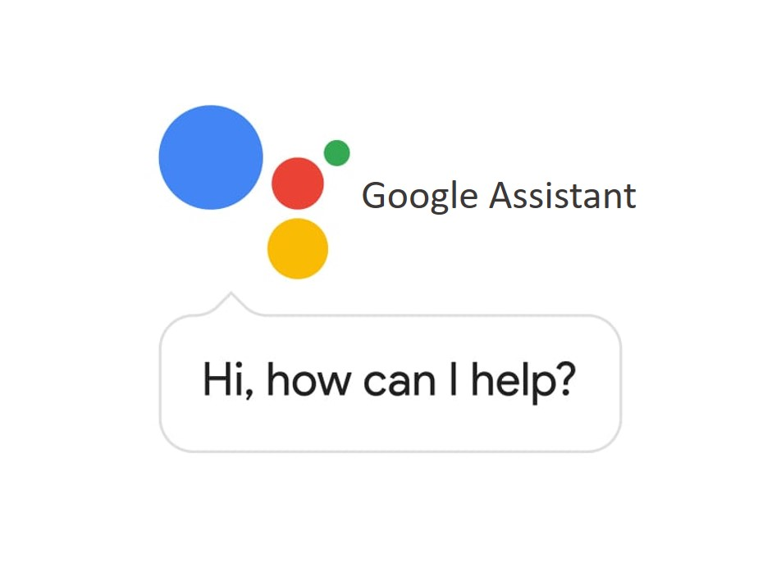
A look back….about 10 years
Notes:
In 2008 Google released its first voice search – for Google Maps on you guessed it a Blackberry
Today we have Google assistant, an AI enabled personal assistant capable of a two way conversation

Slide 14
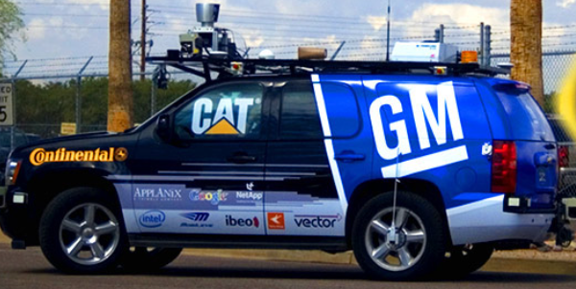
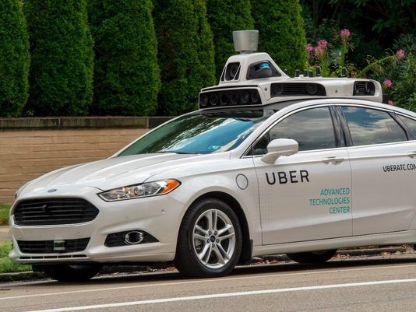
A look back….about 10 years
Notes:
DARPA Urban Challenge winner went 60 miles in 4 hrs.
Today we have self driving Uber taxis

Slide 15
A look back….
Notes:
NAO robot 2008
Boston Dynamics Robot

Slide 16
Why alternate futures?
Remember - The actual future is unknowable.
It is not whether the alternative futures come to pass.
It is whether they broaden our understanding of plausible futures and influence our thinking and actions of our organizations.
Alternate futures, provide a common language and story about which we can discuss – together!
Alternate futures illuminate organizational implications and help you clarify possible next steps.
Our alternate futures, and the challenges and opportunities they represent, are not necessarily mutually exclusive.
The future will probably include elements from each, but at different levels of intensity or in different regions of the world.

Slide 17
Exercises
Flexing Your Futures Muscles

Slide 18
“We don’t see things as THEY are, we see them as WE are.”
—Anais Nin
Notes:
Orient to the future – do the first an then if time do more
I tend to be deeply excited / deeply fearful about the future.
I think technology is bringing us closer together / pushing us further apart.
Look around – do you think this group is representative of the people who will have be shaping things in 2028? Will this affect our bias toward the thinking about the future?
How many of you are IT, or AI specialists? Will this affect our perspective on the future?
I am a true risk-taker / I am risk averse when it comes to making decisions about my personal future

Slide 19
“The future belongs to those who believe in the beauty of their dreams.”
Eleanor Roosevelt
“We don’t see things as THEY are, we see them as WE are.”
—Anais Nin
Notes:
Place your self in 2028 – ten years from now
How old are you? How are old are the important people in your lives now? What phase of life are they in a decade from now.
What are you doing with you time? Where are you living? What might your job be?
1) that's one of the whys of scenarios + immersion—really put yourself in a given future. Imagine yourself, your family, your community, your company, its products/services in that future
2) don't check out! Just for today, it IS your responsibility. You're the one who's going to be back from the future on Thursday or Monday or whatever. What messages will you bring back? And not just to your immediate team—what messages does HR need to hear? Marketing?

Slide 20
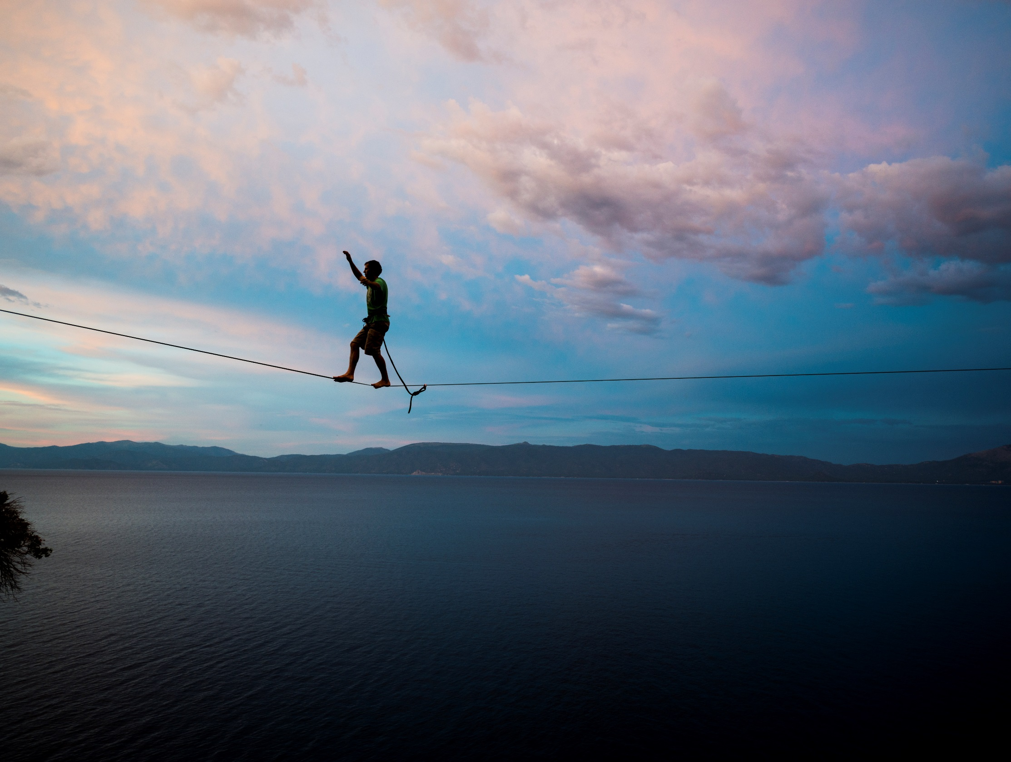
Innovation starts with a story about the future. Imagining and sharing desires and fears about the futures is a way for all of us to shape it. - NESTA
Notes:
Stepping into the future can feel uncomfortable for some people. Some people reject future scenarios, or feel uncomfortable in “not real” places and situations. That is okay but if you have that feel I would ask you to reflect on why you are feeling that way – that is where learning lies!
So we are going to ask you to suspend your disbelief and have fun!
Use your immersion yesterday and knowledge of people and organizations and watch closely and think carefully about what each future means to you, personally and to you companies!

Slide 21
Guardrails
Accept the premise of each future, but
question what it would be like to live in it!
Focus on immersing yourself
There is no ”right” answer, have fun!
Trust the process, and your peers
Soak in the perspectives of others
Stay engaged
Notes:
You have chosen to be here to day, you have a unique chance think about the kind of futures that you and people you care about may be living it. Make the most of it!
Who will be your partners in this trip in a time machine ?- - have teams stand up and group by colored dots.

Slide 22
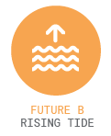
The Alternate Futures
AI-enabled information warfare undermines trust in intelligent systems and leads to a national cyber-arms race. Constant cyber-attacks trigger a global recession, delaying the promise of intelligent systems.
Prolonged economic growth buoys the intelligent-systems evolution. Leadership and coopetition by top AI companies raise the tide for trust, technology, and society.
The democratization of technology leads to decentralized
innovation, increased inequality, and a feeling of constant transition.

Slide 23
FIND YOUR GROUP
Look for you colored DOT
On the back of your badge

