Slide 1
VAPING 101
What Schools Need to Know
Notes:
SUGGESTION: Add your school’s logo to the presentation to personalize it. We suggest adding it to the bottom left corner.

Slide 2

Drivers
73%
Notes:
According to a AAA survey, 73% of US-based drivers consider themselves better than average.
It’s easy to think of ourselves, our community, and our school as above average as well.
According to the National Youth Tobacco Survey, in 2020 more than 3.6 million youth in the United States were current e-cigarette users.
It’s easy to think that the problem exists everywhere else. But we can’t ALL be the exception.
In this presentation…
[add objectives here]

Slide 3
Let’s Get
the FACTS

Slide 4
Myth #1: intro
Vaping isn’t dangerous—it’s better than smoking.

Slide 5
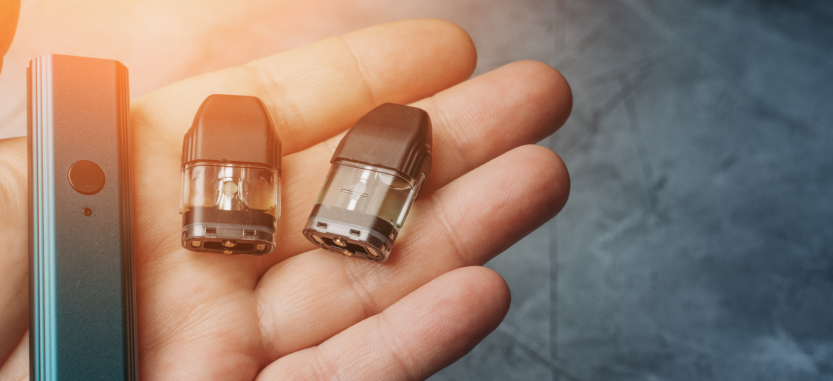
Myth #1: Cartridges
Vaping isn’t dangerous—it’s better than smoking.
1 cartridge = 1 pack of cigarettes
Notes:
The amount of nicotine in one standard JUUL cartridge is roughly equal to the amount of nicotine in a pack of cigarettes (20 cigarettes).
Source: https://truthinitiative.org/research-resources/emerging-tobacco-products/how-much-nicotine-juul

Slide 6
Myth #1: Facts
Vaping isn’t dangerous—it’s better than smoking.
Insert latest statistics here.
Notes:
[Add the facts that are most applicable to your situation.]

Slide 7
Myth #2
Vaping isn’t a middle school problem.
Insert latest statistics here.
Notes:
[Add the facts that are most applicable to your situation.]
Potential statistics to include:
According to the 2020 National Youth Tobacco Survey, 19.6% of high school students and 4.7% of middle school students reported using e-cigarettes. If smoking continues at current rates, 5.6 million or 1 out of every 13—of today’s children will ultimately die prematurely from a smoking-related illness

Slide 8
Myth #3
Vaping isn’t a problem in our school.
Insert latest statistics here.
Notes:
[Add the facts that are most applicable to your situation.]

Slide 9

6 feet from a spider
You are never more
than 6 feet away
from a spider.
*In many outdoor settings
Notes:
Did you know that when you are in most outdoor settings, you are never more than 6 feet away from a spider?
https://arthropodecology.com/2012/06/05/you-are-always-within-three-feet-of-a-spider-fact-or-fiction/

Slide 10

If you don’t see a problem
If you don’t
see a problem,
does it exist?
Notes:
Something can be all around you without your knowing it.

Slide 11
Myth #4 intro
Vaping isn’t a problem in our school.
Notes:
Maybe there’s a problem in the school and maybe there isn’t. But it is a larger societal problem and a community problem.

Slide 12
Myth #4 Fact
Vaping isn’t a problem in our school.
Insert facts about prevalence in your community.
Notes:
Maybe there’s a problem in the school and maybe there isn’t. But it is a larger societal problem and a community problem.
[[Add the facts that are most applicable to your situation. Focus more on the community impact than the impact at your school. This will help reduce perceived blame.]
Possible facts might include % of people vaping in the state/county, perhaps broken down by age. Possible source for research: YRBSS, your state’s youth tobacco division of the state health department.]

Slide 13
Myth #4: Closing
Vaping isn’t a problem in our school.
It will take
work to keep it that way.
Notes:
Even if there isn’t a problem in your school yet, we need to act to help keep it that way.

Slide 14
Let’s Get
HONEST
Notes:
[This section is a continuation of the myth section, heavily challenging the perception that “my” child wouldn’t do this.]

Slide 15
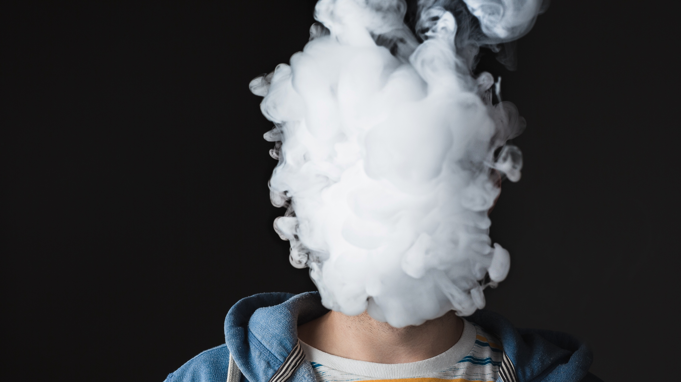
I would know if my child were vaping.
Notes:
[For teachers/administrators, change to “our students.”]

Slide 16
Did you ever….
“Forget” to give your parents a note from the school?
Use the family car without permission?
Try to hide a speeding/parking ticket from your parents?
Sneak out of the house?
Lie to your parents about where you were going?
Forge your parent’s signature on a permission slip?
Notes:
You were a kid once. Take a look at this list. Raise your hand if you ever did any of these things when you were in school.

Slide 17
Debrief
Notes:
Debrief points:
Your parents didn’t know everything you did. We can’t know everything our kids do. Kids test the limits. They experiment.

Slide 18
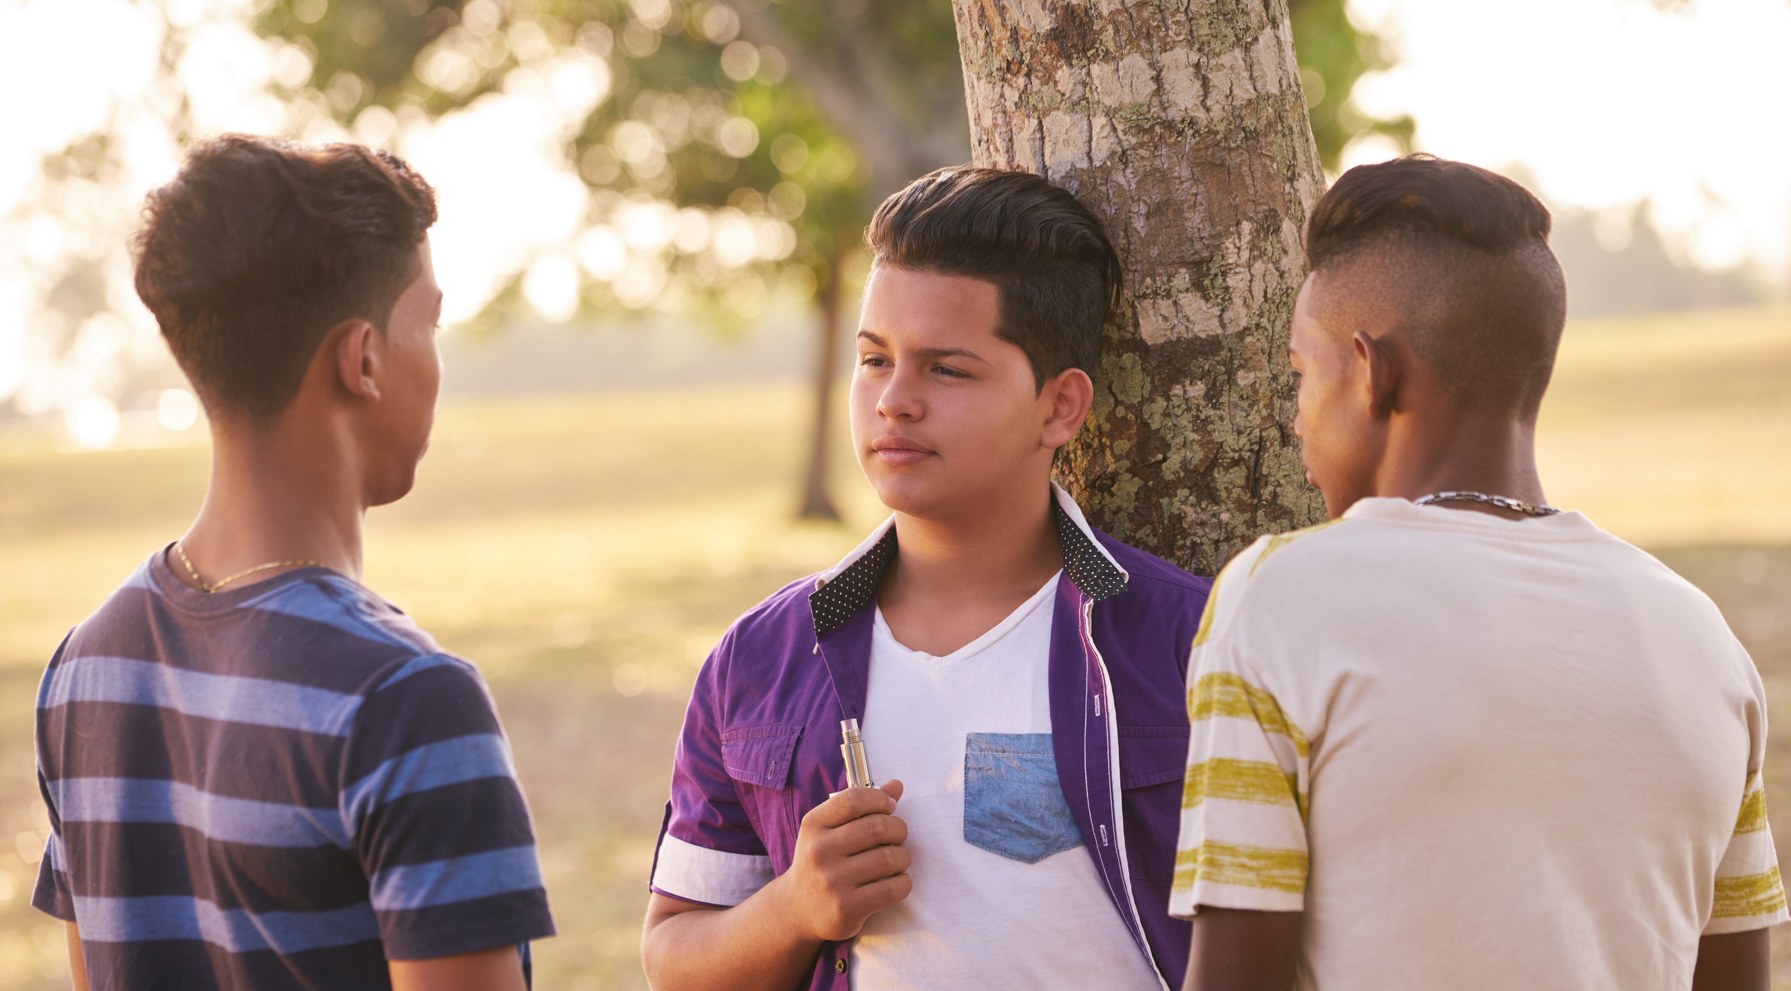
Peer group
Notes:
Even if they aren’t vaping now, they are surrounded by vaping influences.
Ask: where do you think kids are getting messages about vaping?
Potential answers:
Peer group (in person and on social media)
Advertising
Paid influencers on social media

Slide 19
Peer group debrief
Notes:
We need to counter some of those cultural influences.

Slide 20
Let’s Get
READY
Notes:
[In this section, you outline your plan.]

Slide 21
Plan
This is the first of the steps/ phases
This is the next step/phase
This is the final step/phase
1
2
3
4
5
This is the next step/phase
This is the next step/phase
Notes:
[Outline the elements of your program. Use just a few key words on the slide for each. ]
Example:
Create a task force
Solicit funding
Update tobacco policies
Launch an awareness program
Evaluate effectiveness

Slide 22
Timeline
Target date
Target date
Target date
This is the first of the steps/ phases
This is the next step/phase
This is the final step/phase
1
2
3
4
5
This is the next step/phase
This is the next step/phase
Target date
Target date
Notes:
[There are several layout options for a timeline. Choose the one that best fits your needs.]
[Be sure to ask the audience what ideas they have for a timeline to implement the program. Input is essential from stakeholders.]

Slide 23
Timeline
 | Jun | Jul | Aug | Sep | Oct | Nov | Dec | Jan | Feb | Mar | Apr | May
Task/Phase
Task/Phase
Task/Phase
Task/Phase
Task/Phase
Task/Phase
Task/Phase
Key message
Key message
Notes:
[To customize this layout, adjust the column headings based on your time frame. Add or delete columns as needed. Fill in the bars for the timeframe using blue fill or no fill. Add or delete rows as needed.]
[Be sure to ask the audience what ideas they have for a timeline to implement the program. Input is essential from stakeholders.]

Slide 24
Key Dates
Task or phase | Target date
Task or phase | Target date
Task or phase | Target date
Task or phase | Target date
Task or phase | Target date
Task or phase | Target date
Task or phase | Target date
Notes:
[Be sure to ask the audience what ideas they have for a timeline to implement the program. Input is essential from stakeholders.]

Slide 25
Budget
Item | $??.??
Item | $??.??
Item | $??.??
Item | $??.??
Item | $??.??
Item | $??.??
Item | $??.??
Total | $??.??
Notes:
[Include

Slide 26
Funding Options
Notes:
[Include options for program funding, such as local, state, or national grants.]

Slide 27
Additional Needs
Notes:
[Include anything else you might need to ask for, such as input from stakeholders, time on an agenda at a meeting, space to post information, volunteers, etc.]

Slide 28
Outcomes/Measurement
##%
xxxxxxx
##%
xxxxxxx
##%
xxxxxxx
##%
xxxxxxx
Notes:
[Update with your outcomes]
Examples of the type of information you might include on this slide:
45% of students surveyed rate vaping as dangerous
90% of students participated in the educational program
20% reduction in vaping-related disciplinary action

Slide 29
Let’s Get
FOCUSED
Notes:
[NOTE: This section is for potential concerns of administrators. Remove if you are not presenting to administrators.]

Slide 30
Concern #1
We need to be focused on academic issues.
Establish vaping as an academic issue.
Notes:
[Note: Transition to some of the concerns that the audience might have about the plan.]
Students can’t learn if they aren’t healthy.
Most e-cigarettes contain nicotine, which is highly addictive and can harm adolescent brain development, including the parts of the brain that control attention, learning, mood, and impulse control (U.S. Department of Health and Human Services).
[If possible, cite a specific academic goal that the target audience has. For example, a goal to improve standardized test scores. Tie vaping to the achievement of those goals.]

Slide 31
Concern #2
We don’t want people to think we have a problem.
Educate them on the issues up front.
Notes:
[NOTE: The “people” in question might be different based on who is in the audience. One group might care about community perceptions. Another group might care more about state education officials.]

Slide 32
Concern #3
There might be backlash if people think we have a problem.
Involve them in the conversation early.
Notes:
It’s true that parents and community members can be uncomfortable if they think there are serious issues at the school. They might not want to get associated with the stigma. Involve “community members” early to let them know you are taking proactive steps to get out ahead of this issue, so it doesn’t become a problem. Get their input on solutions and messaging.

Slide 33
Concern #4
It’s the
parent’s job.
Focus on the whole child.
Notes:
With some children, we, as school nurses, are the only healthcare professionals in their life.

Slide 34
Let’s Get
STARTED
Notes:
[NOTE: This section is your call for action. Now that you’ve built the case, “close the sale” by clearly asking for what you want. Focus on immediate decisions and agreements needed to get started (don’t need to recap your whole plan.]

Slide 35

The Ask
What
[What are you asking for?]
When
[When do you need it by?]
Notes:
NOTE: Be very clear about what you want and when you want/need it by. The request can be big or small. Make sure you include the most immediate next step you want your audience to take.
Examples:
Approval to apply for grant funding / June 15
20 minutes on the agenda at the PTA meeting / March 15

Slide 36








Which of these students…
Notes:
[For elementary school]
Which of these students…
Is the president of student council? (You can’t tell.)
Has a crush on a teacher? (You can’t tell.)
Has anxiety attacks? (You can’t tell.)
Got straight As? (You can’t tell.)
You can’t tell just by looking at them. The same is true with vaping. Anyone can be impacted. And everyone deserves the best possible chance at success in school and in life.

Slide 37

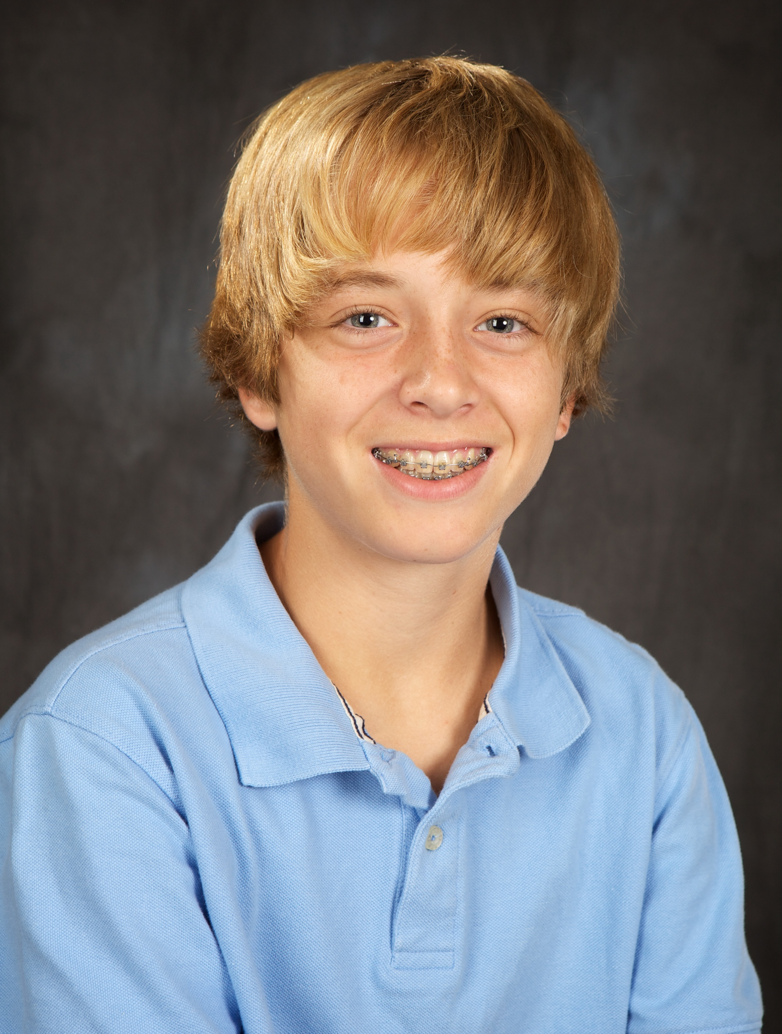




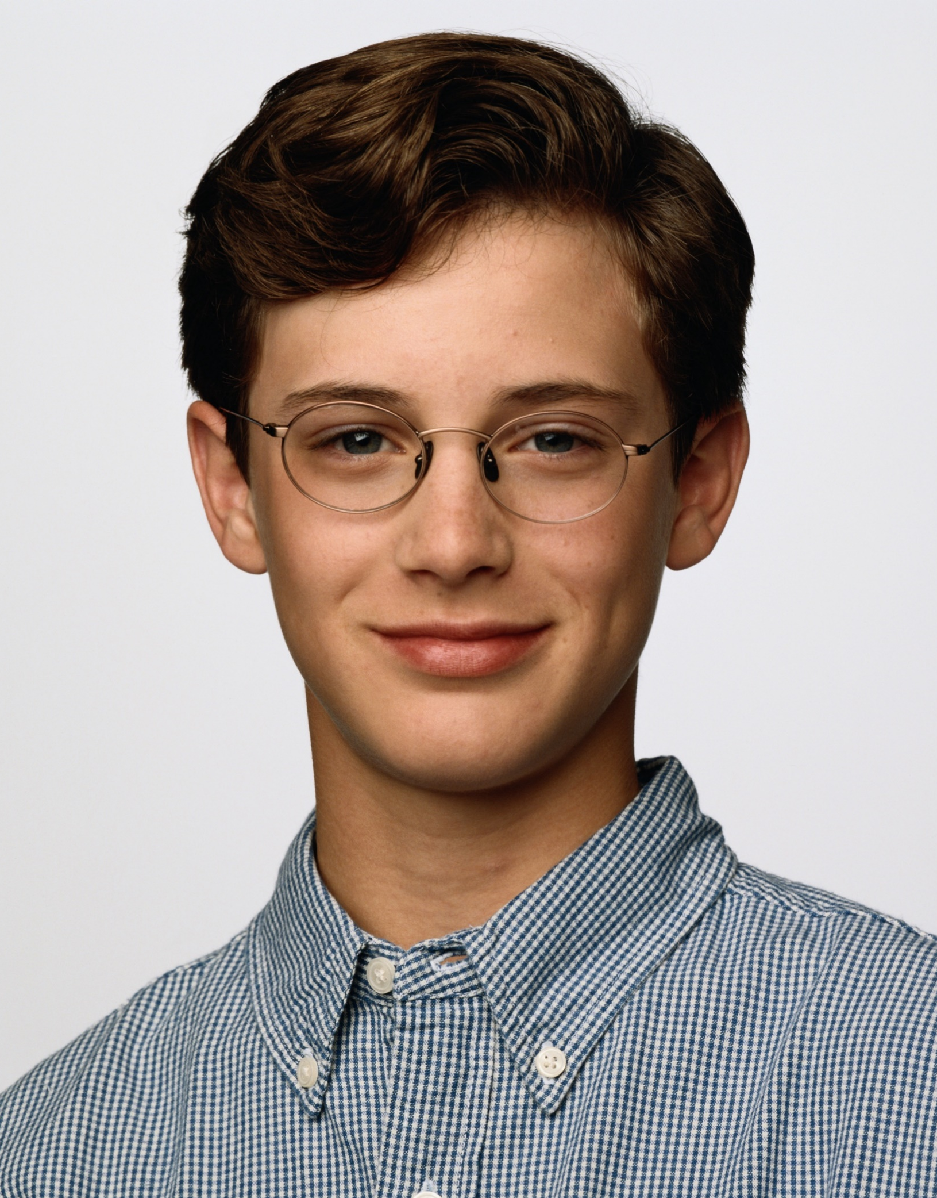
Which of these students…
Notes:
[For middle school]
Which of these students…
Is the president of student council? (You can’t tell.)
Has a crush on a teacher? (You can’t tell.)
Has anxiety attacks? (You can’t tell.)
Got straight As? (You can’t tell.)
You can’t tell just by looking at them. The same is true with vaping. Anyone can be impacted. And everyone deserves the best possible chance at success in school and in life.

Slide 38







Which of these students…
Notes:
[For high school]
Which of these students…
Is the president of student council? (You can’t tell.)
Has a crush on a teacher? (You can’t tell.)
Has anxiety attacks? (You can’t tell.)
Got straight As? (You can’t tell.)
You can’t tell just by looking at them. The same is true with vaping. Anyone can be impacted. And everyone deserves the best possible chance at success in school and in life.

Slide 39
The Ask
References
Truth Initiative: How much nicotine is in a JUUL?
  https://truthinitiative.org/research-resources/emerging-tobacco-products/how-much-nicotine-juul
Anthropodecology: You are always within three feet of a spider: Fact or Fiction?
  https://arthropodecology.com/2012/06/05/you-are-always-within-three-feet-of-a-spider-fact-or-fiction/
AAA Newsroom: More Americans Willing to Ride in Fully Self-Driving Cars
  https://newsroom.aaa.com/2018/01/americans-willing-ride-fully-self-driving-cars/
U.S. Food & Drug Administration: Youth Tobacco Use: Results from the National Youth Tobacco Survey
  https://www.fda.gov/tobacco-products/youth-and-tobacco/youth-tobacco-use-results-national-youth-tobacco-survey
Notes:
[If you add additional references, be sure to site your sources here. Duplicate this slide if you need more room.]

Slide 40
Let’s Get
SERIOUS
Notes:
[Use any of the slides in this section if they related to your specific points.]

Slide 41
Let’s Get
FUNDING

Slide 42
Let’s Get
TALKING

