Slide 1
COVID-FATIGUE:
Tired of being cooped up, careful, uncertain and scared
Steven N. Scoggin M.Div., Psy.D, LCMHC
Associate Vice-President of Behavioral Health
Interim Chair, Department of Psychiatry and Behavioral Medicine
Assistant Professor, Department of Psychiatry and Behavioral Medicine
sscoggin@wakehealth.edu- 336-716-7578

Slide 2
APA’s recent Stress in America 2020 survey:
Significant sources of stress for most Americans:
  Future of our nation (83%)
  COVID-19 Pandemic (78%)
  Violence towards minorities (71%)
  For parents, impact of COVID-19 on children’s social development (71%)
  Government response to the COVID-19 pandemic (66%)
  Racial discrimination (55%)
  For parents, impact of COVID-19 on children’s behavior (55%)
https://www.apa.org/news/press/release/stress/2020/stress-in-America-covid-june.pdf

Slide 3
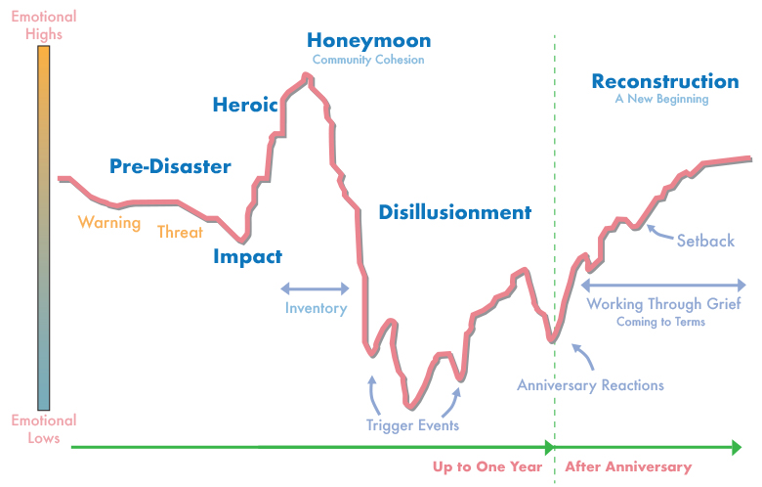
At the end of May, 2020 the US Census Bureau reported a third of Americans are showing signs of clinical anxiety or depression.

Slide 4
10 Eye-Opening Statistics On the Mental Health Impact of the Coronavirus Pandemic
The economy is now a significant source of stress for 70% of Americans.
The government’s response to the crisis is causing stress to 67% of Americans.
More than 1/3 of Americans have displayed clinical signs of anxiety, depression, or both since the coronavirus pandemic began.
Only 50% of employees are comfortable discussing mental health issues.
Nearly one-in-five American say they have had a physical reaction when thinking about the outbreak.
In a March Pew survey, 18% said they had experienced nervousness or anxiety most or all of the time during the past week.
Text messages to a federal disaster distress hotline increased more than 1000% last month.
Mental health is poorest among those unemployed for six months or more (Gallup)
The longer-term psychological consequences of collective trauma can last a decade or more.
Pandemic stress is significantly higher in your people.
Naz Beheshti, Forbes Women, May 2020

Slide 5
Normal emotional responses to COVID-19
Uncertainty, overwhelm, anxiety, panic
Isolation, sense of loss (family, friends, colleagues, support systems)
Difficulty focusing
Fatigue/exhaustion
  Including “decision fatigue”
Sense of pressure (need to work longer/harder)
Heightened potential conflict and stress

Slide 6
Common Emotional Reactions to adverse/highly stressful events
Sadness
Frustration
Embarrassment
Doubt
Anger
Isolation
Concerns about being incompetent
Anxiety
Distress
Fear
Shame
Guilt
Horror

Slide 7
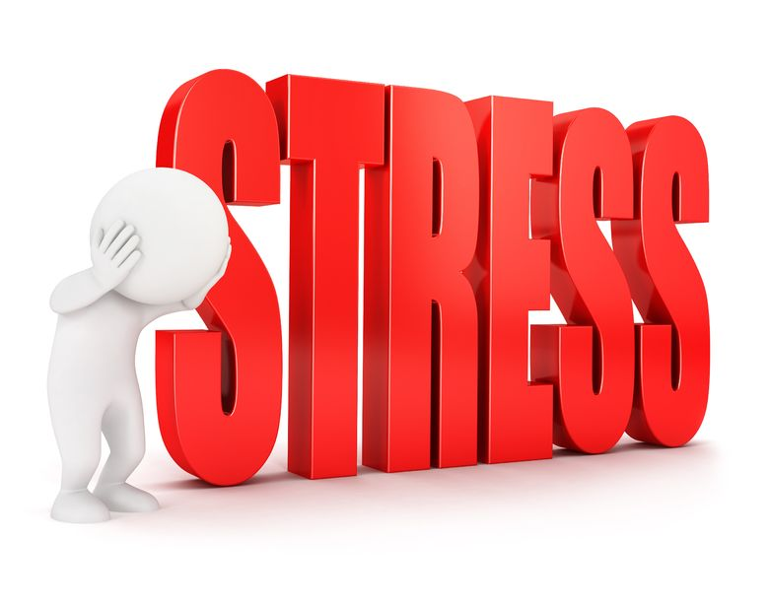
Common Responses to Stress
Physical reactions: rapid heart rate, muscle tension, headaches, GI distress, nausea, insomnia, fatigue, changes in appetite
Emotional reactions: fear, anxiety, anger, irritability, reactivity, argumentativeness, hopelessness, depression, numbness, detachment, despair, lack of emotional balance
Cognitive reactions: difficulty with problem solving or decision making, imagining worst-case scenarios, flashbacks/nightmares
Behavioral reactions: hostility, blaming, unnecessary risk-taking, reduced ability to cooperate, conflicts with peers or family, withdrawal

Slide 8
Some of the feelings we are hearing many of you are experiencing at this time include:
Misplaced anger: Getting irritated or angrier than normal at people and things that would not normally make you upset. This may be driven by underlying thoughts like, “I can’t stand this!” and “When will this end!” as well as grief over the things that we are missing in this time.
Difficulty focusing: As your brain tries to make sense of this transition, integrate all the information, and continue to move forward on a daily basis with the tasks at hand, you may find it more challenging to stay focused.
Worry thoughts: “What will happen next?” “What should I do to prepare?” “How can I stay sane right now?”
Antsy-ness: You maybe be noticing a sense of urgency in your body and mind to DO SOMETHING! You may have even taken action on those urges!
Lethargy: A lack of energy to do much. This may be related to grief as well as the energy it takes to change and integrate new information. This needs to be honored. (Note: If you have a history of depression, you may need to be more careful about balancing rest and action. Depression calls us to “curl up in bed.”)
Paige Bentley, Ph.D., LCMHCS, BCC

Slide 9
Strategies to manage Stress and Maintain Well-Being (Physical Self-Care)
Maintain good health habits. As stress increases, out health habits may get less attention!
  Eat nutritious foods
  Limit alcohol use
  Allow yourself to get enough sleep.
Keep Moving. Exercise is a great way to handle stress and help you sleep well.
  Add nature when possible!
Pace Yourself.
  Healthcare is a marathon.
  We can’t care for our patients, families, or communities when we are running on empty.

Slide 10
Strategies to manage Stress and Maintain Well-Being (Interpersonal Self-Care)
Stay Connected
  Reach out to family, friends, members of faith communities for social contact. Meaningful connections and emotional support are critical to our health and well-being.
  Support one another.
Nurture social relationships
  Make time.
  Express admiration, appreciation, and affection.
  Respond actively to “good news” from the important people in your life. (Make a big deal!)
  Manage (and don’t ignore) conflict.

Slide 11
Strategies to Manage Stress and Maintain Well-Being
Be Present
  Future concerns and “what if” questions can take us out of the present moment.
  Practice mindfulness (simply noticing something in the present moment – your feelings, what you see, what you hear – without judgment) to stay present, focused, and centered.
Check your body language before speaking with a patient (or almost anyone!)
  Check yourself before an interaction – take a deep breath, make sure you’re speaking at a reasonable pace, assume a confident and comforting position with your body language.

Slide 12
What AM I to DO?
Give yourself permission to be where you are. We’re all disillusioned. It’s ok not to be ok all the time. What we resist can persist. Abnormal IS the new normal !
Being strong is overrated. Honesty with yourself is best medicine.
Breathe… deeply…often. Good science behind this one.
Move daily ( exercise sounds like more work).
Stay connected...safely.
Decrease media calories or declare a fast occasionally.
Develop a new routine as our previous ones have been disrupted. Especially important with children at home learning.
Adopt a mindset of a running marathon and not a sprint. Your paradigms shape your behavior. Slow and steady wins the race.
Use this extraordinary moment to do something out of the ordinary.
Rediscover what is most important to you.

Slide 13
THANK YOU
Q & A

