Slide 1


Innovation dashboard practices report
September, 2018

Slide 2


Acknowledgements
  IRI Members
  Tom Kavassalis, Xerox
  Michael Blades, National Gypsum Company
  Alex Lyte, The MITRE Corporation
  Greg Shaw, Swagelok
  Leslie Wainwright, RTI International
  Keith Keller, Milliken & Company
  Mike Blackburn, Cargill
  E.J. Herst, The Dow Chemical Company
  Mary Strzelecki, AdvanSix
  John Hillenbrand, Armstrong Flooring, Inc.
  Robert Buco, Waters Corporation
  Carla McBain, OMNOVA Solutions
  Report Authors
      Phil Watson and Adrienne Brown, Commodore Innovation
      Stewart Witzeman, HB Innovation Partnership Consulting
  IRI Project Manager
      Lee Green, Vice President, Knowledge Creation

Slide 3
contents
section
section
section
Part 1
1
2
3
Who uses innovation dashboards?
What information is on innovation dashboards?
How are dashboards set up and managed?
page 6- 9
page 10- 27
page 28 - 34
section
section
section
Part 2
1
2
3
Example dashboard
IRI’s prior work on innovation metrics & measurement systems
How to establish your own innovation dashboard
page 36 - 41
page 42 - 46
page 47 - 51

Slide 4
Introduction
      Measuring the performance of innovation and R&D is critical to ensuring these functions deliver value to an organization. But the nature of innovation means there are several challenges associated with the design of innovation measurement systems.
      One of those challenges is how best to communicate innovation performance to different audiences in an organization. Innovation dashboards have, in recent years, emerged as one tool to help address that challenge.
      To better understand the current practices related to innovation dashboards, IRI conducted a survey of their members and other organizations in May to June 2018. This report presents the results of that survey.
      Part 1 of this report presents results from the survey. It will be helpful to the reader who is reviewing their current innovation dashboard and one who is considering whether and how to establish a new one from scratch.
      The results are organized to answer three questions:
        Who uses innovation dashboards?
        What information is on innovation dashboards?
        How are dashboards set up and managed?
      Part 2 includes the following three additional resources:
        An illustrative example dashboard, based on a working dashboard used by an IRI member.
        A summary of IRI’s broader work on innovation measurement systems and metrics.
        A simple guide, inspired by the survey, that will be help organizations establish their own innovation dashboards.
This report summarizes results from an IRI survey exploring the uses of innovation dashboards as a tool for communication information about innovation and R&D performance within organizations.

Slide 5
Part 1
Survey Results

Slide 6
Who uses innovation dashboards?
1
section summary
Amongst survey respondents innovation dashboards:
  Are an increasingly popular tool, already in use by a majority of organizations.
  Are predominantly used to communicate information about the organization’s innovation efforts to management audiences (not the organization more generally).
People who responded to the survey typically work for large (e.g., more than $1 billion in annual revenues) industrial or manufacturing firms – for example, the single largest category of respondents were from the Chemicals, Gases, Advanced Materials sector. Most of these organizations typically have very long technology and innovation cycles (compared with, e.g., consumer products). It is, therefore, important to interpret the survey findings through that lens.

Slide 7
Are dashboards used?
Innovation dashboards are an increasingly popular communication tool: most organizations already use dashboards or are actively considering establishing one.
      Just over half of all organizations surveyed communicate information about innovation using a dashboard. Most of these (46%) have a dashboard dedicated to innovation. Some (12%), however, utilize another dashboard (which presumably includes information about multiple topics) to convey information about innovation.
      The survey suggests that use of dashboards may grow further. A significant number of organizations without an innovation dashboard are considering creating one (25% of respondents).
      Only a small share of firms do not have an innovation dashboard (17%) and are not considering creating one. It is unclear what other tracking/communication tools are used by these organizations in place of innovation dashboards. This could be the subject of further research.

Slide 8
The audience for dashboards
Innovation dashboards are predominantly used to communicate with management. Most organizations use dashboards to communicate with multiple management audiences.
      Management is the main audience for an innovation dashboard. The most common audiences are managers (of portfolios, business units, or functions), directors, or VPs. The C-suite is also a common customer for 55% of organizations.
      The dashboards are not often used to communicate with the general organization (only for 19% of respondents’ organizations).
      Most organizations serve multiple audiences with their innovation dashboards: 81% serve at least three audiences, while 50% serve at least 4. Common audience combinations are:
        Portfolio / Business / Functional Manager and above (19% of respondents)
        All but the general organization (19%)
        Portfolio / Business / Functional Manager and above, excluding the C-suite (14%)

Slide 9
Survey demographics
Most of the survey respondents were large firms from manufacturing or industrial sectors.
      Most of the respondents to this survey were from large organizations:
        50% were from organizations with 2017 revenue of at least $5 billion,
        80% were from organizations with 2017 revenue of at least $1 billion
      The respondents represented organizations from 16 different sectors. The most well represented sector was Chemicals, Gases & Advanced Materials (38% of respondents). No other sector was represented by more than 4 firms. Most of the remaining sectors fit under the broad umbrellas of manufacturing or industrial firms.
      Almost all the organizations represented are for profit companies (60% are publicly traded firms), although there are a small number of government and non-profit organizations.

Slide 10
What information is on innovation dashboards?
2
introduction
This section draws on survey findings to identify what information about an organization's innovation efforts is typically communicated via innovation dashboards. The section is divided into four subsections. The first three deal with information about innovation performance at different levels within the organization. Here “innovation performance” refers to what an innovation function produces, and how effectively it does so. The levels covered are project (performance of discrete projects, reported in aggregate), portfolio (projects reported by categories or stages, to gauge coverage and/or diversification), and organization (other measures of the “state of innovation,” more broadly). The fourth subsection looks briefly at the role innovation dashboards can play in exploring innovation capabilities—that is, the tools, resources, assets etc. the organization possess that enable it to be innovative.

Slide 11
What information is on innovation dashboards?
2.1
project-level metrics
section summary
Project-level information reported on innovation dashboards includes metrics on:
  Potential project value – this leading indicator is typically reported using traditional financial indicators measuring either absolute performance (e.g., forecast revenue) or relative performance (e.g., return on innovation). Non-financial indicators are occasionally used, including for non-core or earlier stage initiatives.
  Project’s risk level – this is assessed by a range of approaches from the simple (qualitative assessment) to the more sophisticated (structured scoring systems, risk-adjusted forecast financial metrics).
  Project success – this lagging indicator is most often assessed in terms of sales, but is frequently assessed in terms of the more general measure of whether a project has achieved its original outcome.
Most organizations report these metrics both in aggregate as well as for certain categories of project – such as, by business unit or stage of development.

Slide 12
Potential project Value
Potential project value is one of the most important metrics communicated on innovation dashboards. Financial metrics like estimates of NPV or future revenue dominate.
      Management audiences in most organizations want to know whether the organization’s innovation efforts are going to deliver the desired outcomes, such as revenue growth. It is, therefore, not surprising that 83% of organizations use innovation dashboards to communicate the potential value of innovation projects (e.g., a project’s forecast revenue or earnings).
      Most organizations (83% of respondents – see next page) use financial performance metrics to evaluate potential project value. However, there is also some use (20%) of non-financial metrics.
    Financial Performance Metrics
      Financial performance metrics used include both:
        Absolute performance metrics: sales /revenue, margin/earnings.
        Relative performance metrics: return on investment, internal rate of return, etc.
      Of these metrics, NPV was the most frequently cited (50% of firms), followed by absolute measures of sales or revenue (32%).
      (continued on next page)
IRI Member Quote "It's hard to get away from the typical metrics like NPV...because that's our language.” Research portfolio and program lead, Food, Tobacco & Related Products firm

Slide 13
Accounting for project Value
Non-financial metrics are also used to account for project value, and may be useful for earlier stage innovation projects.
IRI Member Quote "Gross profit, discounted cash flows over the product lifecycle, etc. are less relevant and almost useless when you're trying to penetrate an entirely new market where you haven't decided on the business model." Tom Kavassalis, VP Strategy and Alliances Xerox Research and Product Development.
Survey Response “For projects in the core we look at time to achieve steady state sales, NPV and IRR. For projects outside of the core we look at total available market.” – Industry Machinery, Equipment & Products firm; $1-5 billion in revenue
    Financial Performance Metrics (cont.’d)
      Forecasting the impact of innovation initiatives is inherently uncertain. Some organizations (25%) explicitly consider this uncertainty by probability- or risk-adjusting estimates (of sales, etc.) and/or utilizing real options approaches.
      Some survey participants indicated the timeframes used when considering potential value. Impact at 1, 3, and 5 years after launch and at maturity were all mentioned.
    Non-Financial Metrics
      Non-financial indicators reported include:
        Scoring systems, for example based on market attractiveness and risk.
        Total available market
      A small number of organizations use different approaches to evaluate impact, depending on the type of innovation project, e.g., using traditional financial metrics like NPV for “core” innovations and non-financial metrics like total available market for “non-core” or early stage innovations.

Slide 14
Project risk
Dashboards typically communicate information about projects’ risk level. Approaches to assessing risk vary significantly.
      In addition to potential value, 73% of organizations regard projects’ risk level as an important metric to communicate via their innovation dashboard.
      A variety of different approaches are used to communicate project risk:
        35% use a basic categorization system for characterizing projects’ risk level (e.g., high, medium, low)
        26% use a structured system to give projects a quantitative risk score
        22% risk-adjust financial outcome forecasts.
      The remaining respondents either estimate probability of success or undertake some form of qualitative assessment.
      There are multiple categories of risk that could be assessed in an innovation context. Some respondents provided details on the types of risk they assessed. The most common categories assessed were: technical risk and commercial risk.
Survey Response “Probability of technical success and … commercial success, as well as project evaluation criteria that generates a risk score.” – Food, Tobacco & Related Products firm; > $50 billion in revenue

Slide 15
Risk versus resources
A small share of organizations compare risk level with resources required. Those who do so typically also consider the “size of the prize” (i.e., the importance or attractiveness of opportunities at the same time).
      A relatively small share (34%) of organizations take project risk assessment a step further and compare a project’s risk level with the resources it requires.
      Respondents who indicated a specific approach to this comparison take the following approaches:
        Directly comparing risk level (perhaps using a risk score or categorization – see question 17) with resource investment.
        A three dimensional comparison: market attractiveness, risk score and expenses (including both capital and operating expenses)
        Using a matrix comparing “importance” with “difficulty”
      Some respondents (~3) indicated that this comparison of risk versus resources is done, but only in a relatively informal manner.

Slide 16
Project success
Dashboards are used to communicate ultimate project success, often measured by sales or, more generally, whether the project has achieved its intended outcome.
      In addition to communicating leading indicators of success (e.g., potential project value), almost all organizations (98%) use dashboards to communicate actual results achieved (lagging indicators).
      Most organizations (77%) measure these results, i.e., success, in terms of sales.
      The metrics used clearly need to be relevant to both the organization and the kind of innovation projects it undertakes. As a result, a large share of organizations (69%) use a more general metric assessing whether the project was completed to its “intended outcome” – which can apply to a broader range of innovation projects than just those that will generate new revenue.
      “Other” responses reported include:
        Profitability / cumulative margin
        On-time launch of new products or services
        (Internal) organizational engagement

Slide 17
Categorizing projects
All respondents categorize projects on their dashboards. Common categorization approaches include associating projects with: business unit or market, stage of development, and strategic intent.
*fuzzy front end, stage 1/2/3/4/5 **grow, cost, or defend
      Categorizing information provided on a dashboard is a simple way of communicating complex information about an organization’s innovation initiatives. For example, information about potential project impact can be separated by stage of development to give the audience a sense of both risk and timing.
    All respondents categorize projects on their dashboards.
      The most popular category (74%) is a project’s business unit or market. Other categorizations include: stage of development; strategic intent (grow, cost, or defend) and timeframe (long term versus short term).
      “Other” responses reported were predominantly variants or combinations of the options available in the survey. Examples include:
        The strategic program / initiative with which the project is aligned
        Matrix: technology area versus market category (existing or new)
        Categories that measure the degree of “innovativeness.”

Slide 18
Deep Dive: metric effectiveness
summary
The next two pages are a quick deep dive into the survey respondents’ views on the effectiveness of metrics in two categories: project status and project risk.
The metrics rated as most effective for assessing project status are fairly traditional project management metrics (e.g., whether the project is meeting its milestones). This is interesting given how different innovation projects can be from their more conventional counterparts.
Highly rated project risk metrics cover commonly identified areas of innovation project risk: technology risk, market risk, and execution risk.

Slide 19
Effectiveness of project status metrics
The metrics regarded as most effective for tracking project status in real time are either: project management metrics tracking delivery.
IRI Member Quote ”There's nothing wrong with tracking mileposts, if they just help you remain focused on solving the most critical problems. Just don't be dumb about it… if you've accomplished four out of five mileposts, but the fifth is a real show stopper, saying you've achieved an 80% score is kind of meaningless." Tom Kavassalis, VP Strategy and Alliances Xerox Research and Product Development
      Survey participants were asked to rank the effectiveness of 10 metrics used to track project status in real time.
      All of the metrics were widely used (by at least 70% of respondents), and a majority had a neutral or positive impression of all but one metric (“Time the project manager is able to dedicate to the project”).
      The graph above shows the survey respondents rating of each metric. The metrics are listed in order of their average effectiveness rating – starting with the most effective metric at the top.
      It is interesting to observe that, despite the unique challenges of innovation projects (particularly the uncertain scope, outcomes, and timescales) most of the indicators used are relatively traditional project management metrics that are widely used for more “conventional” project management, e.g., whether a project is meeting its milestones.

Slide 20
Effectiveness of project risk metrics
Metrics regarded as being most effective for assessing project risk cover commonly identified areas of innovation project risk: technology risk, market risk and execution risk.
      Survey participants were also asked to evaluate the effectiveness of 10 metrics used to assign a risk level for projects.
      The metrics identified in the survey are widely used (by at least 65% of respondents), and a majority had a neutral or positive impression of all 10 metrics.
      The graph above shows the survey respondents rating of each metric. The metrics are listed in order of their average effectiveness rating – starting with the most effective metric at the top.
      Three out of the four metrics rated most effective by respondents have strong links to typical categories of innovation project risk:
        Technology risk: technology readiness level
        Market risk: market validation
        Execution risk: Proximity to the core

Slide 21
What information is on innovation dashboards?
2.2
portfolio-Level metrics
section summary
Innovation dashboards can be a useful tool for monitoring the state of an organization’s innovation portfolio. Almost all survey respondents use their dashboard in this way – often using multiple criteria to illustrate their portfolio. Practice is split when it comes to using dashboards to monitor a portfolio’s strategic alignment: around half do, while the other half use other aspects of their innovation process to manage strategic alignment (e.g., project selection).

Slide 22
Categorizing the portfolio
Almost all organizations characterize their innovation portfolio by categorizing projects (e.g., by stage of development). Most use multiple criteria to illustrate the portfolio.
      For most organizations, a “balanced” innovation portfolio is a key management objective. While what balanced means varies by organization, almost all use their dashboards to illustrate the portfolio's current state.
      The 3 most common categories used to illustrate portfolios align with common management questions:
        Stage of development: does the portfolio have an appropriate distribution of risk?
        Impact: is the portfolio comprised of lots of small bets, or one large bet?
        Length of project: will the portfolio have an impact on an appropriate time scale?
      “Other” responses include categories that characterize the degree of innovativeness (e.g., “innovative” versus “non-innovative;” “innovation spectrum;” “disruption”) as well as consideration of markets, customers, and key initiatives.
      Most respondents use multiple categories to illustrate their portfolio – 89% of respondents reported use of at least two categorizations, while 58% use at least three.

Slide 23
Portfolio’s strategic alignment
Nearly 50% of organizations use their innovation dashboards to communicate their portfolio’s strategic alignment. For the remaining 50% alignment is addressed in other parts of their innovation process.
      In addition to ensuring they have a balanced portfolio, organizations also want an innovation portfolio that is aligned with their strategy.
      Nearly 50% of organizations use their innovation dashboard to monitor their innovation portfolio’s strategic alignment.
      By far the most common approach to monitoring strategic fit is to categorize projects by strategic theme – e.g., reporting the total number of projects by theme.
      A few organizations take a different approach and use a scoring system – ranking the degree of strategic alignment on a 1 to 5 scale.
      The other 50% of organizations do not use their innovation dashboards to monitor strategic alignment. Those respondents indicated that strategic alignment was addressed in other aspects of their innovation process (e.g., during project selection).
Survey Response “…projects must show [strategic] alignment before approval. Over time we constantly check alignment in Go/No Go decisions.” – Petroleum & Related Products firm; > $50 billion in revenue

Slide 24
What information is on innovation dashboards?
2.3
Organization-Level metrics
section summary
To communicate information about the “state of innovation” at an organizational level, a mixture of metrics across the following categories are used¹:
  Inputs – measures of tangible quantities put into an innovation process to enable success (e.g., budget).
  Outputs – measures of what an innovation process has produced, including both “finished” innovations (e.g., ready to go to market) and interim outputs (e.g., proof of concept prototype).
  Outcomes – measures of results stemming from use of the outputs of an innovation.
  Relative performance metrics – compare performance of innovation projects, over time as well as across organizations (internally or externally).
¹ Commodore Innovation (2018). Measuring the performance of your innovation project (link).

Slide 25
The State of innovation
Most organizations use innovation performance metrics to measure the state of innovation – especially output metrics and relative performance indicators (e.g., new product introduction rate).
Survey Response “Vitality index, number of innovations in the pipeline, [forecast] revenue” – Chemicals, Gases & Advanced Materials firm, $5-10 billion in revenue
Survey Response “Qualitative - can be multiple metrics [e.g.] reduction in risk. Quantitative - NPV generated from innovation deployments. Transformational [innovations] - may be movement and pace through technology readiness levels.” – Petroleum & Related Products firm; > $50 billion in revenue
      Only 35% of respondents include metrics on the “state of innovation” on their dashboard.
      Most respondents cite use of innovation performance metrics to measure the state of innovation–rather than metrics on innovation capabilities (e.g., culture of innovation). (The only exceptions were: employee retention and employee engagement.)
      The most commonly reported categories of metric were:
        activity-based indicators of output (e.g., number of new ideas).
        speed (e.g., time from inception to product)
        proxies for learning (e.g., movement through TRL).
      A majority (64%) of respondents included metrics on at least 2 high-level categories (input, output, etc.). But none reported using all four categories.

Slide 26
What information is on innovation dashboards?
2.4
innovation capabilities
section summary
The preceding pages in this section have largely dealt with the topic of innovation performance (what an organization’s innovation function produces, how effectively). Innovation dashboards can also be used to report on the state of innovation capabilities (the tools, resources, and assets the organization possesses that enable it to be innovative) – at least that can be tracked with metrics and that benefit from relatively frequent monitoring (e.g., monthly). The following page provides on example of a metric that can be tracked on a dashboard and, as a result, bring focus and visibility to attempts to change innovation processes.

Slide 27
Changing innovation practice
In addition to reporting on innovation performance, dashboards can raise the profile of new processes / behaviors organizations are trying to adopt to enhance their innovation capabilities.
      Survey respondents were asked whether their dashboards are used to report on projects’ alignment with customer needs. Most did not:
        85% do not report customer alignment at all on their dashboards
        12% incorporate it into their risk assessments, which are included on their dashboard.
      However, one organization’s response reveals a potential application of innovation dashboards: driving behavior change / adoption of new practices which enhance innovation capabilities. This organization reports a metric quantifying volume of customer interactions – a practice they are attempting to increase.
      Reporting such a metric on a dashboard gives it visibility, particularly at senior levels within the organization which can sharpen the focus and speed adoption of the new process.

Slide 28
How are dashboards set up and managed?
3
Section summary
Findings from the survey identify common aspects of how innovation dashboards work in practice:
  Dashboards are typically developed internally, using a range of software (e.g., Excel, web-based tools).
  Most organizations update and share their dashboards on a set periodic schedule (e.g., monthly).
  Responsibility for updating is typically shared between manager, project manager, and director-level staff.
  When organizations use dashboards to communicate with multiple audiences, practices are split: half use a one-size-fits-all approach & half use multiple dashboards, tailoring content to specific audiences.
  Depending on the dashboard’s purpose, projects are removed from the dashboard once completed or retained for around 3 years.
  Few organizations conduct formal, periodic reviews of their dashboard’s effectiveness.

Slide 29
One dashboard or many?
When organizations use dashboards to communicate with multiple audiences, practices are split: half use a one-size-fits-all approach and half use multiple dashboards, tailoring content to specific audiences.
      The audience(-s) for dashboards is an important consideration in choosing which information to track and how to report it.
      A small share of organizations (12%) only use an innovation dashboard within a specific business unit or department.
      Most organizations (88%) use innovation dashboards across business units or departments.
      Within that group, practices are evenly split: 45% use the same innovation dashboard throughout the organization.
      The remaining 43% use multiple dashboards. The information included on each dashboard is tailored to the insight needed by the specific business unit or department.

Slide 30
frequency of updating & Communication
Some organizations update and share their dashboards continuously, while others update and share on a periodic basis.
      Dashboards are most effective when they are populated with up to date information, and shared regularly.
      Updating frequency practices vary among respondents to the survey.
      A number of organizations (36%) are able to update their dashboards continuously. Monthly updating (33%) and quarterly updating (24%) are also common.
      Some organizations (26%) are able to make their innovation dashboards continuously available.
      However, just over half of all organizations surveyed (57%) share their innovation dashboard with stakeholders on a set schedule (e.g., weekly, monthly).
      In a small number of cases (17%), the dashboard is only shared upon request.

Slide 31
Development & software tools
Most organizations developed their dashboards internally. There is no dominant tool for dashboards. Excel and web-based dashboards are popular; others include: Microsoft’s Power BI and Tableau.
      Most firms (74%) have developed their innovation dashboard internally. A small number of firms use commercial (off the shelf) products (6%), a custom corporate solution (9%) or a custom standalone solution (2%).
      The software used for a innovation dashboard influences ease of updating, flexibility of design, and ability to integrate with existing systems. Most organizations’ innovation dashboards are built with Excel (30%) or a dedicated website or database (31%). More specialized data visualization software is used by some, including Microsoft’s Power BI (13%) and Tableau (4%).
      Other solutions surfaced by respondents include:
        Qlikview – a business analytics & intelligence tool (www.qlik.com)
        Other Microsoft Office software.
        Bluescape – a collaborative workspace tool (www.bluescape.com)
        Inteum – a technology transfer solution (www.inteum.com)
        Quickbase – an application development platform (www.quickbase.com)
        Salesforce development tool (www.salesforce.com)

Slide 32
Responsibility for updating
Most organizations share responsibility for updating dashboards across multiple levels, typically managers, project managers, and director-level staff.
      Keeping a dashboard up-to-date requires allocation of responsibility to ensure that updating happens. Amongst survey respondents that responsibility typically falls to Managers (of portfolios, business units or functions) – 74% of respondents. Directors and Project Managers also have updating responsibilities in around 40% of organizations. Occasionally that responsibility falls to VP level managers (20%).
      In 40% of organizations, responsibility sits at just one level within the organization, but in the remaining 60%, responsibility is shared across levels.
      The most common groupings of responsibilities are:
        Portfolio/Business/Functional Manager and Project Manager (17% of respondents)
        Director and Portfolio/Business/Functional Manager (10% of respondents)

Slide 33
Retaining projects past completion
Projects are often removed from the dashboard once completed. Organizations that retain completed projects typically do so for about 3 years.
      Slightly less than two-thirds of organizations retain projects on their innovation dashboards until their completion. The remaining organizations keep projects on their dashboards for longer.
      The length of time organizations keep projects on their dashboards varies greatly and appears to be influenced by the specific purpose of the dashboard (e.g., is it an R&D dashboard or an innovation dashboard).
      The shortest response was around one quarter post project completion, while the longest was 10-plus years.
      An average of the raw data provided (i.e., not considering the context in which the timeframe was mentioned) was around 3.6 years, while the most common response was 3 years (and 70% of responses were 3 years or less).

Slide 34
Reviewing the dashboard
Only a small share (20%) of organizations conduct formal, periodic reviews of their dashboard’s effectiveness.
IRI Member Quote "What's the best system for innovation performance measurement? It's one people actual use. If it's something people can update and read, it's much more valuable than a more accurate but more complex system.” -Senior R&D Manager, building materials manufacturer
      Periodically reviewing an innovation dashboard can ensure that it is meeting management’s needs and that it remains relevant. However, slightly more than half of all organizations (55%) do not evaluate the effectiveness of their dashboard. Some organizations (24%) review during ad hoc check ins, while the remainder conduct intentional periodic reviews.
      Processes vary significantly, particularly in their degree of formality. The following bullets summarize the different elements of a process that were mentioned by respondents:
        A review of metrics, by senior marketing and R&D staff, to ensure alignment of metrics with business planning goals.
        Feedback from users of the dashboard, sometimes collected via interviews.
        A review meeting with all levels of stakeholder
        Identified gaps are documented and then reviewed & prioritized for implementation annually.
        Management of the process by the R&D VP and their staff.

Slide 35
Part 2
additional resources

Slide 36
Example Dashboard
1
Section summary
The following pages present an overview of a real innovation dashboard, used by an IRI member and survey participant with nearly 35 years of innovation and R&D experience, including nearly 15 years in senior leadership roles.
The dashboard provides an excellent illustration of many of the survey’s findings.
To protect confidential information the dashboard has been “sanitized” – it provides an explanation of the metrics and associated information presented in the dashboard, rather than the actual data itself.

Slide 37
Dashboard framework and format
Dashboard Overview
Timeframe Category | Backward-looking | Current | Forward-looking
Impact | Value delivered (revenue and margin) from new products | Near-term launch calendar of major new products | Expected value (revenue and margin) from product pipeline
Execution | Launch performance (actual vs. forecast) Cycle time of NPD* projects and Innovation concepts | Current overall status of selected key active programs in NPD* and FEI** | Key risks, opportunities, trends and competitive activities that could influence or disrupt our Innovation agenda
Intellectual property, talent, sustainability | Percentage of new product revenue that is “IP-advantaged” | Current talent deployment: - Core - Adjacent - New | Percentage or number of new products launched that will deliver ongoing sustainability benefits
The dashboard displays meaningful and relevant metrics that drive alignment and decision-making.
Framework
Impact
Execution
Talent
Intellectual Property
Sustainability
*NPD: New Product Development; **FEI: Front End of Innovation
* NPD

Slide 38
IMPACT
Impact: Backward Looking
    Revenue and margin impact of new products (5-year time horizon)
      This section shows a multi-year trend of new product revenue and margin contribution. It is displayed both at the business unit and corporate level as well as by new product category: refresh the core, improve the core, new to the company, or new to the industry.
    Revenue – Top 5 NPD products per business unit
      This section lists the top five new product developments (in terms of revenue impact for each business unit) that contribute to the new product metric above, also noting the year of launch.
Impact: Current
    Product launches by quarter
      This section lists the products launched (by business unit) by quarter in a -1/+3 format, so it provides a rolling 4 quarter view. Key process improvement / productivity projects can also be shown.
Impact: Forward Looking
    First-year revenue and margin estimates for NPD launches by quarter (from Stage-Gate documents)
      This metric is intended to provide a rough valuation of the innovation pipeline, showing revenue and margin forecasts over the next few quarters (based on projected launch dates) from the final business plans of Stage-Gate documents. Default risk adjustments are not applied. Forecast cost savings from key productivity improvement projects can also be shown here.
    YTD new product introduction revenue vs. forecast
      While technically a backward-looking metric, this is intended to deliver a real-time view of the revenue performance of products launched this calendar year vs. the revenue forecast in the Sales & Operations Plan (displayed by Business Unit), enabling appropriate real-time learning and action.

Slide 39
EXECUTION
Execution: Backward looking
    NPD launched projects & pipeline of current projects
      In its simplest form, this can be a plot of products launched per year, plus a snapshot of the current New Product Development and Front End portfolio by stage. More sophisticated views include a snapshot of the entire portfolio, highlighting stage movement each quarter, along with early-stage kills and the more costly later-stage kills. It can also display launch schedule conformance (early, on-time, and late).
    Post launch reviews completed during quarter
      This is where key lessons learned are documented, based on the findings of Post Launch Reviews. These key lessons can be captured in a simple Rose/ Thorn/ Bud format, highlighting a) what went well, b) what could have gone better, and c) any lessons learned or insights that show promise for future launches.
Top program dashboard
      This is a graphical depiction of a subset of the overall innovation portfolio – those designated as “Top Programs.” Typically, the display shows the specific programs mapped on a grid of stage vs. launch date. Arrows show movement from quarter to quarter, and colors are used to call out program status (see key below).
Execution: Forward-looking
    What are the technology risks and opportunities that may influence our innovation agenda?
      This is a tabular listing of specific risks and opportunities that are relevant to the company’s innovation agenda, along with actions being taken to address these risks and opportunities.

Slide 40
Foundational elements
Intellectual property
    IP-advantaged NPD sales and margin
      This metric, rather than simply counting patents, is intended to more directly measure the true impact of IP. It is defined as the percentage of new product revenue (and margin) that is “IP-advantaged” (i.e., protected by issued or pending patents and/or documented trade secrets).
Talent
    Talent Focus Areas
      This page starts with a brief description of key open positions, upcoming moves, and major talent initiatives.
    R&D talent deployed by business unit and project type
      Various snapshots of R&D talent deployment are displayed (e.g., by Business Unit, Product Line, Project Type, etc.).
Sustainability
    Sustainability-advantaged NPD sales and margin
      This metric (similar to the IP-advantaged metric) is intended to highlight the intersection of the innovation and sustainability agendas, measuring the new product revenue (and margin) that will deliver ongoing sustainability benefits (both footprint and handprint).

Slide 41
IRI’s prior work on innovation metrics & measurement systems
2
Section Summary
Innovation dashboards are just one component of an innovation measurement system.

Slide 42
Technology value pyramid
Portfolio Assessment
Integration with Business
Asset Value of Technology
Practice of R&D Processes
to Support Innovation
Value
Creation
Outcomes
Strategy
Previous IRI work yielded the Technology Value Pyramid, a ”menu” of 50 metrics, and advocated the use of anchored scales.
Foundations
      IRI has a long history in the development and use of metrics to measure the performance and value of the research enterprise. The seminal work in this regard was the development in the early to mid ‘90s of the Technology Value Pyramid (TVP).
      The TVP can be thought of as a formalism for looking at metrics along three primary domains, as shown in the graphic above: value creation (the tip of the pyramid), strategic alignment (the center) and foundations (the base). Strategic alignment is further segmented into portfolio and business alignment metrics while Foundations are subdivided into technology asset value and practice of R&D processes to support innovation.
      Associated with the TVP and its corresponding levels are 50 representative metrics. It is important to emphasize that all 50 metrics are not necessary for an innovation measurement program, but rather can be thought of as a “menu of options” to choose from given the specific circumstances. A description of the categories of metrics can be found here*. This early work also advocated the use of anchored scales to enable more consistent application and scoring of inherently subjective measures.
* Note: some links beyond this public page are members-only IRI resources.

Slide 43
Applying the TVP
Portfolio Assessment
Integration with Business
Asset Value of Technology
Practice of R&D Processes
to Support Innovation
Value
Creation
Outcomes
Strategy
The TVP offers a framework for practitioners to ensure that their measurement systems are comprehensive.
Foundations
      The TVP was intended as a guide rather than a prescriptive manual for developing a measurement program. One of the key values of the TVP formalism is to help the practitioner organize their system in a way that captures all of the key elements of the innovation activities of a given enterprise. Thus, while both hard and soft value measures (the tip of the pyramid ) are key to any measurement system, they are not by themselves sufficient.
      In addition to key value measures appropriate for the given business circumstance, assessment of the strategic alignment of the activities and associated value are essential. To this end metrics should be developed that assess strategic alignment and business value associated with the value creation. Finally, the basic “blocking and tackling” of the R&D function are captured in the foundational elements of the pyramid. This latter area includes resultant intellectual property, documentation of findings, and other activities to share and memorialize the resultant work.
      In short, the TVP helps one assess the value created (Outcomes), whether the value created is being done by “working on the right things” (Strategy) and whether that corresponding work is “being done right” (Foundations).

Slide 44
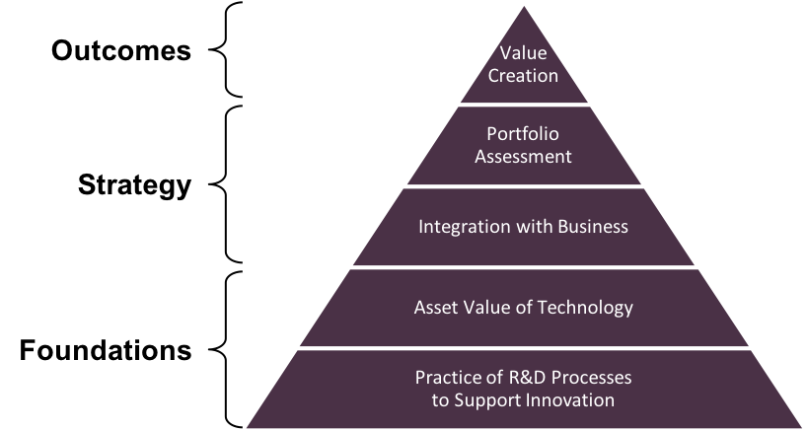
TVP and the current survey
      The TVP describes a framework for an entire innovation measurement system and, as such, it’s scope is broader than what might be reported on an innovation dashboard. Nevertheless, it is interesting to see which aspects of the TVP are reported on dashboards. The survey was not explicitly designed to reveal this, but some insight can still be gained.
    Value Creation
      The survey results confirm that showing value creation is an extremely important aspect of innovation dashboards. Leading indicators of potential project value are widely reported (83% of respondents), using both absolute (e.g., forecast earnings) and relative (e.g., forecast return on investment) measures. Project success (a lagging indicator) is also reported by almost all (98%) organizations.
    Strategy: Portfolio Assessment
      Almost all (98%) organizations illustrate their innovation portfolio using some for of categorization. Stage of development, impact and timeframe are the most commonly used categories.
    Strategy: Integration with Business
      Nearly 50% of organizations use their innovation dashboards to communicate their portfolio’s strategic alignment. For the remaining 50% alignment is addressed in other parts of their innovation process.
    Foundations: Asset Value of Technology; Practice of R&D Processes to Support Innovation
      The innovation dashboard survey focused largely on various aspects of innovation performance, and so it did not explore the “Foundations” components of the TVP. It is worth noting, however, that:
        When asked “Does your innovation dashboard include metrics on the state of innovation (i.e., your culture of innovation) in your organization?” only 2 organizations suggested they monitor any aspect of their innovation culture via their dashboard (they measured employee retention & engagement)
        One organization reported using their dashboard to share a metric related to an aspect of their innovation processes they were seeking to improve (engagement with clients).
The survey results highlight which aspects of the TVP are communicated via an innovation dashboard. The focus is Value Creation and Strategy.

Slide 45
Metrics over time
      In 2009 an IRI working group revisited the TVP and surveyed IRI membership on most commonly used metrics. The results of the survey are shown in Table 1. While most of the top metrics stayed the same, the 2009 study saw new metrics associated with sales of new products, level of business support and quality of people.
IRI surveyed members to identify the most commonly used metrics in 1994 and 2009.
1994 | 2009
 | For-profit | Not-for-profit
Financial return to the business Strategic alignment with the business Projected value of R&D pipeline Sales or gross proﬁts from new products Accomplishment of project milestones Portfolio distribution of R&D projects Market share Customer satisfaction surveys Development cycle time Gross profit margin Product quality and reliability (tie) | Financial return to the business Strategic alignment with the business Projected value of R&D pipeline Gross proﬁt margin Product quality and reliability Sales or gross proﬁts from new products Accomplishment of project milestones Achievement of R&D pipeline objectives Quality of R&D personnel Level of business approval of projects Comparative manufacturing costs (tie) | Strategic alignment with the business Accomplishment of project milestones Quality of R&D personnel Portfolio distribution of R&D projects Clarity of project goals Product quality and reliability Rating of project benefits by customers External peer evaluation of R&D Customer rating of technical capabilities Number of technical reports

Slide 46
How to establish your own innovation dashboard
3
Section Summary
The following pages describe a simple and quick approach to creating your own innovation dashboard. The approach, developed by Commodore Innovation, is inspired by the survey results and informed by broader understanding of companies’ innovation performance measurement systems.
For additional resources on innovation measurement and metrics, visit commodoreinnovation.co

Slide 47
Overview
1
Identify your audience
2
Understand their information needs
3
Choose what information to share
Dashboards have a number of functions, but their primary purpose is communication with leadership. Here’s a simple process to follow – inspired by the survey findings – if you’re updating or creating an innovation dashboard.
4
Build an MVP
5
Select software
6
Implement and launch
7
Review

Slide 48
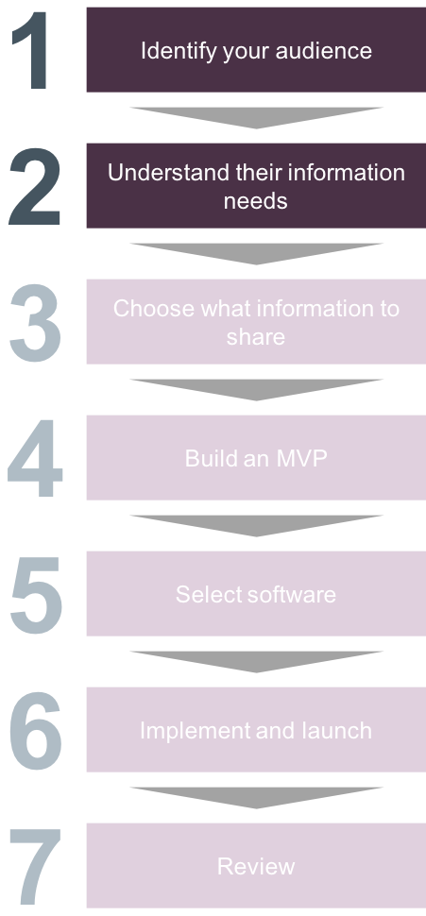
How to establish your own dashboard
1
2
      Just like you would for a new product/service concept, you’ll need to understand the
      “customers” of your dashboard. We know from the survey that dashboards are most often prepared for managers (of portfolios, business units, or functions), directors, or VPs. Take the time to make a list of the people who will likely have access to your dashboard, or to whom you’ll likely present dashboard results.
      You may already know the priorities and preferences of your audience, in terms of what
      information they need, and when they need it. If you don’t, now is a good time to have some brief, informal conversations with them about innovation measurement. Ask what they’re most interested in knowing, what decisions they’ll make on the basis of the dashboard, and how often they’ll want to be kept apprised. You’ll need to temper this with what you know about how information is/can be collected, and which metrics are best for the innovation context. Nonetheless, it’s useful to understand initial expectations.
IRI Member Quote "Dashboards are a great tool for communicating only the things that really matter.” Director of Innovation, industrial machinery and equipment supplier

Slide 49
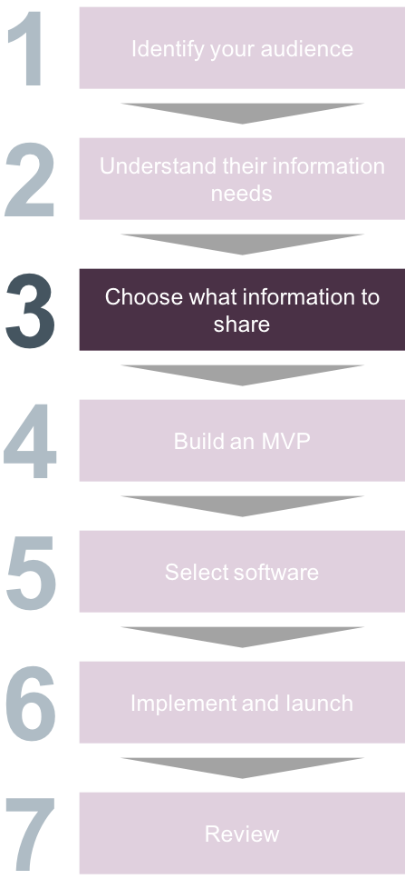
How to establish your own dashboard
3
      We find it helps to translate the information needs you heard in Step 2 above, into question
      format. You’ll end up with a list of questions like
        What is the risk-adjusted value of the projects in our innovation pipeline?
        How is our innovation portfolio balanced in terms of time to market?
        Are using resources efficiently?
        How well is our innovation portfolio aligned with corporate strategy?
      Identify which of these questions can be answered using metrics you already collect. If there are significant gaps for important questions, consider establishing new metrics.
      To establish new metrics, begin by generating a list of candidate metrics to answer the highest-priority questions. We recommend doing this with your team (i.e., those whose success will be judged by the dashboard metrics). They’ll be more invested in the successful implementation of the dashboard if they’ve been involved in its design – and can be on the lookout for potential unintended consequences. Working with your team, downselect to the metrics that best answer the questions.
      Consider whether each metric is:
      Actionable. What will be managed based on a given metric? A good metric enables you to make decisions and change course when necessary.
      Suitable. Does the metric match the context? Be cautious about applying traditional financial metrics, for example, to exploratory or breakthrough programs.
      Feasible. Can the data be collected? Make sure you consider costs (including your time) of data collection.
      We know from the survey that innovation dashboards commonly include measures of:
        project value (both financial, e.g., NPV, and non-financial, e.g., addressable market, for early stage projects)
        risk (most often assigning a simple category like high/medium/low)
        actual results (sales)
        strategic alignment (by assigning projects to categories that align with corporate strategy)

Slide 50
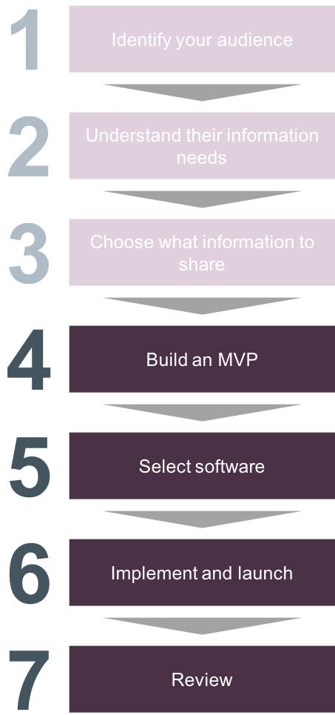
How to establish your own dashboard
4
      Once you have identified the questions you are seeking to answer, and the metrics you’ll
      use to answer them, create a minimum viable version of your dashboard. Do this by building a prototype in PowerPoint (with made-up data), then share it with a sample of your audience and ask them for their honest feedback. The process of doing this will help you determine whether you can use one dashboard for all audiences, or whether you need multiple, tailored dashboards. When you’re asking for feedback, it’s probably worth emphasizing you’d like feedback on whether the dashboard is providing the insight they need (i.e., don’t focus on the design and layout).
      Selection of an appropriate software in which to build your dashboard is important. From the
      survey we know most organizations don’t use off the shelf tools – Excel is the most commonly used tool! See page 31 for a full list of solutions used by survey participants. When selecting your software, the following considerations are likely to be important: ability to integrate with existing enterprise tools (e.g., ERP software, innovation management software, etc.), ease of data input (where integration with existing systems isn’t possible), and flexibility (you may need to make a number of changes to the data on the dashboard as you integrate feedback from users).
      You now have everything you need to build the dashboard, and launch!
      We know from the survey that most organizations don’t review their dashboards once they are in
      place. This can be a quick task and is a great way of ensuring the information provided on a dashboard remains relevant. Organizations that conduct periodic reviews typically do so by:
        Conducting interviews with key stakeholders (this could just be a 5-minute agenda item on a regularly scheduled meeting)
        Identifying gaps or other changes and prioritizing those changes
        Implementing high priority changes on a periodic schedule (e.g., annually)
6
7
5

