Slide 1
Case Study: Low Cost Solar Powered Light Non-Aqueous Phase Liquid (LNAPL) Recovery System
Olusola Ayilara, P.E., P.G.
PST-DCRP Section, Remediation Division
Texas Commission on Environmental Quality
Nathan Johnson, P.E.
Senior Project Manager, Antea® Group
Environmental Trade Fair 2018

Slide 2
Purpose
This case study was conducted at Tulia 66 Service Station (LPST 097453), Tulia, Texas:
To evaluate performance of solar powered LNAPL recovery system.

Slide 3
Site Information
Background
Release reported to Texas Water Commission (now TCEQ) in December 1990.
Initial LNAPL spill volume is unknown.
No threat of ongoing release.
LNAPL is immobile (movement of the LNAPL with respect to the water table).
The city drinking water is supplied from municipal sources and no water supply wells within a half mile radius of the site.

Slide 4
Site Information
Background
46 monitoring wells currently installed to delineate plume.
LNAPL measured in 27 wells with a maximum thickness of 4.35 ft.
The site was transferred to the Petroleum Storage Tank State Lead Program in 2011, when the Reimbursement Program ended and Responsible Party had the option of entering the Program.

Slide 5
Site Information
Site Geology
A perched zone overlying the Ogallala.
Consists of sandy clay from ground surface to ~50 feet below ground surface, and interlayered clayey sands and fine sands from ~50 to 125 feet below ground surface.
Depth to groundwater is ~106 feet below ground surface.
Groundwater flow to the southeast.

Slide 6
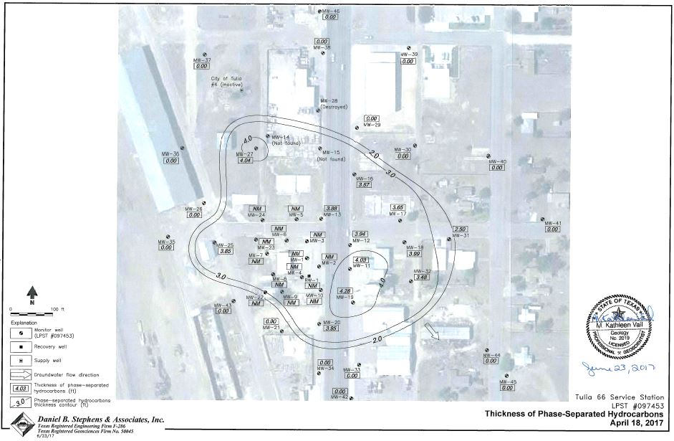
Site Information
Site
Site map showing LNAPL thickness measurement

Slide 7
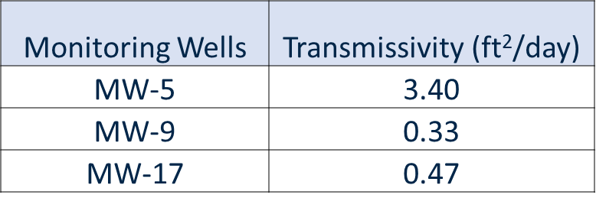
LNAPL Recovery System
Recovery Data - Antea Group performed LNAPL Baildown tests in June 2015 to determine LNAPL transmissivity values for corrective action plan development. - Calculated June 2015 LNAPL Baildown tests transmissivity values from site monitor wells MW-5, MW-9 and MW-17 are: MWs Transmissivity (ft²/day)
MW-5 3.40 MW-9 0.33 MW-17 0.47
- Additionally, LNAPL samples were collected from MW-5, MW-9, MW-17, and MW-19 for fingerprinting, because of widely differing transmissivity values. Fingerprint analysis indicated a commingled plume of gasoline and gasoline/diesel mixture.

Slide 8
LNAPL Recovery System
Recovery System
The Interstate Technology & Regulatory Council, (2009) indicated that significant LNAPL cannot be recovered at LNAPL transmissivity values of between 0.1 to 0.8 ft²/day.
Based on MW-5 transmissivity value greater than the reference range of 0.1 to 0.8 ft²/day, we concluded that pneumatic recovery system will be effective.

Slide 9
LNAPL Recovery System
Recovery System
Initially installed pneumatic skimmer pumps in 3 wells in March 2016, and later expanded to include 5 additional wells in April 2017.
The pneumatic skimmer pumps are driven by a solar powered air compressor (with 2 backup batteries) on an adjustable schedule to extract LNAPL from wells and pump the fluids into a horizontal 1,000 gallon double-walled steel holding tank housed in a mobile trailer.

Slide 10
LNAPL Recovery System Equipment Trailer
Equipment trailer deployed onsite with 1,000 gallons tank for extracted LNAPL storage.

Slide 11
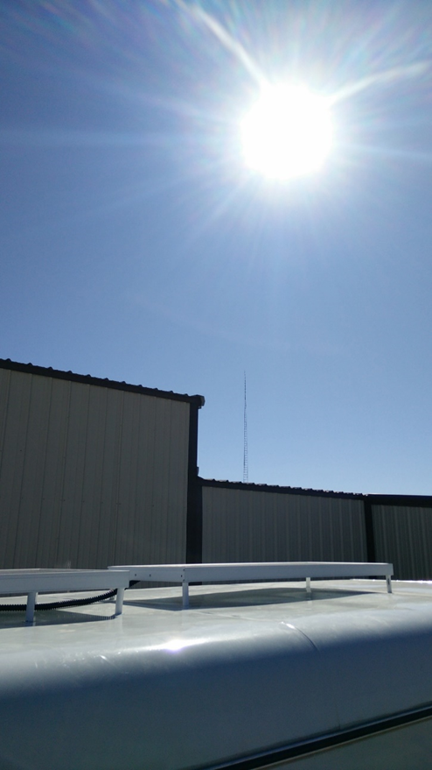
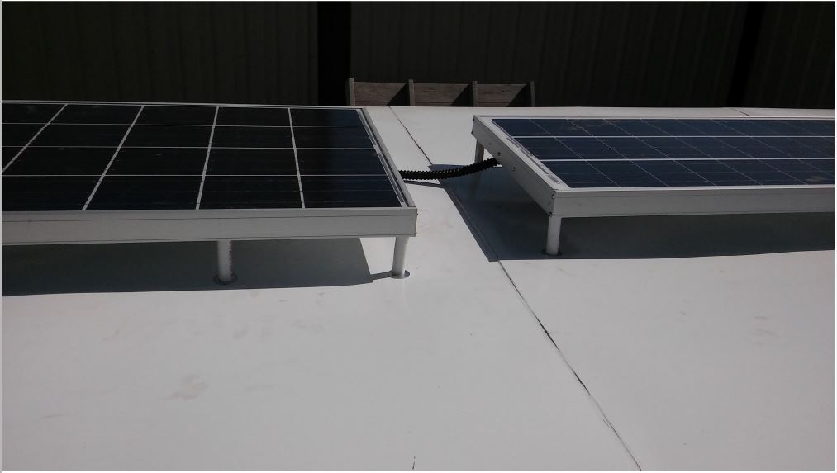
LNAPL Recovery System Equipment Trailer
Solar panels attached on top of trailer
Solar panels attached on top of trailer
Solar powered!

Slide 12
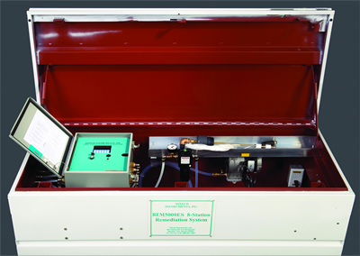
LNAPL Recovery System Controller Equipment Box
Batteries
Programmable Controller
Compressor
Compressed air lines to well pumps
The programmable controller operates up to 8 skimmers pumps intermittently, records run time.

Slide 13
LNAPL Recovery System
Recovery System
Selected skimmer pneumatic pumps are rated by the manufacturer to recover up to 8 gallons per hour.
Observed recovery rates average about 2.5 gallons per hour.
Recovery pumping rate is selected to closely match the LNAPL recharge rate for each well (each pump averages 30 minutes pumping per day).
Recovery pumping rates are controlled by daily per-well pumping frequency and duration.

Slide 14
LNAPL Recovery System
Recovery System
Only 5 of the 8 recovery wells are in operation every week, selected based on current LNAPL recharge and accumulation.
Recovery wells are measured periodically and skimmer pump depths adjusted to optimize LNAPL recovery.

Slide 15
LNAPL Recovery System

Slide 16
Observations
Based on this case study, the following observations are made regarding the low cost solar powered LNAPL recovery system:
LNAPL recovery using solar powered recovery system is cost effective and efficient.
Capital costs and Operation & Maintenance (O&M) costs of solar powered recovery system are low compared to other technologies (e.g. dual-phase extraction).
 | Capital costs | Annual O&M costs
solar powered recovery system | $60,000 | $25,000
Dual-phase extraction | $750,000 | $250,000
Notes:
Capital and O&M costs for dual-phase extraction depend on site size and complexity.
Annual O&M costs for DPE include labor, electricity, sampling, etc.
Annual O&M costs for solar powered recovery system include labor and fluids disposal.

Slide 17
Observations
Note: O&M cost per pound excludes the cost of equipment purchase and installation

Slide 18
Observations
The recovery system has collectively recovered approximately 11,988 lbs (1,691 gallons) of LNAPL from April 2016 through March 2018.
LNAPL is recovered with little or no water production.
Small radius of influence out from the recovery well.
The system is mobile.
Site-specific factors must be considered in the design and implementation of any LNAPL recovery system.

Slide 19
Observations

Slide 20
Future Plans
Future LNAPL Recovery System Location
Current LNAPL Recovery System Location

Slide 21
Questions?
Contact Information
Olusola Ayilara, P.E., P.G.
PST-DCRP Section, Remediation Division
Texas Commission on Environmental Quality
(512) 239 2163
olusola.ayilara@tceq.texas.gov

