Slide 1

Reducing Mental Health Stigma
in the Blind and Low Vision Community
Janice Barrocas, LPC, CRC
Notes:
Open by saying thank you for the work you do in vision rehabilitation
Here we stand at the intersection
I arrive at this crossroads from the other direction [from the street called mental health]
How I got here [my role and background]
Interdisciplinary conversation

Slide 2




Learning Objectives
Reduce stigma among professionals
Reduce stigma in the community
Encourage a cultural shift
Creating safe spaces for blind and low vision individuals to discuss mental health
Addressing biases and misconceptions within the rehabilitation community
Moving toward integrated approaches to vision rehabilitation and emotional wellbeing

Slide 3




Understanding Mental Health Stigma
What is stigma?
Public, self, and institutional stigma
Negative attitudes and beliefs that lead to discounting mental health needs in people we serve
Different forms of stigma that operate at societal, personal, and organizational levels
How it shows up in blindness-specific contexts
Unique manifestations within vision rehabilitation settings and blind communities

Slide 4

Unique Mental Health Stressors
Adjustment to vision loss as trauma
The psychological impact of vision changes can trigger trauma responses
Isolation and independence loss
Reduced mobility and accessibility can lead to social withdrawal
Societal misunderstanding
♢ Misconceptions about blindness impact mental health
♢ Fear of pity, appearing “weak,” or victimization
♢ Inaccessible environments

Slide 5
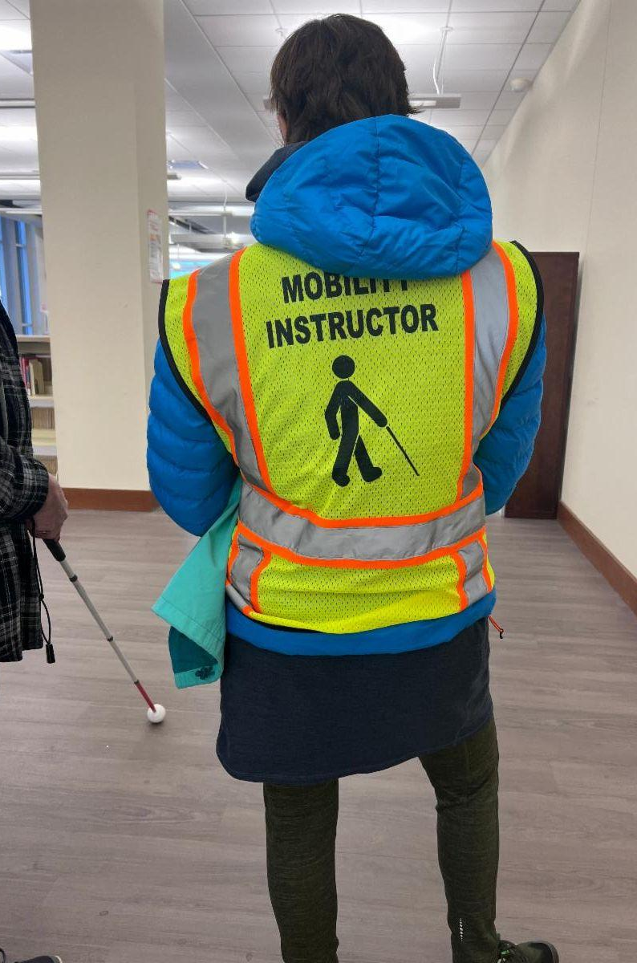


What Keeps Mental Health in the Shadows?
Cultural norms to "push through"
Lack of blind/low vision role models speaking out
Silence from professionals
These barriers create a cycle of silence that prevents open discussion about mental health challenges in the blind and low vision community.

Slide 6




What Can I do?
Empowering language
Use person-first language and avoid stigmatizing terms when discussing mental health and vision loss
Peer modeling
Connect clients with others who have successfully navigated similar challenges
Open interdisciplinary dialogue
Ascribe new meaning to common behaviors

Slide 7





Psychological First Aid
Listen without judgment
Create a safe space for clients to express their feelings about vision loss
Validate feelings
Acknowledge that emotional responses to vision changes are normal and expected
Offer hope
Express confidence in ability to develop resilience and adapt to vision loss
Connect to resources
Provide information about accessible mental health services and support groups

Slide 8

Cultural Shift Starts with Us
Reframe addressing mental health as strength
Seeking help demonstrates courage and self-awareness
Baby steps add up
Noticing and pointing out examples of anxiety or fear, effective responses to same
Build professional partnerships
Develop relationships with mental health providers who understand vision loss

Slide 9

Practice Scenario & Reflection
Scenario: A client cancels multiple appointments and seems withdrawn.
What would you say?
What resources could you offer?
Reflect on trauma-informed responses
Consider open-ended questions that express concern without judgment
Think about accessible support options in your community
How can you approach the situation with sensitivity to potential trauma?
Notes:
In my counseling practice I've observed a correlation between learner's perception of the stressor and their emotional well being and their personal resources

Slide 10

Closing & Next Steps
Revisit objectives
Reduce stigma among professionals
Reduce stigma in the community
Encourage a cultural shift
Share referral resources
988 Crisis Line
Introduce emotional check-ins
Thank you! Q&A

Slide 11
References
Corrigan, P. W., & Watson, A. C. (2002). Understanding the impact of stigma on people with mental illness. World Psychiatry, 1(1), 16–20.
Substance Abuse and Mental Health Services Administration (SAMHSA). (2014). SAMHSA's concept of trauma and guidance for a trauma-informed approach (HHS Publication No. SMA14-4884). https://ncsacw.samhsa.gov/userfiles/files/SAMHSA_Trauma.pdf
Hayward, L. M., & Bright, M. A. (1997). Blindness and psychological well-being: Implications for health professionals. Journal of Visual Impairment & Blindness, 91(1), 6–14.

Slide 12
Feel free to contact me at:
Janice Barrocas, LPC, CRC
Atlanta, Georgia
janice@adjustingtovisionloss.com
470-635-9499 call or text

