Slide 1
Getting to yes … and

Slide 2
Every economy has a problem.

Slide 3
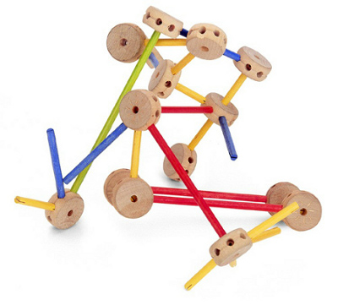

Slide 4
business solutions
technology solutions
increased capabilities

Slide 9
Don't be afraid to take a big step.
You can't cross a chasm in two small jumps.
David Lloyd George, former British Prime Minister

Slide 10
