Slide 1

APTA Academy of Aquatic Physical Therapy
January 25, 2025
Paul Rockar Jr., PT, DPT, MS
President, Board of Trustees
Barbara Malm, MBA
CEO

Slide 2
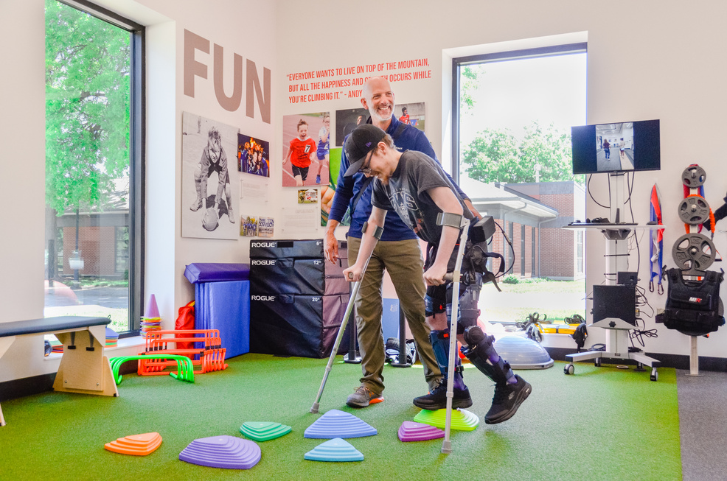
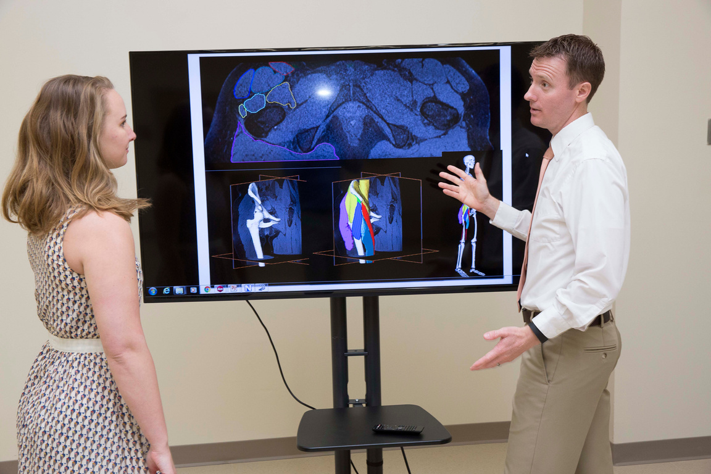
ABOUT
We fund research and develop researchers to optimize movement and improve the health of society
RESEARCH
EDUCATION
Research that helps improve practice and optimize patients’ movement and well-being
Education and development of a highly qualified, diverse, and inclusive next generation of researchers.

Slide 3

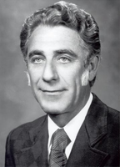



A BRIEF HISTORY
1977
1979
1984
1991
2002
2013
Charles Magistro, PT, FAPTA spearheads the change of the Physical Therapy Fund to the Foundation for Physical Therapy.
Foundation creates Clinical Research Network (PTClinResNet), a 3-year, $1.5M, multi-site study focused on 4 areas.
Foundation celebrates its 5th birthday. Research grants totaled $306k in its first five years.
First Clinical Research Center at the University of Iowa funded $200k/yr for 3 years focused on developing methodologies to document the clinical effectiveness of PT interventions.
$3M campaign launched to support health services and health policy research.
Completed in under 1 year with a $1M APTA gift and $1+M in gifts from Components..
Foundation for Physical Therapy is incorporated as a charitable organization.

Slide 4







WHERE WE ARE TODAY
2025
Researchers who began their careers with Foundation funding have established an evidence base the profession now regularly relies on to treat patients and demonstrate the value of physical therapy to all stakeholders.
>$23.4 million in funding awarded
>700 researchers funded
>$930 million in follow-on funding awarded to Foundation-funded researchers
453 peer reviewed publications submitted
400 scientific abstracts presented
28 trainees trained in health services research

Slide 5
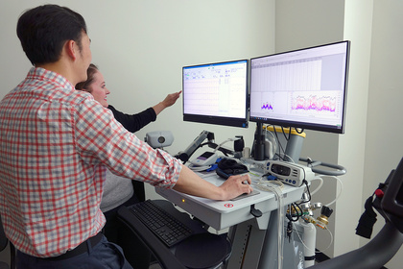
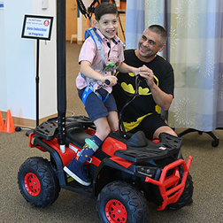
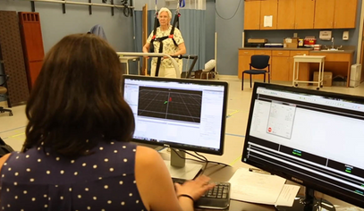
OUR FUTURE
Investing in physical therapy research today will yield lasting benefits for the profession for decades to come.
2025 & beyond
The future of Foundation funding includes:
Developing the next generation of physical therapist researchers
Building health services evidence base in physical therapy
Supporting cost-effectiveness research to demonstrate value of physical therapy to payers and policymakers

Slide 6
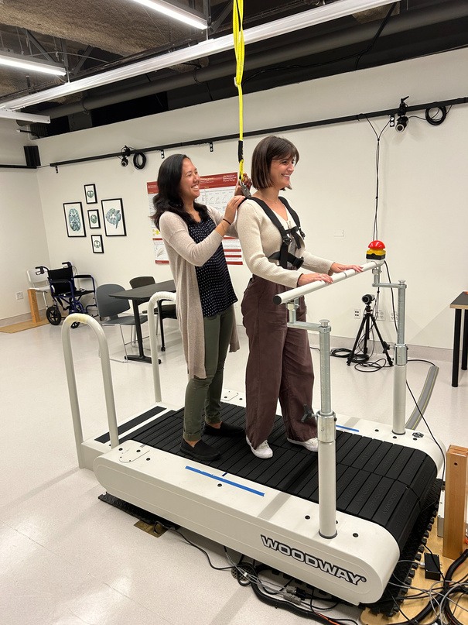
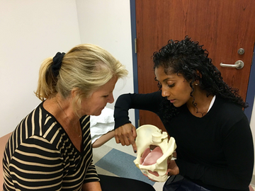
FUNDING OPPORTUNITIES
What we fund
  Doctoral Scholarships
  Post-doctoral Fellowships
  Research Grants
Eligibility
All applicants must be licensed PTs or PTAs and members of APTA
  Doctoral Scholarships
    Pre-candidacy doctoral students
    Doctoral candidates
  Post-doctoral Fellowships
    Doctoral degree within the past two years
  Research Grants
    Emerging investigators
    Established investigators

Slide 7
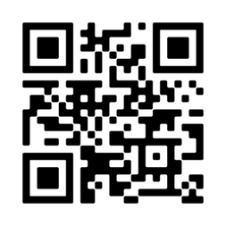

THANK YOU!
Any questions?
Scan here to connect with us and sign up for our newsletter!

