Slide 1
The Changing Landscape of PrEP and
New Options in 2025 Michelle Collins-Ogle, MD, FAAP, AAHIVS
Associate Professor of Pediatrics
Division of Infectious Diseases Children’s Hospital at Montefiore Medical Center Bronx, NY Wm David Hardy, MD, AAHIVS Clinical Professor of Family Medicine Division of Street Medicine-HIV Consultant Keck School of Medicine of USC Los Angeles, CA

Slide 2

This activity is jointly provided by the Partners for Advancing Clinical Education (Partners) and the American Academy of HIV Medicine.
This activity is supported an by independent educational grant from Gilead Sciences.

Slide 3
Target Audience This activity has been designed to meet the educational needs of physicians, physician assistants, nurse practitioners, and pharmacists; other healthcare providers, such as nurses, nutritionists, social workers, and case managers are also encouraged to attend.
Statement of Need/Program Overview Academy credentialed providers and members are very adept at prescribing and retaining patients on PrEP, however, shelter in place and stay at home orders from the early COVID pandemic in the U.S. interrupted patients abilities to test for HIV and STIs and have associated laboratory monitoring. Recognizing that the recommended quarterly testing and monitoring requirements may serve as a barrier to engaging and retaining “hard to reach” patients that may benefit rom PrEP. This series will serve as an elevated discussion on higher-level PrEP topics including different formulations of PrEP and when to use them; HIV testing, laboratory monitoring, and taking a sexual health history; interpreting clinical laboratory information for the rare adherent patient that fails on PrEP and recommendations for initial ARV treatment therapies, future PrEP formulations, and how to reach and retain hard to engage PrEP patients.

Slide 4

Joint Accreditation Statement
In support of improving patient care, this activity has been planned and implemented by the Partners for Advancing Clinical Education (Partners) and the American Academy of HIV Medicine. Postgraduate institute for Medicine is accredited by the American Council for Continuing Medical Education (ACCME), Accreditation Council for Pharmacy Education (ACPE) and the American Nurses Credentialing Center (ANCC), to provide continuing education for the healthcare team.

Slide 5
Physician Continuing Medical Education
CREDIT DESIGNATION
Partners designates this live activity for a maximum of 1.0 AMA PRA Category 1 Credits™. Physicians should claim only the credit commensurate with the extent of their participation in the activity.

Slide 6
Pharmacist Continuing Education
CREDIT DESIGNATION
Partners designates this continuing education activity for 1.0 contact hour(s) (0.1 CEUs) of the Accrediting Council for Pharmacy Education.
(Universal Activity Number JA4008073-9999-25-368-L02-P)
Type of Activity: Application
Upon completion of the online evaluation, your credit will be submitted to CPE Monitor. Pharmacists have up to thirty (30) days to complete the evaluation and claim credit. Please check your NABP account within thirty (30) days to make sure the credit has posted.

Slide 7
Nursing Continuing Professional Development
CREDIT DESIGNATION
The maximum number of hours awarded for this Nursing Continuing Professional Development Activity is 1.0 contact hours.

Slide 8
Disclosure Information
Disclosure of Conflicts of Interest
Partners requires every individual in a position to control educational content to disclose all financial relationships with ineligible companies that have occurred within the past 24 months. Ineligible companies are organizations whose primary business is producing, marketing, selling, re-selling, or distributing healthcare products used by or on patients.
All relevant financial relationships for anyone with the ability to control the content of this educational activity are listed below and have been mitigated according to Partners’ policies. Others involved in the planning of this activity have no relevant financial relationships.

Slide 9
Faculty Disclosures:
The faculty reported the following financial relationships or relationships to products or devices they have with ineligible companies:
Dr. Collins-Ogle, faculty for this educational activity, has no relevant financial relationships.
Dr. Hardy, faculty for this educational activity has the following financial relationships. He receives consulting, advisory or speakers fees from Gilead Sciences, Merck & Co. and ViiV Healthcare; and is a member of the FDA’s Antimicrobial Drug Advisory Committee (AMDAC).

Slide 10
Disclosure of Unlabeled Use
This educational activity may contain discussion of published and/or investigational uses of agents that are not indicated by the FDA. The planners of this activity do not recommend the use of any agent outside of the labeled indications.
The opinions expressed in the educational activity are those of the faculty and do not necessarily represent the views of the planners. Please refer to the official prescribing information for each product for discussion of approved indications, contraindications, and warnings.

Slide 11
Disclaimer
Participants have an implied responsibility to use the newly acquired information to enhance patient outcomes and their own professional development. The information presented in this activity is not meant to serve as a guideline for patient management. Any procedures, medications, or other courses of diagnosis or treatment discussed or suggested in this activity should not be used by clinicians without evaluation of their patient’s conditions and possible contraindications on dangers in use, review of any applicable manufacturer’s product information, and comparison with recommendations of other authorities.

Slide 12
Fee Information
There is no fee for this educational activity.

Slide 13

Pre-Exposure Prophylaxis (PrEP)

Slide 14
The Changing Landscape of PrEP
Objectives
Describe the latest algorithms and options for PrEP to prevent HIV acquisition among at-risk populations focusing on long-acting injectable medications
Explain common structural challenges in improving PrEP uptake, adherence and persistence
Discuss the management of challenging cases, including acute HIV seroconversion within the context of PrEP
Review current and emerging guidelines, clinical efficacy and patient suitability of PrEP options
Analyze how marginalizing science, politicizing HIV prevention— including anti-DEI rulings, restrictions on gender-affirming healthcare, and Medicaid cuts negatively impact PrEP access for vulnerable populations.

Slide 15
Implementation Plan to End the HIV Epidemic in the United States
Focus initially on high-incidence geographic areas
48 counties; Washington, DC; and San Juan, Puerto Rico represent > 50% of new HIV diagnoses
7 states with high rural HIV burdens
Emphasize early diagnosis, immediate treatment, engagement
Treat rapidly to stop transmission
Increase viral suppression from 63% to at least 95%
Expand PrEP
Increase use by at-risk population to at least 50% by 2025
Rapid and overwhelming response to emerging HIV clusters
Monitor for early detection of clusters
Treat each new diagnosis as a “sentinel event”
CDC. Ending the HIV Epidemic: A Plan for America. https://www.cdc.gov/endhiv/index.html.
CDC. Ending HIV transmission. https://www.cdc.gov/vitalsigns/test-treat-prevent/index.html.
Notes:
PrEP, pre-exposure prophylaxis.

Slide 16

Combination HIV Prevention
Biomedical Interventions
PrEP
PEP
TasP
Decision Making Interventions (Behavioral)
Obtain a thorough Sexual History
Structural Interventions
Defunding Prevention Programs
DEI used as a weapon against HIV Prevention
Structural racism exacerbating disparities in HIV prevention

Slide 17
Need for PrEP Is Much Greater Than Population It Reaches
CDC study estimate of population need for PrEP: 2,254,489 people
ie, number of people needing to receive PrEP to prevent an additional HIV infection in populations whose HIV incidence is ≥1% per yr:
Men who have sex with men
People who have heterosexual sex
People who inject drugs
Population actually receiving a PrEP prescription: 366,359 people
PrEP-to-Need Ratio: 366,359/2,254,489 = 16.2%
Kourtis. Ann Epidemiol. 2025;106:48.
Notes:
PrEP, pre-exposure prophylaxis.
Recent CDC study estimated that the total population need for PrEP is 2,254,489 people
In 2021, 366,359 individuals in the US received a PrEP prescription
Population need for PrEP: number of people needed to receive PrEP to prevent an additional HIV infection in populations whose HIV incidence is ≥1% per year
Populations with annual HIV incidence ≥1%:
Men who have sex with men, people who have heterosexual sex, people who inject drugs
366359/2254489

Slide 18
2024 PrEP Use Data
AIDSVu June 2025

Slide 19
Universal PrEP: Recommended by Multiple Guidelines
Most current guidelines recommend that all sexually active adults and adolescents should be informed about PrEP¹⁻³
CDC guidelines also recommend that people who inject drugs should be offered PrEP in combination with substance use disorder treatment or Syringe Services Programs³
1. USPSTF. PrEP Recommendations. 2023. 2. ACOG. Practice Advisory. 2022. 3. CDC. PrEP Guidelines. 2021.
Notes:
PrEP, pre-exposure prophylaxis; SSP, syringe services programs.

Slide 20
PrEP Regimen Options: Something for Everyone
Notes:
PrEP, pre-exposure prophylaxis.

Slide 21


What Is the Ideal PrEP Regimen?
The one that each person decides to take
The “ideal” can change depending on each person's journey
FTC/TAF or FTC/TDF (oral, daily)
CAB (IM injectable, Q2M)
CAB (IM injectable)
LEN (SC injectable, Q6M)
1. FTC/TAF PI. 2. FTC/TDF PI. 3. Cabotegravir PI. 4. Lenacapavir PI.
Notes:
CAB, cabotegravir; FTC, emtricitabine; PrEP, pre-exposure prophylaxis; TAF, tenofovir alafenamide; TDF, tenofovir disoproxil fumarate.

Slide 22




Evidence Supporting PrEP Use
Exposure Route or Population | Daily FTC/TDF | On-Demand FTC/TDF | Daily FTC/TAF | Every-2-Mo IM CAB | Every-6-Mo SC LEN
Insertive anal/vaginal sex
Receptive anal sex
Receptive vaginal/neovaginal sex
Injection drug use
Pregnant/breastfeeding women
Initiate with double dose
CrCl 30-60 mL/min
Osteopenia or osteoporosis
?
Gandhi. JAMA. 2022;329:63. Gandhi. JAMA. 2024;333:609. Landovitz. JAMA. 2025;334:638-639. Patel. MMWR Morb Mortal Wkly Rep 2025;74:541.
Notes:
CAB, cabotegravir; CrCl, creatinine clearance; FTC, emtricitabine; LEN, lenacapavir; PrEP, pre-exposure prophylaxis; TAF, tenofovir alafenamide; TDF, tenofovir disoproxil.

Slide 23
Daily Oral FTC/TDF vs FTC/TAF for PrEP
Effectiveness, % | FTC/TDF | FTC/TAF
Men who have sex with men and transgender women | ~99 | ~99
Heterosexual men and women | ~99 | Unknown
People who inject drugs | 74-84 | Unknown
Bone and renal health
Incremental changes in lab markers of bone metabolism and renal function with FTC/TDF, but no differences in clinically relevant AEs vs FTC/TAF
Lipid and weight changes
Higher rates of triglyceride elevations and weight gain with FTC/TAF vs FTC/TDF
Generic available for FTC/TDF (not for FTC/TAF)
Krakower. Ann Intern Med. 2020;172:281. CDC PrEP guidelines. 2025.
Notes:
AE, adverse event; BMD, bone mineral density; FTC, emtricitabine; LDL, low-density lipoprotein; PrEP, pre-exposure prophylaxis; TAF, tenofovir alafenamide; TDF, tenofovir disoproxil fumarate.

Slide 24
On-Demand Oral FTC/TDF PrEP for HIV Prevention in Men Who Have Sex With Men
ANRS IPERGAY: double-blind, randomized study of on-demand FTC/TDF vs placebo as PrEP for men who have sex with men in France and Canada^{1,2}
On-demand “2-1-1” PrEP regimen³:
On-demand FTC/TDF not recommended for: HBV coinfection, those who may have difficulty adhering to 2-1-1 dosing regimen, and populations at risk of HIV acquisition from vaginal exposure³
2 FTC/TDF pills
1 FTC/TDF pill
1 FTC/TDF pill
Sex
Study Phase | N | Risk Reduction, % (95% CI) | P Value
Placebo controlled, randomized¹ | 400 | 86 (40-98) | .002
Open-label extension² | 361 | 97 (81-100) | NR
2-24 hr before sex
24 hr after first 2 pills
48 hr after first 2 pills
1. Molina. NEJM. 2015;373:2237. 2. Molina. Lancet HIV. 2017;4:e402. 3. CDC PrEP guidelines. 2025.
Notes:
FTC, emtricitabine; HBV, hepatitis B virus; NR, not reported; PrEP, pre-exposure prophylaxis; TDF, tenofovir disoproxil fumarate.

Slide 25
Key Barriers by Principal Population
Principal Population
Key Barriers
Adolescents
Dissatisfaction with medical team, lack of support
Racial and ethnic minority groups
Medical mistrust, stigma, PrEP misconceptions
Cisgender women
Competing priorities, poor PrEP awareness, poor PrEP access, low perceived risk for HIV
Transgender individuals
DDIs with GAHT, medical mistrust, stigma, transphobia
People who inject drugs
Cost, ability to remember to take PrEP daily, social barriers (eg, unstable housing), stigma
Hightow-Weidman. JMIR Res Protoc. 2018;7:e10365. Okafor. Acquir Immune Defic Syndr. 2020;85:23. Crooks. Prev Med Rep. 2022;31:102062. Pasipanodya. BMC Womens Health. 2021;21:220. Dang. AIDS Patient Care STDS. 2022;36:236. Allen. AIDS Behav. 2020;24:1942.
Notes:
DDI, drug–drug interaction; GAHT, gender-affirming hormone therapy; PrEP, pre-exposure prophylaxis.

Slide 26

HIV Prevention for African-American Women
African-American women make up 62 % of women diagnosed with HIV in the U.S.
Disproportionately higher than women of other ethnicity
Lifetime risk for African-American: 1 in 54
Lifetime risk for Hispanic/Latins: 1 in 256
Lifetime risk for Caucasian: 1 in 941
https://www.cdc.gov/hiv/pdf/group/gender/women/cdc-hiv-women-and-PrEP-discussion-series.pdf
Image credit: babylonradio.com

Slide 27
Women and Barriers to PrEP
Women’s perceived lack of knowledge about PrEP, HIV-related health literacy, and personal HIV risk
Challenges in identifying women who might benefit from PrEP and assessing women’s risk of acquiring HIV
Healthcare providers’ bias based on a woman’s race, social class, or sexual behavior that might hinder effective communication about HIV risk and PrEP (gender dynamics)
Lack of resources and infrastructure to provide PrEP for women in settings and venues they frequently use for healthcare
www.cdc.gov/hiv/pdf/group/gender/women/cdc-hiv-women-and-PrEP-discussion-series.pdf

Slide 28
HIV Prevalence among Transgender Persons
Trans women:
Trans men:
14.1%
(95% CI = 8.7%, 22.2%)
3.2%
(95% CI = 1.4% to 7.1%)
Trans women
African-American 44.2%
Latina 25.8%
White 6.7%
Identified risk factors for HIV acquisition among trans women:
More sexual partners
More condomless sex
More STIs
Higher rates of substance use
More transactional sex (sex for money, food, drugs, shelter)
Becasen JS, et al. Am J Public Health. 2019; 109(1):e1-e8;
Golub SA, et al. J Acquir Immune Defic Syndr. 2019;82:e1-e7;
Reisner SL, et al. J Int AIDS Soc. 2019;22:e25391;
Nisly NL, et al. Clin Obstet Gynecol. 2018;61(4):674-686.

Slide 29
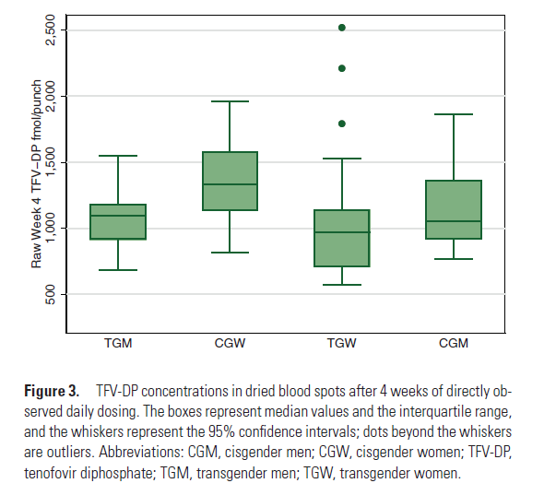
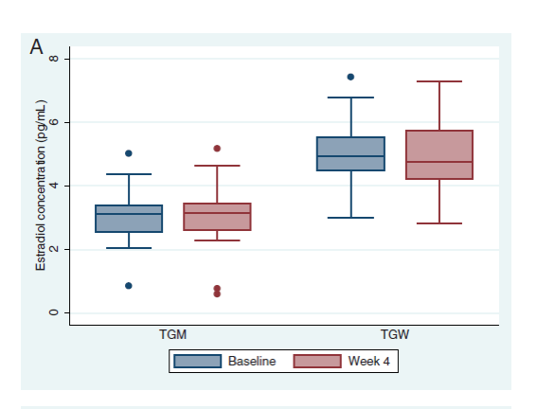
HIV Risk and Prevention in Transgender People: Results from the iBrEATHe Trial
iBrEATHe: studied 24 TGW taking estradiol and 15 CGM taking DOT dosing of FTC/TDF for PrEP
TFV-DP concentrations during PrEP, TGW vs CGM
Estradiol concentrations among TGW before and during PrEP
Mean difference −12%
[95% CI, −27%, 7%],
P = .21
2,500
8
2,000
6
Raw Week 4 TFV-DP fmol/punch
Estradiol concentration (pg/mL)
1,500
4
1,000
2
No statistically significant difference
500
0
TGW
CGM
Baseline
Week 4
TFV-DP=Tenofovir Diphosphate; PrEP=Pre-Exposure Prophylaxis; CGM=Cisgender Men; TGW=Transgender Women; 95% CI=95% Confidence Interval
Becasen JS, et al. Am J Public Health. 2019 ; 109(1):e1-e8; Deutsch MB, et al. Lancet HIV. 2015; 2(12):e512-e519; 109(1):e1-e8;
Grant RM, et al. Clin Infect Dis. 2020;ciaa1160.

Slide 30
What’s New in HIV Prevention?

Slide 31
Why Might We Need Long-Acting HIV Prevention?
Daily oral PrEP effective but has not worked equally well for all populations
Long-acting options may help for:
Unwanted or unplanned sex acts
Alcohol or drug use, when daily adherence may drop
Stigma challenges associated with daily medication
Travel with frequent time zone changes
Offering choice
Golub. Curr HIV/AIDS Rep. 2018;15:190. Flexner. Curr Opin HIV AIDS. 2022;17:192.
Notes:
PrEP, pre-exposure prophylaxis.

Slide 32
PURPOSE 1 and PURPOSE 2: Q6M LEN for PrEP_ UPDATES
Multicenter, randomized, double-blind phase III trials
PURPOSE 1: Cisgender Women Aged 16-25 yr
(Median follow-up: 44.0 wk)
PURPOSE 2: Cisgender Men, Transgender Men and Women, Nonbinary People (Median follow-up: 39.4 wk, n = 752 aged 16-25 yr)
4.0
4.0
2.41
2.37
3.0
2.02
1.69
3.0
2.0
0.93
HIV Incidence per 100 PY (95% CI)
2.0
HIV Incidence per 100 PY (95% CI)
1.0
1.0
0
0.10
0.0
0.0
Background
LEN 0 infections 1939 PY
FTC/TAF 39 infections 1932 PY
FTC/TDF 16 infections 949 PY
Background
LEN 2 infections 1938 PY
FTC/TDF 9 infections 967 PY
2 new incident infections post-primary analysis
1 additional incident infection post-primary analysis. All 3 had LEN-resistant HIV
Of note: 5 of 8 LEN patients with acute HIV infection at BL developed LEN resistance
Lenacapavir PI. Kelley. IDWeek 2024. Abstr 81b. Gill. IAS 2025. Abstr OAC0503.
Notes:
FTC, emtricitabine; LEN, lenacapavir; PrEP, pre-exposure prophylaxis; PY, person-years; TAF, tenofovir alafenamide; TDF, tenofovir disoproxil fumarate.

Slide 33
Lenacapavir Dosing and Interactions
LEN Dosing
Initiation | Day 1: 927 mg subcutaneously (2 x 1.5 mL injections) and 600 mg PO (2 x 300 mg tablets) Day 2: 600 mg PO
Continuation | 927 mg subcutaneously every 6 mo from date of last injection +/- 2 wk
Drug interactions
Substrate of P-gp, UGT1A1, and CYP3A; inhibitor of CYP3A and P-gp
Dose modification: recommended if initiating with strong or moderate CYP3A4 inducers
Refer to labeling for specific adjustments
Coadministration: not recommended with combined P-gp, UGT1A1 and strong CYP3A inhibitors; for CYP3A or P-gp substrates, see substrate PI for dosing and safety monitoring
Administer via SC injection into the abdomen or thigh (alternative) by a healthcare professional
Renal or hepatic adjustment not necessary
accessdata.fda.gov/drugsatfda_docs/label/2025/220020s000lbl.pdf.
Notes:
LEN, lenacapavir.

Slide 34
Lenacapavir PK Study: Safety
AEs Occurring in ≥ 5 Patients, n (%) | LEN 300 mg or Placebo, 1 x 1.0 mL (n = 10) | LEN 900 mg or Placebo, 3 x 1.0 mL (n = 10) | LEN 900 mg or Placebo, 2 x 1.5 mL (n = 10) | Total LEN or Placebo (N = 30)
Injection-site induration | 3 (30) | 8 (80) | 10 (100) | 21 (70)
Injection-site pain | 0 | 6 (60) | 8 (80) | 14 (47)
Injection-site erythema | 1 (10) | 5 (50) | 4 (40) | 10 (33)
Headache | 3 (30) | 4 (40) | 3 (30) | 10 (33)
Injection-site swelling | 0 | 4 (40) | 4 (40) | 8 (27)
Injection-site nodule | 2 (20) | 3 (30) | 0 | 5 (17)
No patient experienced grade 2-4 treatment-related AEs; no discontinuations due to AEs
Grade 3/4 laboratory abnormalities occurred in 7 (23%) patients; none was of clinical relevance
ISRs occurred in 80% of patients; all grade 1 severity, most resolved within days
Begley. AIDS 2020. Abstr PEB0265.
Notes:
AE, adverse event; ISR, injection-site reaction; LEN, lenacapavir; PK, pharmacokinetic.

Slide 35
HPTN 083 and 084: LA IM CAB Q2M vs Daily Oral FTC/TDF for PrEP
International, randomized, double-blind phase IIb/III (083) and phase III (084) trials
LA IM CAB superior to daily oral FTC/TDF in both trials
HPTN 083¹
N = 4566 men who have sex with men and transgender women
12 incident infections on LA CAB
4 with on-time injections
HR for CAB vs FTC/TDF: 0.34 (95% CI: 0.18-0.62)
18 additional infections identified up to 1 yr after study unblinding (2 with on-time injections)^{2,3}
HPTN 084⁴
N = 3224 cisgender women
4 incident infections on LA CAB
1 with on-time injections
1 later determined to be infected at baseline
2 with no CAB injections or recent exposure
HR for CAB vs FTC/TDF: 0.12 (95% CI: 0.05-0.31)
Pregnancies: No safety issues with mothers, neonates
1. Landovitz. NEJM. 2021;385:595. 2. Landovitz. Lancet HIV. 2023;10:E767. 3. Marzinke. Antimicrob Agents Chemother. 2023;67:e0005323. 4. Delany-Moretlwe. Lancet. 2022;399:1779.
Notes:
CAB, cabotegravir; FTC, emtricitabine; LA, long-acting; PrEP, pre-exposure prophylaxis; TDF, tenofovir disoproxil fumarate.

Slide 36
LA CAB PrEP: Post-approval, Real-life Cohort Studies
OPERA¹
Subanalysis of EHR of n = 764 people who received LA CAB PrEP
85% had on-time LA CAB initiation, of which 69% received all injections on time
n = 2 HIV seroconversions (0.3%)
65% received HIV testing at initiation
50% received HIV testing at all subsequent injections
TRIO²
Subanalysis of EHR of n = 526 people who received LA CAB PrEP
Of those with ≥2 injections, 84% received all injections on time
Of those with ≥5 injections, 65% received all injections on time
No HIV seroconversions
Frequency of testing was inconsistent
Community Pharmacist–Managed LA CAB PrEP Program³
At 26 wk, 81% (35/43) were still on LA CAB PrEP, adherence was 94% (115/122 on-time injections)
1. Mills. IDWeek 2024. Abstr 508. 2. Ramgopal. IDWeek 2024. Abstr 505. 3. Tung. IDWeek 2024. Abstr 506.
Notes:
Ab, antibody; Ag, antigen; CAB, cabotegravir; HER, electronic health record; FTC, emtricitabine; LA, long-acting; TAF, tenofovir alafenamide; PrEP, pre-exposure prophylaxis; ARV, antiretroviral.

Slide 37
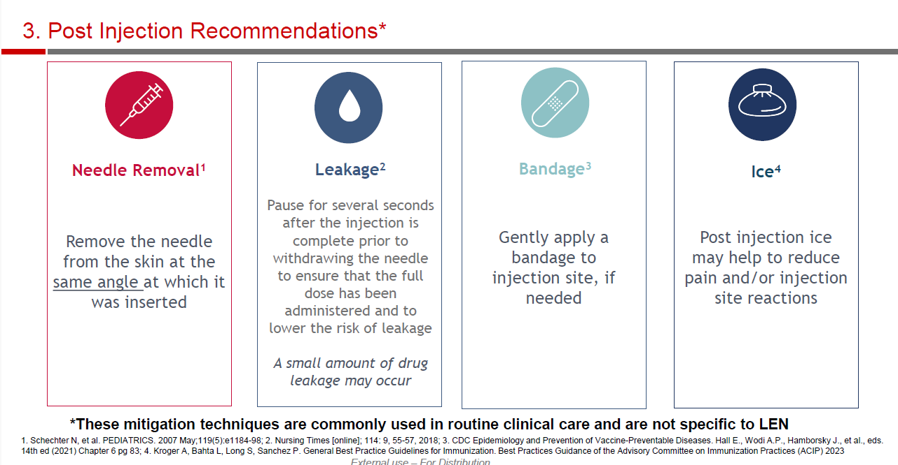
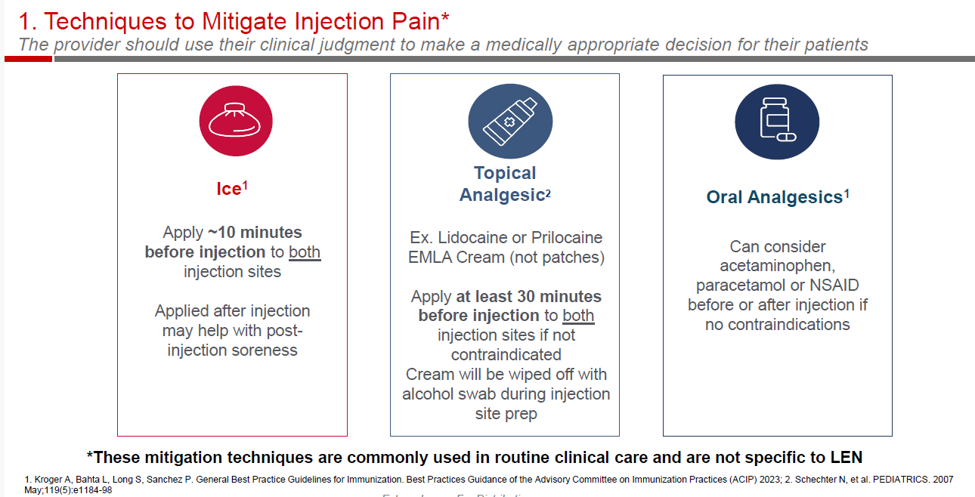






Mitigating Injection Site Pain and Postinjection Recommendations
PrEP Provider Training Toolkit: www.jhpiego.org/HIVPrEPToolkit
Ice
Apply before or after injection to aid with soreness
Needle Removal
Remove needle from skin at the same angle as it was inserted
Topical Analgesic
Eg, Lidocaine, prilocaine EMLA cream
Apply 30 min before injection
Leakage
Pause prior to needle removal to ensure full dose was administered and minimize leakage
Oral Analgesic
Acetaminophen, paracetamol, NSAID
Before or after injection if not contraindicated
Bandage
Gently apply bandage to injection site, if necessary
ACIP General Best Practice Guidelines for Immunization. Schechter. Pediatrics. 2007;119:e1184. Nursing Times. 2018; 114:9,55.
Notes:
NSAID, nonsteroidal anti-inflammatory drug; PrEP, pre-exposure prophylaxis.

Slide 38
Stopping LA Injectable Medications for PrEP
Assess for ongoing risk of HIV exposure
Counsel about the long duration of declining CAB or LEN levels and risk of resistance if HIV acquisition occurs
Give oral PrEP if it is indicated: FTC/TDF or FTC/TAF can begin within 8 wk after last CAB or LEN injection
Continue follow-up quarterly for 12 mo to assess PrEP needs, and complete HIV testing
HIV Resistance and PrEP
HIV infection Resistant infection
1.0
Zone of resistance risk
No drug
No resistance
Infection
No infection
No resistance
Risk of Resistance (Red) HIV Protection (Blue)
0.5
0.0
Low
High
Adherence/Drug Exposure
www.cdc.gov/hiv/pdf/risk/prep/cdc-hiv-prep-guidelines-2021.pdf.
Notes:
CAB, cabotegravir; FTC, emtricitabine; LA, long-acting; PrEP, pre-exposure prophylaxis; TAF, tenofovir alafenamide; TDF, tenofovir disoproxil fumarate.

Slide 39
Phase 2 Clinical Trial of MK-8527 (Novel NRTTI): Study Design
AEs, labs reviewed at each visit through 8 wk after final dose; HIV testing at screening, Day 1, and Q4W
Plasma MK-8527 measured on Days 1-2, Wk 20, or final dose, and FU Day 1; MK-8527 TP in PBMCs in ~20 participants/ group at each visit
International, double-blind, randomized, dose-ranging phase IIa trial
Stratified by sex (female vs male) and region (Africa vs non-Africa)
MK-8527 3 mg PO QM
(n = 101)
Adults aged 18-65 yr without
HIV; low risk of HIV exposure; not pregnant or breastfeeding; no previous use of MK-8527 or islatravir
(N = 350)
MK-8527 6 mg PO QM
(n = 101)
8 wk blinded follow-up (FU Wk 4, FU Wk 8)
MK-8527 12 mg PO QM
(n = 99)
Placebo PO QM
(n = 49)
*Participants left the study for any on-treatment decrease in total lymphocyte and/or CD4+ count (defined as <1.0 x 10⁹/L and <500 cells/mm³ decrease, respectively, with a ≥30% decline from BL, confirmed at 2 consecutive visits).
45-day screening period
Day 1/ Dose 1
Wk 4/ Dose 2
Wk 8/ Dose 3
Wk 12/ Dose 4
Wk 16/ Dose 5
Wk 20/ Dose 6
Coprimary endpoints: safety, number of participants discontinuing treatment due to AE
Secondary endpoints: AUC_{0-last}, C_{max} of MK-8527
Mayer. IAS 2025. Abstr OAS0106LB. NCT06045507.
Notes:
AE, adverse event; BL, baseline; PBMC, peripheral blood mononuclear cell.

Slide 40
MK-8527: Safety
Participants, n (%) | MK-8527 3 mg (n = 101) | MK-8527 6 mg (n = 101) | MK-8527 12 mg (n = 99) | Placebo (n = 49)
With 1 or more AE | 62 (61.4) | 69 (68.3) | 66 (66.7) | 31 (63.3)
With drug-related* AE | 15 (14.9) | 16 (15.8) | 20 (20.2) | 9 (18.4)
With grade 3-4 AE | 5 (5.0) | 2 (2.0) | 4 (4.0) | 4 (8.2)
With SAE | 2 (2.0) | 0 (0.0) | 1 (1.0) | 1 (2.0)
With drug-related SAE | 1 (1.0) | 0 (0.0) | 0 (0.0) | 1 (2.0)
Discontinued due to AE | 0 (0.0) | 2 (2.0) | 1 (1.0) | 2 (4.1)
Discontinued due to drug-related AE | 0 (0.0) | 1 (1.0) | 1 (1.0) | 0 (0.0)
*Determined by investigator.
1 spontaneous abortion ~6 wk gestation in the 3 mg group was deemed related to study drug
Mayer. IAS 2025. Abstr OAS0106LB.
Notes:
AE, adverse event; SAE, serious adverse event.

Slide 41
MK-8527: Focus on Drug-related AEs
Participants, n (%) | MK-8527 3 mg (n = 101) | MK-8527 6 mg (n = 101) | MK-8527 12 mg (n = 99) | Placebo (n = 49)
≥1 drug-related* AE | 15 (14.9) | 16 (15.8) | 20 (20.2) | 9 (18.4)
≥1 drug-related grade 3-4 AE | 1 (1.0) | 0 (0.0) | 1 (1.0) | 1 (2.0)
Most common drug-related AEs (>2% in any MK-8527 group) Headache Nausea CD4+ lymphocytes decreased Lymphocyte count decreased Fatigue | 4 (4.0) 3 (3.0) 2 (2.0) 0 (0.0) 0 (0.0) | 5 (5.0) 4 (4.0) 1 (1.0) 1 (1.0) 3 (3.0) | 2 (2.0) 2 (2.0) 3 (3.0) 4 (4.0) 2 (2.0) | 1 (2.0) 1 (2.0) 1 (2.0) 1 (2.0) 1 (2.0)
*Determined by investigator.
Most drug-related AEs were grade 1 or 2 (per DAIDS) and resolved on study
2 people discontinued MK-8527 for drug-related grade 1 CD4+/lymphocyte count decrease (6 mg) and grade 2 hypoesthesia (12 mg), with resolution within 11 wk
Lymphocyte nadir ↓36.5% and CD4 nadir ↓51.4%, 6 mg; lymphocyte nadir ↓54.1%, 12 mg
Mayer. IAS 2025. Abstr OAS0106LB.
Notes:
AE, adverse event; DAIDS, Division of Acquired Immunodeficiency Syndrome; SAE, serious adverse event

Slide 42
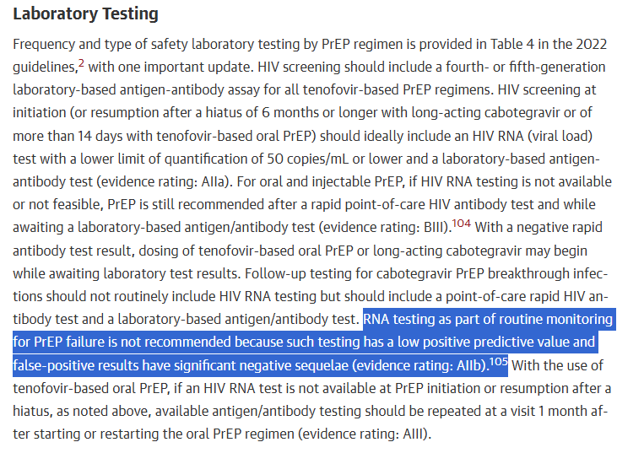
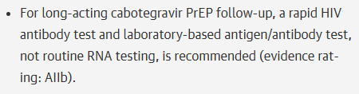
Take-home Points on Long-Acting PrEP
PrEP should be discussed with all sexually active people
FDA-approved injectable PrEP:
Q2M CAB superior to FTC/TDF in men and women
Very rare breakthrough infections despite on-time dosing
Q6M LEN effective in cisgender women, cisgender men, transgender men and women, nonbinary people
Very rare breakthrough infections despite on-time dosing
2024 IAS Guidelines Update: HIV-1 RNA testing recommended at LA PrEP initiation only, not as routine monitoring
Follow-up testing should include point-of-care rapid HIV antibody test and a laboratory-based antigen/antibody test
Notes:
CAB, cabotegravir; FTC, emtricitabine; LEN, lenacapavir; PrEP, pre-exposure prophylaxis; TDF, tenofovir disoproxil fumarate.

Slide 43
Can LA PrEP Be Effective in Vulnerable Populations?
Notes:
LA, long-acting; PrEP, pre-exposure prophylaxis.

Slide 44
PILLAR: LA CAB PrEP Integration in High HIV Epidemic Priority Areas in the US
Phase IV trial assessing integration of LA CAB in 17 clinics
22% of participants had not received oral PrEP 6 months prior to study
Participants,% | N = 201
Men who have sex with men | 94
Transgender men | 6
Race White | 62
Black | 26
Asian | 5
Other | 11
Hispanic or Latino | 38
Persistence
72% (144/201) completed all injections
LA CAB persistence
At Mo 6: 85% (171/201)
At Mo 12: 73% (146/201)
HIV Acquisition
Through Mo 12: 0% (0/201)
8 participants described themselves as both Black and Latino.
Khan. CROI 2025. Abstr 196.
Notes:
CAB, cabotegravir; LA, long-acting; PrEP, pre-exposure prophylaxis; STI, sexually transmitted infection.

Slide 45
LA CAB PrEP in an Urban Safety Net Clinic Population
Study of people at Ward 86 and San Francisco Health Network clinics started on LA CAB PrEP
1.00
0.75
Participants, % | N = 111
Unstable housing | 36
Substance use | 51
Prior PrEP | ~33
0.50
Overall Survival Probability
0.25
Persistence:
On-time injections: 85%
6-mo retention: 83%
0
0
90
180
270
360
450
540
Days
At Risk Events
111 0
65 11
47 15
37 18
24 19
17 19
14 19
Higher than in oral PrEP studies
Spinelli. Clin Infect Dis. 2024;ciae531
Notes:
CAB, cabotegravir; LA, long-acting; PrEP, pre-exposure prophylaxis.

Slide 46
The Role of Telemedicine in PrEP Engagement and Retention
Barriers to getting PrEP
The lack of doctors who are willing to prescribe it, and the perceived—and real—difficulties in obtaining it.
Telemedicine can be helpful for high-risk populations in rural communities and for people in cities who can’t find clinicians who knows about or advocates for PrEP.
Telemedicine apps and mobile-friendly platforms allow users to consult with clinicians, obtain PrEP, and get lab tests (in some cases) without going to a healthcare facility or pharmacy.
PrEP mobile Apps ability to engage in sexual health as well as PrEP use.

Slide 47
LA PrEP: Testing for HIV at Initiation and Beyond
Notes:
LA, long-acting; PrEP, pre-exposure prophylaxis.

Slide 48
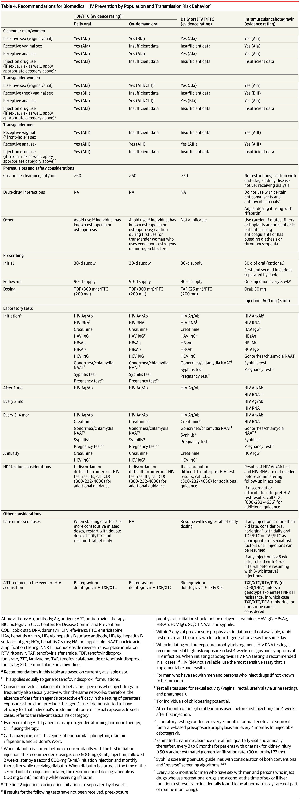
HIV Testing When Starting LA CAB PrEP
When starting IM PrEP, HIV screening should ideally include:
HIV diagnosis after PrEP failure can be challenging, especially with LA PrEP, owing to delayed and inconsistent detection of viremia, antigen, and antibodies
Indeterminate test results should be discussed with experts, such as the PrEP Warmline at the US National Clinician Consultation Center at 1-855-HIVPrEP
With LA CAB, sequential detection of HIV RNA at any level (even below assay LLOQ), is highly predictive of HIV infection
HIV Ag/Ab 4th or 5th gen laboratory based
HIV-1 RNA with LLOQ ≤50 copies/mL | If HIV-1 RNA testing is not possible, PrEP still recommended after a negative result from a rapid point-of-care HIV Ab test, while awaiting a laboratory-based Ag/Ab test
+
Gandhi. JAMA. 2025;333:609. Gandhi. JAMA. 2023;329:63.
When starting PrEP, HIV RNA screening (not rapid POC Ab test) is needed to ensure patients don’t have HIV infection
Frequency and type of safety laboratory testing by PrEP regimen is provided in Table 4 in the 2022 guidelines,2 with one important update. HIV screening should include a fourth- or fifth-generation laboratory-based antigen-antibody assay for all tenofovir-based PrEP regimens. HIV screening at initiation (or resumption after a hiatus of 6 months or longer with long-acting cabotegravir or of more than 14 days with tenofovir-based oral PrEP) should ideally include an HIV RNA (viral load) test with a lower limit of quantification of 50 copies/mL or lower and a laboratory-based antigen-antibody test (evidence rating: AIIa). For oral and injectable PrEP, if HIV RNA testing is not available or not feasible, PrEP is still recommended after a rapid point-of-care HIV antibody test and while awaiting a laboratory-based antigen/antibody test (evidence rating: BIII).104 With a negative rapid antibody test result, dosing of tenofovir-based oral PrEP or long-acting cabotegravir may begin while awaiting laboratory test result
Diagnosis of HIV in the setting of PrEP failure can be challenging, particularly when using long-acting PrEP agents, due to delayed and inconsistent detection of viremia, antigen, and antibodies, termed LEVI (long-acting early viral inhibition).100 Discordant or difficult-to-interpret HIV test results should be discussed with experts, including at the PrEP Warmline at the US National Clinician Consultation Center at 1-(855)-HIVPrEP in the US.106 In the setting of long-acting cabotegravir PrEP, 2 sequential testing algorithm results in which HIV RNA is detected, at any level (even if below the limit of quantification of the assay), is highly predictive of true HIV infection.105
Notes:
Ab, antibody; Ag, antigen; CAB, cabotegravir; LA, long-acting; LLOQ, lower limit of quantification; PrEP, pre-exposure prophylaxis.

Slide 49
HIV Monitoring on PrEP: CDC
CDC guidelines recommend HIV-1 RNA and HIV antigen/antibody assays for monitoring people on oral or LA injectable PrEP¹
Every 3 mo with oral PrEP; every 2 mo with LA CAB
In HPTN 083, HIV detection with antigen/antibody testing was delayed compared with qualitative HIV-1 RNA testing²
5 participants in HPTN 083 (0 in HPTN 084) received LA CAB after HIV infection and developed INSTI resistance^{3,4}
Delays in Diagnosis, Median Days³ | Baseline Infections | Incident Infections
CAB | 62 | 98
FTC/TDF | 34 | 31
1. cdc.gov/hivnexus/hcp/prep/index.html. 2. Marzinke. CROI 2021. Abstr 153. 3. Marzinke. J Infect Dis. 2021;224:1581. 4. Delany-Moretlwe. Lancet. 2022;399:1779.
Notes:
CAB, cabotegravir; FTC, emtricitabine; INSTI, integrase strand transfer inhibitor; LA, long-acting; PrEP, pre-exposure prophylaxis; TDF, tenofovir disoproxil fumarate.

Slide 50
HIV Monitoring on LA CAB PrEP: NEW IAS Update!
When continuing IM PrEP, HIV follow-up monitoring should include:
HIV-1 RNA testing not recommended as routine monitoring for PrEP
Low positive predictive value; false-positive results have significant negative sequelae
HIV Ab point-of-care rapid test
HIV Ag/Ab 4th or 5th gen laboratory based
HIV-1 RNA with LLOQ ≤50 copies/mL
+
+
Gandhi. JAMA. 2025;333:609. Gandhi. JAMA. 2023;329:63.
Laboratory Test | Oral Tenofovir-based PrEP | IM CAB
HIV RNA | Initiation | Initiation
HIV Ag/Ab | After 1 mo, then every 3-4 mo | After 1 mo, then every 2 mo or 3-4 mo
Notes:
CAB, cabotegravir; LA, long-acting; PrEP, pre-exposure prophylaxis.

Slide 51
HIV Testing and Monitoring With LEN: IAS Update
HIV resistance can emerge in individuals with undiagnosed HIV who are taking LEN¹
HIV testing before each injection and throughout therapy is essential
Within 7 days before initiation: Ag/Ab test²
(For people with risk of recent HIV exposure, HIV-1 RNA testing recommended)
At least every 6 mo: Ag/Ab test²
1. Lenacapavir PI. 2. www.jwatch.org/na58959/2025/07/09/lenacapavir-hiv-preexposure-prophylaxis-guidance-ias-usa.
Notes:
AB, antibody; Ag, antigen; LEN, lenacapavir.

Slide 52




Potential Breakthrough HIV Acquisition on Oral or Injectable PrEP
CLINICAL CONSULTATION
RESEARCH STUDY
For rapid expert consultation and advice on HIV and PrEP management
To better understand HIV acquisition on oral or injectable PrEP
seroprep.ucsf.edu
415-539-5688
seroprep@ucsf.edu
nccc.ucsf.edu
844-ASK-NCCC
Contact the team to learn about study eligibility for individuals with confirmed or suspected HIV-1 diagnosis while on any form of PrEP.

Slide 53
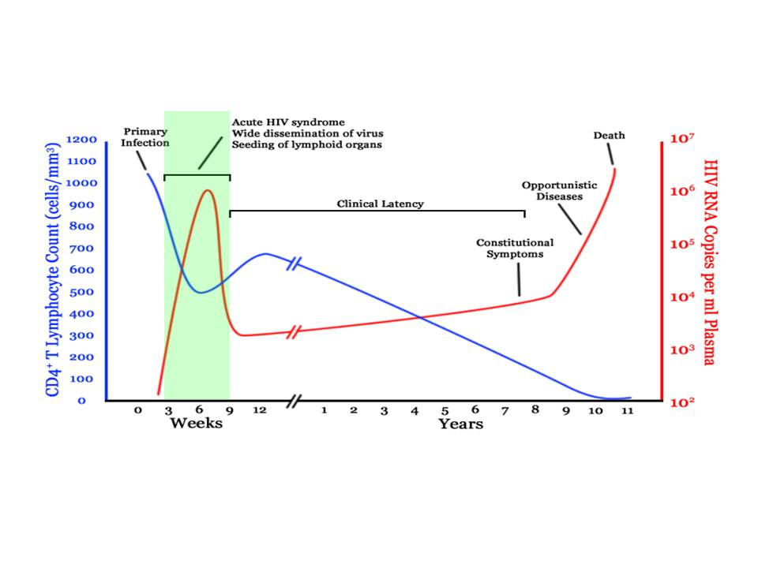
Acute Seroconversion and Risk of HIV Transmission: Case for Rapid Start ART

Slide 54
Patient Information Before Initiating Rapid ART
Needed
Reassurance about normal life expectancy, tolerable therapy
Discuss interest in starting immediate ART
Counsel on medication adherence
Support and empower through positive messaging including U=U
Not needed before initiating ART
CD4+ T cell count
HIV-1 RNA
CBC, chem panel, hepatitis serologies
Resistance test results
Notes:
Monica Gandhi, MD, MPH:
We also agree that it took work, but it was incredibly meaningful work and now we’re there. I think the best part is that you can tell someone on the day of diagnosis that they are going to have a normal life expectancy. They are going to have HIV therapy and it’s going to be tolerated, and if they don’t like this regimen, they can try something else. It’s my fault if they have side effects and I’ll figure it out, and there’s so many options.
You can tell them the day they have a life-altering diagnosis that they get to start therapy that day. That isn’t true in cancer or other diseases, and it makes a huge difference emotionally.
The patient has to be interested and ready, so that is the only thing I think that’s needed. We’ll talk about the labs. We do a physical exam and a history. We talk about the importance of medication adherence and then all this empowering commentary that we’ve already talked about, including U = U.
Jason Halperin, MD, MPH:
When I was first presenting this to my providers, overwhelmingly my providers bought in but they always asked if they can say no if they feel the patient is not ready or if can the patient say no. Of course, if there were a concern, we should not start. Of most importance is asking if the patient is ready.
In our program, all 130 newly diagnosed patients started rapid ART. Even though there might have been concern ahead of time, we are learning over time how accepted this is from the patient standpoint and the provider standpoint.
What is not needed? We don’t need a CD4+ cell count. This is where a good physical exam is important. I do get questions often whether there could be a concern for crypto meningitis or TB meningitis, and the answer is of course. But a good physical exam will help with that more than waiting for the labs.
We don’t need an HIV viral load. Not knowing he HIV genotype has often been the concern of starting ART rapidly. In 2019, we have regimens where we don’t need the genotype. We might decide later to use a different regimen once the genotype comes back for ease or for other patient reasons, but we don’t need the genotype.
Clearly, HLA-B*5701 this is necessary before starting abacavir, but abacavir is not a regimen that I use within our rapid start model; we have so many other options that that testing is not necessary.

Slide 55

Take Away Messages:
Novel strategies and practices have the potential to engage and retain hard to reach populations in PrEP care
Implicit bias and other barriers can serve to keep at-risk individuals from engaging in PrEP
Utilize best practice strategies to prevent, test for, and treat STIs
Incorporate best practice strategies for retaining hard to serve PrEP patients in care such as use of telemedicine
There are no contraindications for Transgender Women to take PrEP
Anyone who asks for PrEP should GET IT!

Slide 56
Method to Obtain CME
To obtain CME for participating in this webinar, please visit: https://education.aahivm.org/courses/119061

