Slide 1


ISMPP University
Plain Language Summaries (PLS) of publications:
Focus on practical application
February 2, 2022
Webinar will begin promptly at:
11 AM ET / 4 PM GMT
Notes:
Hi everyone; welcome and thank you for joining today’s ISMPP U on “Plain Language Summaries (PLS) of publications: Focus on practical application”
Before we get started, we have a few reminders and announcements.
First, this webinar has been approved for 1.5 ISMPP CMPPTM Recertification Credits. Please capture a screenshot of the title slide to document for credit.
This slide will also be shown at the end of the presentation.

Slide 2

ISMPP Would Like to Thank…
1
. . . the following Titanium and Platinum Corporate Sponsors for their ongoing support of the Society:
Notes:
First, a sincere thank you to ISMPP’s titanium and platinum corporate sponsors for their ongoing support of the Society.

Slide 3

ISMPP Announcements
This webinar has been approved for 1.5 ISMPP CMPPTM Recertification Credit. Please capture a screenshot to submit for credit
Be sure to enter CMPP credits earned at the 2022 European Meeting
Registration NOW OPEN for the 18th Annual Meeting, being held in-person in Washington DC
Notes:
A few announcements before we get started.
First, this webinar has been approved for 1.5 ISMPP CMPP recertification credits. Please capture a screenshot to submit for credit.
You can now register for the 18th Annual Meeting.

Slide 4
How To Ask Questions
Feel free to ask a question at any time, however all questions will be held until the end the of the presentation.
To ask a question, open the Q&A window, type your question into the
Q&A box. Click Send
Note: Check Send Anonymously if you do not want your name attached
to your question in the Q&A
We will make every effort to respond to all questions live (out loud)
Notes:
You can submit a question at any time during the presentation by following the instructions on this slide.
The faculty will answer questions at the end of all the presentations.

Slide 5
Plain language summary landscape
Jason Gardner EVP, Head of Medical Services CMC CONNECT | McCann Health Medical Communications

Slide 6


What do we mean by a plain language summary (PLS)?
A short summary of a piece of research presented in a way that
is accessible to non-specialist lay audiences such as patients
Clinical trial PLS, also know as clinical trial summaries (CTS), to inform patients about trial results*
Publication PLS associated with
a journal article, abstract, or congress presentation
*mandatory in the EU for all trials, as part of Clinical Trial Regulation EU No. 536/2014
Notes:
Firstly, What do we mean by a PLS?
The term ‘PLS’ refers to a short summary of scientific research presented in a way that is accessible to non-specialist lay audiences.
They’re associated with publications from journals or congresses
They are not clinical trial summaries that are produced by clinical trial sponsors to tell patients about the trial they’ve been in. That’s different and we won’t focus on that.

Slide 7
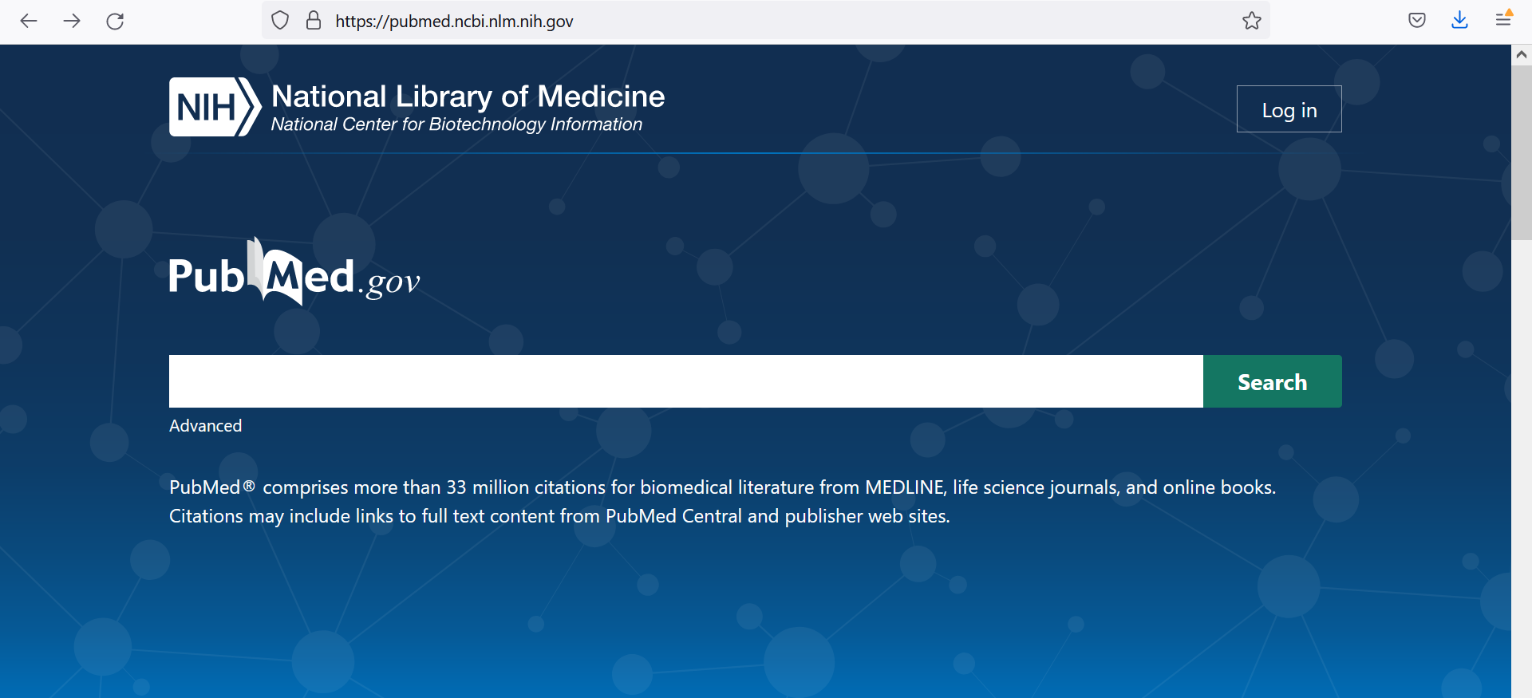

Slide 8
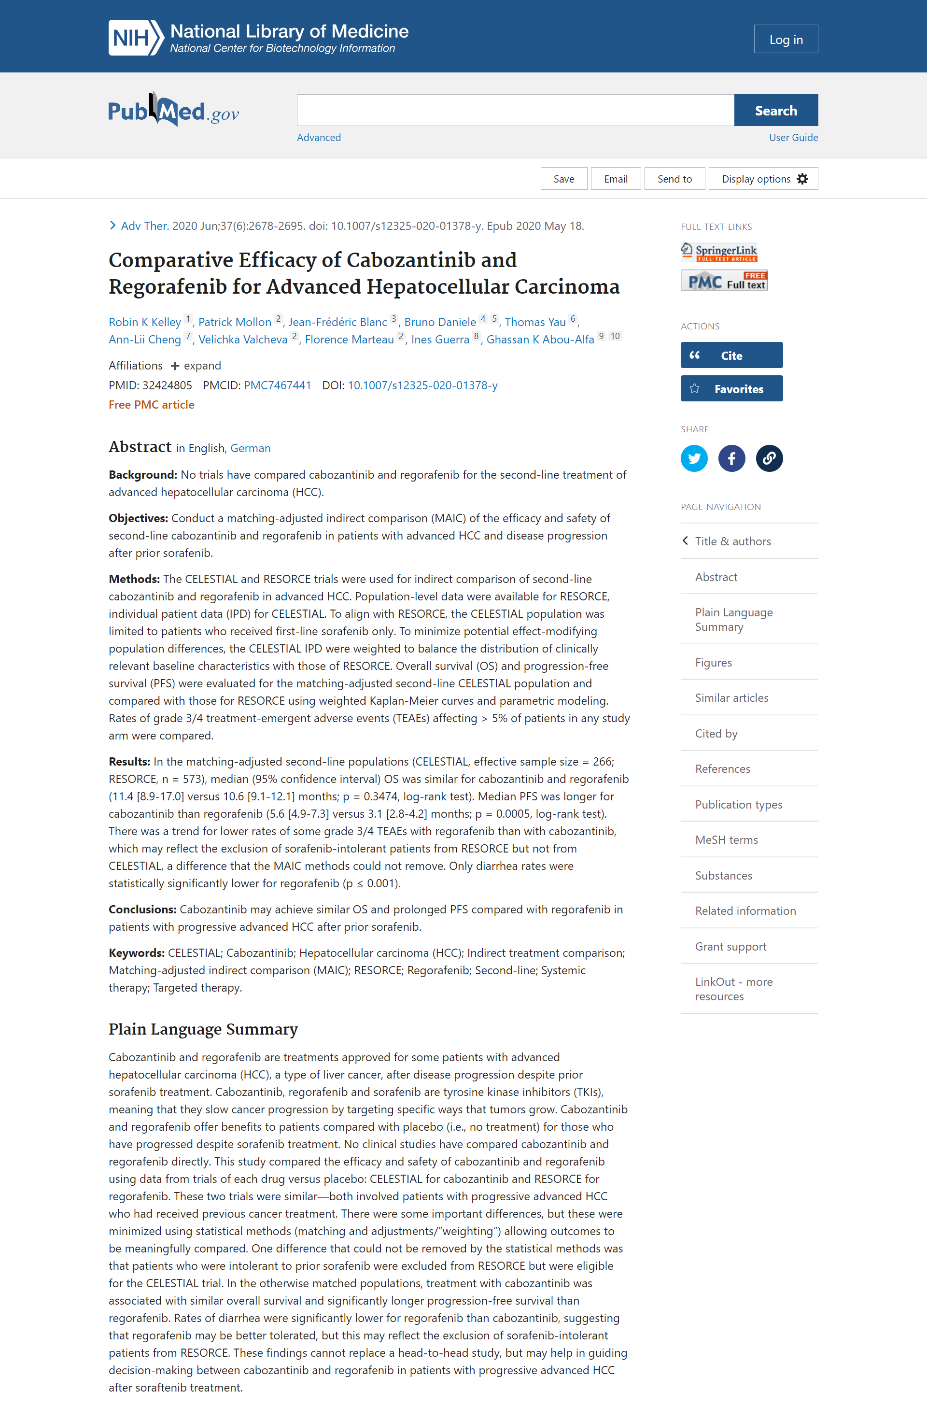
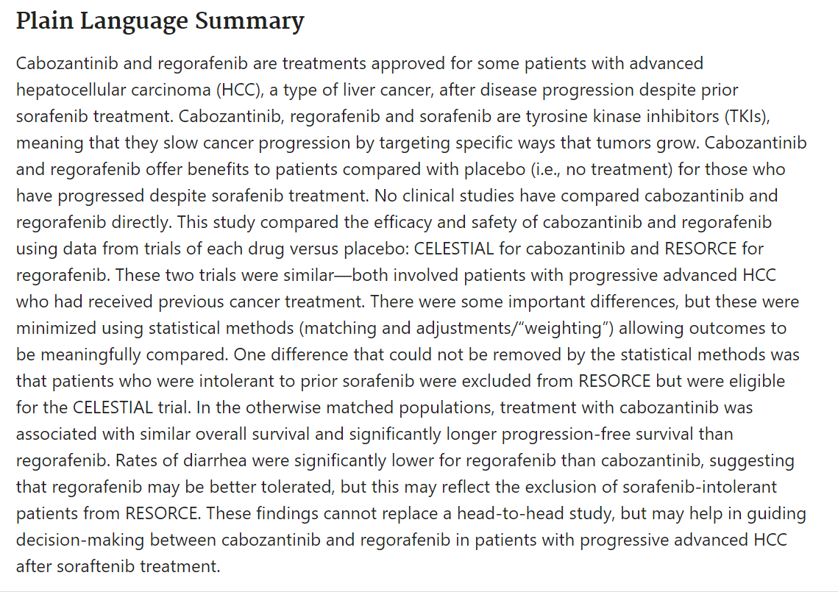

Slide 9
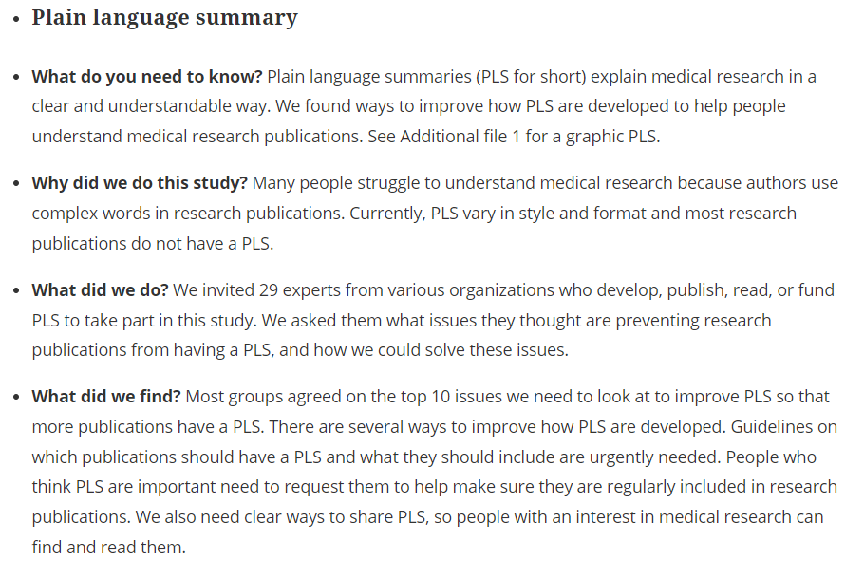
Lobban D, Gardner J, Matheis R. Curr Med Res Opin. 2021 Nov 4:1-12

Slide 10
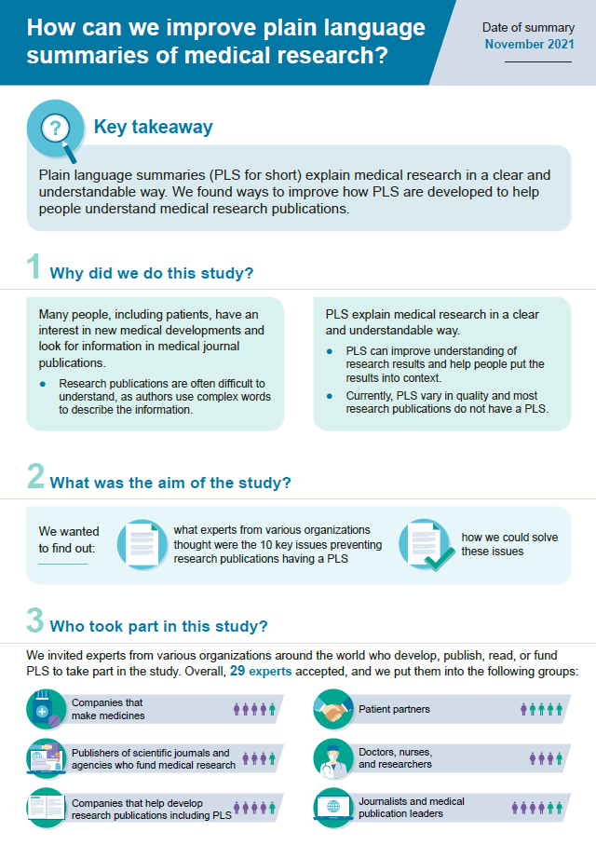
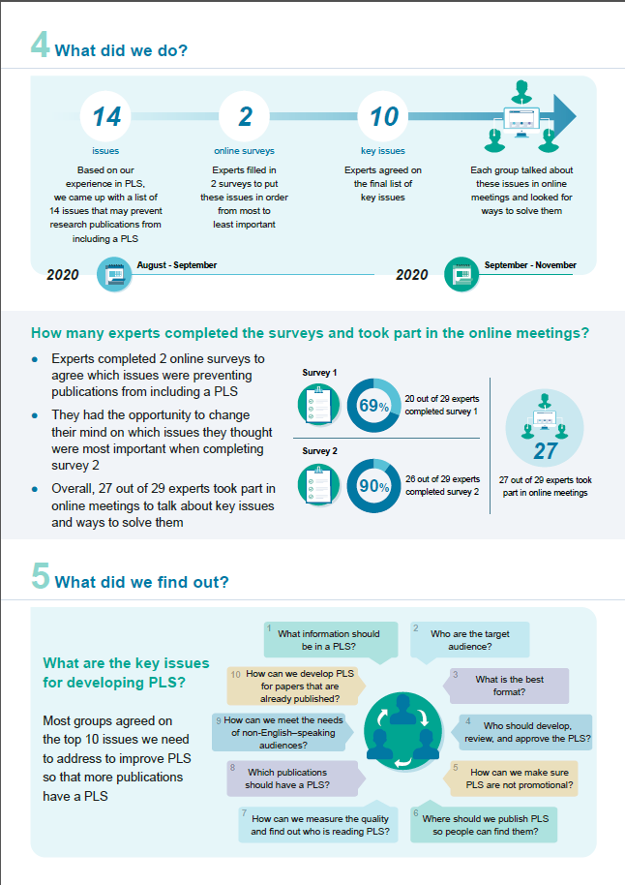
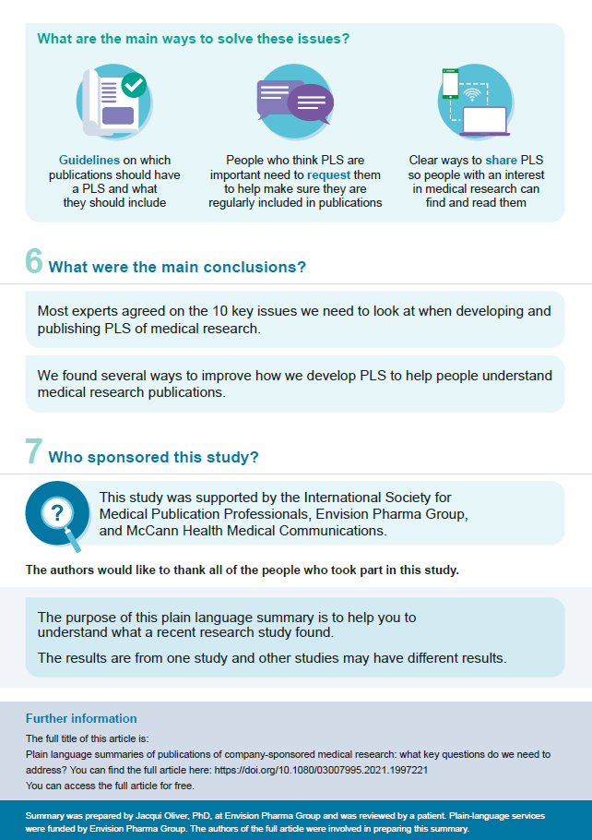
Lobban D, Gardner J, Matheis R. Curr Med Res Opin. 2021 Nov 4:1-12

Slide 11
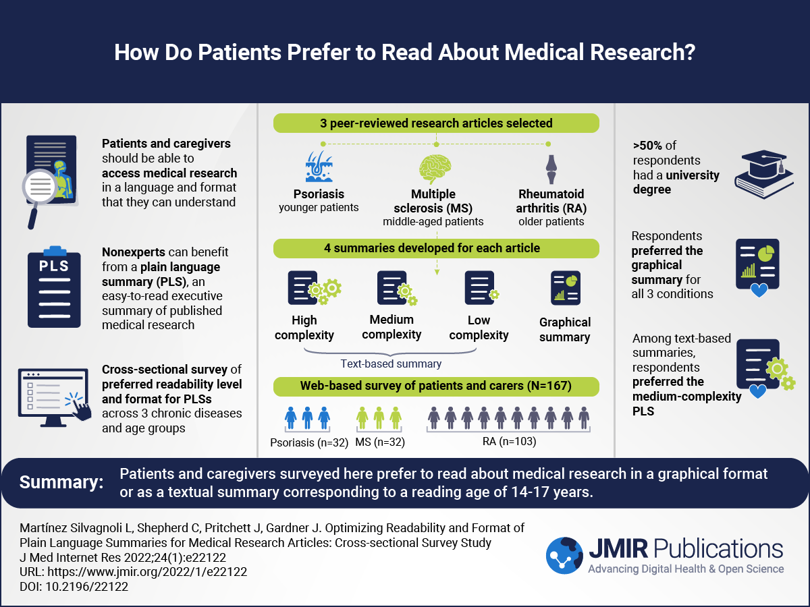
Martínez Silvagnoli L, Shepherd C, Pritchett J, Gardner J. J Med Internet Res. 2022 Jan 11;24(1):e22122

Slide 12
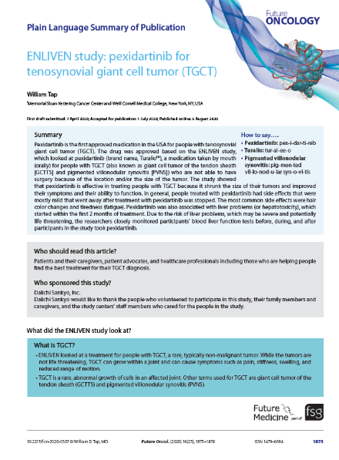
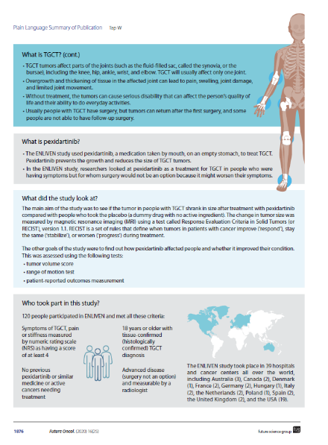
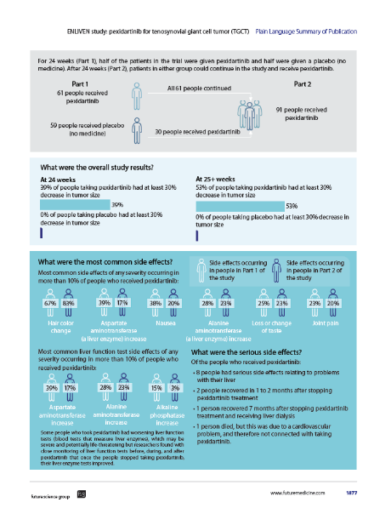
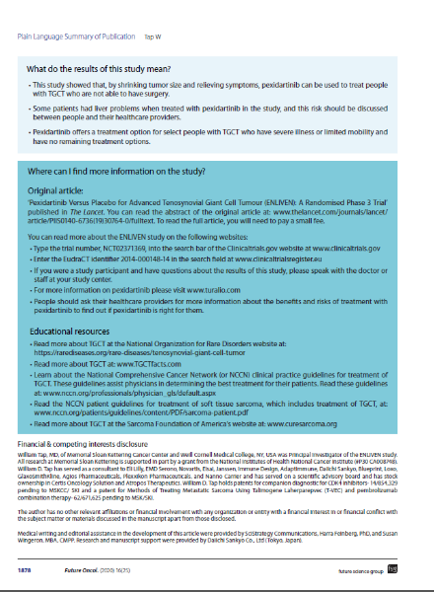
Tap W. Future Oncol. 2020 Sep;16(25):1875-1878

Slide 13

2021
2022
Feb
Mar
Apr
May
Jun
Jul
Aug
Sep
Oct
Nov
Dec
Jan
Feb

Slide 14
2021
2022
Feb
Feb
Mar
Apr
May
Jun
Jul
Aug
Sep
Oct
Nov
Dec
Jan
Feb
Complimentary ISMPP U Webinars:
Plain Language Summaries (PLS) of Publications: Perspectives that will shape the future
1
2
3
  Understand the top
  10 key questions to be addressed relating to
  PLS of publications
  Identify the opportunities for accelerating the uptake of PLS of publications, as identified by 6 key stakeholder groups
  Consider how future
  guidance about PLS
  may be relevant to you and your organization
https://www.ismpp.org/complimentary-ismpp-u-webinars

Slide 15
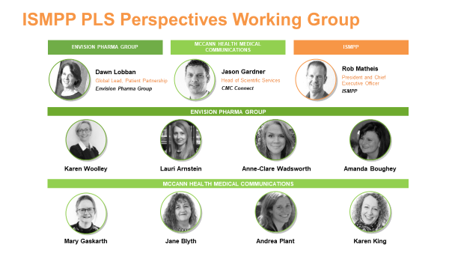

2021
2022
Feb
Mar
Apr
Apr
May
Jun
Jul
Aug
Sep
Oct
Nov
Dec
Jan
Feb

Slide 16
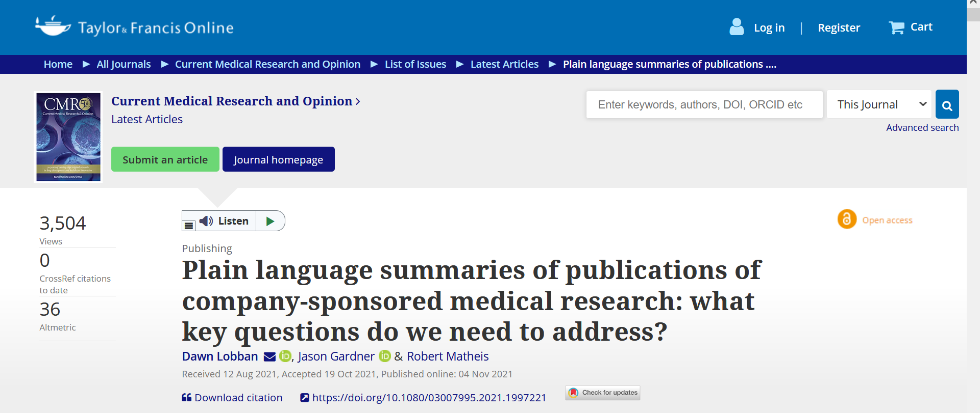
2021
2022
Feb
Mar
Apr
May
Jun
Jul
Aug
Sep
Oct
Nov
Nov
Dec
Jan
Feb

Slide 17
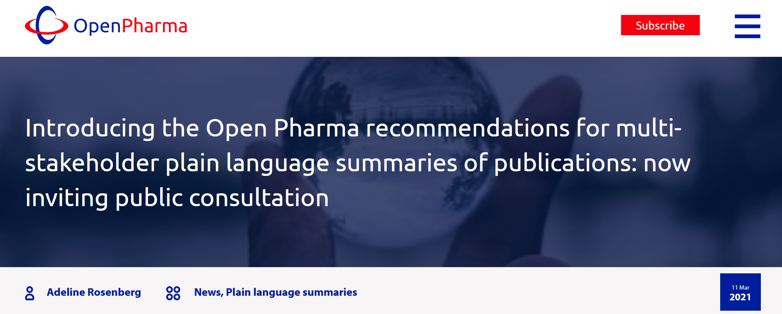
2021
2022
Feb
Mar
Mar
Apr
May
Jun
Jul
Aug
Sep
Oct
Nov
Dec
Jan
Feb
https://www.openpharma.blog/blog/news/introducing-the-open-pharma-recommendations-for-multi-stakeholder-plain-language-summaries-of-publications-now-inviting-public-consultation/

Slide 18
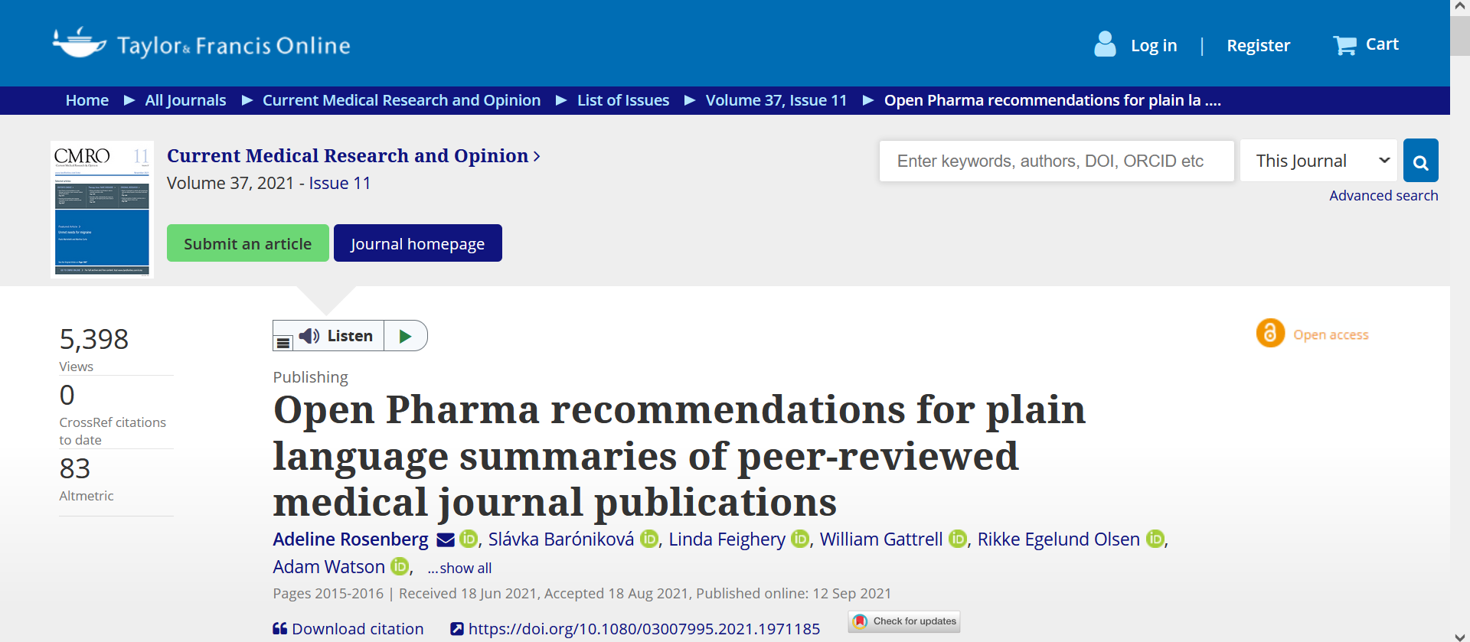
2021
2022
Feb
Mar
Apr
May
Jun
Jul
Aug
Sep
Sep
Oct
Nov
Dec
Jan
Feb

Slide 19
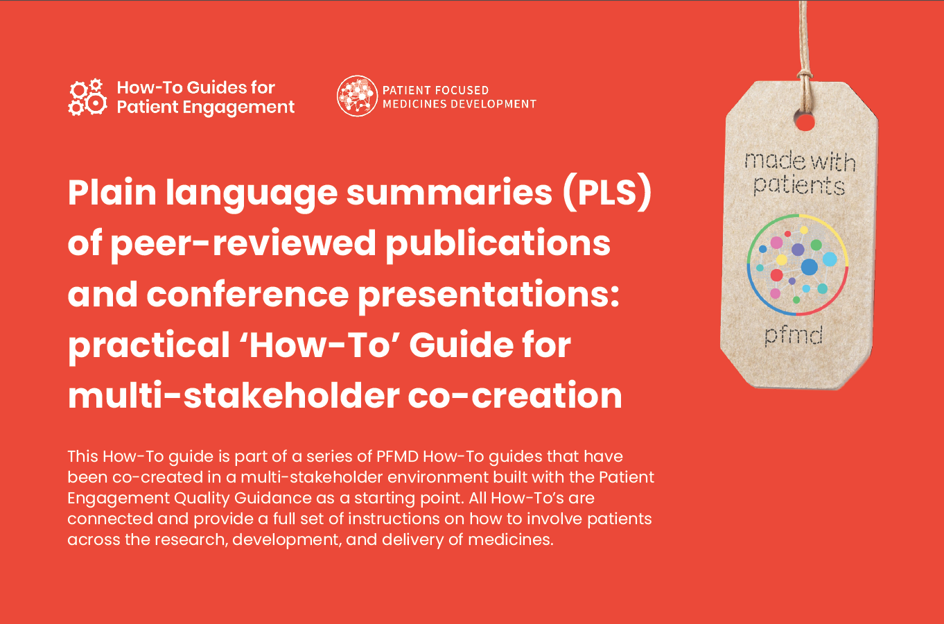
2021
2022
Feb
Mar
Apr
May
Jun
Jul
Aug
Sep
Oct
Nov
Dec
Jan
Feb
https://pemsuite.org/How-to-Guides/WG5.pdf
Notes:
This How-To guide is part of a series from Patient Focused Medicines Development (PFMD) that provides a set of instructions on how to involve patients in the co-creation of plain language summaries (PLS) of peer-reviewed publications, including journal articles and conference presentations

Slide 20

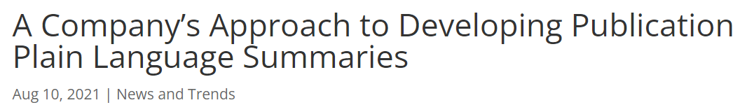
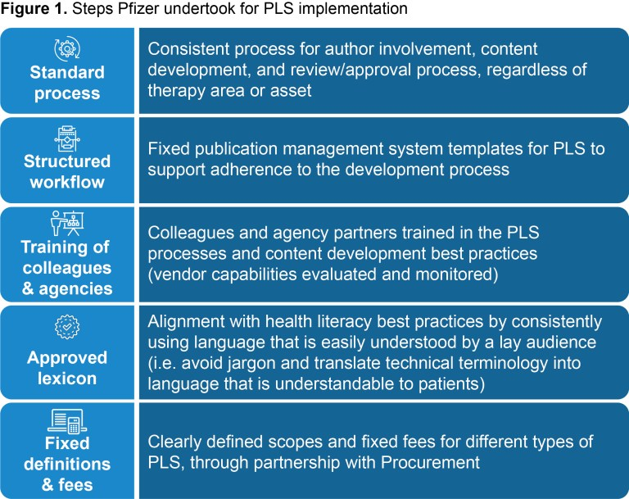
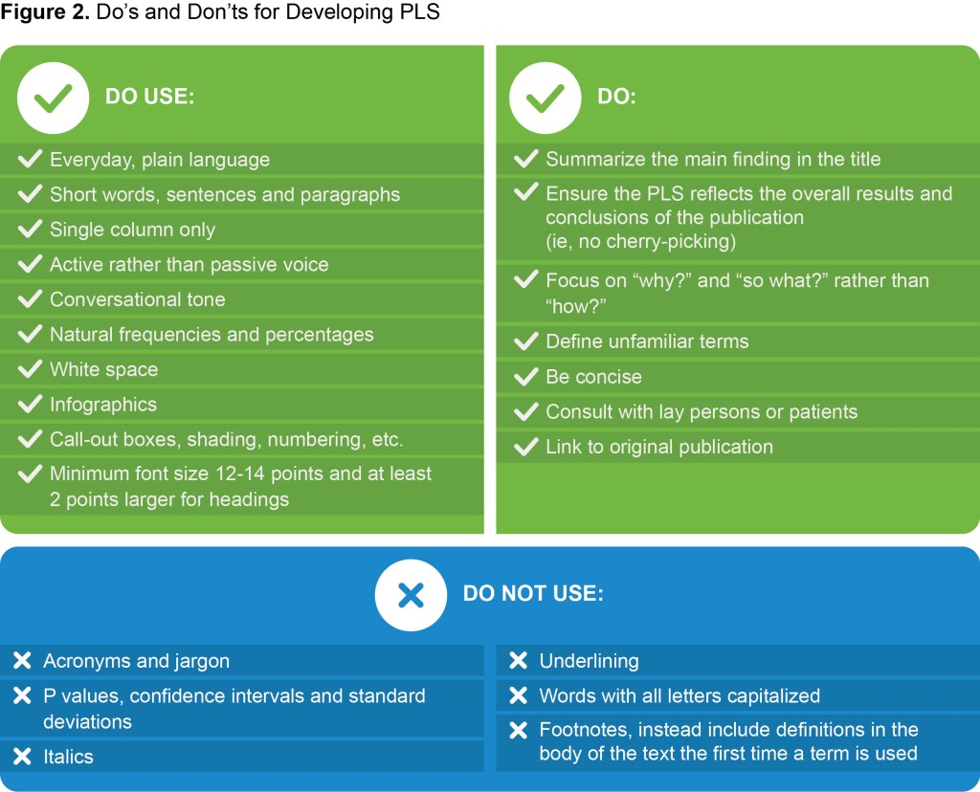
2021
2022
Feb
Mar
Apr
May
Jun
Jul
Aug
Aug
Sep
Oct
Nov
Dec
Jan
Feb
Steps to implementation
Dos and
Don’ts
https://ismpp-newsletter.com/2021/08/10/a-companys-approach-to-developing-publication-plain-language-summaries/

Slide 21

2021
2022
Feb
Mar
Apr
May
Jun
Jul
Aug
Sep
Oct
Nov
Dec
Jan
Jan
Feb
Seek and you will [potentially] find: the impact of plain language summary accessibility on engagement and wider dissemination. Simon Foulcer, David Sheppard, Nichola Gokool
Plain language summaries at congresses: a pharma perspective. Pippa Hadland, Whitney Dunton, Jennifer Eykelenboom, Kyoko Kelly, Sarah Perry, Aliya Seward
Do plain language summaries encourage readers to download your publication? A pilot study.
Steve Winter, Caroline Halford, Mel West and Matt Evans
Do healthcare professionals really value plain language summaries? Dawn Lobban, Jacqui Oliver, Marissa Buttaro, David Falleni and Melissa McGrath
Prevalence and characteristics of plain language summaries indexed in PubMed. William Gattrell,
Kim Wager, Nisha Sheikh and Alison Chisholm
Analysis of reach for different formats of plain language summaries. Shilpa Khobragade, Pippa Perrett, Craig Burgess, Heather Smith, Damian Eade, Aree Cheshire
and Lorraine Law
Notes:
And more on Poster PLS and Enhanced Content & Publication Extenders…

Slide 22


2021
2022
Feb
Mar
Apr
May
Jun
Jul
Aug
Sep
Oct
Nov
Dec
Jan
Feb
Feb

Slide 23

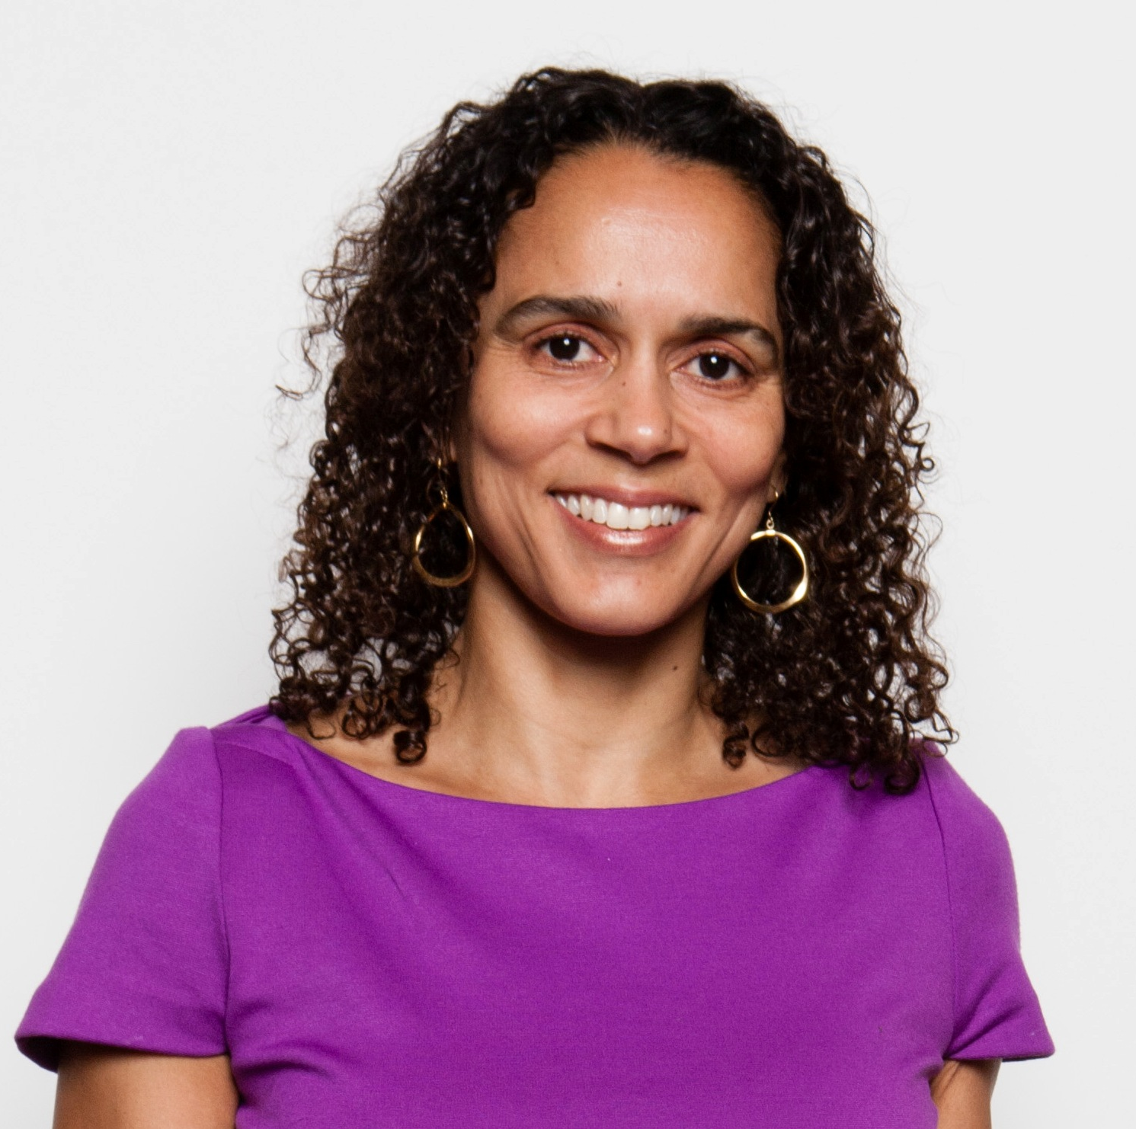


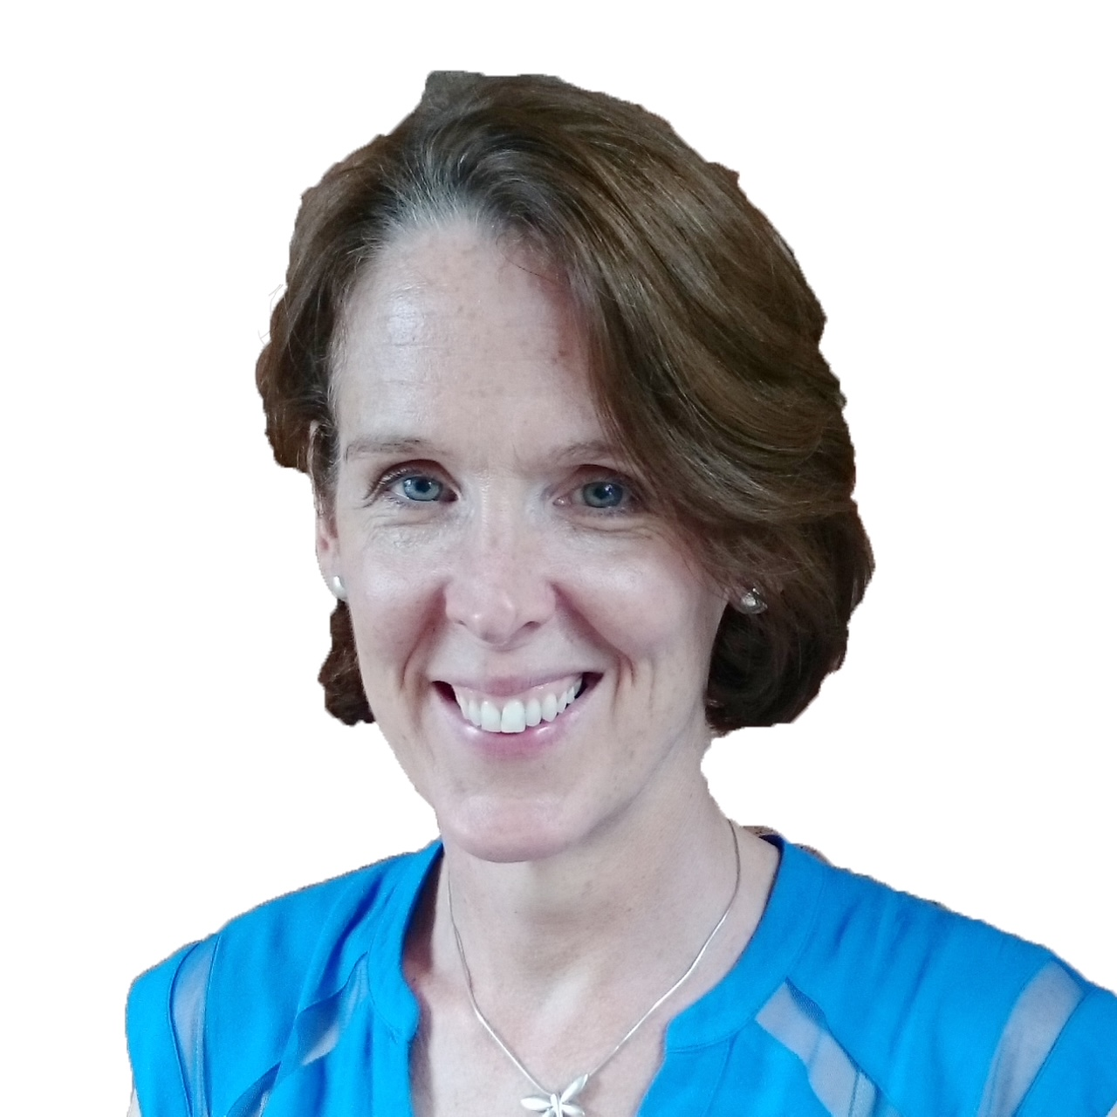

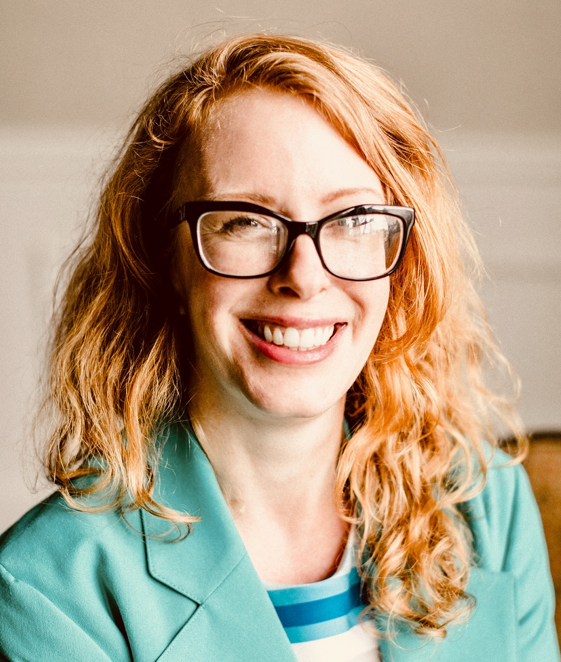
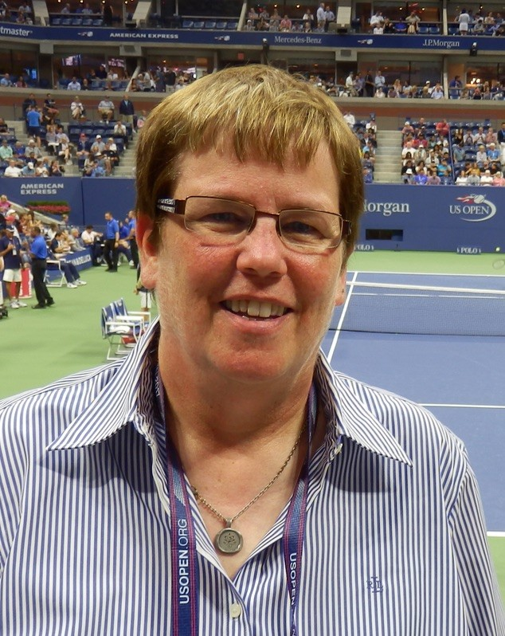
Faculty
Moderator, Jason Gardner
Head of Medical Services, CMC Connect,
McCann Health Medical Communications
Angela Sykes
Publications Standards &
Best Practices Lead, Pfizer
Laura Dormer
Editorial Director,
Future Science Group
Melissa Crouse
Patient/Patient Advocate
(Lung Cancer)
Dawn Lobban
Patient Partnerships,
Envision the Patient, Envision Pharma Group
Will Gattrell
Senior Manager, Global Medical
Publications and Communications, Ipsen
Caroline Halford
Digital Publishing Manager, ADIS│Springer Healthcare
Jessie Daw
Patient/Patient Advocate
(Multiple Myeloma)
Notes:
We have a great set of faculty for today’s webinar. I’m Jason Gardner and I’ll be your moderator for today.
With us we also have Dawn Lobban, Will Gattrell, Angela Sykes, Caroline Halford, Laura Dormer, Jessie Daw and Melissa Crouse.

Slide 24
Disclaimer
Information presented reflects the personal knowledge and opinions of the faculty and does not necessarily represent the position of their current or past employers or ISMPP
Notes:
Please take a moment to read our general disclaimer.

Slide 25
Objectives
Understand key points in the PLS guidance documents and publications developed by the ISMPP PLS Perspectives Working Group, Open Pharma and Pfizer
Understand how to create an implementation process for PLS generation
Understand what medical communication professionals can do to support the discoverability and accessibility of PLS
Understand if PLS increase the impact of published research
Gain knowledge of how to work with patients/patient advocates on PLS generation
Notes:
Listed here are the learning objectives for today’s webinar.
And now I’d like to turn things over to Dawn.

Slide 26
What do you want to know about Plain Language Summaries?
Best practices for developing a PLS
Incorporating PLS development into SOPs
Best practices for working with patients in the development of PLS
How to make PLS more discoverable
Journal perspectives on PLS (ie, value, accessibility, increased readership, etc)
Something else

Slide 27
ISMPP PLS Perspectives Study
ISMPP PLS Perspectives Study’
ISMPP PLS Perspectives Study’
Dawn Lobban Global Head, Patient Partnerships Envision Pharma Group
Dawn Lobban, Jason Gardner and Rob Matheis
on behalf of the ISMPP PLS perspectives Working Group
Curr Med Res Opin. 2021. doi.org/10.1080/03007995.2021.1997221.

Slide 28
What were the objectives of the
ISMPP PLS Perspectives Project?
To provide multi-stakeholder perspectives on the key issues relating to publication PLS
of company-sponsored medical research
To identify key considerations, highlight opportunities and acknowledge potential barriers
Publish an evidence-based paper that provides perspectives
Robust, prospective methodology
Endorsed and promoted by ISMPP
A citeable preprint / reference to support the PLS section of GPP4
and other relevant guidelines

Slide 29



Who was involved?
29 stakeholders were identified
Pharmaceutical industry
Expertise
in their field
Familiarity
with PLS
Location
Publishers, journal editors, and NIH/NLM
Publication/medical education agencies
ASIA
PACIFIC
Patient partners
NORTH
AMERICA
EUROPE
Health care professionals/clinical researchers
Media/ISMPP/MRCT

Slide 30
What did we do?
14
2
10
issues
online surveys
key issues
Initial list of
issues that may prevent publications including a PLS
Modified Delphi approach to prioritise
the list
Stakeholders agreed on
the final list
27/29 stakeholders discussed in online
meetings
2020
August - September
2020
September - November

Slide 31
What were the top 10 key issues discussed?
1
What information must, and must not,
be included in a PLS?
Where and how should PLS be published to ensure
optimal reach and discoverability?
6
2
Who are the target audiences for PLS,
and why?
How can the reach, quality and value of a PLS
be measured?
7
3
What is / are the optimal format(s) for a PLS?
What process should be followed to select
publications that will have a PLS to avoid the perception of selection bias by the sponsor?
8
4
What is the optimal PLS development / review / approval process (when considering the steps relevant to your stakeholder group)?
How can PLS meet the needs of non-English speaking audiences and account for different cultures?
9
5
What is needed to ensure PLS are considered
to be appropriate vehicles that accompany scientific publications, not medical education or promo materials?
What criteria should be met for developing
a PLS for an article already published?
10

Slide 32
Opportunities to overcome real or perceived barriers to uptake of PLS
32
CATEGORY
EMERGING THEMES
WHY?
Target end-users highlight unmet need and advocate for PLS
WHEN?
Clear directive for when manuscripts should have a PLS
Call on key journals to lead the way by publishing PLS
WHO?
PLS stakeholders would benefit from guidance on optimal co-creation
Tools, such as templates, to guide content development
Industry-recognised guidelines to define and maintain quality
WHAT?
HOW?
Use specialist PLS writers and / or undertake PLS training for medical writers and researchers (including patients)
Clarity on optimal format and development process from start to finish
Optimal dissemination and easy access (including searchable repository)
Explore the use of social media to facilitate dissemination
Work with patient advocacy groups and charities to expand the reach of PLS
WHERE?

Slide 33
The authors would like to thank everyone who took part in this study

Slide 34
Open Pharma recommendations &
Ipsen commitment on plain language summaries
Will Gattrell Global Medical Publications and Communications Senior Manager, Ipsen

Slide 35
Disclosure
Will Gattrell is an employee and shareholder of Ipsen

Slide 36
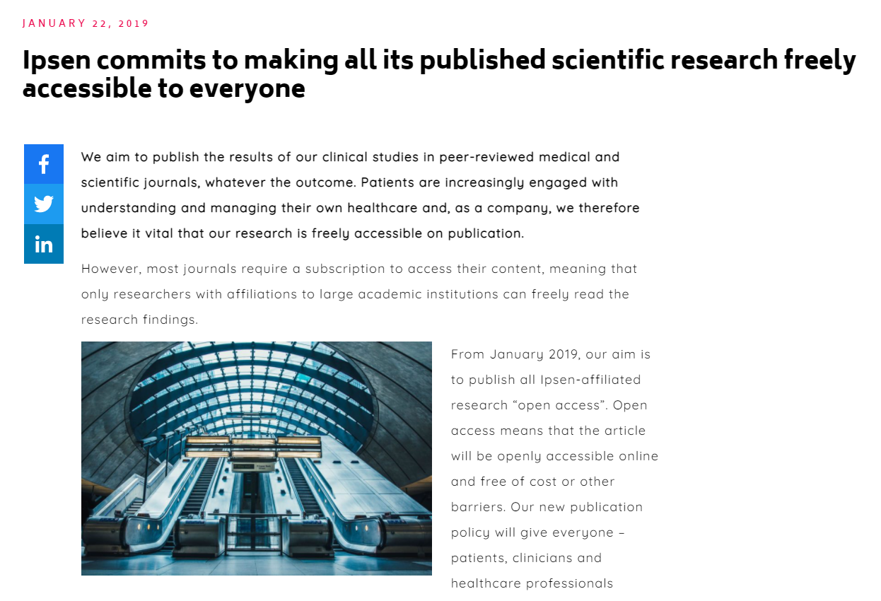
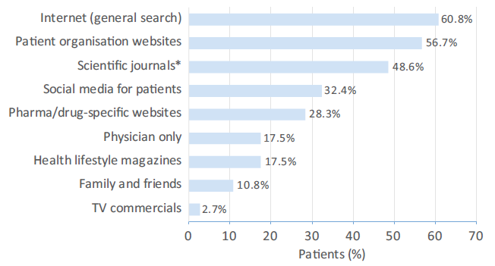
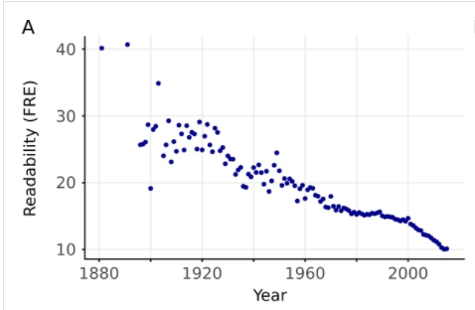
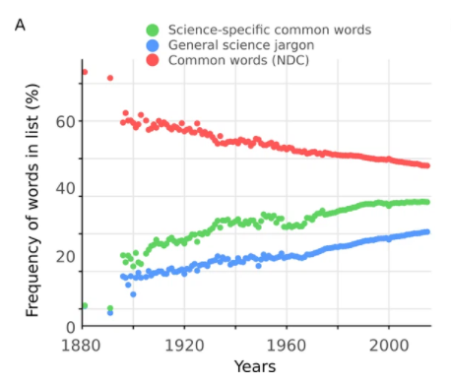
All Ipsen publications are open access from 2019… but is the content accessible?
Patients regularly seek information from journals¹
but the readability of articles is decreasing²
1 Ther Innov Regul Sci 2018; 474-481; 2 Elife 2017 6:e27725. doi: 10.7554/eLife.27725.

Slide 37
Ipsen commitment on PLS
From July 2022, Ipsen commits to publishing, as a minimum, 250-word plain language summaries for all company-sponsored journal publications that include
data from human studies

Slide 38
Open Pharma PLS recommendations
As a minimum standard, we recommend that these plain language summaries are:
text based and concise (of 250 words or fewer)
explicitly linked to the source publication citation and relevant clinical trial identifiers, with brief reference to the existing evidence
consistent with the same overall key points and conclusions as the scientific publication abstract
developed alongside the main content of the manuscript
ideally reviewed by a non-expert during development
fully peer reviewed alongside the main content
made available to read free of charge alongside the scientific publication abstract
tagged with appropriate metadata and keywords to improve discoverability in search engines, directories, and indexes
PLS, plain language summary.
Rosenberg et al. Curr Med Res Opin 2021, 2015-16

Slide 39
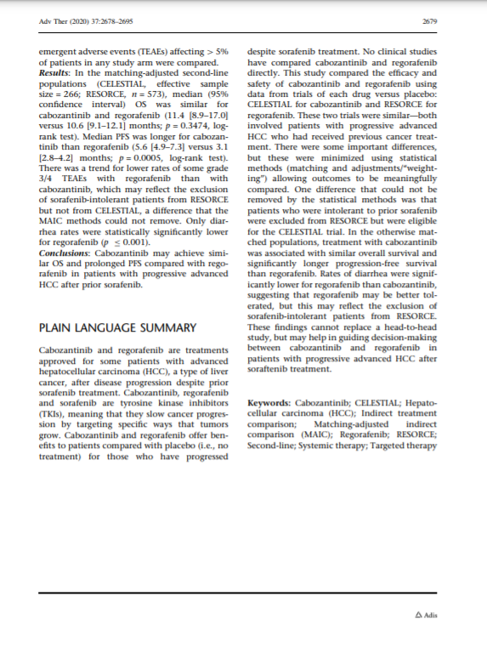
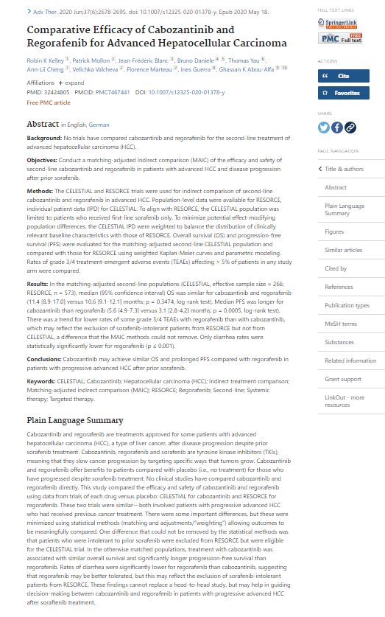
Publishing a PLS on PubMed
Metadata tag
Kelley et al. Adv Ther 2020, 2678-2695.

Slide 40
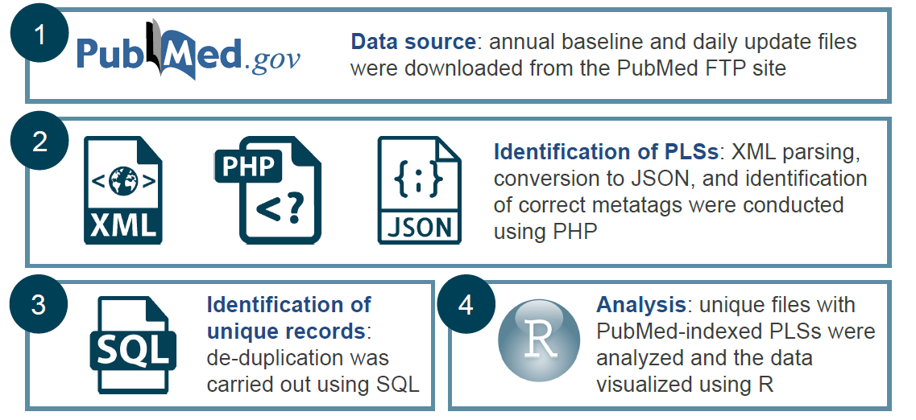
Feasibility of PLS commitment
Evaluation of the prevalence of text-only PLS in PubMed
Gattrell et al. Poster 12, presented at ISMPP EU 2022

Slide 41
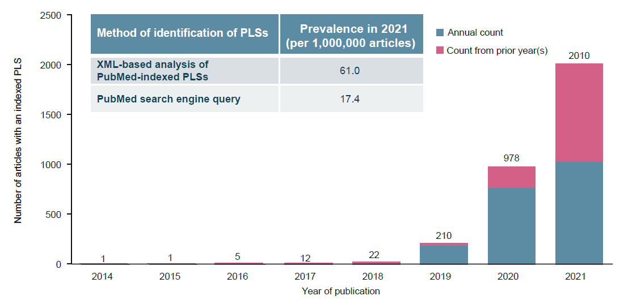
Results
Gattrell et al. Poster 12, presented at ISMPP EU 2022

Slide 42
Of 91 target journals of interest to Ipsen, only 6 have indexed PLSs in PubMed
Acta otorhinolaryngologica Italica:
Advances in skin & wound care
Advances in therapy
American journal of clinical dermatology
Applied health economics and health policy
Archives of public health
Bioanalysis
BioDrugs: clinical immunotherapeutics, biopharmaceuticals
and gene therapy
Biomarkers in medicine
BMC health services research
Canadian journal of surgery. Journal canadien de chirurgie
Cardiology and therapy
Clinical & translational oncology
Clinical drug investigation
Clinical pharmacokinetics
CNS drugs
CNS oncology
Current medical research and opinion
Dermatology and therapy
Diabetes therapy : research, treatment and education of diabetes and related disorders
Drug safety
Drugs
Drugs - real world outcomes
eLife
Environmental entomology
Epigenomics
European journal of drug metabolism and pharmacokinetics
Expert opinion on drug metabolism & toxicology
Expert opinion on pharmacotherapy
Expert review of anti-infective therapy
Expert review of clinical pharmacology
Expert review of gastroenterology & hepatology
Expert review of hematology
Expert review of medical devices
Expert review of vaccines
Family practice
Future cardiology
Future microbiology
Future oncology
Health promotion and chronic disease prevention in Canada : research, policy and practice
Health promotion international
Health technology assessment
Hong Kong medical journal
Immunotherapy
Infectious diseases and therapy
Inflammatory bowel diseases
International journal of phytoremediation
JBJS case connector
JBJS reviews
Journal of biological regulators and homeostatic agents
Journal of comparative effectiveness research
Journal of eating disorders
Journal of patient-reported outcomes
Journal of psychosocial oncology
Journal of tropical pediatrics
Medical mycology
Menopause
Nanomedicine
Neurodegenerative disease management
Neurology and therapy
Oncology and therapy
Ophthalmic plastic and reconstructive surgery
Ophthalmology and therapy
Orphanet journal of rare diseases
Paediatric drugs
Pain and therapy
Pain management
Pathologica
Personalized medicine
Pharmaceutical medicine
PharmacoEconomics
PharmacoEconomics - open
Pharmacogenomics
Postgraduate medicine
Pulmonary therapy
Regenerative medicine
Reproductive health
Research involvement and engagement
Rheumatology and therapy
Spine
Sports medicine
Stress
Targeted oncology
The British journal of surgery
The International journal of neuroscience
The Journal of asthma : official journal of the Association for the Care of Asthma
The Journal of bone and joint surgery. American volume
The patient
Therapeutic delivery
Tidsskrift for den Norske laegeforening
Translational behavioral medicine

Slide 43
Timeline & process
Sep
Oct
Nov
Dec
Jan
Feb
Mar
Apr
May
Jun
Jul
Aug
Open Pharma PLS
recommendations
Commitment
made public
at ISMPP EU
Commitment
comes into effect
Ethics approval
Leadership
endorsement
2021
2022
PLS pilot study & benchmarking
Process for lay review of PLSs
Internal guidelines on writing & reviewing PLS
Vocabularies for Ipsen therapeutic areas
ISMPP, International Society of Medical Publication Professionals

Slide 44
A Company’s Approach to Implementing a Global Publication Plain Language Summary (PLS) Process
Angela Sykes Publications Standards & Best Practices Lead Pfizer

Slide 45
The Road to Success
December 2021
5
Publication PLS HLT Launch
PLS incorporated into Publications SOP & Launch of Pfizer Figshare Portal
July 2021
4
Publication PLS HLT Pilot
Q3-Q4 2020
3
Enterprise-wide PLS Guidance
February 2020
2
2018 - 2019
Oncology abstract PLS pilot
1
HLT=Health Literacy Tool.

Slide 46
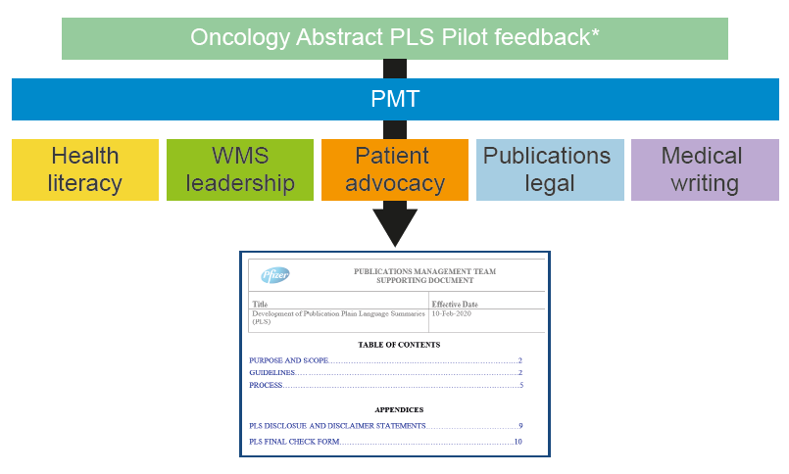
46
Congress Abstract PLS Pilot
Publications Management Team (PMT) partnered with Oncology Medical Affairs to implement a congress abstract PLS pilot
Pilot ran for 18 months, during which 185 abstract PLS were developed
Feedback gathered from patients, congress organizers, HCPs/authors, internal stakeholders and used to develop a company-wide Publication PLS Guidance
Guidance also incorporated aspects of Pfizer’s Medical Writing Group Standard Operating Procedure (SOP) requirements for development of Plain Language Study Results Summaries (PLSRS)
WMS=Worldwide Medical and Safety.

Slide 47
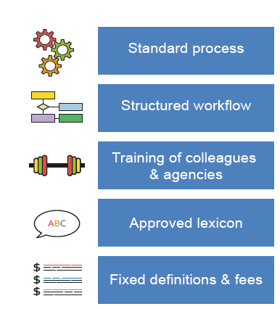
47
Enterprise-Wide PLS Guidance
Development of Publication PLS Guidance began in October 2019
Guidance was implemented across the organization in February 2020
  Includes standards for development of abstract and manuscript PLS
The PMT:
  Established 7 standard levels of service definitions for various kinds of PLS & set fixed rates with vendors
  Built abstract and manuscript PLS workflows in publications management software system
  Trained Scientific Publication Committees and agency partners
  Developed Publication PLS SharePoint page that includes Guidance, training slides, Business Rules etc.
Best Practices for PLS Implementation

Slide 48
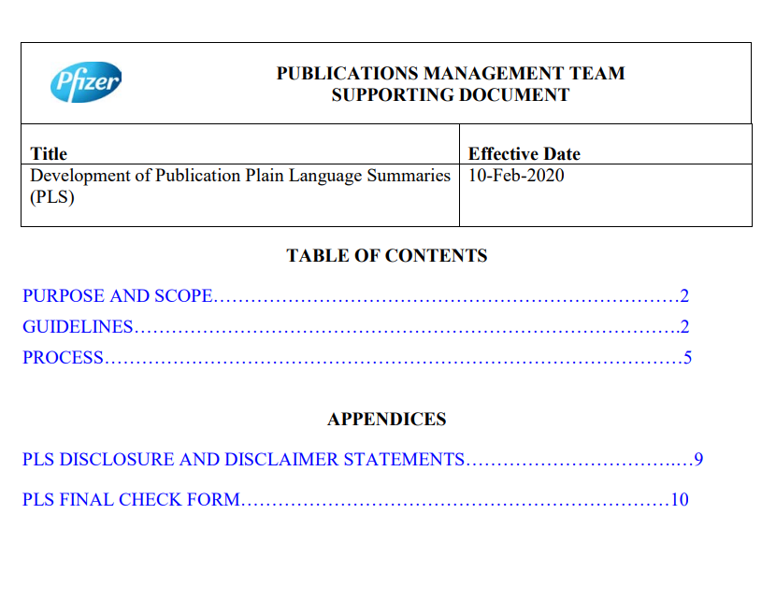

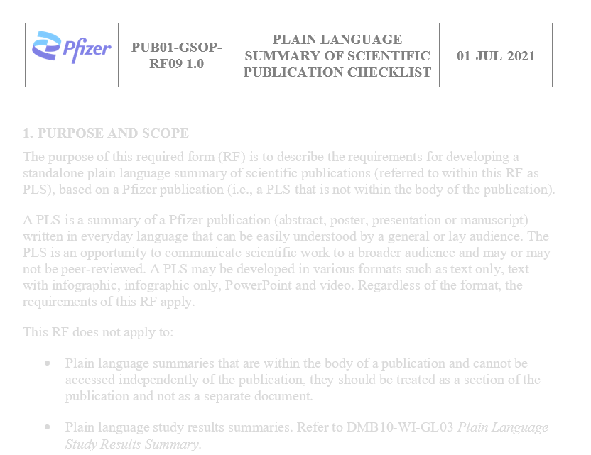
PLS Guidance and Best Practices Incorporated into Global SOP
48
Enterprise-Wide PLS Guidance
February 2020
PLS Health Literacy Best Practices Manual
October 2020
PLS Included in New Global SOP
July 2021

Slide 49
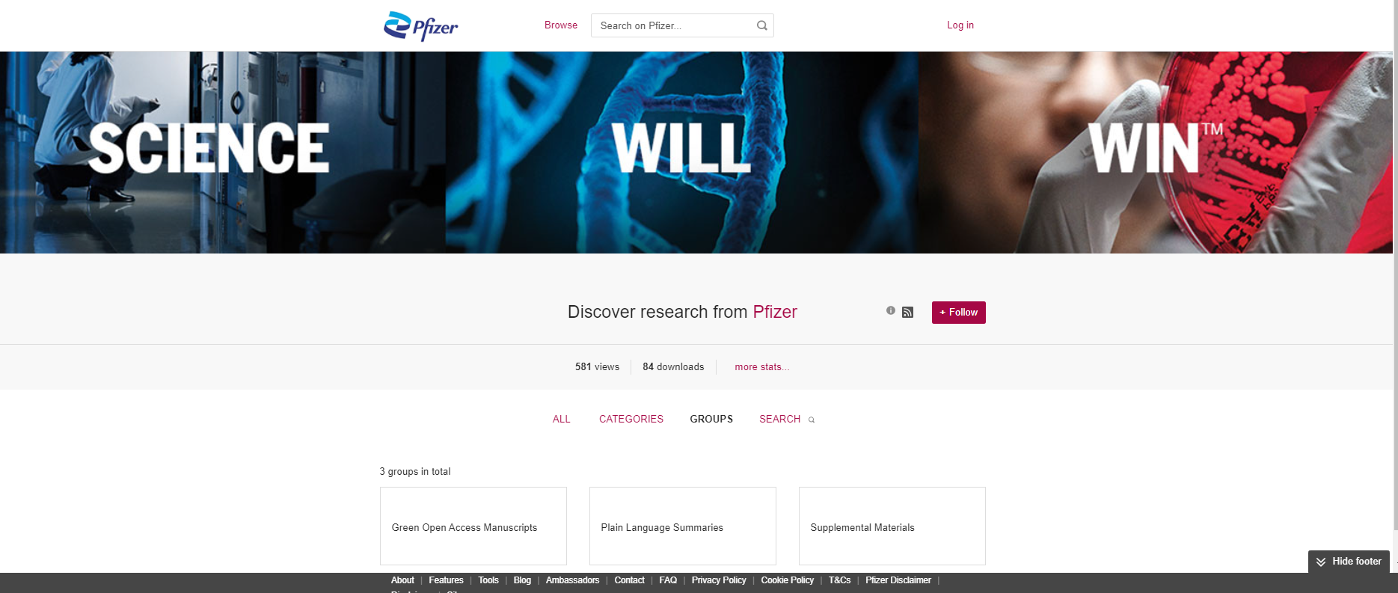
Launch of Pfizer Figshare Portal
49
Custom-branded web-based interface for sharing PLS, supplemental data and green open access manuscripts
Ability to curate what information is made available and to whom
Allows upload of any file type
Provides dashboard with detailed metrics (e.g., views, downloads, citations, Altmetrics
https://pfizer.figshare.com.

Slide 50
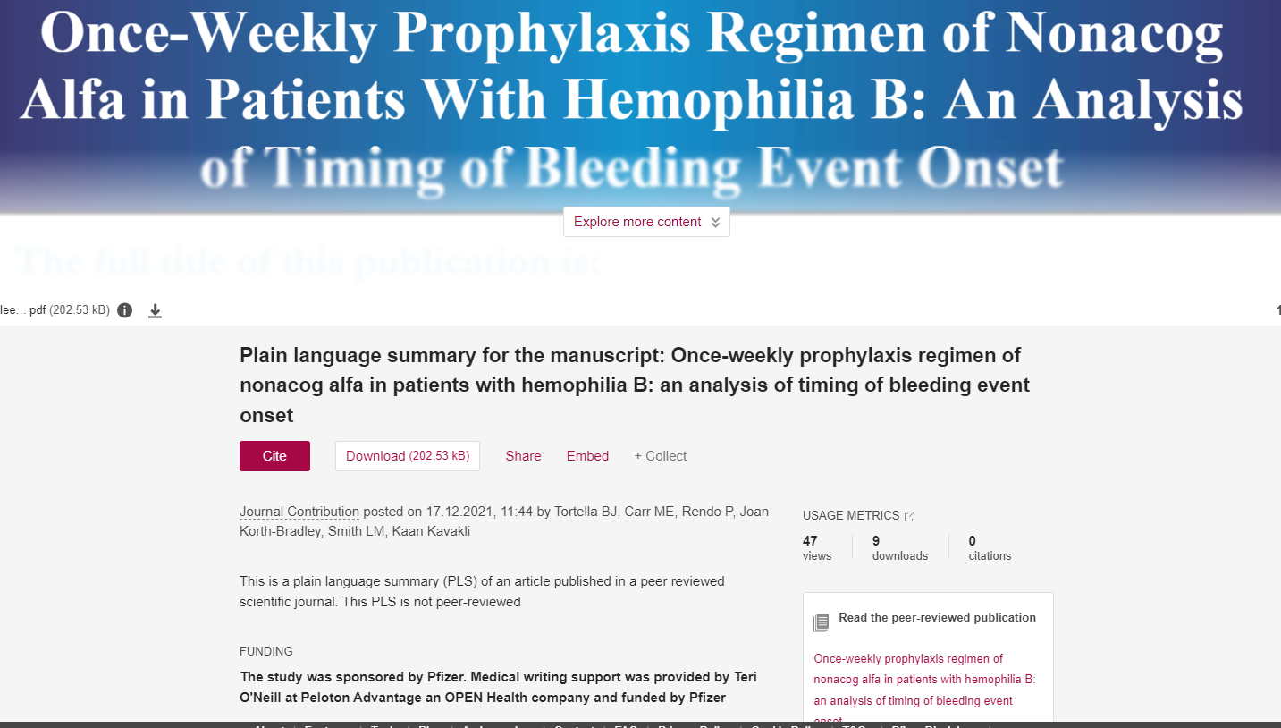
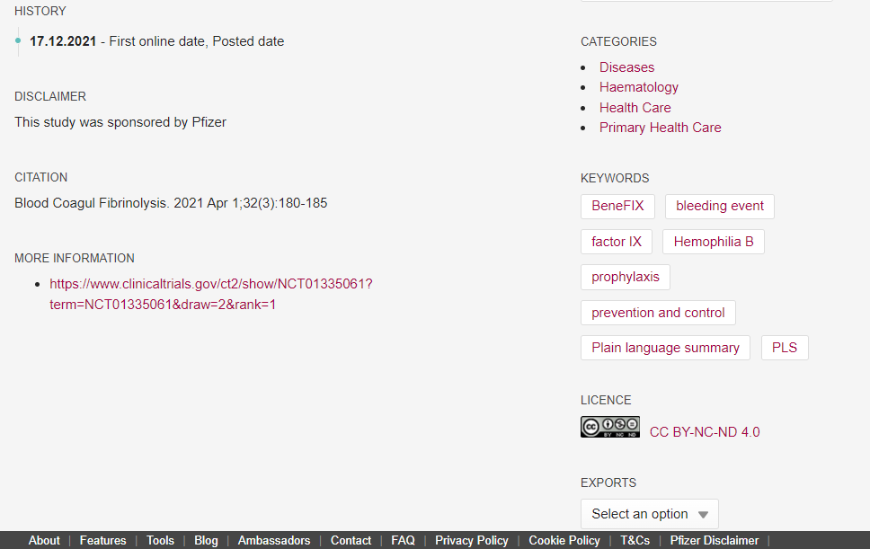
Manuscript PLS Published on Figshare
  Title of PLS
  Brief description of content (e.g., This Figshare page contains a plain language summary of …)
  Citation of underlying publication associated with PLS, data file or video
  Link to underlying publication
  Copyright license (CC-BY-NC-ND)
  Keywords (e.g., drug name, therapeutic area)
  Digital object identifier (DOI)
  Where to go for further information (e.g., link to study record on ClinicalTrials.gov), if applicable
  Relevant disclosures & disclaimers

Slide 51
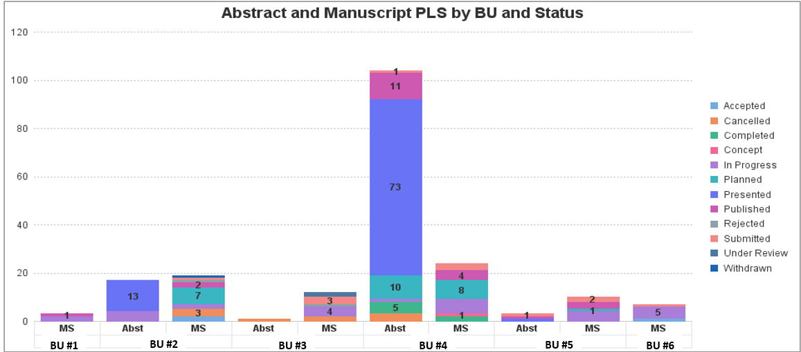
Rapid Uptake in PLS Across the Enterprise
51
PLS Type | 2020 | 2021 | Increase
Abstract | 116 | 125 | 9 (8%)
Manuscript | 39 | 75 | 36 (92%)
Publications Team, Review Time* (hours) | 117 | 225 | 108 (92%)
Data as of December 31, 2021. *Publications team conducts detailed review of manuscript PLS only.

Slide 52

Need For an Enterprise-Wide PLS Optimization Solution
  Opportunity
  Solution
Make information more understandable
  Automated health literacy checks – improved quality and understandability
  Substantial time savings for agencies, authors and reviewers
  Greater efficiency – reduction in number of versions
  Improved consistency - Pfizer works with 12 different publication agencies which support 94 Scientific Publication Committees (SPCs)
  Increased positive impressions of Pfizer’s scientific contributions by the improved delivery of high-quality content that is optimized for a lay audience
  Scalability - publications PLS HLT used as template for HLT developed for other groups (e.g., medical writing, commercial, etc.)
  Opportunity to share clinical information in a way that is more understandable and accessible to a broad audience, including patients and caregivers
Successfully manage increased demand
Publications Management Team (PMT), Medical Affairs & Pfizer’s Health Literacy Lead partnered with Pfizer Digital for a 12-week (7/27/2020 – 10/23/2020) POC and built an Information Quality Assessment Prototype
Incorporated Health Literacy principles from SOP and the PLS Health Literacy Manual
  Increasing volume will outstrip capacity to produce consistent and high-quality content
  Substantial amount of time and resources are required to develop PLS
No commercial tools available
  General-purpose readability software exists, but they cover only a small fraction of the growing number of health literacy principles

Slide 53
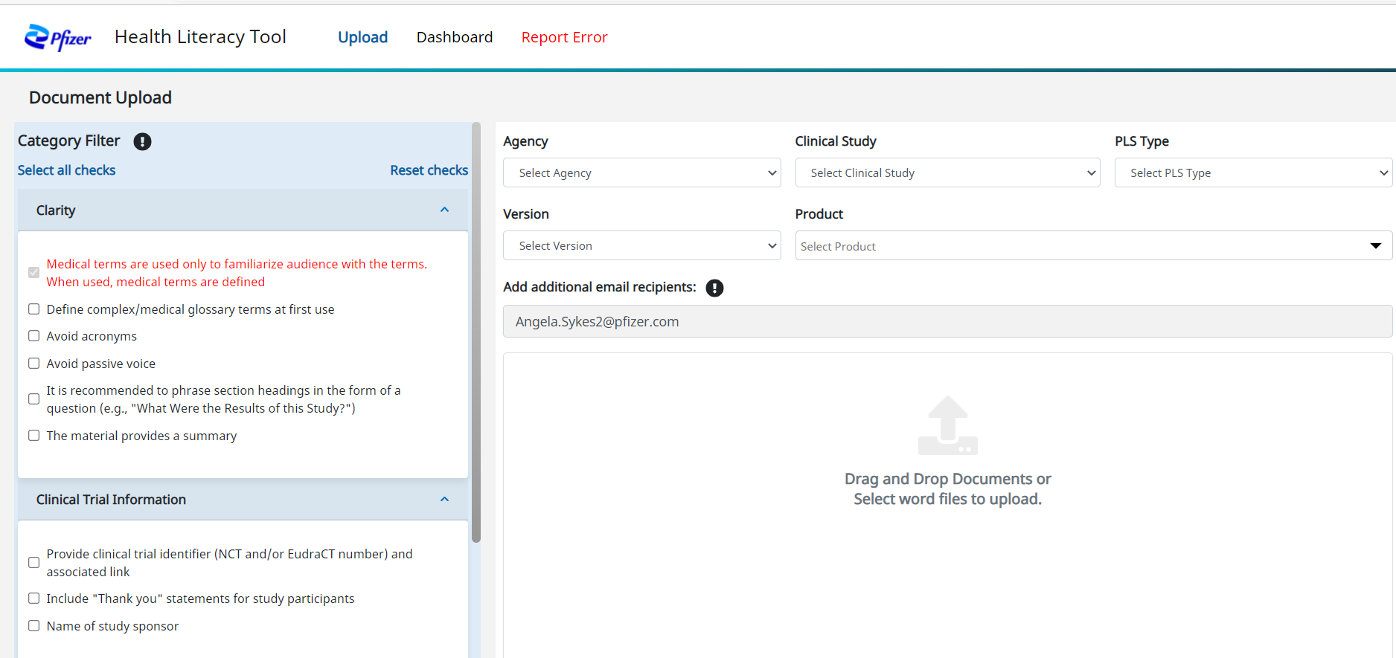
Launched PLS Health Literacy Tool
53
Bespoke online tool specifically designed to assess health literacy quality of publication PLS
Available to Pfizer colleagues and agency partners involved in the development of PLS
Identifies up to 36 ‘deviations’ to health literacy principles
Includes a mix of required and optional checks, allowing users flexibility to customize which checks are applied to each document

Slide 54
Do plain language summaries encourage readers to access your publication?
A pilot study
Caroline Halford Digital Publishing Manager ADIS│Springer Healthcare
Steve Winterª, Caroline Halford^{b}, Mel Westª and Matt Evans^{b} ªinScience Communications, Springer Healthcare Ltd, Chester, UK
^{b}Adis, Springer Healthcare Ltd, Chester, UK

Slide 55
Objective
      There has been significant growth in the number of articles published with a PLS¹
      To our knowledge, no studies have explored whether PLS increase the impact of published research
      We investigated whether articles with PLS are accessed more often than similar articles without PLS
PLS, plain language summary
1. Plain Language Summaries (PLS) of Publications: Perspectives that will shape the future.
Available at: https://www.pathlms.com/ismpp/courses/24746/webinars/15307 (accessed 2 December 2021).
Notes:
We have definitely seen a big rise in Adis journals. Increases year on year. Across all therapy areas. In different formats. Been publishing them since 2017.
We know that authors see the value in them because they write them
But not yet seen evidence of whether they increase impact
So that’s why we thought we’d study this. Looked into whether articles with PLS are accessed more often than those without
Published 47 already in 2022!
2017 = 8
2018 = 48
2019 = 73
= 98
= 151
= 47

Slide 56
Research design and methods
Step 1
Identified open-access articles with an accompanying PLS published in Adis journals between January 2018 and March 2021 (n=50)
Step 2
Compared each with a similar open-access article published without PLS
Step 3
Calculated average number of accesses per month for each article, and arbitrarily defined a significant difference as having 25% more (or fewer) accesses, on average, per month
Notes:
Step 1……
We do publish more PLS than this. But the reason that we only included 50 is because we wanted to only include PLS of the same type – i.e. 250-word, plain text PLS that are part of the article HTML and PDF. And also pulled through to PubMed.
Step 2……
Similar time…. Eg approx. within 1 month of each other
Same disease area with similar trial design…. E.g. if the PLS article was a phase 3 trial looking at an MS drug….. We’d find the same type without a PLS
Step 3……
Average accesses per month for each article.

Slide 57
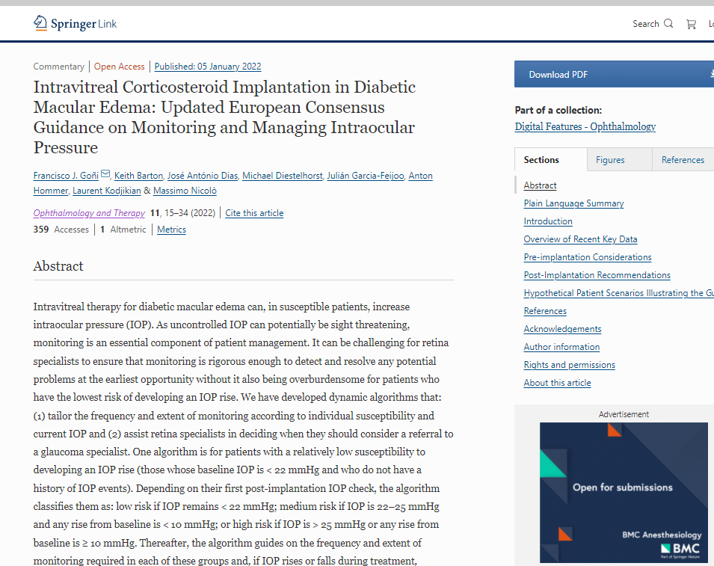

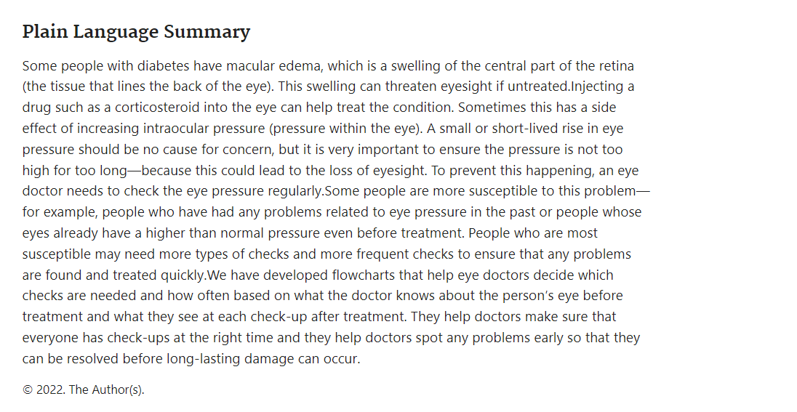
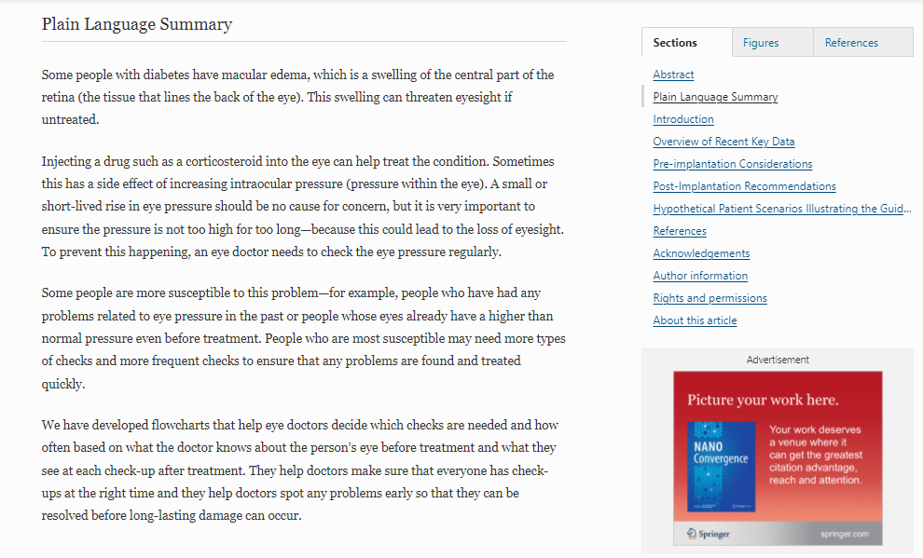
Adis article with PLS

Slide 58
What criteria did we apply to identify a ‘similar’ article?
Published in the same journal
At a similar time (+/- 1 month)
Within the same disease area
Similar trial design
Notes:
Step 1……
We do publish more PLS than this. But the reason that we only included 50 is because we wanted to only include PLS of the same type – i.e. 250-word, plain text PLS that are part of the article HTML and PDF. And also pulled through to PubMed.
Step 2……
Similar time…. Eg approx. within 1 month of each other
Same disease area with similar trial design…. E.g. if the PLS article was a phase 3 trial looking at an MS drug….. We’d find the same type without a PLS
Step 3……
Average accesses per month for each article.

Slide 59
Results: tornado plot
      Percentage difference in number of accesses/month vs article without a PLS
Decreased access
Increased access
      Dermatology
      Diabetes
      Neurology
      Oncology
      Ophthalmology
      Respiratory
      Rheumatology
      Other
Notes:
See here, across the board, articles with a PLS consistently got more downloads than those without.
Across every therapy area. Only a few articles had decreased accesses

Slide 60
Results: key findings
      30% (15/50) of comparisons there was no significant difference found between access numbers
      62% (31/50) of articles with PLS were accessed significantly more often than those without a PLS
      8% (4/50) had significantly fewer
      accesses
Decreased access
Increased access
Significant difference = 25% more (or fewer) accesses, on average, per month
Notes:
When we dig into the details a bit more….. You can see
62% were accessed significantly more
8% fewer
30% fell into the nonsignificant detail
A reminder that the 25% cut-off for a ‘significant’ difference was arbitrary. If we applied a lower cut-off of 10%, then the positive access rate increases to 68% (and negative to 18%), while the number of ‘neutral’ articles is 14%.

Slide 61
Results: by therapy area
      The following therapy areas all demonstrated significantly higher average number of accesses per month for articles with PLS compared with articles without PLS:
        Ophthalmology (100%, 4/4)
        Rheumatology (75%, 9/12)
        Oncology (75%, 3/4)
        Diabetes (60%, 6/10)
PLS, plain language summary
Notes:
Small article numbers here – but when we break down the PLS into therapy areas, you can see these are the highest areas where there was significant increase. And this is roughly what we expected. Rheum and diabetes are chronic disorders and have an engaged patient population who are looking for research. And also these are areas that are most often first seen by primary care, etc. And we do see increasingly that primary care are looking for PLS to help get a quick overview of a study.

Slide 62
Conclusions
      These preliminary results suggest that, for an open-access article, inclusion of a PLS may contribute to increased access to the publication
      More research is needed to confirm this link, and contextualise other factors that may influence the popularity of articles with/without PLS
PLS, plain language summary
Notes:
We do need to do more research here

Slide 63
Post-study reflections: There is a lot of variation in PLS formats
Format
Text
Graphical
Audience
Patients
The public
Hosting
Journal
Separate platform
Audio
Multiple
Multiple
Article type
Reviews
Research
Commentary
Generalist HCPs
PubMed
Slides
Brief reports

Slide 64
Faculty Discussion
You can submit questions at any time.
To ask a question, open the Q&A window, type your question into the Q&A box. Click Send.

Slide 65
Audience Q&A
To ask a question, open the Q&A window, type your question into the Q&A box. Click Send.

Slide 66
What’s your level of PLS adoption?
Already on board
Ready to start adopting
Waiting for GPP4
Unlikely to adopt

Slide 67
PLS Resource Slide
      A Company’s Approach to Developing Publication Plain Language Summaries | the Map (ismpp-newsletter.com)
      Plain language summaries of publications of company-sponsored medical research: what key questions do we need to address? (tandfonline.com)
      ISMPP-Sponsored Study on PLS Now Published in CMRO Presents Expert Perspectives | the Map (ismpp-newsletter.com)
      Open Pharma recommendations for plain language summaries of peer-reviewed medical journal publications (tandfonline.com)
      Journal of Medical Internet Research - Optimizing Readability and Format of Plain Language Summaries for Medical Research Articles: Cross-sectional Survey Study (jmir.org)
      PFMD guide https://pemsuite.org/How-to-Guides/WG5.pdf

Slide 68
Upcoming ISMPP U Webinars
March 2, 2022:
2022 European Meeting Member Research
Upcoming topics:
Updated CHEERS Statement
Copyrights
Notes:
Here’s a quick look at upcoming ISMPP Us. We hope you can join us!

Slide 69

Notes:
Jason to talk on the many benefits of ISMPP membership; testimonial

Slide 70

Thank you for attending!
We hope you enjoyed today's presentation.
After closing out of Zoom, please click the CONTINUE button
on your screen to take our short survey. Thank you!
Notes:
Thank you again for attending today’s webinar. Please take a moment to fill out the survey link that will be sent to you.
After closing out of ZOOM, please click the ‘continue’ button on your screen to take a short survey.
Thank you!

Slide 71
ISMPP University
Plain Language Summaries (PLS) of publications:
Focus on practical application
February 2, 2022

Slide 72
Faculty Bios

Slide 73

Melissa Crouse
Clinical trial participant
Passionate about advocacy, mentoring and keeping abreast of developments in scientific research
Founder, RET Renegades
Founder of Southwest Florida Lung Cancer Support Group
Emmy Winner for ‘Melissa’s Story’ about her and her family’s journey living with lung cancer
CMPP, certified medical publications professional; ISMPP, international society of medical publications professional

Slide 74
Jessie Daw
Patient Advocate, Multiple Myeloma; GSK Oncology Patient Council
Myeloma Mentor, Multiple Myeloma Research Foundation
Myeloma Coach, Myeloma Crowd
Co-founder/lead of the Eastern South Dakota Multiple Myeloma Support Group
Member, International Myeloma Foundation's 2021 ASH social media team
CMPP, certified medical publications professional; ISMPP, international society of medical publications professional

Slide 75
Laura Dormer
Editorial Director at the Future Science Group, first publisher of standalone Plain Language Summary of Publication articles
Interest in patient engagement in publications and publication ethics
GPP4 steering committee member and member of the PFMD ‘How to’ Guide for PLS working group
CMPP, certified medical publications professional; ISMPP, international society of medical publications professional

Slide 76
Jason Gardner
Passionate about bringing clarity to communications – for all audiences
Researcher into optimal readability and format of PLS
Co-lead of the ISMPP PLS Perspectives project, published recently in CMRO
CMPP, certified medical publications professional; ISMPP, international society of medical publications professional

Slide 77
Will Gattrell
Publications geek
Leading on implementing Ipsen’s PLS commitment for all journal publications with human data
Co-author on Open Pharma PLS recommendations
CMPP, certified medical publications professional; ISMPP, international society of medical publications professional

Slide 78
Caroline Halford
First publisher to enable PLS publication on PubMed
Publishes many patient-focused article types, including ‘Patient Physician Perspectives’
Presented data at ISMPP EU 2022 on PLS metrics
CMPP, certified medical publications professional; ISMPP, international society of medical publications professional

Slide 79
Dawn Lobban
Expertise in patient engagement across the lifecycle of medicine development
Interest in optimizing plain language summaries of publications
Active participant in key initiatives including ISMPP PLS Perspectives Working Group and PFMD ‘How to’ Guide for PLS
CMPP, certified medical publications professional; ISMPP, international society of medical publications professional

Slide 80
Angela Sykes
Developed and implemented enterprise-wide PLS process and requirements
Experience with applying health literacy principles to scientific content
GPP4 co-author
CMPP, certified medical publications professional; ISMPP, international society of medical publications professional

