Slide 1
Aneurysmal Subarachnoid Hemorrhage Nursing Self-Paced Case Study Level: Challenging
Christina Watford, BSN, RN, CCRN
Briana Witherspoon, DNP, ACNP-BC
Cynthia Bautista, PhD, APRN, FNCS

Slide 2
Introduction
Welcome to the Neurocritical Care Society’s Self-Learning Module on Aneurysmal Subarachnoid Hemorrhage!
The target audience for this module is experienced neurocritical care nurses and APRNs, although the information provided may also be helpful to newer nurses and to other professionals. Because the module allows the learner to tailor the information reviewed, the time required for completion varies from 30 minutes to several hours.
To move through the module, use the arrow buttons on your keyboard or select Next and Back buttons within presentation.
There are a number of interactive hyperlinks throughout the module that allow the learner to review additional information and test knowledge.
Click on the underlined item to follow the links.
After reviewing information using one of the interactive features, click the “return” button to return to the presentation.
If you have questions or comments about this module, please email Cynthia Bautista, PhD, APRN, FNCS at cabbrain@aol.com
Next

Slide 3
Objectives
At the completion of this self-paced case study, the learner will be able to:
1. Understand and discuss an overview of aneurysmal subarachnoid hemorrhage.
2. Describe the assessment and diagnosis of aneurysmal subarachnoid hemorrhage.
3. Explore the initial management of aneurysmal subarachnoid hemorrhage.
4. Review the general nursing measures in caring for patients with aneurysmal subarachnoid hemorrhage.
5. Identify a variety of treatments and management strategies for complications secondary to aneurysmal subarachnoid hemorrhage.
Next

Slide 4
Case Study
Mrs. Jones is a 57-year-old African American female admitted for decreased level of consciousness (LOC) after presenting to the ED. Family called EMS when Mrs. Jones verbalized a sudden-onset, severe headache that followed a retro-orbital pattern, neck discomfort, nausea/vomiting, and photophobia.
Past medical history reveals hypertension, polycystic kidney disease, and cigarette smoking (3 packs a day for 35 years).
Next

Slide 5
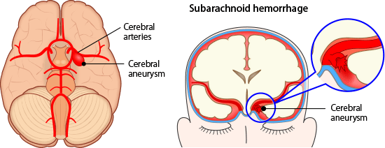
Aneurysmal Subarachnoid Hemorrhage Overview
Next

Slide 6
Introduction
Aneurysmal subarachnoid hemorrhage (aSAH) is a neurological emergency
Epidemiology:
2-16 cases per 100,000 yearly worldwide
33,000 cases per year in USA
African Americans and Mexican Americans 2x greater incidence
Women > men (1.24x greater incidence)
Mean age 55 years old
20% of individuals with one aneurysm will have multiple aneurysms
Morbidity and mortality:
15% of patients with aSAH die at the time of rupture
45% die within 30 days
At 1 year, survivors often report difficulty with memory, mood, speech, and self care
de Rooij NK., et al., 2007, Feigin VL., et al., 2009

Slide 7
Aneurysm Types
There are several different types of aneurysms, with varying causes and treatment implications. Click on each type of aneurysm to learn more:
Berry/Saccular
Fusiform
Traumatic
Mycotic (infectious)
Dissecting

Slide 8
Aneurysm Size
Aneurysm size impacts the risk of rupture and subarachnoid hemorrhage. In addition, the size and shape of the aneurysm impacts the choice of treatment.
Aneurysm size is classified as follows:
Small up to 9 mm
Large 10 – 24 mm
Giant > 25mm
Bader et. al., 2016

Slide 9
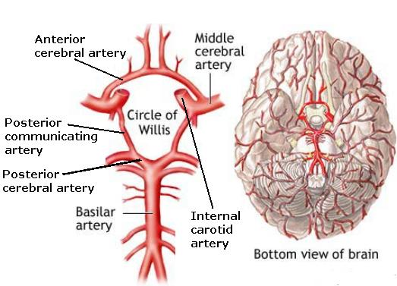
Location Location Location
Aneurysms occur in the Circle of Willis, generally near bifurcations or trifurcations where blood flow is more turbulent.
25-30% occur in the posterior communicating or internal carotid artery
30% occur in the anterior communicating or anterior cerebral artery
20% occur in the middle cerebral artery
15% occur in the posterior circulation (off of the vertebral or basilar arteries)
(Hickey, 2014)
Accessed online: http://www.neuroems.com/2014/04/18/blood-flow-through-the-brain-pt-3-circle-of-willis/

Slide 10
Pathophysiology and Etiology of Aneurysm Formation
The arterial wall is composed of three layers- intima(innermost), media (smooth muscle), and adventitia (outermost, connective tissue)
Saccular aneurysms result from breakdown of the media, and outpouching of the intima and adventitia
Disruption of arterial wall integrity can be:
Congenital: defect between adventitia and media layer of arterial wall – medial gap
Degenerative: hemodynamically induced, causes bulge, ballooning, rupture of vessel
Trauma: due to trauma…penetrating trauma
Infection: infectious process involving the arterial wall Mycotic aneurysms, septic emboli – endocarditis
Genetic: screen first degree relatives (especially siblings) …..certain pathologies-polycystic kidney disease, Marfan’s Syndrome

Slide 11
Aneurysm Pathophysiology and Rupture
Bulge or area of outpouching
Occurs at weakness in vessel wall
Along with turbulent blood flow, rupture can occur due to physical limitations of collagen at the vessel wall and humoral factors such as inflammatory mediators and adhesion molecules
In aneurysmal subarachnoid hemorrhage (aSAH), the aneurysm ruptures, causing blood to spill in the subarachnoid space and cerebral spinal fluid (CSF) around the brain and spinal cord
As blood is distributed within the CSF, damage can occur to the cerebral tissues
Rapidly elevating intracranial pressure
Altering the brain’s natural autoregulation mechanism
Hickey, 2014

Slide 12
Risk Factors for aSAH
Hypertension
Smoking
Heavy alcohol use
Sympathomimetic drugs (cocaine)
Inherited conditions (autosomal dominant polycystic kidney disease, Ehlers Danlos type IV)
Familial intracranial aneurysms
Previous ruptured aneurysm
(Cohen-Gadol & Bohnstedt, 2013)

Slide 13
Case Study Question 1
Mrs. Jones’ past medical history reveals hypertension, polycystic kidney disease, and family history of an cerebral aneurysm.
Which of these preventable risk factors would most significantly increase the patient’s risk of aSAH?
African American
Hypertension
Polycystic kidney disease
Family history

Slide 14
Prognosis and Predictors of Poor Outcome
Presence of thick blood, intraparenchymal clot, and ventricular blood are associated with worse outcomes
Location of aneurysm (posterior less favorable)
Increasing Hunt-Hess Grade has shown poor prognosis
Degree of cerebral vasospasm and delayed cerebral ischemia
Complications during critical care course of treatment (rebleeding, infection, myocardial infarction)
High risk for disability and death age ≥ 65 years of age
Cocaine use have a poor prognosis
Some patients will improve with aggressive initial resuscitation

Slide 15
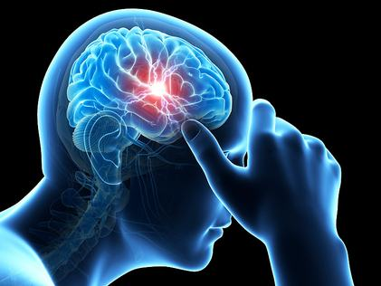
Assessment and Imaging

Slide 16
Case Study
Mrs. Jones has the following vital signs while in the Emergency Department….
BP 220/95, HR 103, RR 12, Sp0₂ 92% on room air.
Her assessment is as follows:
Lethargic, but opens eyes to voice and follows commands
Right sided pupil dilation and ptosis
Mild left hemiparesis
Complaining of nausea

Slide 17
Clinical Signs and Symptoms
Common clinical signs and symptoms of aSAH include:
“Worst headache of my life”
Nausea and/or vomiting
Meningeal irritation
Nuchal rigidity, blurred vision, photophobia, mild temperature elevation
Focal neurological deficit (e.g. 3rd cranial nerve palsy, motor deficits)
Seizure

Slide 18
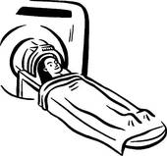
Diagnosis

Slide 19
Case Study
The neurosurgeon is called to the Emergency Department to assess Mrs. Jones. She is lethargic but opens her eyes to voice and follows commands. She has a mild left hemiparesis, a dilated pupil on the right, and right ptosis. Mrs. Jones is oriented to her name and to “hospital” but not to date or time.

Slide 20
Case Study Question 2
Based on this information, what is Mrs. Jones’ Hunt and Hess grade?
Grade 1
Grade 2
Grade 3
Grade 4
Grade 5
I don’t know, and would like to review the Hunt and Hess classification system.

Slide 21
Case Study: Imaging
Mrs. Jones is taken to CT scan. A CT angiogram (CTA) is performed which reveals diffuse thick SAH from a ruptured right posterior communicating aneurysm. Mild to moderate hydrocephalus is also noted.
The neurosurgeon reviews the CT scan and states Mrs. Jones’ Modified Fisher Grading Scale is a Grade 3.

Slide 22
Non-contrast CT Scan
High sensitivity (>95%) for detection for SAH
False negative if volume of blood very small, hemorrhage several days ago, hematocrit low
Use early (< 48 hours old) scans
Use of Modified Fisher Grading Score to determine amount of blood seen on CT scan

Slide 23
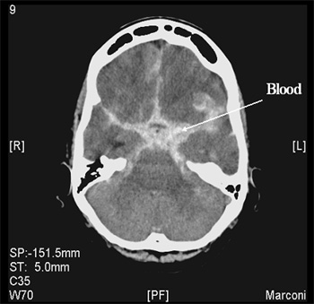
Non-contrast CT Scan
Accessed online:
http://www.uhs.nhs.uk/OurServices/Brainspineandneuromuscular/Neurovascularservice/Neurovascularconditions/SubArachnoidHaemorrhage/Investigations.aspx

Slide 24
Modified Fisher Grading Score
Grade Appearance of hemorrhage
Grade 1 None evident
Grade 2 Less than 1 mm thick
Grade 3 More than 1 mm thick
Grade 4 Diffuse or none with intraventricular hemorrhage or parenchymal extension

Slide 25
Case Study Question 3
Mrs. Jones’s Modified Fisher Grade is Grade 3.
Do you anticipate Mrs. Jones’s will have blood in her ventricles?
Yes
No
Back

Slide 26
Vascular Imaging
Non-invasive angiography (CTA or MRA)
Sensitive for ≥ 5 mm
If negative perform Digital Subtraction Angiography (DSA)
Catheter Cerebral Angiography
Gold Standard
Identifies presence of ruptured aneurysm and anatomical features
Negative angiogram appears 20% of the time, need to repeat within few days to weeks

Slide 27
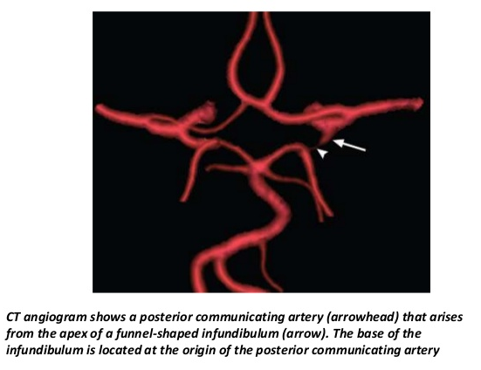
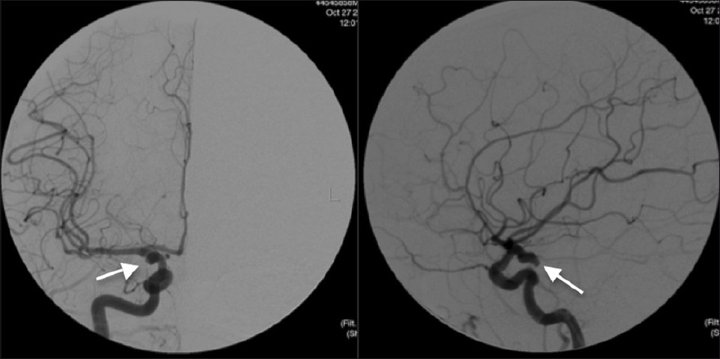
Vascular Imaging
CT Angiogram
Cerebral Angiography
Right Posterior Communicating Aneurysm
Accessed online: https://www.slideshare.net/sunilchendur/imaging-and-anatomy-of-blood-supply-of-brain
Accessed online: http://www.clinicalimagingscience.org/viewimage.asp?img=JClinImagingSci_2012_2_1_27_96542_u2.jpg

Slide 28
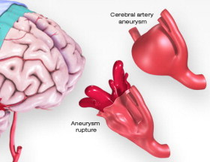
Initial Management

Slide 29
Case Study
Mrs. Jones begins to desaturate and occlude her airway due to her decreased level of consciousness. She is intubated in the Emergency Department to protect her airway. She is then transferred to the Neuroscience Intensive Care Unit for frequent neurological assessments, blood pressure monitoring and management.

Slide 30
Initial Management
Begin aggressive life-support measures
Ensure adequate ventilation and oxygenation
Oxygen saturation monitoring
Intubate for decreased GCS, elevated ICP, hemodynamic instability
Monitor for pulmonary edema

Slide 31
Initial Management - Continued
Frequent neurological exams
Baseline cardiac assessment
Echocardiography
Consider monitoring cardiac output in patients with hemodynamic instability or myocardial dysfunction
Continuous ECG
Assess for tall peaked T-waves, ST segment depression, and prolonged QT segments

Slide 32
Initial Management - Continued
Blood pressure control (SBP <160 mm Hg)
BP > 160 mm Hg might be associated with re-bleeding
Use titratable agent nicardipine, labetalol, and clevidipine
Avoid nitrates as they can increase ICP
Consider an infusion over intermittent IV pushes to avoid sudden drop in perfusion pressure to prevent ischemia

Slide 33
Initial Management - Continued
Fluid administration
Maintain euvolemia with accurate measurement of intake and output
Consider indwelling urinary catheter if unable to accurately measure I & O
Grade 1 and 2 usually can be managed with an intermittent urinary catheter
Provide pain management
Avoid over sedating but pain should be treated to diminish hemodynamic fluctuations increasing risk of re-bleeding
Provide antiemetic
Vomiting can increase ICP

Slide 34
Case Study Question 4
Which of the following assessment findings required intervention?
Oxygen saturation is 98%
Stable neurological exam
Cardiac monitor displays normal sinus rhythm
Blood pressure is 168/88

Slide 35
General Measures
Monitor serum sodium, assess for hyponatremia
Use 3% saline for significant hyponatremia
Use sodium tablets for mild hyponatremia
Maintain normal body temperature
Fever associated with worse outcome
Provide glucose control
Hyperglycemia associated with worse outcome
Assess glucose levels every 6 hours

Slide 36
General Measures - Continued
Nutrition
Enteral feedings
Dysphagia screening prior to PO intake
Anemia
Associated with worst outcome
Higher hemoglobin levels are associated with fewer cerebral infarctions and improved outcomes
Hemoglobin goal has not been defined, most evidence suggests a target above 8-10 g/dl

Slide 37
General Measures - Continued
Avoid straining
Provide stool softeners
Prevent Stress Ulcers
Administer H2 receptor blockers or proton-pump inhibitors

Slide 38
General Measures - Continued
DVT Prevention
Intermittent pneumatic compression devices
Application of compression stockings
Do not use enoxaparin due to risk for intracerebral hemorrhage
Use of low-dose unfractionated subcutaneous heparin is generally acceptable after aneurysm has been secured

Slide 39
Case Study
Mrs. Jones is resting comfortably. You assess the following items:
1) Intermittent pneumatic compression device is turned on and wrapped around her lower legs to prevent DVT
2) Review labs for hyponatremia – serum sodium is 132mEq/L
3) Continue to monitor her temperature for hyperthermia - 99°F
4) Monitor her glucose levels – BS is 160 mg/dL

Slide 40
Case Study Question 5
Mrs. Jones was reassessed a few hours later. Which of the following needs to be treated?
Blood glucose of 140 mg/dL
Sodium level of 128 mEq/L
Temperature 98.8°F
Hemoglobin 9 g/dl

Slide 41
Placement of Ventriculostomy
Patients with acute hydrocephalus on initial CT scan should have ventriculostomy inserted to allow for direct measurement of ICP and draining of CSF as needed
Reversal of antithrombotic agents should occur prior to drain placement
Conscious sedation may be required in some patients
Placement of a drain prior to surgical intervention is preferred to allow for monitoring of ICP intra-operatively

Slide 42
Case Study
Shortly after arriving to the Neuroscience ICU, the Neurosurgery team arrives and places an external ventricular drain (EVD) in Mrs. Jones. Initial ICP is > 20 mm Hg. The EVD is set to 10 mm Hg. Shortly after the drain is placed Mrs. Jones begins to follow commands intermittently.

Slide 43
Case Study Question 6
Mrs. Jones is at risk for which of the following ventriculostomy-associated complications?
Stroke
Hydrocephalus
Seizure
Infection - ventriculitis

Slide 44
Prevent Rebleeding
Risk of re-bleeding over first 24 hours is 4% – 14%
Risk factors
Women
Poor clinical grade SAH
Larger aneurysm
Sentinel headaches
Poor medical condition
Elevated SBP
Catheter angiography within 3 hours of initial rupture
Naidech AM et al., (2005)

Slide 45
Prevent Rebleeding - Continued
Fifty percent (50%) of patients who re-bleed die
Factors associated with re-bleed include
Cough
Valsalva
Rapid CSF drainage
Excessive stimulation
Headache
Agitation

Slide 46
Prevent Rebleeding - Continued
Best method to prevent rebleeding is to secure the aneurysm as soon as possible
Treat aneurysm within 24 hours of hospitalization
Always attempt intervention before the fourth day
Antifibrinolytic drug (aminocaproic acid)
Increase risk of infarction, no benefit
Use for high risk rebleed, postponed intervention
4g IV load, 1g/h IV maintenance
Short term use < 72 hours, intermittent doses
Avoid hypotension & hypovolemia

Slide 47
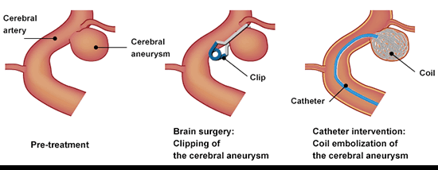
Treatment for Cerebral Aneurysm

Slide 48
Case Study
After the EVD is successfully placed, Mrs. Jones is taken to the neuro-interventional suite for embolization of her right posterior communicating aneurysm. The aneurysm is successfully obliterated with 5 coils.

Slide 49
Clip or Coil to Prevent Rebleeding
In the setting of aSAH, the aneurysm should be secured as soon as possible using either surgical clipping or endovascular embolization (coiling).
American Heart Association/American Stroke Association Guidelines(2012) states “Coiling may be preferred”
International Subarachnoid Aneurysm Trial (ISAT)
Randomized study with 2143 patients
Compared clipping and embolization in patients with ruptured aneurysms
The American Society of Interventional and Therapeutic Neuroradiology, and the American Society of Neuroradiology issued a joint position statement that "patients with subarachnoid hemorrhage and aneurysm anatomy indicating a high likelihood of success with endovascular therapy should be offered that option" as a primary treatment”

Slide 50
Coiling
These are situations in which coiling is typically felt to be the better option
All SAH Hunt & Hess Grades
Posterior circulation
Small to medium size
Narrow neck (< 4mm)
Saccular and calcified aneurysms
> 70 years old
Medical comorbidities
No hematoma

Slide 51
Balloon and Stent Assisted Coiling
Attempting coil embolization of an aneurysm with a wider neck may result in the coil becoming dislodged and floating into the parent vessel
A Balloon may be temporarily inflated in the parent vessel across the neck of the aneurysm while coils are deployed into the aneurysm
Balloon is then deflated, coil mass is assessed for movement or dislocation
Stents may also be used where the aneurysm has a wider neck
Similar approach to balloon assisted coiling is used; the microcatheter is either inserted through the holes in the mesh stent or placed in the aneurysm prior to deploying the stent
Stents are permanent, requiring the patient to be on aspirin and clopidogrel
Stents are associated with a higher rate of hemorrhage due to dual platelet therapy
Froehler MT, 2013

Slide 52
Post Coiling Nursing Management
Frequent neuro assessments
Blood pressure management
Site care
Groin check for bleeding
Check for pulses
Check for femoral sheath patency
Assess for retroperitoneal bleed

Slide 53
Case Study Question 7
Which of the following nursing management items is a priority for Mrs. Jones who has just arrived in the NICU after having her aneurysm coiled?
A. Observe groin site for infection
B. Perform frequent neurological assessments
C. Monitor and treat fever as ordered
D. Reposition every 2 hours

Slide 54
Clipping
These are situations in which clipping is typically felt to be a better option
Very wide neck, incorporate branching vessels
Hunt & Hess Grade I to III
Anterior circulation location
Size is < 3mm
Giant with neck > 5mm
Saccular, fusiform, abnormal branches
Younger patients (<60years old)
Presence of intraparenchymal hematoma

Slide 55
Clipping - Continued
Complications associated with clipping include
New or worsened neurologic defects caused by
Brain retraction
Temporary arterial occlusion
Intraoperative hemorrhage
Intraoperative re-rupture (20% risk)

Slide 56
Intraoperative Angiography (IOA)
After aneurysm secured with clip
Verifies patency of parent vessels and occlusion of aneurysm
Revision of clip replacement found on IOA occurred 12.4%

Slide 57
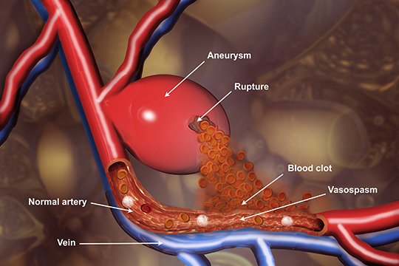
Post Treatment Management

Slide 58
Case Study
Upon return to the Neuro ICU from angiogram the Neurosurgeon places the following orders:
Neuro checks every hour with neurovascular checks every 15 minutes for 2 hours
Monitor ICP hourly and record drain output hourly
SBP goal < 180 now that aneurysm is secure, contact team for SBP > 180 as it may be indicative of vasospasm
Obtain Transcranial Dopplers daily
Nimodipine 60 mg PO every 4 hours for 21 days
Acetaminophen 650 q6h PRN for headache
Insulin sliding scale or infusion for glucose control
Chemistry panel daily to monitor sodium

Slide 59
Vasospasm
Can result from thicken arterial wall, narrow lumen, impaired relaxation, impaired antiregulatory function, intravascular depletion
Risk for vasospasm is present during days 3 – 21, highest risk is approximately day 7
Less than 4% of deficits occur after day 13
60% incidence, 30% become symptomatic
At risk
Younger patients with poor neurological grade
Thick subarachnoid clot
IVH
History of smoking
Symptoms
Headache, confusion, decreased LOC, focal deficit

Slide 60
Monitor for Vasospasm Transcranial Doppler (TCD)
Noninvasive linear blood flow velocities
Velocity changes seen on TCD typically precede clinical signs of vasospasm
Conduct daily studies to monitor trends of vasospasm
Limitation to use of TCD
Operator dependent
Poor temporal windows (older women)
Sensitivity & specificity 70% - 80%

Slide 61
Transcranial Doppler (TCD) Results
Assess for elevated blood flow velocities
Mean velocity > 120cm/sec indicative of vasospasm, >150 moderate, >200 severe
Review Lindegaard Ratio
Intracranial to extracranial vessel mean flow velocity ratio
Vasospasm vs. hyperemia
> 3 vasospasm present
> 6 Severe vasospasm present

Slide 62
Delayed Cerebral Ischemic (DCI)
Any neurological deterioration presumed related to ischemia that persists for more than an hour and cannot be explained by other physiological abnormalities noted on standard radiographic, electrophysiologic, or laboratory findings
Occurs after SAH and has a gradual onset (5 – 7 days)
Involves more than single artery territory
Event presentation
50% have decreased LOC & focal deficits
25% have hemispheric focal deficits
25% have just a decreased LOC
Predicted by amount of blood & loss of consciousness
Other factors include hypovolemia and hypotension
Diringer MN., et al. (2011)

Slide 63
Monitor for Delayed Cerebral Ischemia
Brain tissue oxygen catheter (PbtO₂)
Catheter placed in white matter of brain tissue
Measures regional cerebral ischemia
Ischemia present at 15mm Hg
Electroencephalogram (EEG)
Assess alpha/delta ratio
Microdialysis
Assess lactate to pyruvate ratio
Ischemia is present when lactate to pyruvate ratio > 25mm Hg

Slide 64
Nimodipine
Calcium channel blocker
Give 60mg every 4 hours for 21 days
Only given enterally
Given as whole capsule or liquid preparation
Decreases risk of delayed ischemic damage and poor functional outcome
Does not decrease angiographic vasospasm
Ensure systemic blood pressure is not compromised
May need to give 30mg every 2 hours

Slide 65
Case Study Question 8
It is time for Mrs. Jones to receive her Nimodipine. You notice that her blood pressure is 160/86. After giving Mrs. Jones her Nimodipine you notice that her blood pressure drops to 120/80. Which of the following actions would you consider?
Discontinue giving Mrs. Jones Nimodipine
Continue to give Mrs. Jones Nimodipine 60mg every 4 hours
Give the next dose at 30mg every 2 hours
Give Mrs. Jones a Normal Saline 100cc bolus

Slide 66
Monitor & Treat Vasospasm Digital Subtraction Angiography (DSA)
Highly accurate for detecting vasospasm
Provides treatment for vasospasm (angioplasty, intra-arterial calcium channel blocker or vasodilator)
Monitor insertion site post-procedure for complications

Slide 67
Assess for Vasospasm CT Angiography (CTA)
Good correlation with digital subtraction angiography (DSA)
Can identify aneurysms 5mm or larger with high degree of sensitivity
Noninvasive, can quickly and easily be obtained
90% agreement for severe vasospasm between CTA and DSA
Discrepancy seen with mild to moderate spasm
Similar to DSA, CTA requires the administration of IV contrast

Slide 68
Assess for Vasospasm CT Perfusion
Good correlation with digital subtraction angiography (DSA)
Severe vasospasm seen with
< 25ml/100 g/min cerebral blood flow
>6.5s mean transit times
Identifies ischemic risk
Be aware of cumulative radiation exposure from CT perfusion studies

Slide 69
Case Study
On post embolization 5/post bleed day 6 Mrs. Jones’ TCDs are noted to have increasing velocities in the Left MCA with a Lindegaard Index of 5.2.
The nurse taking care of Mrs. Jones also reports new onset of confusion and decreased level of consciousness.
A CTA/CTP is obtained and confirms severe vasospasm in the left MCA with new areas of decreased perfusion noted on CTP, indicative of new infarctions.

Slide 70
Vasospasm Treatment
Provide induced hypertension
Medications used: phenylephrine, norepinephrine, dopamine
If no improvement with blood pressure augmentation, consider inotropic therapy to augment cardiac output (dobutamine, milrinone)
Caution with vasopressin as it can exacerbates hyponatremia
MAP > 130 or < 70mmHg associated with severe disability or death
(Diringer et al (2011), Connolly ES (2012))

Slide 71
Treatment for Vasospasm Endovascular Therapies
Use for refractory to medical therapy, not for prevention of vasospasm
Used to open narrowed arterial walls
Super-selective intra-arterial infusion of vasodilators
Intra-arterial infusion of calcium channel blockers
Transluminal balloon angioplasty

Slide 72
Treatment for Vasospasm Transluminal Balloon Angioplasty
Highly effective
Relieves focal vasospasm in proximal segments
Early treatment averts ischemia
Complication rate of 5%

Slide 73
Treatment for Vasospasm Intra-arterial Vasodilators
Improves distal and diffuse vasospasm
Transient effect, may need repeat intervention
Drugs used: Milrinone, Nicardipine, and Verapamil

Slide 74
Vasospasm Treatment - Continued
Volume status - Euvolemia
Use of isotonic fluids unless hyponatremic, in which case sodium replacement with hypertonic saline is appropriate.
Maintain euvolemia with fluids
0.9% saline (if normal serum sodium level)
1.5% saline (if hyponatremia)
3% or 7.5% saline (if hyponatremic)
5% and 25% Albumin
Uncertain use of supplemental 5%
No evidence for routine use
Maintain euvolemia if there are no clinical signs of vasospasm
Prophylactic hypervolemia is not recommended

Slide 75
Increased Intracranial Pressure Treatment
Osmotic Therapy
Hypertonic Saline – monitor serum sodium levels
Osmotic diuretic (mannitol) – consider monitoring osmolar gap
Avoidance of Fever
Antipyretic medication ( acetaminophen, NSAIDs)
Cooling measures
Caution with negative results of shivering

Slide 76
Communicating Hydrocephalus
Acute hydrocephalus within first 72 hours occurs 30% of the time
Delayed hydrocephalus can occur up to several weeks 25% of the time
Risk factors associated with hydrocephalus
IVH
Posterior circulation aneurysms
Low GCS on presentation
Assess for diminished level of consciousness
Treat with temporary or permanent CSF diversion
Ventricular drain and external ventricular drainage system
Lumbar drain may be required if ventriculostomy is at risk for causing infection
Some patients with acute hydrocephalus will require shunt placement for treatment of chronic hydrocephalus

Slide 77
Hyponatremia
Most common electrolyte imbalance in aSAH patients, 30% -50% incidence
Monitor sodium levels frequently - Very low (<120mEq/L) or rapid decline causes depressed level of consciousness and seizures
Do not fluid restrict, increases risk of vasospasm
Consider fluid replacement with mildly hypertonic solutions (1.5% -3% saline)
Syndrome of Inappropriate ADH
Excessive secretion of ADH, free water retention
Slightly expanded intravascular volume
Cerebral Salt Wasting
Volume reduction due to natriuresis increasing risk of vasospasm
Fludrocortisone may limit natriuresis

Slide 78
Neurocardiogenic Injury
Prevalence of 20% to 40%
Seen more often in poor clinical grade
Results from excessive sympathetic stimulation
Catecholamine storm
Cardiomyopathy “stunned myocardium”
Apical ballooning syndrome, Takotsubo cardiomyopathy
Slight increase in cardiac enzymes (cTnI ≥0.3ng/mL)
Arrhythmias
Manifests over the first 48 hours
Reverses spontaneously over 2-3 weeks

Slide 79
Treatment Neurocardiogenic Injury
Management should focus on supportive care
Avoid excessive fluid intake
Judicious use of diuretics with goal of euvolemia
Inotropic agents
High concentrations of oxygen
Positive end-expiratory pressure

Slide 80
Seizures
Clinical seizures are uncommon after initial aneurysm rupture
Predictor of poor outcome
Can be indicative of a re-rupture in patients with an unsecured aneurysm
Risk factors for seizures in SAH patients are
Surgical repair of an aneurysm in a patient > 65 years old
Thick subarachnoid clot
Presence of ICH
Delayed infarction
MCA aneurysm

Slide 81
Continuous EEG
Detects subclinical seizures, delayed cerebral ischemia, & responses to treatment
Monitor for Non-Convulsive Seizures (NCS)
In patients with poor grade SAH and low GCS
May be detected on cEEG in up to 20% of cases
Predicts patient outcome - unfavorable outcome with
Periodic epileptiform discharges
Electrographic status epilepticus
Absence of sleep architecture

Slide 82
Anticonvulsants
Provide until aneurysm secured
Consider short term use (3-7days)
Give for clinical or electrographic seizures
Avoid long term use of antiepileptic drugs
Consider other antiepileptic drug besides phenytoin
Phenytoin associated with poor outcome (Naidech,2005)
Causes functional & cognitive disability

Slide 83
Case Study – The End
Mrs. Jones’ neurological status slowly improves. She is extubated successfully, and she remains hemodynamically stable. She begins to work with nursing and physical therapy to increase her mobility. She is transferred to the progressive care unit for continued neurological assessments. After 10 days, she is transferred to the neurological floor and is evaluated for acute rehabilitation.

Slide 84
Review
Subarachnoid hemorrhage due to ruptured cerebral aneurysm is a neurological emergency.
Early complications include rebleeding, hydrocephalus, and cardiopulmonary complications.
Initial management focuses on attaining cardiopulmonary stability, BP management (< 160 mm Hg), management of hydrocephalus, and definitive treatment of the aneurysm through clipping or embolization.
Ongoing management focuses on close neurological monitoring, maintaining euvolemia, avoiding fever, and avoiding significant hyperglycemia.
Late complications of aSAH include delayed cerebral ischemia due to vasospasm, which occurs 3-21 days after aneurysm rupture (peak incidence around day 7).
Treatment of vasospasm includes induced hypertension and endovascular therapy (infusion of vasodilators and, in some cases, angioplasty).

Slide 85
References
Al-Yamany M, Ross IB. Giant fusiform aneurysm of the middle cerebral artery : successful Hunterian ligation without distal bypass. Br J Neurosurg. 1998;12:572–575.
Bader, M. K., Littlejohns, L. R., Olson, D. M. (2016). AANN Core Curriculum for Neuroscience Nursing. IL: AANN
Brisman, J. L. (2016). Neurosurgery for Cerebral Aneurysm: Fusiform aneurysms. Medscape. Retrieved from http://emedicine.medscape.com/article/252142-overview#a4
Cohen-Gadol, A. A., & Bohnstedt, B. N. (2013). Recognition and evaluation of non-traumatic subarachnoid hemorrhage and ruptured cerebral aneurysm. American Family Physician, 88(7), 451-456.
Connolly, E. S. Jr et al. Guidelines for the management of aneurysmal subarachnoid hemorrhage: a guideline for healthcare professionals from the American Heart Association/American Stroke Association. Stroke 43, 1711–1737 (2012).

Slide 86
References (con’t)
de Rooij NK, Linn FH, van der Plas JA, Algra A, Rinkel GJ. Incidence of subarachnoid haemorrhage: a systematic review with emphasis on region, age, gender and time trends. J Neurol Neurosurg Psychiatry. 2007;78:1365–1372
Diringer MN, Bleck TP, Claude Hemphill J 3rd, Menon D, Shutter L, Vespa P, Bruder N, Connolly ES Jr, Citerio G, Gress D, Hänggi D, Hoh BL, Lanzino G, Le Roux P, Rabinstein A, Schmutzhard E, Stocchetti N, Suarez JI, Treggiari M, Tseng MY, Vergouwen MD, Wolf S, Zipfel G; Neurocritical Care Society.. Critical care management of patients following aneurysmal subarachnoid hemorrhage: recommendations from the Neurocritical Care Society's Multidisciplinary Consensus Conference. Neurocrit Care. 2011 Sep;15(2):211-40. doi:10.1007/s12028-011-9605-9. Review. PubMed PMID: 21773873.
Feigin VL, Lawes CM, Bennett DA, Barker-Collo SL, Parag V. Worldwide stroke incidence and early case fatality reported in 56 population-based studies: a systematic review. Lancet Neurol. 2009;8: 355–369
Froehler, M.T. Curr Neurol Neurosci Rep (2013) 13: 326. doi:10.1007/s11910-012-0326-z

Slide 87
References (con’t)
Hickey, J. (2014). The Clinical Practice of Neuroscience and Neurosurgical Nursing. PA: Wolters Kluwer
Kannoth S, Iyer R, Thomas SV, Furtado SV, Rajesh BJ, Kesavadas C, Radhakrishnan VV, Sarma PS (2007) Intracranial infectious aneurysm: presentation, management and outcome. J Neurol Sci 256:3–9
Kannoth, S., & Thomas, S. V. (2009). Intracranial microbial aneurysm (infectious aneurysm): current options for diagnosis and management. Neurocritical care, 11(1), 120.
Naidech AM, Janjua N, Kreiter KT, Ostapkovich ND, Fitzsimmons B, Parra A, Commichau C, Connolly ES, Mayer SA. Predictors and Impact of Aneurysm Rebleeding After Subarachnoid Hemorrhage. Arch Neurol.2005;62(3):410–416. doi:10.1001/archneur.62.3.410
Subarachnoid hemorrhage. (2017). In Lippincott Advisor. Retrieved from http://advisor.lww.com/lna/document.do?bid=4&did=525895

Slide 88
End of Presentation
You have reached the end of the presentation
Please click “Exit Presentation”

Slide 89
Berry (Saccular) Aneurysms
Most common form of cerebral aneurysm
Usually occurs at arterial junctions or bifurcations within the Circle of Willis
Causes can be related to:
Congenital defects
Trauma
Degenerative processes
Return to Presentation

Slide 90
Fusiform Aneurysm
Represent approximately 3%-13% of all intracranial aneurysms (Al-Yamany, 1998)
Outpouching of weakened arterial vessels
Caused by atherosclerotic formation within the vessel wall
Vasculature is often tortuous in nature
Less commonly found within the cerebral vasculature
Occurs more often in the elder population
Complications most notably seen:
Intraluminal clot formation
Cranial nerve palsies due to vessel compression
Return to Presentation
Al-Yamany M., et al. (1998), Brisman JL, et al. (2016)

Slide 91
Mycotic Aneurysms
Represent less than 5% of all intracerebral aneurysms
Carry a higher mortality rate compared to berry aneurysms
Etiology stems from an infectious process (i.e. sepsis)
Infection leads to intracranial vessel wall infection
Bacterial endocarditis is the most common cause
Most common organisms:
Viridians Streptococci
Staphylococcus aureus
Return to Presentation
Kannoth S. et al. (2007, 2009)

Slide 92
Traumatic
Result from severe penetrating head trauma or closed head injuries
Causes direct mural injury or indirect stretching injury to arterial walls
Constitute a small fraction of all aneurysms in adults
Not uncommon following penetrating head injury or severe closed head trauma with skull fracture
Important to detect as they carry a high risk of progressive growth and rupture
Return to Presentation

Slide 93
Dissecting
Pseudoaneurysm
Rare type
Usually due to trauma
Occur in areas of arterial wall injury
Creates a false lumen (intimal flap)
Most often occur in carotid or vertebral arteries
Can cause ischemic stroke due to emboli formation
Return to Presentation

Slide 94
Case Study Question 1
Your answer is correct!
Hypertension significantly increases risk, and while hypertension can be related to genetics, it can and should be managed. African Americans, family history and individuals with autosomal dominant polycystic kidney disease (Ehlers Danlos type IV) are also at increased risk, but these risk factors are not preventable.
Return to Presentation

Slide 95
Case Study Question 1
Your answer is incorrect.
Hypertension significantly increases risk, and while hypertension can be related to genetics, it can and should be managed. African Americans, family history, and individuals with autosomal dominant polycystic kidney disease (Ehlers Danlos type IV) are also at increased risk, but these risk factors are not preventable.
Return to Presentation

Slide 96
Your answer is CORRECT!
Mrs. Jones has a Hunt and Hess Grade 3 SAH.
Hunt and Hess Grading Score
Grade I: Asymptomatic or mild headache
Grade II: Moderate to severe headache, nuchal rigidity, no focal deficits other than cranial nerve palsy
Grade III: Confusion, lethargy, or mild focal deficits other than cranial nerve palsy
Grade IV: Stupor or moderate to severe hemiparesis
Grade V: Coma, extensor posturing, moribund appearance
Return to Presentation

Slide 97
Your answer is INCORRECT.
Mrs. Jones has a Hunt and Hess Grade 3 SAH.
Hunt and Hess Grading Score
Grade I: Asymptomatic or mild headache
Grade II: Moderate to severe headache, nuchal rigidity, no focal deficits other than cranial nerve palsy
Grade III: Confusion, lethargy, or mild focal deficits other than cranial nerve palsy
Grade IV: Stupor or moderate to severe hemiparesis
Grade V: Coma, extensor posturing, moribund appearance
Return to Presentation

Slide 98
Hunt and Hess Grading Score
Grade I: Asymptomatic or mild headache
Grade II: Moderate to severe headache, nuchal rigidity, no focal deficits other than cranial nerve palsy
Grade III: Confusion, lethargy, or mild focal deficits other than cranial nerve palsy
Grade IV: Stupor or moderate to severe hemiparesis
Grade V: Coma, extensor posturing, moribund appearance
Return to Presentation

Slide 99
Correct!
Return to Presentation

Slide 100
Incorrect.
Return to Presentation

