Slide 1
TCEQ Laboratory Accreditation Program (LAP): What Questions Would You Like to Ask?
Ken Lancaster
J. Steven Gibson, Ph.D.
Jessica Hoch
Frank Jamison
TCEQ
May 17, 2017

Slide 2
Agenda
Presentation
Q&A Session
Where We’ve Been
Where We Are
Where We’re Going

Slide 3
Where We’ve Been

Slide 4
Where We’ve Been
TCEQ Laboratory Accreditation Program Timeline
2000
2005
2010
2015
2017

Slide 5
Where We’ve Been
TCEQ Laboratory Accreditation Program Timeline
2000
2005
2010
2015
2017
2002
TCEQ Promulgates Accreditation Rules:
30 TAC Chapter 25
This chapter describes requirements for accreditation and certification of environmental testing laboratories. Accreditation is voluntary; however, the commission may accept environmental testing laboratory data and analyses for use in commission decisions regarding any matter under the commission's jurisdiction relating to permits or other authorizations, compliance matters, enforcement actions, or corrective actions only if the data and analyses are prepared by an environmental testing laboratory accredited by the commission under this chapter, except as provided in §25.6 of this title (relating to Conditions Under Which the Commission May Accept Analytical Data)

Slide 6
Where We’ve Been
TCEQ Laboratory Accreditation Program Timeline
2000
2005
2010
2015
2017
2005
TCEQ LAP recognized as a National Environmental Laboratory Accreditation Program accreditation body

Slide 7
Where We’ve Been
TCEQ Laboratory Accreditation Program Timeline
2000
2005
2010
2015
2017
2008
All environmental laboratories providing analytical data to TCEQ for commission decisions must be accredited according to TAC Chapter 25 on or after July 1, 2008

Slide 8
Where We’ve Been
TCEQ Laboratory Accreditation Program Timeline
2000
2005
2010
2015
2017
2011
TCEQ switches from the 2003 NELAC Standard to the 2009 TNI Standard as the standard for accreditation on July 1, 2011

Slide 9
Where We’ve Been
TCEQ Laboratory Accreditation Program Timeline
2000
2005
2010
2015
2017
2011
TCEQ revises the accreditation fees on September 1, 2011. There have been no fee increases since this time.

Slide 10
Where We’ve Been
TCEQ Laboratory Accreditation Program Timeline
2000
2005
2010
2015
2017
2016
TCEQ performs the most recent revision to its Fields of Accreditation on October 15, 2016, for clarification and to reflect the Revised Total Coliform Rule.

Slide 11
Where We Are

Slide 12
Where We Are TCEQ Laboratory Accreditation Program
Configuration
Program Manager
Deputy Program Manager
8 assessors
1 Records Specialist
Contract assessors perform some of the assessments

Slide 13
Where We Are TCEQ Laboratory Accreditation Program
Scope
~ 270 Accredited labs
161 Primary
105 Secondary
4 Primary and Secondary

Slide 14
Where We Are TCEQ Laboratory Accreditation Program
Assessments
Perform ~ 80 on-site assessments per year
Duration: 1 - 5 days; Audit Team: 1 - 4 assessors
Generate >90% of assessments reports within 30 days
Review/approve a Corrective Action Response (CAR) for each on-site assessment
~ 90% of CARs are not approved on first attempt

Slide 15
Where We Are TCEQ Laboratory Accreditation Program
Applications
Review/approve ~ 100 applications per year (initial and amendment)
Administrative review within 15 days
Technical review within 45 days after administrative review
Timeline resets for incomplete applications
~ 60% are administratively incomplete
~ 75% are technically incomplete

Slide 16
Where We Are TCEQ Laboratory Accreditation Program
Technical Manager (TM) Reviews
Review/approve ~ 50 TM qualifications per year
Submitted documentation must demonstrate that the candidate meets the appropriate TM requirements in the 2009 TNI Standard Unless previously recognized by TCEQ or another accreditation body
Requirements include education and experience/training

Slide 17
Where We Are TCEQ Laboratory Accreditation Program TM Review
Education
Must submit a transcript
Equivalency document required for foreign institutions
Only classes where credit was awarded will apply
Only one set of credit hours for duplicated classes will apply
Only classes offered through the chemistry department will apply to a chemistry TM

Slide 18
Where We Are TCEQ Laboratory Accreditation Program TM Review
Experience/Training
Must submit Personnel Qualification Worksheet: page 9 of the application Generally documents broad experience
If necessary, submit a resume or similar document detailing the candidate’s experience in environmental analysis of representative analytes for which the laboratory seeks or maintains accreditation i.e. methods performed, bench experience, etc.

Slide 19
Where We Are Recent Changes
Frequently Asked Questions Page
Added to the TCEQ Laboratory Accreditation Program web page
https://www.tceq.texas.gov/agency/qa/env_lab_accreditation.html
Will be expanded in future

Slide 20
Where We Are Recent Changes

Slide 21
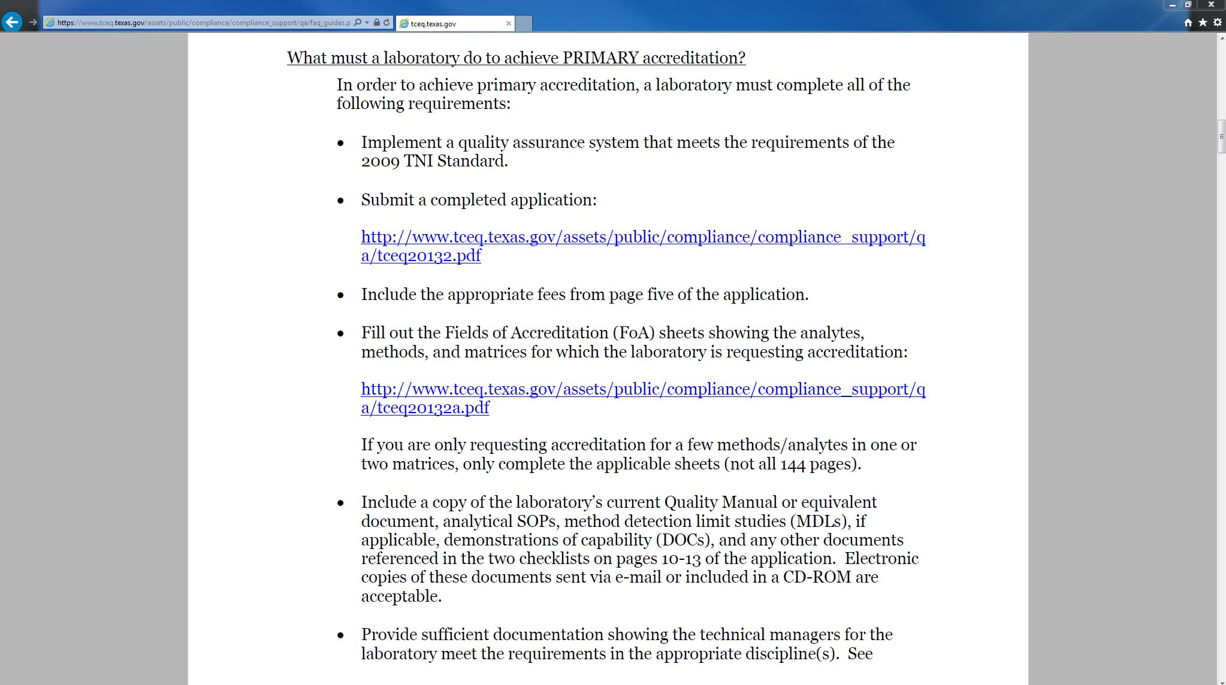
Where We Are Recent Changes

Slide 22
Where We Are Recent Changes
New Procedures for Assessing Non-Contiguous Facilities
Minimum Requirements:
Visit each facility
Assess quality systems at each facility
Assess at least one method at each facility

Slide 23
Where We’re Going

Slide 24
Where We’re Going
New Corrective Action Response Form
Will be implemented June 1, 2017
Training provided at 2017 TCEQ Trade Fair
New Application
Will be implemented June 1, 2017
Clarifies document submittal requirements
Section 10 added

Slide 25
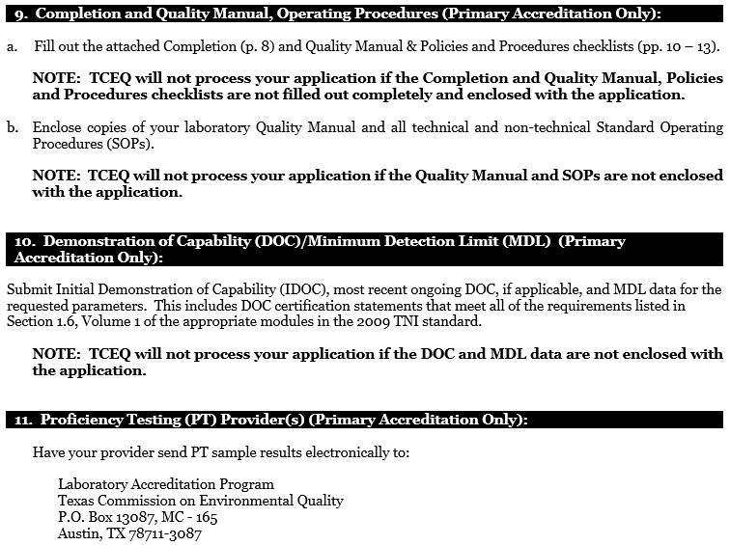
Where We’re Going

Slide 26
Where We’re Going
Implementation of New TNI Standard
TNI Accreditation Council (AC) adopts new standard
TNI AC establishes implementation date
May be up to 2 years
30 TAC Chapter 25 incorporates new standard on implementation date
Time given for some states rulemaking process, training, and preparation for implementation
TCEQ will notify labs via TCEQ web page and email updates list can sign up for email updates on web page
TCEQ will continue to assess to 2009 TNI Standard until implementation date
General Guideline: Laboratories may transition to portions of the new standard prior to implementation date provided that the requirement in the new standard is not less stringent than the requirement in the current standard

Slide 27
Where We’re Going Example: Thermometer Calibrations/Verifications – V1M2 5.5.13.1
Current Requirement: All support equipment shall be calibrated or verified at least annually, using a recognized National Metrology Institute, such as NIST, traceable references when available, bracketing the range of use. …
New Requirement: Temperature measuring devices shall be calibrated or verified at least annually. Calibration or verification shall be performed using a recognized National Metrology Institute traceable reference, such as NIST, when available.
i. If the temperature measuring device is used over a range of 10°C or less, then a single point verification within the range of use is acceptable.
ii. If the temperature measuring device is used over a range of greater than 10°C, then the verification must bracket the range of use.
TCEQ assessment: require adherence to current standard

Slide 28
Where We’re Going Example: Calibration Procedures – V1M4 1.7.1.1
Current Requirement: …if a reference or mandated method does not specify the number of calibration standards, the minimum number of points for establishing the initial instrument calibration shall be three.
New Requirement: …for regression or average response/calibration factor calibrations, the minimum number of non-zero calibration standards shall be as specified in the table below;
TCEQ assessment: allow transition to new standard
Type of Calibration Curve | Minimum Number of Calibration Standards
Threshold Testing | 1
Average Response | 4
Linear Fit | 5
Quadratic Fit | 6

Slide 29
Where We’re Going Example: PT Sample Frequency – V1M1 4.2 and 5.2
Current Requirement: … The analysis dates of successive PT samples for the same accreditation FoPT shall be at least five (5) months apart and no longer than seven (7) months apart…
New Requirement: The closing dates of subsequent PT study samples for a particular accreditation FoPT shall be no more than seven (7) months apart…
TCEQ assessment: require adherence to current standard

Slide 30
Q & A Session
Ken Lancaster: Program Manager
J. Steven Gibson, Ph.D.: Senior Technical Auditor
Jessica Hoch: Senior Microbiologist
Frank Jamison: Records Specialist

