Slide 1
The Role of Nature & Green Spaces in Health & Well-Being
Pooja Tandon, MD, MPH
Health Director, Land and People Lab, Trust for Public Land
Associate Professor, University of Washington & Seattle Children’s

Slide 2








The Trust for Public Land
A national nonprofit, “working to create parks and protect land for people, ensuring healthy, livable communities for generations to come.”
Our strategic commitments:
Our projects:

Slide 3
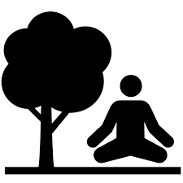



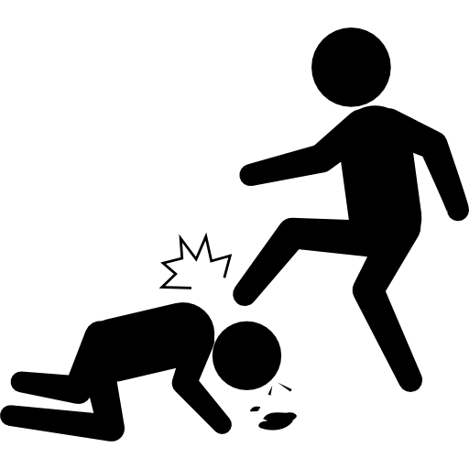



Parks and greenspace: Pathways to health
Nature contact
Social connections
Safety
Climate resilience
Physical activity
Happiness
Noise reduction
Air quality

Slide 4
Parks and greenspace: Pathways to health
Nature contact
Social connections
Safety
Climate resilience
Physical activity
Happiness
Noise reduction
Air quality

Slide 5
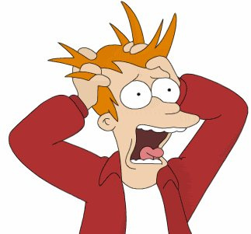
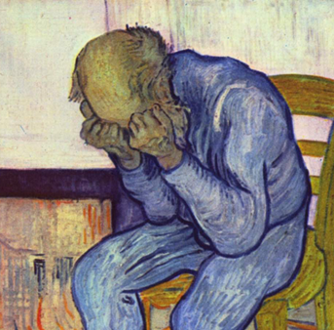


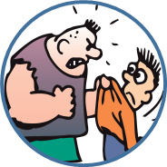
Nature contact: Mental and behavioral health
REDUCED STRESS
REDUCED DEPRESSION AND ANXIETY
REDUCED ADHD SYMPTOMS
PROSOCIAL BEHAVIOR
REDUCED AGGRESSION

Slide 6
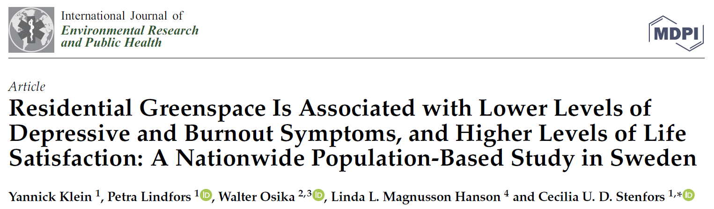
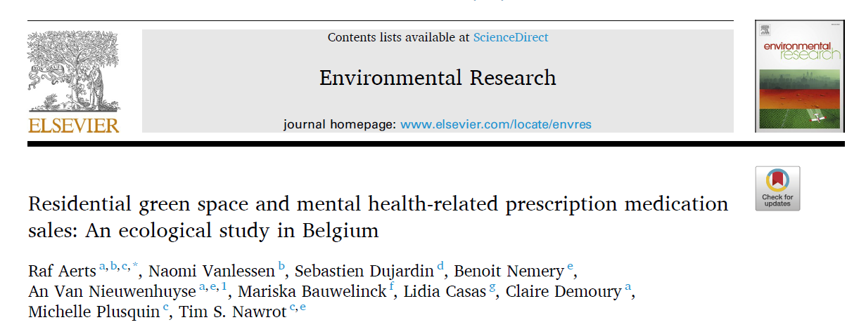
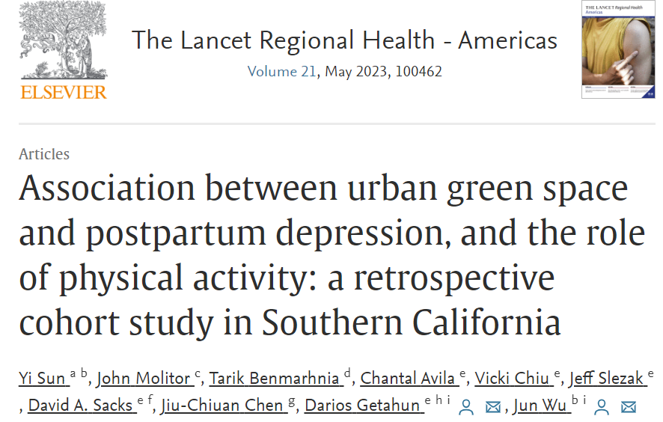
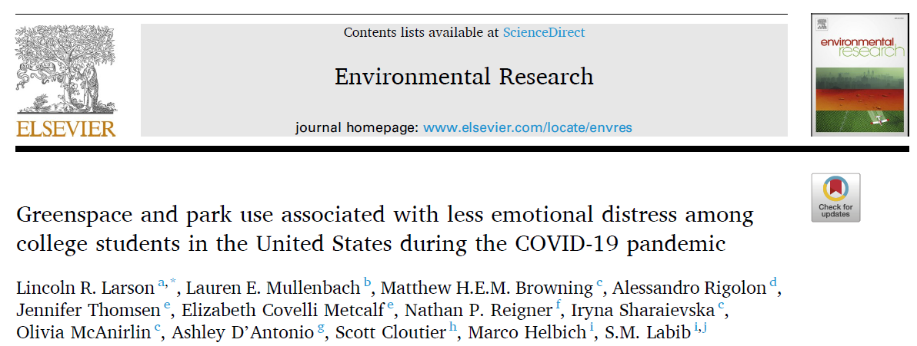
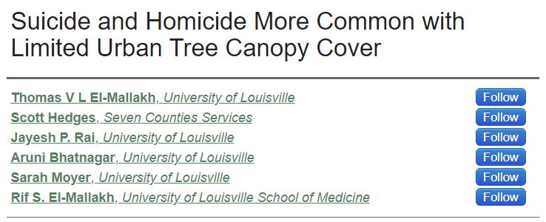
Nature contact: Mental and behavioral health
More greenspace exposure associated with…
Fewer depressive and burnout symptoms.
Lower sales of mood and anxiety disorder medications.
Less post-partum depression.
Less emotional distress during the COVID pandemic.
Lower suicide rates.

Slide 7
Aims:
1) To examine associations between perceived park access and mental health outcomes among children and their parents.
2) To examine associations between park access and co-participation of parent and child in time outdoors, and child and parent physical activity.
Notes:
Validated survey measures as much as possible for PA and SDQs

Slide 8
Conclusions
Access to a park within a 10-minute walk was associated with fewer parent and child mental health symptoms.
Park access was associated with more participation of parents and children in time spent outdoors together.
Access to nearby parks may be an important resource to promote health and well-being, for both individuals and families.

Slide 9
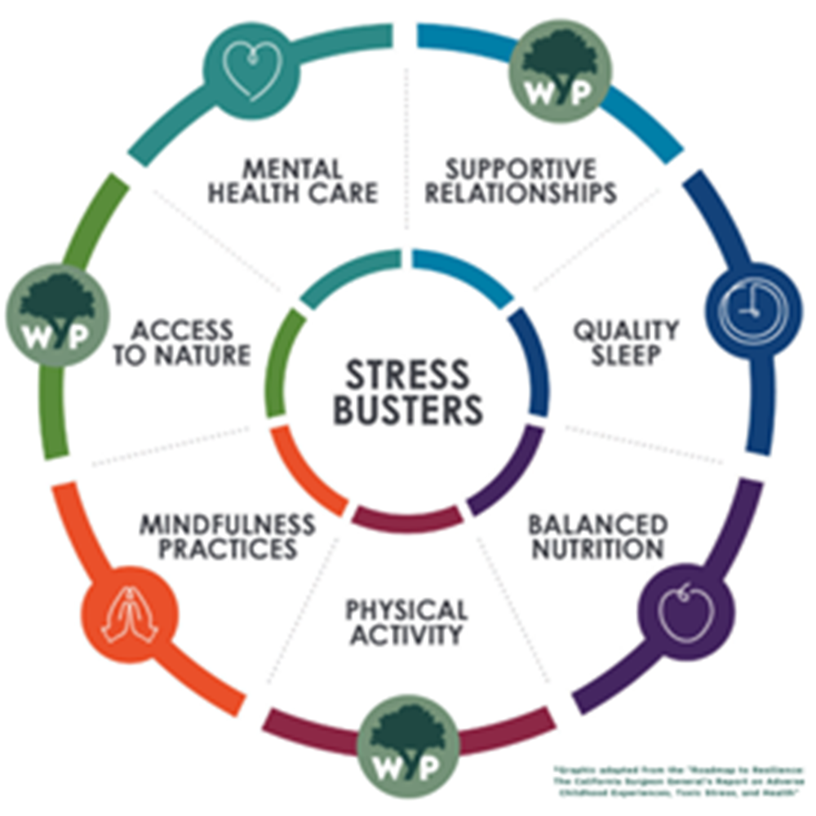
Strategies for Preventing and Mitigating Toxic Stress

Slide 10
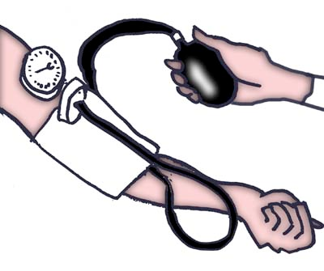
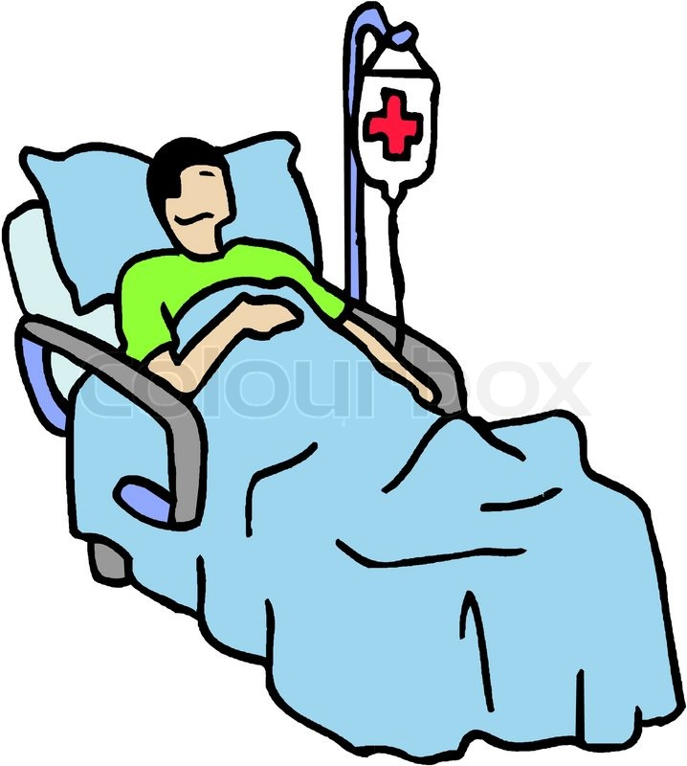

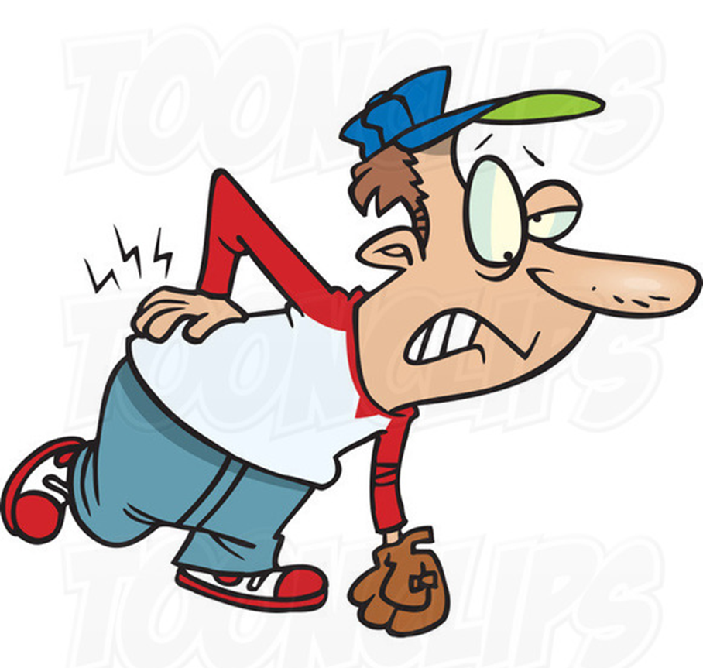
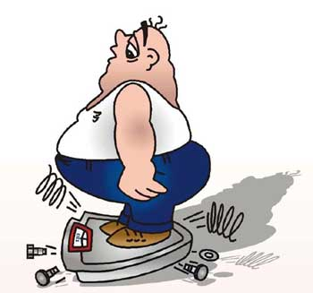
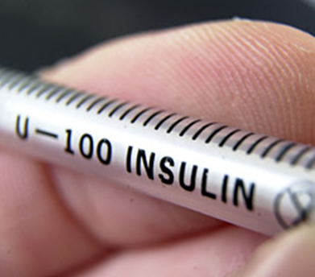

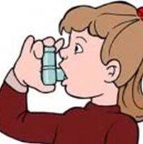
Nature contact: Physical health
LOWER BLOOD PRESSURE
SMOOTHER POST-OP RECOVERY
BETTER BIRTH OUTCOMES
IMPROVED PAIN CONTROL
LESS OBESITY
REDUCED DIABETES
BETTER EYESIGHT
+/- ASTHMA & ALLERGY EFFECTS

Slide 11
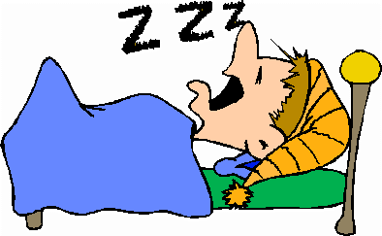


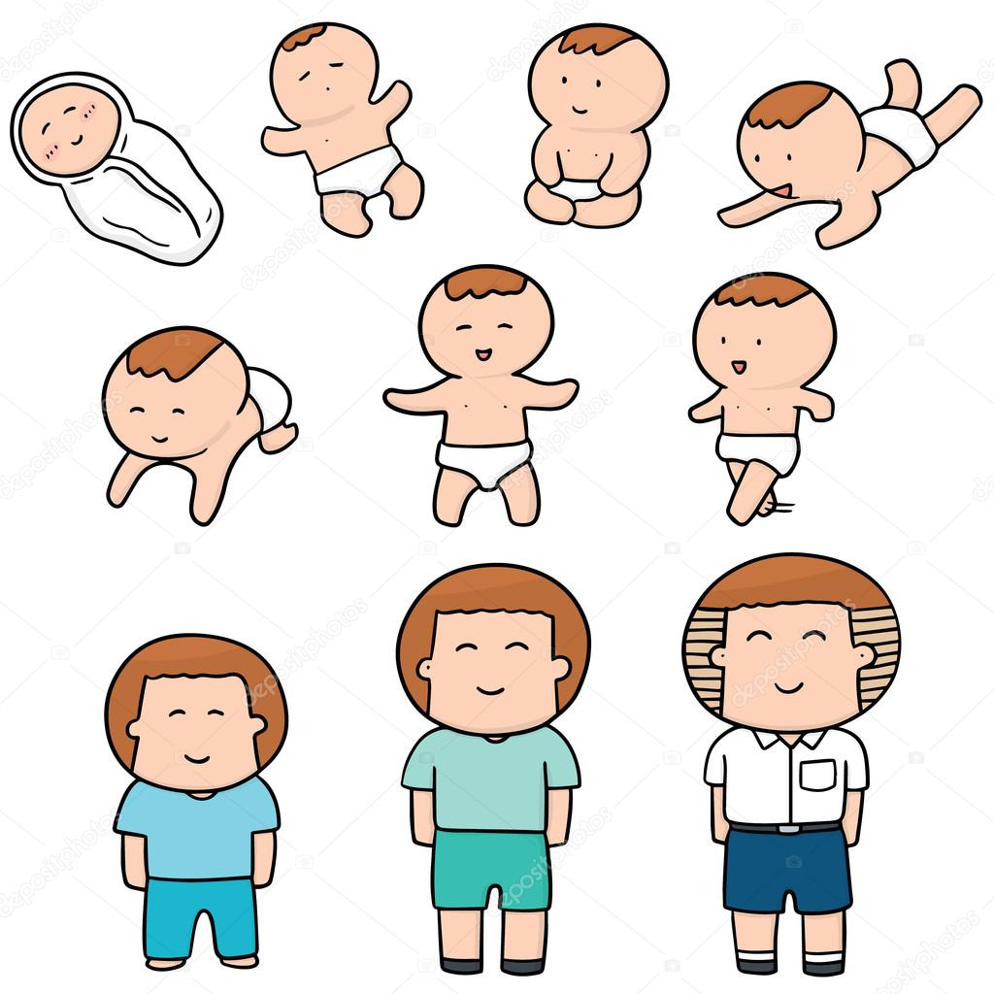
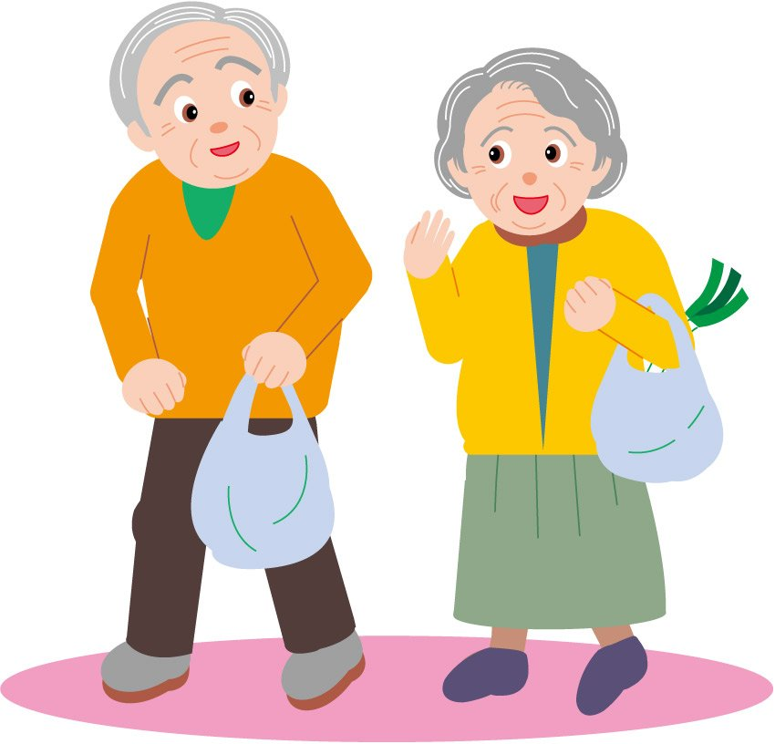

Nature contact: Overall health and well-being
IMPROVED SLEEP
IMPROVED HEALTH IN CANCER PATIENTS
BETTER GENERAL HEALTH
HEALTHIER CHILD DEVELOPMENT
LONGER LIFE EXPECTANCY
GREATER HAPPINESS

Slide 12
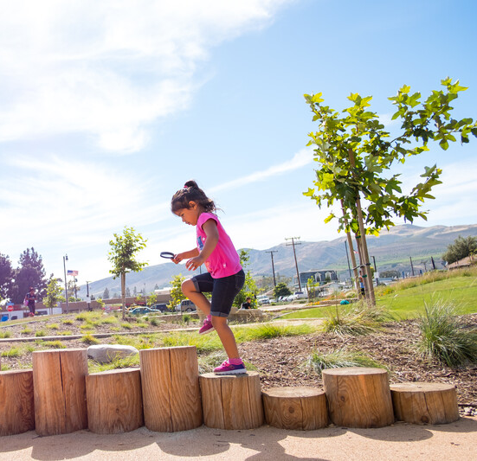
Greenspace / Park inequity = health inequities
Parks serving a majority people of color are, on average, half as large and serve nearly five times more people as parks that serve a majority-white population.
Parks serving primarily low-income households are, on average, four times smaller than parks that serve a majority of high-income households.
Notes:
I’m sure many of you have seen these stats or similar ones…and this is so foundational to why I’m at TPL. Parks are not just a nice to have, but rather a powerful public health strategy for improving health inequities.
Parks serving a majority people of color are, on average, half as large and serve nearly five times more people as parks that serve a majority-white population.
Parks serving primarily low-income households are, on average, four times smaller than parks that serve a majority of high-income households.

Slide 13
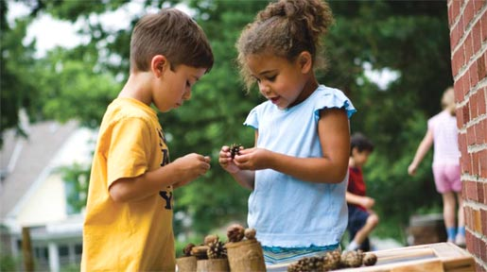
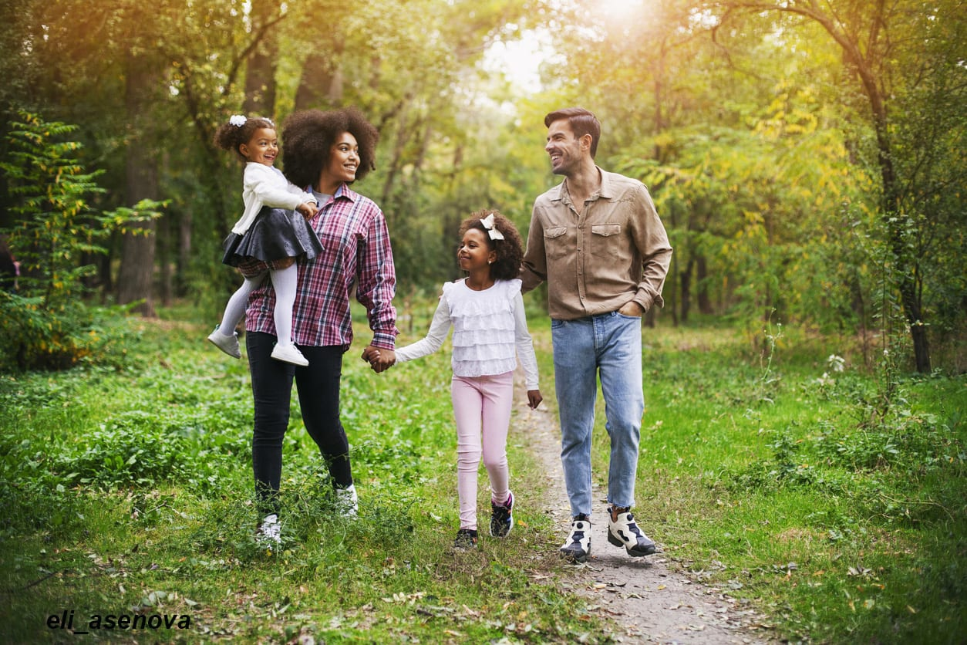
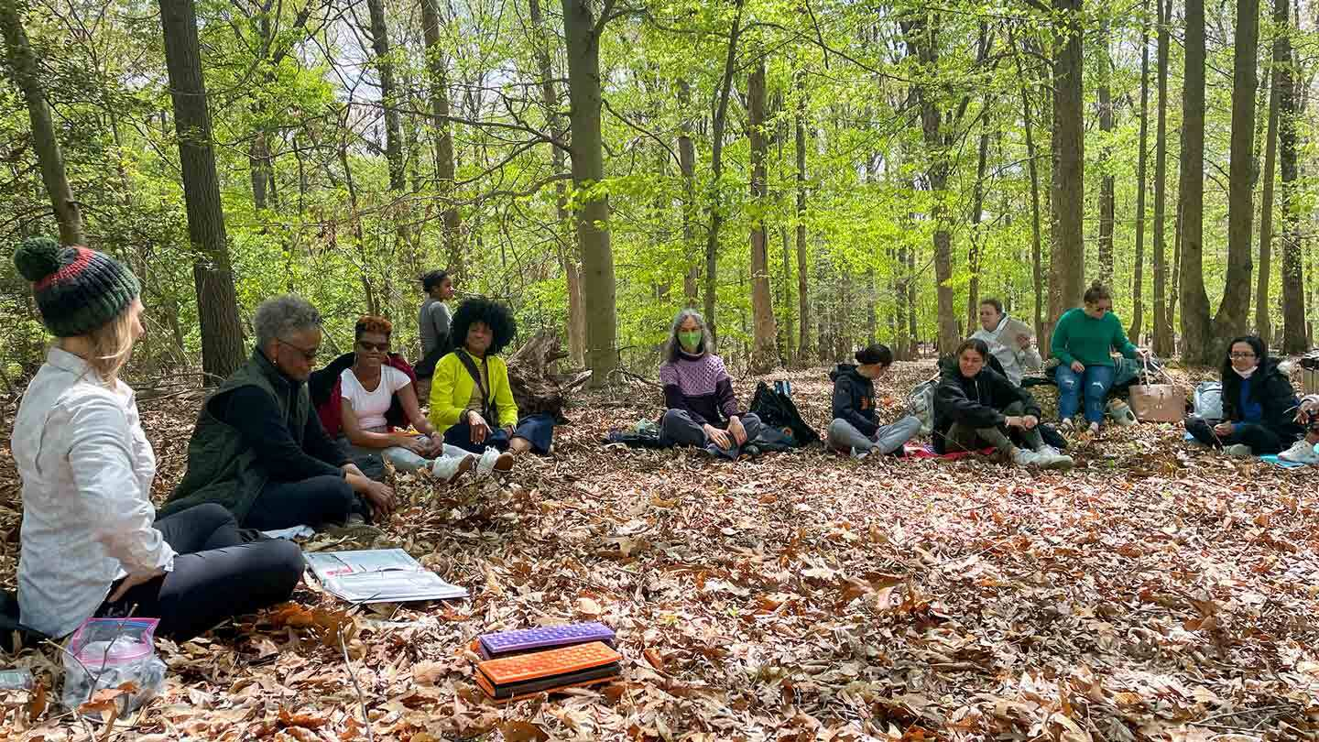
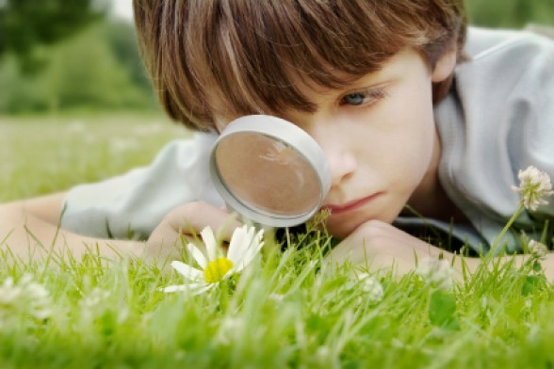
Nature based climate solutions: for human & planetary health…and health equity

Slide 14

Thank you!
Pooja.tandon@tpl.org

