Slide 3
Learning Intentions
Today, we are continuing to learn:
to apply what we’ve learned in our leadership practice.
how collaborative inquiry can help with improvement efforts.
about specific challenges with implementation.

Slide 4
Success Criteria
By the end of this session, we will be able to:
articulate ways to increase meaningful student involvement in initiatives in your school/district.
identify ways that collaborative inquiry can be a powerful design for professional learning.
brainstorm solutions to challenges of implementation.

Slide 5
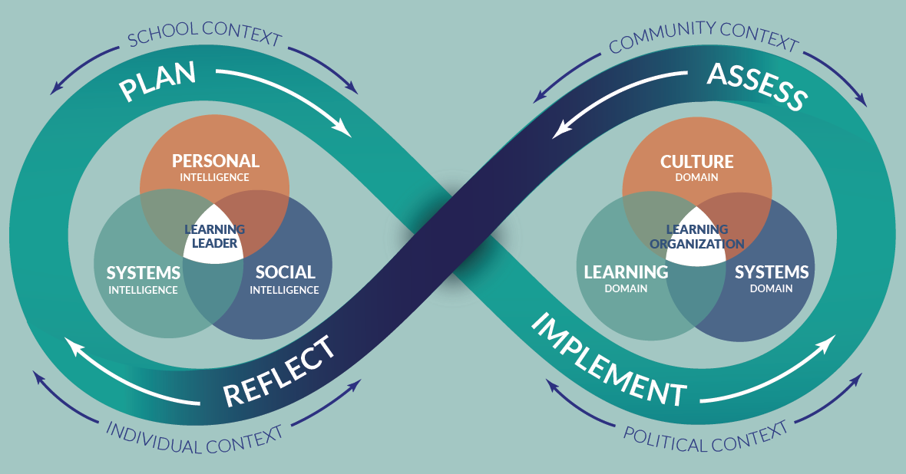
School Leader Paradigm

Slide 7
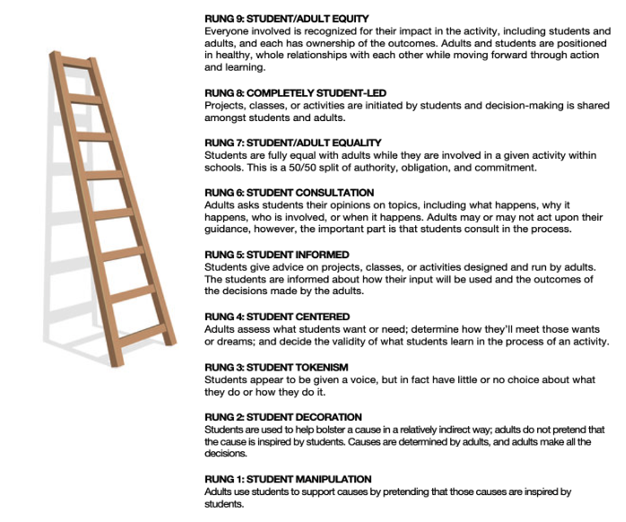
Ladder of Student Involvement
How have you used the ladder of
student involvement?

Slide 8
Collaborative Inquiry
Hearing about others’ inquiries makes you consider new ideas both for yourself and for your district.
Documenting your own learning (placemat) helps you understand what this process is like for others.
Relationships don’t need to come before the work begins; they can develop as you do the work.
Learning with an ‘outside’ critical friend can be an important part of the learning experience.
Katz, S. (2015). What Are We Learning About Supervisory Officer Learning?
Ontario Public Supervisory Officers Association

Slide 9
Challenge Protocol
Identify one of the most difficult challenges you’re having when it comes to implementing…
an aspect of your collaborative inquiry cycle (placemat),
or
a leadership move you’ve learned from a past NLL session.
https://docs.google.com/document/d/11Yi_E83MHFc6ZH0LwrrGl11a4u6ujfMq8EoUapgO2n4/edit?usp=sharing
Notes:
Select something that you’d like to gain some insight on from your peers. The best type of challenge to discuss is one that …
1.Isn’t already on its way to being resolved.
2.Is something you can influence by changing your leadership approach/actions.

Slide 10
Challenge Question
Pose a question around the challenge that gets to the heart of the matter.
Remember that the question you pose will guide the peer group in their discussion of the challenge.

Slide 11
Sample Challenge Questions
1. I have been spending time on my collaborative inquiry cycle (placemat). One task related to the theory of action is to provide additional training to teachers around______________. We had a workshop on the topic and teachers left expressing excitement about what they’d learned. However, when I’m in classrooms I’m seeing very little evidence of what was taught in the workshop transferring to their teaching practice.
Question: What can I do to improve implementation?
2. I left the last NLL session excited to _____________. When I returned to the district I got so caught up in the urgency of my daily tasks and all the other initiatives that I’m leading that I haven’t taken any action.
Question: How can I prioritize non-urgent but important tasks?

Slide 12
Challenge Protocol
Three roles: Presenter - Facilitator - Timer
First 5 minutes:
The presenter gives an overview of the dilemma (2 minutes)
The peer group asks clarifying & probing questions of the presenter (3 minutes)
Next 5 Minutes
The group talks with each other about the challenge presented. The presenter doesn’t speak during this discussion, but instead listens and takes notes. (5 minutes)
Final 5 minutes
The presenter reflects on what they heard and on what they are now thinking, sharing with the group anything that particularly resonated for them during any part of the Consultancy.
Modified from the NSRF Consultancy Protocol

Slide 13
Challenge Protocol Debrief
What about the protocol was the most challenging for you?
What about the protocol was the most helpful for you?
How might you use this protocol in the future?

Slide 14
Activity Extension for Later
Ask AI your challenge question!

Slide 15
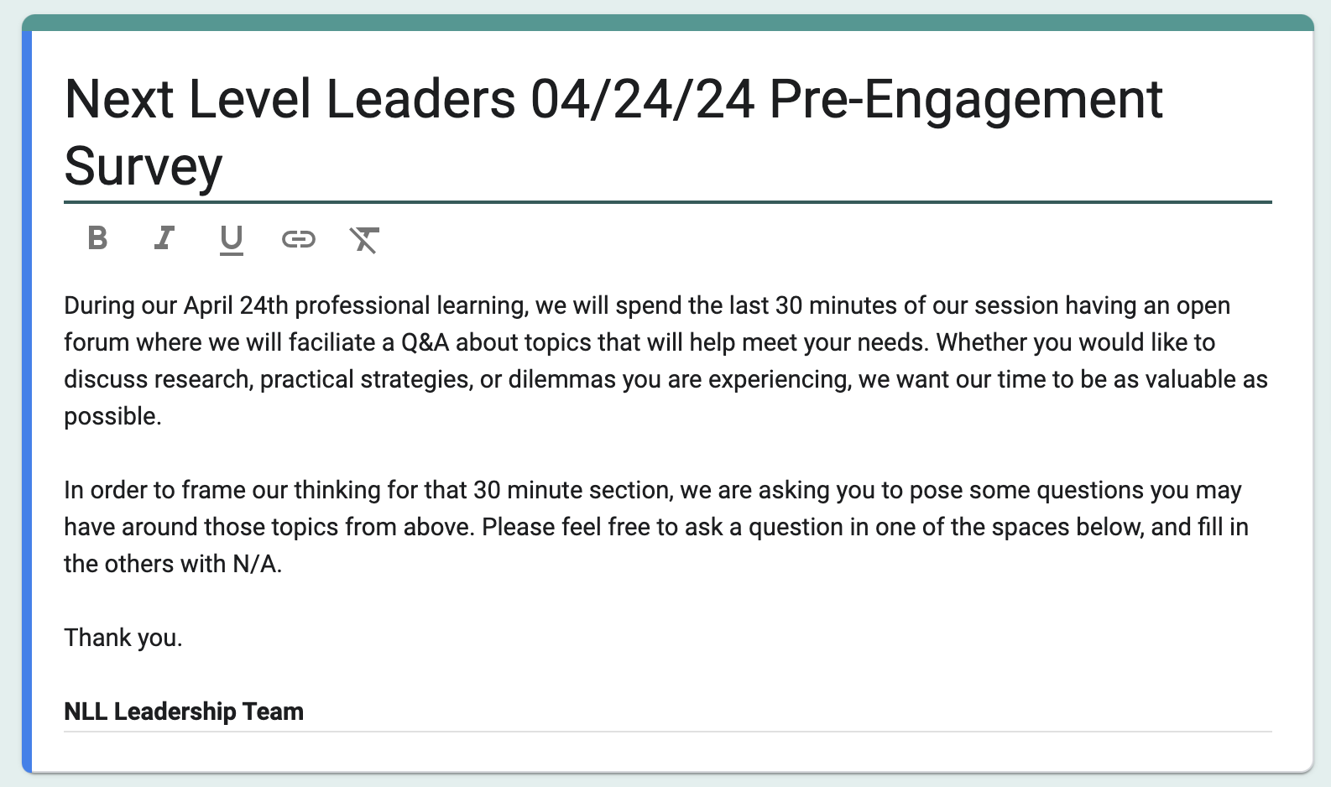
Q & A

Slide 16
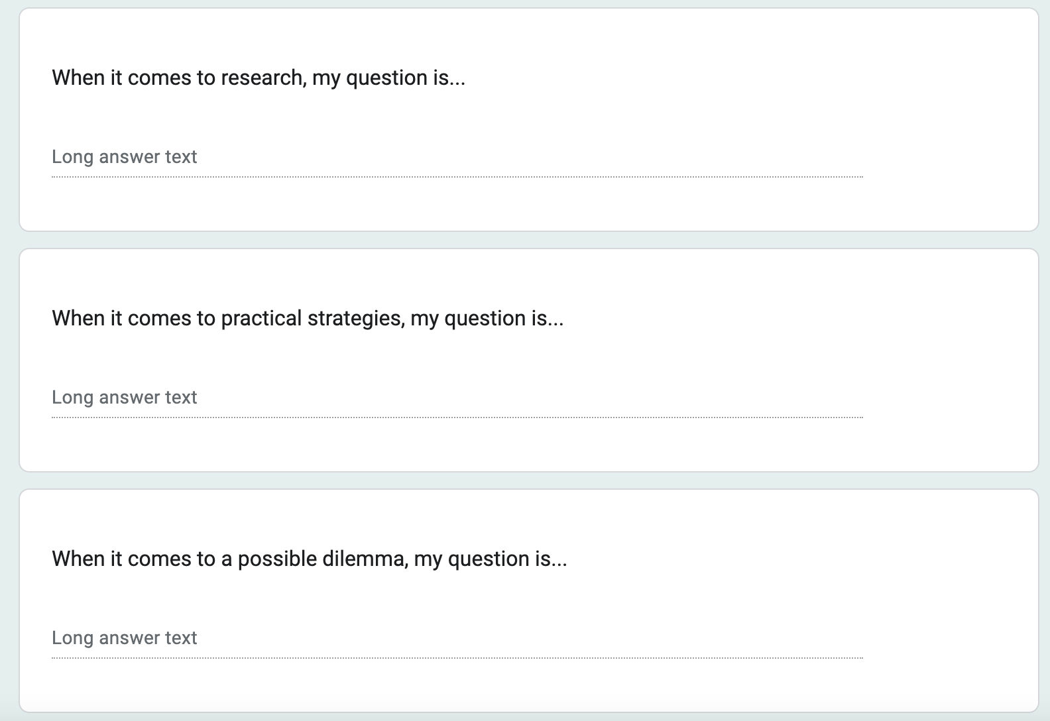
Q & A

Slide 17
“Who are you, question mark?
I often ask myself questions.
In your festive garb
You look like a judge
You are the happiest of punctuation marks
At least you get answers.”
Patricia Duncker. Hallucinating Foucault
@Instructional_Lead_Collective

Slide 18
Questioning is a uniquely powerful tool for unlocking value in organizations: It spurs learning and the exchange of ideas, it fuels innovation and performance improvement, it builds rapport and trust among team members. And it can mitigate business risk by uncovering unforeseen pitfalls and hazards.
Wood-Brooks, A; John, Leslie, K. The Surprising Power of Questions. Harvard Business Review.
@Instructional_Lead_Collective

Slide 19
Question - Storming?
“Question-storming”—brainstorming for questions rather than answers—is now a creativity technique.
Arnaud Chevallier, Frédéric Dalsace, and Jean-Louis Barsoux
The Art of Asking Smarter Questions. Harvard Business Review.

Slide 20
Category | Questions
Research | 1. How to best find the time to be intentional and effective, yet well-informed? 2. What conditions best support teacher growth, our current reality, and where are we hitting/missing the mark? 3. Who is the researcher and how was it verified? 4. Best practice for improving attendance or supporting students with trauma? 5. How do we know what research is most relevant? 6. What are top needs of current leaders and how do we strengthen networking to have a sustainable leadership 7. How do you narrow the body of research to find what you are interested in with limited time? 8. What are some ways to empower students, colleagues, and families to support student growth? 9. Tier 1 strategies for new principals to focus on within their SIP?
Practical Strategy | 1. How best can I work my elementary staff into looking at things completely differently? 2. How do I spend my time effectively to improve instruction? 3. What systems or strategies do others use to stay in front or ahead of the work? 4. What strategies are you using to re engage families in the schools? 5. How do I have candid conversations with low-performance staff while maintaining honor? 6. Can we generate a bank of PD strategies for new central office leaders? 7. Managing needed change within tighter resources?
Dilemma | 1. How can I convince my staff that they need to work all day long, not just when students are in their classrooms? 2. Best way of transitioning work to a new principal after moving to another role? 3. How can we address attendance and apathy in a way that makes a difference? 4. How do I start over, training my staff on PLC work when they don’t want to attend? 5. Working with Fundamentalist Teachers who want to maintain the status quo. 6. How do I support the person taking over my building and support my current staff through the transition? 7. Building instructional leadership capacity of central office. 8. How to staff for student achievement and improvement with limited staffing?

Slide 21
Theme | Description
Time Management and Prioritization | Questions show a need for managing time effectively and prioritizing tasks amidst a busy schedule. Leaders are seeking strategies to efficiently allocate time to research, strategic planning, and daily responsibilities to maximize their effectiveness in leadership roles.
Professional Development and Empowerment | There is a focus on enhancing professional development for educators and empowering school communities. This includes building leadership skills, fostering student and staff ownership of educational processes, and implementing impactful professional development strategies.
Engagement and Relationship Building | Leaders are interested in improving engagement with families, staff, and other stakeholders. They seek methods to strengthen community ties, enhance communication, and create collaborative environments that support educational goals.
Resource Management and Strategic Implementation | With constraints in funding and resources, questions center on utilizing existing resources most effectively and strategically implementing changes to achieve educational outcomes. Leaders are looking for guidance on navigating these challenges to support student achievement and school improvement.

Slide 22
Success Criteria
By the end of this session, we will be able to:
articulate ways to increase meaningful student involvement in initiatives in your school/district.
identify ways that collaborative inquiry can be a powerful design for professional learning.
brainstorm solutions to challenges of implementation.

Slide 23
Until Next time…..and additional opportunities

Slide 24
NEXT LEVEL LEADERS June MEETING
GRAND HOTEL, SPOKANE
JUNE 21, 2024 (arrive June 20)

Slide 25
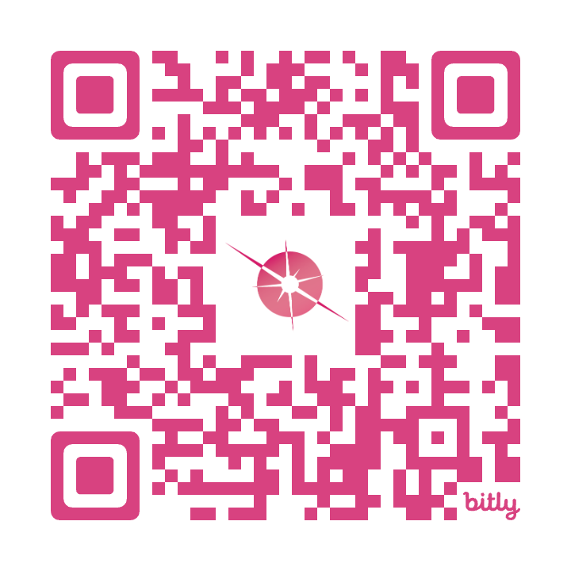
1:1 Leadership Coaching Offer
Personalized Leadership Coach
Six (3) x 60-minute sessions and a leadership assessment!
Your schedule, your context
No additional costs!
To secure your spot sign up using the QR code or email
Alyssa.Gallagher@btsspark.org

Slide 26
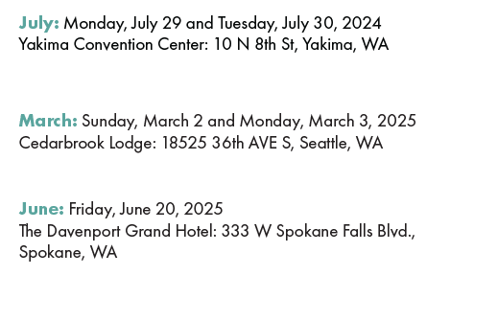
SAVE THE DATE!
2024-2025
Professional Learning
Schedule

Slide 27
REGISTRATION IS OPEN!
wasa-oly.org/Summer24

Slide 28
Register today at www.awsp.org/LSL

Slide 30
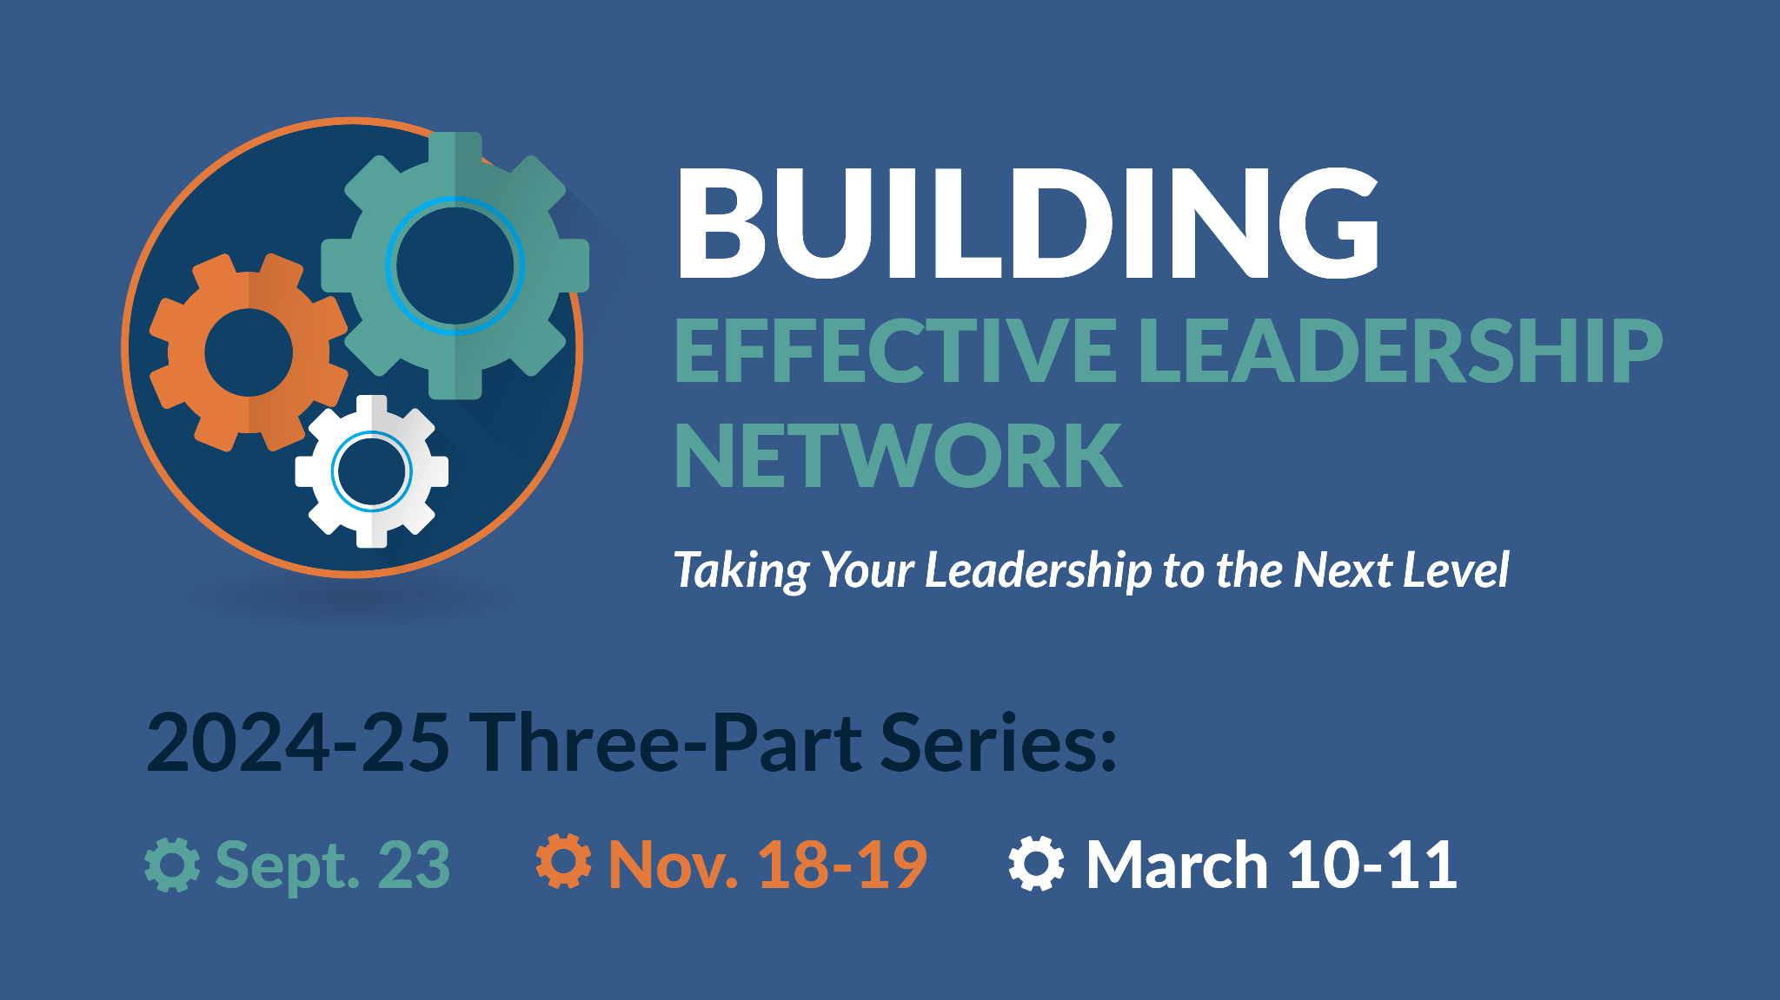
REGISTER NOW @AWSP.OG
Register today at www.awsp.org/BEL

Slide 31
Notes:
Lunch

Slide 34
STUDENT ENGAGEMENT. STUDENT EMPOWERMENT. STUDENT VOICE.

