Slide 1

Overview of Changes to TCEQ & Occupational Licensing Program
Environmental Trade Fair 2018
Jaya Zyman, P.E., Division Director
Permitting and Registration Support Division
Texas Commission on Environmental Quality

Slide 2
Contents of Presentation
Occupational Licensing Organizational Structure
Occupational Licensing Program Overview
Occupational Licensing Program Updates
Criminal History Evaluations
Notes:
1. Content of presentation – read slide

Slide 3
What is Occupational Licensing?
Issues company registrations and individual occupational licenses for 10 environmental occupations for the State of Texas.
Ensures operational competency of individuals licensed and entities registered by TCEQ.
Timely, relevant and accessible services for our customers

Slide 4
Organizational Structure
PRS Division Organization
Division Administration
Jaya Zyman, P.E., Division Director
Registration & Reporting Section
Don Kennedy, Section Manager
Occupational Licensing Section
Russell Gardner, Section Manager
Division Administration
Jaya Zyman PE, Director
Registration & Reporting Section
Don Kennedy,
Section Manager
Occupational Licensing Section
Linda Saladino,
Section Manager
Notes:
Division structure
Two sections
Registration and reporting – MSW, IHW, DC, PST, sludge transporters and medical waste
Occupational licensing will be the focus of this presentation

Slide 5
Organizational Structure (cont.)
Occupational Licensing Organization
Jaya Zyman, P.E. Division Director
Tamara Calhoun
Work Leader Water Program
Occupational Licensing Section
Linda Saladino, Section Manager
Ivan Messer, PhD, Program Support Coordinator
Erwin Madrid
Work Leader WW/Installer Program
Sarita Nazareth
Work Leader Training/Exam Program
Deric Patton, Team Leader
Water, WW & Installer Programs
Division Administration
Jaya Zyman, P.E., Division Director
Registration & Reporting Section
Don Kennedy, Section Manager
Occupational Licensing Section
Russell Gardner, Section Manager
Notes:
Occupational licensing section
3 work groups
Tamara Calhoun, Work leader – Water Program (Water operators, BPAT, CSI, WTS)
Erwin Madrid, Work leader – WW/Installer (WW operators, irrigation, OSSF, MSW, LPST and UST)
Sarita Nazareth, work leader – training and continuing education credits. Review and approval of training providers and qualifying instructos and exam development
Deric Patton is the team leader for the licensing processing of all new and renewal applications.

Slide 6
Occupational Licensing Overview
Review and approve training courses and providers
Oversee license examinations
Complete job task analysis – to update curriculum and exam content within each occupation
Issue environmental occupational licenses
Notes:
Read Slide
Complete job task analysis - use to determine valid job content and employment requirements within the occupations we regulate– involves surveying subject matter experts in the field, analyzing data, determining criticality and frequency of tasks. This information is used to develop and/or update curriculum and exams. These JTAs need to be updated periodically to keep up with new technology and industry changes.

Slide 7
Occupational Licensing Overview
Occupational Licensing Section Activity
Notes:
As you can see, most of our licenses are water and wastewater operator related (drinking water operators, distribution, collections and ww operators, backflow prevention assembly testers, customer site inspectors, water treatment specialist and irrigators). There is a small number of MSW supervisors, LPSTs and septic installers (OSSF).

Slide 8

Occupational Licensing Overview
In FY 2017 alone we
Issued 20,798 licenses
Processed 10,401 examinations
A total of 55,849 licensed environmental professionals
Notes:
Read slide

Slide 9


Occupational Licensing Overview
List of Licenses that the TCEQ issues
Backflow Prevention Assembly Tester (BPAT)
Customer Service Inspector (CSI)
Landscape Irrigator, Technician and Inspector
Leaking Petroleum Storage Tank (LPST) Corrective Action Specialist and Project Manager
Municipal Solid Waste (MSW) Supervisor
On-Site Sewage Systems (OSSFs), Including Septic Tanks
Smoke School: Visible Emissions Evaluators
Stage II Vapor Recovery Facility Representative & Approved Training Providers
Underground Storage Tank Contractors and On-Site Supervisors
Wastewater Treatment and Collection Operators
Wastewater Collection Operators
Water System Operators
Water Treatment Specialist (WTS)
Notes:
All the licenses we issue at a glance. Each license has different classes or levels of skill and complexity depending on what the license certifies them to do.

Slide 10

Occupational Licensing Overview
Requirements for Obtaining a License
Meet education and experience requirements
Complete training through TCEQ approved providers
Pay the application fee ($111.00)
Submit a complete application
Clear a criminal background check
Obtain approval to sit for the exam
Register for and Pass the corresponding exam (score of >70 percent)
Notes:
Applications can be submitted online. All applications need to be approved before sitting for the exam.

Slide 11

Occupational Licensing Overview Occupational Licensing Exams
  CBT (Computer Based Testing)
    Testing Center
    Immediate test results
    Immediate feedback of weaknesses and strengths
    Offered 5-7 days a week
    Ability to retest same day
Paper based
  Classroom
  Regional/Central Office
  Grading/results in 1 week
  Offered monthly
Notes:
Each applicant has 4 attempts within a year to pass an exam. After 4 attempts or a year, a new application and fee needs to be submitted. We have paper and computer based exams. We are continually working to expand our testing center offerings. I will discuss this more a bit later.

Slide 12
Occupational Licensing Overview License Renewal
Requirements for a License Renewal:
Additional 3 years
Submit a complete application
Pay renewal fee of $111
Completion of 10 hours of continuing education credits per year for a total of 30 CEC’s
Notes:
Additional 3 years
CEC’s vary, 30 CECs is average for most licenses (about 10 years)
Renewals involve passing another criminal background check. We look at criminal activity that may have happened since last review. Screening based on risk level of license.

Slide 13

Training Requirements
Regulatory Guidance (RG) 373 is a document will help guide those interested in applying to have their training curriculum reviewed and approved by TCEQ.
Delivery methods of training:
  Classroom
  Conferences
  Association Meetings
  Distance Training
  Correspondence Training
  Technology-Based Training
Notes:
There is regulatory guidance RG 373 to inform vendors on how to develop training for obtaining a license. All interested parties need to submit the proposed training curriculum to TCEQ for review and approval before offering the training. The training can take many forms from classroom to correspondence. More about training providers approval later on today.

Slide 14

Occupational Licensing Program Updates
OL program efficiencies
Upcoming upgrades to current online application for new licenses
Exam updates
Rule making for HB 1508
Criminal history evaluations
Notes:
Now to the core of this presentation. I will discuss the status of recent improvements and updates within the occupational licensing section.

Slide 15

Occupational Licensing Updates:
Program Efficiencies
Use of electronic application has significantly increased from 25% to 89% today.
Application processing times have been significantly reduced from 45 days to 3-4 weeks
Notes:
Read slide. The use of the electronic online application for new licenses is equivalent to the electronic renewal of applications, both approximately at 90%

Slide 16

Occupational Licensing Updates
Upcoming online application upgrades
Current e-App
Online based
Can’t save application
Pay online
Upload supplemental information
Limited validation
Manual transfer to compliance data base
Can’t print for your records
Upgraded e-App
Online access
Can save application
Pay online
Criminal history form built in
Validation of inputted information
Look up current licenses and information
Prepopulate existing data
Able to print for your records
Automatic transfer to compliance database
Notes:
Linda will discuss more specifics about the e-app in the next presentation.

Slide 17

Exams updates
More CBT sites
Upcoming upgrade of exam registration portal
Current CBT centers
Paper vs. CBT exam statistics
Notes:
Read slide and say: more details later.

Slide 18
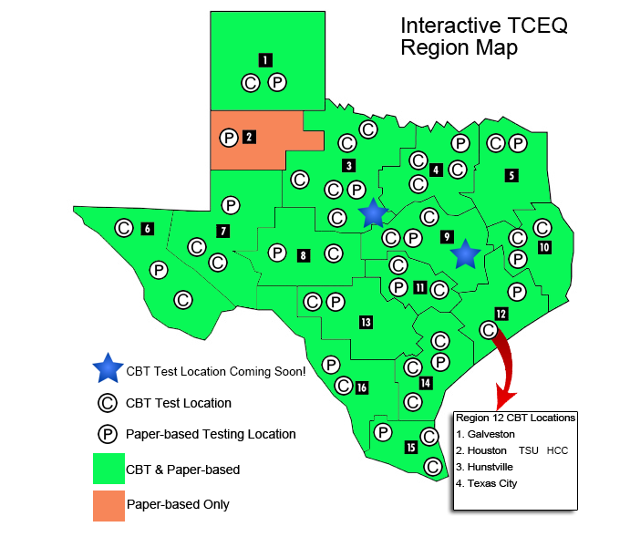
Exam Updates
More CBT Sites
Notes:
Computer Based Tests
We have continued to expand the CBT offerings throughout the state and will continue to expand. This interactive map is on our website. If you hover your mouse over the C and P you can find the exam address and location
P = paper exam at regional office
C = CBT test center
Green = offers both paper and CBT
Orange = only paper exams at this time
2 more CBT sites coming (indicated by the stars)
Only region 2 lacks CBT centers.

Slide 19
Exam Updates: Upcoming Upgrades to Web Based
Exam Registration Portal
Current Method
Uses Plone to enter exam registration
No validation of application approval status
No validation of exam sitting capacity
No validation of duplicate registrations
Future Method
Oracle based
Will validate approval status
Will ill keep track of seats available
Will eliminate duplications of registrations
Will validate CN, exam type and personal information
Notes:
Funding has been requested and prioritization is in the works. We are hoping to begin this effort in FY19 if funding is granted.

Slide 20
Exam Updates - Current CBT test centers
Amarillo College | Sam Houston State University | University of Texas at El Paso
Austin Community College | Central Texas College | University of Texas Rio Grande Valley
Lamar Institute of Technology | Texas A & M University at Kingsville | University of Texas at Permian Basin
The University of Texas at Brownsville | Stephen F. Austin University | Howard College
Texas A & M Engineering Extension Service | Alamo College – San Antonio College | Odessa College
Del Mar College | Texarkana College | Sul Ross State University
Tarrant County College | College of the Mainland | Grayson College
Galveston College | The University of Houston at Victoria | Texas State Technical College
Houston Community College | Weatherford College | Vernon College
Texas Southern University | Midwestern State University | Vernon College – Wichita Falls
Notes:
This is a list of all the active CBT centers as of today. Let audience scan slide.

Slide 21
Exam Updates: CBT vs. Paper Exam Statistics
Notes:
In the first quarter of FY 17, CBT usage was 25% and most of the exams were being administered at the regional offices and regional schools. By the end of 2nd quarter of FY 8 CBT, usage has increased to 54%. The usage of CBT is expected to continue to increase even more in the future based on more location availability and convenience.

Slide 22
Upcoming Rule for HB 1508 Implementation
Applies to training providers for new licenses only
Must notify students of:
HB 1508 became effective September 1, 2017
Potential ineligibility based on criminal history
Provide criminal history review guidelines
Inform students of their right to an evaluation
Notes:
All training providers that prep[are students for a new license must comply with these notification requirements. Providers of courses to support renewal of licenses are not subject to this requirement, although are encouraged to inform students.

Slide 23

Upcoming Rule for HB 1508 Implementation
Training providers must maintain records of notification
Students denied due to criminal history that were not properly notified are entitled to reimbursement of all tuition and TCEQ application fees paid
TCEQ will adopt rules to guide:
  Type of notice required
  Complaint investigation
  Enforcement actions for failure to comply
  Administrative hearing process
Rule making has been initiated
Expected rule adoption in late 2019
Draft rule language will be available for review and comment
TCEQ will mediate in case of a dispute
  Order reimbursement if provider fails to prove potential denial notification was provided
  Rescind training approval if provider refuses to refund the cost of training or can’t provide notification that proper notice was provided
Notes:
Draft rule language will be available for review and comment

Slide 24
Criminal History Evaluation
Who should request a criminal history evaluation?
Concerned about your criminal history,
Applying for a high risk license (license with more contact with the public), and
Committed a crime in the following categories:
  An offense that directly relates to the duties and responsibilities of the licensed occupation (example: Fraud/Theft connected to business, negligence in occupation)
  An offense that does not directly relate to the license but was committed < 5 years before the application for a license;
  An offense listed in Texas Code of Criminal Procedures (CCP) 42.12 (Murder, Indecency with a child, aggravated kidnapping, aggravated robbery)
  A sexually violent offense, identified in CCP 62.001-Mostly related to sexual assault.
NOTE: TCEQ is not concerned with driving violations, etc.
Notes:
Note – only new license applicants that have committed an offense are eligible to request an evaluation prior to applying for the license. Evaluations are currently free of charge.
Provide all arrests and convictions in any state or country, including pending, deferred or dismissed cases must be included.
Four general factors we consider:
1. The nature and seriousness of the crime.
2. The relationship of the crime to the purposes for requiring a license to engage in the occupation.
3. The extent to which a license might offer an opportunity to engage in further criminal activity of the same type.
4. The relationship of the crime to the ability, capacity, or fitness required to perform the duties and discharge the responsibilities of the licensed occupation.
There are six principal factors that we consider in determining your fitness to perform the duties and discharge the responsibilities of the licensed occupation:
1. The extent and nature of your past criminal activity.
2. Your age when the crime was committed.
3. The amount of time that has elapsed since your last criminal activity.
4. Your conduct and work activity before and after the criminal activity.
5. Evidence of your rehabilitation or rehabilitative effort while incarcerated or after release.
6. Other evidence of your fitness, including letters of recommendation from the following:
a. Prosecutors, law-enforcement officers, and correctional personnel who prosecuted, arrested, or had custodial responsibility for you.
b. The sheriff or chief of police in the community
Deric will be discussing more details about criminal history in a later presentation

Slide 25
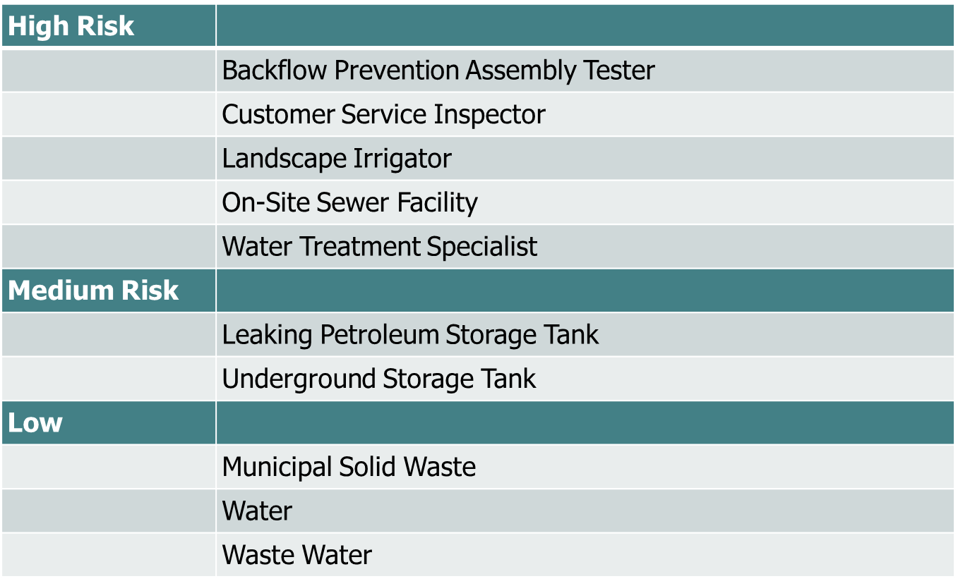
Criminal History Evaluation
Risk based classification of TCEQ’s Occupational Licenses:
Notes:
We have categorized our 10 basic license types into three risk categories. High, medium, and low based on possible contact with the public.
High Risk license holders work on private residences and have access to the general public and to unattended property, hence the criminal background screening is more stringent. An example of a High Risk license would be a Landscape Irrigator who could install an irrigation system in someone's backyard.
Medium Risk license holders work at businesses, like gas stations, where there may be some or occasional public interaction.
Low Risk license holders work at businesses, like Treatment Plants or landfills, where there is little to no public interaction.
Please note that an individual could be approved for a low risk license but not a high risk, based on his criminal record.

Slide 26

QUESTIONS?
Jaya Zyman, P.E., Director
Permitting & Registration Support Division
512-239-2012
jaya.zyman@tceq.texas.gov

