Slide 1


Towards patient-friendly electronic product information
What it means for us all as patients, clinicians and publication professionals
November 13, 2024
Webinar will begin promptly at: ​
11 AM ET / 4 PM GMT
Notes:
Hello everyone; welcome and thank you for joining today’s ISMPP U, titled: Towards patient-friendly electronic product information: What it means for us all as patients, clinicians and publication professionals.
Please take a moment to capture a screenshot for CMPP credit. You will also be sent a certificate with credit attached after the webinar.

Slide 2




















ISMPP Would Like to Thank…
2
. . . the following Titanium and Platinum Corporate Sponsors for their ongoing support of the Society:
Notes:
First a sincere thank you to all of ISMPP’s titanium and platinum corporate sponsors for their ongoing support of the Society.

Slide 3

ISMPP Announcements
Application deadline for the March CMPP
exam is February 1
Notes:
And, for those who are seeking to become CMPP-certified or looking to renew your certification, the application deadline for the next exam window is 1 February 2025

Slide 4
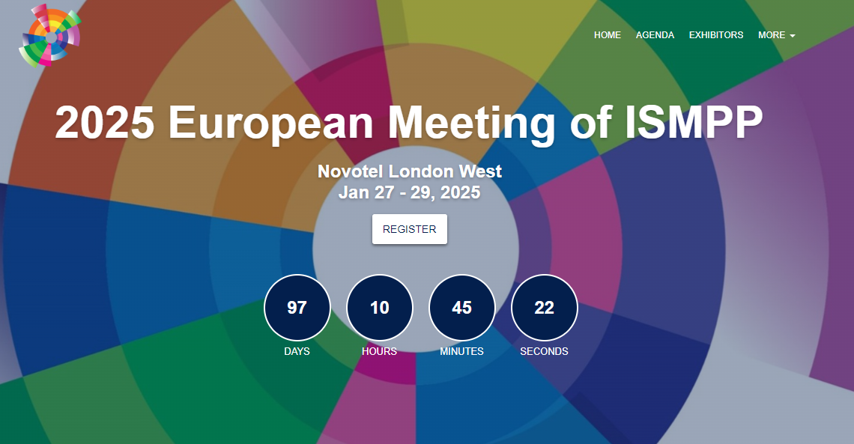
Notes:
Also, just a reminder that registration is now open for the 2025 European Meeting of ISMPP, where this year, sessions will focus on “core values for an integrated age.” The meeting this year will be held in London from January 27-29. Looking forward to it.

Slide 5
How To Ask Questions
Feel free to ask a question at any time, however all questions will be held until the end the of the presentation.
To ask a question, open the Q&A window, type your question into the
Q&A box. Click Send
Note: Check Send Anonymously if you do not want your name attached
to your question in the Q&A
We will make every effort to respond to all questions live (out loud)
Notes:
You can submit a question at any time during the presentation by following the instructions on this slide.
The faculty will answer questions at the end of all the presentations.

Slide 6
Disclaimer
Information presented reflects the personal knowledge and opinions of the faculty and does not necessarily represent the position of their current or past employers
Notes:
Please take a moment to read our general disclaimer.

Slide 7
Objectives
By the end of the session, attendees will:
Understand the evolving regulatory perspective about electronic product information (ePI)
Evaluate the opportunity for PLS of publications to become an easily accessible source of evidence for ePI users
Analyze barriers to widespread use of ePI and their linkage with PLS
Remember to raise this topic internally in their organizations
Notes:
Listed here are the learning objectives for today’s webinar. (please read them aloud or summarize if you feel comfortable)

Slide 8





Introductions
Behtash Bahador
Director, The Center for Information
and Study on Clinical Research
Participation
Catherine Skobe
Senior Director, Publications Management Team Lead, Pfizer
Trishna Bharadia
Owner and Patient Advocate, The Spark Global
Chris Winchester
Chief Executive Officer,
Oxford PharmaGenesis
Christopher Rains
Principal, CPR BioPharma Consulting
This information is for educational use only. Do not copy. Do not distribute.

Slide 9
Electronic product information and discoverability of medical content
Chris Winchester

Slide 10
Results from polling questions at the 20th Annual Meeting of ISMPP
How important or unimportant do you feel it is to link ePI to the underlying medical evidence?
This information is for educational use only. Do not copy. Do not distribute. Results are presented from the 20th Annual Meeting of ISMPP plenary session on ePI.
ePI, electronic product information; ISMPP, International Society for Medical Publication Professionals.
Notes:
During the 20th Annual Meeting of ISMPP 2024 plenary session on ePI on Wednesday 12 May, attendees answered questions on how important it is to link ePI to underlying medical evidence.
Attendees answered this question before and after the presentation and panel discussion.

Slide 11
Results from polling questions at the 20th Annual Meeting of ISMPP
We as publication and communication professionals have a role to play in shaping the future of ePI
This information is for educational use only. Do not copy. Do not distribute. Results are presented from the 20th Annual Meeting of ISMPP plenary session on ePI.
ePI, electronic product information; ISMPP, International Society for Medical Publication Professionals.
Notes:
During the 20th Annual Meeting of ISMPP 2024 plenary session on ePI on Wednesday 12 May, attendees were asked to answer questions regarding the importance of ePI and the role of publication professionals in the future of ePI.
Attendees answered this question before and after the presentation and panel discussion.

Slide 12



Product information is undergoing digital transformation
The paper era
Legally watertight, universally accepted, widely unread
The PDF era
Current, convenient, customizable,
but without impacting understanding
The digital era
Interoperable, equitable, informative and empowering
The democratic option
Accurate and authentic
Availability in pack
Migration to online locations
Live information via QR codes
Font size, search,
multi-format
Underlying digital data backbone
Personalizable with healthcare
Potentially useful to all
Slide courtesy of Shimon Yoshida, Executive Director, Head of International Labeling Group at Pfizer.
This information is for educational use only. Do not copy. Do not distribute.
Notes:
We talk a lot about communicating with patients, but the challenge is often reaching them.
But there’s one piece of paper that reaches almost every patient taking an approved medication. And that’s the piece of paper in the pack. The Product Information (umbrella term) or Prescribing Information (US).
The recent medical communications landscape has been characterized by moves to improve accessibility and understandability for all: open access mandates; plain language summaries (PLS, PLSPs, PLSRS etc.)
Digitization and adoption of electronic formats (e.g. to reduce waste, expedite publication, increase reach)

Slide 13




ePI provides a common basis for shared decision-making
ePI
$
This information is for educational use only. Do not copy. Do not distribute.
ePI, electronic product information.
Notes:
Need to reach an increasing range of stakeholders – not just prescribing HCPs – other HCPs, patients, policy-makers, payers.
Common basis for shared decision-making by all stakeholders – not just prescribing HCPs – other HCPs, patients, policy-makers, payers.

Slide 14
Regulators recognize that ePI can help to meet the information needs of patients
1938
2023
Information on prescription-only medicines should “appear only
in such medical terms as are not likely to be understood by the ordinary individual”
The “FDA recognizes the importance of providing written information to patients about their prescription drug products. Evidence suggests that such information can … improve health outcomes”
Original FDA guidance (1938): https://www.govinfo.gov/content/pkg/FR-1938-12-28/pdf/FR-1938-12-28.pdf
FDA consultation (2023): https://www.fda.gov/drugs/fdas-labeling-resources-human-prescription-drugs/patient-medication-information-pmi
This information is for educational use only. Do not copy. Do not distribute.
ePI, electronic product information; FDA, US Food and Drug Administration.
Notes:
This transformation in formats is supported by a transformation in attitudes. Easy to think that regulations are set in stone when in fact they evolve in line with regulatory views.
The original FDA guidance from 1938 on drug labelling specified that the language should be inaccessible to the lay person and only understood by medical professionals. Page 8, col 1, para b2. (p3168 of the original document) states that information on prescription-only medicines should “appear only in such medical terms as are not likely to be understood by the ordinary individual”.
ePI could be expanded to include an electronic option in addition to the physical paper format. Patients would have a choice to receive PMI in paper or electronic format. Paper is the default method of distribution and must always be provided unless a patient requests electronic delivery.

Slide 15

Patients (f
“
I love the ability to see simple instructions and videos on how
to use my inhaler – all within
the NHS app, which I trust.
“
I’d like to see the results of the original clinical trials that led to
the information in this label.
“
I trust my Doctor to prescribe me the right medicine. I just want to see how to take it, where to store it, and when I need a refill.
”
”
”
“
I don’t trust digital solutions. I’m concerned about data privacy. I want to receive a paper label.
“
I want to see an integrated dosing regimen for the 6 medicines my mother has to take every day, with reminder alerts when needed.
“
”
I’m travelling in Japan and forgot to pack my medicine. How do I make sure I get the right one?
”
”
Slide courtesy of Shimon Yoshida, Executive Director, Head of International Labeling Group at Pfizer. This information is for educational use only. Do not copy. Do not distribute.
NHS, UK National Health Service.
Notes:
There’s a lot of research going on – these are some illustrative quotes. Be mindful of phrasing to ensure it is clear that they are ILLUSTRATIVE – things that patients MIGHT say.

Slide 16
“
I love the ability to see simple instructions and videos on how
to use my inhaler – all within
the NHS app, which I trust.
“
I’d like to see the results of the original clinical trials that led to
the information in this label.
“
I trust my Doctor to prescribe me the right medicine. I just want to see how to take it, where to store it, and when I need a refill.
”
”
”
“
I don’t trust digital solutions. I’m concerned about data privacy. I want to receive a paper label.
“
I want to see an integrated dosing regimen for the 6 medicines my mother has to take every day, with reminder alerts when needed.
“
”
I’m travelling in Japan and forgot to pack my medicine. How do I make sure I get the right one?
”
”
Slide courtesy of Shimon Yoshida, Executive Director, Head of International Labeling Group at Pfizer. This information is for educational use only. Do not copy. Do not distribute.
NHS, UK National Health Service.
Notes:
There’s a lot of research going on – these are some illustrative quotes. Be mindful of phrasing to ensure it is clear that they are ILLUSTRATIVE – things that patients MIGHT say.

Slide 17
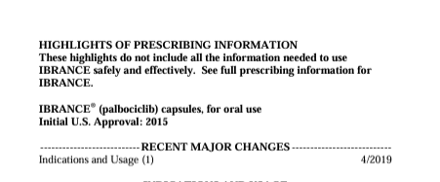
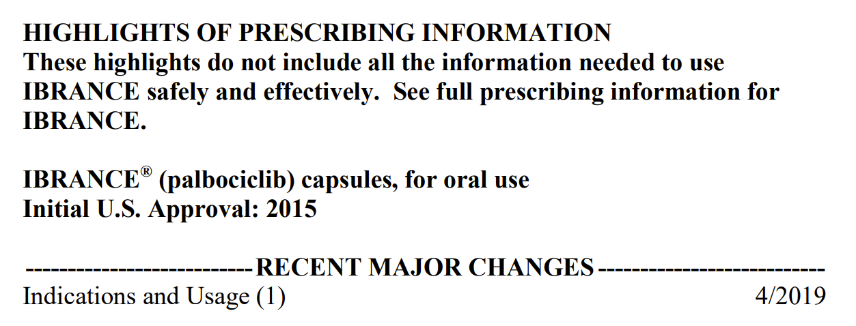
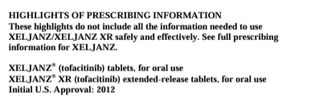
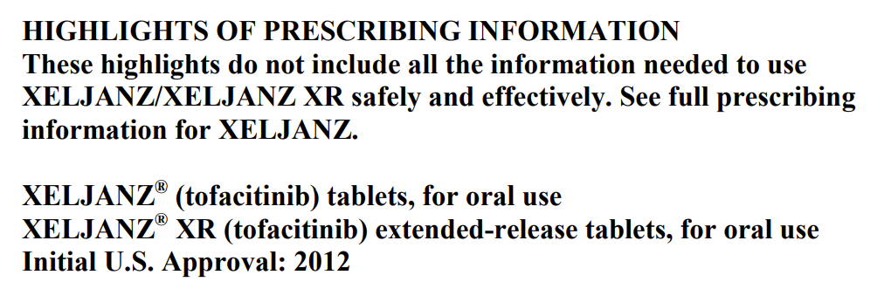
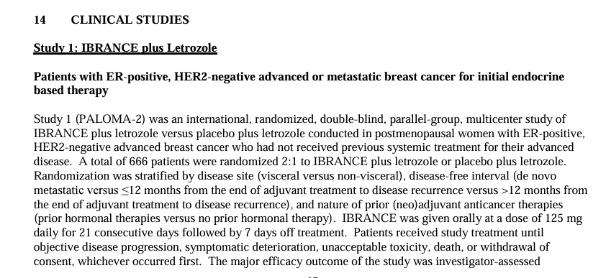
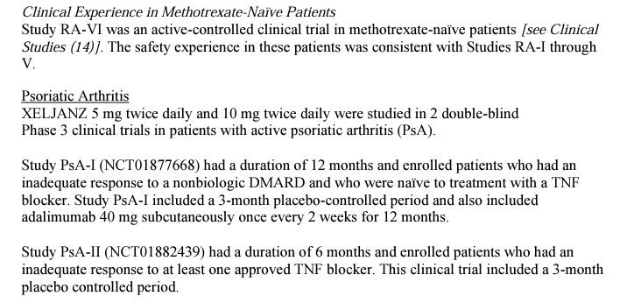
Product information is already evolving to embrace transparency
This information is for educational use only. Do not copy. Do not distribute.
Notes:
Evolving already – though you might have to look closely to spot it!
https://www.accessdata.fda.gov/drugsatfda_docs/label/2017/207103s004lbl.pdf

Slide 18

An electronic format allows us to take the next step towards linking product information to the underlying evidence
This information is for educational use only. Do not copy. Do not distribute.
ePI, electronic product information.
Notes:
https://www.accessdata.fda.gov/drugsatfda_docs/label/2019/207103s008lbl.pdf
https://www.accessdata.fda.gov/drugsatfda_docs/label/2018/203214s018lbl.pdf

Slide 19
ePI could link together all electronic publications and disclosures to increase discoverability and use by all
ePI
News
outlet
Journal 1
Preprint server
Journal 2
Ethics
approval
Trial results
summary
platform
ClinicalTrials.gov
Data
repository
Congresses
Funder clinical
trial registry
e-Poster platform
Clinical study reports on FDA/EMA websites
Funder
repository
This information is for educational use only. Do not copy. Do not distribute.
EMA, European Medicines Agency; ePI, electronic product information; FDA, US Food and Drug Administration.
Notes:
So, what if we could take all this information that is currently scattered across the Internet?
https://www.neoteryx.com/microsampling-blog/5-extraordinary-clinical-trials

Slide 20

The prize
Including live links in ePI has the potential to:
  increase access to and use of the highest quality, peer-reviewed evidence
  bring together the key information about a clinical study in a single place
    HCPs
    patients and carers
    MSLs
    industry critics
  increase discoverability of plain language summaries of publications, infographics and other assets that often get lost in supplementary materials
  improve health literacy, transparency and trust
This information is for educational use only. Do not copy. Do not distribute.
ePI, electronic product information; HCP, healthcare professional; MSL, medical science liaison.
Notes:
Nancy Collins - http://www.abohemianadventure.net/nepal-photo-gallery.html
https://en.wikipedia.org/wiki/Sacred_mountains#/media/File:Machapuchre-wow.jpg

Slide 21
Increasing the availability of ePI is part of a global movement towards digitization
Supply
chain
efficiency
Transparency
Environmental sustainability
Limiting risk of human error
Consistent communication of medicines information
Storage and resource capacity
Health equity
Audience choice
Variety
User centricity
Trust
This information is for educational use only. Do not copy. Do not distribute.
ePI, electronic product information.

Slide 22
Who do you think ePI should be for?
Response options (please select all that apply):
  Healthcare professionals (prescribers)
  Healthcare professionals (non-prescribers)
  Patients and caregivers
  Patient advocacy groups
  Pharmaceutical companies
  Pharmacies
  Payers
  Scientific researchers
  Publication professionals
  Policymakers
This information is for educational use only. Do not copy. Do not distribute.
ePI, electronic product information.
Notes:
Please read the question in full as the Zoom question and answer options as sometimes the polling covers the screen and the Zoom question text is small.

Slide 23
What types of resources do you think are suitable for linking to ePI?
Response options (please select all that apply):
  Peer-reviewed publications
  Plain language summaries
  Publication enhancements
  Regulatory trial result summaries
  Clinical study reports
  Individual patient data (e.g. Vivli, CSRD, YODA)
  Congress publications
  Systematic literature reviews
  Clinical guidelines
  Health technology appraisals
This information is for educational use only. Do not copy. Do not distribute.
CSRD, Clinical Science Research and Development; ePI, electronic product information; FDA, US Food and Drug Administration; QRdb, quick response database; YODA, Yale University Open Data Access.
Notes:
Please ask read the question in full as the Zoom question sometimes covers the screen and the Zoom question text is small.
When presenting, please avoid promotion and stress the importance of the limitations of congress publications versus enduring materials such as manuscripts, especially when congress publications may be presenting interim data, for example.

Slide 24
What are the most important factors to consider when selecting materials to linking to ePI?
Response options (please select all that apply):
  Accuracy
  Date of publication
  Disclaimers (for transparency)
  Format
  Open access
  Source (i.e. third-party or arm’s length)
  Understandability
  Other
This information is for educational use only. Do not copy. Do not distribute.
ePI, electronic product information.
Notes:
Please ask the audience to add any other factors to the chat function.

Slide 25
Panel discussion
All

Slide 26
Is the current status quo
‘fit for purpose’?
This information is for educational use only. Do not copy. Do not distribute.
Notes:
Trishna Bharadia
Is the current state of medicines information suitable for a range of individual needs?
What are the benefits and challenges associated with current access to healthcare information?

Slide 27
How is product information evolving?
What drivers have contributed to the digitization of medicines information?
This information is for educational use only. Do not copy. Do not distribute.
Notes:
Christopher Rains and Behtash Bahador
How have regulatory attitudes to product information evolved? What is the impact of this?
How have changing attitudes to product information improved open access to core medicines information content and additional information sources (e.g. peer-reviewed publications, PLS, information about side effects, translations and/or multi-media content)?
OPTION: what are the drivers for a transition from product information to medicines information (paper waste reduction, readability, reach, etc.)?

Slide 28
How can ePI best meet the needs of patients and other audiences?
This information is for educational use only. Do not copy. Do not distribute.
Notes:
Trishna Bharadia and Catherine Skobe

Slide 29
How can publication professionals get involved in the optimization of ePI?
This information is for educational use only. Do not copy. Do not distribute.
Notes:
Christopher Rains and Behtash Bahador
What is the global viability of product information, considering (for example) the variation in access to digital resources and audience age and education profiles?
How can product information be used to address data access inequalities and improve access to/use of existing open access healthcare content appropriate for a wide range of needs (e.g. peer-reviewed evidence, PLS)?
What is the role of variety (e.g. content types, formats/multi-media, translations) in ensuring patient-driven solutions that are balanced with user needs?
What medicolegal complications are associated with the introduction of product information?

Slide 30
What is our call to action – what can we do to reimagine ePI for the benefit of all?
This information is for educational use only. Do not copy. Do not distribute.
Notes:
All
How can we work towards closer working relationships between patient organizations, publication professionals and marketing experts to maximize the potential benefits of product information by simplifying language and improving accessibility?
How can product information be utilized to increase access to PLS and accessible clinical data to improve transparency and trust in the pharmaceutical industry?
How can we leverage existing initiatives to optimize medicines information content?
What are the potential barriers to optimal digitization of ePI?

Slide 31
Q&A

Slide 32
How can publication and communication professionals initiate activities to support the optimal digitization of ePI?
Notes:
All
How can publication and communication professionals get started?
Who should be involved when initiating these activities?
What resources might be required?
What key decisions points are involved?
What barriers may need to be addressed?

Slide 33
“The Ask”: 4 practical steps in the right direction
Publish and disclose research in a way that can be easily accessed, understood and found by all
Explore the possibility of companies adding links in ePI documents they or their partners host
Advocate for regulators to add/require links in ePI documents they host
Work together cross-functionally to include the transparency perspective in the development of ePI
This information is for educational use only. Do not copy. Do not distribute.
ePI, electronic product information.

Slide 34




1. Publish and disclose research in a way that can be easily accessed, understood and found by all
Metadata
Open Access
Plain Language Summaries
This information is for educational use only. Do not copy. Do not distribute.
Notes:
In the meantime, we can take steps in the right direction by publishing our research open access and with PLS so that it is accessible and understandable by all. And is correctly tagged so that it can be collated automatically.

Slide 35
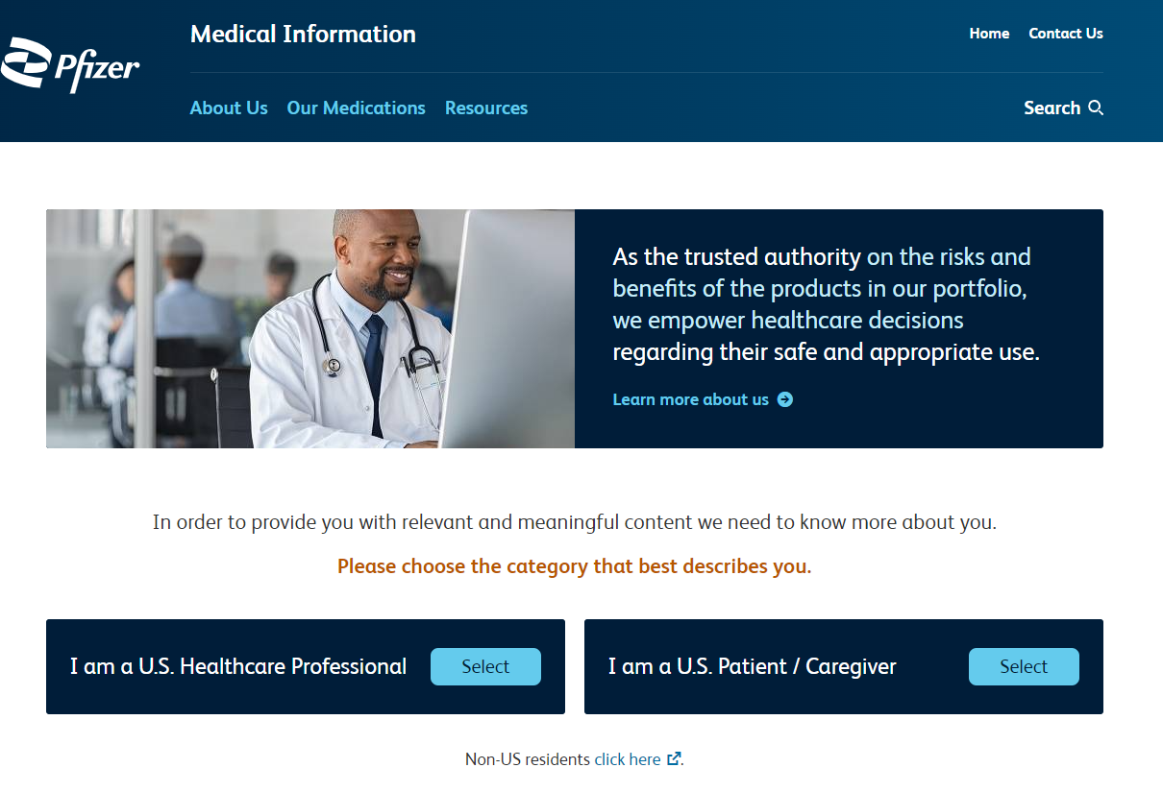
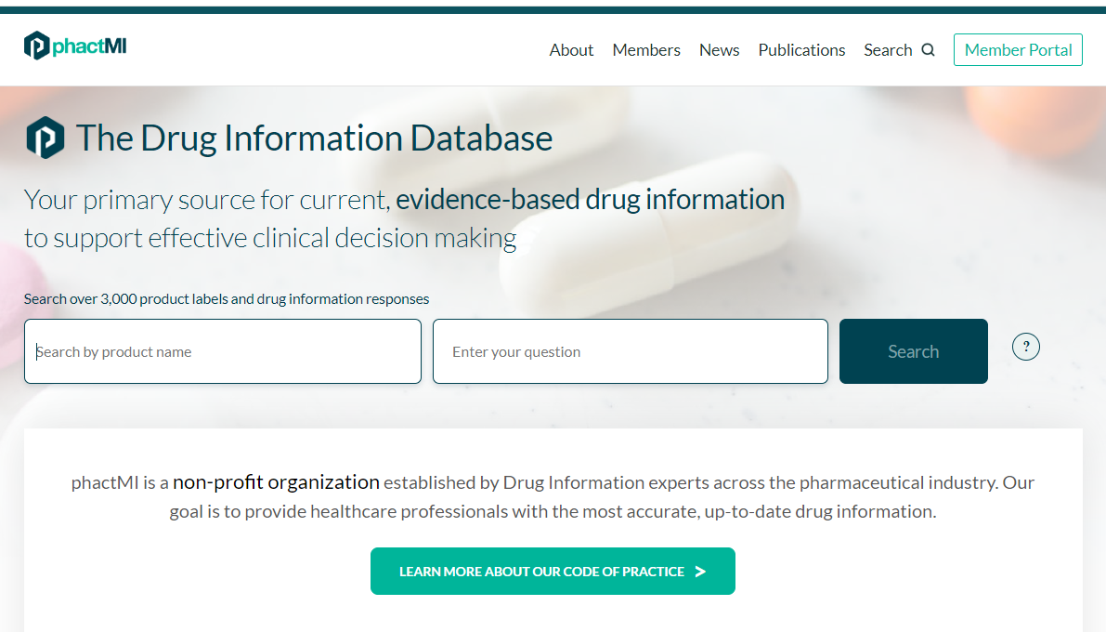
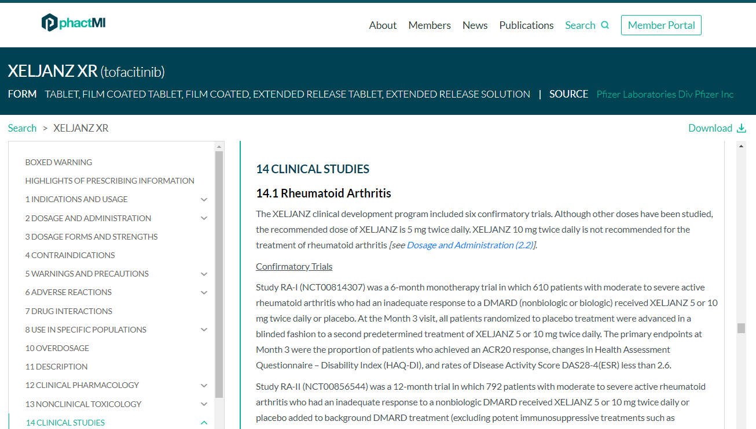
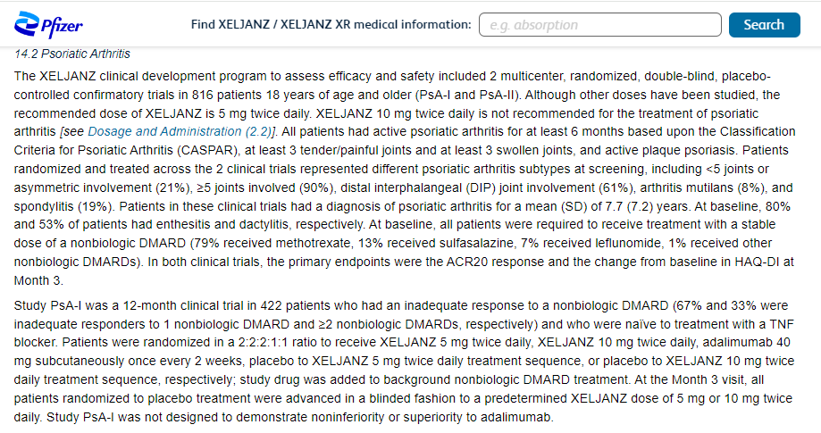
2. Explore the possibility of companies adding links in ePI documents they or their partners host
This information is for educational use only. Do not copy. Do not distribute.
Zeljanz Prescribing Information on Pfizer website. 2024. https://www.pfizermedicalinformation.com/Xeljanz (Accessed 22 October 2024) and phactMI. 2024. https://www.phactmi.org/search (Accessed 22 October 2024).

Slide 36







3. Advocate for regulators to add/require links in ePI documents they host
This information is for educational use only. Do not copy. Do not distribute.
Notes:
DCI Network
Alliance for Modernizing Prescribing Information
Sustainable Medicines Partnership
FDA
Pfizer
AstraZeneca

Slide 37
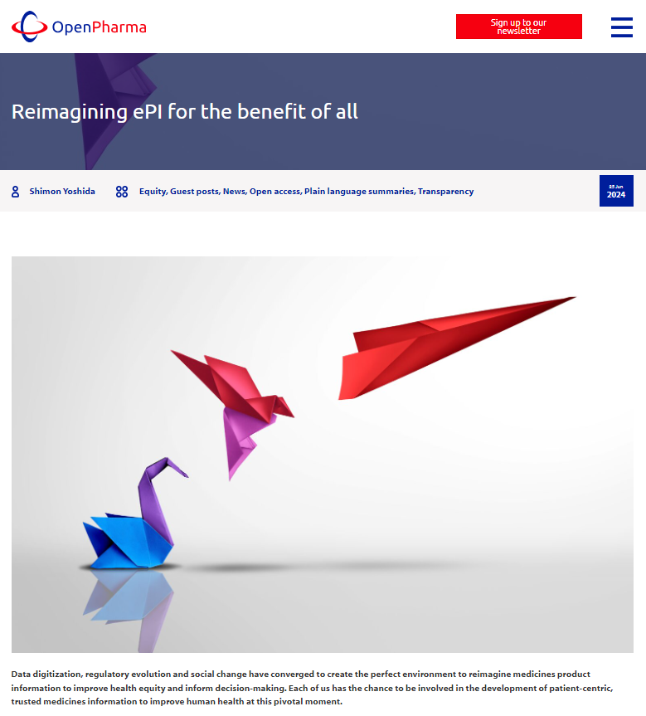
4. Work together cross-functionally to include the transparency perspective in the development of ePI
If you care about the principles of patient-centricity, transparency, equity and trust, we urge you to join us in this endeavor to realize a future in which patients are empowered with accessible, reliable information on their medicines.
Formal calls for participation will be issued shortly, but if you are interested in getting involved, please click on the following link and send your expression of interest to the team at Open Pharma.
Publications ● Transparency ● Medical information ● Labelling
This information is for educational use only. Do not copy. Do not distribute
ePI, electronic product information.
Yoshida S. Open Pharma blog 2024. 2024. Available from: https://openpharma.blog/blog/guest-posts/reimagining-epi-for-the-benefit-of-all/ (Accessed 22 October 2024).

Slide 38
“The Ask”: 4 practical steps in the right direction
Publish and disclose research in a way that can be easily accessed, understood and found by all
Explore the possibility of companies adding links in ePI documents they or their partners host
Advocate for regulators to add/require links in ePI documents they host
Work together cross-functionally to include the transparency perspective in the development of ePI
This information is for educational use only. Do not copy. Do not distribute.
ePI, electronic product information.

Slide 39
Upcoming ISMPP U Webinars
November 20, 2024:
Open Access - ISMPP U - Introducing LearningBUILDER™ - ISMPP's New Certification Management Platform Dedicated to the CMPP™ Credential!
December 2024:
Actioning EDI for Our Industry: Turning Principles into Practice
Notes:
Here is a snapshot of the upcoming ISMPP U for November. Next week, there will be an open access ISMPP U highlighting the new certification management platform Learning Builder. Registration is now open.
Also be on the lookout for our December ISMPP U around Actioning EDI for Our Industry: Turning Principles into Practice. Registration will open soon.

Slide 40
Towards patient-friendly electronic product information
What it means for us all as patients, clinicians and publication professionals
November 13, 2024
Webinar will begin promptly at: ​
11 AM ET / 4 PM GMT
Notes:
If you were unable to take a screenshot at the beginning of the webinar, please do so now

Slide 41

Thank you for attending!
We hope you enjoyed today's presentation.
After closing out of Zoom, please click the CONTINUE button
on your screen to take our short survey. Thank you!
Notes:
Thank you again for attending today’s webinar. Please take a moment to fill out the survey link that will be sent to you.
After closing out of ZOOM, please click the ‘continue’ button on your screen to take a short survey.
Thank you!

Slide 42

Catherine Skobe
Publications Management Team Leader at Pfizer
Co-Lead ISMPP Patient Engagement Task Force
Past-Chair of ISMPP, 2019-20
Member of Open Pharma, Vision Task Force member
CMPP, certified medical publications professional; ISMPP, international society of medical publications professional

Slide 43

Trishna Bharadia
Multi-award winning with ~15 years experience working with multiple stakeholders in patient advocacy and engagement
Visiting lecturer on patient engagement at King's College London's Centre for Pharmaceutical Medicine Research
Specific experience in patient involvement in medical publications, information and communications
CMPP, certified medical publications professional; ISMPP, international society of medical publications professional

Slide 44

Behtash Bahador
Director of Health Literacy at the non-profit organization CISCRP
Master of Science in Health Communication from the Tufts University School of Medicine
Since 2014, has collaborated with a range of stakeholder groups to establish and implement patient- and community-centric initiatives across the life-cycle of clinical research
This has included supporting the development of regulatory and cross-disciplinary best practice guidelines, operationalizing key elements of evidence-based public health programing into research engagement activities, and always keeping the needs of patients, participants and the public at the forefront of his work
CMPP, certified medical publications professional; ISMPP, international society of medical publications professional

Slide 45
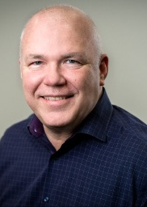
Chris Rains
Chris is the principal consultant at CPR Biopharma Consulting.
Prior to that he was a VP, Global Medical Affairs at Takeda, responsible for core Medical Affairs capabilities such as Publications, Medical Communications, Evidence Generation, Scientific Training and Medical Information.
He is a co-founder of Open Pharma and has been responsible for driving the biopharma industry to be more transparent and innovative in its approach to communications.
CMPP, certified medical publications professional; ISMPP, international society of medical publications professional

Slide 46

Moderator: Chris Winchester
Co-founder of Open Pharma
Over 20 years of European and global communications experience
Wide-ranging therapeutic experience
Active researcher and communicator in medical communications, publications and transparency
Chair of the International Society for Medical Publication Professionals (2018–19)
CMPP, certified medical publications professional; ISMPP, international society of medical publications professional

