Slide 1
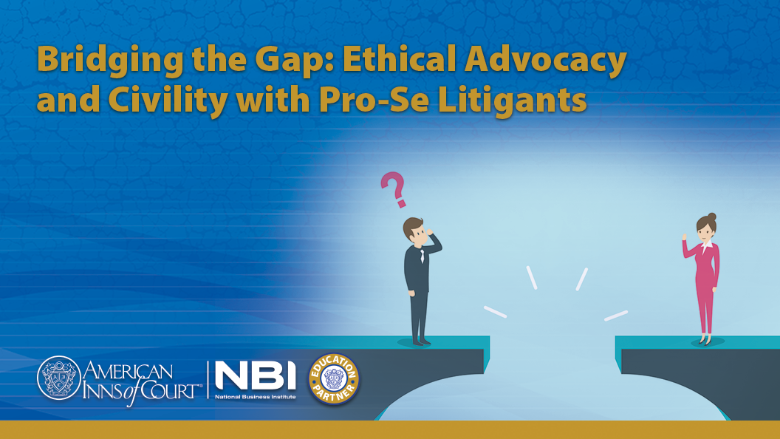
Notes:
NBI Intro

Slide 2

Carree Nahama
Founder and Owner
Notes:
CAREE

Slide 3
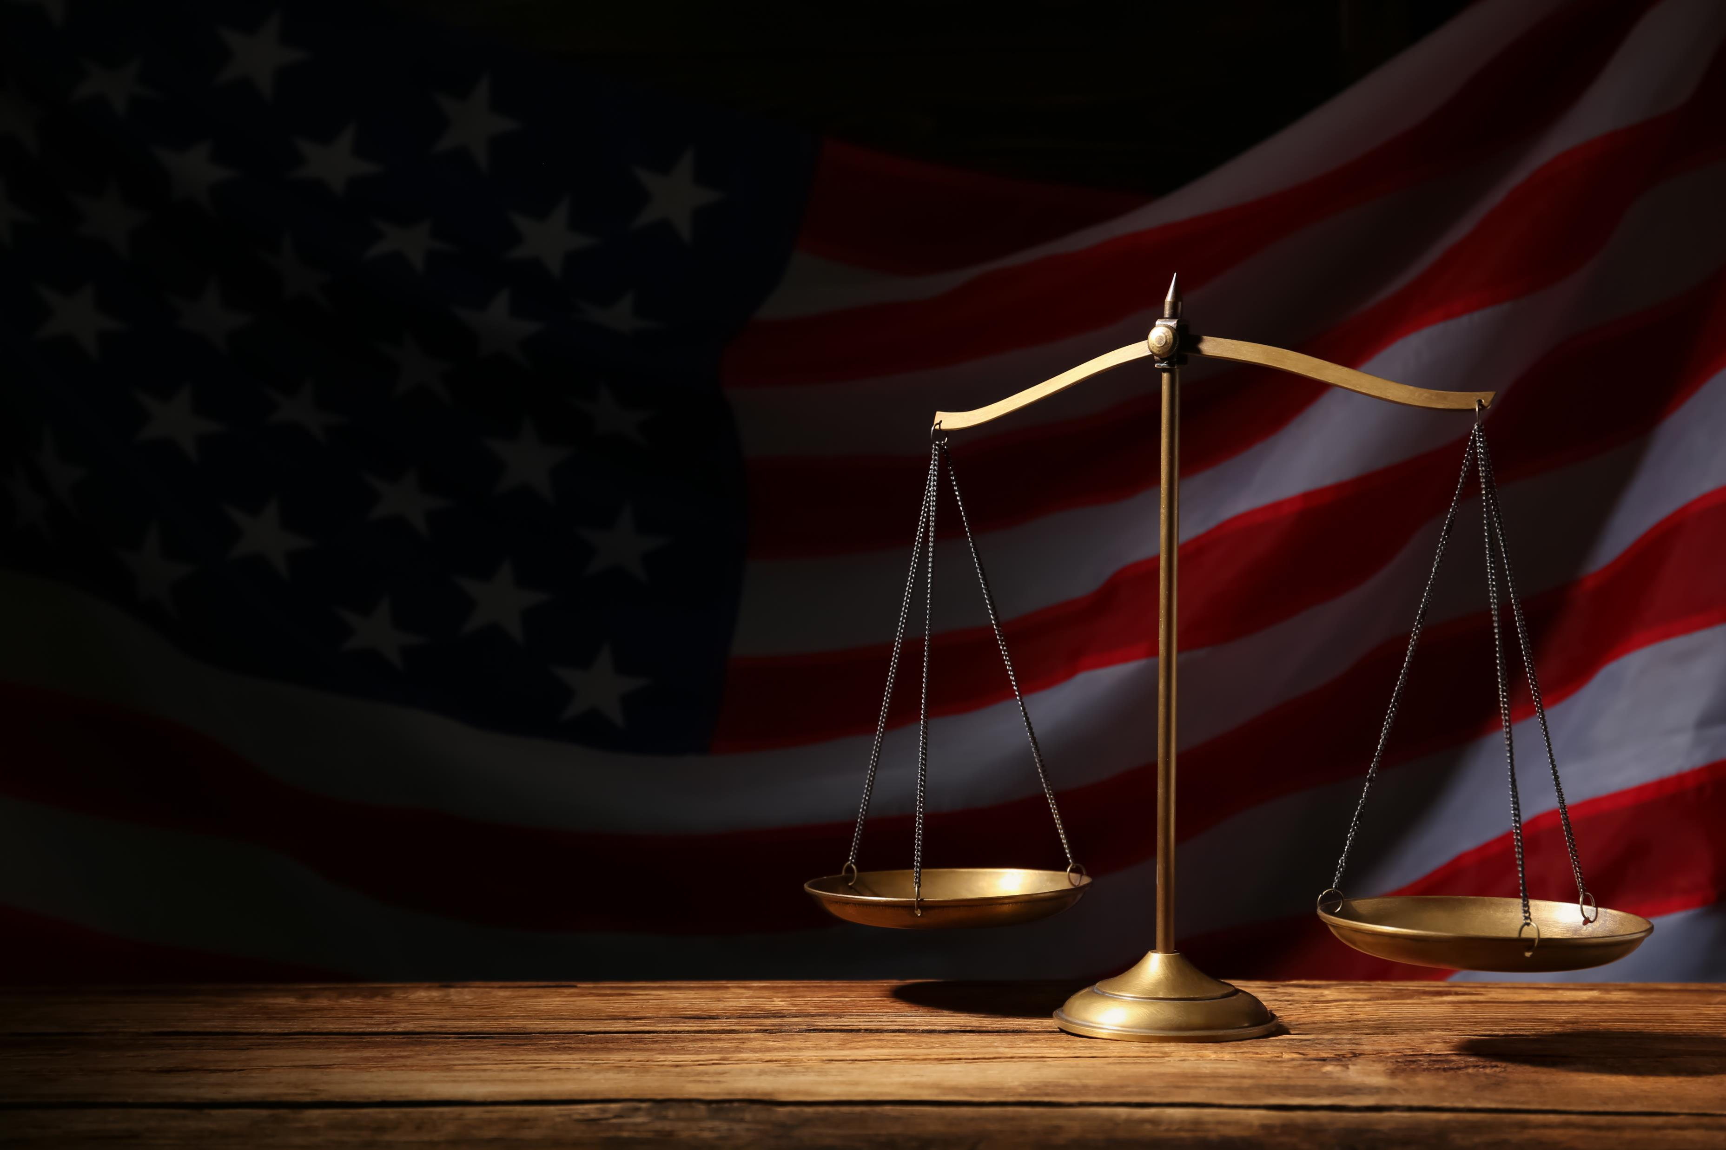
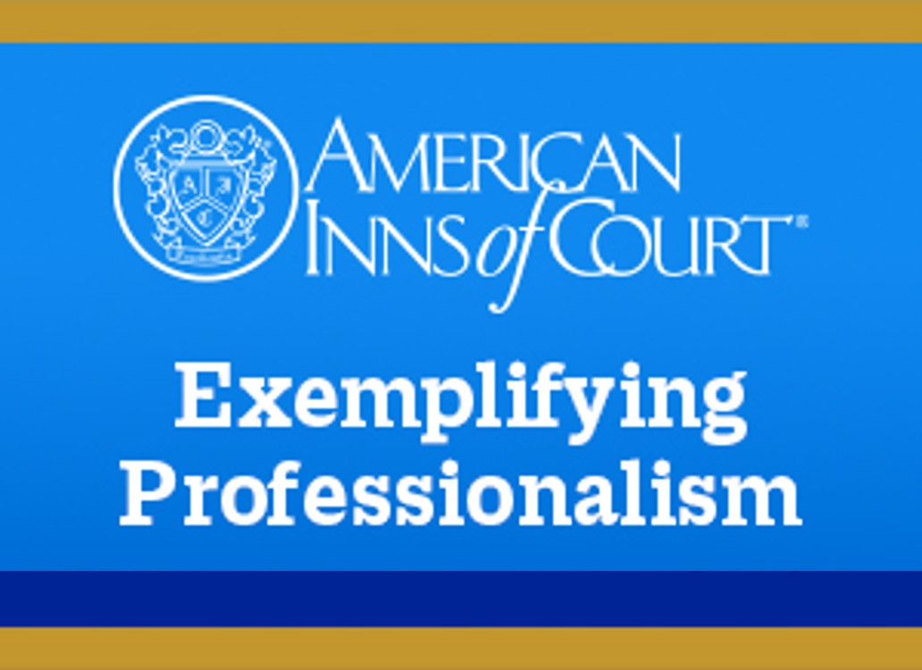
www.innsofcourt.org
I will treat the practice of law as a learned profession and will uphold the standards of the profession with dignity, civility and courtesy.”
–The American Inns of Court’s Professional Creed
Notes:
CAREE
Series Intro
This program is part of a series of courses designed to explore the critical role of professionalism in legal practice, examining how civility shapes relationships with clients, colleagues, opposing counsel, and the court.
Using the American Inns of Court's Professional Creed as a springboard you’ll learn practical applications of professionalism and ensure your advocacy is not only effective but also exemplary.
For those of you who are unfamiliar with us, the American Inns of Court is a national voluntary professional society for lawyers and judges whose mission is to inspire the legal community to advance the rule of law by achieving the highest level of professionalism through example, education, and mentoring.

Slide 4
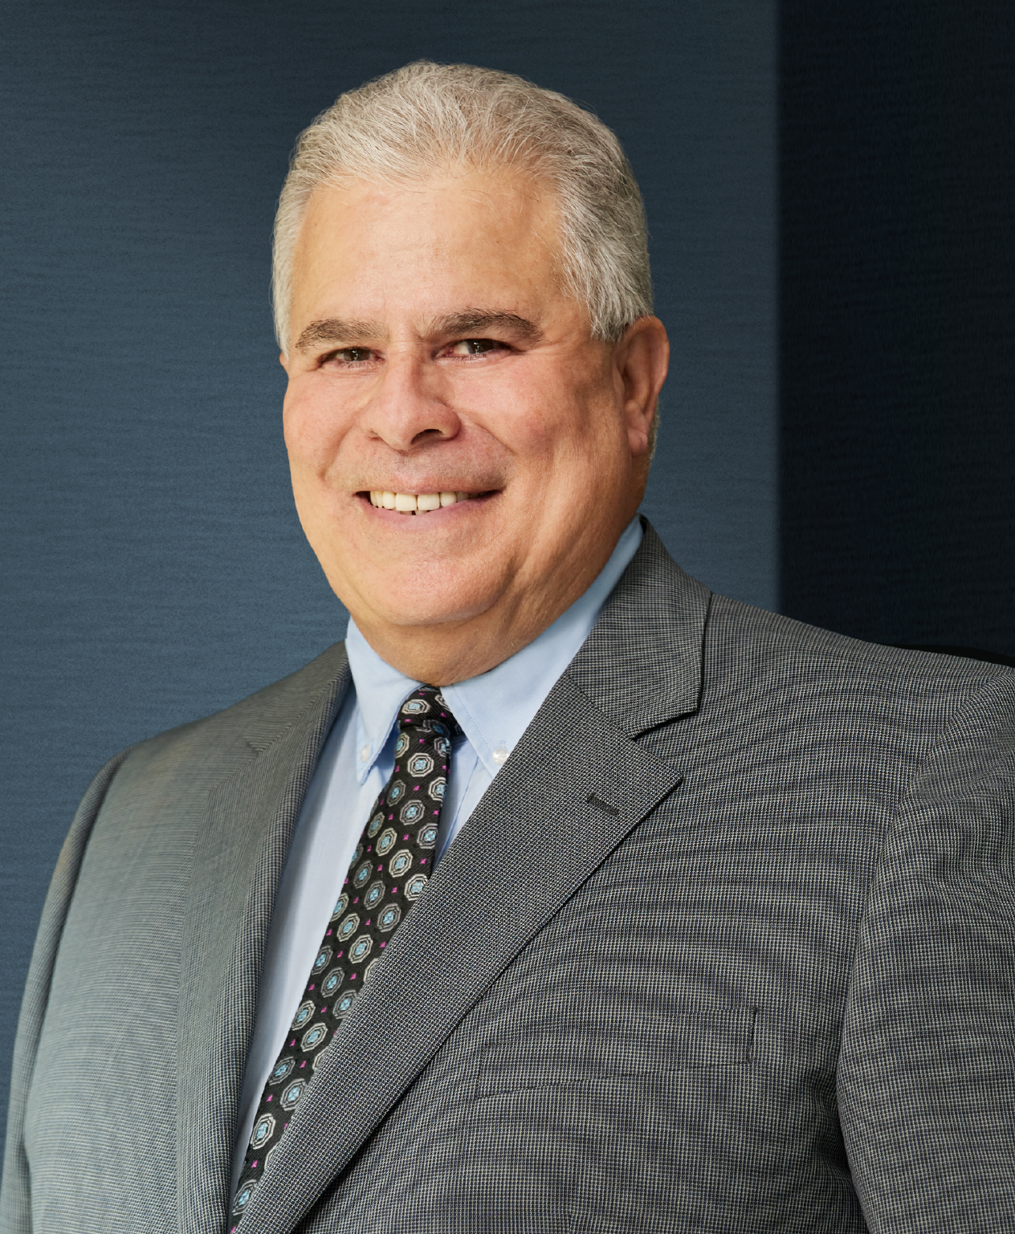
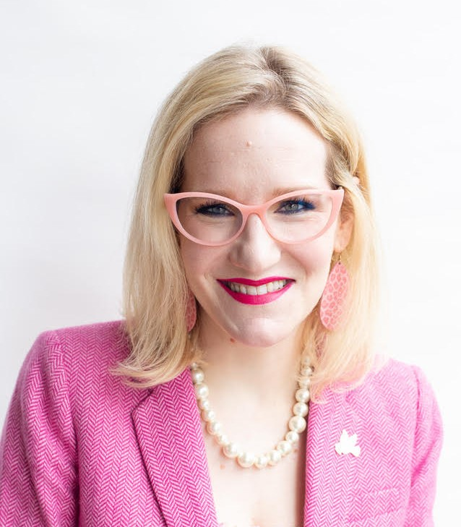
Hon. Kenneth J. Medel (Ret.)
Jenn French, Esquire
Signature Resolution
Lynch Carpenter, LLP
Notes:
CAREE
Joining us for this program is Judge Kenneth Medel, who is retired from the San Diego County Superior Court and is now working as a neutral with Signature Resolution. He brings 14 years of judicial experience and 23 years of civil litigation experience as a trial attorney to the program today. Welcome, Judge Medel!
We’re also lucky to have Jenn French for the program. While her day-job is representing plaintiffs in complex class action litigation, her passion is access to justice, serving as court-appointed counsel Appellate Defenders, Inc. and as pro bono counsel through Casa Cornelia Law Center, the San Diego Volunteer Lawyer Program, and the Southern District of California’s Pro Bono Panel. Welcome, Jenn!
Both Judge Medel and Jenn are longtime fellow members of the Louis M. Welsh American Inn of Court and I’m delighted they can join me today.
Today’s Bridging the Gap program will provide you with the tools and knowledge needed to navigate challenging scenarios with pro-se litigants with confidence and integrity.

Slide 5
Agenda
Standards of Professional Conduct
Lack of Legal Knowledge
Impropriety or Manipulation
Hostility or Unreasonable Expectations
Assisting without Overstepping
Practical Takeaways
Notes:
CAREE
Over the course of this program, we’ll provide an overview of the relevant professional conduct standards, including state bar expectations and American Inns of Court guidelines. We’ll then explore real world challenges when working with a pro se litigant, such as:
Their possible lack of legal knowledge
How attorneys can avoid the appearance of impropriety or manipulation of the pro se litigant
What happens when a pro se litigant becomes hostile, unprofessional according to bar standards or has unreasonable expectations of opposing counsel
Managing the court’s expectations of assistance to the pro se litigant
We’ll leave some time for Q&A, but please utilize the chat box for your questions throughout.

Slide 6
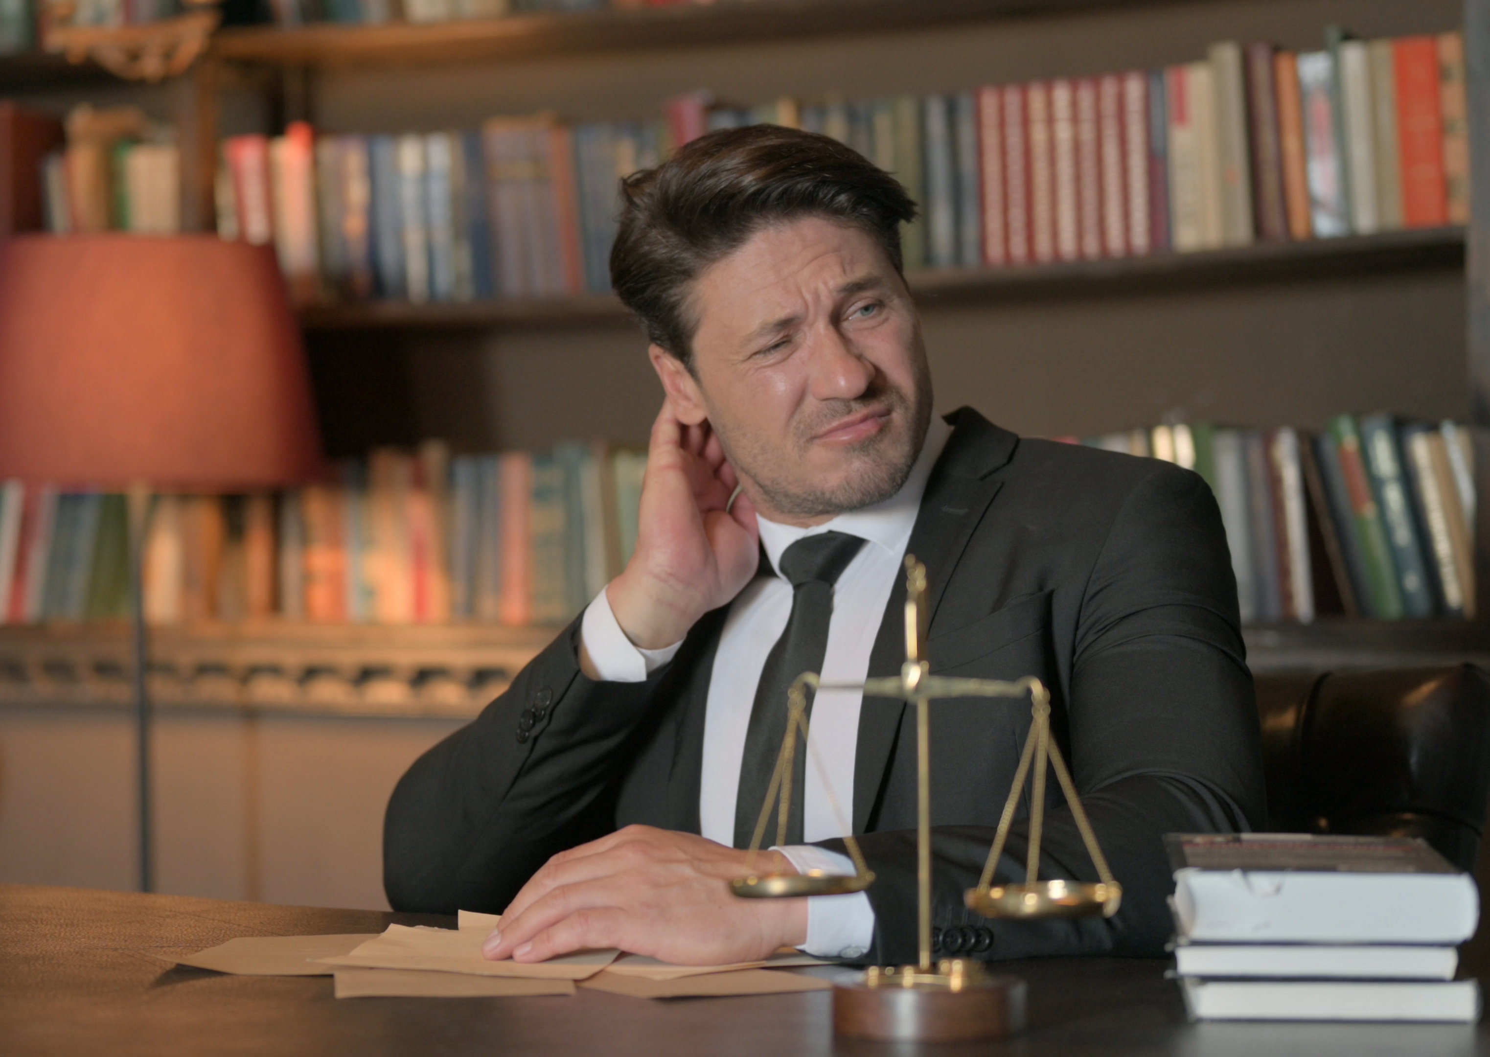
Why this topic matters
Notes:
Why civility and professionalism when interacting with non-attorney represented parties (Pro Per) matters.
Pro-se litigants can be found at all levels and in all types of courts.
This session will provide you with the tools and knowledge needed to navigate interactions with them while maintaining civility and professionalism.
Goals:
Understanding ethical expectations.
Developing professional strategies.
Avoiding pitfalls that can harm your reputation.

Slide 7

The Prevalence of the Pro Se Litigant
Cost of legal assistance
Access to legal aid
Online legal resources
Notes:
The prevalence of the pro-se litigant can be attributed to:
Cost of legal assistance
Difficulty accessing legal aid
Proliferation of and easy access to online legal resources
In addition, there is a perception by many that any individual can navigate the legal system with the right information, even in complex cases.
These factors increase the chances of encountering pro-se litigants at some point during your career.
Legal codes of conduct dictate that an attorney exhibit legal professionalism, even in interactions with those not bound by such codes, making it a particular challenge for an attorney to uphold their professional and ethical obligations.

Slide 8

Standards of Professional Conduct

Slide 9


I will serve as an officer of the court, encouraging respect for the law in all that I do and avoiding abuse or misuse of the law, its procedures, its participants and its processes.
I will honor the requirements, the spirit and the intent of the applicable rules or codes of professional conduct for my jurisdiction and will encourage others to do the same.
—The American Inns of Court Professional Creed
Notes:
CAREE
Our focus will be on these two tenets of the American Inns of Court Professional Creed.

Slide 10
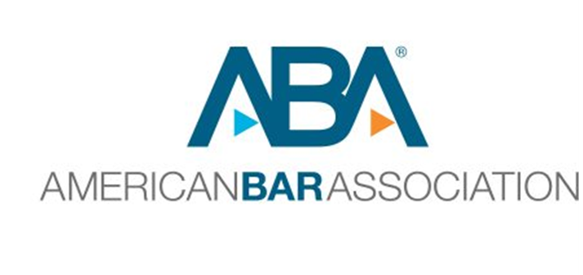
Model Rules of Professional Conduct
Rule 1.2: Scope of Representation and Allocation of Authority
Rule 1.6: Confidentiality of Information
Rule 3.4: Fairness to Opposing Party and Counsel
Rule 4.1: Truthfulness in Statements to Others
Rule 4.3: Dealing with Unrepresented Persons
Rule 8.4: Misconduct
Notes:
Overview of common state bar regulations regarding attorney advertising and online conduct.
ABA Model Rules of Professional Responsibility
Rule 1.2- Scope of Representation and Allocation of Authority
Cannot mislead pro-se litigant into believing they have legal representation
Rule 1.6- Confidentiality of Information
Avoiding improper disclosures of info when dealing with self-represented party
Rule 3.4- Fairness to Opposing Party and Counsel—Still applies to Pro Pers
Rule 4.1- Truthfulness in Statements to Others
Rule 4.3- Dealing with Unrepresented Persons
Rule 8.4- Misconduct – Attorneys must act with honesty and integrity in all professional dealings

Slide 11

Real World Challenges
Notes:
Pro Se Lack of Legal Knowledge
Avoiding Appearance of Impropriety or Manipulation
Hostility or Unreasonable Expectations from Pro Se Litigant
Courts Expectations – Attorney to “Assist” Pro Se Without Overstepping

Slide 12

Lack of Legal Knowledge
Notes:
Pro Se Lack of Legal Knowledge
Direct them to neutral resources
Avoid exploiting misunderstandings
Being lenient where you can—ie. They miss a deadline
Discuss examples

Slide 13

What might this look like in reality?
Notes:
Discuss examples

Slide 14

An Imbalance of Power
Notes:
Avoiding Appearance of Impropriety or Manipulation
Attorney legal knowledge can create an imbalance of power
Avoid aggressive negotiation tactics that exploit pro se
Document everything- encourage them to seek guidance of counsel (ie. Settlement agreements)
Discuss examples

Slide 15
What might this look like in reality?
Notes:
Discuss examples

Slide 16

Hostility or Unreasonable Expectations
Notes:
Hostility or Unreasonable Expectations from Pro Se Litigant
Maintain calm, professional demeanor to de-escalate tension
Let judge handle misconduct to avoid engaging directly
Document
Discuss examples

Slide 17
What might this look like in reality?
Notes:
Discuss examples

Slide 18
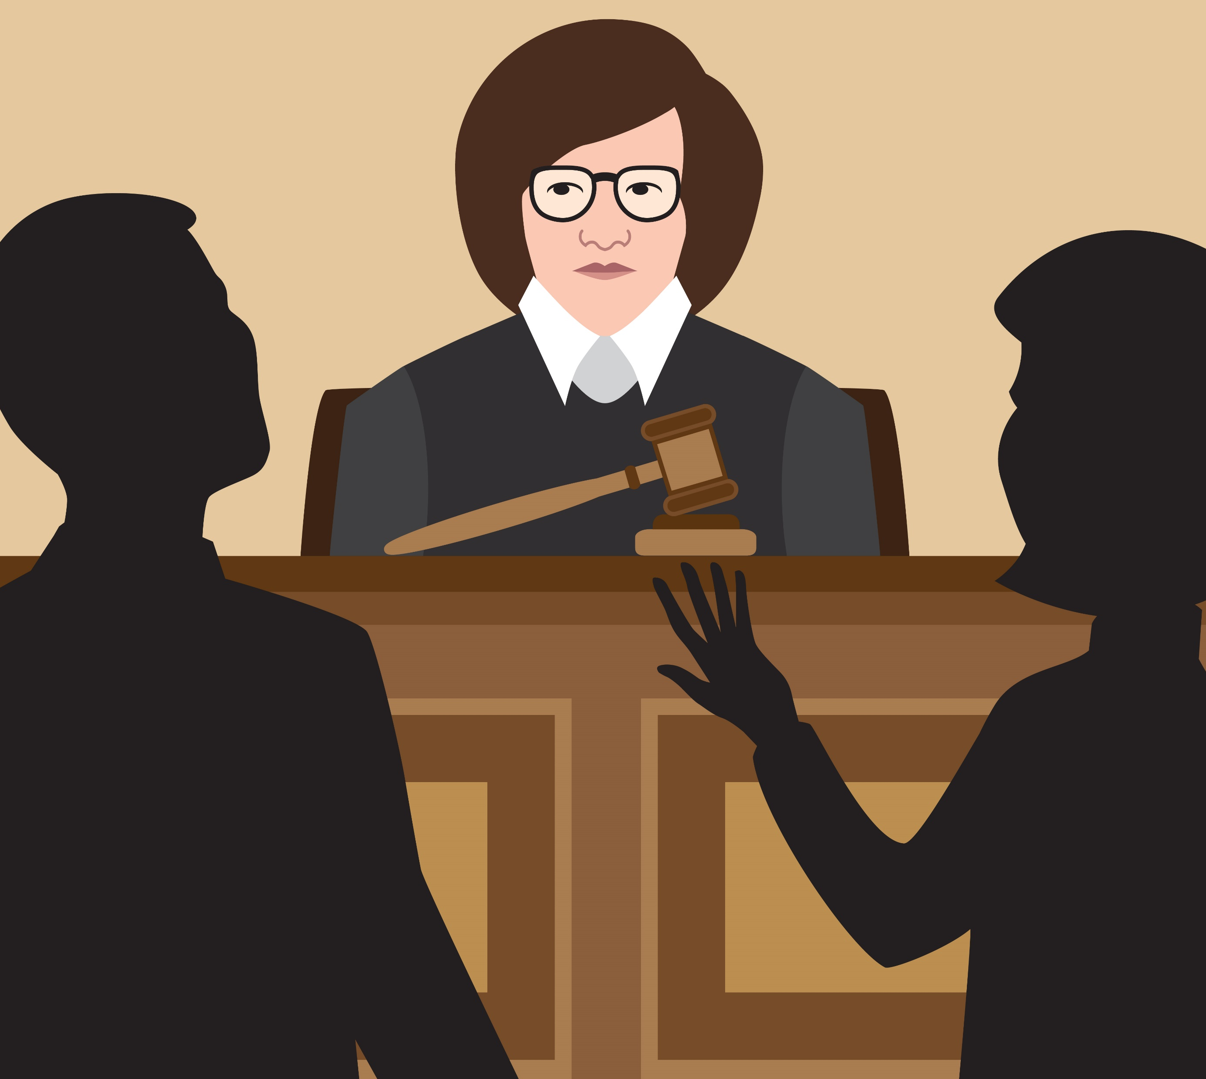
Expectations of the Court
Notes:
Courts Expectations – Attorney to “Assist” Pro Se Without Overstepping
Okay to explain court procedures without legal strategy
Direct to neutral resources
Professional courtesy and unauthorized assistance
Discuss examples

Slide 19
What might this look like in reality?
Notes:
Discuss examples

Slide 20

Practical Strategies for Working with Pro Se Litigants
Notes:
CAREE
Develop a content strategy aligned with your professional goals.

Slide 21

Reputation Management
Notes:
CAREE
Q&A
(Be sure to have some “pocket” questions in case nobody asks anything!)

Slide 22
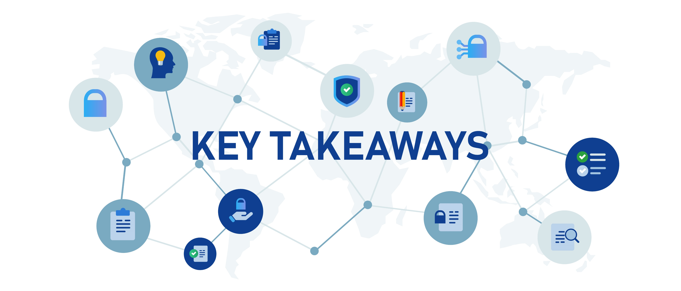
Standards and guidelines
Tips for managing pro se interactions
Knowledge of the court’s expectations
Why civility and professionalism matter
Anticipating challenges
Notes:
CARREE
To review, we hope you will leave the webinar with:
Standards and guidelines for working with pro se litigants and why civility and professionalism matter.
Information to anticipate the challenges of working with a pro se litigant, such as:
Their possible lack of legal knowledge
What happens when a pro se litigant becomes hostile, unprofessional according to bar standards or has unreasonable expectations of opposing counsel
Managing the court’s expectations of assistance to the pro se litigant
Understanding your professional and ethical obligations as they pertain to the pro se litigant, including manipulation and avoiding even the appearance of impropriety

Slide 23

wendypatrickphd@icloud.com
cnahama
@cknlaw.com
cnahama
@cknlaw.com
Notes:
If you have any questions, please feel free to contact us.
If you’re interested in finding out more about the American Inns of Court or joining a local Inn of Court near you, please visit www.innsofcourt.org.

Slide 24


