Slide 1
The Need for Science Advocacy and How to Get Started
May 2020

Slide 2
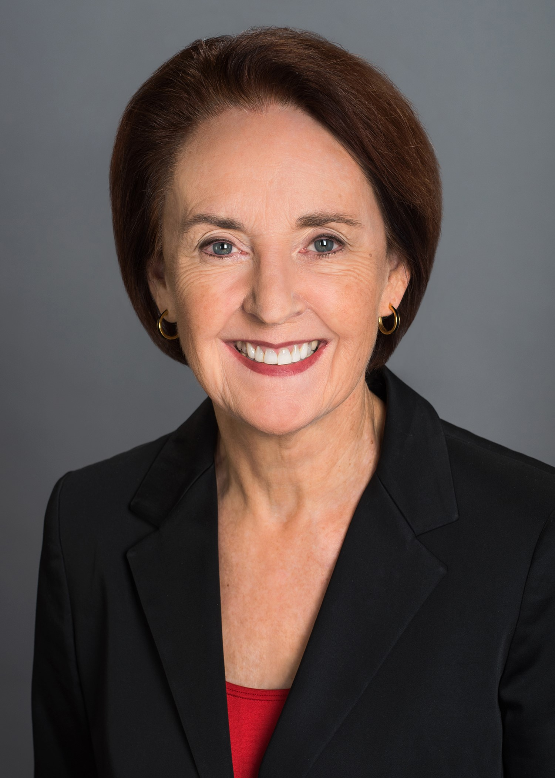
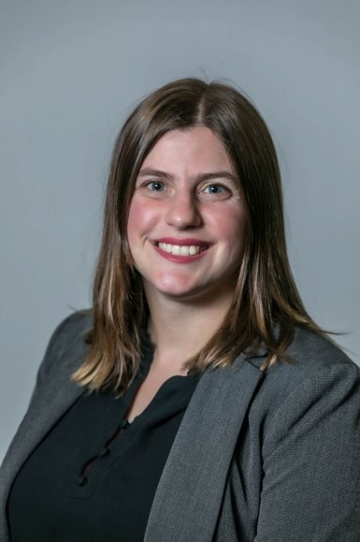
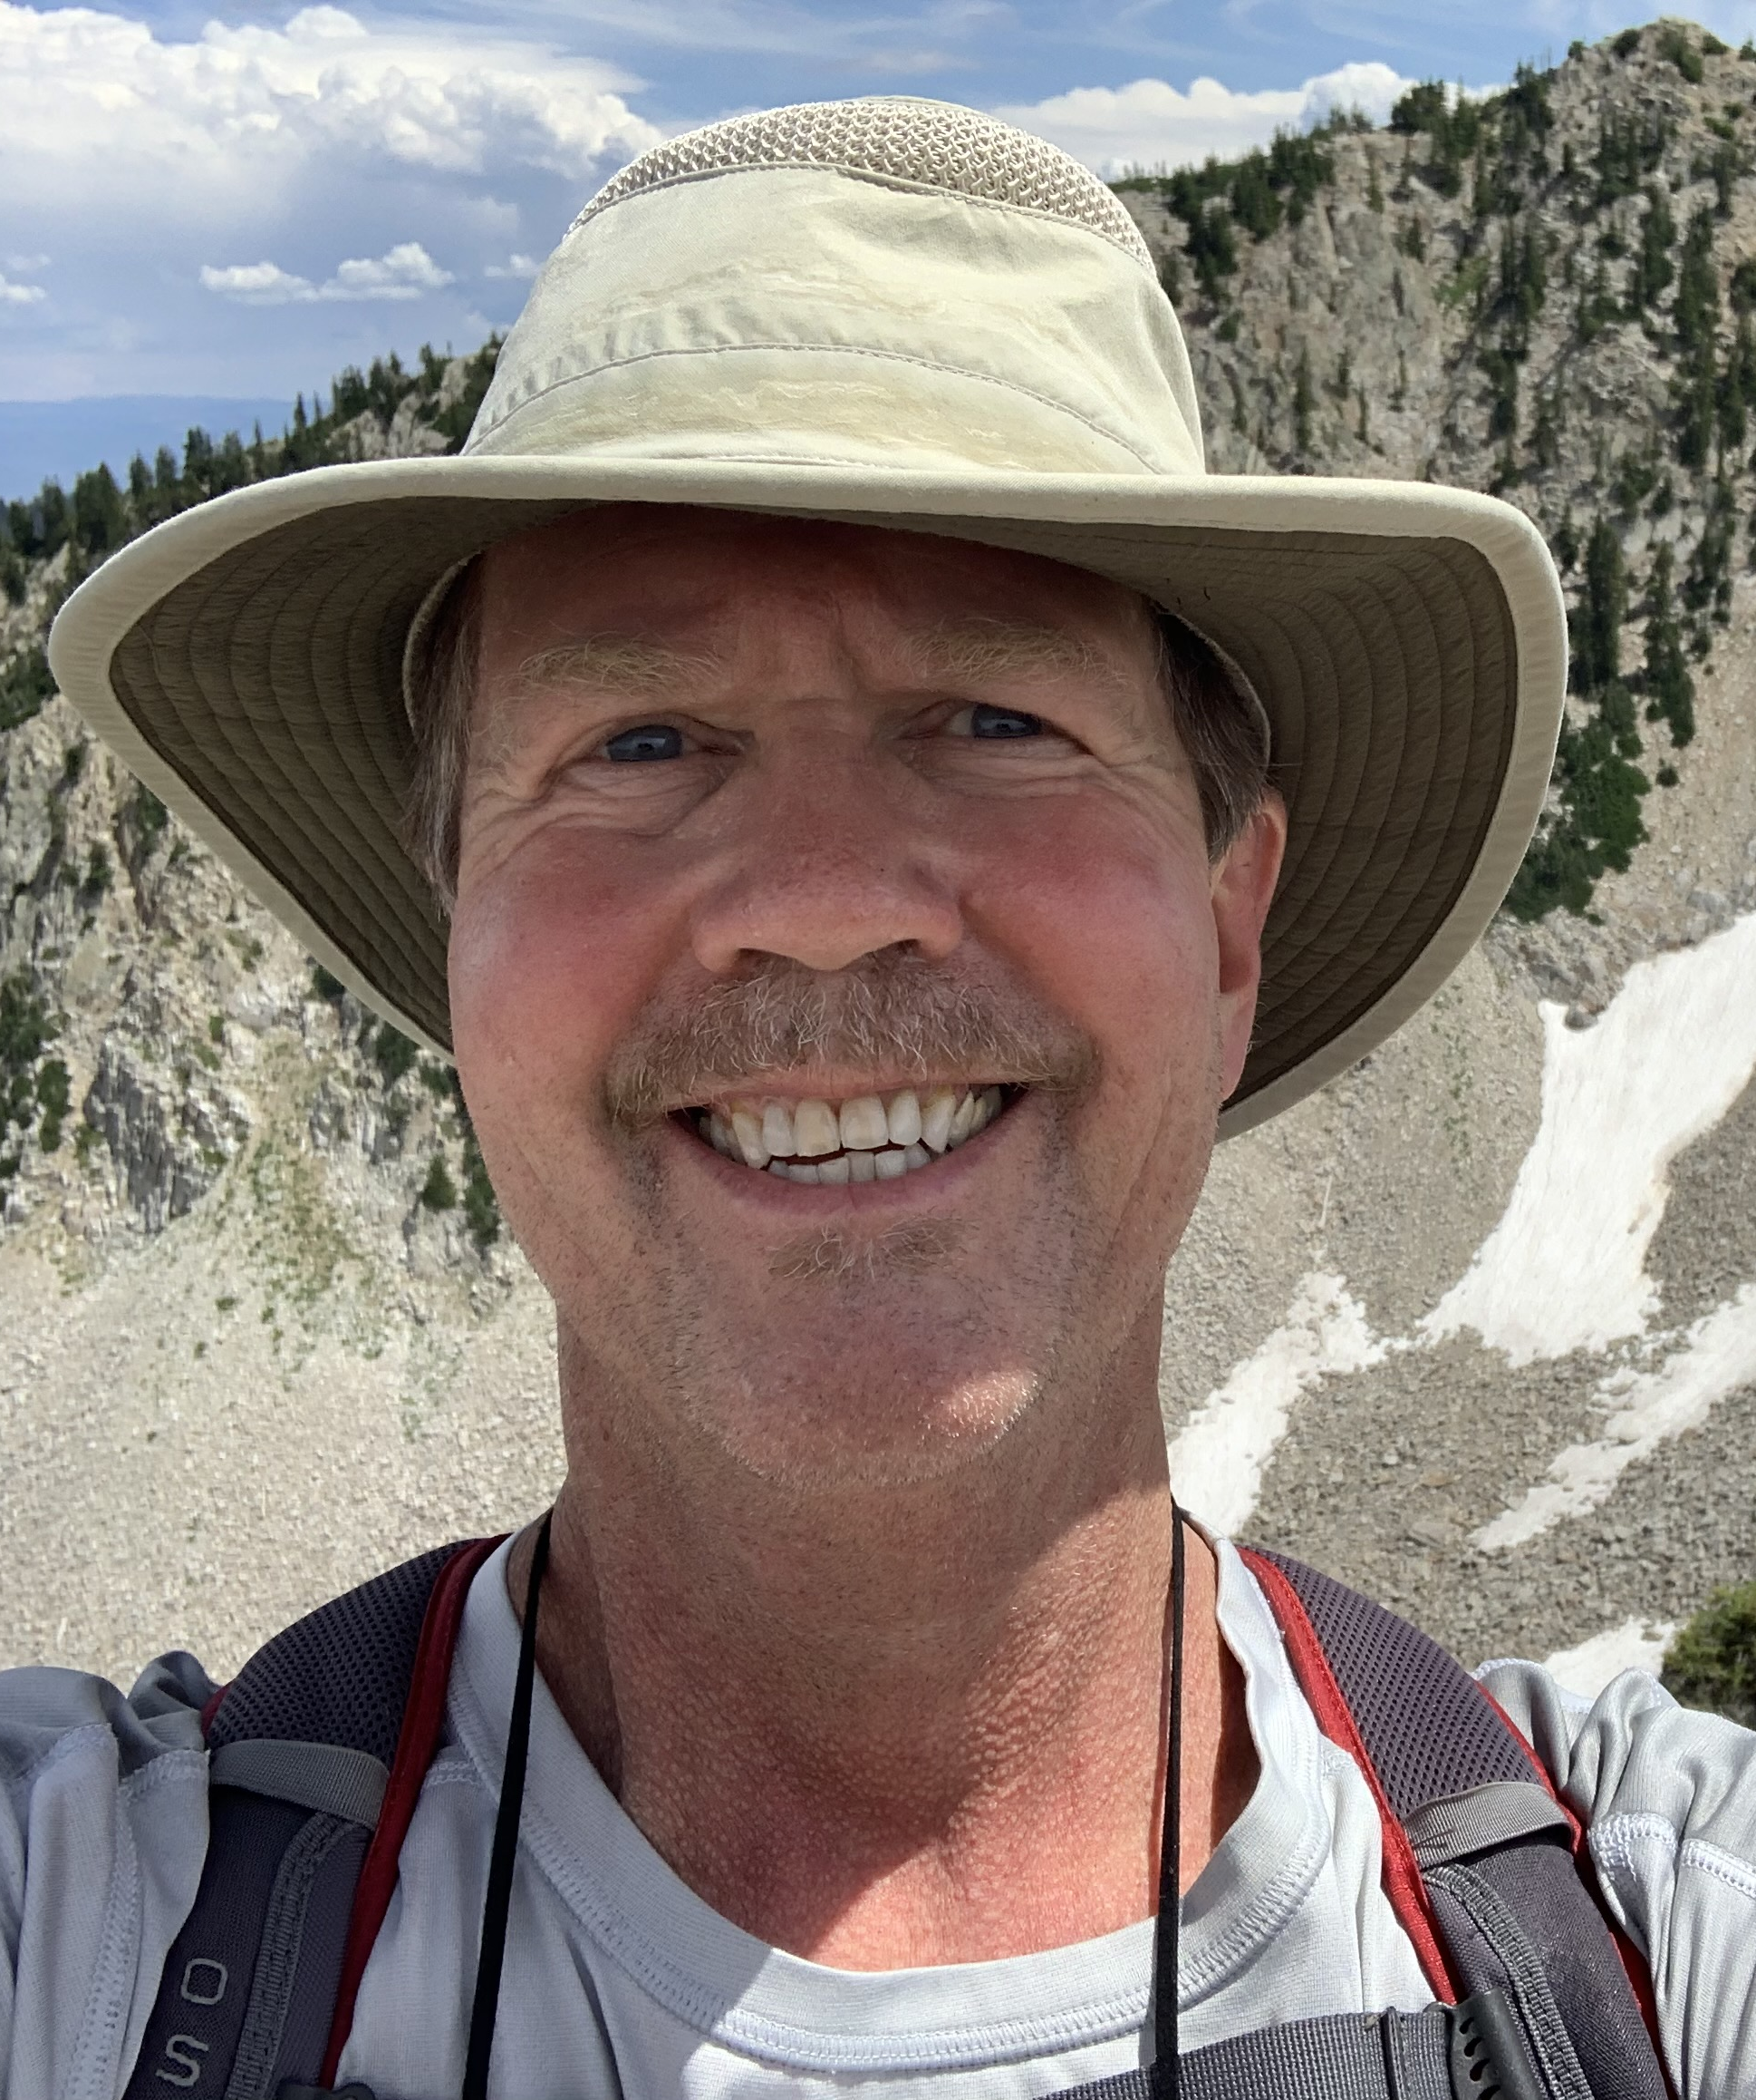
Today’s Presenters
Mary Woolley
Allison McCague, PhD
Lynn Jorde, PhD, Moderator

Slide 3
Winning Hearts and Minds for Research in 2020 and Beyond
American Society for Human Genetics
May 6, 2020

Slide 4


Research!America’s Mission
The Research!America alliance advocates for science, discovery, and innovation to achieve better health for all.
Research!America is an innovator in advocacy for research
@researchamerica
research_america

Slide 5
Research! America Alliance
We bring stakeholders together to heighten the priority of research and to help assure scientific progress and the health and vitality of the scientific enterprise.
Formulate concrete solutions to persistent challenges
Academia
Industry
Patient groups and nonprofits
Scientific societies
Foundations and state/local groups
Act to effect change

Slide 6
Research!America Strategies for Success
Keep a finger on public pulse via public opinion surveys
Develop and deliver timely messages
Track investment in research
Design and trigger grassroots plus grasstops advocacy strategies
Drive earned and paid media attention
Empower members of the science community as advocates
Engage congressional champions

Slide 7
What We Accomplished Together in 2019: Advocacy Works!
Advocacy for Research
Raised the budget caps
$2.6 billion increase for NIH in FY20
Increased funding for NIH, CDC, FDA and NSF
Strengthened our public health disease tracking capabilities
Protected funding for AHRQ and reauthorized PCORI
Secured repeal of the medical device tax
$636 million increase for CDC in FY20
$203 million increase for NSF in FY20
$91 million increase for FDA in FY20
FY20 Budget

Slide 8
National Institutes of Health Appropriations
Fiscal Year 1989 – 2020
Notes:
Please ask policy team to update to show the supplementals, as per next slide – maybe use dotted line, as for ARRA
TS – updated by Anna Z

Slide 9
Agency Funding with Supplementals
Agency | FY18 Enacted | FY19 Enacted | Original FY20 Appropriations
NIH | $37.08 | $39.08 | $41.68
CDC | $8.30 | $7.28 | $7.92
FDA | $2.81 | $3.08 | $3.17
NSF | $7.77 | $8.10 | $8.28
AHRQ | $0.33 | $0.34 | $0.34
Agency | Coronavirus Preparedness and Response Supplemental Appropriations Act - 3/6/2020 | CARES Act - 3/27/2020 | Paycheck Protection Program and Health Care Enhancement Act – 4/24/20 | Total FY20 Supplemental Funding | Total FY20
NIH | $0.84 | $0.95 | $1.80 | $3.58 | $45.26
CDC | $2.20 | $4.30 | $1.00 | $7.50 | $15.42
FDA | $0.06 | $0.08 | $0.02 | $0.16 | $3.33
NSF | $0.00 | $0.08 | $0.00 | $0.08 | $8.36
AHRQ | $0.00 | $0.00 | $0.00 | $0.00 | $0.34
*All amounts in billions
Notes:
TS – Updated By Anna Z.

Slide 10
The Current Budget Reality
2019 budget deal enabled increases for
FY20 & FY21
  $25B front-loaded to $20B for FY20
  FY21 has been set at $5B for all non-defense spending, including education, agriculture, transportation, and much, much more
  NIH increase in FY20 = ½ FY21 total!
Ongoing COVID-19 pandemic presents challenges to regular order
Election year
Notes:
MW – Election year shouldn’t be a sub-bullet of COVID19
TS – we will update this slide and State of Play
AP – I edited the second main bullet; I think the first bullet (and it’s sub-bullets) are still fine

Slide 11
State of Play
Past performance is not a guarantee of future results
COVID-19 and beyond
We must think and act with both short and long term in mind
Smart messaging is crucial now
Warning: Uncertainty
ahead
Notes:
TS – we can update this slide
AP – made some edits

Slide 12
What We Must Do Together
Engage policymakers and the public
Short term
Long term
Respond to COVID19 + FY21 Budget
Election
Social Media Outreach Campaign
Candidate Outreach
Empower and encourage student voices
Empower many more scientists to advocate for research

Slide 13
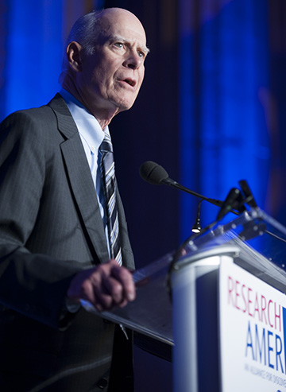
“You can change the image of things to come. But you can’t do it sitting on your hands…The science community should reach out to Congress and build bridges.”
Research!America Chair Emeritus,
Former Congressman John Edward Porter

Slide 14

Important for Scientists to Engage Policymakers
How important is it for scientists to inform elected officials about their research and its impact on society?
Source: A Research!America survey of U.S. adults conducted in partnership
with Zogby Analytics in January 2018.
Notes:
TS - keep

Slide 15
Constituent voices matter
Pre-pandemic: When congressional staff were asked what advocacy factors would have some or a lot of influence:
  94% said “in-person issue visits from constituents”
  92% said “individualized email messages” from constituents
In COVID-19 context: staff have been very receptive to calls and virtual meetings
Source: “Citizen-Centric Advocacy: The Untapped Power of Constituent Engagement,” Congressional Management Foundation, 2015
Notes:
MW – good idea – go for it
TS – suggest we keep but add that during pandemic hill staff have been very receptive to calls and virtual meetings.

Slide 16
Constituent interests matter
91% of congressional staff said it’s helpful to have information about the impact the bill/issue would have on the district or state.
79% percent said a personal story from a constituent related to the bill or issue would be helpful.
  Research!America can help you frame your story!
Source: “Citizen-Centric Advocacy: The Untapped Power of Constituent Engagement,” Congressional Management Foundation, 2015
Notes:
TS – suggest we keep

Slide 17
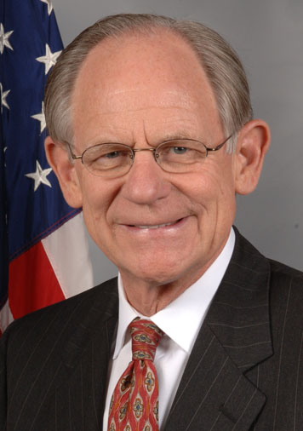
“Scientists deepened my understanding of the promise of embryonic stem cell research during a time when there was huge opposition in Congress and the White House for federal support of such research. This interaction led to the development of bipartisan legislation introduced by me and Rep. Diana DeGette (D-CO) in 2005 that expanded federal funding of embryonic stem cell research.”
-- Q&A with Society for Neuroscience,
Fall 2017
Research!America Chair
Former Governor & Congressman Michael N. Castle (R-DE)

Slide 18
Q: What do elected officials and scientists have in common?

Slide 19
Q: What do elected officials and scientists have in common?
A: Serving the public’s interest.
You can effectively start a conversation with any elected official by thanking them for serving the public’s interest. And then say how you serve the public’s interest.

Slide 20
Important for Scientists to Engage Public
How important is it for scientists to inform the public about their research and its impact on society?
Source: A Research!America survey of U.S. adults conducted in partnership
with Zogby Analytics in January 2018.

Slide 21
Q: What else do elected officials and scientists have in common?
A: They like data. Just different kinds of data.

Slide 22
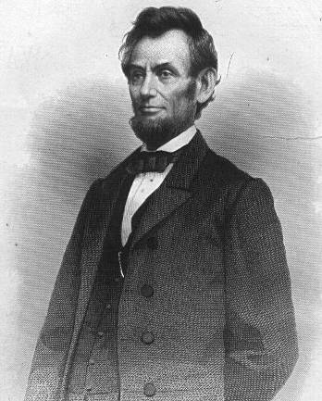
“…public sentiment is everything. With public sentiment, nothing can fail; without it nothing can succeed.”
President Abraham Lincoln

Slide 23
Research!America Surveys
Commissioning public opinion surveys on research issues for 28 years:
    National Surveys
    State-Based Surveys
    Issue-Specific Surveys
Online surveys are conducted with a sample size of 1000-2000 adults and sampling error of +/-3.1% to +/-2.1%. The data are weighted in two stages to ensure accurate representation of the U.S. adult population.
Notes:
23
MW – yes, for sure.
TS – should we add some of the genetics survey in this section?

Slide 24

Strong Majority Agree Basic Research is Critical
Do you agree or disagree with the following statement? Even if it brings no immediate benefits, basic scientific research that advances the frontiers of knowledge is necessary and should be supported by the federal government.
86% strongly or somewhat agree – increase from 63% in 2017
Source: A Research!America poll of U.S. adults conducted in partnership with Zogby Analytics in January 2020

Slide 25
Americans Feel Positive About Human Genetics Research
How would you describe your feelings about human genetics research?
Source: A Research!America poll of U.S. adults conducted in partnership with Zogby Analytics in December 2019

Slide 26
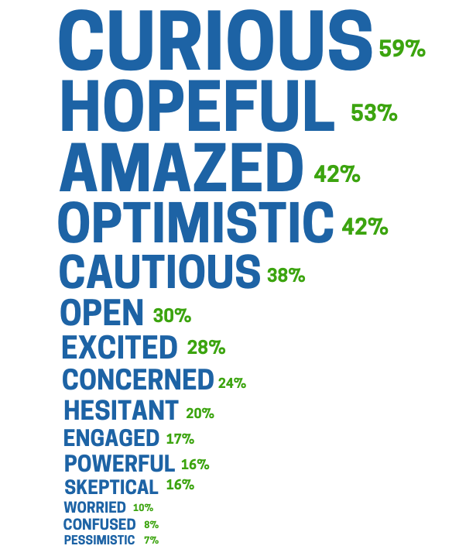
Americans Are Curious About Human Genetics Research
Please select from the following the top five words that best reflect your attitudes towards human genetics research:
Source: A Research!America poll of U.S. adults conducted in partnership with Zogby Analytics in December 2019

Slide 27
Americans Think More Research is Needed in Human Genetics
Please indicate the extent to which you agree or disagree with the following statements: More research is needed in human genetics
Source: A Research!America poll of U.S. adults conducted in partnership with Zogby Analytics in December 2019

Slide 28
Americans Think Research is Important to Improving Family Health
Do you agree or disagree that genetic research is important to improving your family's health?
Source: A Research!America poll of U.S. adults conducted in partnership with Zogby Analytics in December 2019

Slide 29
Americans Support Federal Funding For Genetic Research
How important is it to increase federal funding to support genetic research?
Source: A Research!America poll of U.S. adults conducted in partnership with Zogby Analytics in December 2019

Slide 30
Decline in Those Saying We are Making Enough Progress
Do you believe we are making enough progress in health research in the U.S.?
Source: Research!America surveys of U.S. adults conducted in partnership with Zogby Analytics in December 2019, July 2017, and May 2013
Notes:
MW – not sure of your thinking? Seems relevant right now – I’ll bet the % saying “yes” would be even lower now – and thus an argument for more research support? Maybe not? Tell me your thinking.
TS – suggest we delete
-TS – had been thinking that the only medical progress that matters right now is COVID, so that might be a distraction.

Slide 31
Shifting Voter Priorities
Which of the following should be included among the priorities of candidates running for national office THIS YEAR? (Choose all that apply) (selected responses)
 | 2016 | 2020
Creating jobs/economic growth | 74% | 57%
Speeding medical progress | 36% | 46%
Improving infrastructure | 38% | 49%
Taking action on climate change | 32% | 42%
Improving education | 58% | 39%
Strengthening defense and national security | 58% | 45%
Addressing immigration and border security | 48% | 47%
Source: A Research!America poll of U.S. adults conducted in partnership with Zogby Analytics in January 2020
Notes:
MW – the second column should say 2020, right? And I guess my point here would be that if anything, were we to do a survey again today, speeding medical progress will go up, but concern re economy will still be high! I’d like to work in a slide that shows the relevance of investing in science to driving the economy. There is some data on that; I’m not sure where it resides – policy team might know
TS will work on this with policy
- update – policy wasn’t sure about anything recent other than what is in investment report. Maybe a call to discuss what you have in mind.
Still think the second column should be labelled 2020. And I’m sure there is info on impact of funding research as driving the economy. I saw figures just today in an AdHoc letter – near the end – and these figures have been around for years – ITIF maybe?
TS – aha, found the Ad Hoc letter. See next slide.

Slide 32
Research and the Economy
In FY 2019, NIH-funded research supported more than 476,000 jobs across the U.S. and generated more than $81 billion
in new economic activity
Stimulates an additional $8.38 investment in the private sector after 8 years
A $1 increase in public basic research
A $1 increase in public clinical research
Stimulates an additional $2.35 investment in the private sector after 8 years
Notes:
From the Ad Hoc letter: In FY 2019, NIH-funded research supported more than 476,000 jobs across the U.S. and generated more than $81 billion in new economic activity.3 A $1 increase in public basic research stimulates an additional $8.38 investment in the private sector after eight years. A $1 increase in public clinical research stimulates an additional $2.35 in private sector investments after three years

Slide 33
Majority Favor Doubling Funding for Medical Research over the Next Five Years
Do you favor or oppose doubling federal spending on medical research over the next five years?
Source: A Research!America poll of U.S. adults conducted in partnership with Zogby Analytics in January 2020

Slide 34
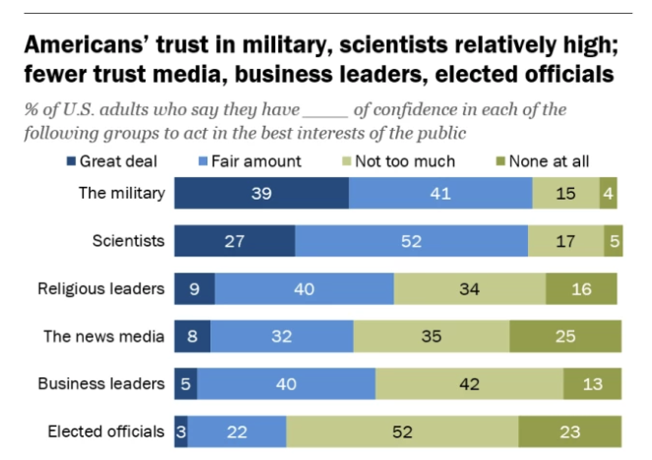
Americans Express Confidence in Military, Scientists
Note: respondents who did not give an answer are not shown. Source: Survey conducted Jan. 29 - Feb. 13, 2018
PEW RESEARCH CENTER

Slide 35
And Yet, Despite High Levels of Public Confidence,
Scientists are Invisible in Our Society…

Slide 36
Can Americans Name a Living Scientist?

Slide 37
Most Americans Cannot Name a Living Scientist
Can you name a living scientist?
Neil deGrasse Tyson | 16%
Bill Nye | 13%
Jane Goodall | 12%
Timothy Berners-Lee | 10%
James Watson | 7%
Alan Guth | 4%
Richard Dawkins | 3%
Other | 36%
*Increase by 5% of those saying “yes” since 2019
Source: A Research!America poll of U.S. adults conducted in partnership with Zogby Analytics in January 2020

Slide 38
Do Americans Know Where Medical or Health Research is Conducted?
@researchamerica
research_america

Slide 39
Only Half of Americans Can Name a Place Where Medical or Health Research is Conducted
Can you name any institution, company or organization where medical or health research is conducted?
18% increase from 2018 when only 35% could name
St. Jude Children's Research Hospital | 12%
Mayo Clinic | 12%
Johns Hopkins University/Hospital | 7%
Center for Disease Control and Prevention (CDC) | 5%
National Institutes of Health (NIH) | 5%
Cleveland Clinic | 3%
Pfizer Inc. | 3%
Other | 54%
Source: A Research!America poll of U.S. adults conducted in partnership with Zogby Analytics in January 2020

Slide 40
The Majority of Americans Do Not Know That Research is Conducted in All 50 States
To the best of your knowledge, would you say that medical research in the U.S. is conducted in all 50 states?
Increase in “yes” – up 6% from 27%
Source: A Research!America poll of U.S. adults conducted in partnership with Zogby Analytics in January 2020

Slide 41

Increase the Visibility of Science

Slide 42

Tell the right story
The first reason we have not been able to engage the audience is simple: we are telling the wrong story.
We are telling our story, not theirs.
The first thing you must do is
convey that your mission helps
to meet their needs.
Narratives project, 2016
research_america
@researchamerica

Slide 43



Aspirational Communications
THEN… Known as the “first molecular disease” sickle cell disease (SCD) was only curable with a bone marrow transplant—a treatment option not available for most patients.
NOW… Thanks to advances in basic and translational research, gene therapies and gene editing tools, such as CRISPR/Cas9, are becoming possible treatment options for SCD.
IMAGINE… Curing all patients of SCD.
Research finds solutions to what ails us!

Slide 44





Re-Cap: How to Think About Talking to Non-Scientists
Know your audience
Use the Then-Now-Imagine message frame
Be visible
Use emotion
Remember -- if people are skeptical, they are thinking like scientists!
Convey your personal commitment/passion
Communicating well demonstrates understanding, sensitivity and accountability.

Slide 45
Put a Face on Research: YOURS!

Slide 46
Remember
The most important four words a scientist can say and convey are …

Slide 47






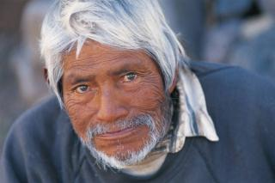



“I work for you.”

Slide 48




Research!America Works for You
Connect with us
www.researchamerica.org
www.facebook.com/researchamerica.org
www.twitter.com/researchamerica
www.youtube.com/researchamerica
mwoolley@researchamerica.org

Slide 49

Become an ASHG Advocate
Take the Advocate’s pledge on ASHG’s Advocacy Center.
Commit to advocating for human genetics
Get relevant and timely updates on issues and advocacy opportunities
Take action by contacting your policymakers
www.ashg.org/pledge

Slide 50
Getting involved in advocacy as a trainee or early career scientist
Allison McCague
May 6, 2020

Slide 51

My path
Graduate school activities
  Dual thesis project
  Writing for The Nascent Transcript
  Johns Hopkins Science Policy Group
  ASBMB Hill Day
Work with ASHG GPAC
Eagleton Science & Politics Fellowship

Slide 52
Advocacy tips for trainees
Seek out opportunities to engage…
At your institution
  Science policy groups/clubs
  Student government
Elected officials and non-scientists
  Invite elected officials to your lab/institution
  Patient advocacy groups
With your home scientific society
  Become an ASHG advocate
  Organized Hill Days
Notes:
If you study a specific disease, become involved in that disease advocacy group. Ex: Cystic Fibrosis Foundation Great Strides, inviting CFF folks to our lab, etc.

Slide 53
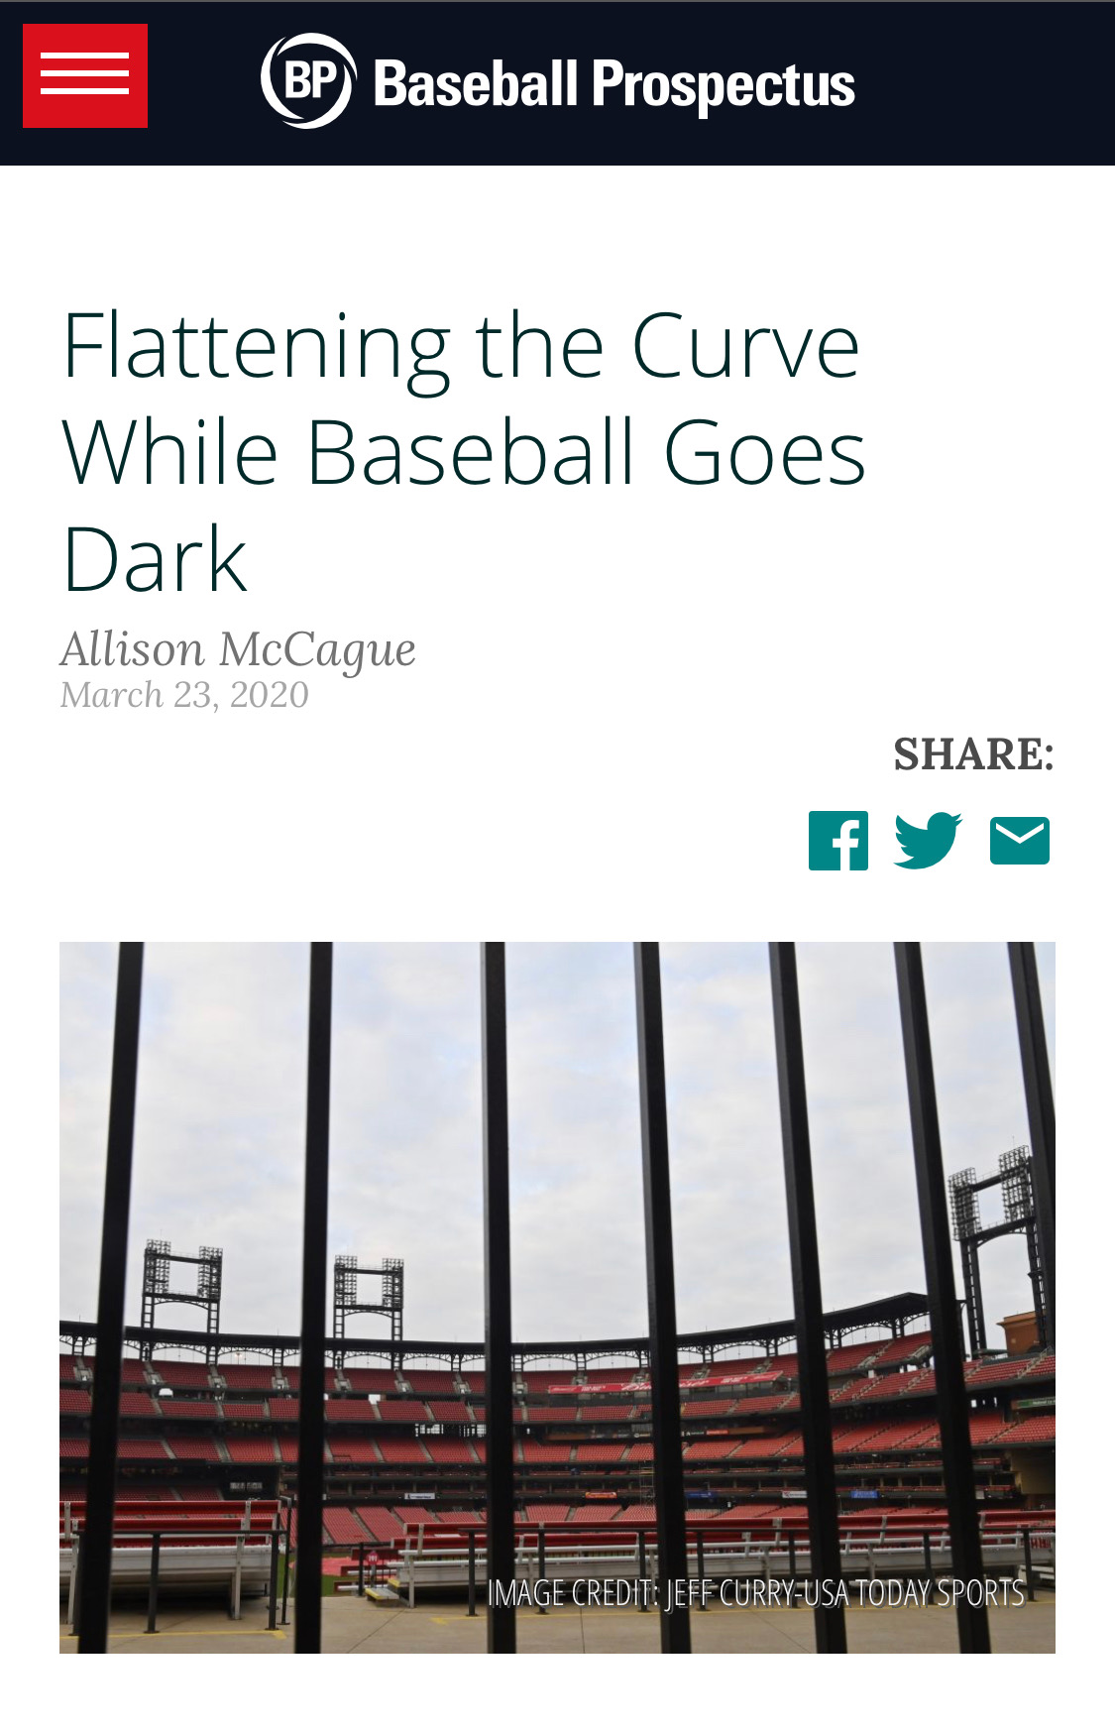
Advocacy tips for trainees
The narrative power of storytelling
Writing and blogging
  Can be via a scientific society, your institution, or on your own
  Op-eds
  Perspectives in journals
Use your other interests to reach a wider audience
Social media
  Seize the moment – post about relevant issues
Notes:
Me using my platform as a baseball writer to write about COVID-19 is an example of using my other interests to reach a wider audience.

Slide 54
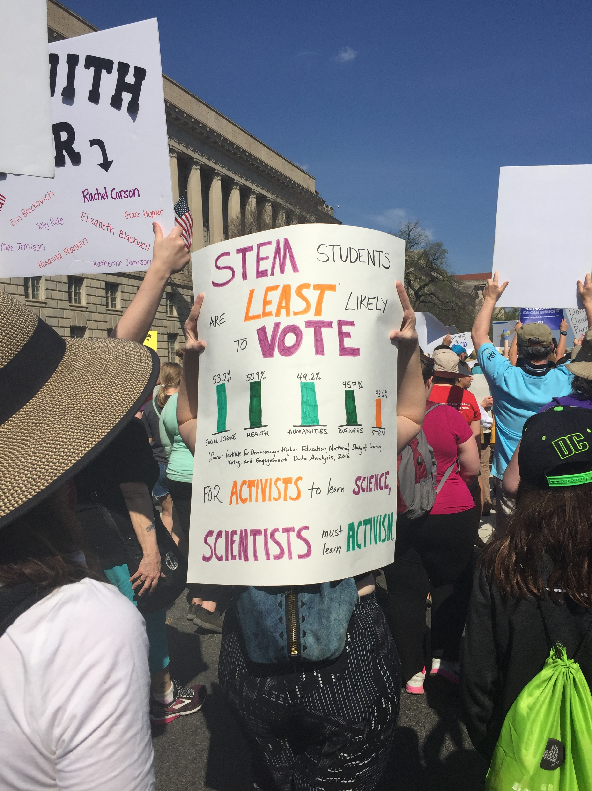
Why trainee and early career voices matter
You can provide a perspective others can’t about how certain policies impact you
  Grad student tax
  NIH funding and training grants
You are the future of the scientific community!
Young people have historically been the activists/drivers of change
Source: Allison McCague, 2018 March for Science

Slide 55
Resources and Links
ASHG Advocacy Center: https://www.ashg.org/advocacy/advocacy-center/
Union of Concerned Scientists: https://blog.ucsusa.org/science-blogger/empowering-early-career-scientists-to-engage-in-science-advocacy-policy-and-communication
National Science Policy Network: https://scipolnetwork.org/
AAAS: https://www.aaas.org/resources/take-action-toolkit
And many more! Feel free to reach out to me: mccague.allison@gmail.com

Slide 56
Q&A with Speakers
Mary Woolley
Allison McCague, PhD
Lynn Jorde, PhD, Moderator

