Slide 1


Slide 2

What is NAPCRG?
NAPCRG is an international organization that aims to support and nurture clinicians, scientists, students and patients around the world as they pursue primary care research.
Through our ongoing support, conferences, and programs, we bring researchers together, connecting them with the resources they need as they shape the future of primary care.

Slide 3
What is PaCE?
The Patient and Clinician Engagement (PaCE) committee is a community of patients, frontline clinicians, and researchers with knowledge and understanding of the unique features of patient-centered research related to primary care. The committee consists of a diverse group of individuals and holds two seats on the NAPCRG Board of Directors as patient representatives, one from the US and one from Canada.
The main goal of PaCE is to encourage patient and clinician engagement in collaborative primary care research.

Slide 4
The History of PaCE
Developed in 2013 as a special project, forming dyads of patient-partners and clinicians who advocated for the patient voice in research
These dyads were invited to host a pre-conference workshop in 2014 to engage and build partnerships throughout NAPCRG, now an annual offering at the meeting
PaCE received numerous grants for funding through PCORI, before they were made into a formal committee at NAPCRG
The mission and vision remain the same: to create an environment of belonging and advocate for patient and clinician engagement in primary care research

Slide 5
Objectives of PaCE
  Cultivate a desire for relationship between patients and primary care researchers
  Be a connecting point for patients and NAPCRG members and an advocate for ongoing engagement practices
  To create a diverse community through the life experiences of the members in addition to the work they have previously been a part of.

Slide 6
Values of PaCE
  Support and nurture frontline clinician voices within primary care research and NAPCRG membership
  Enhance the diversity of the NAPCRG membership
  Create a community of belonging
  Educate and train patient partners about research and what to expect when they’re a part of a research team

Slide 7
Deliverables of PaCE
  Pre-Conference Workshop at NAPCRG Annual Meeting
  Poster and Workshop Presentations at the Practice-Based Research Network (PBRN) Conference and NAPCRG Annual Meeting
  Articles and Publishings in Annals of Family Medicine
  PaCE Distinguished Service Award given at the NAPCRG Annual Meeting
  PaCE Tea-Time Chats
  PaCE Approved Pins

Slide 8
Membership
Benefits of a membership include:
  Engagement with a global community
  Access to year-round training program
  Access to Annals of Family Medicine supplements
  Opportunities to serve on a committee or the Board of Directors
  And much more!

Slide 9
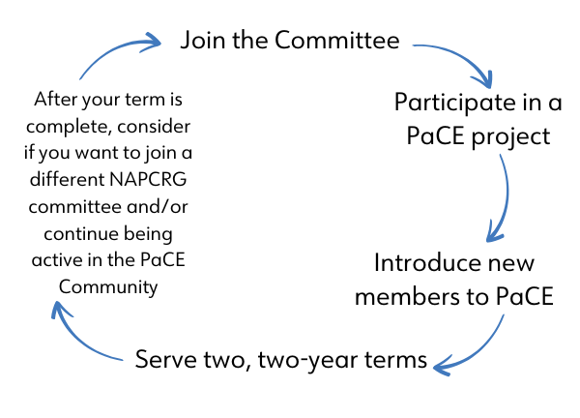
PaCE Committee Life Cycle

Slide 10
Any questions?
?
?
?

