Slide 1

Emerging Paths: Insights From Zoo & Aquarium Professionals

Slide 2
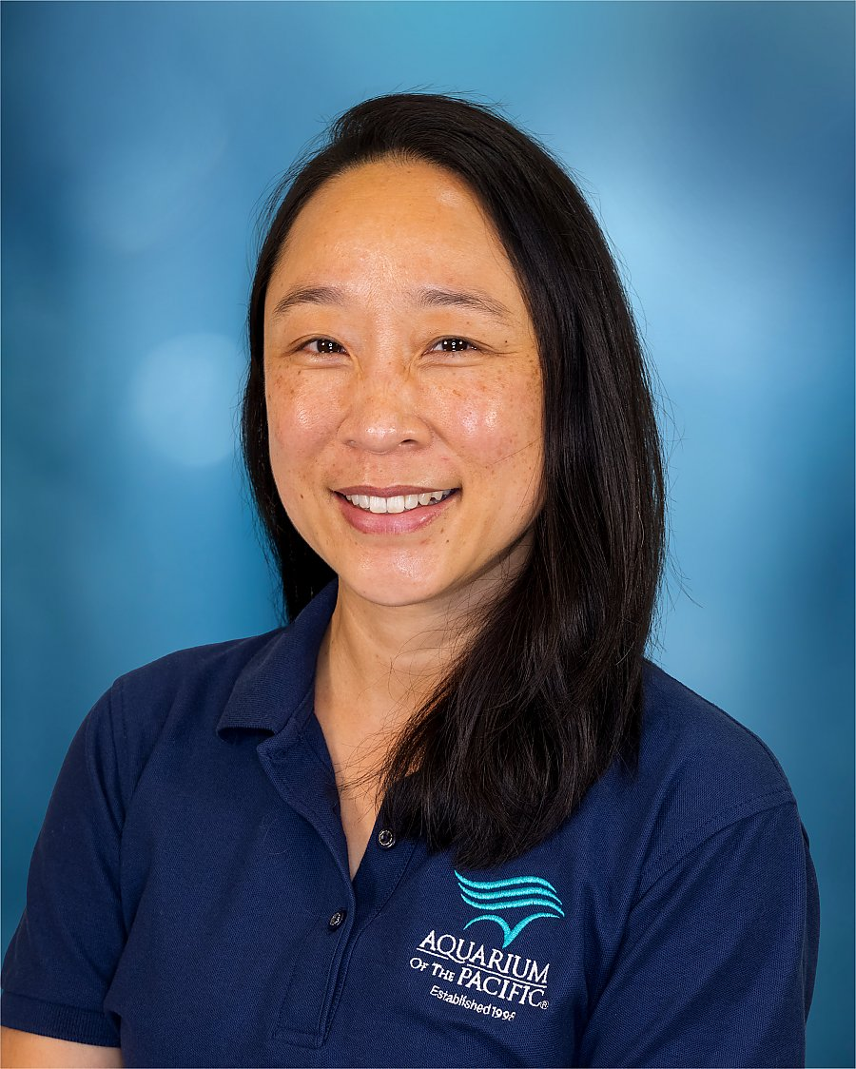
Staci Wong
Interpretation Manager
Aquarium of the Pacific
25 years in the industry; Senior Education Associate/Outreach Lead, Education Specialist/Aquarium on Wheels Coordinator, Education Supervisor, Interpretation Manager
Leads interpretation team with guest engagement/exploration as they interact at animal encounter spaces, visit general exhibits, participate in tours, and join our shows. Management of messaging and training for staff and contributing to the exhibit sign creation.
Bachelor of Science in Animal Physiology and Neuroscience at the University of California, San Diego
Masters in Arts with a focus on informal education; Miami University’s Project Dragonfly program.
swong@lbaop.org

Slide 3
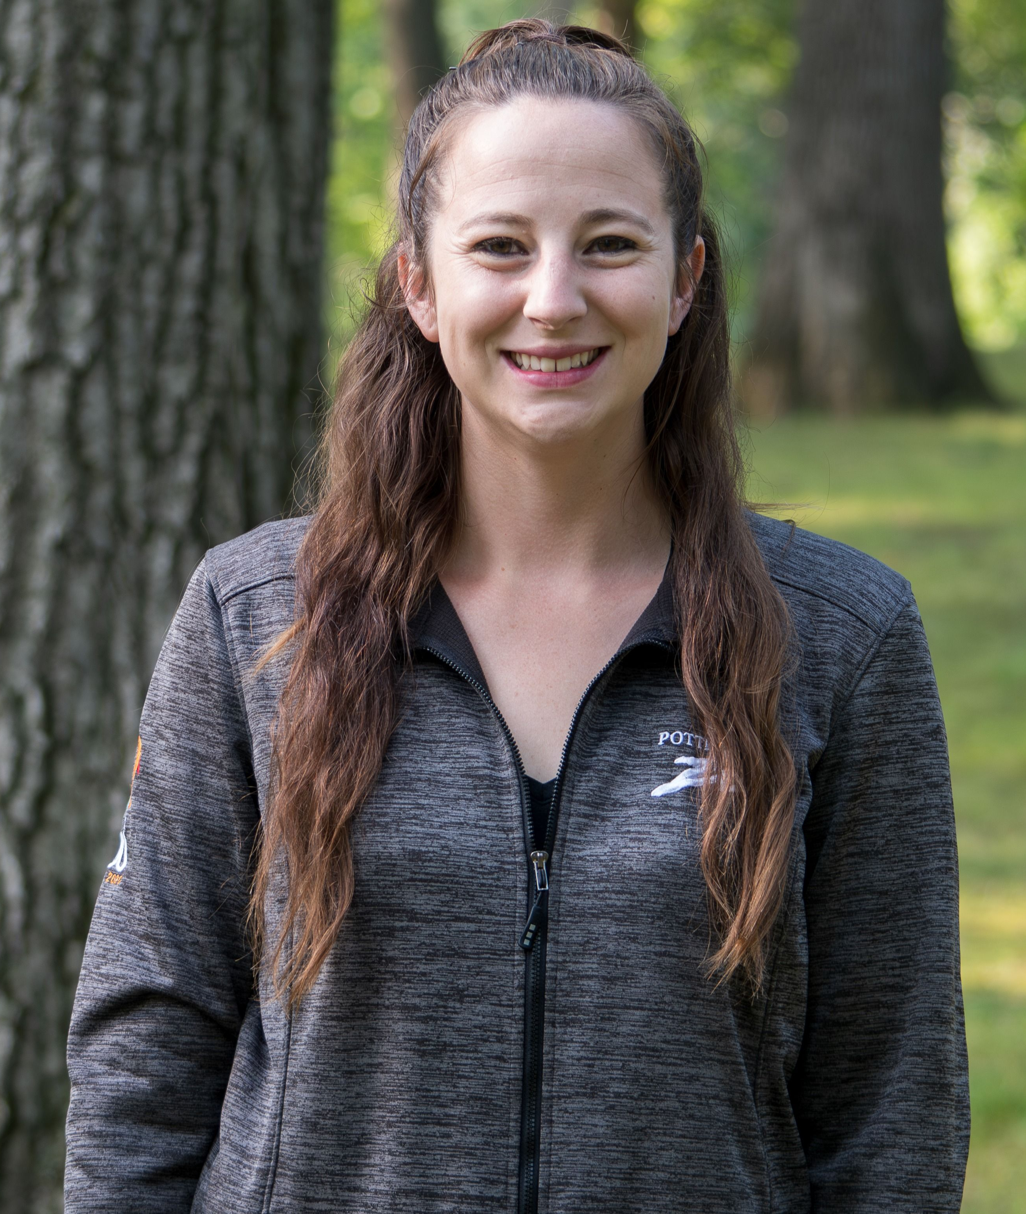
Mariah Martinez
Equity and Engagement Program Manager
Potter Park Zoo
8 years in the industry; Zoo in Your Neighborhood Coordinator, Community Engagement Coordinator, Community Engagement and Inclusion Specialist, Equity and Engagement Program Manager
Leads all Diversity, Equity, Access, and Inclusion (DEAI) initiatives, including coordination of the Zoo in Your Neighborhood and FALCONERS community programs. Oversees staff and volunteers involved in these programs, manages planning, and maintains strong community connections. Additionally, supports all departments in advancing accessibility, inclusion, and engagement efforts.
Bachelor of Science in Zoology, Concentration Zoo and Aquarium Science; Michigan State University
mmartinez@ingham.org

Slide 4
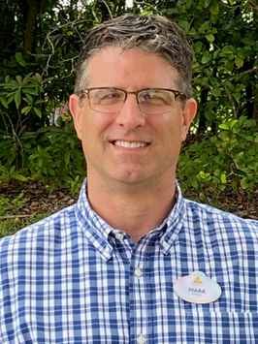
Mark Kamhout
Animal Care Director
Disney’s Animal Kingdom
30 years in the industry; Intern, Zookeeper, Animal Hospital
Manager, Zoological Manager, Curator, Director
Current role: Animal Care Director at Disney’s Animal Kingdom in charge of all the husbandry teams that take care of the animals on Kilimanjaro Safari and at Disney’s Animal Kingdom Lodge resort in addition to managing the animal care Night Team
Master’s of Science in Zoo and Aquarium Management; Michigan State University
Bachelor’s of Science in Zoology; Michigan State University
Mark.V.Kamhout@disney.com

Slide 5
Questions or Comments: Membership@aza.org

Slide 6



