Slide 1

New Users Guide to
NetDMR

Slide 2
Presentation Topics
What is NetDMR?
Electronic Reporting
EPA Databases
Account Creation (Live Presentation)
Basics of NetDMR (Live Presentation)

Slide 3
What is NetDMR?
Web-based tool that allows permittees to electronically submit Discharge Monitoring Reports (DMRs)
EPA hosts the national NetDMR
TCEQ previously hosted Texas NetDMR
  On March 26, 2018, TCEQ began migrating its NetDMR users to the EPA’s hosted national NetDMR Customer

Slide 4
Electronic Reporting Rule
EPA NPDES Electronic Reporting Rule, effective
December 21, 2016
E-reporting wavier (TCEQ Form 20754)

Slide 5
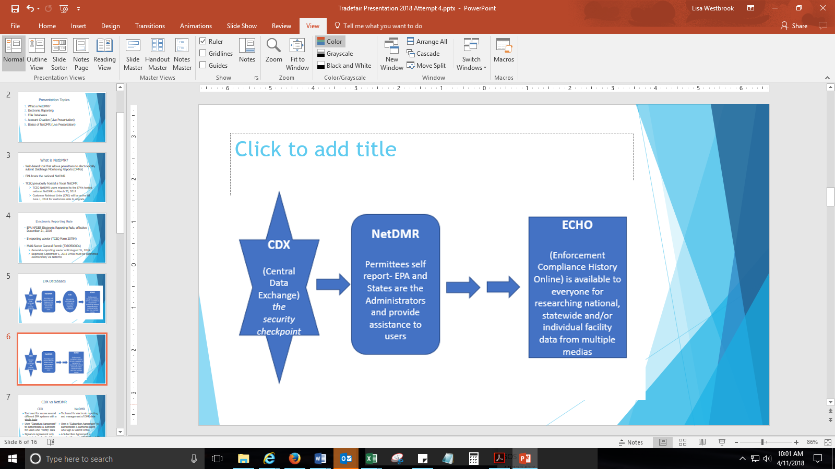
EPA Databases

Slide 6
CDX vs NetDMR
CDX
Tool used to access several different EPA systems with a single login
Uses "Signature Agreement" to authenticate & authorize for users who "certify' data
Signature Agreement needs to be submitted & approved only once per CDX account
NetDMR
Tool used for electronic reporting and management of DMR data
Uses a "Subscriber Agreement" to authenticate & authorize users who Sign & Submit DMRs
A Subscriber Agreement is required for each NPDES Permit ID Signatory Role Request

Slide 7
CDX User Types & NetDMR Roles
Term | Who | Available NetDMR Roles | Definition
Permittee (signature) | If you work for the company and will sign/submit DMRs | Signatory, Permit Administrator, Edit, View | A person authorized to sign, view, edit and submit DMRs for a specific permit. Will also be able to approve roles for others except signatory.
Permittee (no signature) | If you work for the company but will NOT sign/submit DMRs | Permit Administrator, Edit, View | Can view, enter and upload DMRs into NetDMR, edit CORs, and approve roles for other users within NetDMR
Data Provider | Lab, Contractor or 3rd Party Affiliate | Edit, View | Allowed to view, enter and import DMRs into NetDMR and edit CORs but they cannot sign and submit forms
Internal User | This is for state/EPA Agency Personnel only | Internal Administrator | A regulatory authority staff member with a NetDMR Account

Slide 8
Account Creation (Live Presentation)

Slide 9
CDX Account Creation - Pitfalls
Individual Email Needed
User ID (case sensitive)
3 to 8 Different security questions answers (case sensitive)
Program Service: NDMR-TX: Texas Commission on Environmental Quality
Choose Correct CDX User Type
Identity proofing (3rd party - LexisNexis): Uses personal identifying information
Last 4 numbers of SSN
Home address (cannot use PO Box)
Electronic Signing of ESA – click “Yes”

Slide 10
Requesting Access (Live Presentation)

Slide 11
NetDMR Access Requests - Pitfalls
EPA ID No. is needed (TX…)
When requesting access, enter permit ID No. & hit update
Parent or Facility
Choose Parent if you work at a corporate headquarters or offsite office
Choose Facility if you work at or near to the location of the wastewater treatment facility.

Slide 12
NetDMR Access Requests - Pitfalls
For electronically signed subscriber agreements, if you are a Duly Authorized Representative (DAR) and not an Responsible Official (RO), the RO will need a CDX account to approve
A DAR will need to know the RO’s first and last name, title, phone number, and email address

Slide 13
Basics of NetDMR (Live Presentation)

Slide 14
Useful Website Links
NetDMR
https://cdxnodengn.epa.gov/oeca-netdmr-web/action/login
NetDMR Support Portal (netdmr.Zendesk.com/hc/en-us)
https://netdmr.zendesk.com/hc/en-us
Self-reported data can be accessible through EPA’s ECHO database https://echo.epa.gov/

Slide 15
Questions?

