Slide 1


Advocating for Your Patients in Louisiana
SEERSUCKER STRATEGIES LLC | LOUISIANA CHAPTER OF AAP

Slide 2




executive summary
Louisiana pediatric outcomes are heavily policy-driven
Pediatricians are the most credible advocates in the system

Slide 3

Louisiana Reality
Foster Care
4,100 children in foster care daily
Behavioral Health Access
Significant behavioral health access gaps
Medicaid
Medicaid policy drives access and delays

Slide 4

Case Study: Prior Authorization Delay
Child requires therapy services
Authorization delays push care outside intervention window
Results in worsened long-term outcomes

Slide 5

Policy Makers
WHO CONTROLS OUTCOMES
Legislature: funding and mandates
LDH: Medicaid rules
DCFS: child safety and placement
MCOs: approvals and access

Slide 6




Advocacy Framework
Reality
Simplicity
The Ask
01
Tell a Real Patient Story
01
Remember Policymakers are not Experts
01
Have a Prepared Concise Request for Solution
02
Connect the issue to the policymakers area.
02
Provide simply data - no acronyms
02
Show Up with a Recommended Resolution
03
Show Proof of Actual Impact Where Possible
03
Make Sure Your Information is Accurate
03
Don’t Just Connect When Something is Wrong

Slide 7
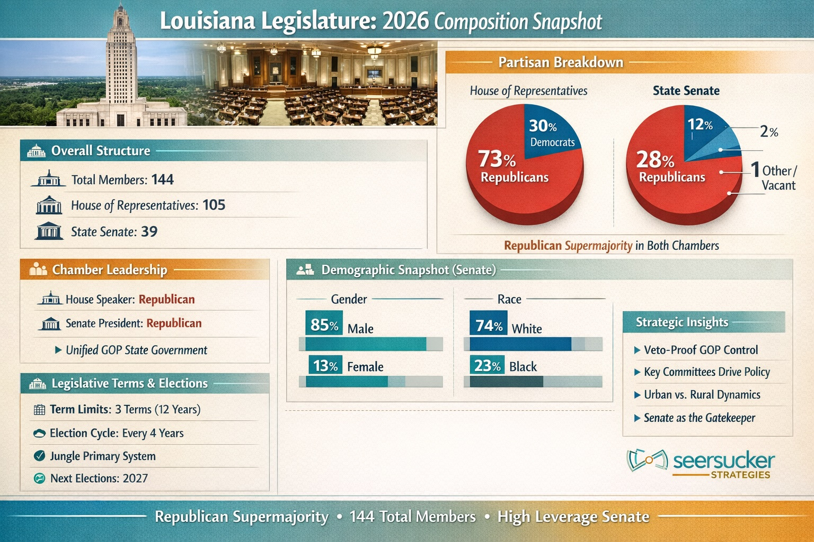

Slide 8



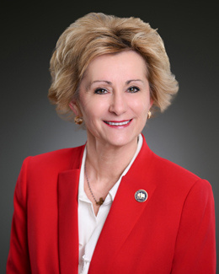
KEY LEGISLATORS
HOUSE SIDE
Dustin Miller
Gabe Firment
Rhonda Butler
House Health and Welfare Chair
House Insurance Chair
House Health and Welfare Vice Chair

Slide 9



KEY LEGISLATORS
SENATE SIDE
Patrick McMath
Kirk Talbot
Katrina Jackson-Andrews
Senate Health and Welfare Chair
Senate Insurance Chair
Senate Health and Welfare Vice Chair

Slide 10

Agency Advocacy
Regulatory Intelligence
Operationalize “Regulatory Intelligence” into your advocacy cadence. Map the decision architecture within key agencies (e.g., Louisiana Department of Health, Medicaid managed care organizations, licensing boards) and track rulemaking dockets, waiver amendments, and sub-regulatory guidance. Align your advocacy asks to where authority actually sits—distinguishing between statutory constraints and discretionary agency action.
Pediatricians who anchor requests in the agency’s existing regulatory authority (e.g., State Plan Amendments, EPSDT obligations) are far more likely to gain traction than those seeking legislative fixes prematurely.

Slide 11

Agency Advocacy
Clinical Outcomes
Translate clinical outcomes into budget-neutral or cost-saving narratives. Regulators are fundamentally constrained by fiscal notes and program integrity requirements. Frame pediatric advocacy in terms of downstream cost avoidance (e.g., reduced NICU utilization, avoided ED visits, improved immunization compliance).
Use claims data, peer-reviewed benchmarks, and pilot program results to present “actuarially credible” proposals that align with Medicaid’s value-based purchasing priorities—this shifts your position from advocacy to solution-provider.

Slide 12

Agency Advocacy
Early Engagement
Engage early through informal rulemaking channels and staff-level relationships. The most consequential influence occurs before formal Notices of Intent are published. Build working relationships with bureau directors, medical directors, and policy analysts—not just agency heads. Offer to serve as a technical resource during policy drafting, provide redlined language, and submit pre-rule concept memos.
Consistent, non-adversarial engagement positions pediatricians as trusted subject-matter experts rather than episodic stakeholders.

Slide 13

Agency Advocacy
Coalitions
Leverage multi-stakeholder coalitions with aligned regulatory incentives. Pair pediatric voices with hospitals, MCOs, patient advocacy groups, and, where relevant, education agencies to present unified proposals that reduce fragmentation. Regulators are more receptive to initiatives demonstrating system-wide alignment (e.g., care coordination models, school-based health integrations).
Structured coalitions—backed by letters of support, shared data, and coordinated testimony—signal implementation feasibility and political durability.

Slide 14
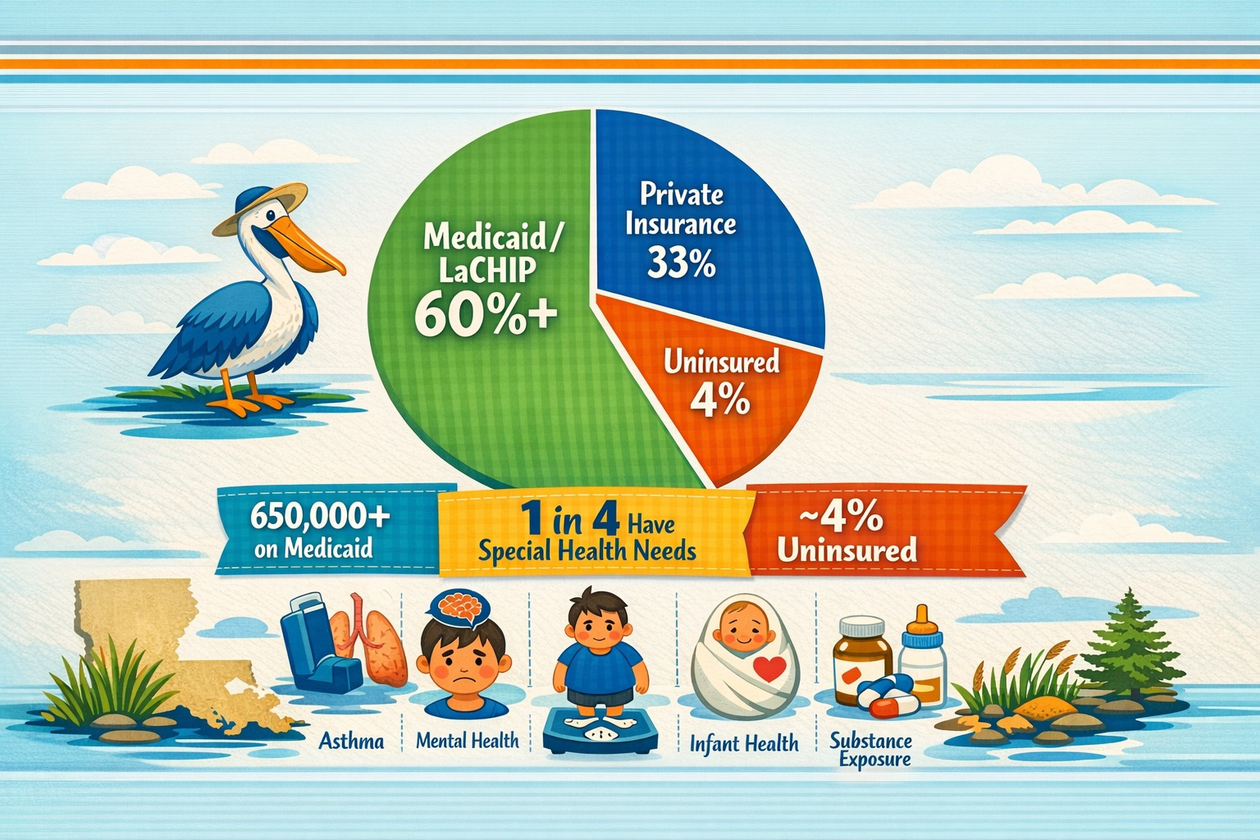

Slide 15


Health Plan Strategy
Translate Advocacy Into Value Propositions
Frame every patient advocacy issue (e.g., prior authorization delays, formulary exclusions, care coordination gaps) in terms of total cost of care (TCOC),
01
02
Example
Downstream cost avoidance (e.g., avoided ED visits or NICU readmissions)
03
Example
Impact on HEDIS/STAR metrics
04
Example
Alignment with the plan’s medical loss ratio targets. Plans engage fastest when advocacy is positioned as margin-protective or revenue-accretive.

Slide 16

Build plan-specific “micro-pilots” tied to contract levers.
Instead of broad asks, propose narrowly scoped pilots (90–180 days) with defined populations (e.g., high-risk asthma, ADHD medication adherence, early developmental screening). Tie success metrics to contractual levers—care management fees, pay-for-performance bonuses, or shared savings corridors. Offer to co-design workflows with the plan’s medical directors and utilization management team to reduce friction and demonstrate scalability.
Health Plan
ADVOCACY

Slide 17
Engage the right internal stakeholders—simultaneously.
Effective advocacy requires coordinated outreach to multiple nodes inside the plan: Medical Director (clinical policy), Pharmacy Director (formulary), Network/Provider Relations (contracting), and Quality Improvement leadership (HEDIS/STAR). Pediatricians should request joint working sessions rather than siloed conversations, ensuring that proposed changes (e.g., easing step therapy for pediatric populations) are evaluated across clinical, financial, and operational lenses at once—this accelerates decision-making.
Health Plan
ADVOCACY

Slide 18
Leverage pediatric-specific data collaboratives and peer benchmarking.
Health plans respond strongly to comparative performance data. Pediatricians should aggregate de-identified outcomes across practices (via IPA/ACO structures or state chapter collaboratives) to show variance vs. peers and national benchmarks (e.g., National Committee for Quality Assurance metrics). Position advocacy requests as mechanisms to close measurable gaps (e.g., immunization rates, well-child visit adherence), not as isolated exceptions—this reframes the request as system-level quality improvement rather than provider preference.
Health Plan
ADVOCACY

Slide 19





Twitter and Facebook are the most highly utilized social media platforms by Louisiana policy-makers.
01
Social
Media
Strategy
Platforms
Outside of State-Wide Elected Officials, most policymakers are managing their own accounts and will see any negative comments you leave and remember them.
Be Respectful
02
Tag and Follow Up
Policymakers Appreciate Social Media Engagement - Tag Officials in Posts and Follow Up on Previous Interactions.
03

Slide 20


thank you
QUESTIONS ARE WELCOMED!

