Slide 1
Tackling the Crisis of Physician Burnout: Strategies for Building Resiliency & Enhancing Professional Fulfillment for Improved Patient Safety
Yvette M. Ervin, JD
Monica Ludwick, Pharm D

Slide 2
Disclosure to Learners
No planner, reviewer, faculty, or staff for this activity has any relevant financial relationships with ineligible companies.

Slide 3
Objectives
Describe the prevalence of burnout and impact on patient safety
1
Understand the cause of burnout & compassion fatigue
2
List contributing factors to burnout
3
Identify strategies to recognize and prevent burnout to promote safe and effective patient care
4

Slide 4
Burnout Defined
Defined in ICD-11 as follows:
Burn-out is a syndrome conceptualized as resulting from chronic workplace stress that has not been successfully managed. It is characterized by three dimensions:
(1) feelings of energy depletion or exhaustion;
(2) increased mental distance from one’s job, or feelings of negativism or cynicism related to one's job; (3) and
reduced professional efficacy.
Burnout is a manifestation in an individual of the dysfunction in the workplace, not a lack of personal resilience

Slide 5
Burnout in Physicians vs Employed US Population
 | Physicians N=3971 | Population N=5198 | P
Male | 57% | 52% | <0.001
Age (median) | 50 | 52 | <0.001
Hrs/Wk (median) | 50 | 40 | <0.001
Burnout* | 40% | 28% | <0.001
Dissatisfied WLI | 43% | 21% | <0.001
*As assessed using the single-item measures for emotional exhaustion and depersonalization adapted from the full MBI domain score
Shanafelt MD et al. Changes in Burnout and Satisfaction with Work-Life integration in physicians and the general US working population between 2011-2017. Mayo Clin Proc. September 2019;94(9):1681-1694 https://doi.org/10.1016/j.mayocp.2018.10.023
Notes:
*add in depersonalization and EE

Slide 6
Contributors
Laws, regulations and standards
Health care reform and payment policies
Medical record documentation and coding requirements
Quality measurement and reporting
The physician-patient relationship
Prescription monitoring drug programs
Maintaining privacy and security
Prior authorization access
Professional licensure
Maintenance of certification
Professional Liability

Slide 7
A Note About Time
4.5 hours/day on computer
86 min working out of the office on private time
8.7 hours(>20 hr) /week on administrative tasks
27% of a physician’s day is spent with patients

Slide 8
Consequences of Physician Burnout
Impaired professionalism
Reduced patient satisfaction
Blunted growth in medical knowledge
Medical errors
Depression and suicidal ideation
Implicit bias
Staff turnover, reduced hours*
*Total costs over $4.6 billion/year
Physicians leaving the private practice or medicine altogether--- reducing access to care and increasing workload for other physicians, leading to…… MORE burnout

Slide 9
Prevalence& Impact Medical Errors
Medical errors are estimated to account for 100,000 to 200,000 deaths/year
Physician burnout equally responsible for medical errors as unsafe workplace conditions
Half of practicing physicians suffer from burnout
Physicians experiencing burnout had more than twice the odds of self-reported medical error
Rates of medical errors tripled in medical units, if physicians working on that unit had high levels of burnout
Tawfik et al. Evidence Relating Health Care Provider Burnout and Quality of Care: A Systematic Review and Meta-analysis. Ann Intern Med. 2019 Oct 15;171(8):555-567. doi: 10.7326/M19-1152. Epub 2019 Oct 8. PMID: 31590181; PMCID: PMC7138707.

Slide 10
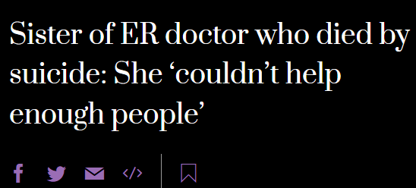
Prevalence& Impact Well-being
Physicians have the highest suicide rate of any professionals, at 40 suicides per every 100,000 physicians, according to a March 15 2023 Medscape report.

Slide 11
Negative emotional states shown to be associated with greater explicit racial bias in medical decision-making
Burnout and depression, also can impede cognitive performance, making implicit biases more likely to play a role in behaviors and decision-making
Burnout, could activate bias, and reduce cognitive capacity
Prevalence& Impact Implicit bias

Slide 12
Implicit bias has been correlated with:
Decreased patient-centered communication
Negative patient perception of the health care provider or health care interaction
Interpersonal treatment
Communication with health care provider
Trust in health care provider
Health care provider’s contextual knowledge (e.g. patient’s values and beliefs)
Differences in clinical decision making
Prevalence& Impact Implicit bias

Slide 13
62% of 847 clinicians had personal knowledge of other primary care clinicians who retired early or quit during the pandemic
29% knew of practices that closed
Preexisting shortage of general and family medicine physicians.
A quarter of clinicians planned to leave primary care within 3 years
23.8% of the more than 9000 physicians from various disciplines in the study and 40% of 2301 nurses planned to exit their practice in the next 2 years
70% of US physicians now work as employees (hospital, health system, or private corp)
Prevalence& Impact
The Practice of Medicine
Abbasi J. Pushed to Their Limits, 1 in 5 Physicians Intends to Leave Practice. JAMA. 2022;327(15):1435–1437. doi:10.1001/jama.2022.5074

Slide 14
About Resilience
Physicians score higher in resiliency when compared to the general public
Resilience in elements of
Emotional exhaustion
Depersonalization
Overall burnout
Of those in the higher resiliency group, 30% experienced burnout
Concerning levels of burnout in those with low resiliency scores
Of those responding to a resilience rate of 50% or lower, 70% experience burnout
The higher the resiliency score, the lower the rate of each
Goroll, A."Resilience and Burnout Among Physicians and the General US Working Population." JAMA Netw Open. 2020 Jul 1;3(7):e209385.

Slide 15
Identifying Symptoms of Burnout
Exhaustion
Substance use
Relationship problems
Medical errors
Tension with Colleagues & Staff
Depression

Slide 16
Burnout vs. Compassion Fatigue
External Factors
Internal Factors (Empathy)
Compassion Fatigue:
A form of burnout originating from exposure to suffering of others/the feelings about caring for others that are suffering
Sometimes referred to as “secondary traumatic stress” or “vicarious trauma”
Prevalence has not been extensively studied or well-known
https://roborman.com/stimulus/96-compassion-fatigue/

Slide 17
Compassion Fatigue
Signs & Symptoms Include:
Profound emotional and physical exhaustion
The sense that you cannot give any more/extend
Depersonalization and cynicism
Fatigue/headaches/poor sleep
Example: You may notice changes in behavior such as not having the urge to console someone who is crying/in pain/suffering
Many similarities with burnout symptoms including:
Depersonalization
Reduced sense of accomplishment, purpose, and meaning
Physical exhaustion
Burnout score was most significant determinant of CF (EMR study)
Compassion Fatigue is Similar in Emergency Medicine Residents Compared to other Medical and Surgical Specialties; West J Emerg Med. 2014 Sep; 15(6): 629–635.

Slide 18
Case Example
Andy had always been an energetic and dedicated family physician. Now, at 38, he's tired, cynical and lonely. He's angry at the health care system for forcing him to see more patients in less time and annoyed with his patients for what he perceives to be their increasingly demanding natures. Although his relationships with his patients once thrived, they no longer seem to give him the same satisfaction. Even talking to his wife, who's always been a supportive partner, has not relieved his feelings of intense isolation.
“Go-To” Habits:
Multi-task (eat lunch while dictating chart notes or returning calls/emails)
Eliminate things you don’t have time for- exercise, hobbies, relaxed meals, time with loved ones
Complain to colleagues
Blame others/circumstances
May Lead To:
Increased feelings of dissatisfaction and hopelessness
Higher levels of burnout and compassion fatigue
Decreased productivity
Low levels of morale in the workplace– more sick days, higher turnover

Slide 19
Self- Assessment Tool

Slide 20
Helping A Colleague
What should you do if you observe symptoms of burnout in a colleague?
Remember: burnout is experienced differently by different people
Important to point it out in a non-judgmental way, if comfortable
Options for bringing it up to physician leaders/support persons
Sharing your own experiences/vulnerability
Be sensitive to the “star” physician
If you are serving in a leadership role, role model, and provide safe forums for people to share (small group, 1:1, larger forum, etc.)
https://www.ama-assn.org/practice-management/physician-health/when-colleague-struggles-burnout-here-s-how-reach-out

Slide 21
There is Hope

Slide 22
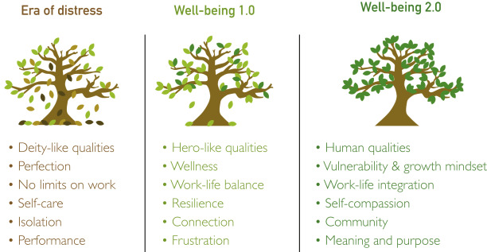
Physician Wellness- A Renewed Focus
From attempted remedies to proactive approach to cultivating well-being and preventing occupational distress
Physician Well-being 2.0: Where Are We and Where Are We Going? (Shanafelt, MD; Mayo Clinic Proceedings Vol. 96, Issue 10
https://doi.org/10.1016/j.mayocp.2021.06.005

Slide 23
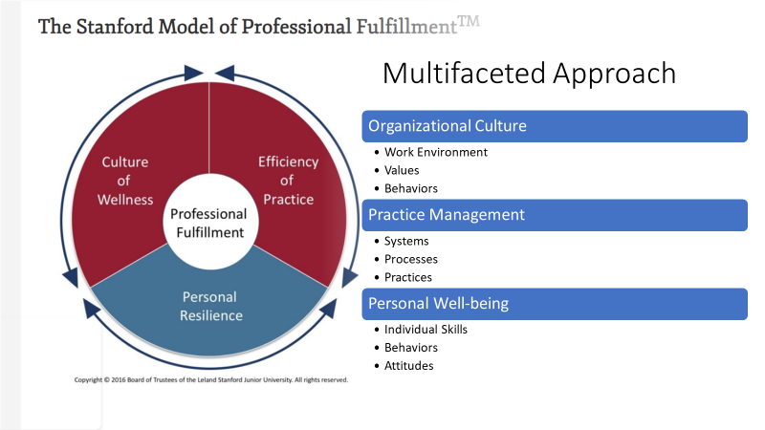
https://wellmd.stanford.edu/about/model-external.html

Slide 24
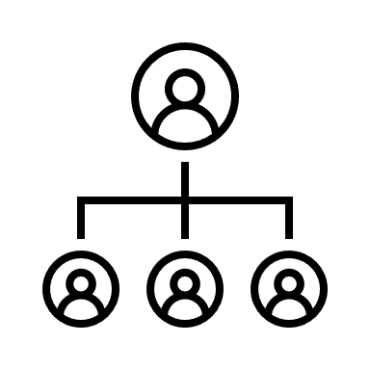
Organizational Strategies
Wellness as an organizational strategy & value on investment
The rise of the “Chief Wellness Officer”
Culture- engagement & recognition
People focus- human factors that apply to both patients and providers
Focus on individual need for work-life integration
Embracing humanity in healthcare and need for connection and vulnerability
Schwartz Rounds
EAP
Physician Wellness Committees
Peer-Peer Programs

Slide 25
Technology Solutions
“De-implementation” Checklist for Streamlining Workflow (AMA)
Simplify Logins (Single Sign-On, bio-identification)
Reducing unnecessary charting templates that add little clinical value
Eliminate duplicative notifications of same test results/consult notes
Electronic Health Record Optimization
Demanding better products from vendors- EHR customization
Develop new models of team-based documentation
Collaborate with EHR Vendors to limit low-value documentation
Community Support
On-demand scheduling/ pooled staffing for increased flexibility in work schedule/telehealth
Online forums for building physician community

Slide 26
Individual Strategies
Introspection
Identify your NEEDS that are NOT being met (i.e. sleep, nutrition, connection/community)
Care for yourself
Set boundaries around identified needs (designated time for breaks/lunch, sleep, exercise, leisure)
Make caring for yourself a daily habit
Prioritize and accelerate your well-being by doing the following DAILY:
Spend quality time alone to practice mindfulness and/or connect with a spiritual source
Recharge daily– i.e. walk/exercise; taking time to eat without distractions
Hold one focused and meaningful conversation every day– connect with your loved ones and friends

Slide 27
Recovering from Burnout Do’s & Don’ts
DO:
Find someone to talk to.
Understand that the pain you feel is normal.
Start exercising and eating properly.
Get enough sleep.
Take some time off.
Develop interests outside of medicine.
Identify what's important to you.
Create your own “principles of practice” by asking yourself what brings joy and meaning to your life and setting parameters around that.
DON’T:
Blame others.
Look for a new job, buy a new car, or get a divorce.
Fall into the habit of complaining with your colleagues.
Work harder and longer.
Self-medicate.
Neglect your own needs and interests.
“When practicing medicine feels more like labor than a labor of love, take steps to heal the healer.”JOHN-HENRY PFIFFERLING, PhD, AND KAY GILLEY, MS
https://www.aafp.org/pubs/fpm/issues/2000/0400/p39.html#fpm20000400p39-bt3

Slide 28
Let’s Revisit Dr. Andy
To Recover from Burnout, Dr. Andy…
…took a month off and then worked part time for two more months before he began practicing again full time.
During that time, Andy started exercising again and began eliminating the junk food that he often ate while working. He spent time with friends and family he hadn't seen in recent months and took long morning walks with his wife to reconnect to the world. He even made a leisurely visit to his aging parents — a luxury he hadn't allowed himself since he was an undergraduate — and started some projects that he'd fantasized about doing “when I have time.” Never a religious person, Andy took a mindfulness meditation class that taught him how to still his mind and be present in the moment. Through it, he came to feel the presence of a higher being, something bigger than himself that he found reassuring.

Slide 29
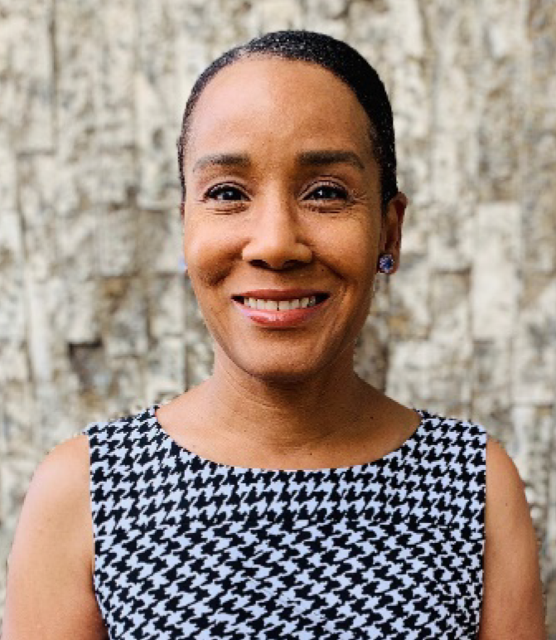
Physician Testimonial: Gracie Ann Dinkins MD, FACS

Slide 30
Resources
AMA STEPS Forward Innovation Academy: Practice resources for promoting professional satisfaction, efficient use of technology, practice sustainability and quality patient care https://www.ama-assn.org/practice-management/ama-steps-forward/ama-steps-forward-innovation-academy
The FlameProof Course: course designed by clinicians to help clinicians find joy in their medical practice and elevate their career
https://guidewirecoaching.com/flameproof/
Physician Coaching with Rob Orman, MD & free resources related to physician practice and professional fulfillment
https://roborman.com/
Maslach Burnout Inventory (“MBI”) Self-Assessment: https://shayahealth.com/resources/Maslach%20Burnout%20Inventory%E2%84%A2%20(MBI)%20Abbreviated.pdf

Slide 31
Thank You

