Slide 1
Rising From the Ashes - Life Lessons That Came From Tragedy by Faith Horter, TVI/COMS

Slide 2
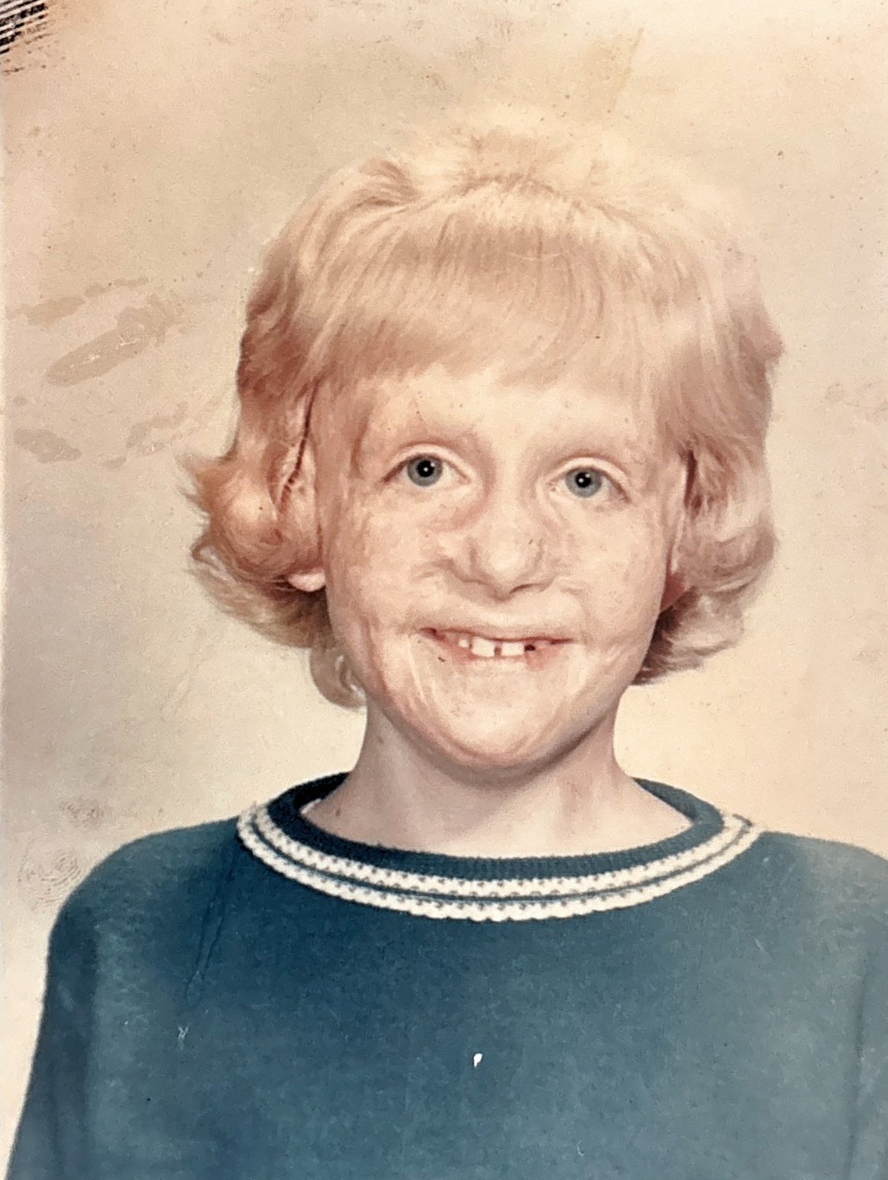
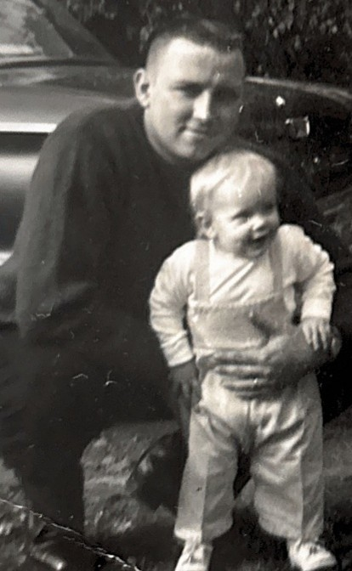

Tragedy Strikes
Technically not ashes, but a pot of grease…..
This Photo by Unknown Author is licensed under CC BY-NC-ND

Slide 3
The Lessons Begin….
“Get Rid of Stinking Thinking”

Slide 4
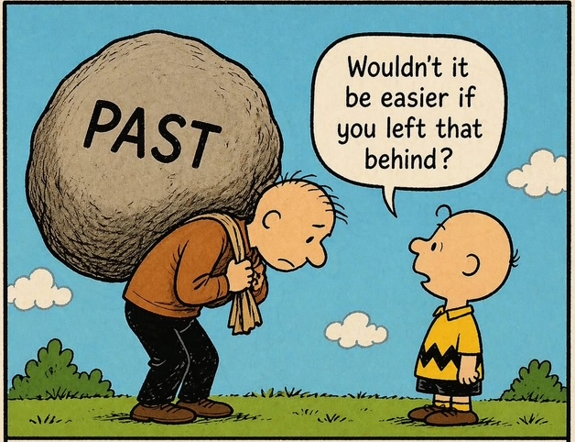
1. Carrying the past makes it hard to pursue the future.

Slide 5
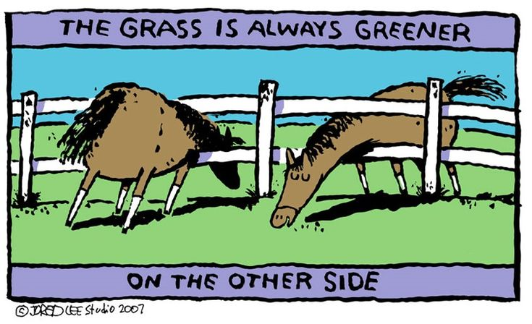
2. Ignore Your Neighbor’s Grass.

Slide 6

3. Beauty Is Not Skin Deep.

Slide 7
In With the New Ways of
Handling Trials…

Slide 8
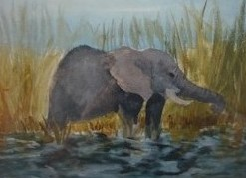
3. Talk About the Elephant in the Room.

Slide 9

5. Just Ask
-Do you mind if we…..
-I’d really appreciate it if…..
-I’m really interested in….
-Would it be okay with you if….
-What do you think about…

Slide 10
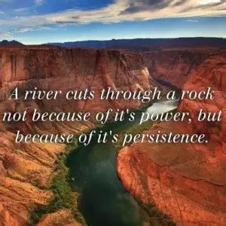
6. Sometimes Persistence Pays Off

Slide 11
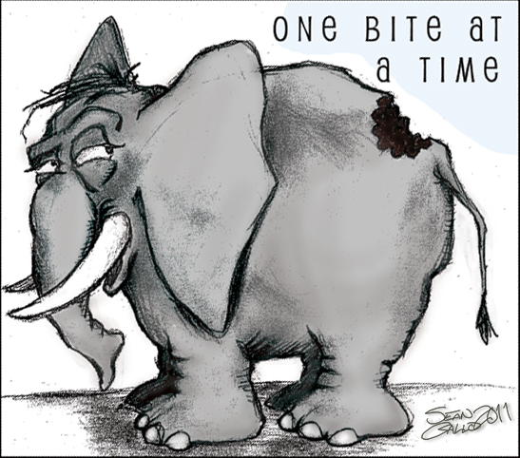
7. Even You, Can Eat An Elephant; One Bite At A Time.

Slide 12

8. Keep Hitting a Wall?
Time to Change Direction.

Slide 13
When You Want to Assess…

Slide 14

9. If You Want to Know How Far You’ve Come; Check Behind You.

Slide 15
Thank You!
Please feel free to contact me with comments and/or requests for future engagements.
faithhorter@gmail.com

